Slide 1

Quiz Vibes A Full Stack Quiz Platform Project
ALX Final Project
Team Members:
Dad Mohamed
Elabassi Zouhair
Date:
29 October, 2024

Slide 2
About
Welcome to our presentation on Quiz Vibes, an engaging quiz platform project! I’m Mohammed, a primary teacher from Morocco, and my colleague Zouhair Elabbassi, a topographic surveyor, and we have combined our expertise to bring this project to life.
Quiz Vibes is a result of our journey in the ALX Software Engineering program. Our goal is to create a fun, interactive platform where users can test their knowledge across various subjects and levels. Join us as we share the development process, challenges, and the lessons we’ve learned through this enriching experience.

Slide 3
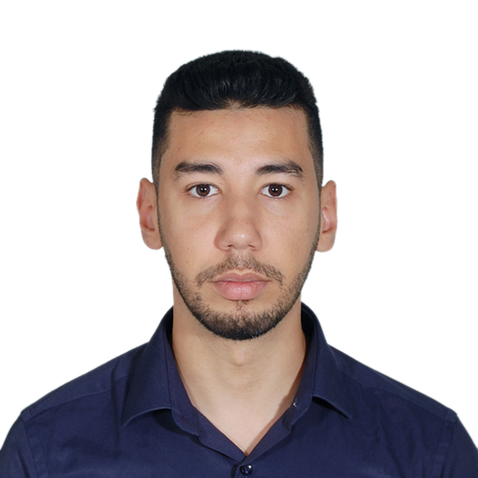
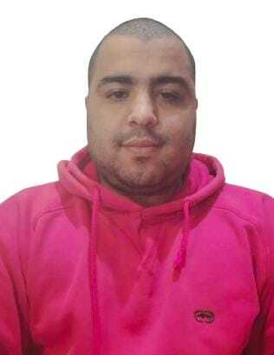
Meet the Developers
Background
Mohammed dad: primary teacher (3ed year).
Zouhair Alabassi: topographic surveyor.
Origins
Mohammed dad: Fes – Morocco.
Zouhair Alabassi: Casabalnca – Morocco, currently live in Tangier-Morocco.
Mohammed Dad
Passion
Mohammed dad: Gym, Reading books, Learning anything related to computer science.
Zouhair Alabassi: Topographic photography, traveling, exploring.
Goal
Aspiring to become a skilled software engineer, crafting elegant solutions to complex challenges.
Zouhair Elabassi

Slide 4
Project Overview
Problem Statement:
Traditional learning can be monotonous and lacks engagement.
Few platforms effectively blend education with entertainment.
Solution:
QuizVibe: An interactive quiz platform designed to make learning fun and accessible through dynamic quizzes, real-time scoring, and customizable difficulty.

Slide 5
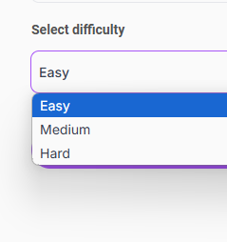
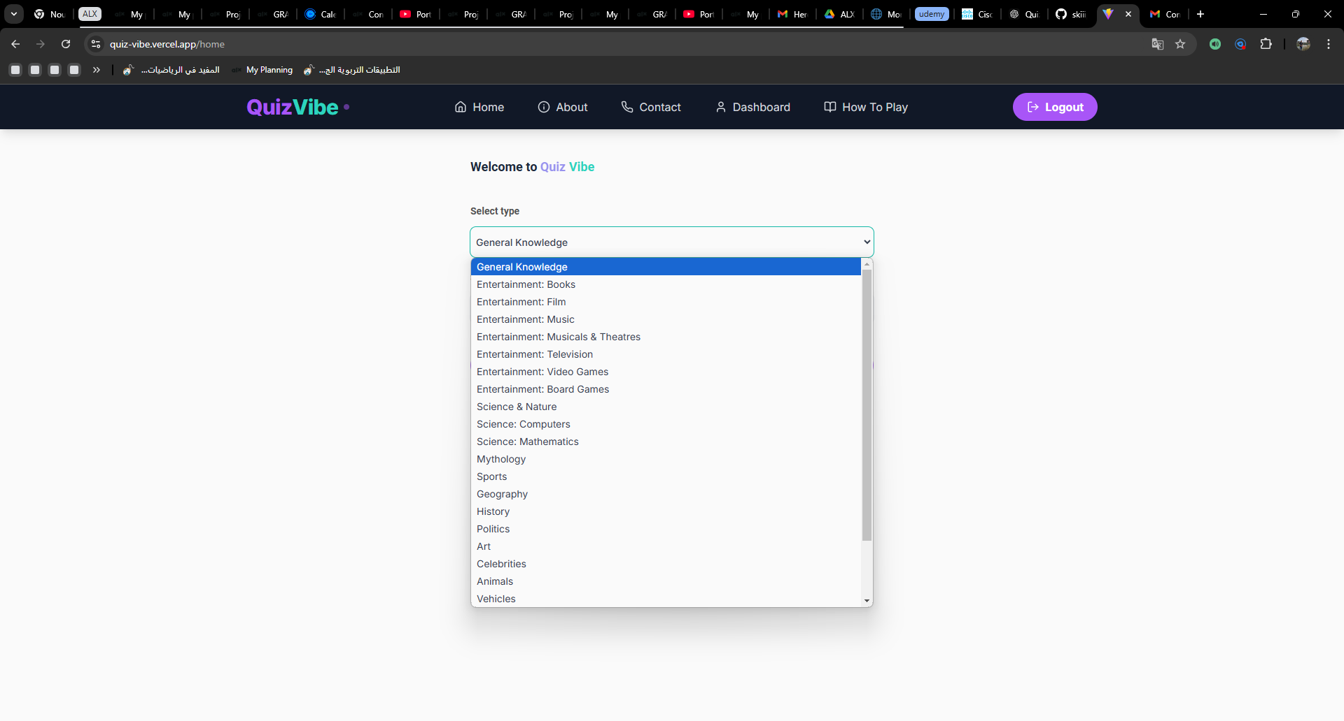
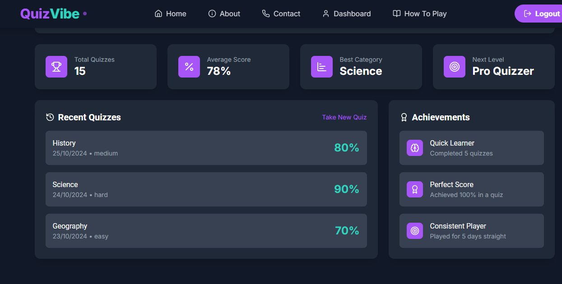
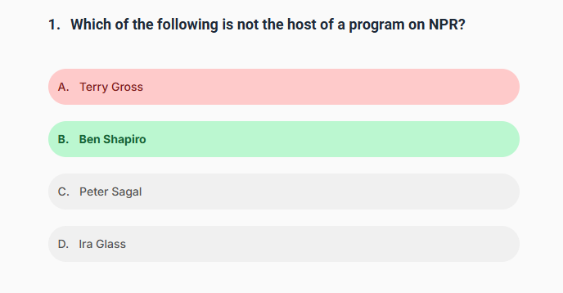
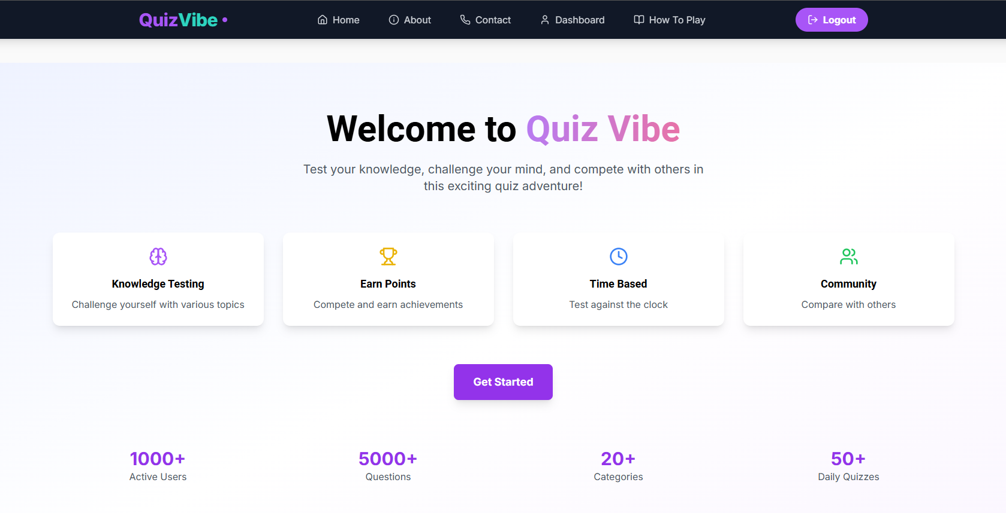
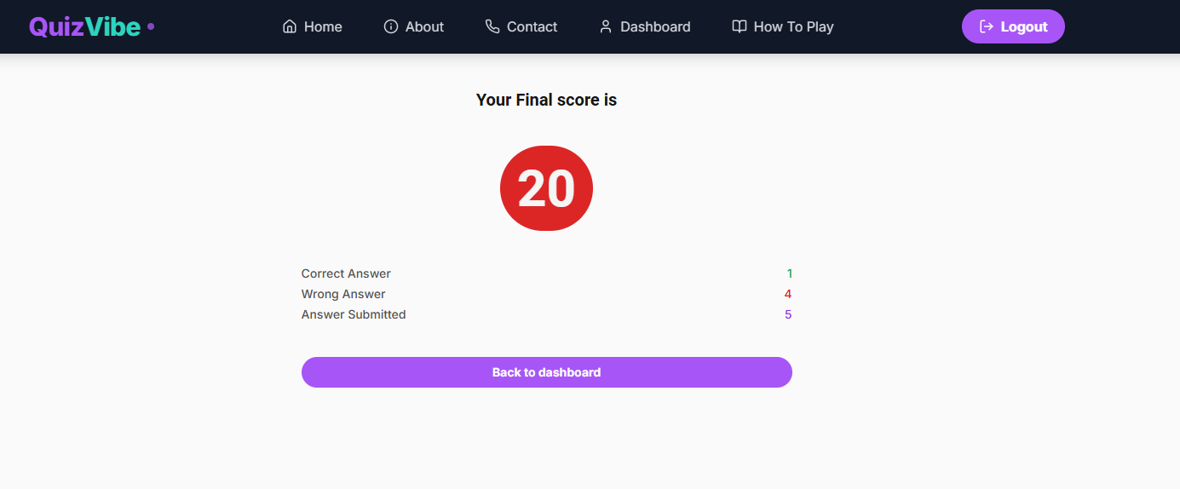
Core Features Implementation
Category & Difficulty Selection: Choose from various topics and difficulty levels to match user interests and skill.
Dashboard: Personalized insights with performance summaries, recent activity, and quiz recommendations
Answer Explanations: Shows correct answers and brief explanations for wrong responses to aid learning.
User Interface: Features a mobile-friendly and responsive design for easy navigation. It includes intuitive layouts and smooth animations to enhance user experience.
Real-Time Scoring: Instant feedback on answers with a final performance summary.

Slide 6
Technology Stack
Front End:
We've chosen React and Next.js for our frontend, leveraging their powerful features for building dynamic user interfaces. Tailwind CSS helps us create beautiful, responsive designs with ease.
Back End:
Our backend is powered by Node.js and Express.js, providing a robust and scalable server-side solution. This allows us to handle complex operations and API requests efficiently.
Database:
Firebase (for user authentication and real-time data storage)

Slide 7
Development Challenges
In developing your "Quiz Vibes" project, we faced these challenges:
User Authentication: Implementing secure authentication and ensuring data privacy.
Real-Time Updates: Displaying quiz progress and results in real-time while handling multiple users.
Responsive Design: Ensuring a seamless user experience across devices, particularly for quizzes with various content types.
Error Handling: Managing edge cases, such as timeouts or server failures, to provide a smooth user experience.
Scalability: Handling large numbers of concurrent users, especially for performance-heavy features like timers and animations.
These challenges require attention to detail in both the technical and user-experience aspects of the platform.

Slide 8

Reflecting on the Alx Journey
Technical Growth
The Alx 12-month software engineering program has been an incredible journey of technical growth. We've mastered a wide range of technologies and best practices in software development.
Problem-Solving Skills
Through numerous projects and challenges, we've honed our problem-solving skills, learning to approach complex issues with creativity and persistence.
Collaboration
Working on team projects has taught us the importance of effective communication and collaboration in the software development process.
Industry Readiness
The program has prepared us for real-world software engineering roles, giving us the confidence to tackle industry-level projects.

Slide 9






Contact Information
Thank you for your attention and interest in the QuizVibes project. We're excited about the potential of this platform and look forward to any feedback or questions you might have. Your support and engagement are greatly appreciated as we continue to grow and innovate in the field of software engineering.
Email
Mohammed dad:
mohammed.dad@ens@gmail.com
Zouhair Alabassi:
Phone
Mohammed dad:
+212 701305189
Zouhair Alabassi:
LinkedIn
Mohammed dad:
https://www.linkedin.com/in/dad-mohammed/ Zouhair Alabassi:

