Slide 1

T🏰E Camelot

Slide 2

Hello!
We are from Group 1
We are here because We love to give presentations.

Slide 3
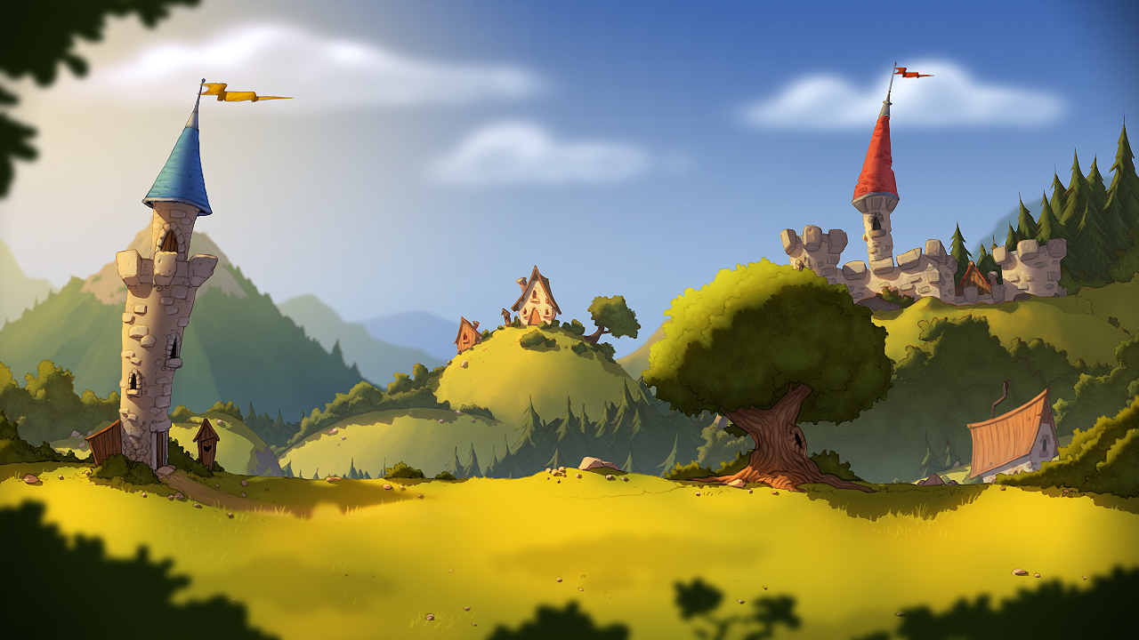





Slide 4
1.
About “The Camelot”
Let’s begin to understand more clearly about it!!

Slide 5
Having the following rules
Genre : Denfense game
Mode : Single player
No. of players : 1 player
Camera : Isometric
Visual : Rotoscoping 2D art style
Controls : Mouse
Gameplay : To build army of troops and lead them to destroy enemy war, defend your city.
Story : Please click me!

Slide 6
2. Core Game
How game theory strategy improves
decision making…

Slide 7
Game features
Game menu system
Way of loading resources
Upgrading heroes
Calculating scores
Creating new heroes/ monsters
Reusing system functions

Slide 8
Our process is so easy…
1
Planning
2
Flow chart
3
Project structure
Resource
4
5
6
Coding
Testing

Slide 9
Planning
Strategy & Defense game
Main characters : Heros, Monsters, Tower
Creating heroes to attack monsters appearing automaticcally

Slide 10
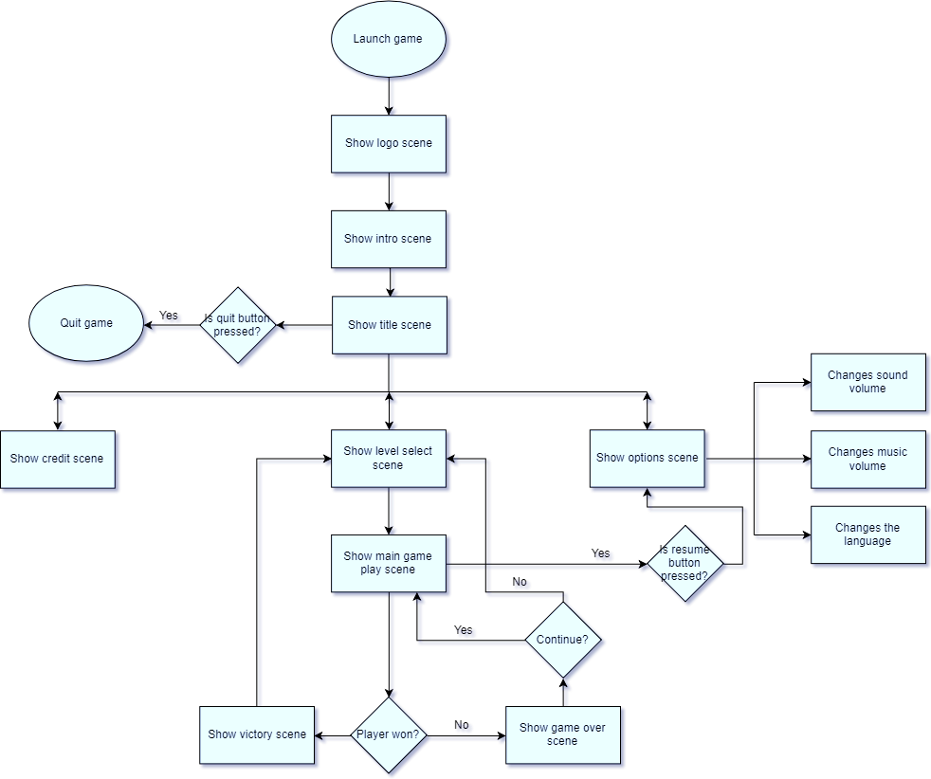
Flow chart

Slide 11
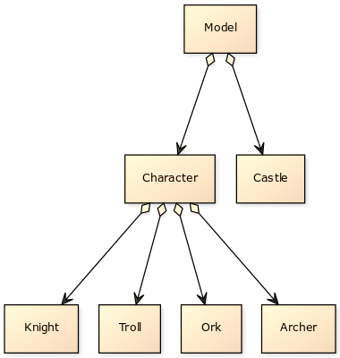
Project structure

Slide 12
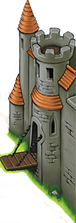












Resource
Heroes
Archer
Knight
Monsters
Troll
Ork

Slide 13
Coding
Handling communications with player
Game physics
Creating scenes

Slide 14
Testing
There is no crash in game.
Making sure code runs correctly.
Checking exception while playing game.

Slide 15

Taking money
Watch advertisements.
Recharge to buy hidden heroes.

Slide 16

How to play
To prevent towel from dark army’s attack
- Drag & drop a set of soldiers → They’ll attack automatically.
- Enemies are going to move from left side of screen to tower.
- When enemies are killed, they’ll fall down & drop coins.
- There is a “wild ambulance” can get coins and revive soldiers & even enemies.
If HP is 0, you lose…
Else you win!

Slide 17

Demo
Show and explain our game!

Slide 18

Thanks!
Any questions?

