Slide 1


Lists, Mutation, and Aliasing
Bunyod Samandarov
Doctor of Science (DSc),
Professor, Al-Khwarizmi University

Slide 2
Quick Recap — What Have We Learned So Far?
Before working with lists, let’s recall some important Python concepts.
Variables and Values
name = "Ali"
score = 85
2. Decisions
if score >= 60:
print("Pass")
else:
print("Fail")
3. Loops
for number in range(3):
print(number)
4. Functions
def double(number):
return number * 2

Slide 3
Quick Questions
What will this code print?
for number in range(1, 4):
print(number)

Slide 4
Quick recap
What will this code print?
for number in range(1, 4):
print(number)
1
2
3

Slide 5
So far, we have often stored one value in one variable.
But what if we need to store many related values together?
score1 = 85
score2 = 72
score3 = 91
score4 = 68
score5 = 88
# Is there a better way?

Slide 6
Why Do We Need Lists?
Imagine we want to store the scores of 5 students.
Without a List
A Better Solution — A List
score1 = 85
score2 = 72
score3 = 91
score4 = 68
score5 = 88
scores = [85, 72, 91, 68, 88]
This works, but what if we have 100 students?
Now one variable can refer to a collection of related values.
A list allows us to store multiple values together in an ordered collection.

Slide 7
What Is a List?
A list is an ordered collection of values stored together in Python.
scores = [85, 72, 91, 68, 88]
Here:
scores → variable name
[ ] → square brackets define the list
85, 72, 91, 68, 88 → items (elements)
, → separates the items

Slide 8
Lists Can Store Different Types of Values
numbers = [10, 20, 30]
names = ["Ali", "Sara", "Tom"]
mixed = ["Ali", 20, True, 85.5]
Important: A Python list can contain values of the same type or different types.

Slide 9
Creating Lists with List Literals
The simplest way to create a list is to place values inside square brackets [ ], separated by commas.
colors = ["red", "green", "blue"]

Slide 10
Different Examples
ages = [18, 20, 19, 21]
prices = [12.5, 8.99, 15.0]
names = ["Ali", "Sara", "John"]
answers = [True, False, True]
students = [ ]
A list can also start with no items:

Slide 11
Important
These are all list literals
[10, 20, 30]
["apple", "banana"]
[True, False]
[]
List literal = a list written directly in the program using [ ].

Slide 12
Quick Check
Which of these is a list?
A. 10, 20, 30
B. [10, 20, 30]
C. (10, 20, 30)
D. "10, 20, 30"

Slide 13
Quick Check
Which of these is a list?
A. 10, 20, 30
B. [10, 20, 30]
C. (10, 20, 30)
D. "10, 20, 30"

Slide 14
Accessing List Items with Indexes
Each item in a list has a position called an index.
colors = ["red", "green", "blue", "yellow"]
Index Positions
List: ["red", "green", "blue", "yellow"]
↑ ↑ ↑ ↑
Index: 0 1 2 3
Important: Python starts counting indexes from 0, not 1.

Slide 15
Access an Item
Use the list name followed by the index inside square brackets:
List: ["red", "green", "blue", "yellow"]
↑ ↑ ↑ ↑
Index: 0 1 2 3
print(colors[0])
print(colors[2])
red
blue

Slide 16
General Form
list_name [index]
students = ["Ali", "Sara", "Tom"]
print(students[1])
Sara

Slide 17
Quick Check
What will this print?
numbers = [10, 20, 30, 40, 50]
print(numbers[3])
?

Slide 18
Quick Check
What will this print?
numbers = [10, 20, 30, 40, 50]
print(numbers[3])
40

Slide 19
Accessing Items from the End
Python also allows negative indexes to access items starting from the end of a list.
Positive and Negative Indexes
List: "red" "green" "blue" "yellow"
↑ ↑ ↑ ↑
Positive: 0 1 2 3
Negative: -4 -3 -2 -1
-1 always refers to the last item.
Example:
print(colors[-1])
print(colors[-2])
yellow
blue

Slide 20
Why Is This Useful?
Instead of finding the length and calculating the last index:
colors[len(colors) - 1]
we can simply write:
colors[-1]

Slide 21
Quick Check
What will this print?
numbers = [10, 20, 30, 40, 50]
print(numbers[-3])

Slide 22
Quick Check
What will this print?
numbers = [10, 20, 30, 40, 50]
print(numbers[-3])
30

Slide 23
How Many Items Are in a List? — len()
The built-in len() function returns the number of items in a list.
colors = ["red", "green", "blue", "yellow"]
print(len(colors))
Length = number of items
Last positive index = length − 1
4

Slide 24
Quick Check
What will this print?
scores = [75, 82, 91, 68, 88, 95]
print(len(scores))
What is the output?
What is the index of the last item?

Slide 25
Quick Check
What will this print?
scores = [75, 82, 91, 68, 88, 95]
print(len(scores))
6
the index of the last item is 5

Slide 26
Getting Part of a List — Slicing
Sometimes we do not need just one item. We want to get several items from a list.
numbers = [10, 20, 30, 40, 50, 60]
Use a slice:
numbers[1:4]

Slide 27
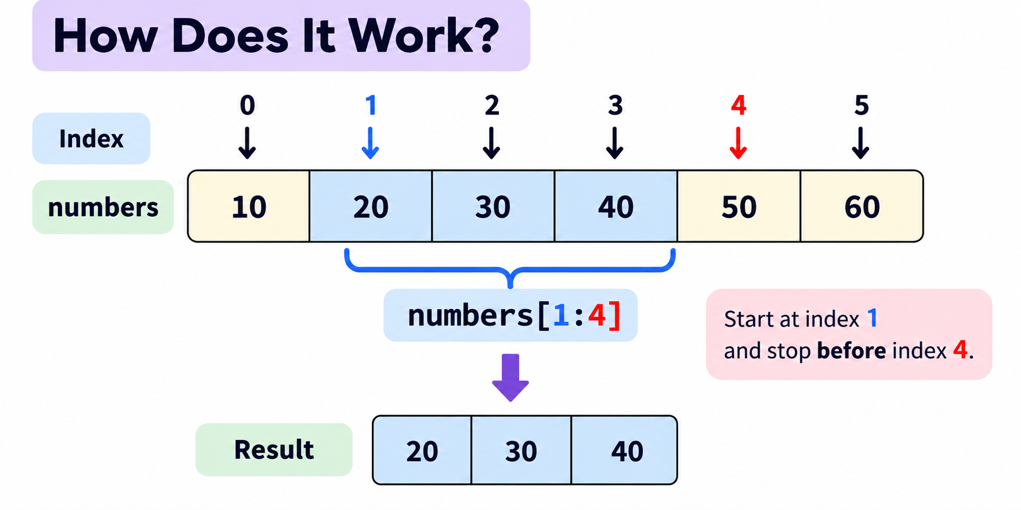
start → included
stop → not included

Slide 28
Quick Check
What will this print?
letters = ["A", "B", "C", "D", "E"]
print(letters[1:3])

Slide 29
Quick Check
letters = ["A", "B", "C", "D", "E"]
print(letters[1:3])
[“B”, “C”]

Slide 30
Slicing Shortcuts
When slicing a list, we can leave out the start or stop index.
If we omit stop, Python continues to the end:
numbers = [10, 20, 30, 40, 50, 60]
print(numbers[ :3])
numbers = [10, 20, 30, 40, 50, 60]
print(numbers[3: ])
[10, 20, 30]
[40, 50, 60]
[ :stop] → from the beginning
[start: ] → to the end
[ : ] → the whole list

Slide 31
Quick Check
letters = ["A", "B", "C", "D", "E"]
print(letters[:2])
print(letters[2:])
?

Slide 32
Quick Check
letters = ["A", "B", "C", "D", "E"]
print(letters[:2])
print(letters[2:])
['A', 'B']
['C', 'D', 'E']

Slide 33
Going Through a List — Traversal
Often, we want to process every item in a list.
This is called traversal.
fruits = ["apple", "banana", "orange"]
We can traverse the list using a for loop:
The variable fruit takes one item at a time from the list.
apple
banana
orange
for fruit in fruits:
print(fruit)

Slide 34
Membership Testing with in
Python provides the in operator to check whether a value exists in a list.
fruits = ["apple", "banana", "orange"]
print("banana" in fruits)
fruits = ["apple", "banana", "orange"]
print("grape" in fruits)
True
The result is always a Boolean value:
False

Slide 35
Using in with if
This becomes more useful when combined with a decision:
students = ["Ali", "Sara", "Tom"]
name = "Sara"
if name in students:
print("Student found")
else:
print("Student not found")
Student found

Slide 36
Lists Are Mutable
One important feature of Python lists is that they are mutable.
Mutable means that an existing object can be changed after it is created.
colors = ["red", "green", "blue"]
colors[1] = "yellow"
print(colors)
Important:
We did not create another list here.
We modified the existing list.
Changing an existing object is called mutation.
['red', 'yellow', 'blue']

Slide 37
Quick Check
What will be printed?
numbers = [10, 20, 30]
numbers[0] = 100
print(numbers)
?

Slide 38
Quick Check
What will be printed?
numbers = [10, 20, 30]
numbers[0] = 100
print(numbers)
[100, 20, 30]

Slide 39
Adding Items with append()
The append() method adds one item to the end of an existing list.
fruits = ["apple", "banana"]
fruits.append("orange")
print(fruits)
['apple', 'banana', 'orange']

Slide 40
Adding Items with append()
Starting with an Empty List
students = []
students.append("Ali")
students.append("Sara")
students.append("Tom")
print(students)
Important
append() modifies the existing list.
['Ali', 'Sara', 'Tom']

Slide 41
Quick Check
What will be printed?
numbers = [10, 20]
numbers.append(30)
numbers.append(40)
print(numbers)
?

Slide 42
Quick Check
What will be printed?
numbers = [10, 20]
numbers.append(30)
numbers.append(40)
print(numbers)
[10, 20, 30, 40]

Slide 43
Removing Items with pop()
The pop() method removes an item from a list and returns the removed value.
fruits = ["apple", "banana", "orange"]
removed = fruits.pop()
print(fruits)
print(removed)
fruits → ['apple', 'banana']
removed → 'orange'
fruits.pop()
With no index, pop() removes the last item:

Slide 44
Remove a Specific Index
We can also specify which position to remove:
numbers = [10, 20, 30, 40]
removed = numbers.pop(1)
print(numbers)
print(removed)
[10, 30, 40]
20

Slide 45
Quick Check
What will be printed?
scores = [70, 80, 90, 100]
value = scores.pop(2)
print(scores)
print(value)
?

Slide 46
Quick Check
What will be printed?
scores = [70, 80, 90, 100]
value = scores.pop(2)
print(scores)
print(value)
[70, 80, 100]
90

Slide 47
Tracking List Changes
Let’s combine item assignment, append(), and pop().
numbers = [10, 20, 30]
print(numbers)
numbers = [10, 20, 30]
numbers[1] = 25
print(numbers)
[10, 20, 30]
[10, 25, 30]

Slide 48
Quick Check
What is the final list?
items = [1, 2, 3]
items.append(4)
items[0] = 10
items.pop()
print(items)
?

Slide 49
Quick Check
What is the final list?
items = [1, 2, 3]
items.append(4)
items[0] = 10
items.pop()
print(items)
[10, 2, 3]

Slide 50
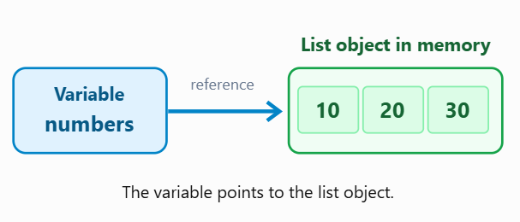
Variables Store References to Lists
When we create a list, Python creates a list object in memory.
The variable does not directly contain all the list items. Instead, it refers to the list object.
Example:
numbers = [10, 20, 30]

Slide 51
Important Concepts
List object: The actual list stored in memory.
Reference: A connection to an object.
Variable: A name that refers to an object.
What Happens When We Modify the List?
The list object changes, but numbers still refers to the same list object.
Key Takeaway
A list variable refers to a list object. Modifying the list changes that object, not the reference itself.
numbers = [10, 20, 30]
numbers[1] = 99
print(numbers)
[10, 99, 30]

Slide 52
Think About It
a = [10, 20, 30]
b = a
?
Question: Does Python create a second list, or do both variables refer to the same list?

Slide 53
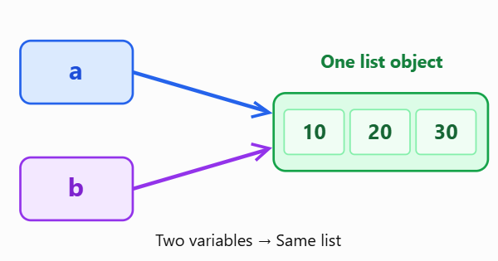
Aliasing: Two Variables, One List
Aliasing occurs when two or more variables refer to the same object in memory.
Does Python create two separate lists?
No! Both a and b refer to the same list object.
a = [10, 20, 30]
b = a
[99, 20, 30]
[99, 20, 30]

Slide 54
What Happens If We Change b?
a = [10, 20, 30]
b = a
b[0] = 99
print(a)
print(b)
?

Slide 55
What Happens If We Change b?
Why Did Both Change?
Because a and b refer to the same list. Changing the list through b is also visible through a.
Important
a = [10, 20, 30]
b = a
b[0] = 99
print(a)
print(b)
b = a
This does not copy the list. It creates another reference to the same object.
[99, 20, 30]
[99, 20, 30]

Slide 56
Quick Check
Predict the Output
x = [1, 2, 3]
y = x
y.append(4)
print(x)
?

Slide 57
Quick Check
Predict the Output
x = [1, 2, 3]
y = x
y.append(4)
print(x)
[1, 2, 3, 4]

Slide 58
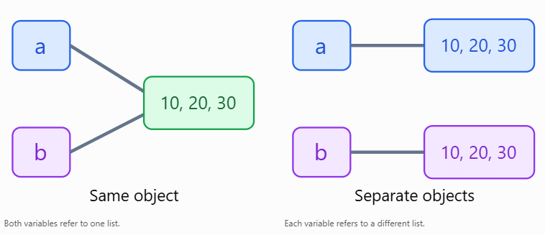
Aliasing vs Copying a List
When assigning a list to another variable, we must understand whether we are creating another reference or a new list.
a = [10, 20, 30]
b = a
a = [10, 20, 30]
b = a[:]

Slide 59
Aliasing vs Copying a List
When assigning a list to another variable, we must understand whether we are creating another reference or a new list.
a = [10, 20, 30]
b = a
b[0] = 99
print(a)
print(b)
a = [10, 20, 30]
b = a[:]
b[0] = 99
print(a)
print(b)
[99, 20, 30]
[99, 20, 30]
[10, 20, 30]
[99, 20, 30]

Slide 60
Key Difference
Aliasing b = a | Copying b = a[:]
Same list object | New list object
Changes are shared | Changes to top-level items are independent
No new list created | Shallow copy created
Remember: b = a creates an alias, while b = a[:] creates a new list containing the same elements.

Slide 61
Quick Check
Predict the Output
x = [5, 10, 15]
y = x[:]
y.append(20)
print(x)
print(y)
?

Slide 62
Quick Check
Predict the Output
x = [5, 10, 15]
y = x[:]
y.append(20)
print(x)
print(y)
[5, 10, 15]
[5, 10, 15, 20]

Slide 63
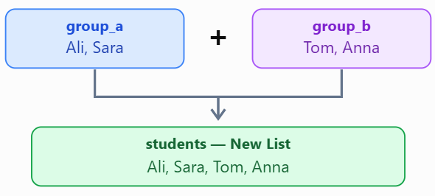
Can We Combine Two Lists?
Python allows us to combine lists using the + operator. This is called list concatenation.
Example: Combining Two Groups
How Does It Work?
group_a = ["Ali", "Sara"]
group_b = ["Tom", "Anna"]
students = group_a + group_b
print(students)
['Ali', 'Sara', 'Tom', 'Anna']

Slide 64
Another Example
numbers = [10, 20]
more_numbers = [30, 40]
result = numbers + more_numbers
print(result)
Important: The + operator creates a new list. The original lists remain unchanged.
[10, 20, 30, 40]

Slide 65
Finding the Highest Score in a List
Imagine a teacher has the exam scores of five students.
Task: Find the highest score without using Python’s built-in max() function.
scores = [75, 92, 68, 85, 90]
highest = scores[0]
for score in scores:
if score > highest:
highest = score
print("Highest score:", highest)
Highest score: 92

Slide 66
Mini Challenge
Predict the Output
a = [1, 2]
b = [3, 4]
a + b
print(a)
?

Slide 67
Mini Challenge
Predict the Output
a = [1, 2]
b = [3, 4]
a + b
print(a)
[1, 2]
The expression a + b creates a new list, but the result is not assigned to any variable.

Slide 68
How Many Students Passed the Exam?
A teacher has the following exam scores:
scores = [75, 42, 88, 35, 91, 60, 48, 82]
Task: Write a Python program that counts how many students passed the exam.
Rules:
A student passes if their score is 60 or higher.
Use a for loop and an if statement.
Do not use count() or other built-in counting functions.
Print the total number of students who passed.
Expected Output: Students passed: 5

Slide 69
How Many Students Passed the Exam?
A teacher has the following exam scores:
scores = [75, 42, 88, 35, 91, 60, 48, 82]
passed = 0
for score in scores:
if score >= 60:
passed += 1
print("Students passed:", passed)

Slide 70
Can You Update a Shopping List?
You are creating a shopping list using Python.
shopping = ["milk", "bread", "eggs"]
Your Task:
Add "rice" to the end.
Replace "bread" with "cheese".
Remove the last item using pop().
Print the final list.

Slide 71
Can You Update a Shopping List?
You are creating a shopping list using Python.
shopping = ["milk", "bread", "eggs"]
shopping = ["milk", "bread", "eggs"]
shopping.append("rice")
shopping[1] = "cheese"
shopping.pop()
print(shopping)
['milk', 'cheese', 'eggs']

Slide 72
What Will Python Print?
numbers = [10, 20, 30, 40]
numbers.append(50)
numbers.pop(1)
print(numbers[2])
?
A. 20
B. 30
C. 40
D. 50

Slide 73
What Will Python Print?
numbers = [10, 20, 30, 40]
numbers.append(50)
numbers.pop(1)
print(numbers[2])
40
A. 20
B. 30
C. 40
D. 50

