Slide 1

Redbus
Data Scrapping

Slide 2

Problem Statement
The "Redbus Data Scraping and Filtering with Streamlit Application" aims to revolutionize the transportation industry by providing a comprehensive solution for collecting, analyzing, and visualizing bus travel data. By utilizing Selenium for web scraping, this project automates the extraction of detailed information from Redbus, including bus routes, schedules, prices, and seat availability. By streamlining data collection and providing powerful tools for data-driven decision-making, this project can significantly improve operational efficiency and strategic planning in the transportation industry.

Slide 3

approach
Data Scrapping
Extraction Of Redbus
Data Using Selenium
Data Storage
Storing the Scrapped data in a Data base using SQL
Streamlit
Build Streamlit App to display scrapped data

Slide 4




Technologies Used
Selenium
SQL
Streamlit
Selenium is an open-source tool for web scraping that automates browser interactions, enabling data extraction from dynamic, JavaScript-rendered websites. It supports multiple browsers and programming languages,making it versatile but resource-intensive compared to alternatives like BeautifulSoup.
SQL is a language used to manage and manipulate relational databases, enabling tasks like data retrieval, updating, and deletion through simple queries. It is essential for working with structured data.
Streamlit is an open-source Python framework for creating interactive web apps with minimal code, ideal for data science and machine learning projects. It integrates easily with libraries like Pandas and Matplotlib, offering fast deployment and real-time interactivity.

Slide 5
Selenium :
1. Browser Automation and Dynamic Content Handling: Automates interactions like clicking and typing, handles JavaScript-rendered content, and manages infinite scrolling.
2. Element Identification and Navigation: Uses multiple locators (ID, XPath, CSS Selector) for element recognition and automates multi-page navigation (e.g., pagination).
3. Advanced Features: Handles pop-ups, frames, and alerts; supports custom wait mechanisms (e.g., `WebDriverWait`) for precise interaction timing.
4. Cross-Browser and Data Extraction: Offers compatibility with major browsers, extracts attributes (e.g., href, src), and supports advanced interactions like hovering and dragging.

Slide 6
SQL :
1. Core SQL Operations: Manages relational databases with SQL for data retrieval (`SELECT`), manipulation (`INSERT`, `UPDATE`, `DELETE`), and advanced filtering (`WHERE`, `HAVING`).
2. Data Summarization and Relationships: Offers aggregation functions (`COUNT`, `SUM`, `AVG`, etc.) and combines data across tables using `JOIN` operations.
3. Performance and Security: Enhances query efficiency with indexing and ensures data security through user privileges and roles.
4. Transactions and Scalability: Supports `COMMIT` and `ROLLBACK` for transaction management and is compatible with various database systems (e.g., MySQL, PostgreSQL, Oracle).

Slide 7
Streamlit :
1. Simplified Development: Streamlit enables quick creation of interactive Python-based web apps with minimal code and built-in interactive widgets (e.g., sliders, buttons).
2. Real-Time Interactivity and Data Visualization: Supports real-time app updates and integrates seamlessly with visualization libraries like Matplotlib, Plotly, and Seaborn.
3. Customization and Machine Learning Integration: Offers custom layouts for better UI design and simplifies deploying machine learning models as interactive applications.
4. Ease of Deployment and Community Support: Allows hassle-free deployment on platforms like Streamlit Cloud and benefits from an open-source community for resources and plugins.

Slide 8
Outcomes of the Project
Automated Real-Time Data Scraping :Ensures up-to-date information availability.
Comprehensive Filtering and Visualization:Offers filtering by route, price, availability, and ratings with a user-friendly interface.
SQL-Based Data Analysis and Retrieval: Enables efficient querying and handling of large data sets.
Simplified Data Management and Insights: Facilitates streamlined data collection and actionable decision-making.
Enhanced Efficiency and Resource Savings : Improves operational performance and reduces time and costs in the transportation sector.

Slide 9
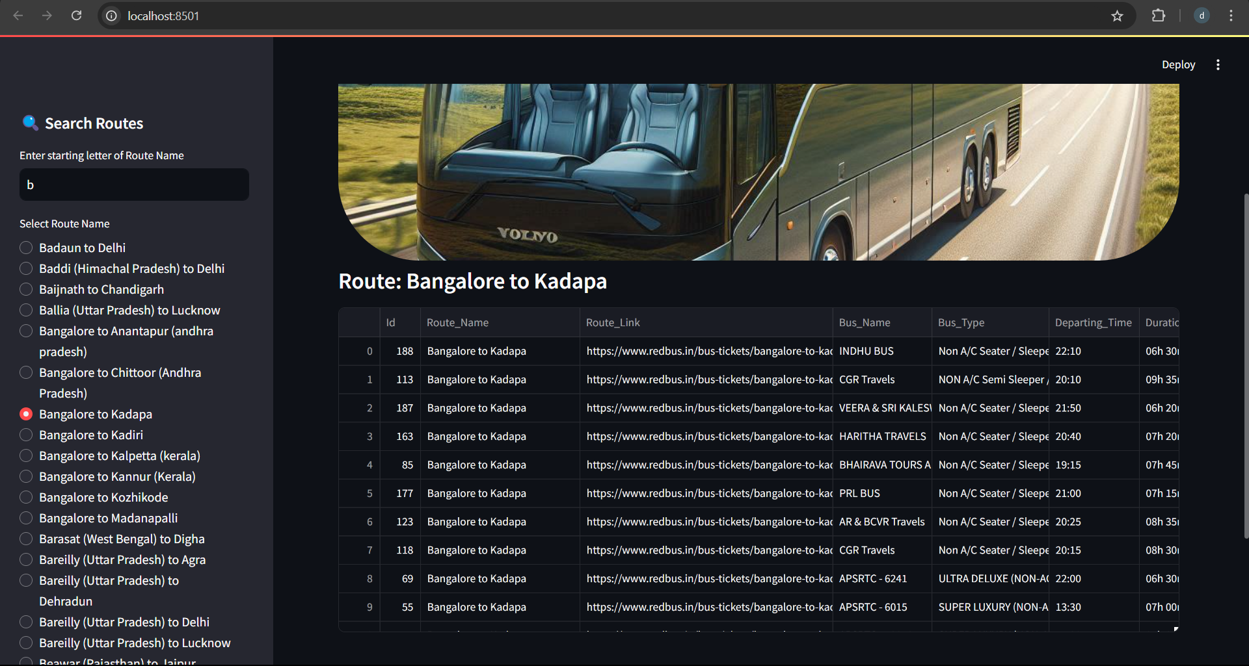

Slide 10
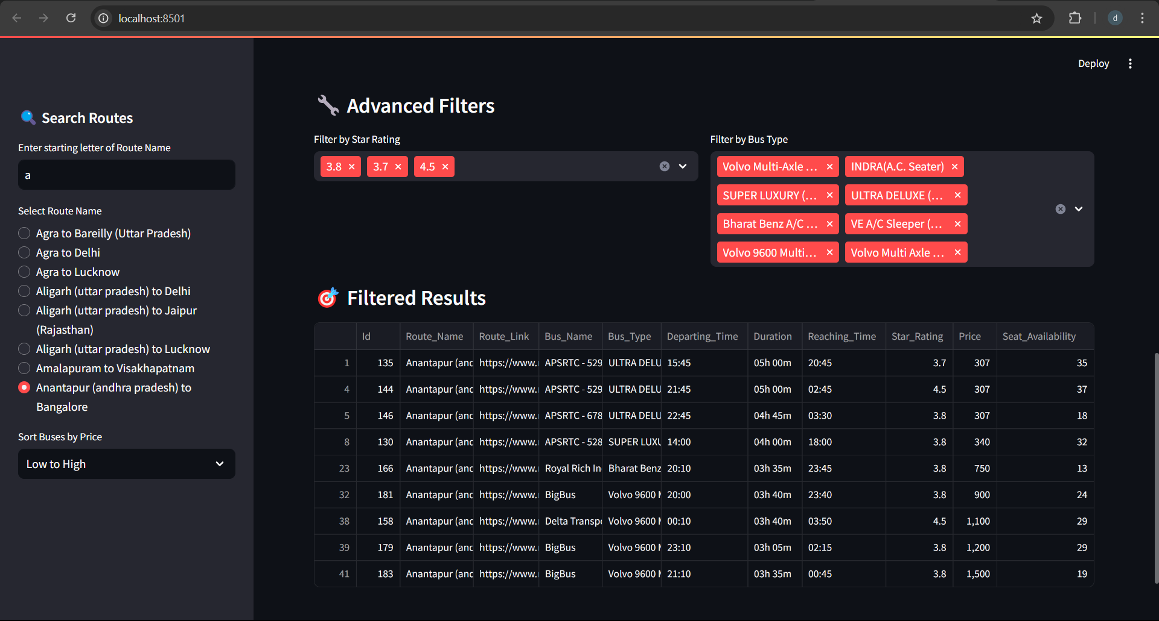

Slide 11


Thank You
“The expert in anything was once a beginner”.

