Slide 1
Knowledge and Data Integration: Military weapons and warfare
Jinghui WANG
Shuai YANG

Slide 2

Outline
Project purpose
Scenario
Sources
Inception phase
Informal Model
Formal Model
Data Integration
Visualization
Reference

Slide 3

Project Purpose
Providing users with information on military weapons and their use
Users are able to learn more easily about the weapons they are interested in and how they are used
Weapon information includes development time, owner, use event, use event, length, weight, and flight speed.
The war information includes the warring countries, the time of the war, the place of the war, the economic strength of the warring countries, the comprehensive national strength, etc.

Slide 4

Scenarıo
Person:army enthusiasts , soldiers,journalists,students
Various scenarios such as:
write a report
research weapons
make decisionsn

Slide 5




sources
Data Sources:
Open Data World Bank: a website that provides open access to global GDP rankings and increases/decreases.
Junshi:Open source weapons information
Knowledge Source:
Yago-knowledge.org

Slide 6

Inceptıon phase
Common, core, contextual kernel concepts are decided
Device,Organization,Action as common kernel concept
Country,Warfare , Weaponry as examples of core kernel concepts
Utilization, belligerent countries as contextual kernel concepts

Slide 7
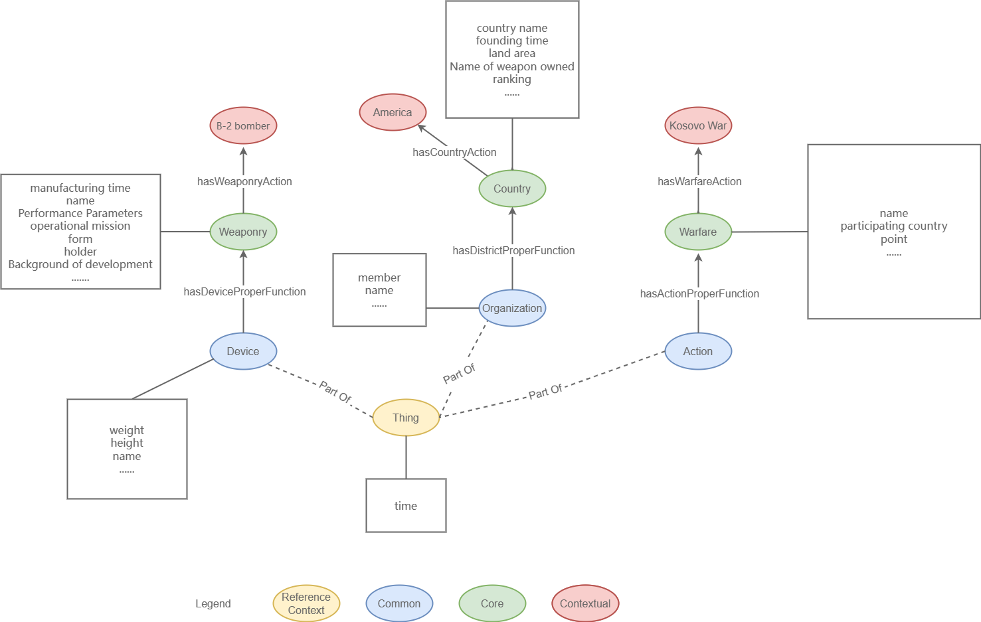
Informal Model
Common, core, contextual kernel concepts defined at e-type level
ER Model is formed using yED tool
Device,Organization and Action as main e-types
Thing defined as common e-type

Slide 8

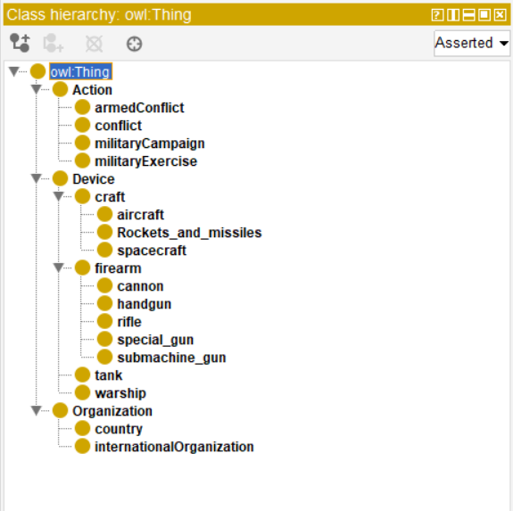
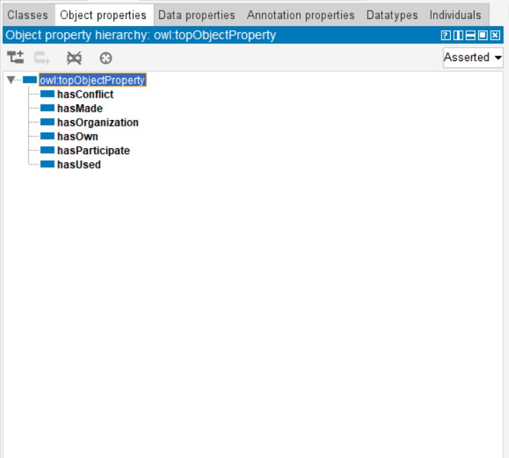
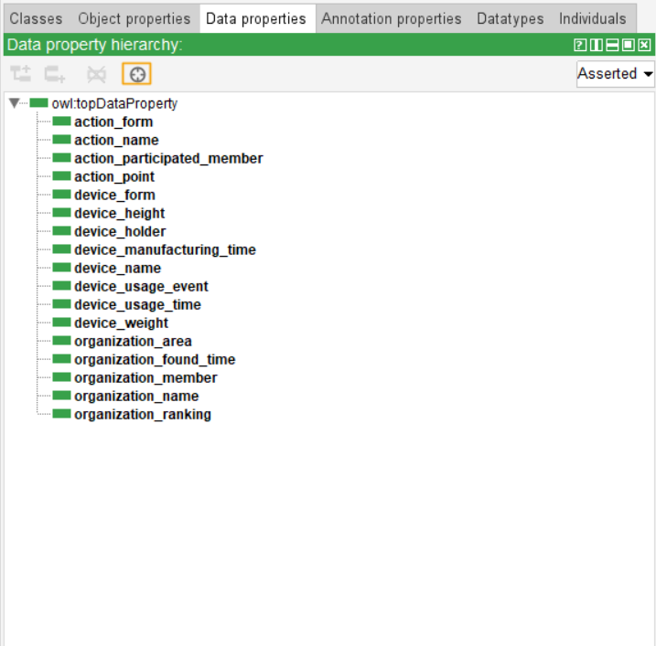
Formal modeling
ETG model
Classes
Object properties
Data properties

Slide 9
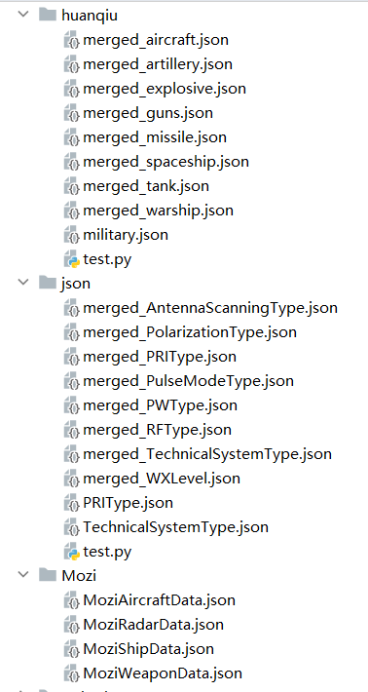
Data management
Clear data
Convert json file

Slide 10
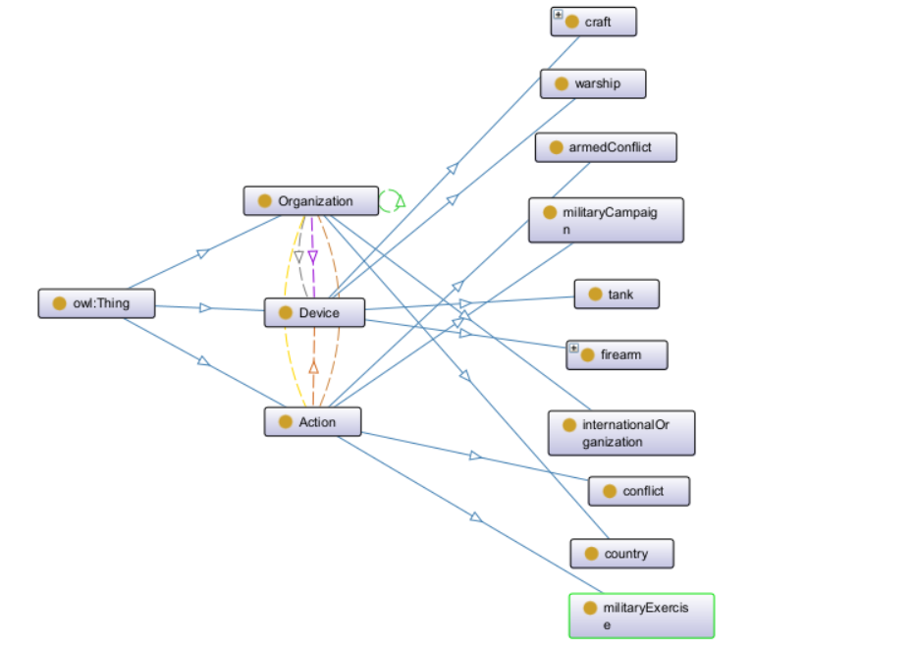
Data integration ~ KARMALINKER
We want to match the Datasets to the defined Ontology.
The final step to create the Military weapons and warfare

Slide 11
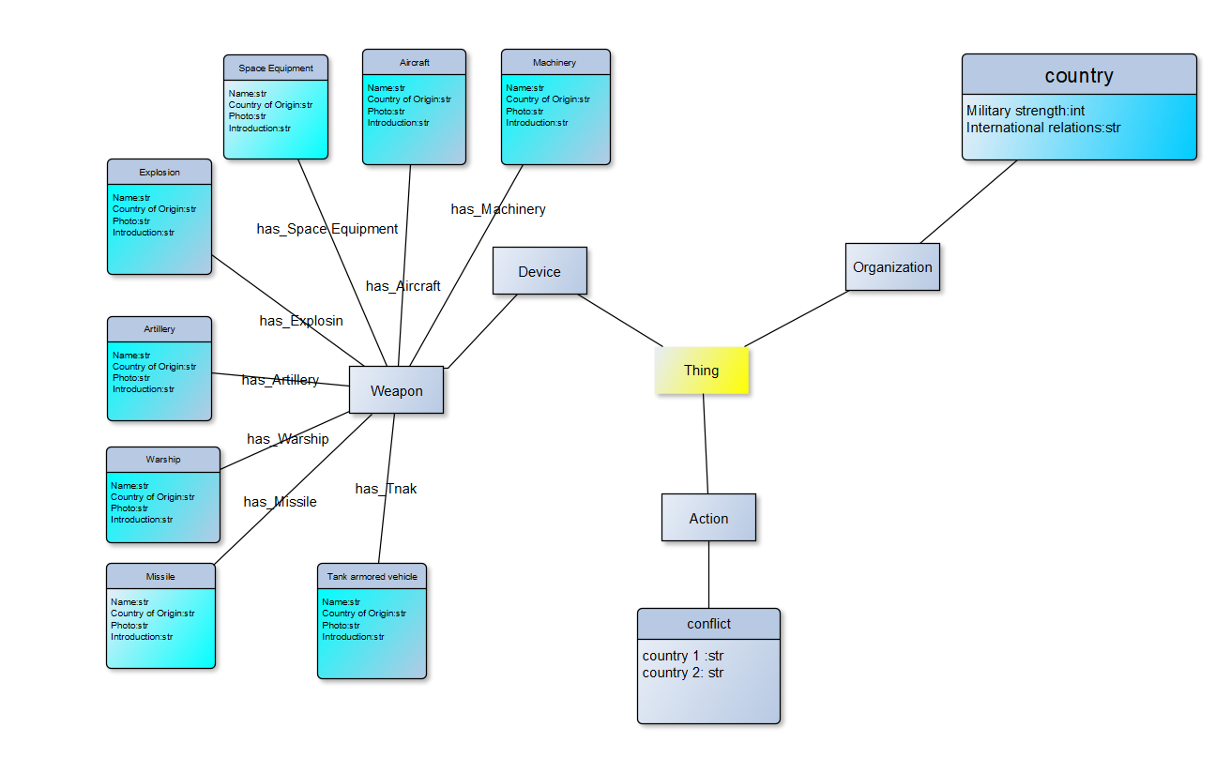
E-R Graph

Slide 12

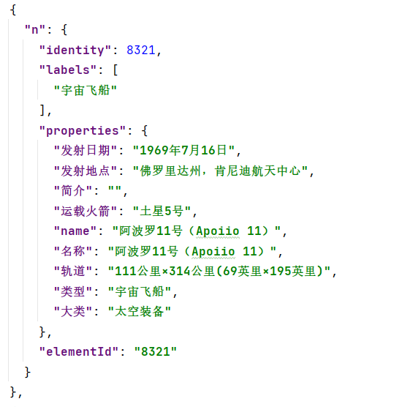
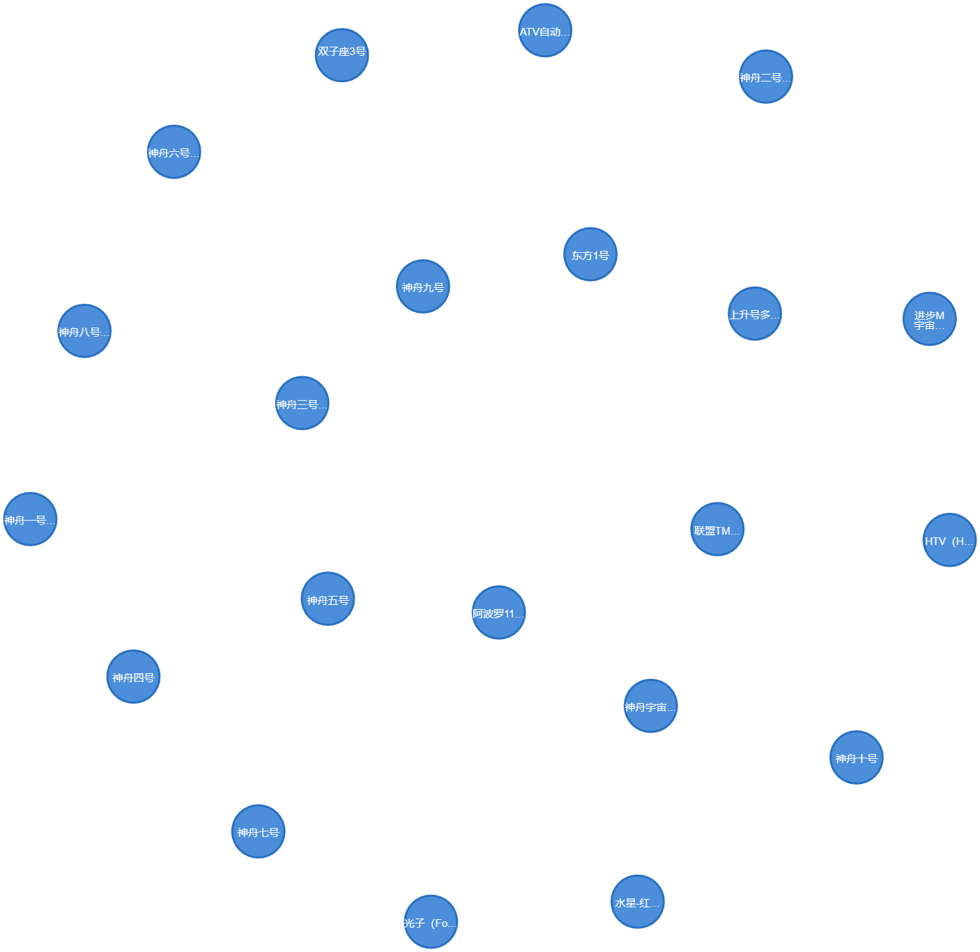
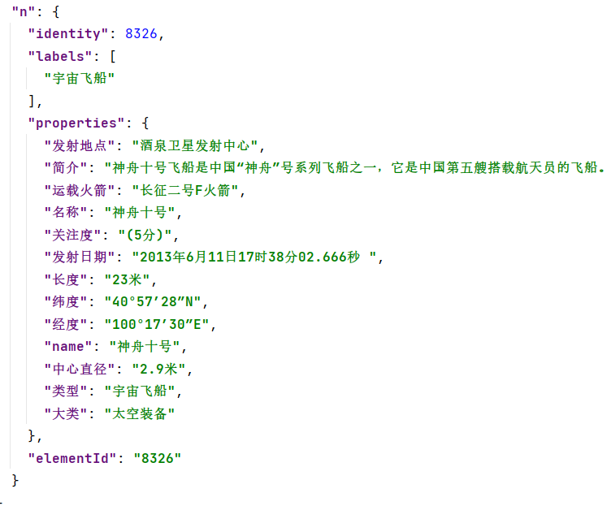
Visualization
How to know about spacecraft
Click to display spacecraft information and expand relationships with different categories

Slide 13

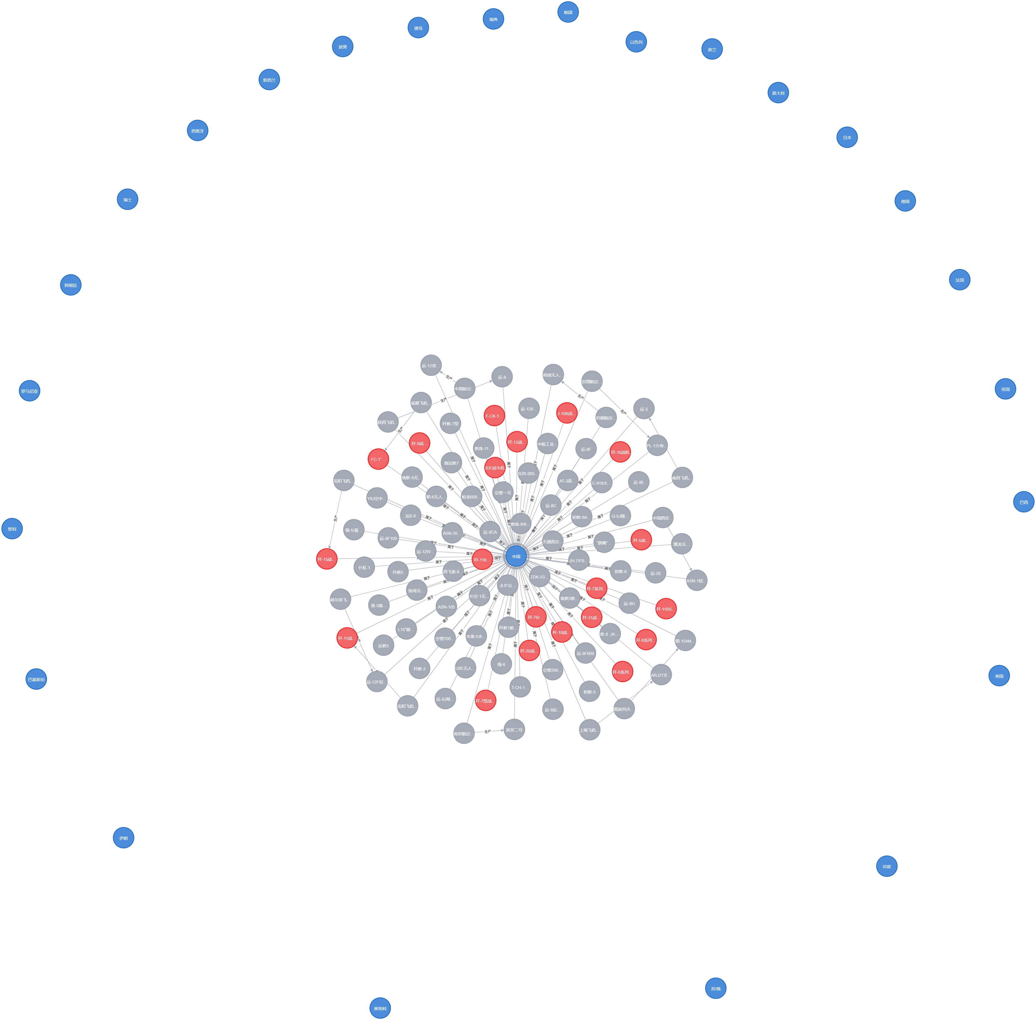
Visualization
Give the graph of military weapons to the country?
Return graph of country with information's.

Slide 14
Visualization
Please watch VCR

Slide 15
reference:
Repository for KDI_Events_in_Trentino data integration project
（https://github.com/AnnaFetz/KDI_Events_in_Trentino）
领域知识图谱数据采集、数据处理以及可视化
（https://github.com/Louis-tiany/Military-KG）
基于mongodb存储的军事领域知识图谱问答项目（https://github.com/RomanGao/QAonMilitaryKG）
基于本体的主战武器装备知识图谱构建(https://www.zhkzyfz.cn/CN/10.3969/j.issn.1673-3819.2020.04.001)

Slide 16
Thank you for lıstenıng

