Slide 1


Trip Mania - Travel Application App
Mobile Application Development Course Project
Academic Year 2024/2025
Group - 14
D. Reverberi, S. Franceschini, D. d’Amico, G. Mancari Pasi

Slide 2
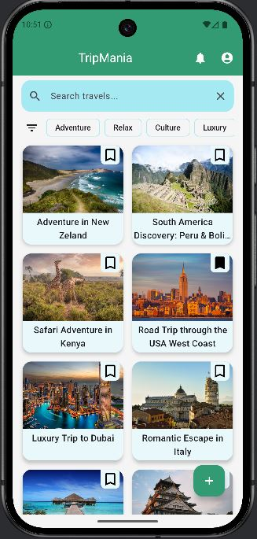
Product Vision & Strategy
Mobile app to create and join shared trips
Group travel coordination
Social and collaborative travel experience
Community driven travels

Slide 3



Main Target (Personas)
Travel enthusiasts looking for shared experiences
Travel organizations
Solo travelers who wants to join organized trips
People interest in last-minute travel proposals

Slide 4
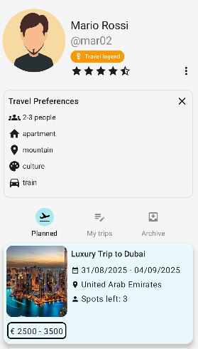
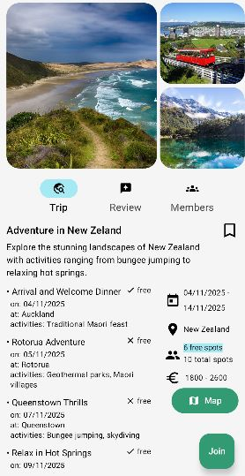
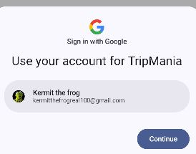
Key features
Create and join an existing trip
Trip details page
User authentication
User profile page
Trips and users review
Notifications

Slide 5
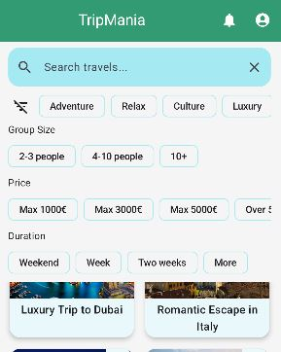
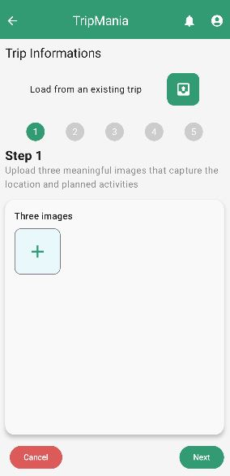
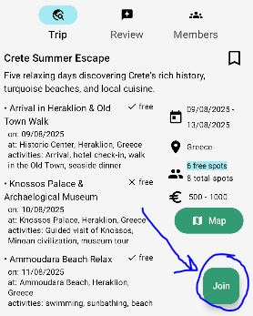
UX Highlights
Minimalist Design
Creation of trip by steps
Application in 1 click
Advanced search filter for travels
Easy to read notifications

Slide 6
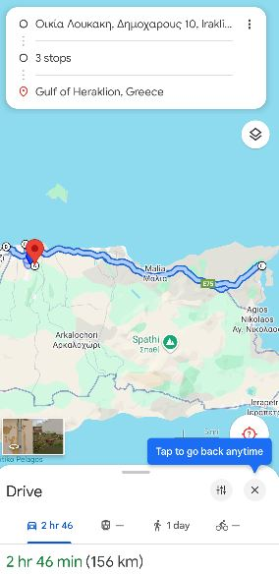
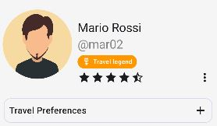
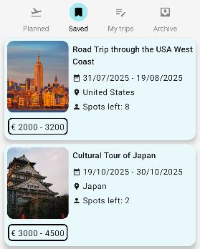

Extra Features
Badge for experienced user
Viewing all the itinerary on google maps
Save trips
Reply to review
Join Telegram travel group

Slide 7
Thank you for your attention

