Slide 1
Artificial Intelligence
Recap: Machine Learning – Classification
Decision Tree – Random Forest

Slide 2
Types of ML algorithms

Slide 3
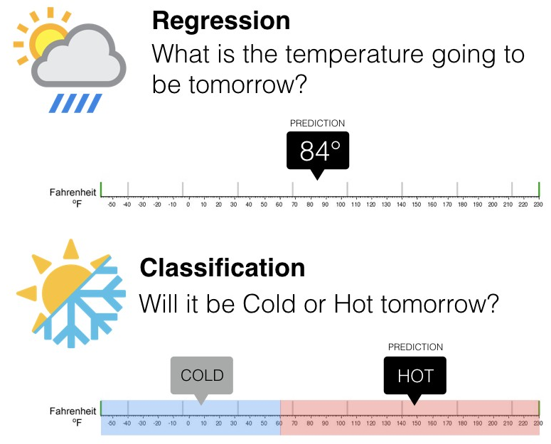
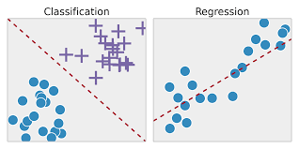
Supervised Learning (with labels)
X
y

Slide 4
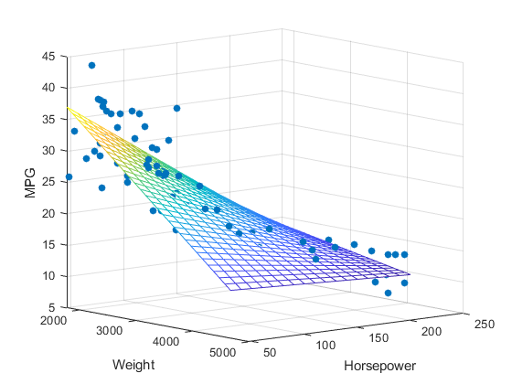
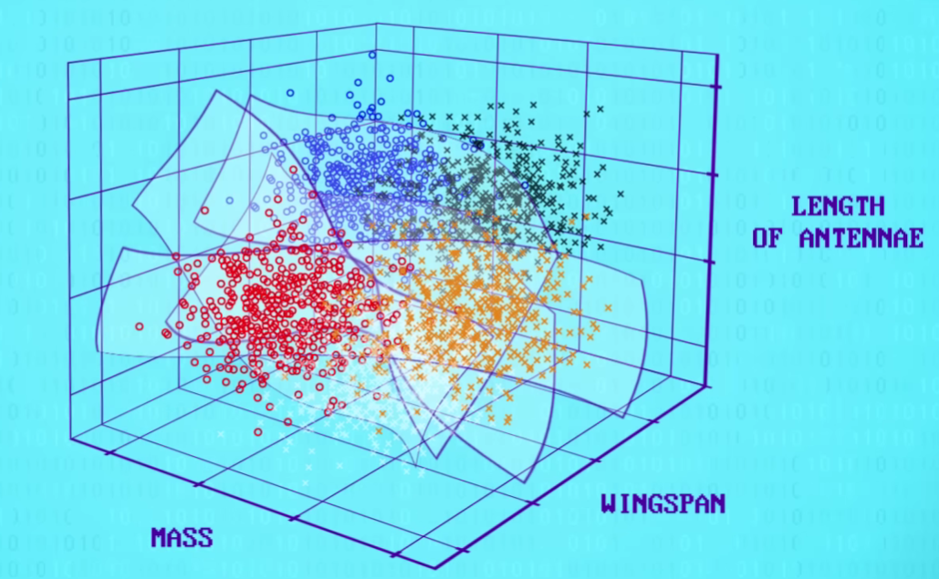
Hyperplanes Classification versus Regression

Slide 5
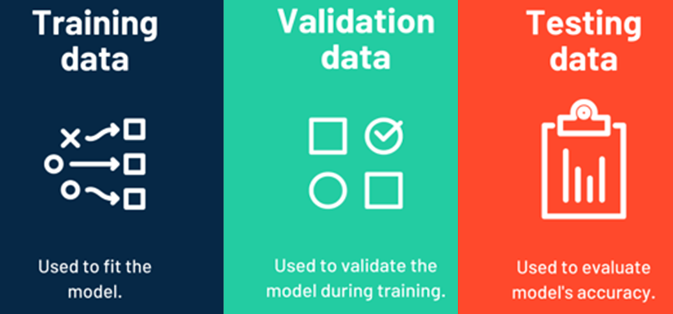
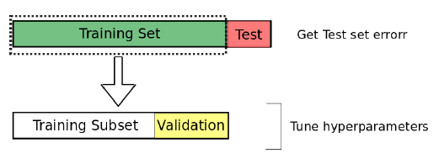
Model Fit: data sets

Slide 6
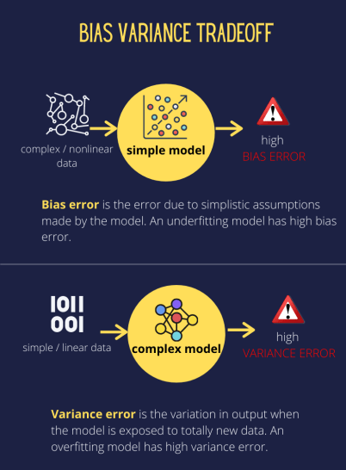
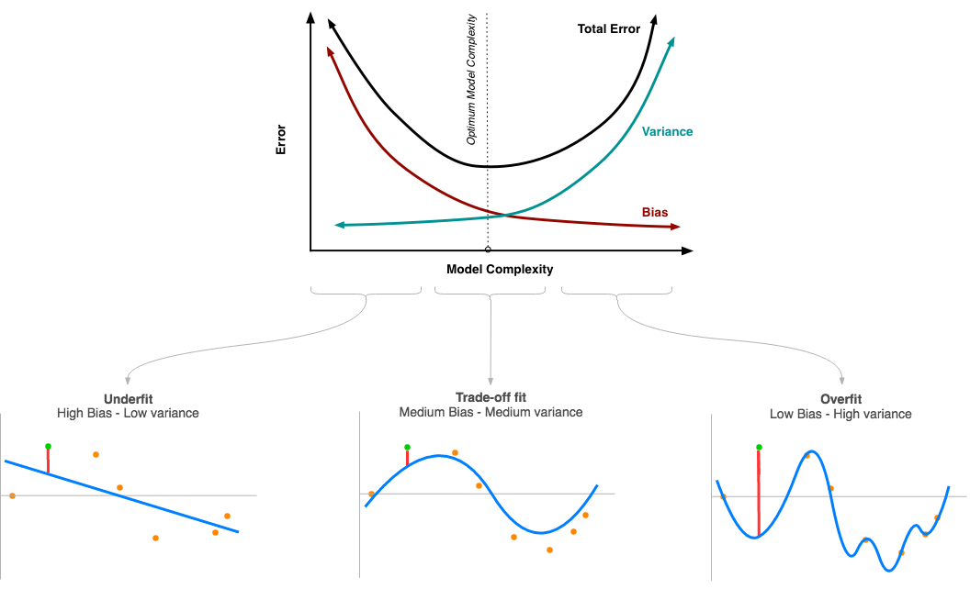
Model Fit: model complexity Bias Variance Tradeoff

Slide 7
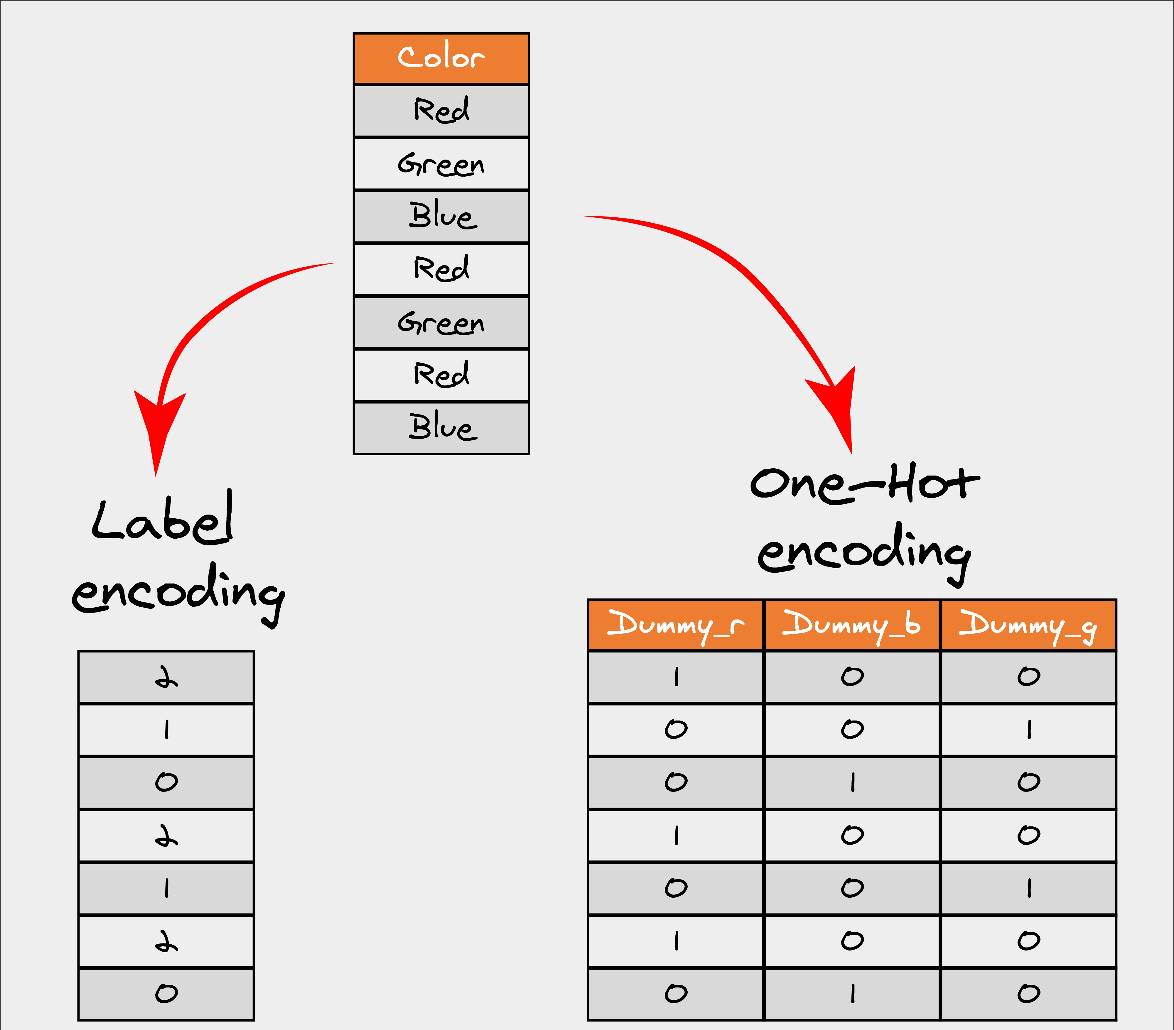
Encoding data

Slide 8
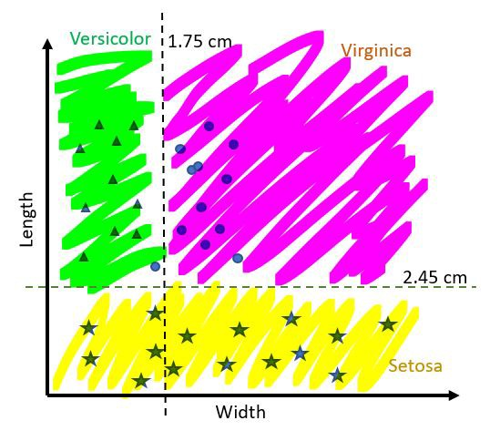
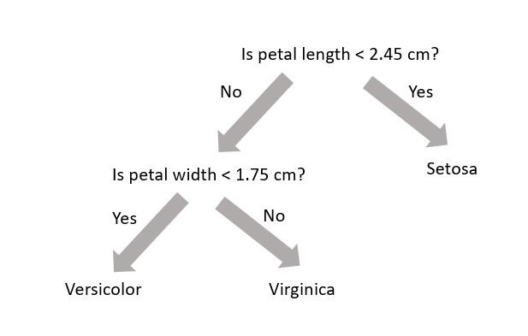
Classification: Decision Tree

Slide 9

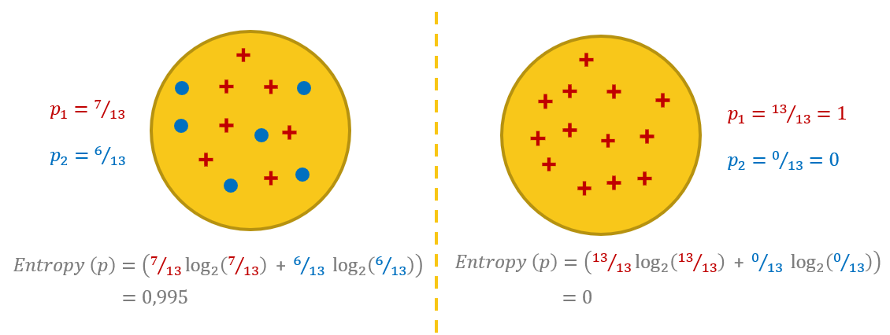
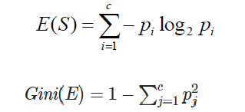
‘Purity’ of a data set
Gini impurity and Entropy are both mathematical calculations to measure the ‘purity’ of a data set
Aka: the level of chaos (versus order)

Slide 10
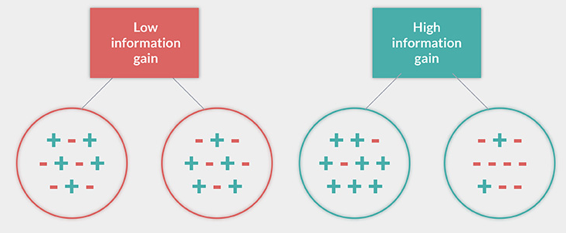
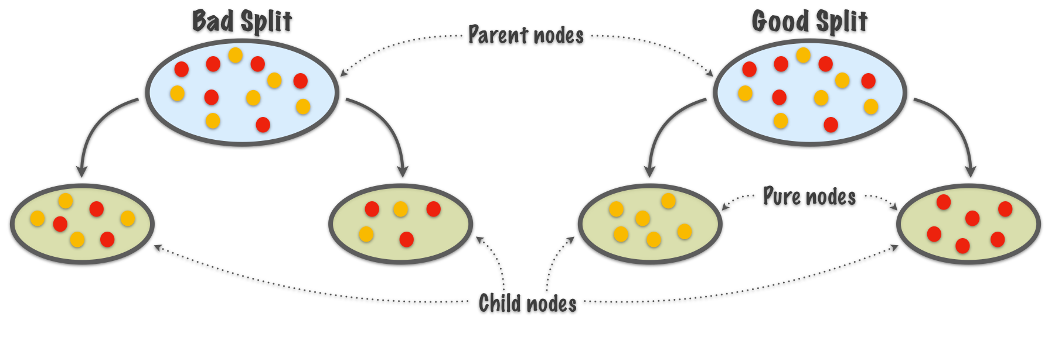
Information Gain
How to split? → split with highest ‘Information Gain’

Slide 11
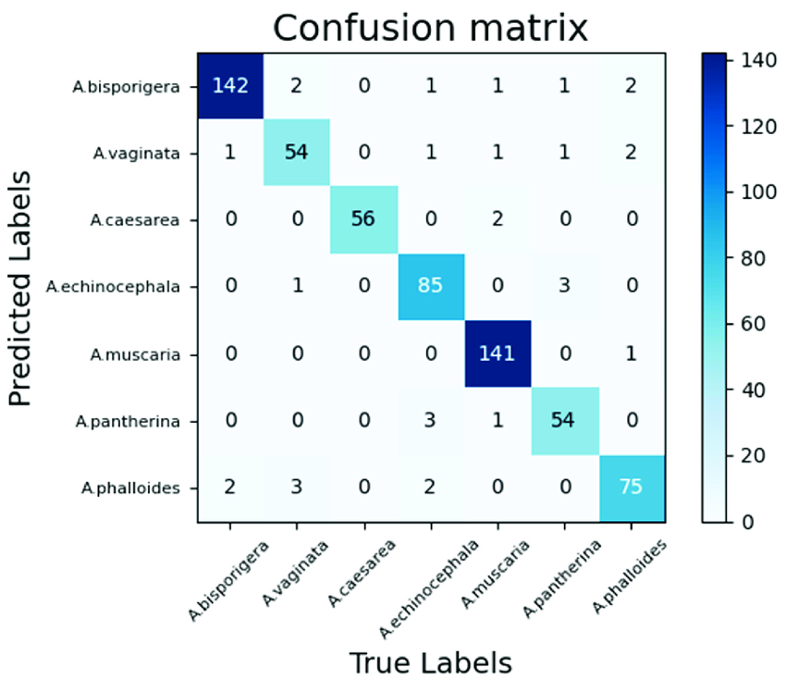
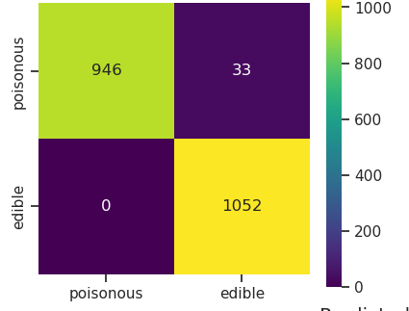
Evaluation: Confusion Matrix

Slide 12
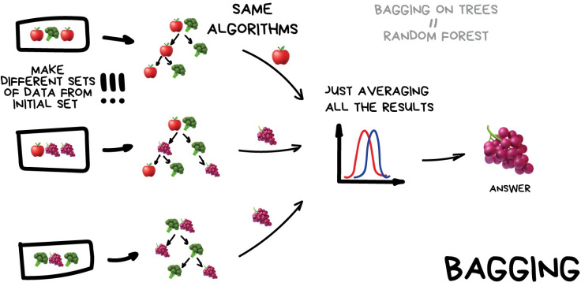
Random Forest Data + Feature bagging

Slide 13
Machine Learning
Linear Regression

Slide 14
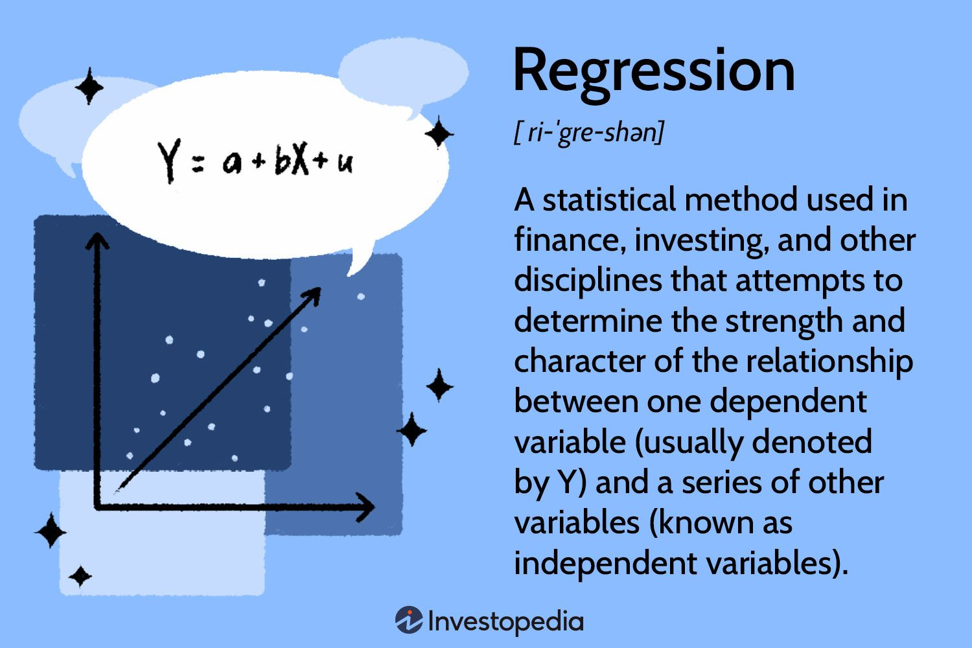
(Linear)
a = intercept
b = slope
u = error

Slide 15
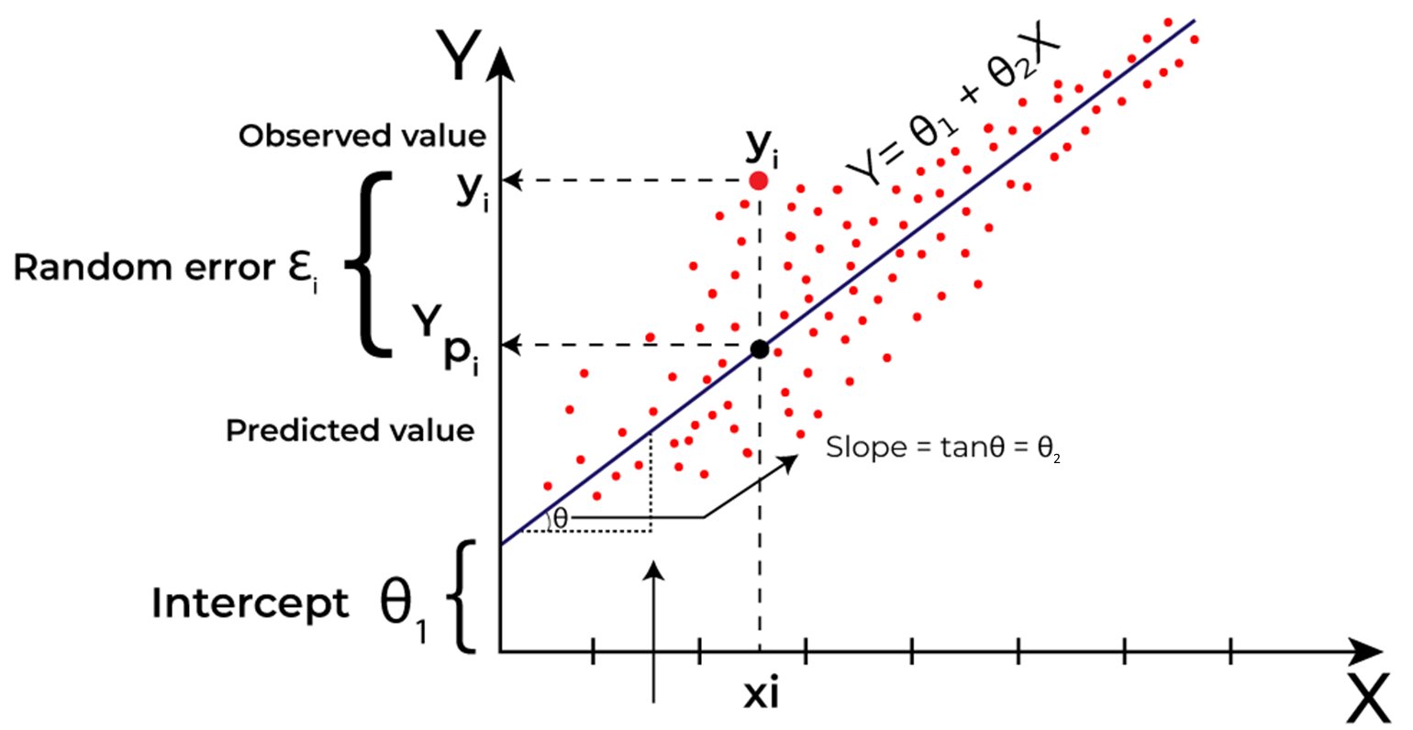
Linear Regression (Mathematical View)

Slide 16
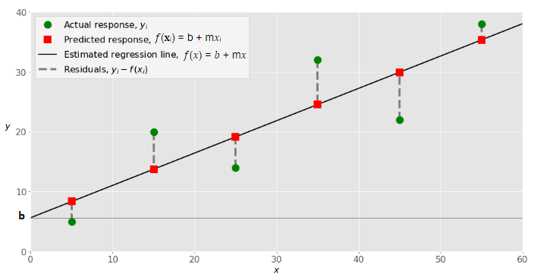

Linear Regression (1-dim, 1 feature)
Find a straight line (model) to map the data as close as possible
Aka: find ‘m’ (slope) and ‘b’ (offset) so you minimize your error (your mistakes, the residuals)
You can ‘tweak’ 2 parameters (m,b) to get the best fit
Search strategy: can be one shot learner by using complex math (Ordinary Least Squares), or an iterative approach like gradient descent (see neural networks)

Slide 17
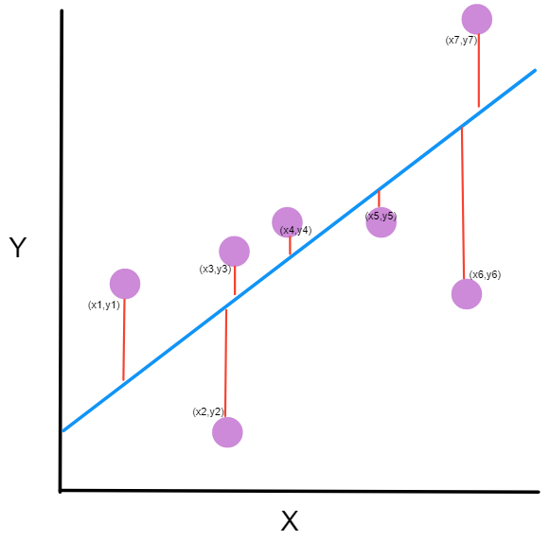
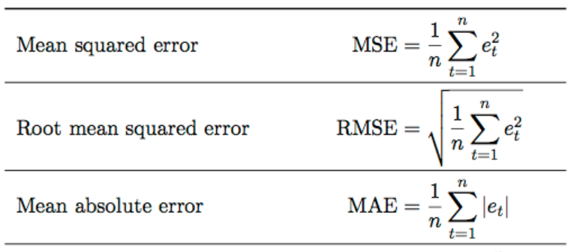
Minimizing the error (residuals)

Slide 18
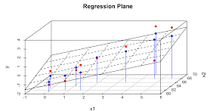

(Multiple) Linear Regression (n-dim, n features)
With 1 feature, we can map it to a line. With 2 features, to a regression-plane
With 3, 4, or n features… = hyper planes
→ mind blown!
In math this is straightforward (abstract thinking)
Libraries make this easy for us, they will implement the search strategy to solve for the hyper-parameters for us

Slide 19
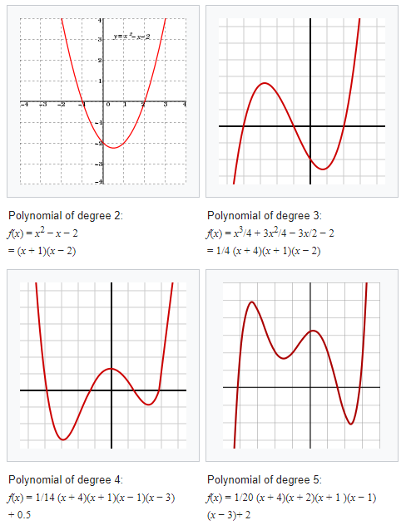
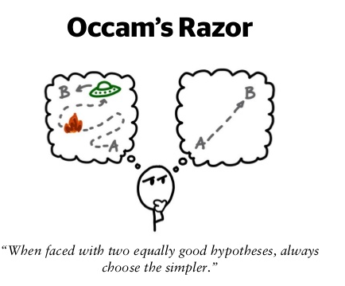
Polynomial Regression (Out of Scope)
Life isn’t linear, so use more flexible lines – curves (x², x³,…), more degrees of freedom to fit your data better
But…sometimes too much flexibility
Too many parameters you can tweak!
Risk of overfitting! Making it too complex!

Slide 20
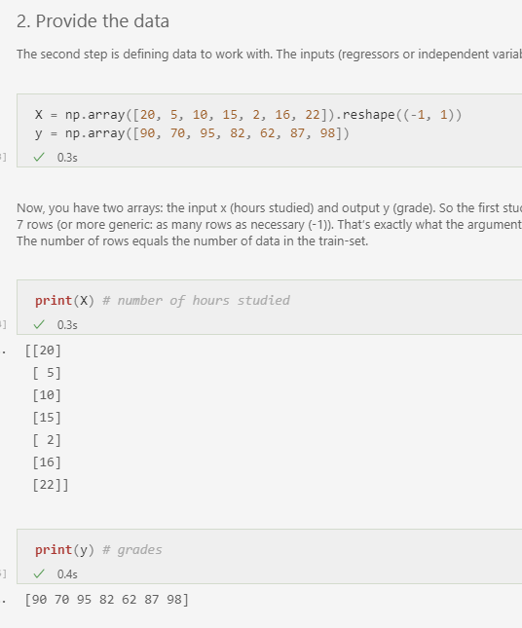
Regression Modeling
Importing & wrangling data
Get the data you want to model with (the ‘clay’)
The ‘independent’ data = X (the features)
Must be 2-D matrix: [nrows,ncols]
(nrows:observations, ncols:features)
So, 1 feature, should be [nrows, 1]
You might need to ‘reshape(-1,1)’ so you have a 2-D matrix of 1 col, and as many rows you need (-1 is like a wildcard)
Get the data you want to predict (the label)
The ‘dependent’ data = y
Usually this is a 1-D vector [nrows,]
X
y

Slide 21
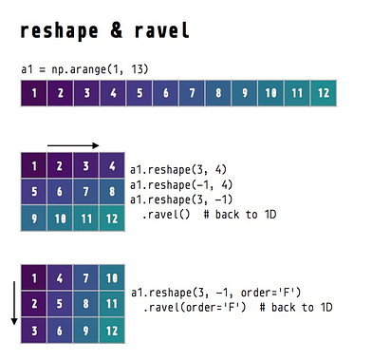
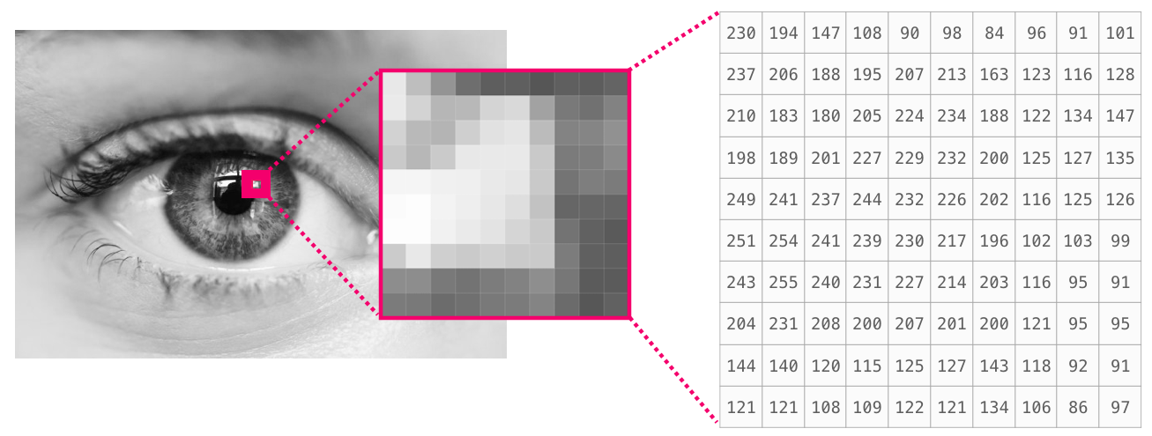
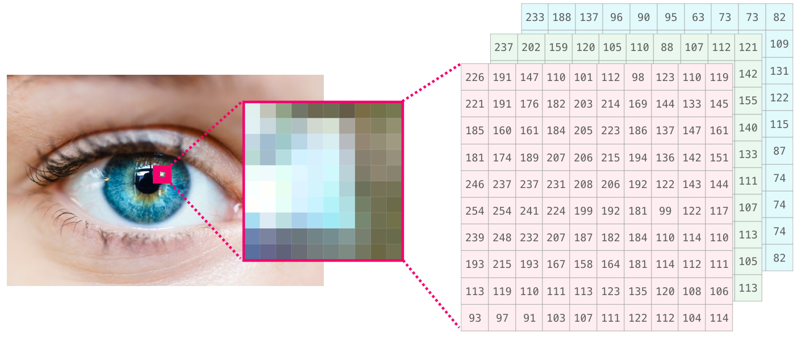
Wrangling data = Hardest thing
2-D matrix: [nrows,ncols]
(3-D matrix: [nchannel, nrows, ncols])
Transform into 1D
Reshape(-1) = Ravel()
creates 1D flattened view
Flatten()
creates 1D copy

Slide 22
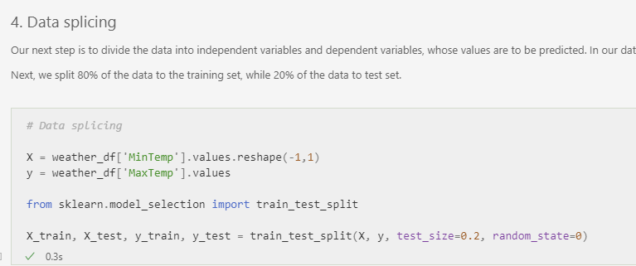



Regression Modeling
Next, the ML stuff:
Split the data into train and test set
Fit your X- and y-train (supervised) data to a model (=create statistical model)
Plug your X-test data into model, to get the predictions y_pred
Calculate performance of your model

Slide 23
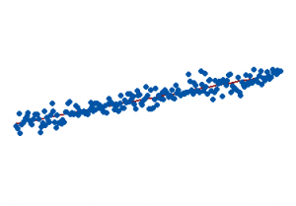
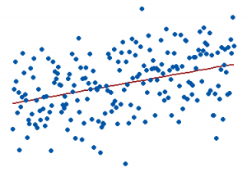
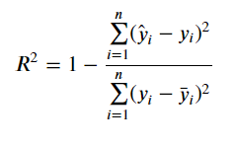
Regression: Model Performance
Minimize the RMS-error
R² (residuals squared)
Statistical measurement
Takes the spread of the datapoints into account
How well does your model fit the spread of your datapoints? In %
R²: 15% R²: 85%
Notes:
R² = coefficient of determination = the proportion of the variation in the dependent variable that is predictable from the independent variable

Slide 24
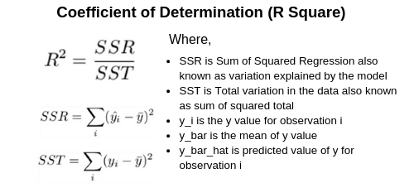
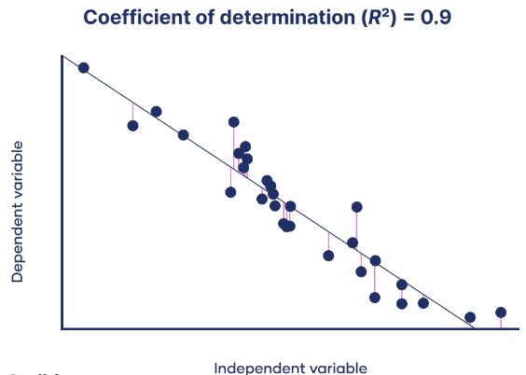
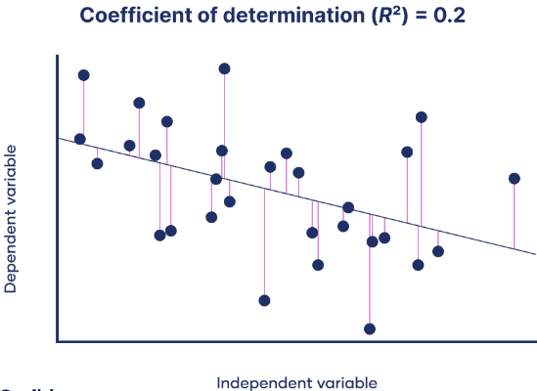

Slide 25
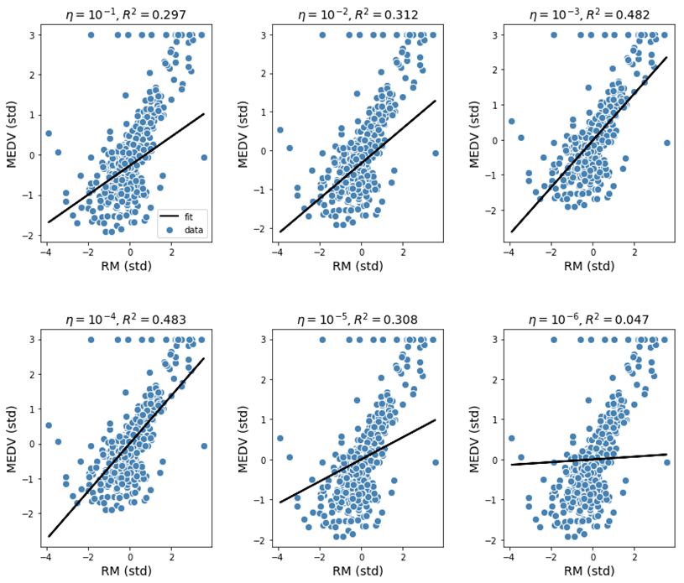
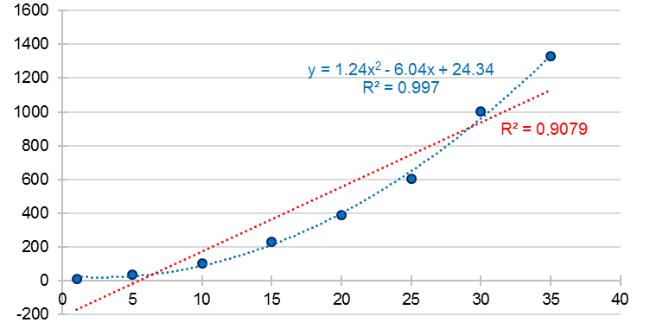
Regression: Model Performance
R² (residuals squared)
Used to compare different models, on how well they explain the variance in the data

Slide 26



Over to you

