Slide 1
Artificial Intelligence
Recap: Computer Vision

Slide 2
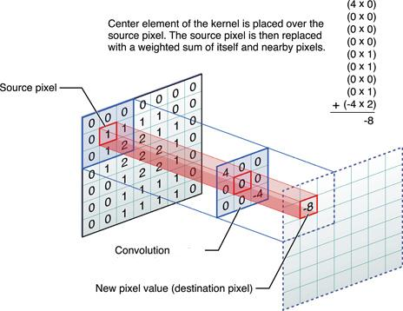
Image Filtering: Convolution

Slide 3
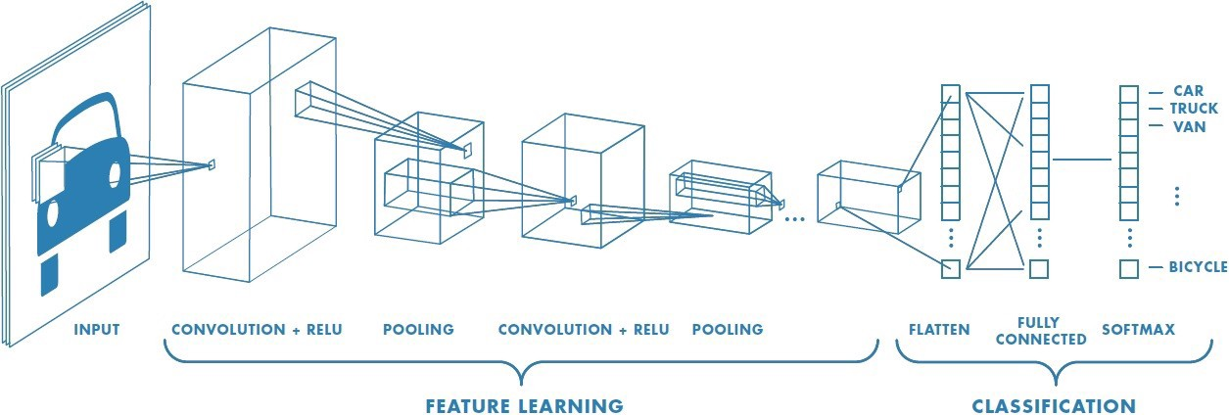
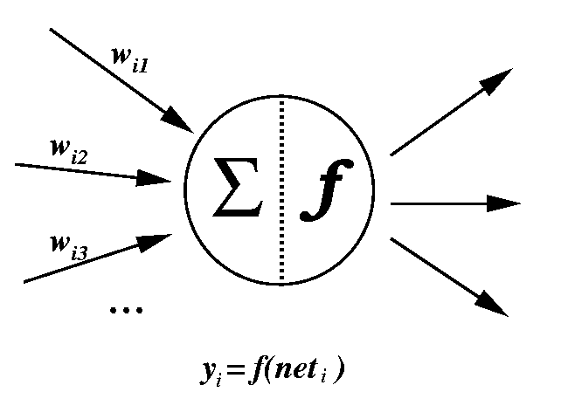
Convolutional Neural Network General Overview
1.
2.
3.

Slide 4
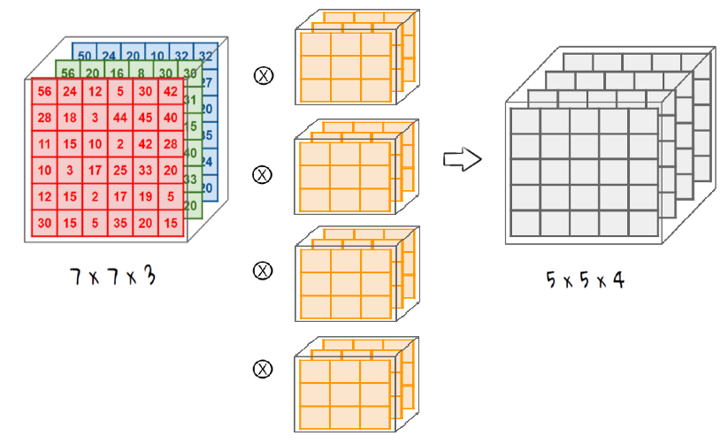
1. Convolution Filtering from, and adding new, dimensions

Slide 5
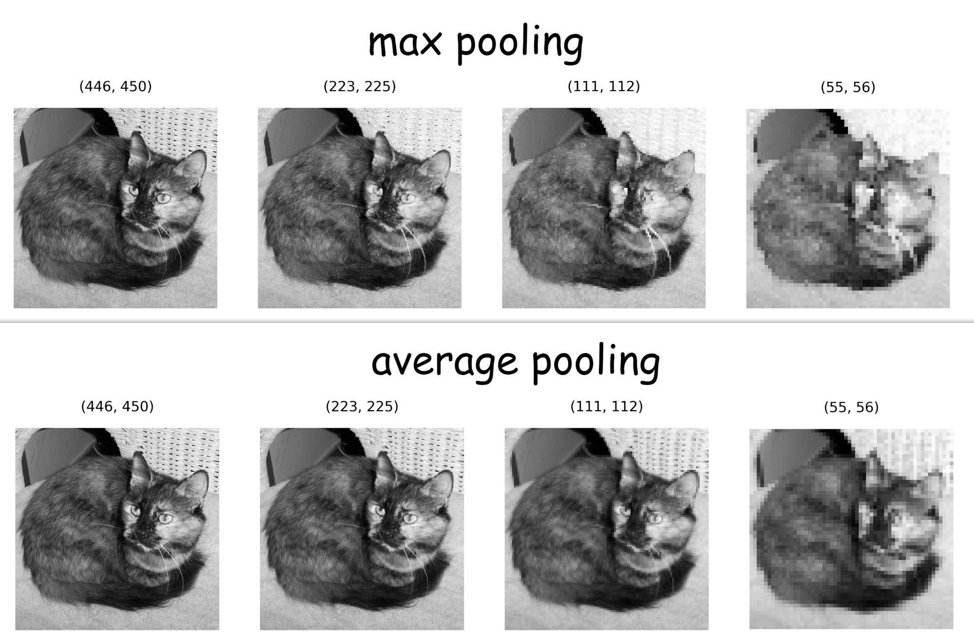
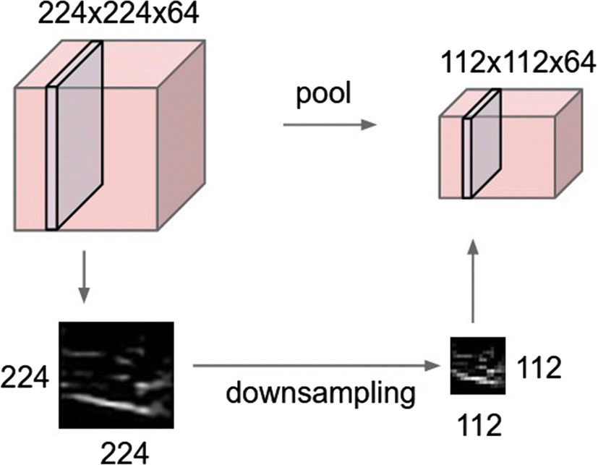
2. Pooling = downsampled feature map

Slide 6
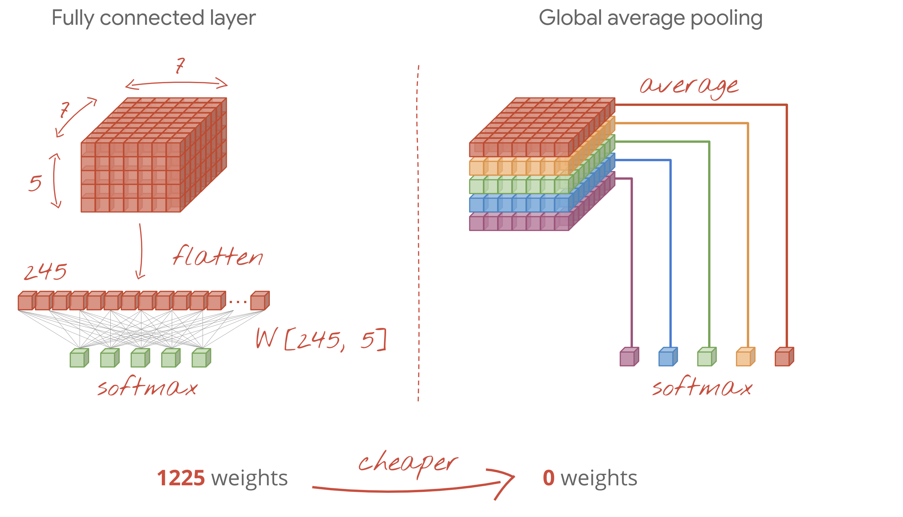
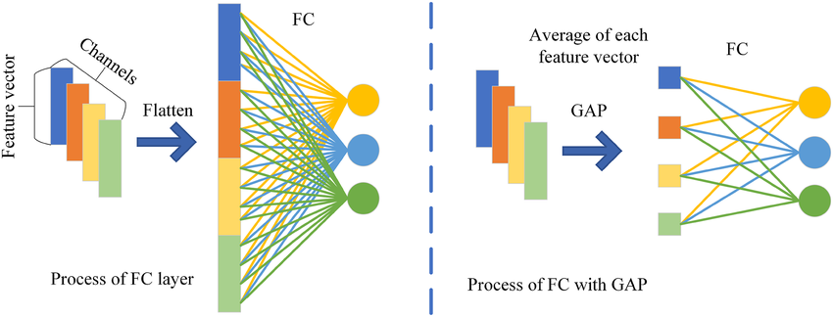
3. Flattening versus Global Average Pooling (GAP)
With Flattening, we still need to learn which parts are important for the output neuron
+ can handle complex patterns
- more calculations needed
In GAP, we take a shortcut. We do enough convolutions so the average of a feature map is a good predictor for the output neuron
+ simplification, faster
- sometimes too simple

Slide 7
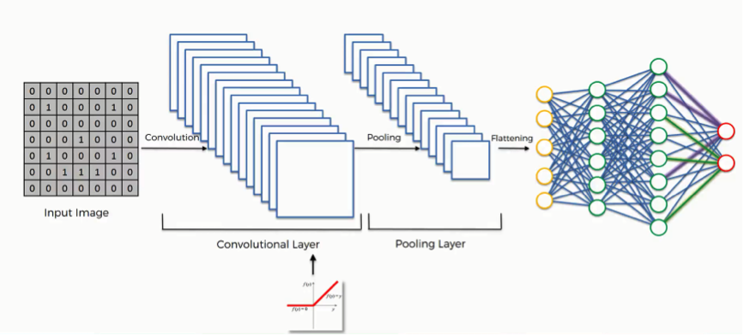
Simplified View

Slide 8
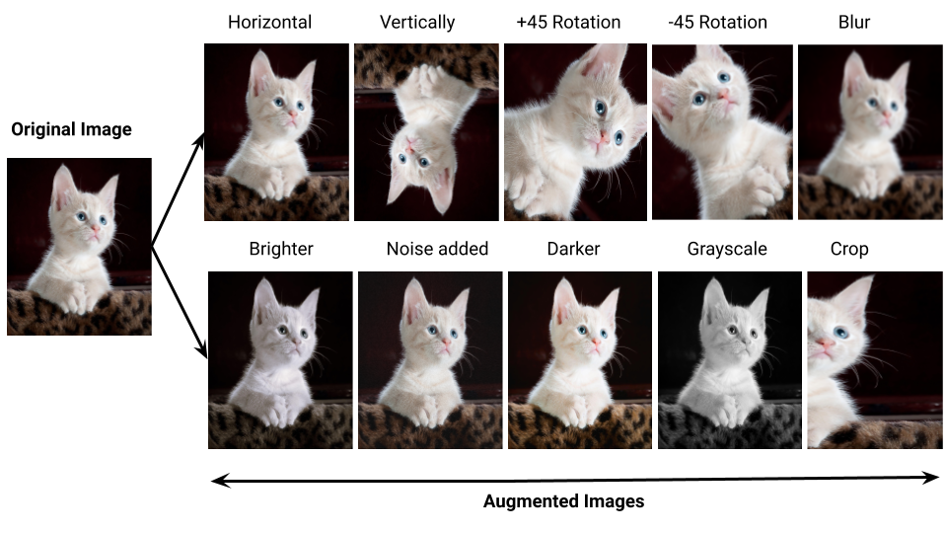
Data Augmentation Enlarge dataset & prevent overfitting
Only during training!

Slide 9
Artificial Intelligence
Transfer Learning

Slide 10
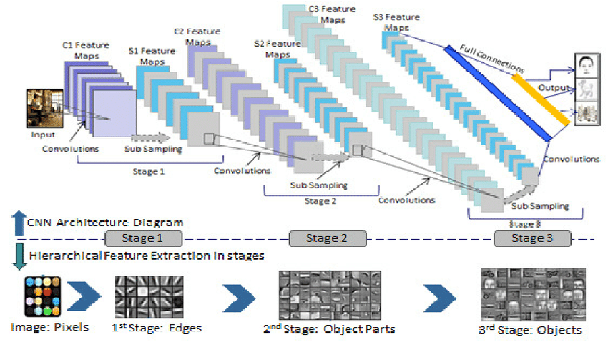

Problem statement:
Deep neural network architectural design is still more of an art-form, and proves to be pretty challenging!
And, it is also data hungry, and time consuming to train

Slide 11
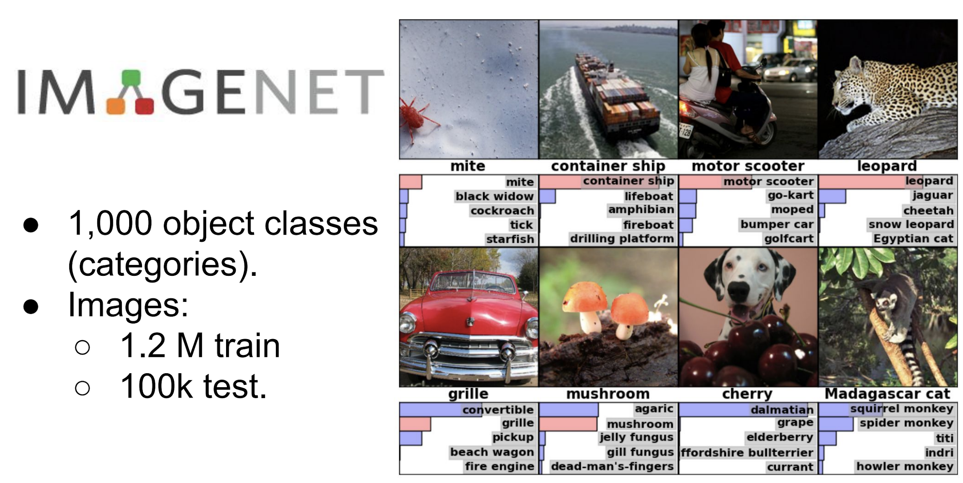
Enter: CV Benchmark Competition - Imagenet

Slide 12
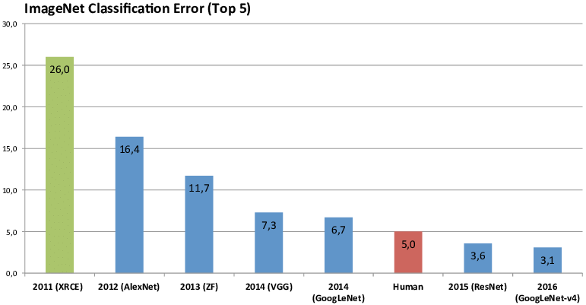
Competition drives innovation
Big, deep CNN networks started to win the competition
Yearly new innovations in CNN architecture
Architectures + weights are open sourced

Slide 13
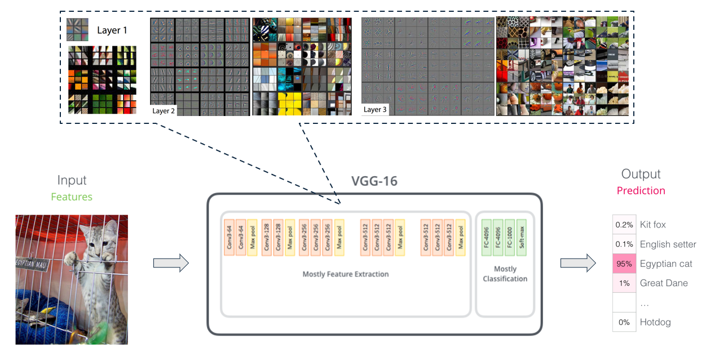
Example of pre-trained network

Slide 14
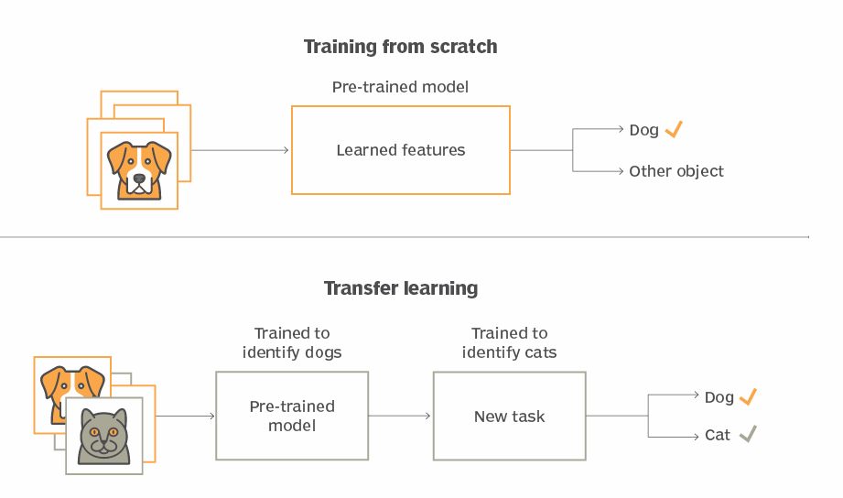
Concept of Transfer Learning

Slide 15
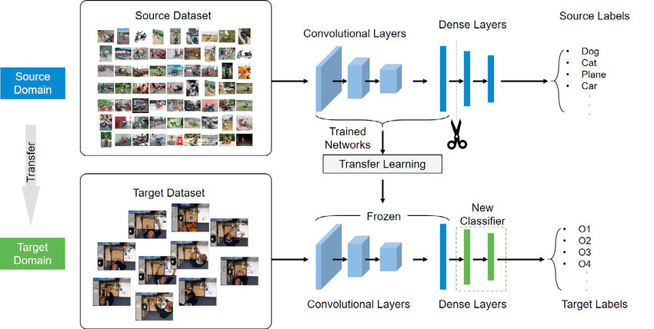
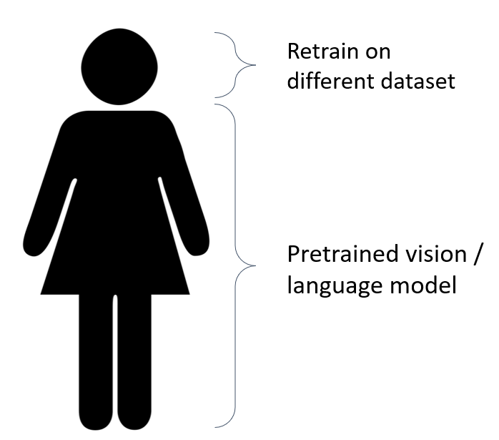
Re-usable Model Body
‘Body’
‘Head’

Slide 16
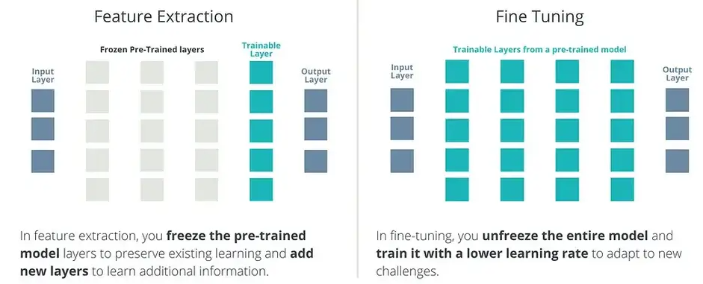
Transfer Learning: two modes

Slide 17
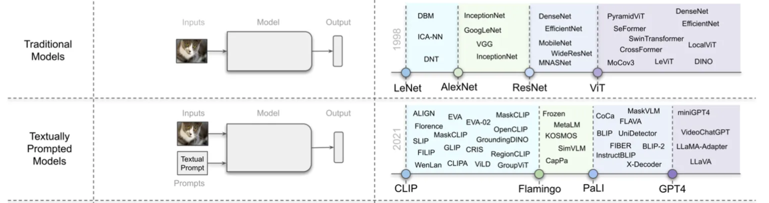
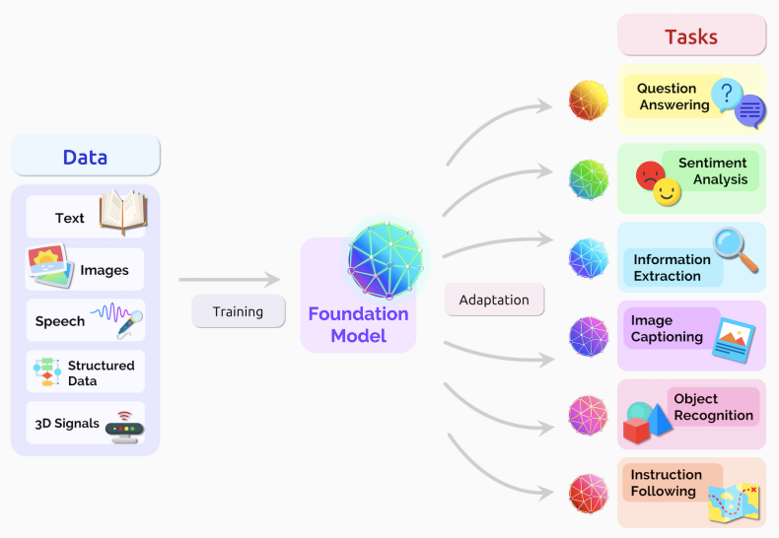
Base Models
Evolution to ‘Foundational Models’, even multi-modal models
i.e.: using different modes of knowledge input, to transform the information into multi-dimensional latent space

Slide 18

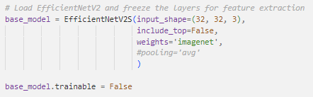
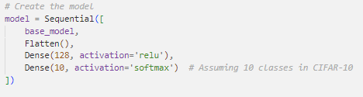
Transfer Learning in code
Use same preprocessing as base model
Import base_model (without head), with pretrained weights + freeze weights
Add custom classifier head to model
Compile and train (possibly unfreeze, and gently train further)

Slide 19


Slide 20



Over to you

