Slide 1
Artificial Intelligence
Recap: Transfer Learning

Slide 2
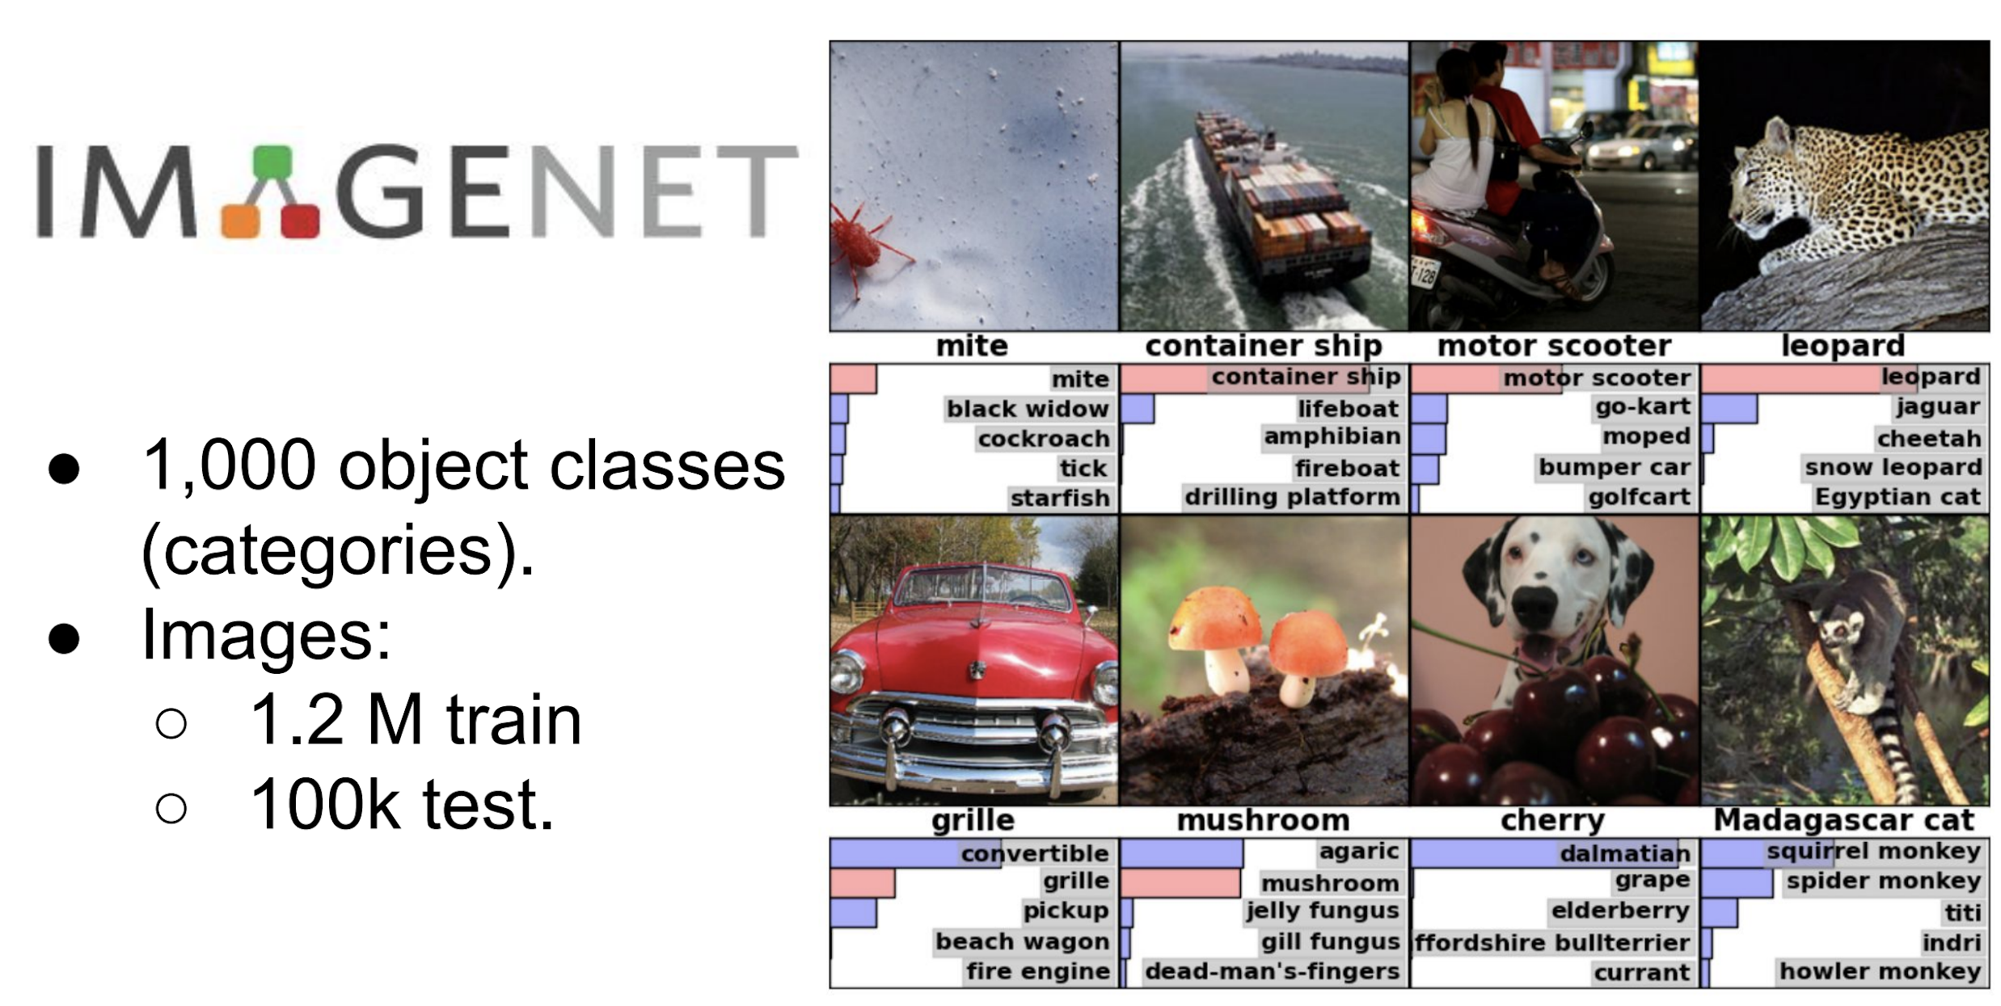
Enter: CV Benchmark Competition - Imagenet

Slide 3
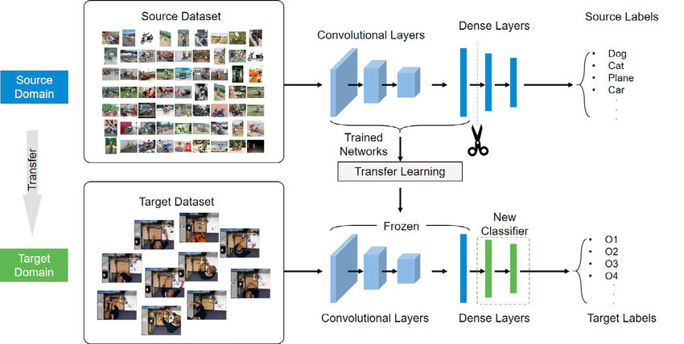
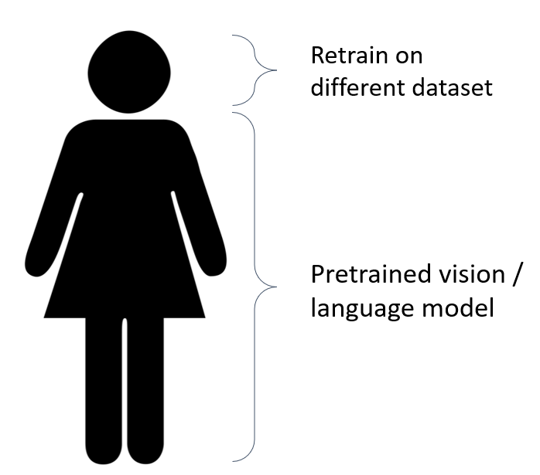
Re-usable Model Body
‘Body’
‘Head’

Slide 4
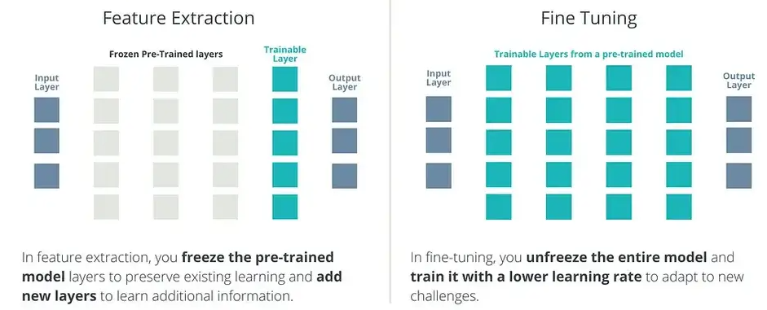
Transfer Learning: two modes

Slide 5
Artificial Intelligence
Natural Language Processing (NLP)

Slide 6
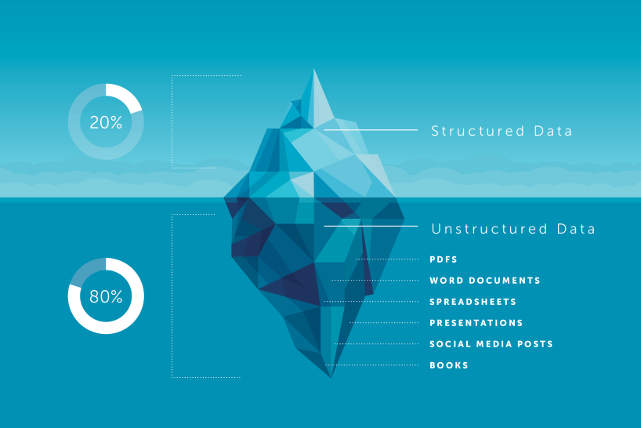
Text = Unstructured Data

Slide 7
Language is (very) complex Example:

Slide 8
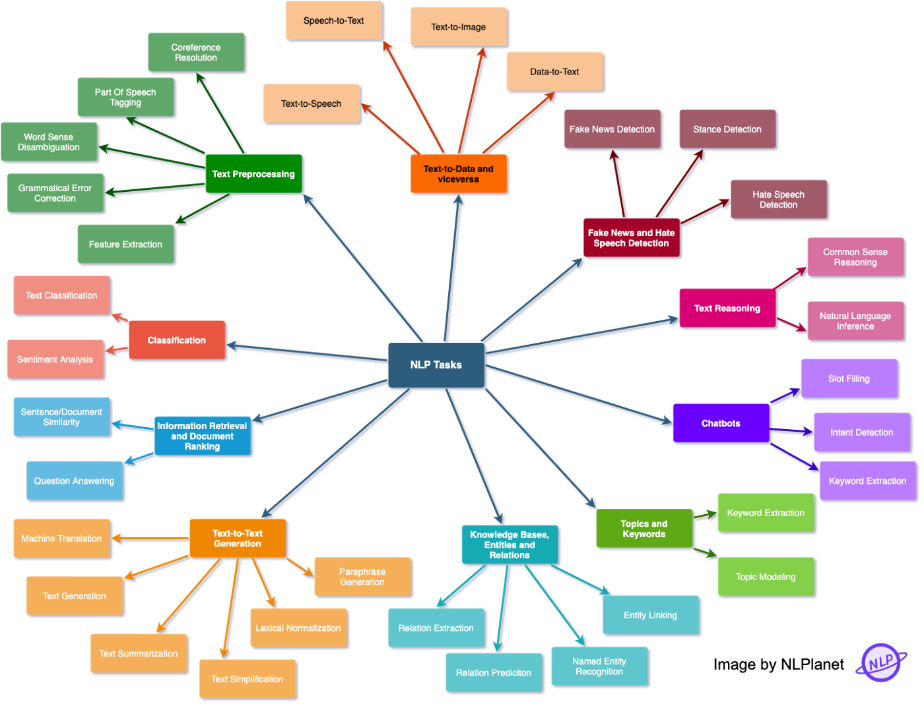
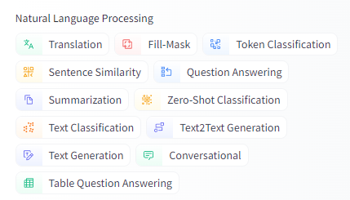
Overview main NLP Tasks

Slide 9

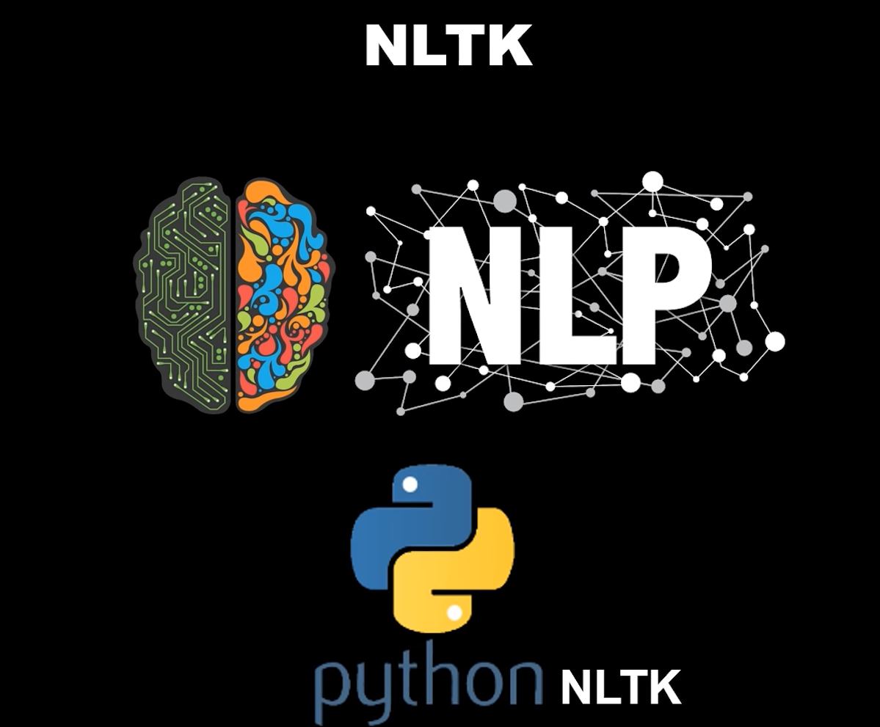
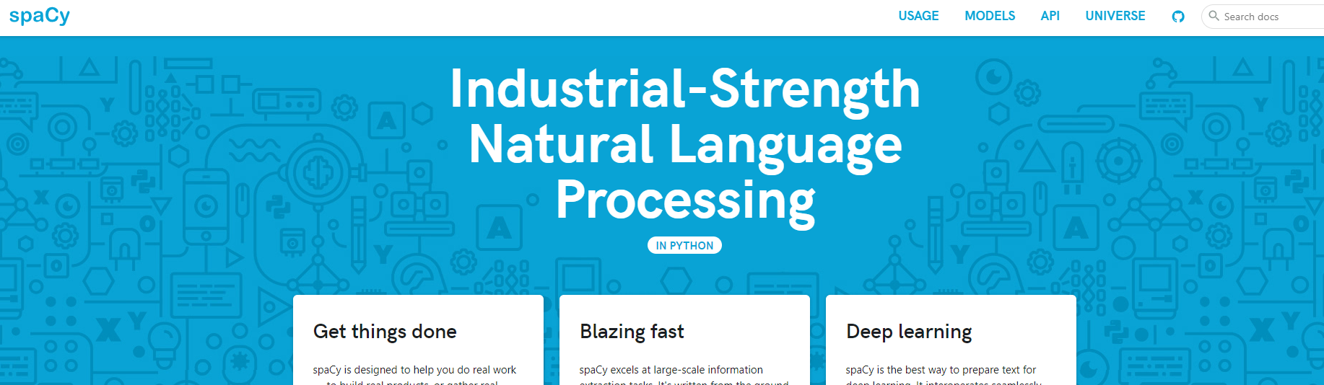

NLP Toolkits

Slide 10

NLP Pipeline

Slide 11

NLP Pipeline
Goal:
‘Transform textual data into numerical vectors, so we can apply ML and DL analysis & modeling techniques’
Vectorize letters (n-gram), or
Vectorize words (tokens), or
Vectorize sentences, or
Vectorize document, or …
It all depends on use case.
Most common: vectorize tokens

Slide 12
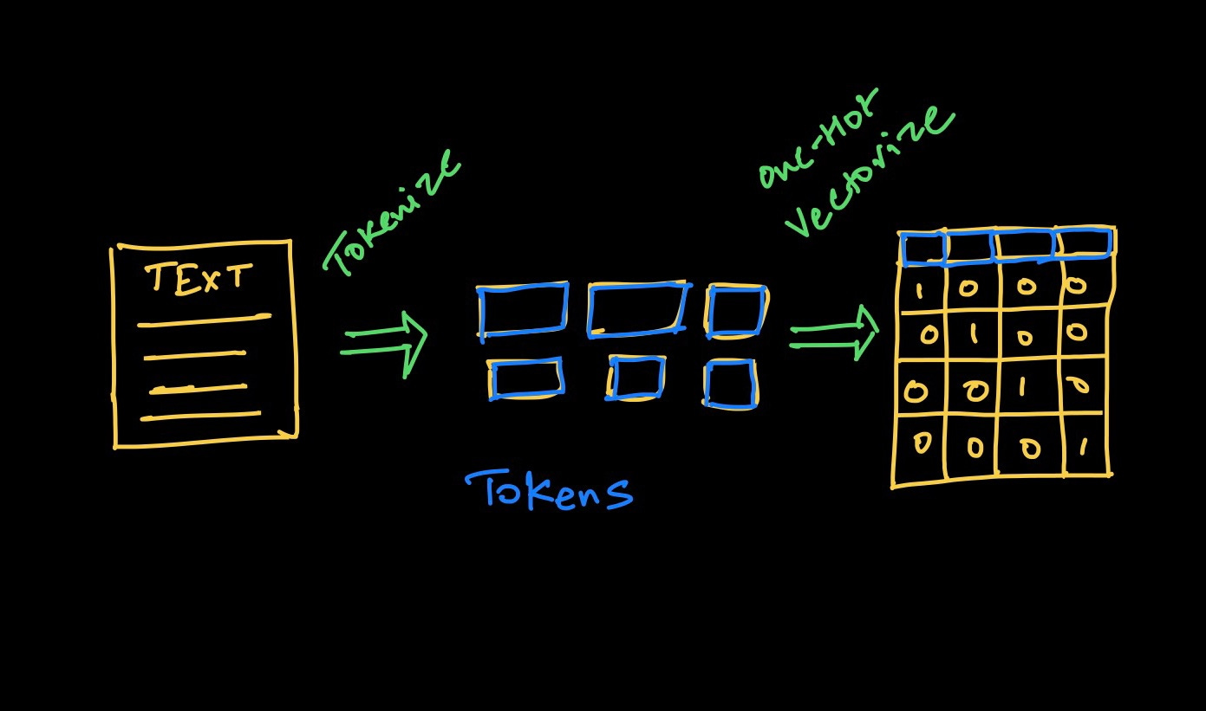
NLP Pipeline: Tokenize & Vectorize

Slide 13
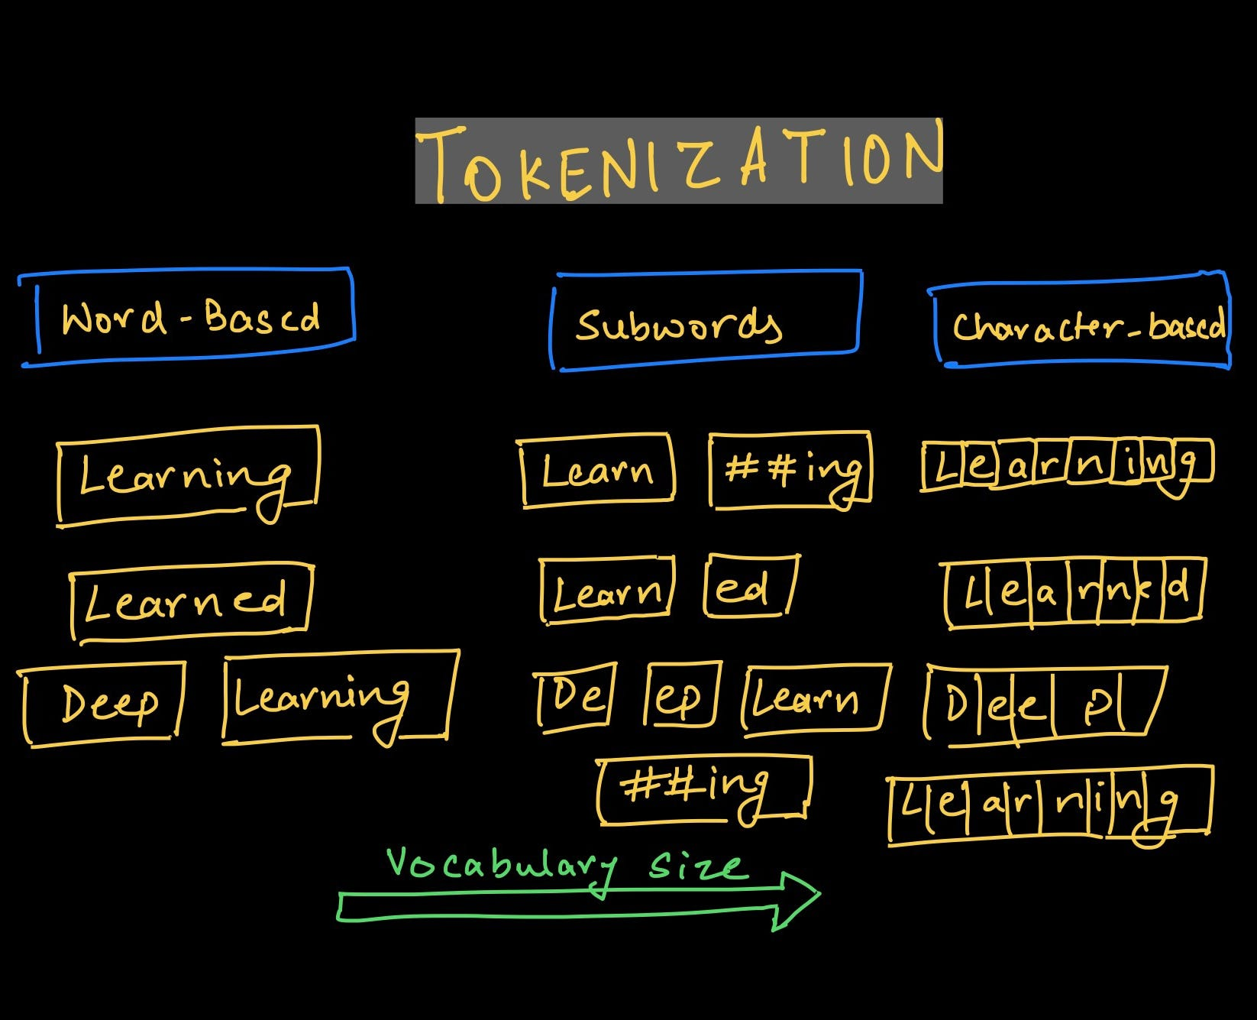
Tokenization

Slide 14
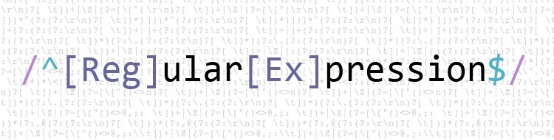

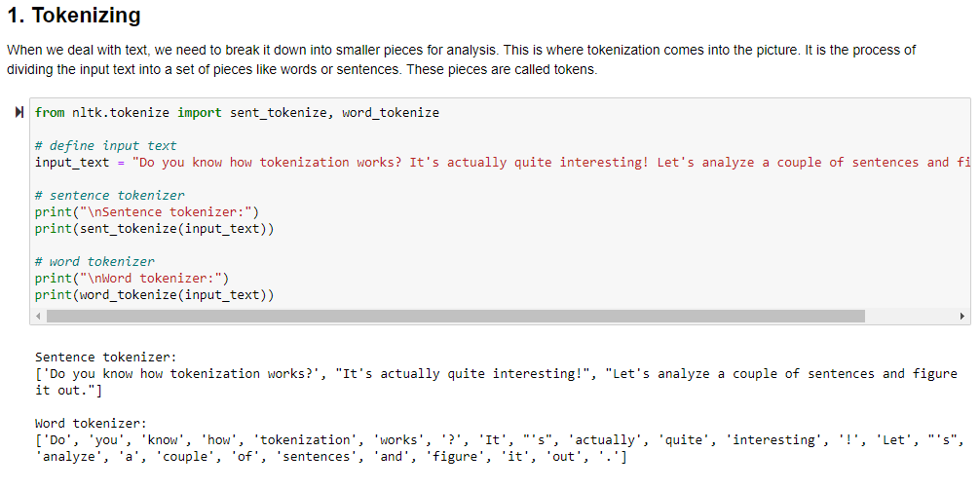
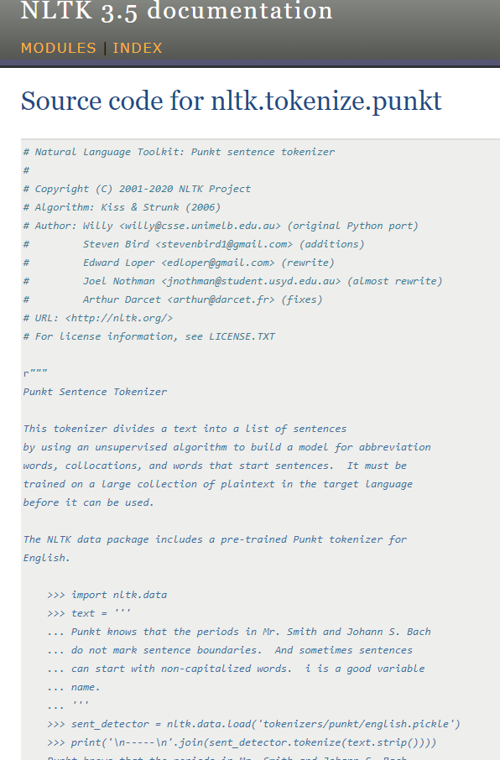
Tokenization

Slide 15
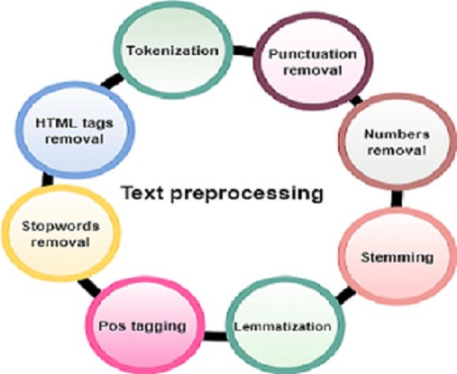
Possible NLP Pipeline steps
Before or after tokenization, we might want to do:
Text Preprocessing
Text Cleaning:
removing punctuation, special chars, html tags, etc
Normalization:
convert to lower case, removing accents, etc.
Remove stopwords
Reduce sequence to base form
Stemming
Lemmatization
Feature Engineering (typical ML approach)
Enrich our data, via
PoS (Part of Speech) tagging
NER (Named Entity Recognition)
NER

Slide 16
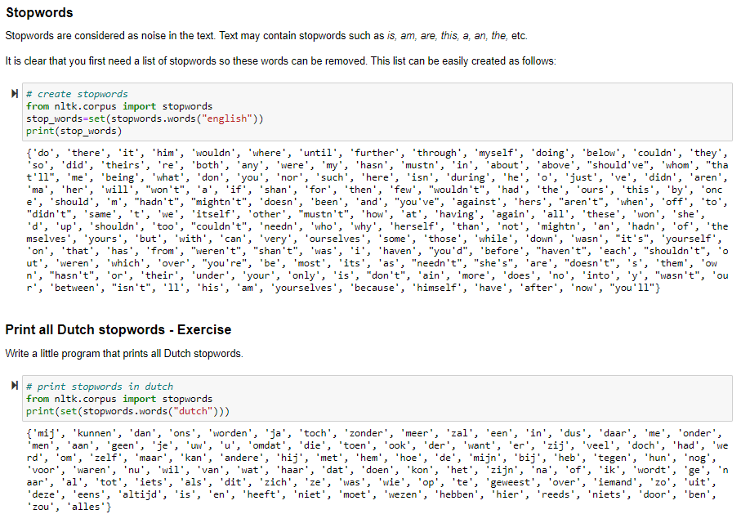

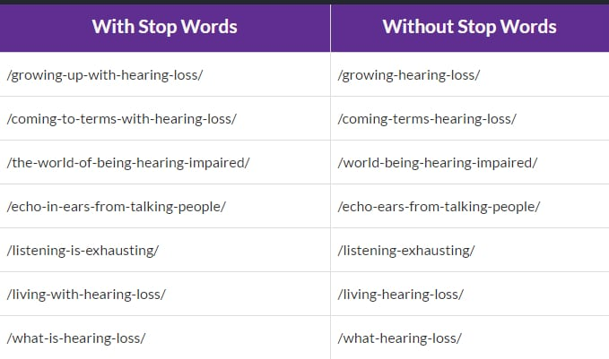
NLP Preprocessing: Stop Words

Slide 17
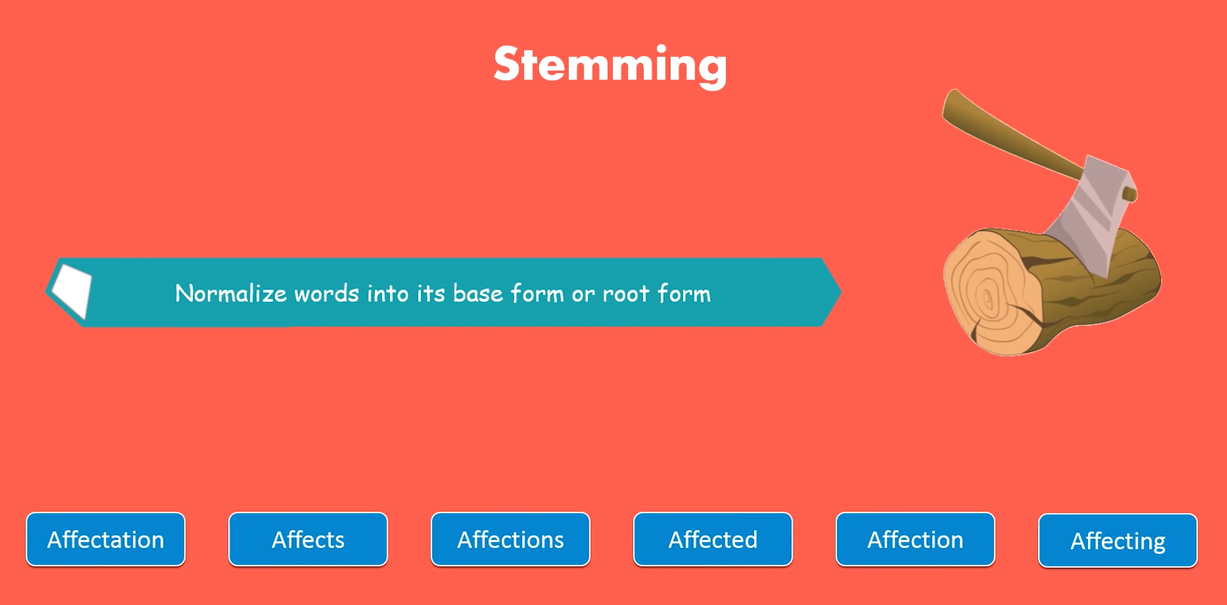
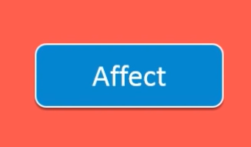

Slide 18
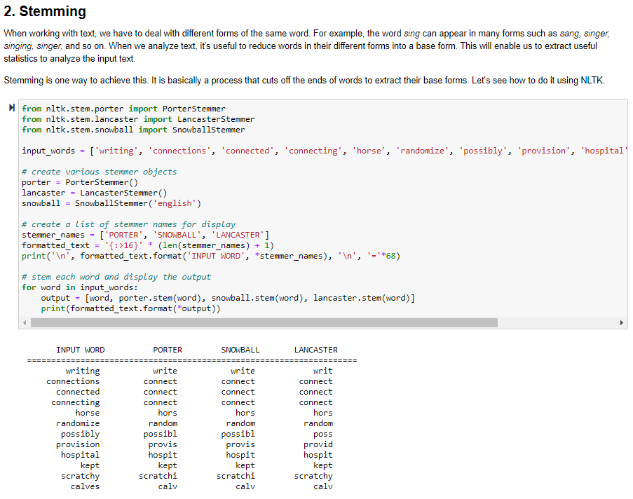
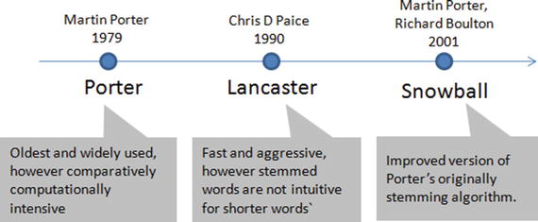
Stemming

Slide 19
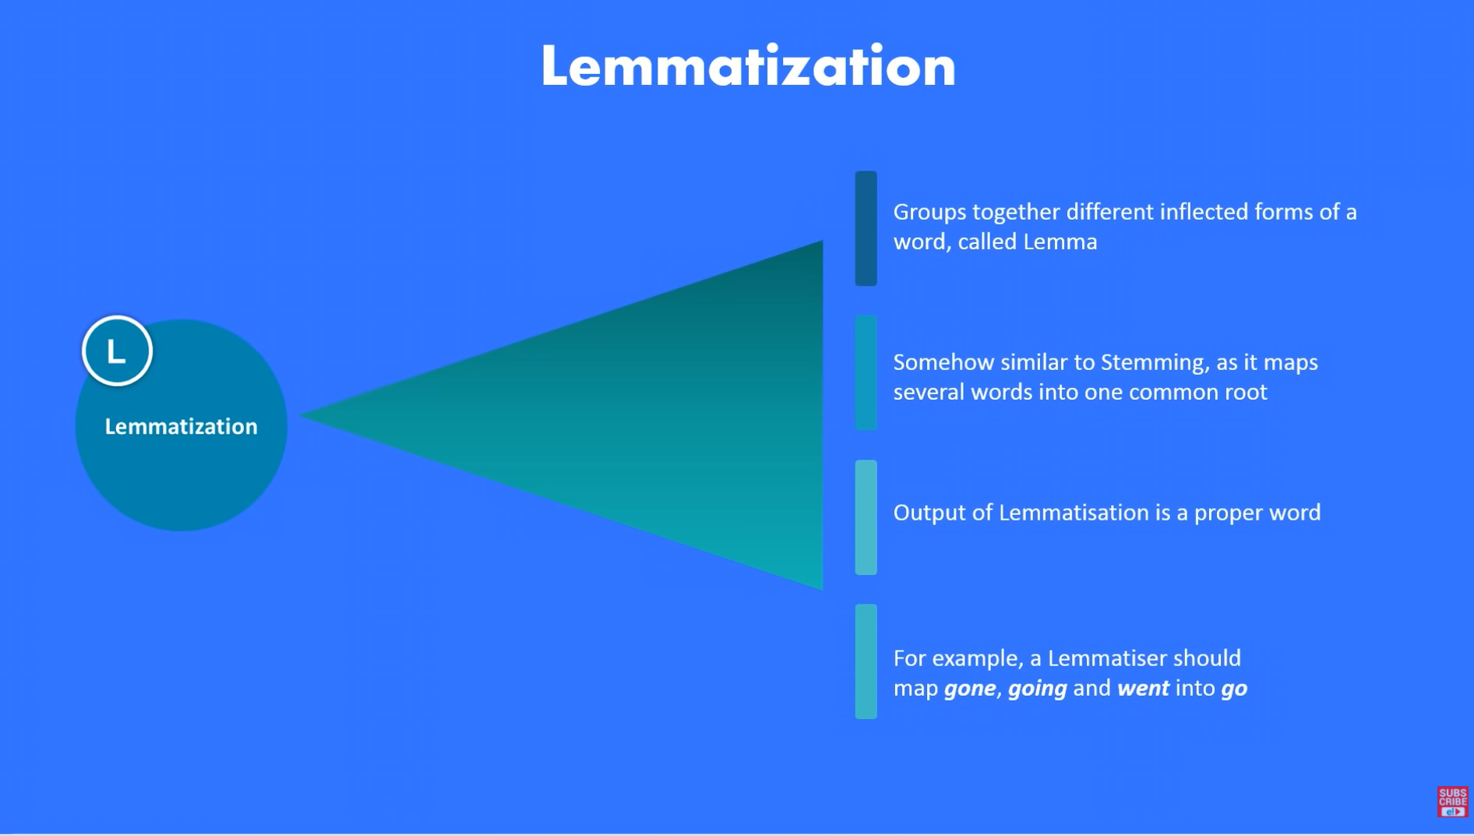
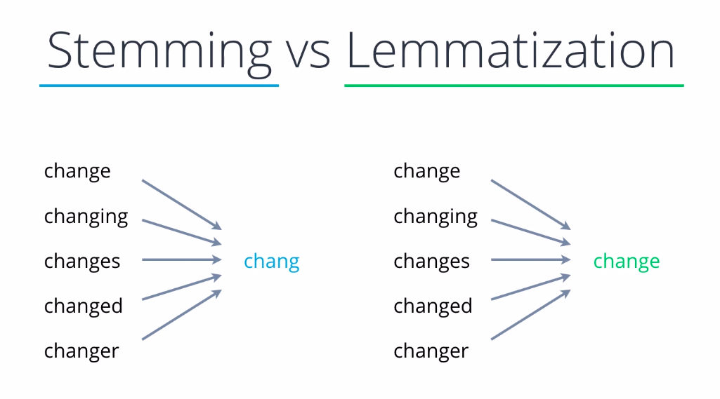
,

Slide 20
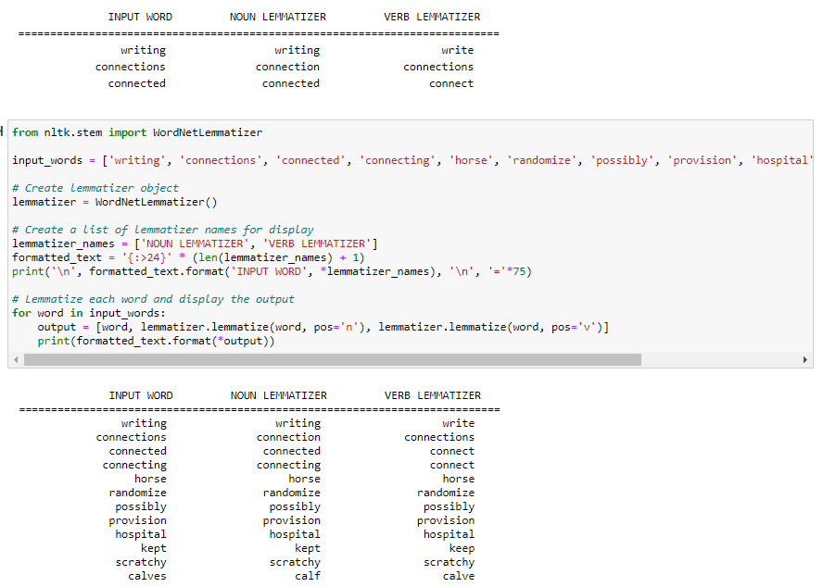
Lemmatization

Slide 21

General NLP Pipeline
… student
spend
entire night
code
…
... code: 25
…
spend: 13
… entire: 9
…
night: 2
student: 2
…
code
spend
entire
… code: 25
…
spend: 13
… entire: 9
…
…
.06
.05.58
.03
.12
.01
.02
…
… .04
.07
.12
.26
.51
.10
.05
…
… .81
.02
.01
.07
.05
.01
.02
…
the students spend their entire night coding!
Corpus
Tokens
Dictionary
Vocab(ulary)
Tensors
Stemming
Lemmatization
Stop word removal
Count tokens and order
Keep V most frequent V can be huge!
Represent every word, or entire document, as a vector
Step1 Tokenize
Step2 Vectorize

Slide 22
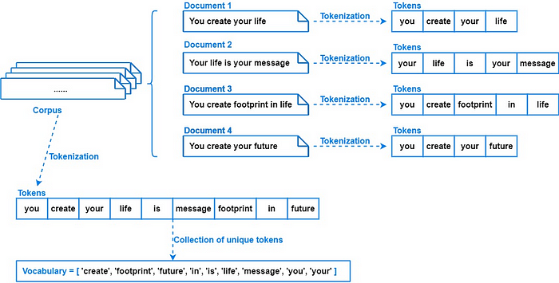
General NLP Pipeline

Slide 23

Data Enrichment

Slide 24
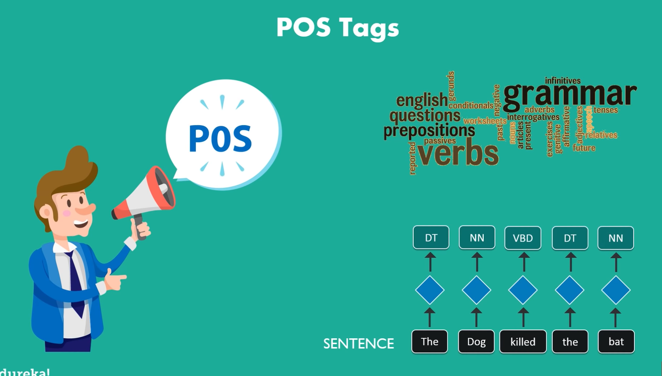
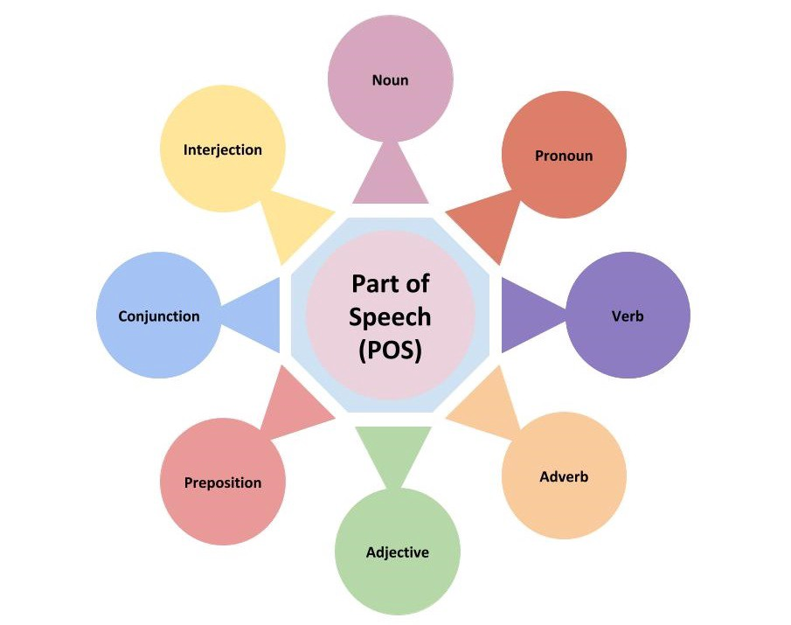
Data Enrichment: PoS tagging
Possible enrichment for better analysis, or to get a better vector representation

Slide 25
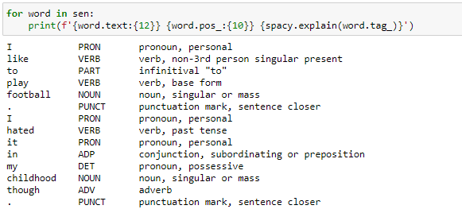


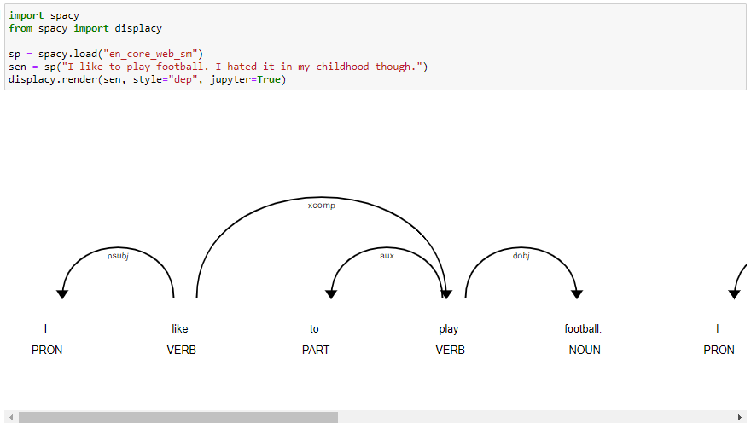

PoS tagging requires ‘Language Model’

Slide 26
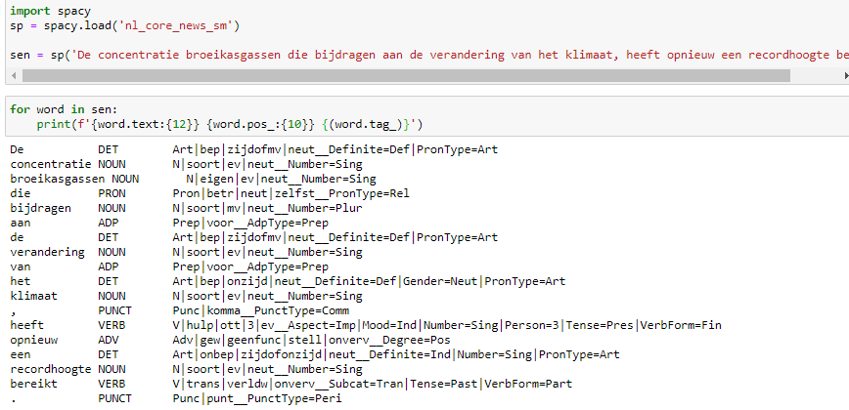
Dutch PoS model

Slide 27
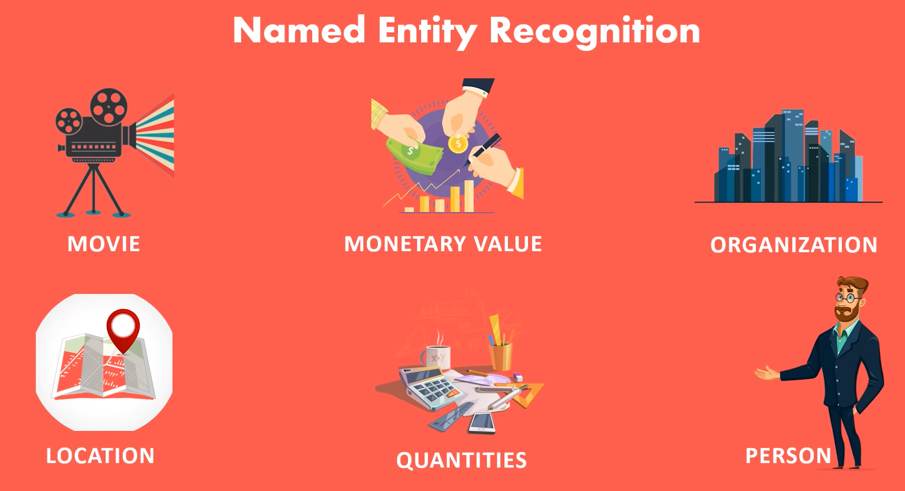
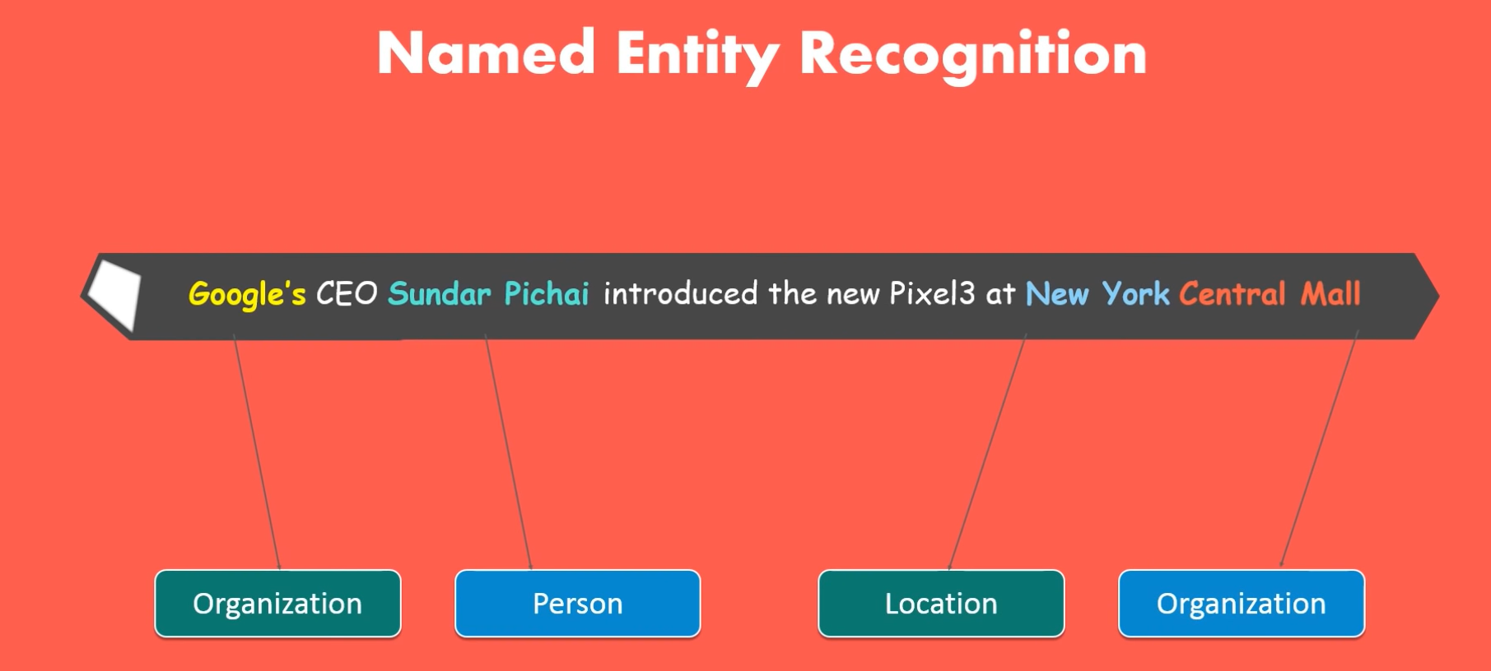
Data Enrichment: NER

Slide 28
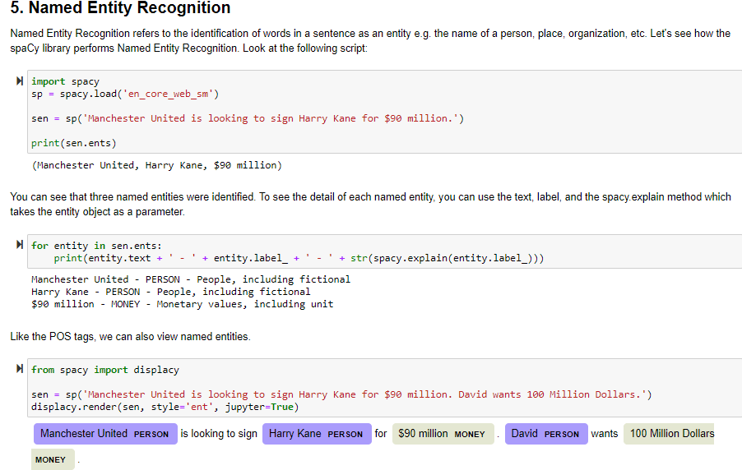
NER (Named Entity Recognition)

Slide 29
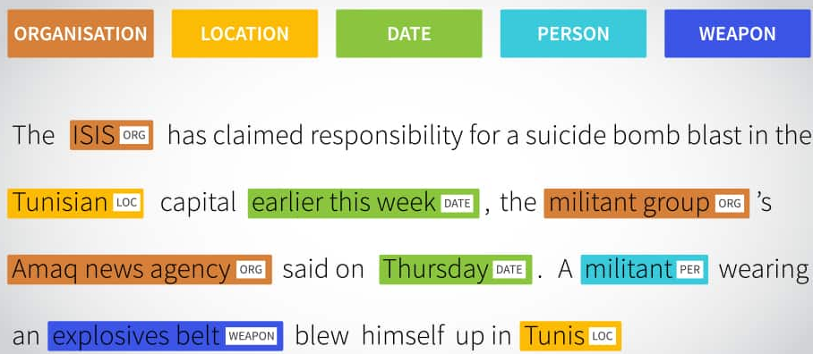
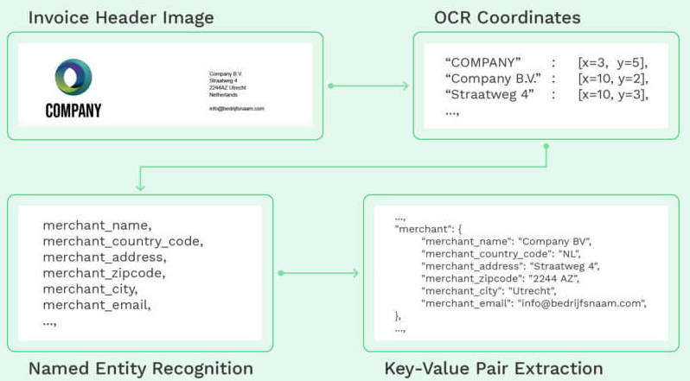
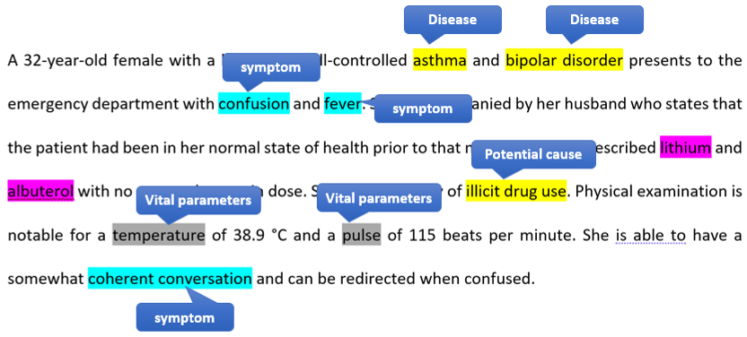
NER: Many different Use Cases
NER tries to extract structured information out of unstructured data, by chunking together tokens and classifying them
Typical use cases: extracting useful info out of different types of invoices, tagging posts for quick search, or in the context of recommendations, extract relevant info from healthcare documents, etc.

Slide 30
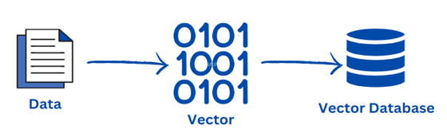
Vectorization

Slide 31
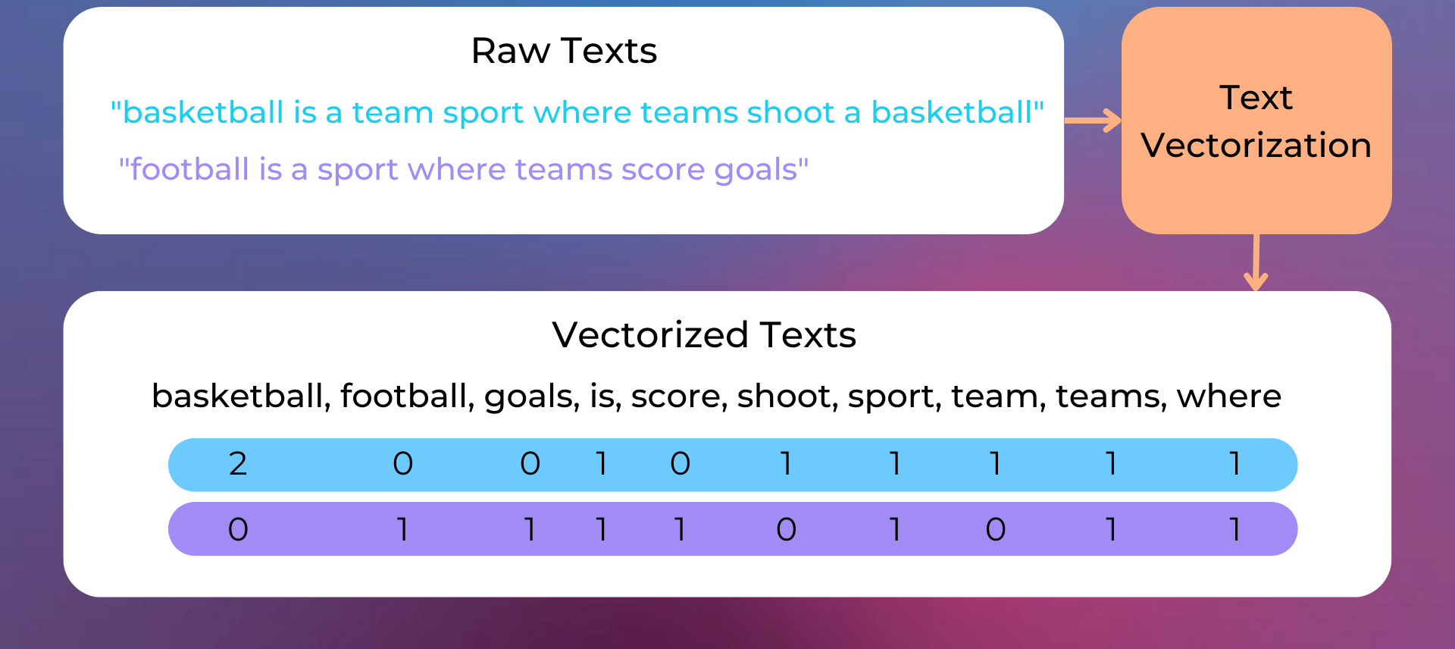
Bag of Words (‘One’ Hot Encoding) (Context-Independent Word Embedding)
Notes:
https://www.nlplanet.org/course-practical-nlp/01-intro-to-nlp/11-text-as-vectors-embeddings

Slide 32
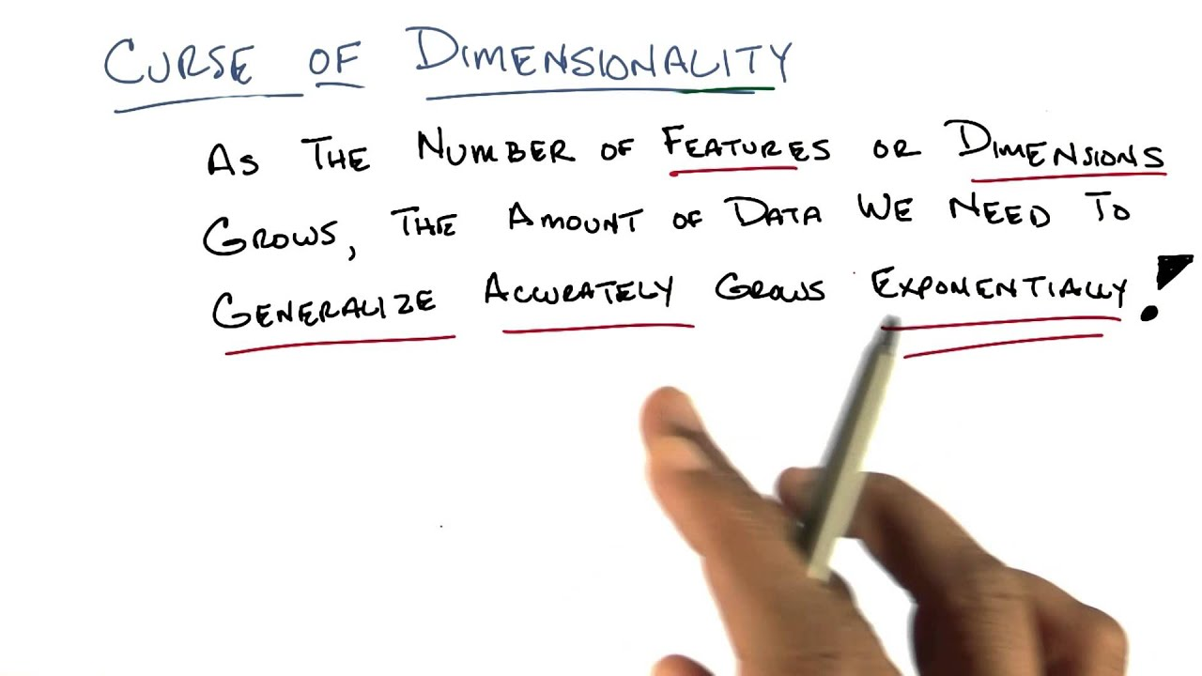
Problem: BoW Embedding

Slide 33
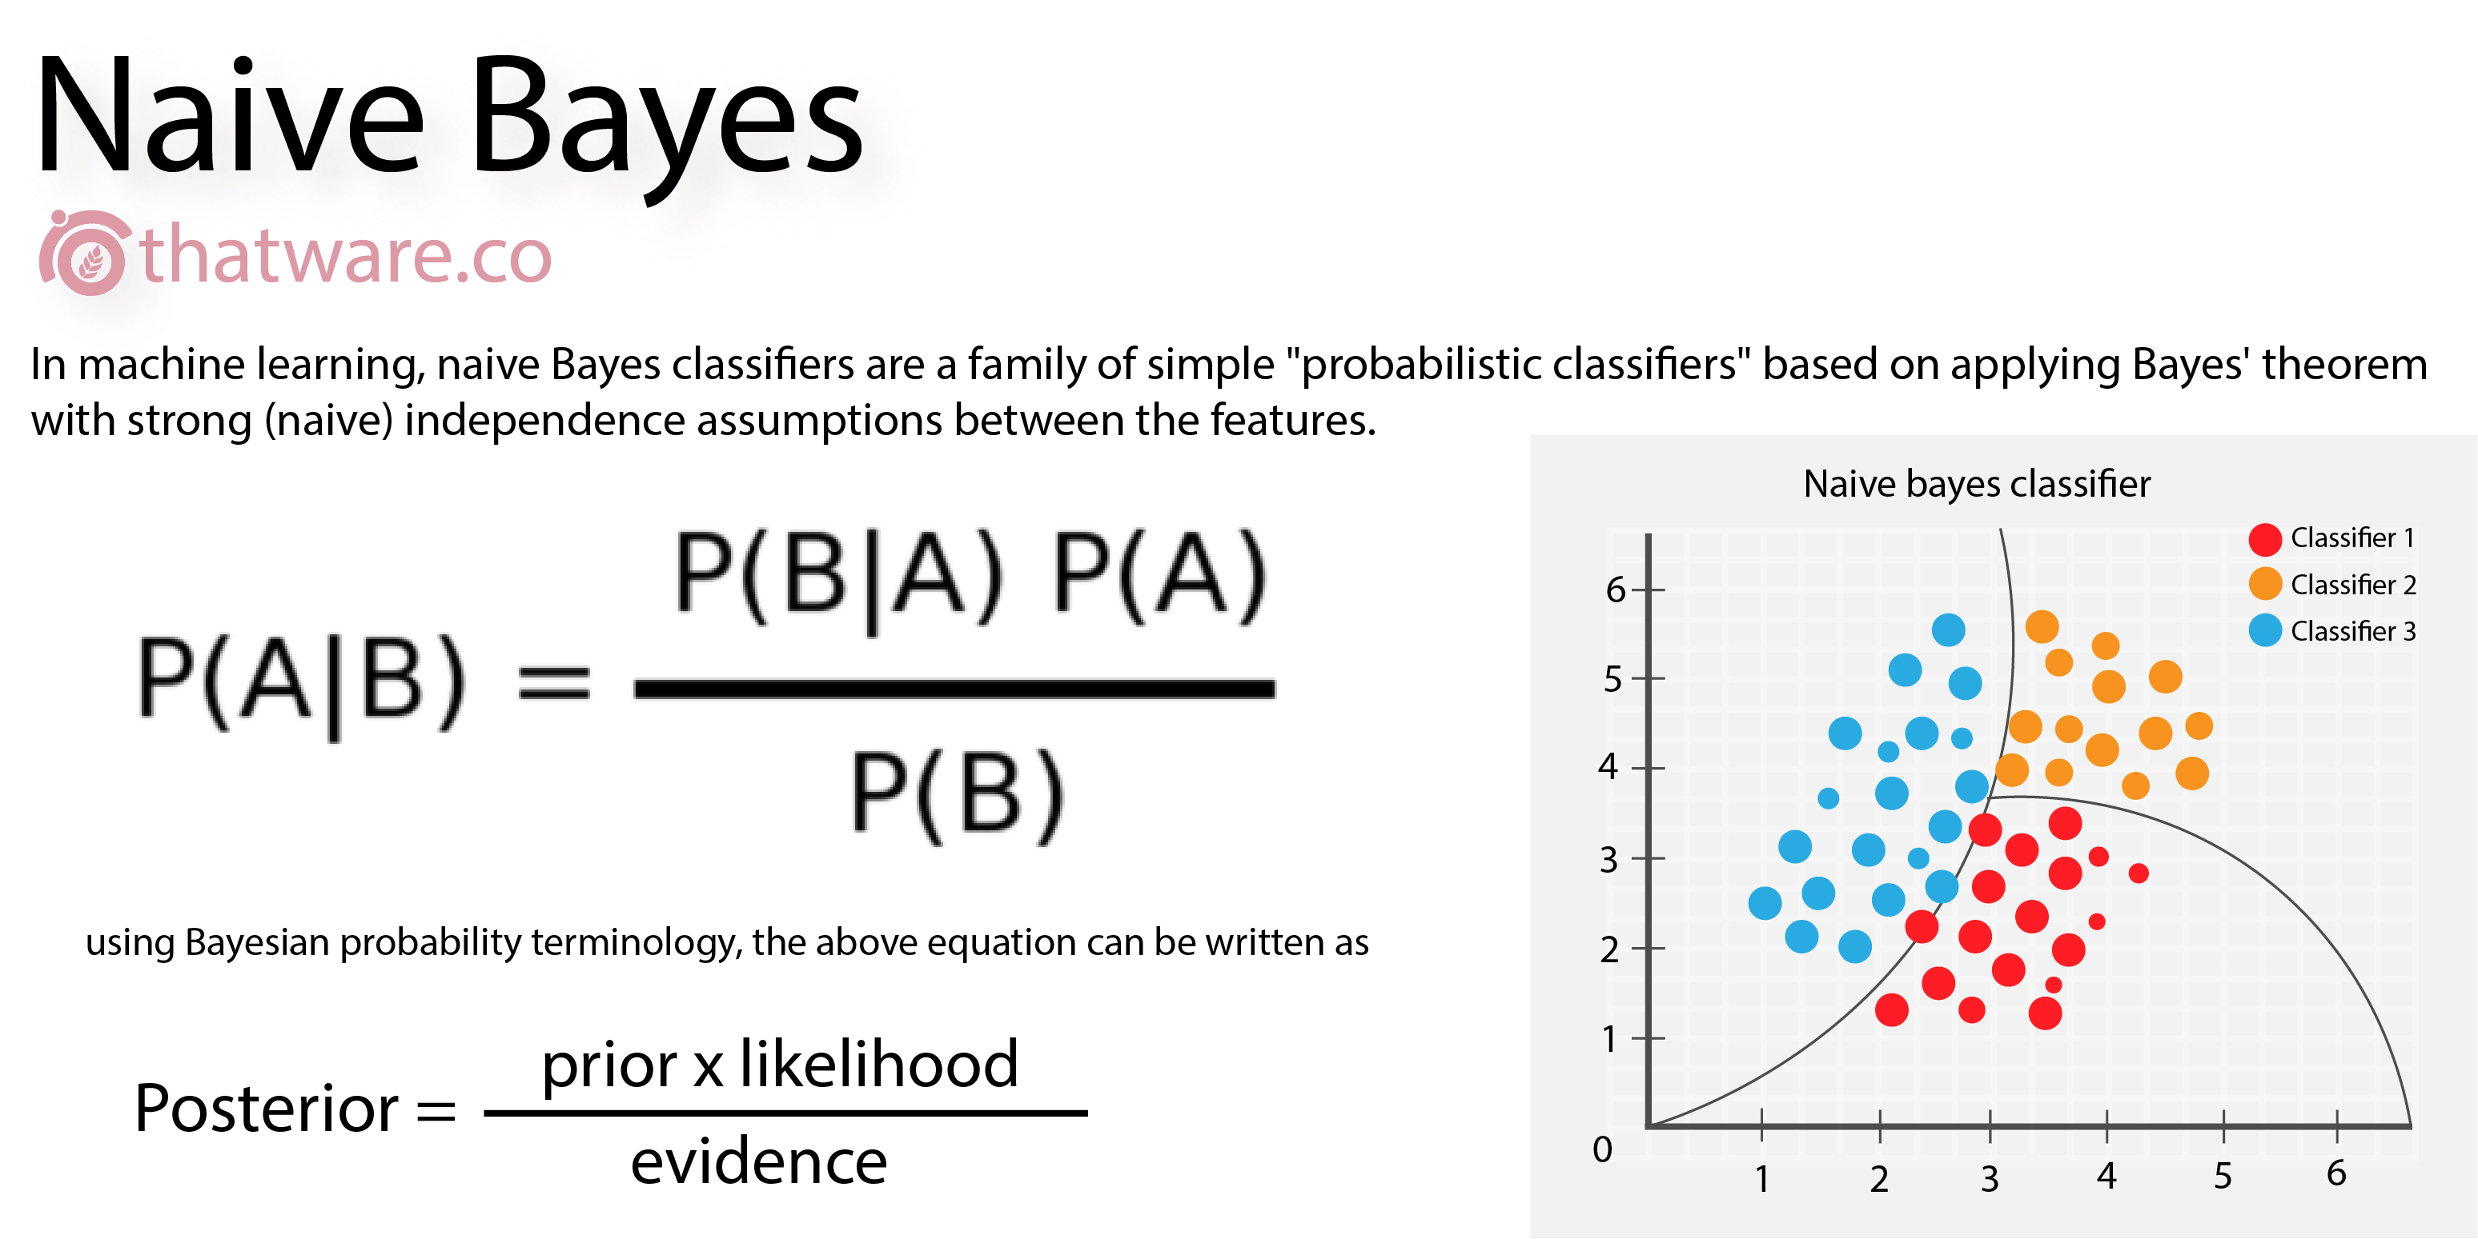
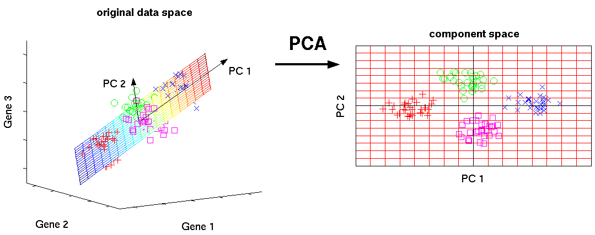
BoW Embedding with modeling
Bag-of-Words approach yields, high dimensional sparse data vectors
Very hard, even problematic to model
Possible modeling technique: Naïve Bayes (out of scope)
Alternative solution: reduce the dimensionality of the vectors, by compressing them to most informative dimensions = Principal Components Analysis (out of scope)

Slide 34
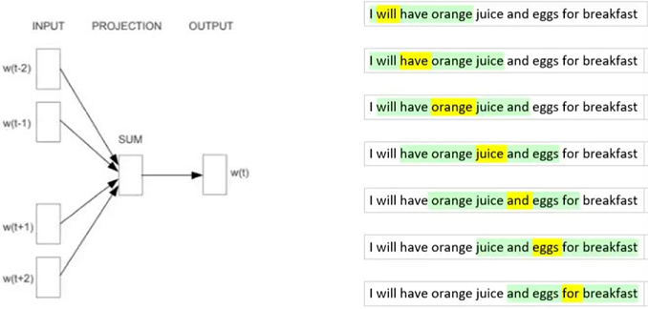
Solution Pre-trained Dense Word Embedding
Word2Vec, Glove, etc.
Vector Embeddings are trained on general corpus (Wikipedia), using context words

Slide 35
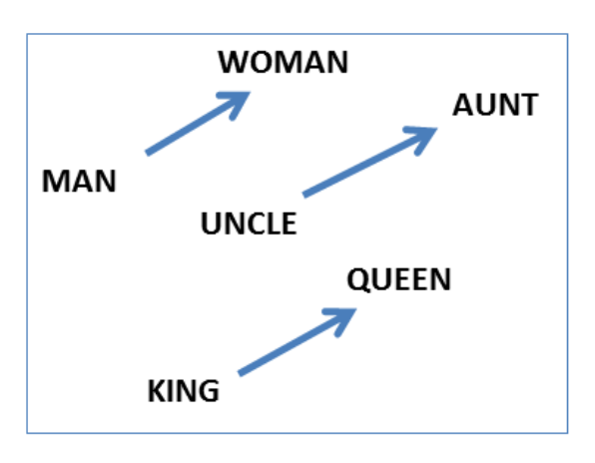
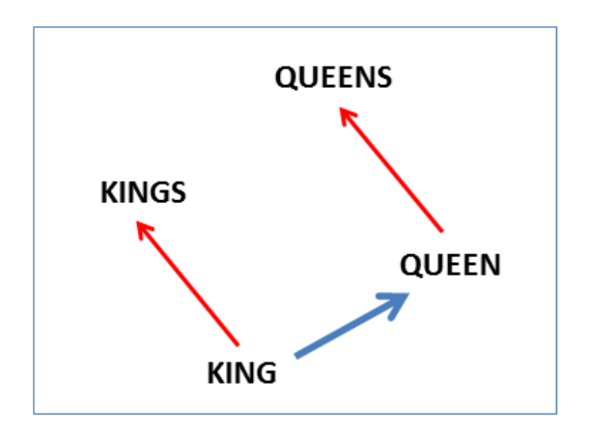
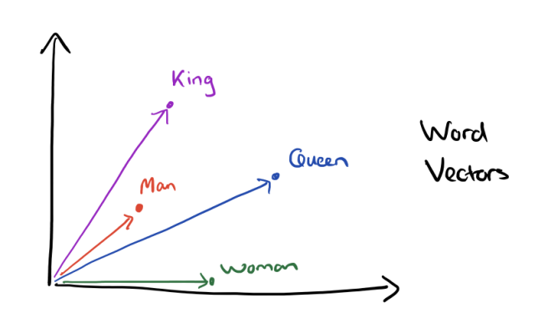
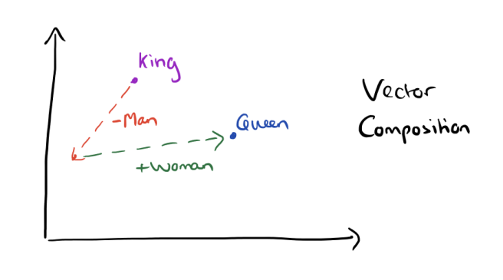
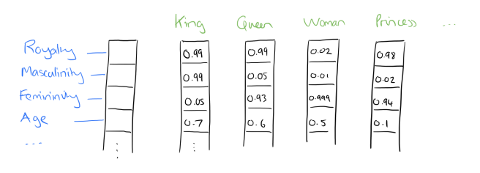
Word2Vec Embeddings
Better vectorization, trained with neural network on large context corpus (like Wikipedia)
Vectorization is so good, we can even reason with language
Embeddings can be downloaded

Slide 36
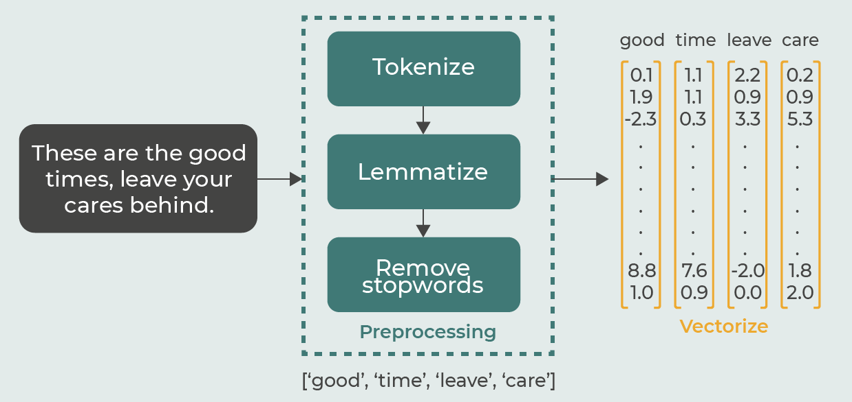
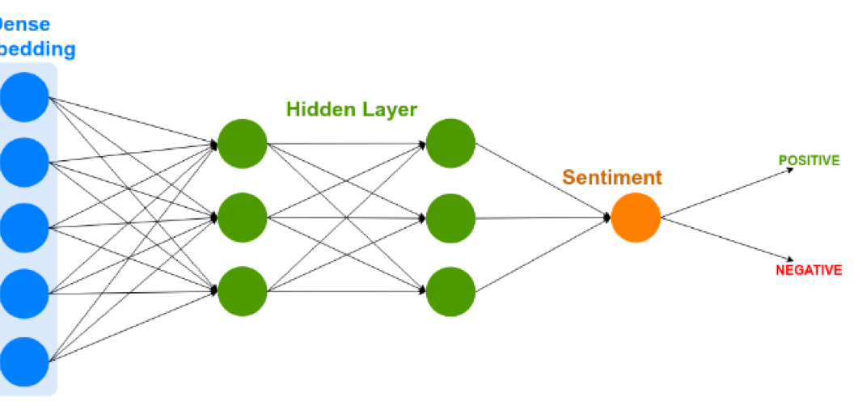
Putting it all together…
Word2Vec Embeddings

Slide 37
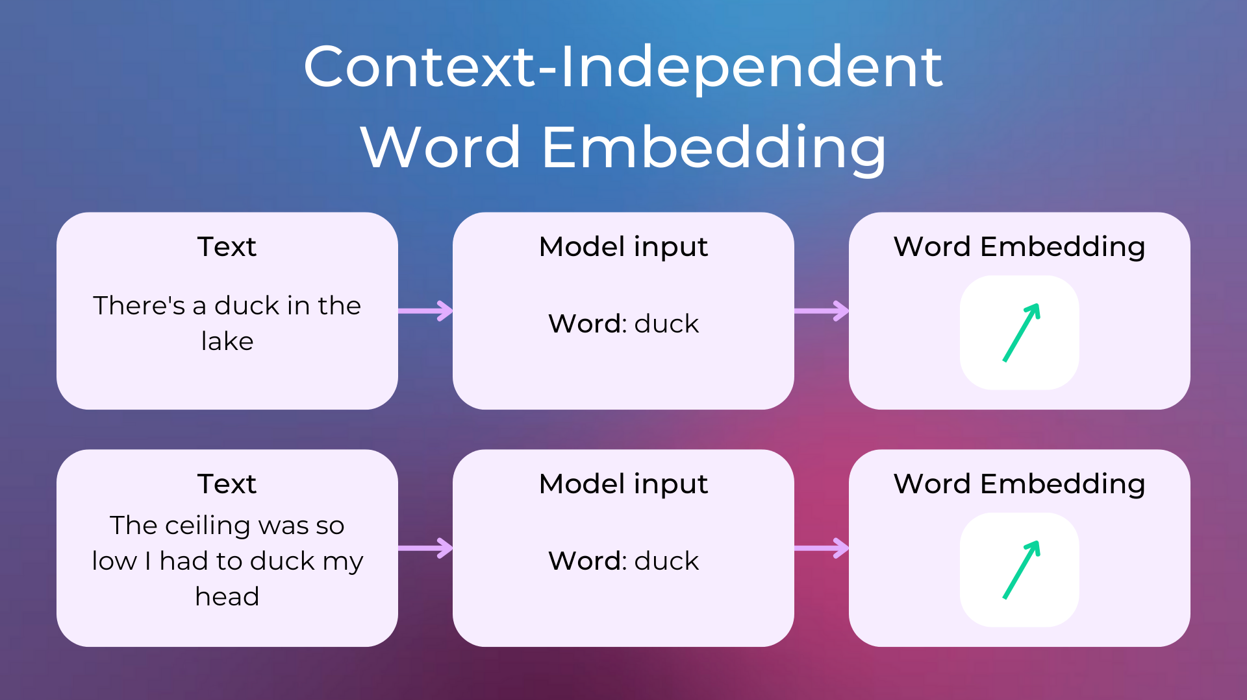

Problem Word Embeddings
Static embeddings are not perfect. In order to move from static embeddings to context-aware vectorizations, we need a (Large) Language Model that takes the context window into account to tweak the vectorizations of the tokens
→ See follow-up course in 3AI: Deep Learning
Notes:
https://www.nlplanet.org/course-practical-nlp/01-intro-to-nlp/11-text-as-vectors-embeddings

Slide 38

SOTA (State of the Art - Hugging Face)
Today, preprocessing & tokenization are all dependent on the pre-trained (Large) Language Model you want to use

Slide 39



Over to you

