Slide 1



Employee Data Analysis
STUDENT NAME: Vijayalakshmi B
REGISTER NO: 312200821
DEPARTMENT: Commerce
COLLEGE Pachaiyappas College For Women,
Notes:
1.7.2013
1
‹#›

Slide 2


Project Title
Employee Performance Analysis using Excel

Slide 3
Content
Problem Statement
Project Overview
End Users
Our Solution and Proposition
Dataset Description
Modelling Approach
Results and Discussion
Conclusion
01
02
03
04
05
06
07

Slide 4



Problem Statement
The performance of employees plays a crucial role positive environment the organisations growth.To foster and recognize employee's contribution,which can be achieved through promotions.By investing in their employees morale but also ensures sustained progress and success for all

Slide 5

Who are the end Users ?
chief operating officer
CEO financial officer
Marketing officer
sales manager

Slide 6


Our solution and its value proposition
Conditional formatting-Missing values
Filter - Filter out missing values
Pivot table - summary of data

Slide 7
Dataset Description
Employee Dataset-kiggle
Features-26
consider-9
Employee ID-Numerical
First Name-Text
Employees Type
Performance level

Slide 9

The 'won' In Our Solution
Predictive Analytics: Integrating predictive models to forecast future performance trends based on historical data, giving managers a proactive approach to workforce planning.
Automated Alerts: The tool can be set up to send automated alerts for critical performance issues, ensuring that managers are immediately notified when attention is needed.

Slide 10
Modeling
Data collection
1 Download-gaggle
2 Edunet dashboard-File download
1 Employees I'd
2 first name
3 employees type
4 perormance level
5Gender -Male or female

Slide 11

Modeling
Charts
Purpose: To visualize the data in an easily interpretable format, making trends and patterns more apparent.
Implementation: Various types of charts (e.g., bar charts, line charts, pie charts) will be created based on the pivot table outputs. For instance, a line chart could show the trend of an employee’s productivity over time, while a bar chart could compare performance across different departments.
4. Conditional Formatting
Purpose: To highlight specific data points that meet certain conditions, making it easier to spot trends, outliers, or areas of concern.
Implementation: Conditional formatting will be applied to cells based on rules, such as highlighting cells in red if an employee’s performance falls below a certain threshold, or in green if targets are exceeded. This immediate visual cue helps in quickly identifying critical areas needing attention.

Slide 12






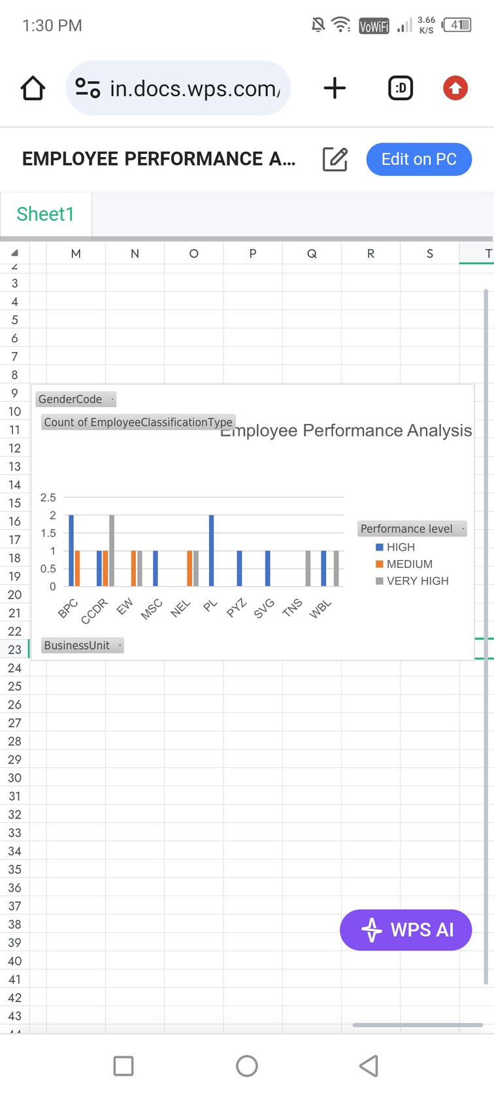






Results

Slide 13

Conclusion
The "Employee Performance Analysis Using Excel" project provides a robust and user-friendly solution for evaluating and managing employee performance. By leveraging Excel's powerful tools—such as filtering, pivot tables, charts, and conditional formatting—the project transforms raw performance data into actionable insights. The resulting interactive dashboards and customizable reports empower managers to make data-driven decisions, optimize workforce productivity, and foster continuous improvement across the organization. This solution not only streamlines performance management but also offers a cost-effective, scalable approach to enhancing overall organizational efficiency.

