Slide 1

ZERO KNOWLEDGE PROOF
Dadhija Patel
SIDDHI U SHIDRUK
Guruprasath Murugesan

Slide 2
AGENDA
ZERO KNOWLEDGE PROOF
VARIATIONS
IZKP
NIZKP
PROOF OF CONCEPT

Slide 3
PROOFS x + y < 10
P class problem
Say x=5 and y=3, then we can say that the above statement is true.
Complete: This proof is complete because we can always either come to the conclusion of true or false.
Soundness: The proof is sound as there is no way to convince the verifier that x=11 and y=9 will lead to result 2.
NP class problem
There is a graph with edges and vertices. The edges are coloured in three colors such that no adjacent edges have the same colour.
Complete: Just check every edge is coloured and no adjacent edges have the same color.
Soundness: The verifier can see the graph and properly check all the conditions.

Slide 4
DEFINITION
Consider the NP problem we saw in the previous example. In the same problem if the verifier does not find out any information about the graph at the end of the protocol, it becomes a zero-knowledge proof.
A zero-knowledge proof is a proof that one party (the prover) knows the value x to another party (the verifier) ​​without providing any information other than the fact that it knows the value x. It is possible.
The essence of zero-knowledge proofs is simply that it is easy to prove that someone knows certain information. The challenge is to justify such ownership without disclosing the information itself or any additional information.
Zero-knowledge proof is convincing someone that you know the message without sharing or providing any additional information.

Slide 5
CORRECTNESS
Completeness: If the information provided by the prover is true, then a ZKP method must enable the verifier to verify that the prover is telling the truth.
Soundness: If the information provided by the prover is false, then a ZKP method must allow the verifier to refute that the prover is telling the truth.
Zero-knowledge: The method must reveal to the verifier nothing else than whether the prover telling the truth or not.

Slide 6
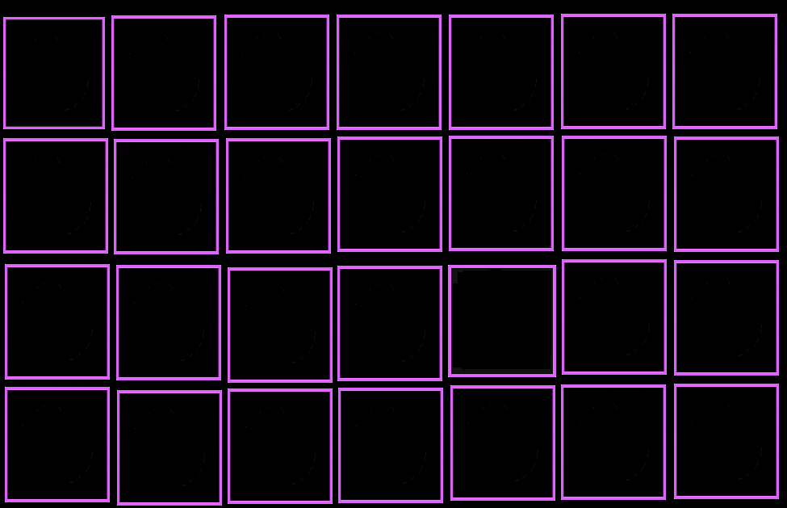
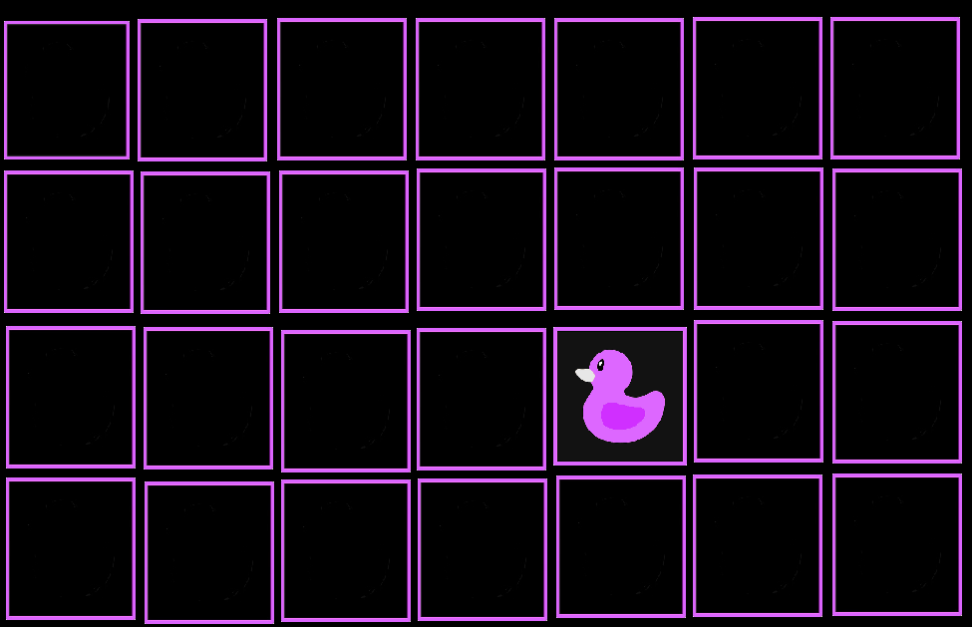
EXAMPLE

Slide 7
TYPES OF ZKP
Interactive Zero Knowledge Proof –
It is a way for a prover (P) to prove to the verifier (V) that a statement is true until the Verifier V is convinced about the statement being true , It is interactive as The P and V can communicate n number of times until the V is convinced.

Slide 8
Non-Interactive Zero Knowledge Proof
The Fiat-Shamir heuristic was the first introduction to NIZK.I t is a type of zero knowledge proof where communication between the prover and the verifier becomes unnecessary so proof generation can be done ofline. In this system, a common reference string is used for proof.
A variation of the NIZK model was suggested by De Santis, Micali, and Persiano. In their non-interactive with preprocessing model, the verifier and prover create a common reference string during an interactive preliminary stage. Based on this common reference string the prover can then prove any single NP statement (of bounded length)..

Slide 9
What Is Interactive Zero Knowledge
Informally, the goal of a proof is to convince someone that a certain statement is true.

Slide 10
Interactive Zero Knowledge Proof
An interactive proof system for a language L is a protocol between two algorithms: a (possibly unbounded) prover P and an efficient (probabilistic polynomial time) verifier V
At the start of the protocol, both the prover P and the verify V are given some instance x.
At the end of the protocol, the verifier V either accepts (it is convinced that x ∈ L) or rejects (it is not convinced that x ∈ L).

Slide 11
CORRECTNESS
For a proof system to be useful it must satisfy the following two properties: ,
1. Completeness: If x ∈ L, then an honest prover P that just follows protocol specification should be able to convince V .
2. Soundness: If x /∈ L, then no prover P (that can possibly cheat by deviating from the protocol specification) should not be able to convince V

Slide 12
What Types Of Languages Have An Interactive Proof System?
The simplest example is the class of languages in NP.
Let L ∈ NP. Then, by definition, there exists an efficient algorithm M(·,·) such that
x ∈ L ⇐⇒ ∃ w ∈ {0, 1} poly(|x|) s.t. M(x, w) = 1.
Therefore, we can specify the protocol as follows:
• P(x): Compute a witness w ∈ {0, 1} poly(|x|) and send it to V .
• V (x): When P sends over w, check if M(x, w) = 1. Output “accept” if this is the case and “reject” otherwise

Slide 13

Where is wally ?

Slide 14


Slide 16
Issues with the above example
The main issue with the above example is that the prover can change the puzzle at any point during the interaction. There is no way that the verifier can confirm that the same puzzle is used every single time.
Therefore, we introduce a new example of Hamiltonian graphs to show completeness and soundness of protocols.

Slide 17
Hamiltonian Graph proof
Hamiltonian graph is a graph in which each vertex is visited exactly once.
Steps:
Generate a graph G.
Make permutation of graph G.
The verifier can either ask for the used permutation or the permuted graph in a round and can continue asking until he is satisfied that the graph is Hamiltonian.

Slide 18
CORRECTNESS
Completeness: The proof is complete as it can be proven if the graph is Hamiltonian or not.
Soundness: The verifier can confirm that no bad behaviour is done while permutation. If the prover is trying to prove a non-Hamiltonian graph Hamiltonian, either it is not properly permuted or it is not hamiltonion. There is a 50% chance of tricking the verifier in every round. If we do this a 128 times then the probability of tricking the verifier is very small like (½)^128.
Zero knowledge: At the end of the protocol, the verifier gains no information about the original graph G.

Slide 19
Non-Interactive Zero Knowledge Proof
NIZK has become an important primitive for cryptographic protocols, with applications such as signature schemes and encryption schemes secure against chosen ciphertext attack [NY]. NIZK proof systems for
The prover P writes down a zero-knowledge proof that an input x belongs to a prespecified language L, and any verifier V can check the validity of this written proof against a universal publicly available random string (such as the RAND string of one million random digits), called the common reference string

Slide 20
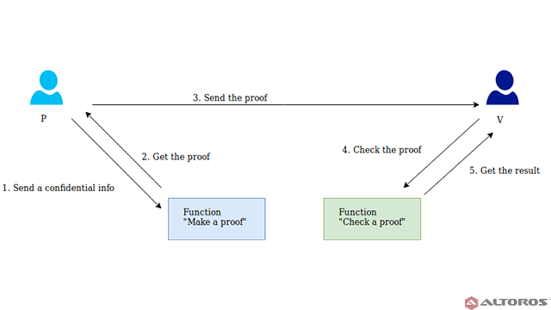
Image Reference: https://www.altoros.com/blog/zero-knowledge-proof-improving-privacy-for-a-blockchain/

Slide 21
NZIK Proof
In interactive zero knowledge proof a sigma protocol is used.
A Sigma protocol is this 3-message interaction "per round" that looks like
Prover sends message a to Verifier
Verifier sends challenge c to Prover
Prover sends response z to Verifier
Each round can be written as (a, c, z)
To convert this into non-interactive zero knowledge proof the prover generates a transcript of many interactions and sends this to the verifier.

Slide 22
Consider a graph G that the prover has to prove Hamiltonian.
Prover generates A as the permutation of the graph G.
A = Prem(G)
C = random bit
This random bit chooses if the prover sends the cycle in permuted graph or the permutation.
Z is either the Hamiltonian cycle in Prem(G) or the permutation.
Z depends on the random bit in C.
Suppose the prover sends transcript of 128 rounds. Then for each round:
(a_1, c_1,z_1), (a_2, c_2,z_2) …….. (a_n,c_n,z_n)

Slide 23
NZIK Correctness
The permutation function is a strong one way function in which inversion is not possible.
Completeness: The verifier can check all Z by considering the random bit in C.
Soundness: If the prover is trying to change the permutation or the graph, then it will be reflected in the output.
Zero knowledge: At the end of the protocol, the verifier is not aware of the graph G.

Slide 24
NZIK Applications
ZK snark: zk-snark is an acronym that stands for “zero-knowledge succinct non-interactive argument of knowledge.”
A zk-snark is a cryptographic proof that allows one party to prove it possesses certain information without revealing that information.
This proof is made possible using a secret key created before
The transaction takes place. It is used as part of the protocol for the cryptocurrency, zcash.
The advantage of zk snark is that it is very small as compared to the transcript generated in non interactive zero knowledge proof.

Slide 25
References
Multiple non-interactive zero knowledge proofs under general assumptions.
https://www.investopedia.com/terms/z/zksnark.asp

Slide 26

Thank You

