Slide 1
CSAI SEMESTER 5 • MACHINE LEARNING EVALUATION (PHASE 1)
DRIFT-SENSE
IMU
Predicting IMU Dead-Reckoning Position Drift
from Window-Level Motion Features
200 Hz • 6-AXIS • 2.0 s WINDOWS
PROJECT TEAM & ROLES
EXECUTIVE SUMMARY
Guru Manohar Gupta [2401010125] — Team Lead & Preprocessing Pipeline
Harsith Priyan S [2401010398] — EDA & Flight Dynamics
Pranavi Mathur [2401020046] — Domain Feature Engineering (104 Descriptors)
Yatin Singh [2401010243] — Model Development, Tuning & Evaluation
Dadi Dinesh [2401010136] — Dataset, Literature, Report & PPT
“Autonomous drones drift quadratically when cameras or GPS fail. We engineer 104 motion features from raw 200 Hz IMU signals to predict 2.0-second position drift with 2.50 cm accuracy on unseen flights, cutting baseline error by 45%.”
01

Slide 2
01
SECTION 01
Problem Statement & System Architecture
The Physics of Inertial Compounding and the Drift-Sense Solution
DRIFT-SENSE • AUTONOMOUS ROBOTICS & FLIGHT TELEMETRY
02

Slide 3
SECTION 01 • PROBLEM STATEMENT & MOTIVATION
The Dead-Reckoning Crisis: Quadratic Compounding (∫∫ a dt²)
THE REAL-WORLD ENGINEERING FAILURE
WHAT DRIFT-SENSE DEALS WITH & SOLVES
How drones navigate: Micro Aerial Vehicles rely on Visual-Inertial Odometry (VIO), but visual tracking fails in darkness, smoke, aggressive turns, or textureless corridors.
Dead-reckoning fallback: when cameras fail, the drone adds up accelerometer and gyroscope readings 200 times per second.
Pedometer analogy: a half-inch mistake per step can miss a target by 3 feet after 50 steps.
Quadratic curse: position is the double integral of acceleration. A 0.05 m/s² sensor offset can compound into metres of error within seconds.
Input: short 2.0-second slices of raw, noisy 6-axis IMU readings without camera images.
Goal: supervised ML predicts accumulated position drift magnitude (err_mag_m) from motion patterns.
Operational impact:
• Real-time uncertainty: estimate error before an accident.
• Trajectory correction: subtract predicted drift vectors.
• Failsafe trigger: hover when drift exceeds safety limits.
03

Slide 4
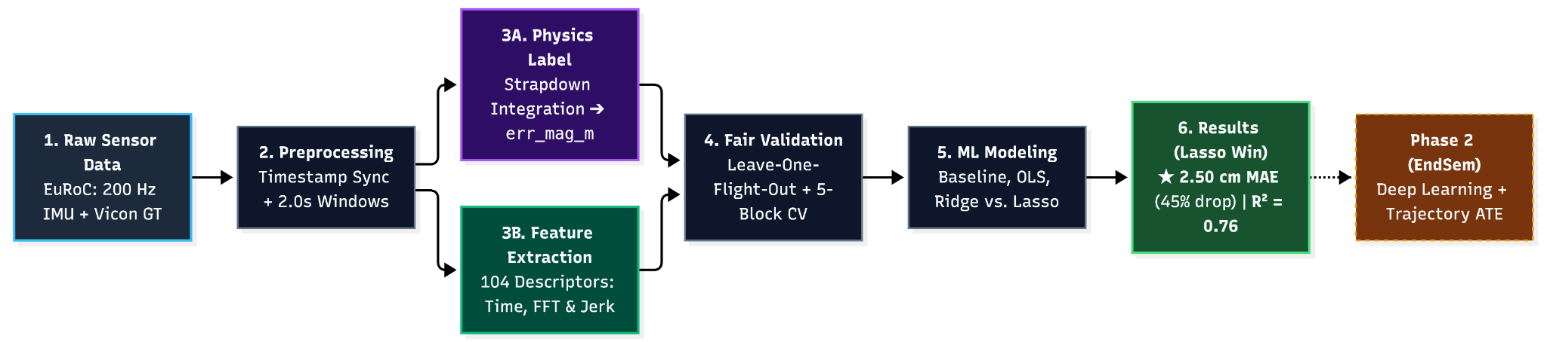
SECTION 01 • SYSTEM ARCHITECTURE
The Drift-Sense Pipeline: From 200 Hz Sensors to 2.5 cm Accuracy
SYNCHRONOUS ALIGNMENT
PARALLEL DECOUPLED PIPELINES
LEAKAGE-SAFE MODELING
Align onboard sensors and Vicon tracking within a 20 ms tolerance to eliminate independent clock drift.
Part A builds ground-truth drift targets via Newtonian physics; Part C extracts 104 features from raw IMU.
Split by entire flights (LOSO) and temporal blocks to prevent overlapping-window leakage.
04

Slide 5
02
SECTION 02
Data Preprocessing & Ground-Truth Labeling
Synchronization, Calibration, Windowing, and Physics Integration
DRIFT-SENSE • AUTONOMOUS ROBOTICS & FLIGHT TELEMETRY
05

Slide 6
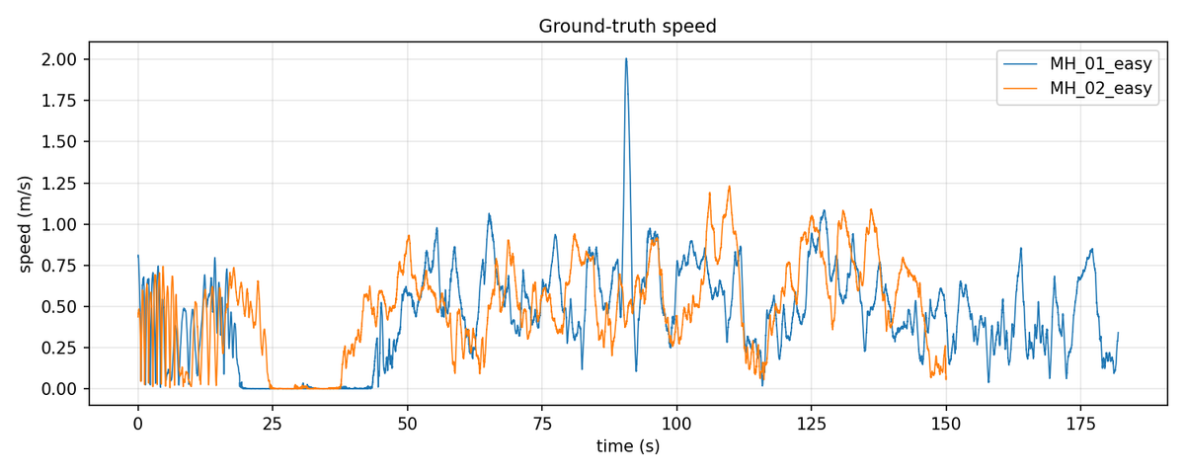
SECTION 02 • DATASET SPECIFICATIONS
EuRoC MAV Benchmark: Real Drone Flight Parameters
FLIGHT OVERVIEW
Platform: AscTec Firefly hexacopter in an industrial machine hall (30 m × 10 m × 5 m).
MH_01_easy: 184.1 s • 36,820 IMU rows • 81 m path • mean speed 0.44 m/s • peak 2.0 m/s.
MH_02_easy: 152.0 s • 30,400 IMU rows • 74 m path • mean speed 0.49 m/s • peak 1.2 m/s.
DATA COMPLETENESS & SENSOR STREAMS
Raw IMU (7 columns): nanosecond timestamp, 3-axis gyroscope (rad/s), 3-axis accelerometer (m/s²).
Ground truth (17 columns): timestamp, 3D position, orientation quaternion, velocity, and sensor biases.
Quality check: exactly ZERO missing/NaN values. Sampling interval is 5.0 ms (200 Hz).
06

Slide 7
SECTION 02 • PREPROCESSING IMPLEMENTATION
The 6 Core Preprocessing Operations Explained
1 • CLEANING & UNITS
2 • TIME SYNCHRONIZATION
3 • COORDINATE PROBE
Standardized headers to gx, gy, gz, ax, ay, az; confirmed SI units (rad/s, m/s²).
Nearest timestamp within 20 ms. Dropped 1.17% (MH_01) and 1.32% (MH_02), only at entry/exit; zero mid-flight drops.
Tested 4 frame/gravity sign combinations on 0.25 s. Correct g = −9.81 m/s² and body-to-world rotation gave 0.017 m probe error vs 0.27–0.63 m wrong frames.
4 • SLIDING WINDOWS
5 • MEAN-REMOVAL BEFORE FFT
6 • ZERO-LEAKAGE SCALING
2.0 s windows (400 samples), advancing 0.25 s (50 samples); 1,312 training windows total.
Subtract window mean before FFT to remove the 9.81 m/s² gravity DC spike and isolate vibration/aerodynamic oscillations.
Save feature CSVs unscaled; fit StandardScaler strictly on training flights only.
07

Slide 8
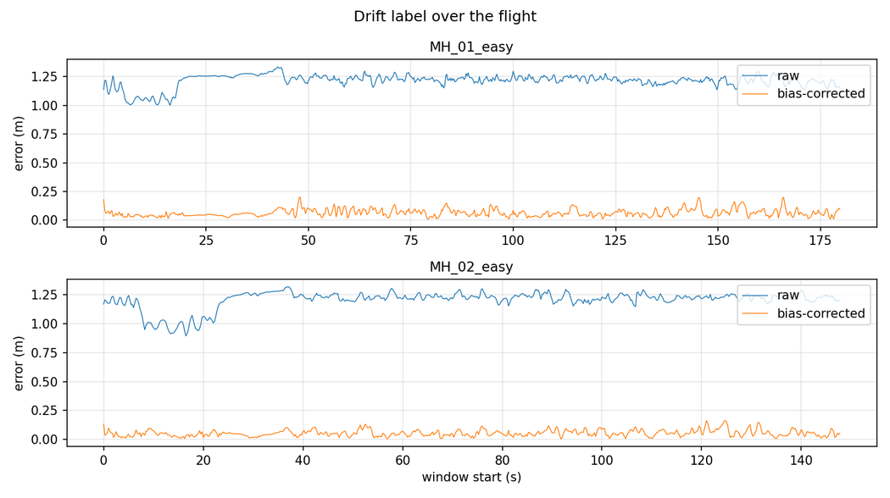
SECTION 02 • LABEL FORMULATION & PROCESSED CSVS
Physics Label Construction & The 6 Processed Datasets
STRAPDOWN INERTIAL INTEGRATION
Each 2.0 s window starts from true state (p₀, v₀, q₀) and integrates raw IMU across 400 samples using Newton–Euler mechanization.
Δqᵢ = quat(ωᵢ, Δt); a_world,ᵢ = R(qᵢ)a_body,ᵢ + g
pᵢ₊₁ = pᵢ + vᵢΔt + ½a_world,ᵢΔt²
Target: err_mag_m = ||p̂_end − p_true,end||₂ = √(Δx² + Δy² + Δz²), approximately 1.21 m.
95% SENSOR BIAS DISCOVERY
THE 6 PROCESSED CSV DATASETS
Raw IMU drift averages 1.21 m. Subtracting sensor bias (err_mag_m_bc) reduces error to 0.058 m (5.8 cm).
≈95% of raw dead-reckoning drift is caused by constant sensor bias, not random motion.
features_MH_01_easy.csv — 720 rows, 107 cols
features_MH_02_easy.csv — 592 rows, 107 cols
windows_MH_01_easy.csv — 720 rows, 12 cols
windows_MH_02_easy.csv — 592 rows, 12 cols
physics_leave_MH_01/02.csv — 1,312 rows, 6 cols (analytical benchmark)
08

Slide 9
03
SECTION 03
Exploratory Data Analysis & Windowing Strategy
Understanding Sensor Signals, Distributions, and Avoiding Data Leakage
DRIFT-SENSE • AUTONOMOUS ROBOTICS & FLIGHT TELEMETRY
09

Slide 10
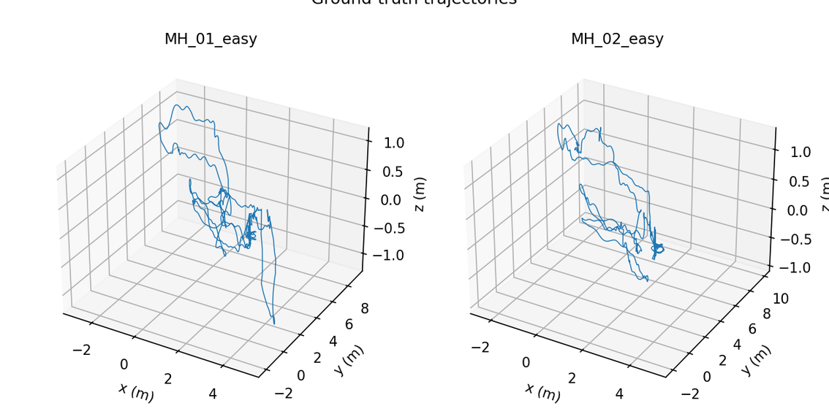
SECTION 03 • EXPLORATORY DATA ANALYSIS
Flight Path Comparison & Drift Distribution
MACHINE HALL FLIGHT DYNAMICS
Both flights occupy comparable industrial workspace volumes with similar hovering pitch attitudes.
Acceleration magnitude stays near 9.80 m/s² (gravity + flight thrust). Gyroscope signals show small-amplitude chatter (~0.2 rad/s), not extreme tumbling.
TARGET LABEL CHARACTERISTICS
MH_01_easy: mean 1.215 m • std 0.058 m • range 1.00–1.34 m.
MH_02_easy: mean 1.203 m • std 0.079 m • range 0.89–1.32 m.
Slight negative skew (−1.66 to −2.11) is caused by take-off transition.
WHY NO LOG TRANSFORM?
Drift is tightly bounded (0.89–1.34 m). Applying log(y) would compress centimetre-level variation without mathematical benefit; log transforms suit data spanning orders of magnitude.
10

Slide 11
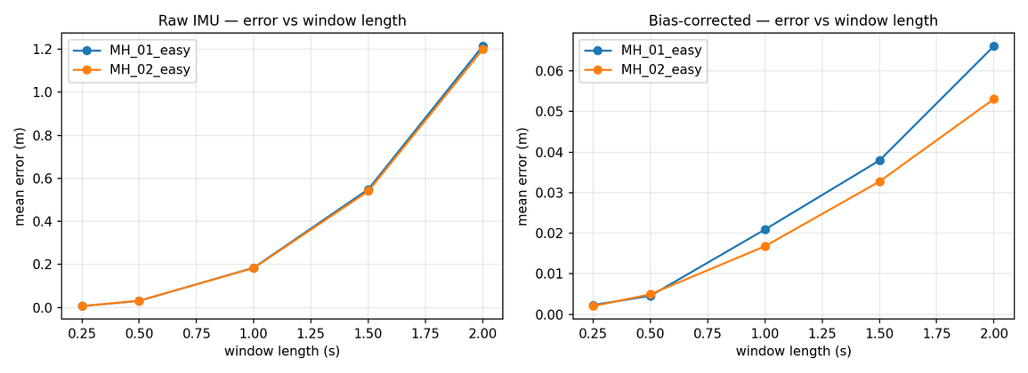
SECTION 03 • VALIDATION PROTOCOL
Why 2.0s Windows and Leave-One-Flight-Out Splitting?
WHY 2.0 s INSTEAD OF 1.0 s?
At 1.0 s, drift is ≈18 cm; bias has not grown sufficiently above sensor noise. Theoretical R² ceiling ≈0.50.
At 2.0 s, double integration lets bias drift reach 1.21 m, above random vibration noise. Predictability ceiling rises from 0.50 to 0.83.
THE 87.5% OVERLAP & LOSO
Windows advance 0.25 s every 2.0 s, sharing 87.5% of sensor samples. Random splitting leaks near-duplicates across train/test.
Fold 1: train MH_02 (592 windows) → test unseen MH_01 (720).
Fold 2: train MH_01 (720) → test unseen MH_02 (592).
11

Slide 12
04
SECTION 04
Domain Feature Engineering
Extracting 104 Motion Descriptors and the Physics of Tilt
DRIFT-SENSE • AUTONOMOUS ROBOTICS & FLIGHT TELEMETRY
12

Slide 13
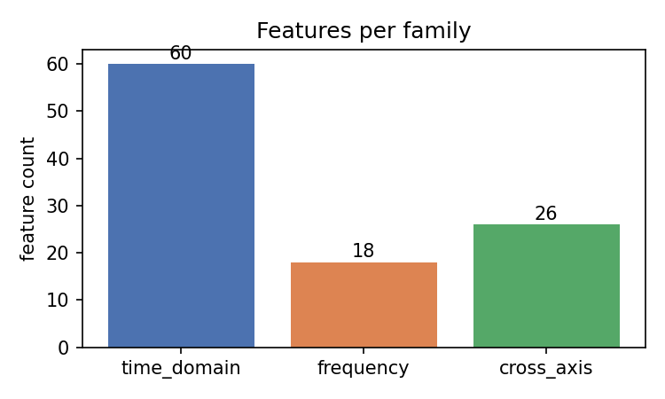
SECTION 04 • FEATURE EXTRACTION
From 400×6 Raw Signals to 104 Informative Features
TIME-DOMAIN STATISTICS • 60
10 statistics across six IMU axes (gx, gy, gz, ax, ay, az): mean, standard deviation, variance, RMS, min, max, peak-to-peak range, skewness, kurtosis, and ZCR.
Captures motion energy, physical limits, and transient thrust spikes.
FREQUENCY-DOMAIN FFT • 18
Dominant frequency, spectral energy, and spectral entropy across six axes.
Subtract window mean before FFT to remove constant 9.81 m/s² gravity DC bias.
Entropy: 0 = pure-tone hover; 1 = turbulent broadband chatter.
CROSS-AXIS & MOTION COUPLING • 26: vector magnitudes (6), jerk statistics (5), and Pearson correlations across 15 axis pairs.
13

Slide 14
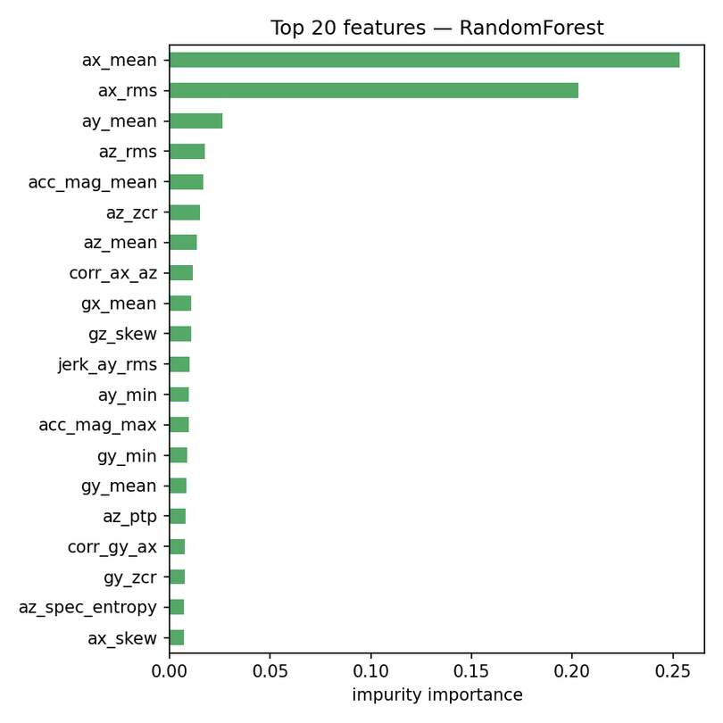
SECTION 04 • FEATURE SIGNIFICANCE & MULTICOLLINEARITY
Physical Discovery: Why Vehicle Tilt Controls Drift
DOMINANT LINEAR CORRELATES
Accelerometer mean and energy are the strongest correlates.
• az_mean (r = −0.88)
• ax_rms (r = 0.87)
Top Random Forest importance features: az_mean, az_rms, ax_rms.
Accelerometer mean measures tilt relative to gravity. With 95% of drift from bias, tilt controls how vertical bias projects into horizontal position error. Spectral entropy correlates at r ≈ 0.65–0.74.
MULTICOLLINEARITY & SAFE SCALING
22 feature pairs exceed |r| > 0.95 (e.g. variance vs. standard deviation, RMS vs. mean). Unregularized linear regression can suffer weight explosion. This motivates L1 regularization (Lasso) to prune redundant features.
14

Slide 15
05
SECTION 05
Model Development & Evaluation
Regularization, the Take-Off Median Rule, and Benchmark Results
DRIFT-SENSE • AUTONOMOUS ROBOTICS & FLIGHT TELEMETRY
15

Slide 16
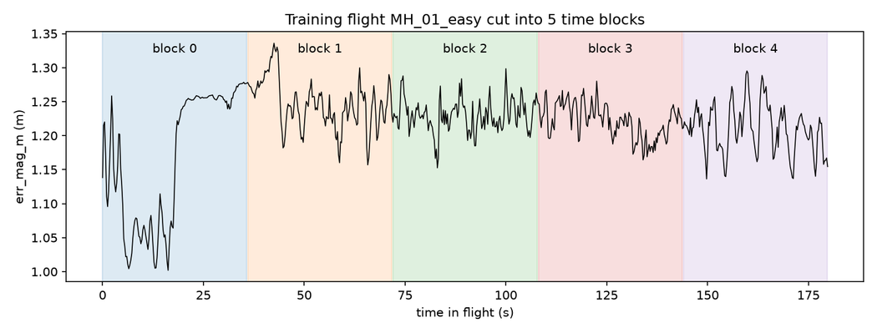
SECTION 05 • MODEL DEVELOPMENT & CROSS-VALIDATION
The 4 Compared Models & The Median Rule Innovation
MEAN BASELINE
OLS • LINEAR
Always predicts training-flight mean. Reference every model must beat (R² ≤ 0).
Unregularized least squares: 105 parameters on approximately 600 windows.
5-BLOCK TIME CV & MEDIAN RULE
RIDGE • L2
LASSO • L1
Training flight is split into 5 contiguous time blocks; a 4.0 s buffer (16 windows) is purged on each side.
Mean CV failed: take-off Block 0 has 1.0 m drift and 3–5× higher variance, skewing mean error and forcing α to infinity (baseline collapse).
Fix: choose α using Median Block Error to insulate tuning from take-off distortion.
Minimizes MSE + α||w||²₂. Shrinks weights to handle correlated features.
Minimizes MSE + α||w||₁. Forces weak/redundant weights exactly to zero.
16

Slide 17
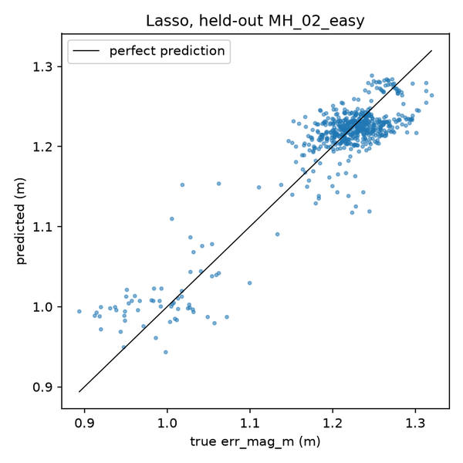
SECTION 05 • HELD-OUT EXPERIMENTAL RESULTS
Held-Out Flight Evaluation: Lasso Outperforms
Model Pipeline | MAE MH_01 | MAE MH_02 | Mean MAE | Mean R² | Test/Train
Mean Baseline | 4.40 cm | 4.65 cm | 4.53 cm | −0.03 | 1.01
OLS (Linear) | 3.12 cm | 2.87 cm | 2.99 cm | 0.58 | 1.81 (high)
Ridge (L2) | 2.80 cm | 2.60 cm | 2.70 cm | 0.72 | 1.38 (moderate)
Lasso (L1) | 2.59 cm | 2.42 cm | ★ 2.50 cm | ★ 0.76 | ★ 1.24 (best)
KEY PERFORMANCE HIGHLIGHTS
45% error reduction: baseline 4.53 cm → 2.50 cm.
Explains 76% of drift variation on unseen flights (R² = 0.76; peaks at 0.84 on MH_02).
Mean prediction bias: −0.12 cm.
Prunes 104 features to 7–18 core descriptors: az_mean, ax_rms, gx_max, gy_mean, gz_dom_freq, az_spec_entropy, corr_ax_az.
17

Slide 18
SECTION 05 • SCIENTIFIC RIGOR & ERROR DECOMPOSITION
Honest Failure Analysis: Take-Off vs. Cruising Regimes
WHERE MODELS WIN & STRUGGLE
Take-off (first 20%): Lasso achieves R² = 0.84–0.86 and tracks the transition drop from 1.22 m to 1.0 m.
Cruising (remaining 80%): R² = 0.10–0.17. Drift fluctuates only 1–2 cm due to turbulent motor vibration; smooth linear predictions cannot track sub-cm micro-chatter.
Lasso still beats baseline in MAE: 2.12 vs 2.57 cm.
STANDALONE PHYSICS BENCHMARK
Integrating IMU with the training flight’s calibrated bias, without ML, achieves R² = 0.82.
This supports the conclusion that 2.0 s drift predictability is governed by sensor-bias projection geometry.
18

Slide 19
06
SECTION 06
Research Foundations, Team & Phase 2 Outlook
System Rigor, Team Matrix, and Deep Learning Trajectory Correction
DRIFT-SENSE • AUTONOMOUS ROBOTICS & FLIGHT TELEMETRY
19

Slide 20
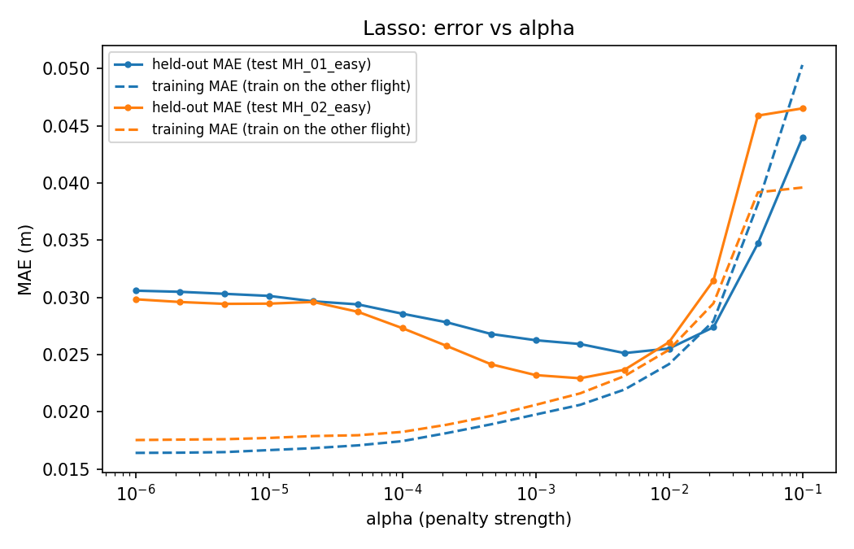
SECTION 06 • REPRODUCIBILITY & FUTURE OUTLOOK
Software Rigor, Research Literature & Phase 2 Roadmap
AUTOMATED PYTEST VERIFICATION
LITERATURE FOUNDATIONS
test_no_leakage.py: asserts zero sequence overlap in folds.
test_windowing.py: guarantees exactly 400 rows and zero NaNs per window.
test_label_sanity.py: confirms error grows monotonically from 0.25 s to 2.0 s.
Burri et al. (IJRR 2016): EuRoC MAV ground-truth benchmark.
Mourikis & Roumeliotis (ICRA 2007): MSCKF VIO drift formulation.
Tibshirani (JRSS 1996): Lasso regression for sparse feature selection.
PHASE 2 DEEP LEARNING ROADMAP (END-SEMESTER)
1. Scale to all 11 EuRoC sequences (Medium & Difficult aggressive flights).
2. Train 1D-CNNs and LSTMs directly on raw (N, 400, 6) window tensors.
3. Build a Hybrid ML-DL model fusing physics features with neural embeddings.
4. Closed-loop trajectory correction evaluated via Absolute Trajectory Error (ATE) using the evo library.
20

Slide 21
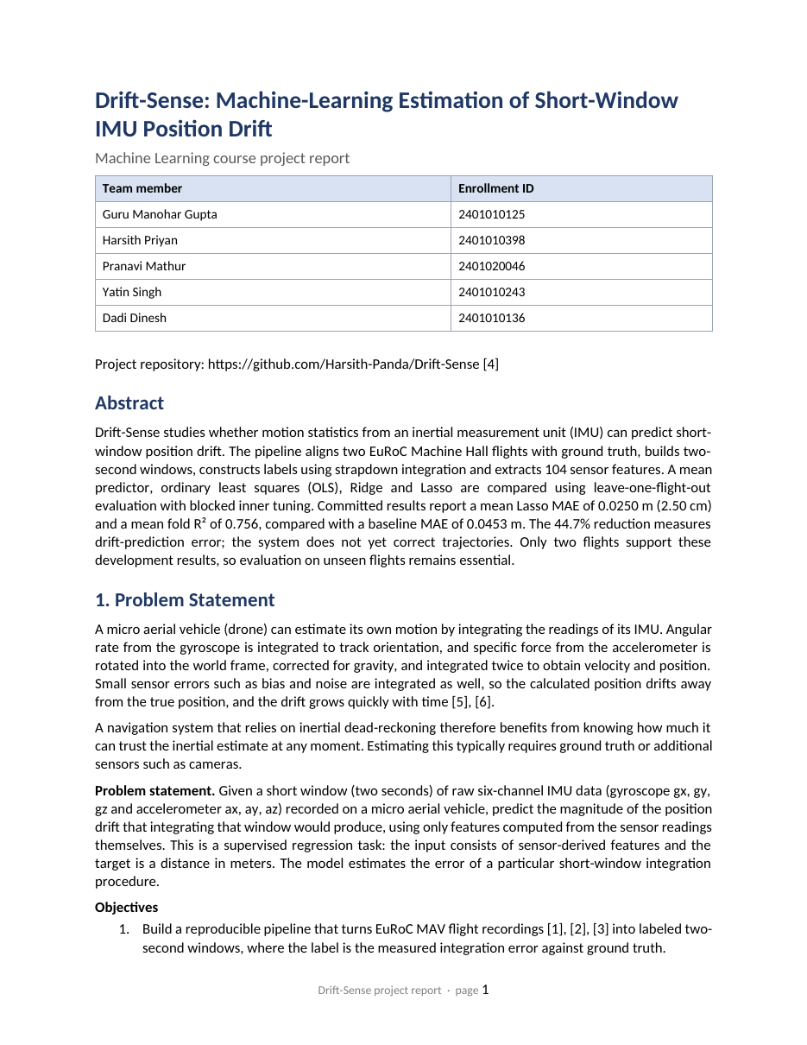
SECTION 06 • PROJECT REPORT
The Full Project Report
IEEE-STYLE PROJECT REPORT
Drift-Sense: Machine-Learning Estimation of Short-Window IMU Position Drift
Problem statement and objectives • Dataset and preparation
System architecture • Drift label construction
Feature engineering • Models and evaluation
Results • Final model • Limitations and references
Open the report →
Click the button or the report cover to open it
21

Slide 22
SECTION 06 • RUBRIC ITEM 7 INDIVIDUAL ASSESSMENT
Team Contributions & Final Concluding Statement
Team Member | Roll Number | Subsystem Role | Key Phase 1 Deliverables
Guru Manohar Gupta | 2401010125 | Team Lead & Preprocessing | Pipeline architecture, align.py synchronization, sliding windows, coordinate calibration.
Harsith Priyan S | 2401010398 | EDA Analysis | Speed/trajectory comparisons, signal quality, target distribution, zero-leakage split.
Pranavi Mathur | 2401020046 | Feature Engineering | 104 features: time, mean-removed FFT, cross-axis/jerk; feature dictionary and scaling.
Yatin Singh | 2401010243 | Model Development & Evaluation | Baseline/OLS/Ridge/Lasso, 5-block Time CV, Median Rule, segment failure analysis.
Dadi Dinesh | 2401010136 | Dataset, Report, PPT & Research | EuRoC/MSCKF literature, IEEE LaTeX report, slide deck, CI pytest suite.
CLOSING NOTE
“By bridging fundamental Newtonian strapdown mechanics with regularized machine learning, Drift-Sense proves that dead-reckoning drift is not unpredictable noise—it is a physically structured signal that can be estimated to within 2.50 cm on completely unseen flights. We are fully prepared for your questions. Thank you!”
Speaker cue: Here is our complete team contribution matrix across all five core areas. Each member has taken full ownership of their subsystem, and we look forward to defending our work in the viva. Thank you!
22

