Slide 1
Learning Management System (LMS)
By: Dadip Bhattarai
Pramila Karki
Richa Bhandari
Sharmila Rai

Slide 2
Introduction
What is an LMS?
A digital platform for managing educational courses, training, and learning programs.
Used in schools, universities, and corporate training.
Enhances accessibility, efficiency, and interactivity in education.

Slide 3
Purpose of LMS
Centralized platform for educators and students.
Key features:
Course creation & management.
Content delivery (PDFs, videos, quizzes).
Progress tracking & assessments.
Real-time feedback & communication.

Slide 4
Scope of LMS
Supports large-scale learning environments.
Works across multiple devices.
Enhances collaboration between students, teachers, and administrators.
Provides a secure and structured educational experience.

Slide 5
Literature Review
Evolution of LMS from simple course management to AI-integrated platforms.
Examples of LMS platforms: Blackboard, Moodle, Canvas.
Challenges: Scalability, User resistance, Integration with new technologies.

Slide 6
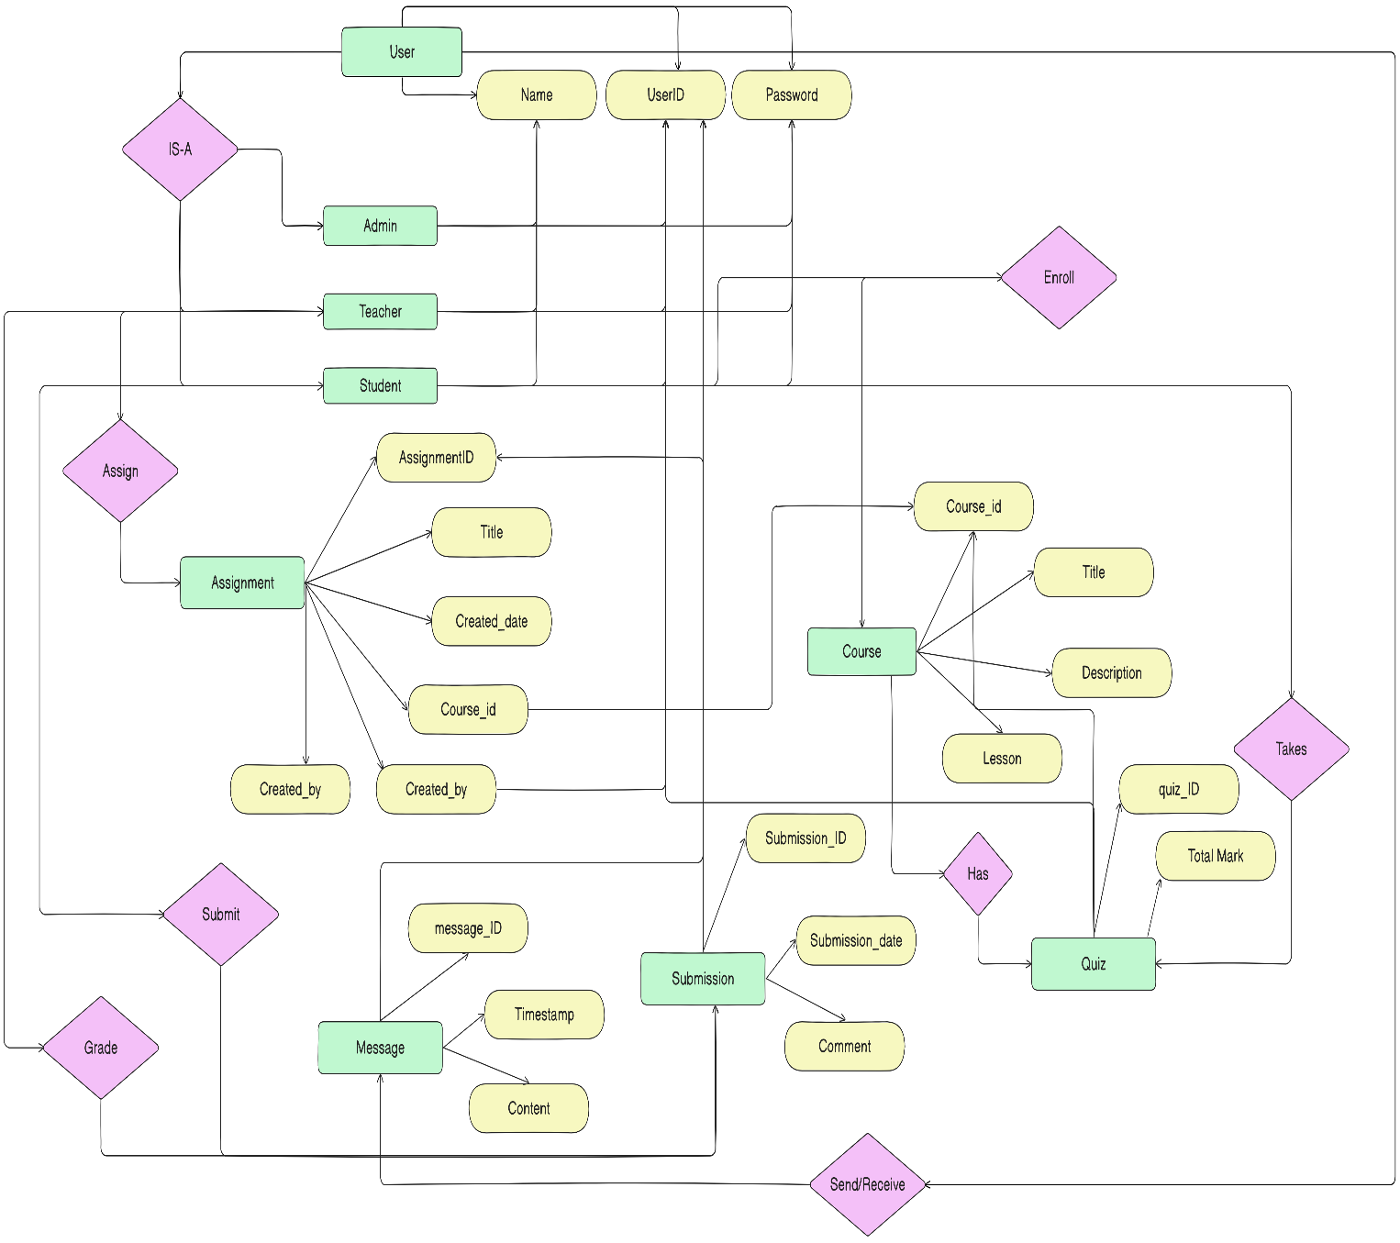
ER Diagram

Slide 7
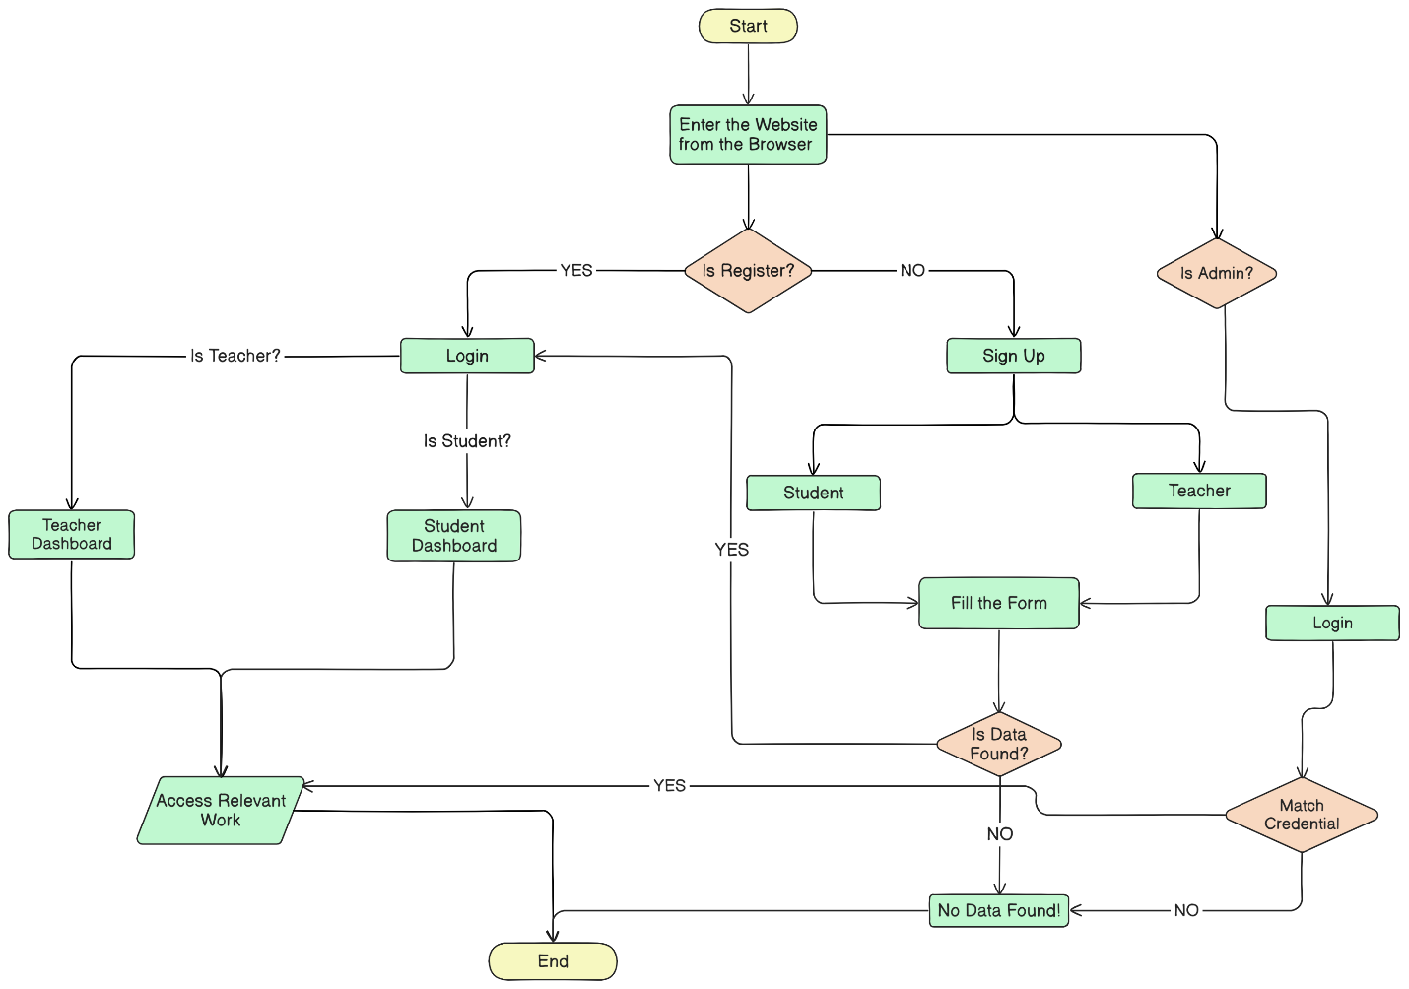
Flow Chart

Slide 8
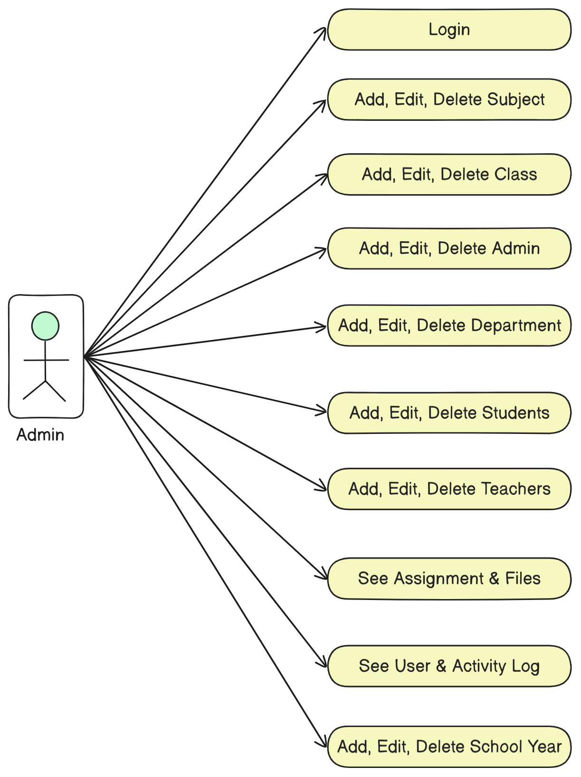
Use Case for Admin

Slide 9
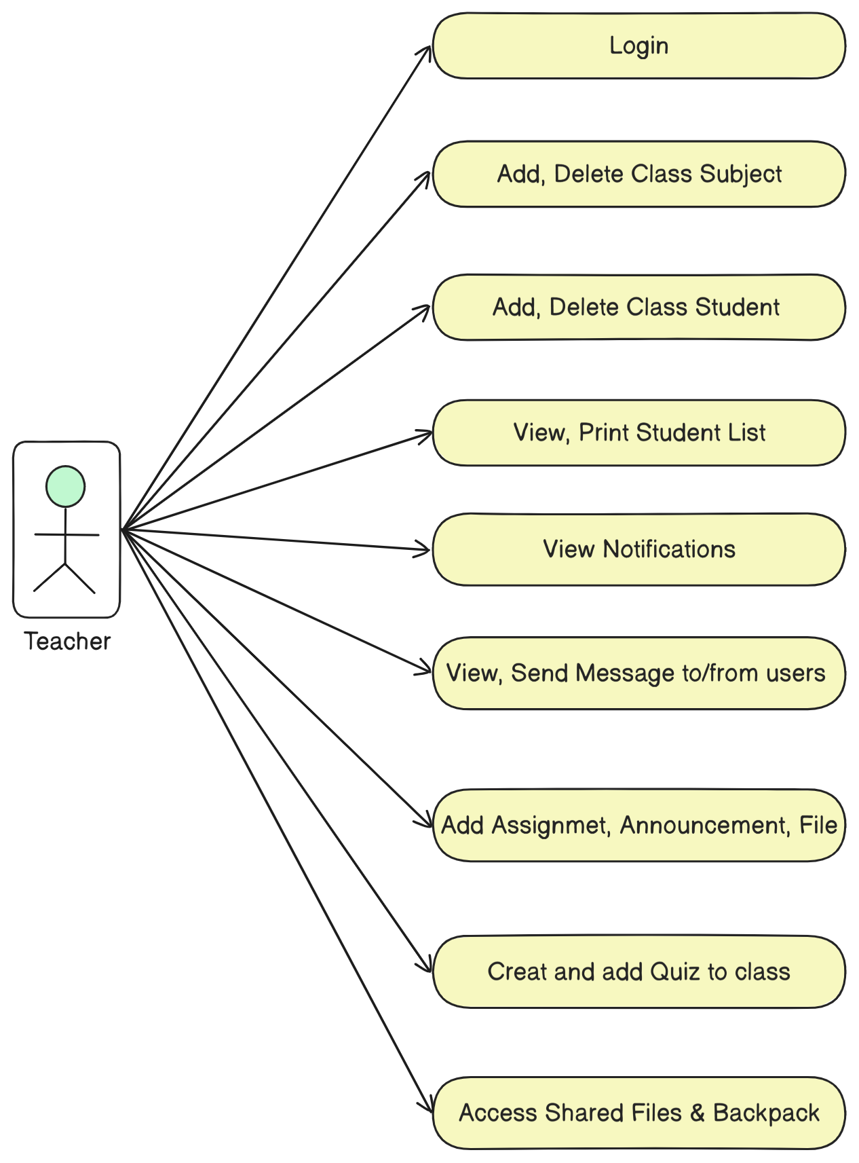
Use Case for Teacher

Slide 10
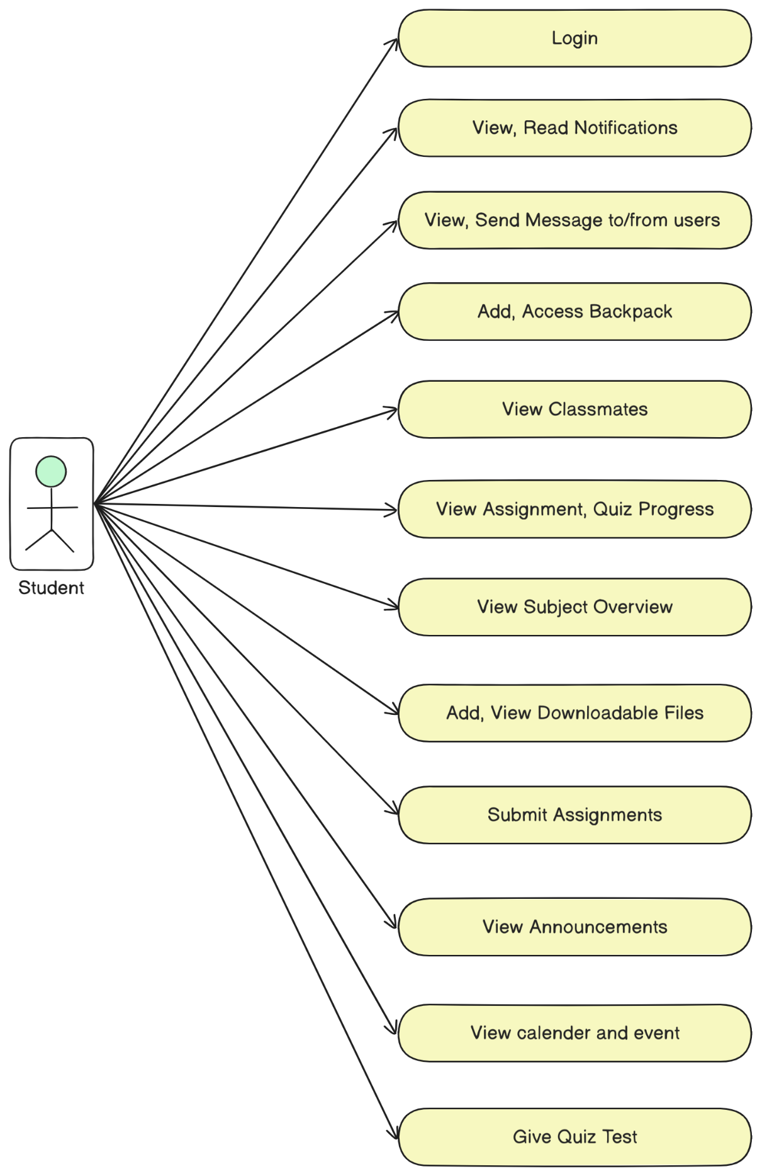
Use Case for Student

Slide 11
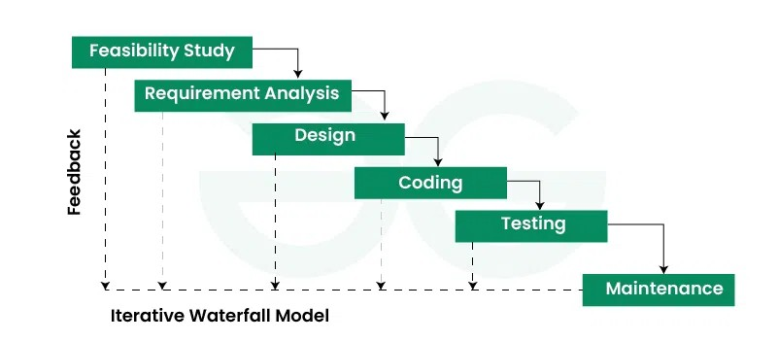
Methodology

Slide 12
Features and Functionalities
User Management
Course Enrollment & Management
Assignments & Quizzes
Automated Grading & Feedback
Discussion Forums & Messaging
Progress Tracking & Reporting.

Slide 13
Testing & Validation
Types of Testing:
Unit Testing
Integration Testing
System Testing

Slide 14
Deployment & Maintenance
Deployment Environment:
Localhost via XAMPP
Future scalability for cloud hosting.
Maintenance Strategies:
Regular updates & security patches.
Bug fixes & performance improvements.
User feedback integration.

Slide 15
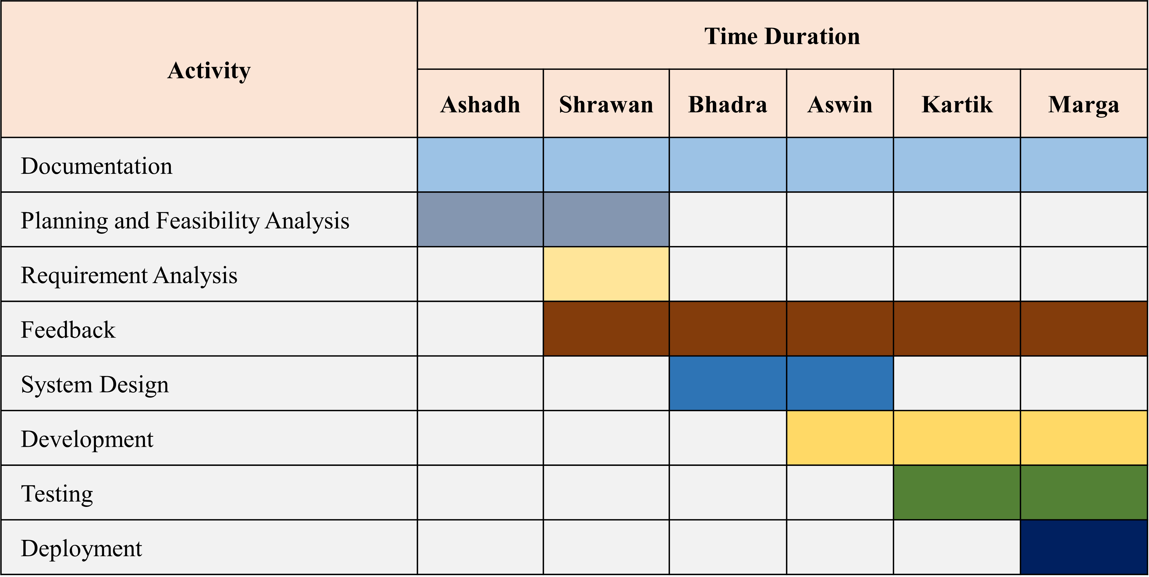
Gantt Chart

Slide 16
Conclusion & Future Enhancements
Impact of LMS:
Streamlined learning experience.
Reduced administrative workload.
Improved accessibility & collaboration.
Future Enhancements:
AI-driven personalized learning.
Cloud-based scalability.
Mobile app development.

Slide 17
Thank You!

