Slide 1
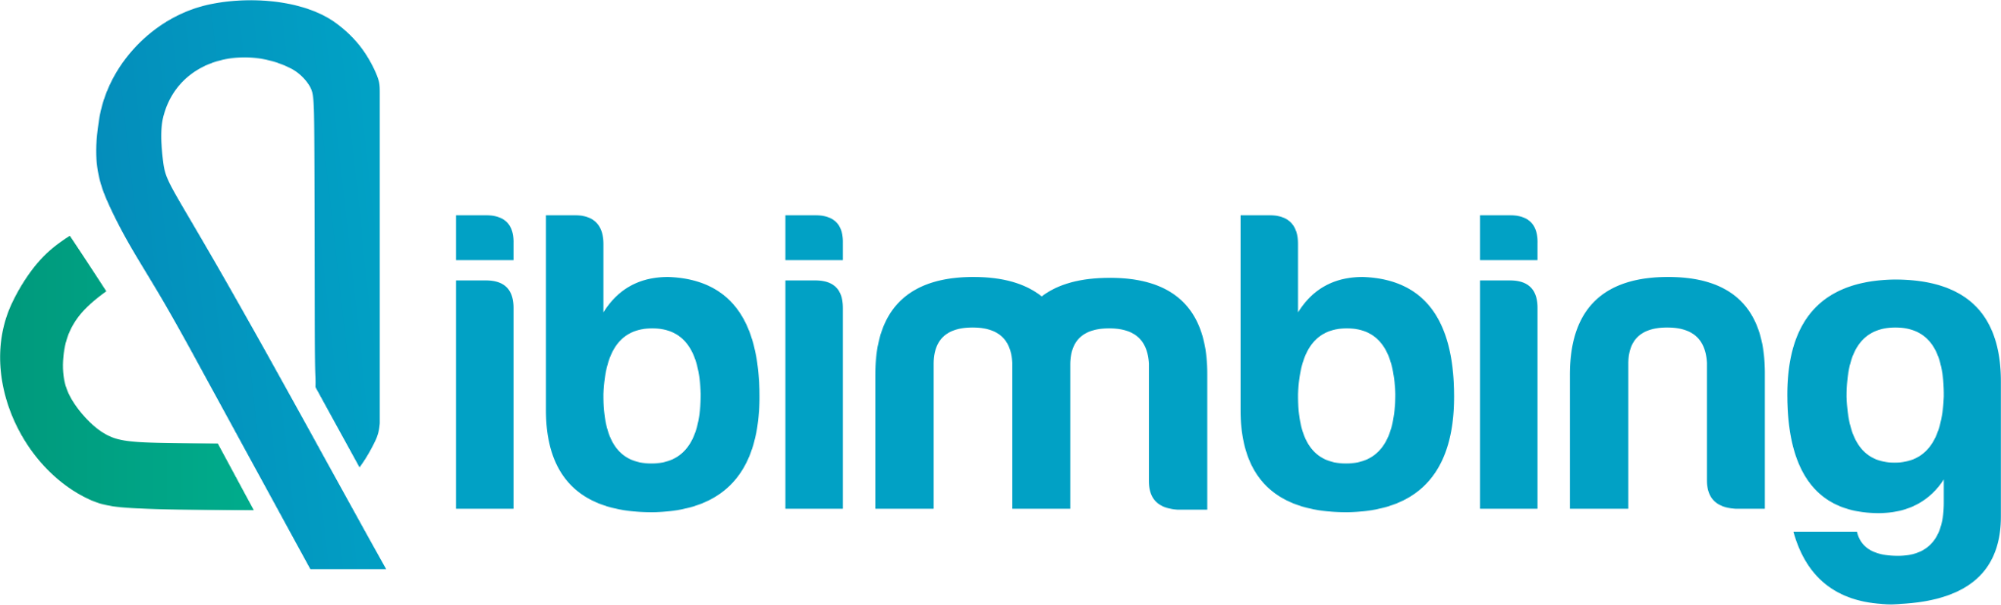
Marketing Analysis Campaign Performance DataTech Solution
Batch 32B | Bootcamp Data Science and Data Analyst

Slide 2
TABLE OF CONTENTS
Introduction
Previous projects
Main Project
Appendix

Slide 3
Introduction

Slide 4


Dimas Adi Prasetyo
Student
Data Scientist & Data Analyst
Experience
Education
Aug 2023 - Dec 2023
Game Development
Infinite Learning Indonesia
Present - Feb 2025
Data Science Bootcamp
dibimbing.id
Feb 2023 - Jul 2023
Machine Learning
Bangkit Academy
Aug 2024 - Jul 2020
Bachelor of Science in Informatics Engineering
Universitas Krisnadwipayana
LinkedIn: https://www.linkedin.com/in/dimasadiprasetyo

Slide 5
Previous projects

Slide 6

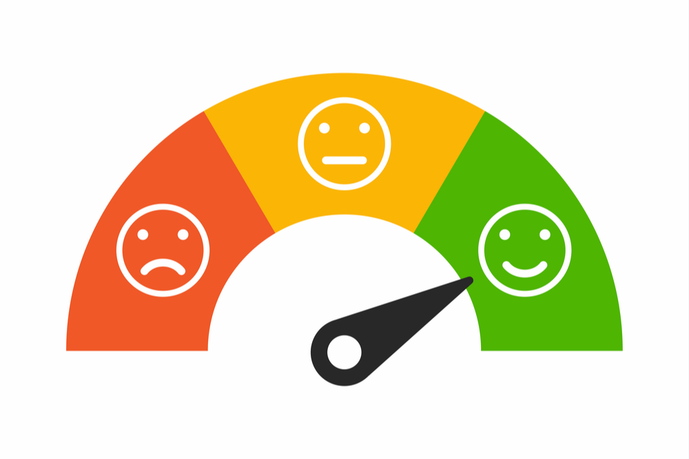
What I Have Learned in the Bootcamp
People Analytics (10 - 16 May 2025)
This project investigates employee job satisfaction using survey data collected from various departments within an organization. The goal is to uncover insights into the factors that influence satisfaction and to provide strategic recommendations for improving employee well-being. It aims to identify patterns and insights related to job satisfaction, work-life balance, workload, and training, and to present the findings through interactive visualizations and business recommendations.
https://github.com/Dadipp/People_Analytics
Customer Satisfaction & Sentiment Analysis (3 - 8 May 2025)
This project analyzes customer feedback data using sentiment analysis and CSAT/NPS metrics to evaluate service satisfaction. Key insights include customer loyalty trends, issue categories, and overall service perception over time. All findings are visualized through Power BI dashboards.
https://github.com/Dadipp/Customer_Satisfaction_and_Sentiment_Analysis

Slide 7
Main Project

Slide 8
Project Background
Analyze the effectiveness of each marketing channel to find out which channel is the most profitable and efficient, so that the company can allocate the marketing budget more precisely.

Slide 9
Business Objective
Main Objective
This project aims to analyze the effectiveness of marketing channels for DataTech Solutions to identify the most profitable and efficient ones, enabling optimized budget allocation time periods (2021).
Specific Objective
To achieve the main objective, there are several specific objectives to accomplish:
1. What are the average ROI, Conversion Rate, Click-Through Rate (CTR), and Engagement Score for each marketing channel ?
2. Which marketing channels perform best across different customer segments?
3. Which customer segments and marketing channels yield the highest ROI and Engagement Scores, as well as the best Conversion Rates?
4. How does Acquisition Cost correlate with campaign outcomes such as ROI, CTR, and Conversion Rate across different channels?
5. What insights can be derived from comparing channel performance metrics (ROI, Engagement Score, CTR, Conversion Rate) to optimize future campaigns?

Slide 10
Data Understanding
Collected from an internal marketing dataset company DataTech Solution, focusing on marketing campaign performance analysis across various channels.
Includes campaign details, channel usage, customer segments, and performance metrics such as ROI, Conversion Rate, Clicks, Impressions, and Engagement Score.
Covers data 2021, Contains 40,012 transaction records and 16 columns.

Slide 11






Channel
Email
Facebook
Google Ads
Instagram
Website
Youtube

Slide 12
Data Preprocessing
Step 1
Step 2
Step 3
Step 4
Step 5
Removing Duplicate
Handling missing values
Outlier Check
Transformasi Data
Saving preprocessed
data for the dashboard
Numerical data transform Acquisition_Cost to numeric
No duplicate data
No missing data
No extreme outlier
csv cleaned data ready to use

Slide 13
Data Preprocessing Result
200,000
Data
16
Columns
40,012
Cleaned Data
16
Columns
Data Preprocessing

Slide 14


Result and Insight
What are the total and average values related to campaign performance metrics?
Insight :
High Total Conversions (40K): Reflects strong customer response to campaigns, indicating high conversion potential and effective channel targeting.
Average CTR of 14.08%: Shows decent campaign attraction level. Further improvement may be achieved through enhanced audience segmentation and creative optimization.
Efficiency Score of 124: Indicates excellent resource utilization. Channels with high efficiency scores should be prioritized in future budget planning.
Strong ROI (40K): Suggests substantial returns from marketing investments, confirming the success of current channel strategies.
High Engagement (26K): Demonstrates solid customer interaction. High-engagement channels are valuable for retention campaigns and brand awareness.
Low Average CPC (3K): Low cost per click highlights cost-efficiency, allowing for broader campaign reach at minimal spend.

Slide 15
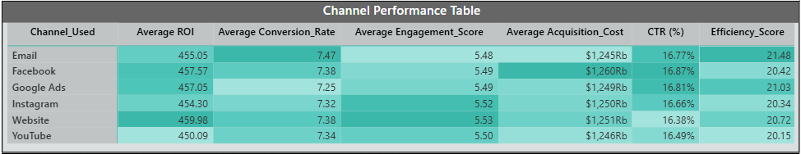
Result and Insight
What are the total and average values related to campaign performance metrics channels for DataTech Solutions?
Insight :
The performance metrics across marketing channels show only minor variations, suggesting a balanced outcome. For example, the difference between the highest and lowest average ROI is just 9.89 points—from 459.98 (Website) to 450.09 (YouTube). Similarly, Conversion Rate (7.47% to 7.25%) and CTR (16.87% to 16.38%) also show minimal gaps. Even the Efficiency Score varies only slightly (from 21.48 to 20.15), indicating no channel significantly outperforms or underperforms the others.
These small margins suggest that all channels contributed relatively evenly, with no clear dominant platform. Thus, strategic decisions should focus less on metric comparisons and more on channel alignment with campaign goals, audience fit, and cost-efficiency.
In conclusion, the data supports adopting a multi-channel strategy, leveraging each platform’s strengths based on context and objectives, rather than relying solely on top-line metrics.

Slide 16
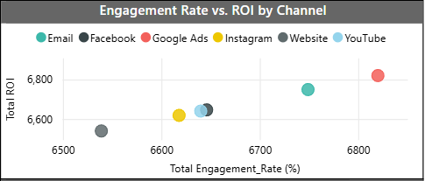
Result and Insight
What are the relationships between Engagement Rate and ROI across marketing channels, and which channels deliver the best balance of audience interaction and returns?
Insight :
Google Ads stands out with the highest engagement rate and strong ROI, making it the most balanced and effective marketing channel overall.
Email delivers a well-balanced performance with high ROI and solid engagement, indicating consistent and cost-efficient campaign results.
Facebook and YouTube have relatively low engagement rates but maintain competitive ROI, suggesting these platforms are good for awareness but need improved interaction strategies.
Instagram and Website appear in lower ROI and engagement zones, indicating the need for optimization in content strategy or audience targeting.

Slide 17
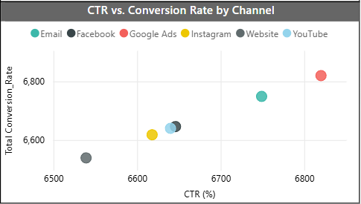
Result and Insight
How do marketing channels perform in terms of Click-Through Rate (CTR) and Conversion Rate, and which channels demonstrate the strongest ability to convert audience interest into action?
Insight :
Google Ads ranks highest in both CTR and Conversion Rate, indicating its strong ability to attract clicks and convert them into meaningful actions. This reflects effective ad content and precise targeting.
Email comes next with high conversion performance and solid CTR, making it a reliable channel for consistent conversion.
Instagram, Facebook, and YouTube cluster in the middle range, suggesting moderate performance that could be enhanced with content or targeting improvements.
Website shows the lowest performance in both CTR and Conversion Rate, suggesting a need to revisit its strategy or refine the target audience.

Slide 18
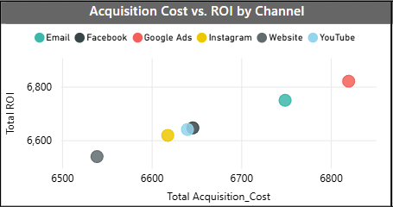
Result and Insight
How does Acquisition Cost relate to ROI across marketing channels, and which channels deliver the highest returns relative to their cost?
Insight :
Google Ads delivers the highest ROI despite the highest acquisition cost, indicating that investments in this channel are highly profitable.
Email stands out as the most cost-efficient channel, achieving high ROI with relatively lower acquisition costs, making it a strategic choice for scaled campaigns.
Instagram, Facebook, and YouTube are positioned in the middle range, suggesting moderate ROI performance that may still justify their costs depending on campaign goals.
Website shows the lowest acquisition cost but also the lowest ROI, implying that low cost does not necessarily translate to high value, and content or targeting strategies might need improvement.

Slide 19
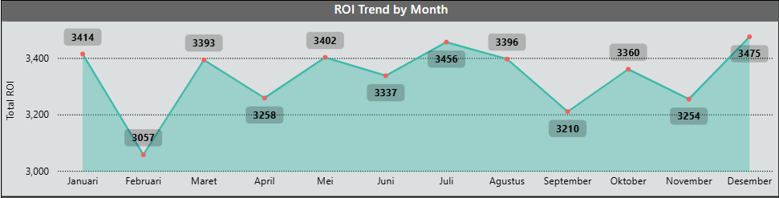
Result and Insight
How does ROI fluctuate month-to-month, and what patterns can be observed to inform strategic campaign timing throughout the year?
Insight :
December shows the highest ROI (3,475), indicating strong end-of-year campaign performance. This highlights a key opportunity for seasonal or holiday marketing strategies.
July and May also recorded high ROI values, making them favorable months for launching major campaigns or boosting promotional efforts.
February had the lowest ROI (3,057), likely reflecting post-holiday slowdown. This period may benefit from either reduced spend or adjusted targeting strategies.
Overall, ROI demonstrates a bi-monthly fluctuation pattern, suggesting that campaign planning should align with market seasonality and consumer behavior.

Slide 20
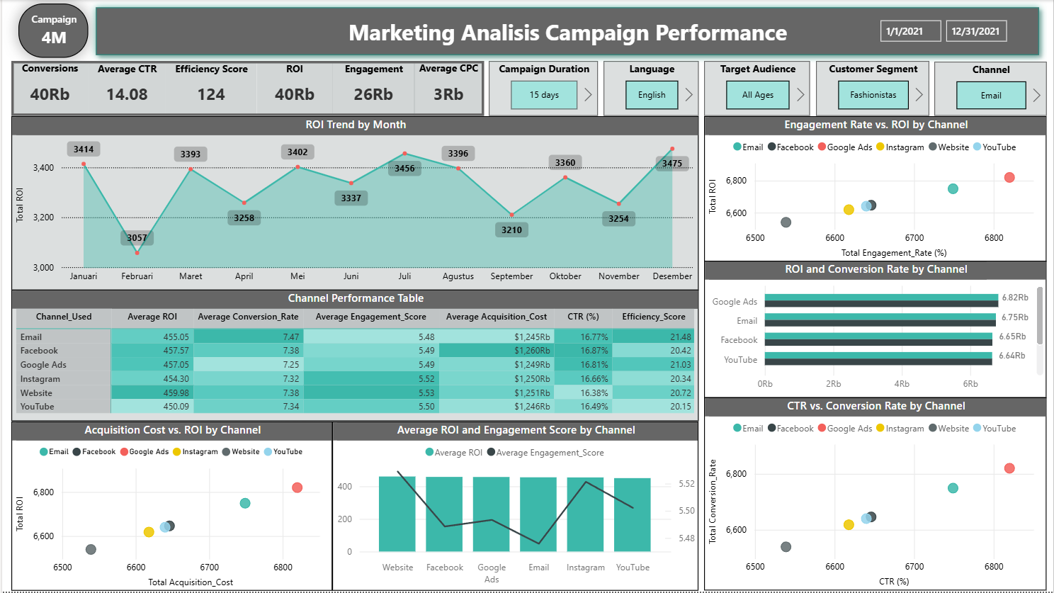
Visualisasi Dashboard

Slide 21
Recommendations
Strategic Recommendations to Improve Marketing Performance Based on Campaign Insights:
Prioritize High-Performance Channels: Allocate more budget to channels like Google Ads and Email, which show strong ROI, CTR, Conversion Rate, and Engagement.
Improve Content Strategy on Underperforming Channels: Revise content quality, visual appeal, and targeting for Instagram, YouTube, and Website to boost efficiency and engagement.
Capitalize on Seasonal ROI Trends: Schedule major campaigns in peak ROI months (May, July, December) and optimize resources in low-performing periods like February.
Optimize Ad Creative and Targeting: Use Google Ads’ successful strategies (precise targeting, strong ad copy) to improve CTR and conversions across other channels.
Monitor Efficiency Scores for Budget Planning: Prioritize channels with high Efficiency Scores (e.g., Email, Facebook) to ensure optimal resource allocation.

Slide 22
Appendix

Slide 23
Link
Dashboard: DS32B_Finpro_DA_Marketing_Analisis_Campaign_Dimas.pbix
Preprocessing: DS32B_Finpro_DA_Marketing_Analisis_Campaign_Dimas.ipynb

Slide 24
Terima
Kasih

Slide 25
Result and Insight
What are?
Insight:

Slide 26
Key Relevant Variables:
ROI: Target variable, measures the return on investment for each campaign.
Conversion_Rate: Conversion rate of the campaign, indicates the percentage of successful conversions.
Engagement_Score: Scale 1-10, measures customer engagement level (numeric).
Channel_Used: Marketing channel used for the campaign.
Customer_Segment: Target customer segment.
Acquisition_Cost: Cost incurred to acquire customers through the campaign (in USD).
Clicks: Number of clicks generated by the campaign, proxy for campaign reach.
Impressions: Number of impressions generated by the campaign, indicates visibility.
Duration: Campaign duration.
Date: Date of the campaign (datetime, range 2021-01-01 to 2021-12-11), indicates the campaign timeline.

