Slide 1
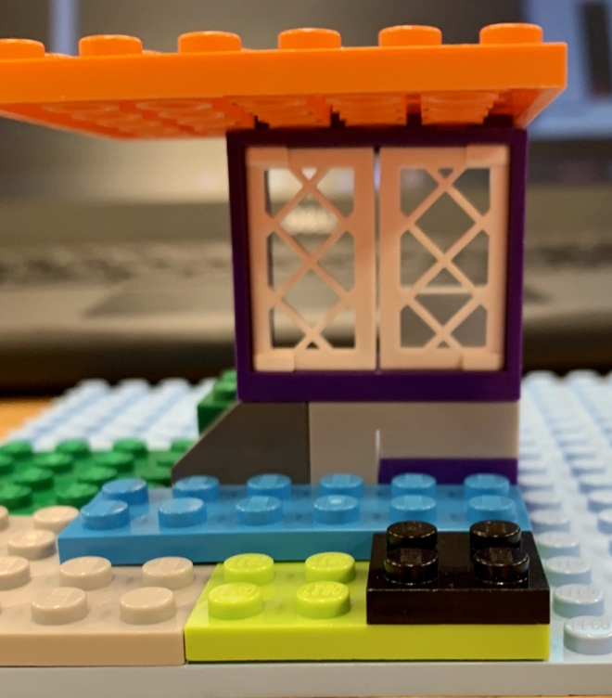
Cabana
Included are instructions to create your own cabana. The skill level required is beginner.

Slide 2
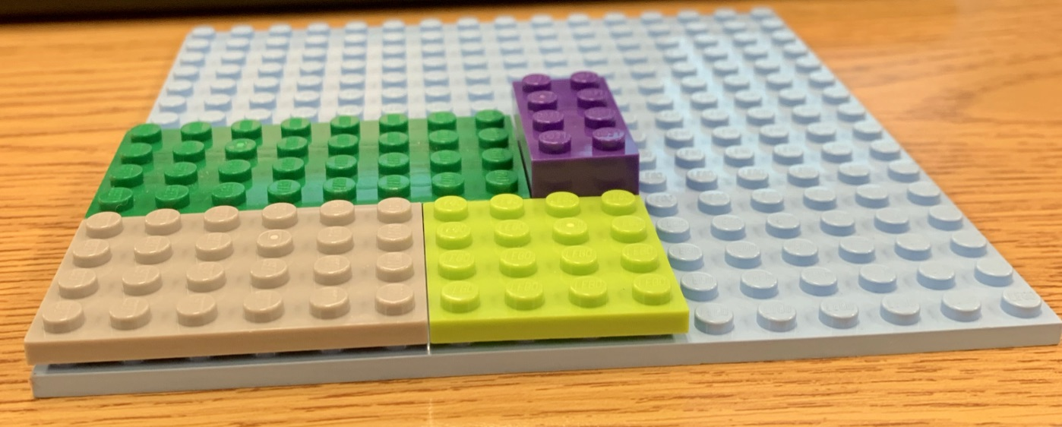
Step 1
Place the shown pieces as shown
Hint: There are 5 pieces

Slide 3
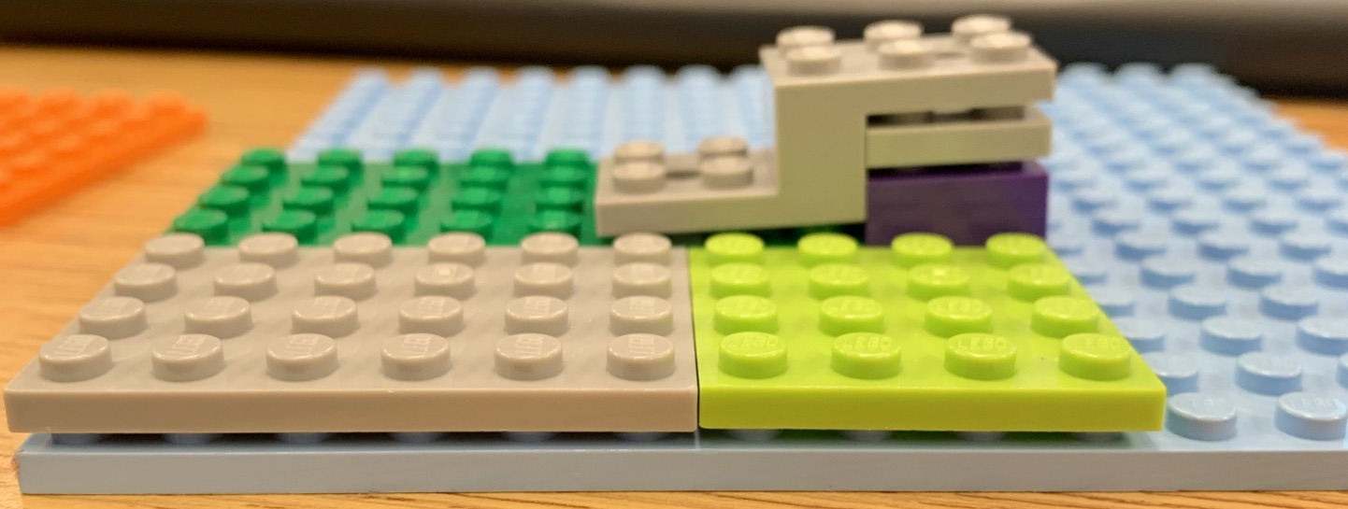
Step 2
Place one piece on top of the purple piece
Then take the other piece and place it on top of both the purple and newly added piece to overlap the green piece

Slide 4
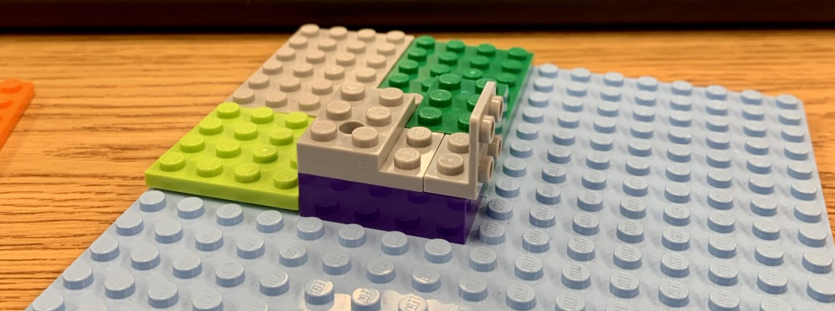
Step 3
Add “L” shaped piece with the smallest side attached to the edge of the purple piece
Add the green 3X2 behind “L” shape on top of green

Slide 5
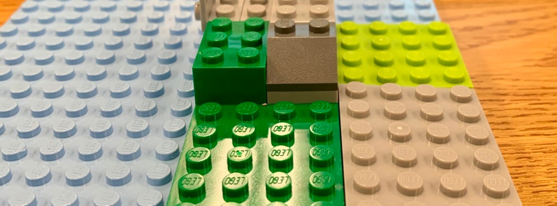
Step 4
Add tall grk
Add slanted piece

Slide 6
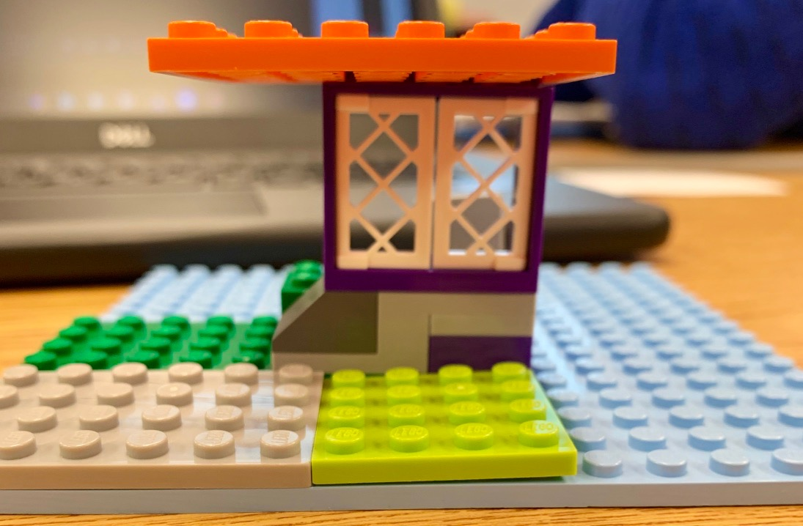
Step 5
Add window piece
Add orange awning piece

Slide 7
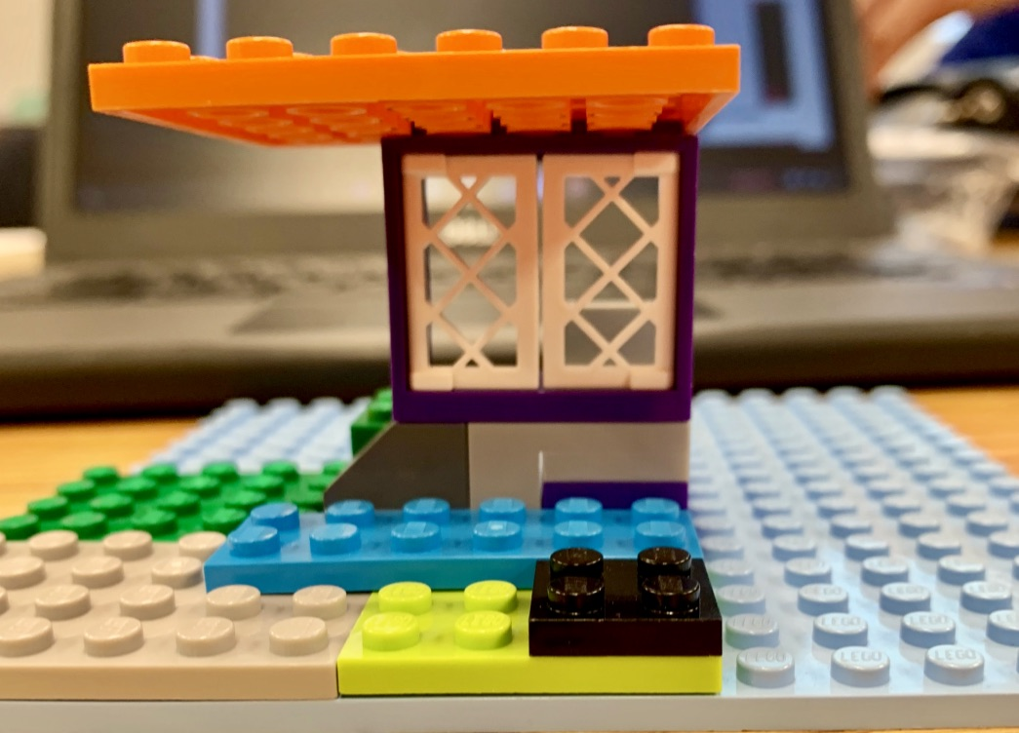
Step 6
Add blue rug
Add black stepping stone

Slide 8
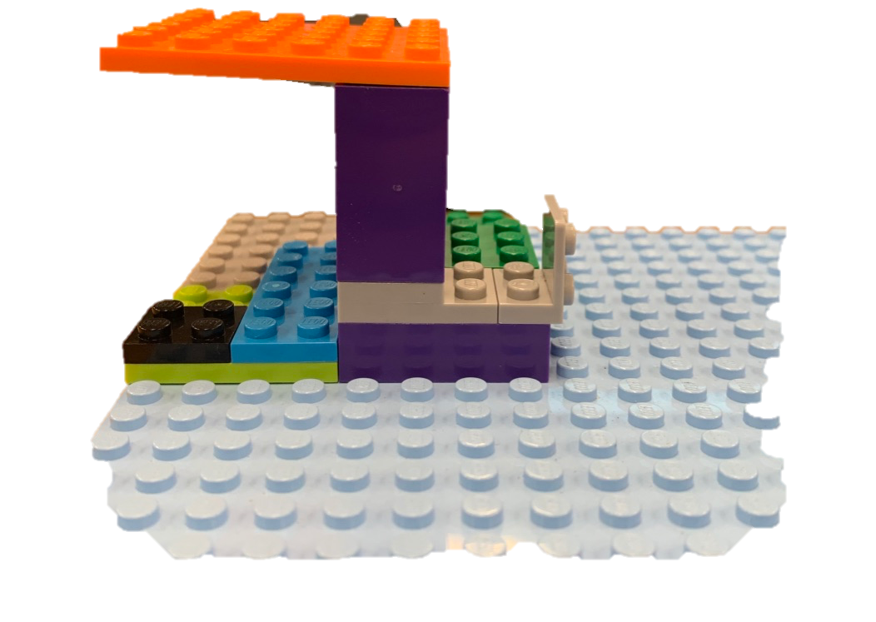
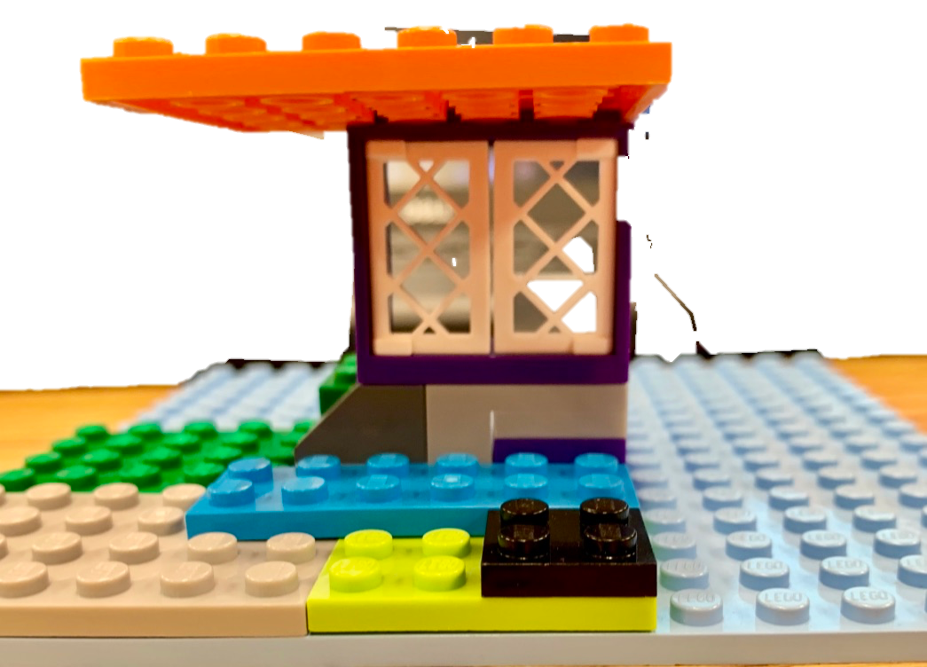
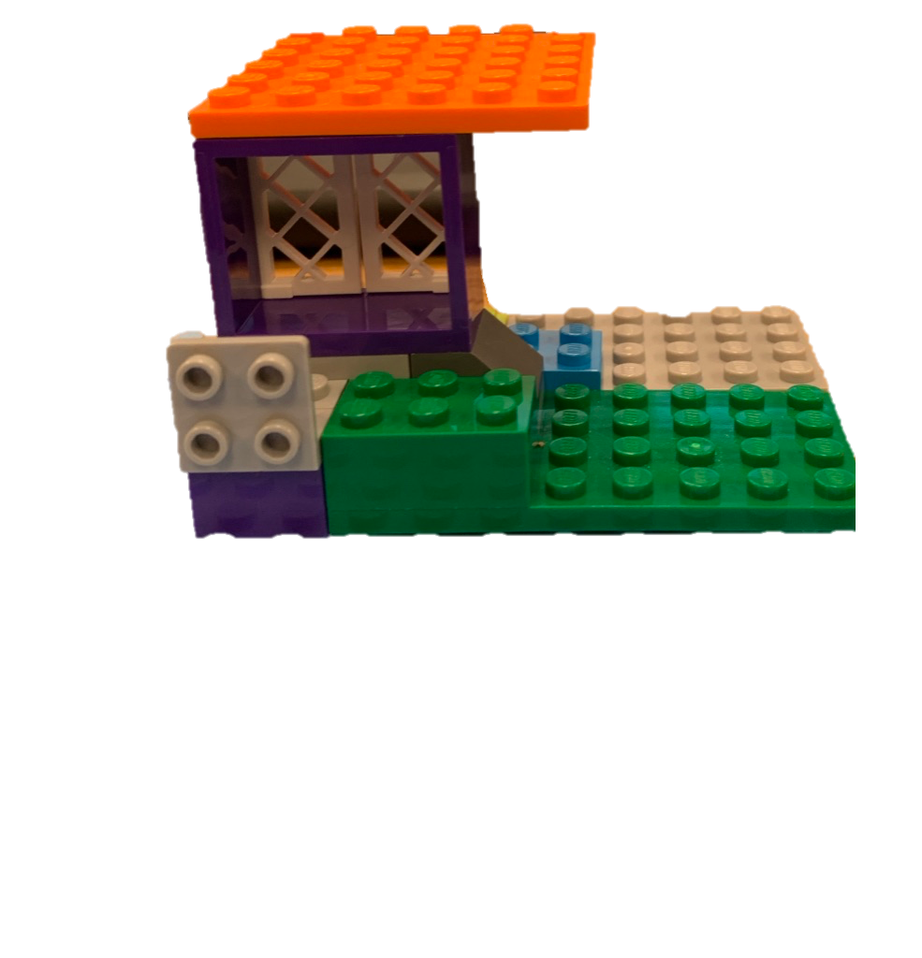
Congratulations! You’re complete!

Slide 9

Created by
Megan M Koenig
For your enjoyment and English 235 Winter 2020

