Slide 1


FPGA Capstone
Paper Presentation
Partial dynamic reconfiguration framework for FPGA: A survey
with concepts, constraints and trends
T. Siva Sankar Phani, Anitha Arumalla, M. Durga Prakash
Keywords: Dynamic Reconfiguration, Reconfiguration controller
Accepted 26 January 2021
http://www.elsevier.com/locate/matpr

Slide 2
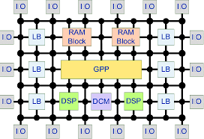
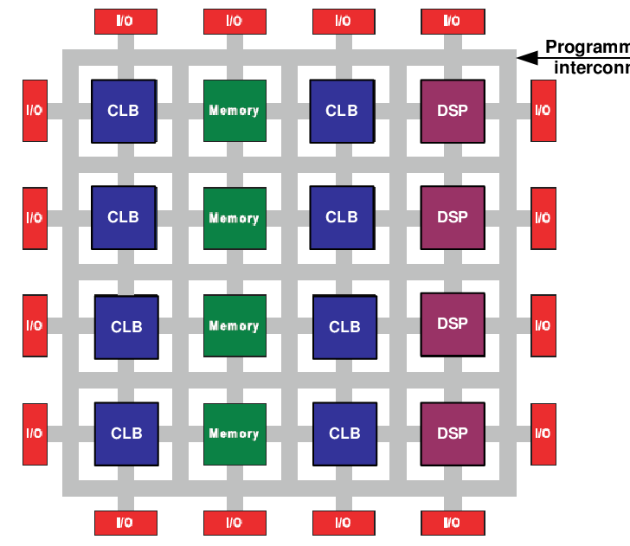
What is a FPGA
FPGA stands for Field Programmable Gate Array
An FPGA operates by configuring its Look-Up Tables (LUTs) to implement logic functions, using memory devices for state storage, and interconnecting via a reconfigurable routing fabric. These components enable custom hardware designs, executed in parallel, tailored for specific tasks, with clock management and I/O blocks facilitating system integration.

Slide 3
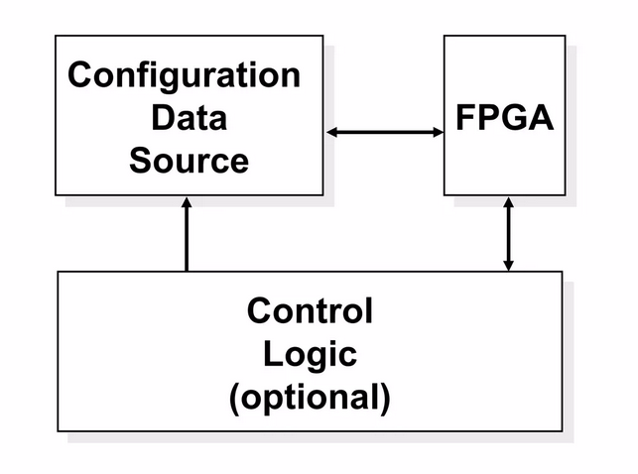
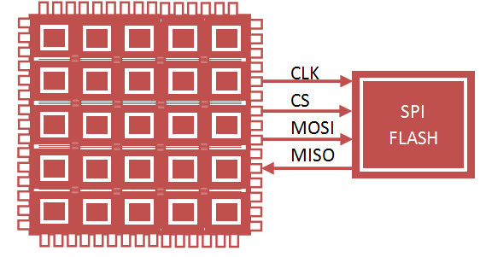
What is a FPGA Configurations?
FPGA configuration is the process of programming the device to realize a specific hardware design, defining its intended functionality.
This involves loading a bitstream—a binary file generated from a hardware description language (HDL) design—onto the FPGA.
The configuration defines the operations of LUTs, routing fabric, flip-flops, and other resources, enabling the desired behavior.

Slide 4
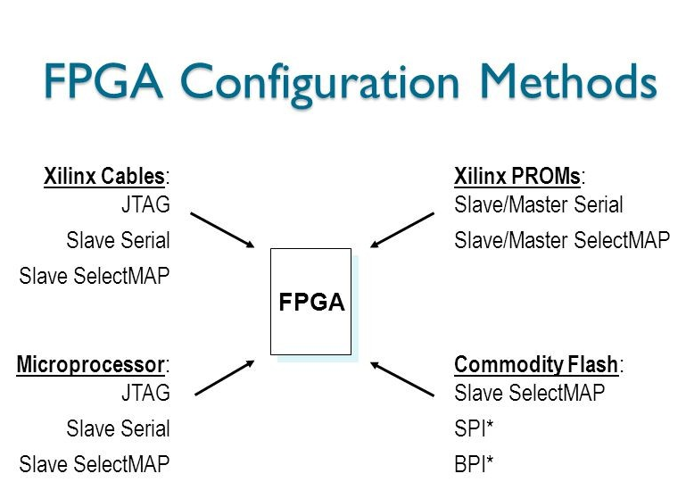

Slide 5
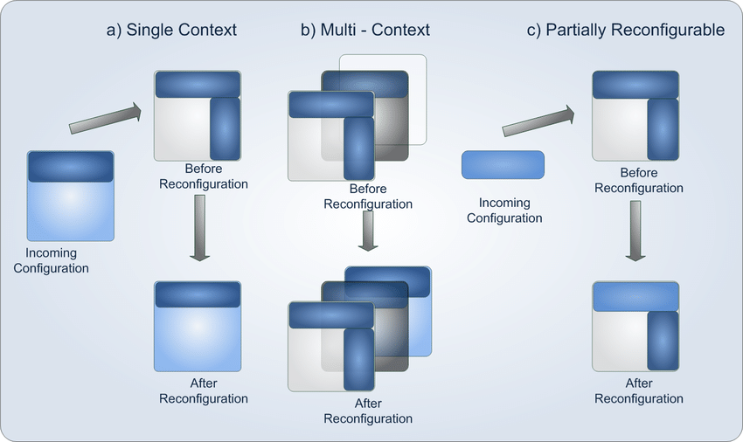
What is Reconfiguration?
Reconfiguration in general computing involves modifying software, system settings, or hardware to adapt to new requirements or optimize performance.
This process includes updating software configurations, adjusting system parameters, or reallocating resources such as in cloud or virtualization environments.
Reconfiguration enables improved flexibility, scalability, and responsiveness to dynamic workloads or functional changes.

Slide 6
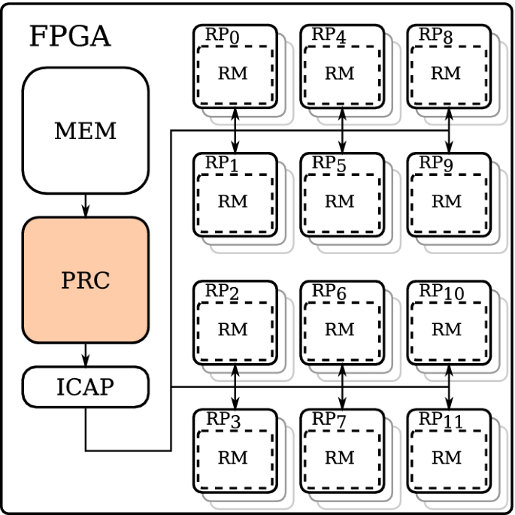
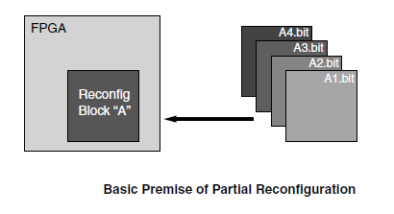
What is a FPGA Reconfiguration?
Reconfiguration in FPGA refers to altering the device's hardware functionality by loading a new or updated bitstream.
This process involves either full reprogramming (static reconfiguration) or modifying specific regions (partial reconfiguration) while keeping other parts operational.
FPGA reconfiguration supports hardware-level adaptability, optimizing performance and enabling real-time task switching or system upgrades.

