Slide 1
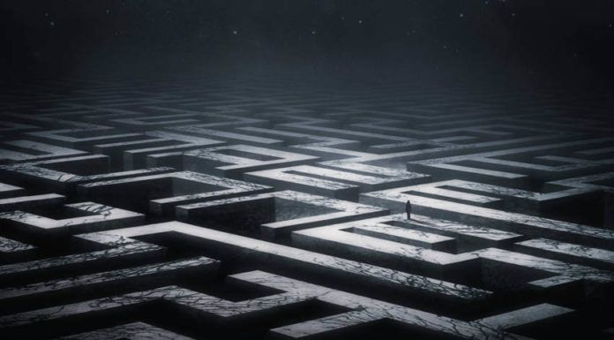

Daedalus
Fears Are Made To Overcome.

Slide 2
The Aim Of The Game
What Are You Doing?
Why Are You Doing It?
How Are You Doing It?
Facing Your Fears in a labyrinthian nightmare.
To finally get a good nights rest.
To overcome his problems in life.
Solving complex puzzles as you try to make it through the night.

Slide 3
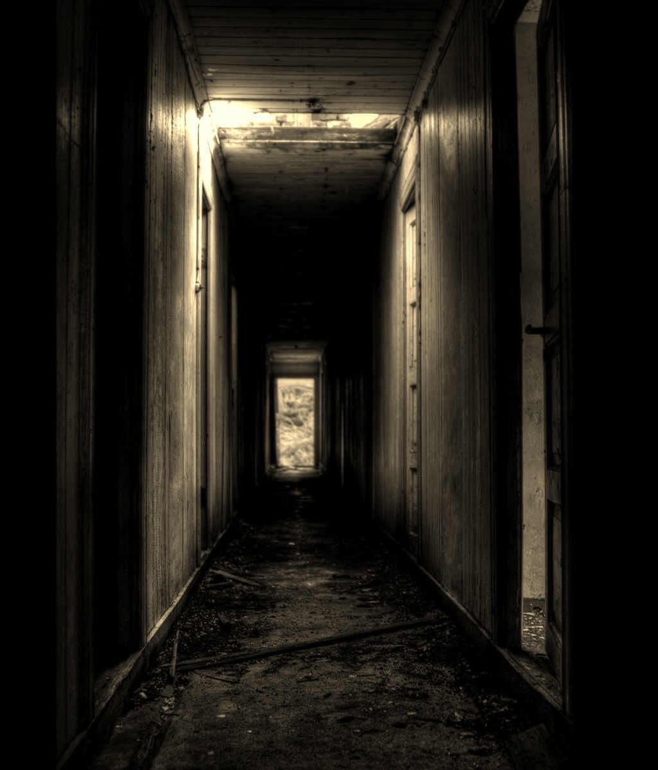
What To Expect
Playstation 4, Xbox One, Pc (Switch in the future)
Horror/Puzzle
Release Date: TBC
DLC will be released 3 months after launch.
Single Player, PvE and PvT
Game length depends on player skill.

Slide 4
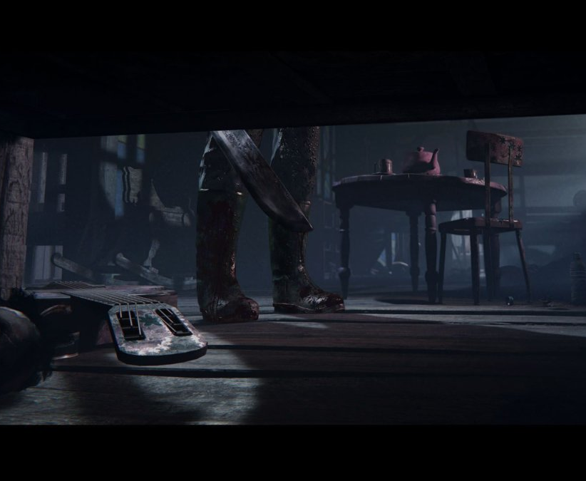
Gameplay Mechanics
Stuck Walking(Can’t Run From Problems)
Jumping(To get over obstacles)
Crouching(For Hiding)
Opening Doors
Picking up objects(Keys)
Pushing objects
Flashlight(Outlast)

Slide 5

Specific Features
Solve Puzzles around the labyrinthian house
Specific Length of Time for each Day(chosen by Player)
Time is adjusted based on number of attempts and progression.
Passive Combat through movement.
Child has a nightmare each night and must survive them.
Ghost chaser will speed up his walking pace if he takes to long to solve a puzzle.

Slide 6

Storyline
A Young Boy Faces daily challenges.
Each Night, he overcomes them by facing them in his nightmares.
He must complete a puzzle each night to defeat his fear on that day.
The boy is the creator of his own nightmares.

Slide 7

Main Characters
Young Boy(Daedalus)
Ghost Chaser

Slide 8
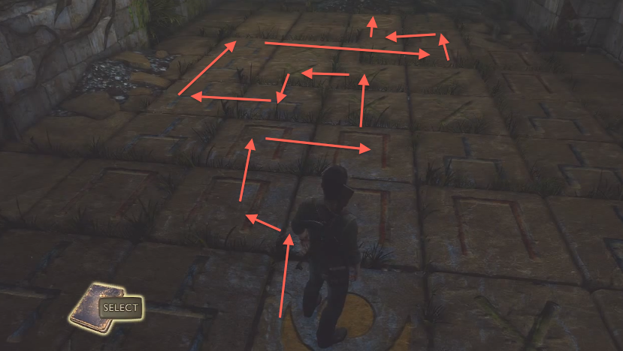
Puzzles
You must find the room with your fear.
Then…..
You must find a key in that room without getting caught.
It’s not that easy. You must traverse obstacles and figure out where it is.
Then….
You must find your bedroom and use the key to get in.

Slide 9

Aesthetics
Facing Fear
Closure
Sympathy
Revenge
Problem Solving
Empowerment

Slide 10
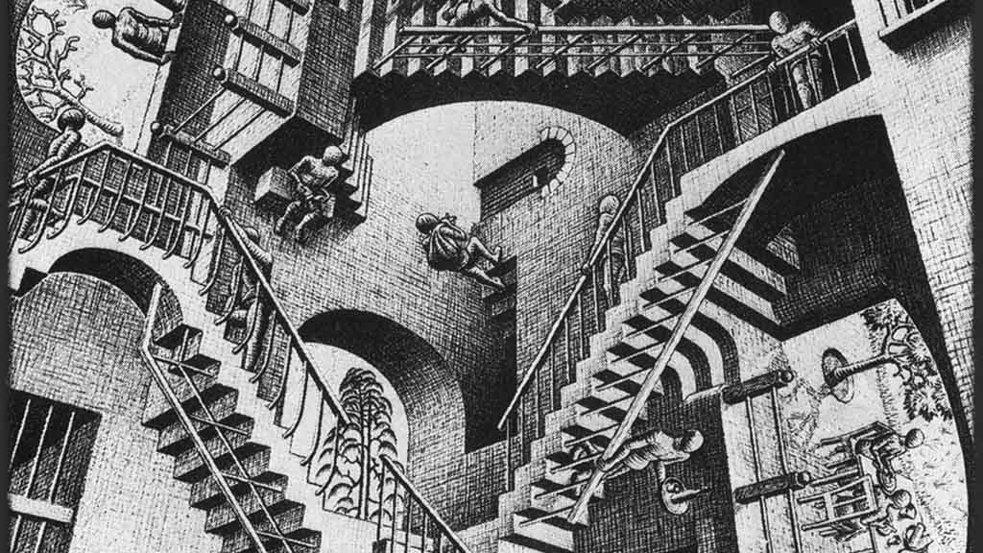
Questions on our AWESOME game?

