Slide 2
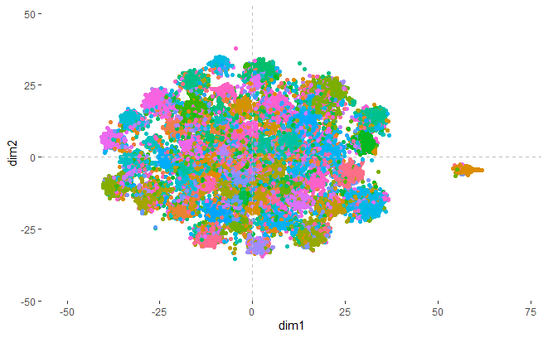
p200

Slide 3
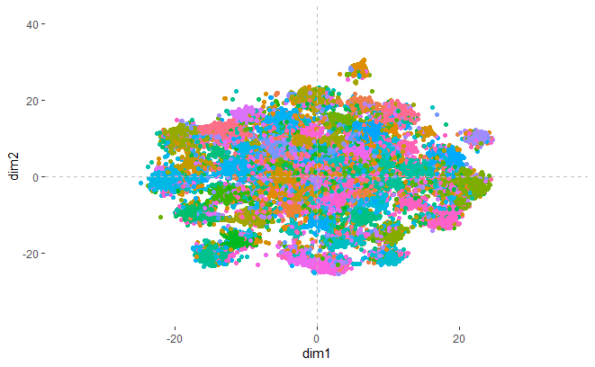
p500

Slide 4
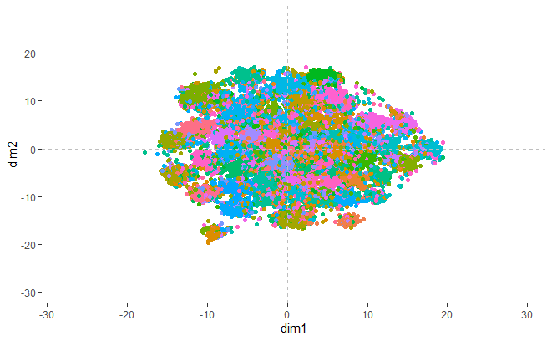
p1000

Slide 5
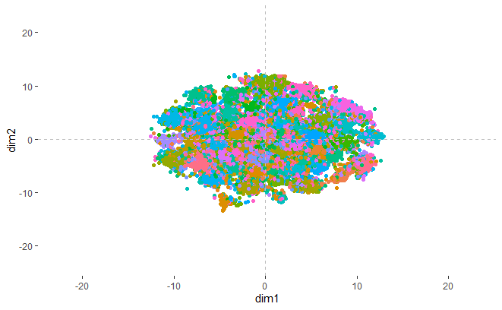
p2000

Slide 6
ghg ggb<jloidewflpojkljhklhlkjlseykkikkkl

