Slide 1
Media Software Engineering
Milestone 1
Team GOGUMA

Slide 2
Contents
1. Idea Description & Motivation
2. Game Features
3. Technology & Tools
4. Product Backlog
5. Project Plan
6. Work Division

Slide 3
Idea Description & Motivation

Slide 4
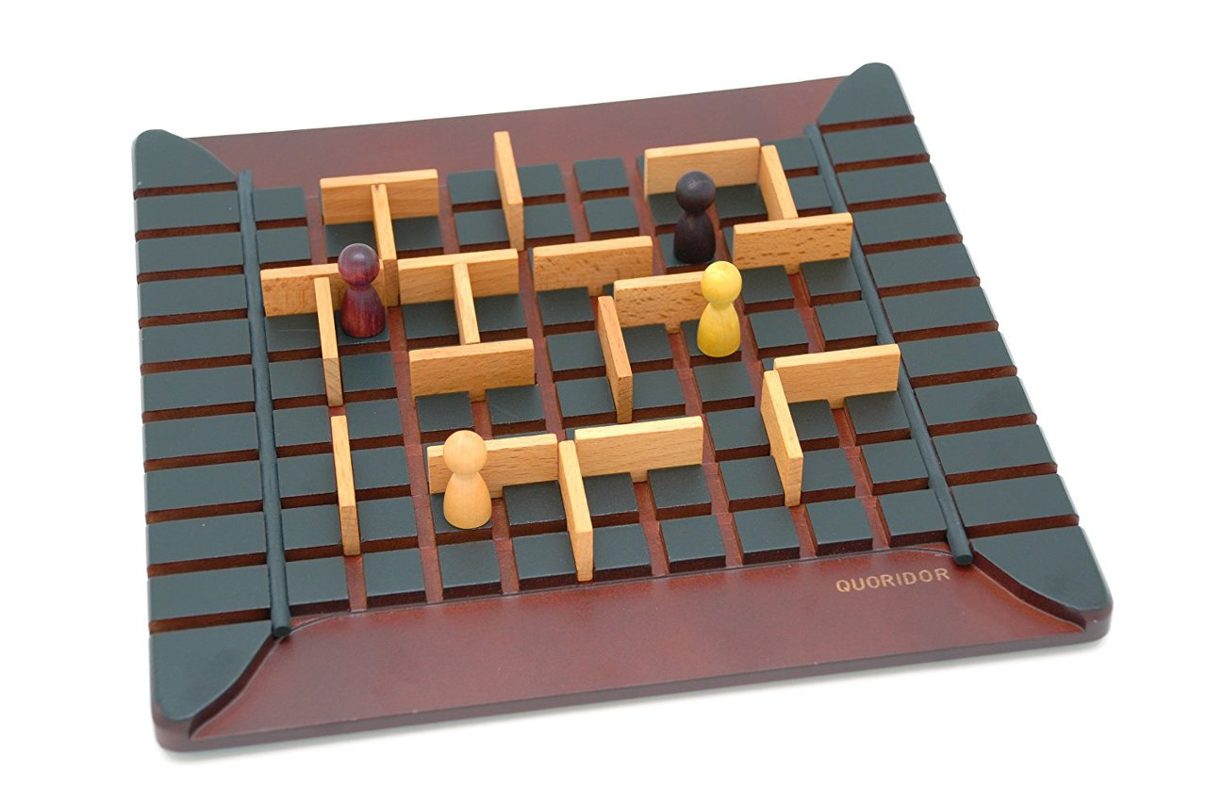
Idea Description
Game Idea ?
Quoridor board game
A popular board game worldwide
Classic and formal design

Slide 5
Idea Description
???
Game Idea ?
Upgrade an existing Quoridor board game with a different theme.
->

Slide 6
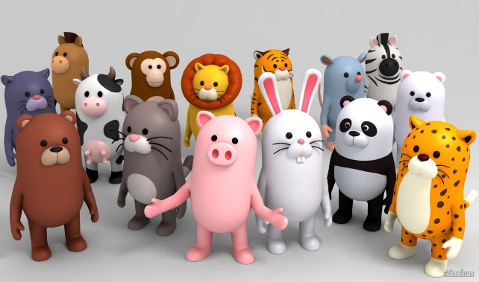
Idea Description
Game Idea ?
Anido
Friendly image and casual theme
Enjoyed by anyone
PC platform Casual Strategy Board game

Slide 7
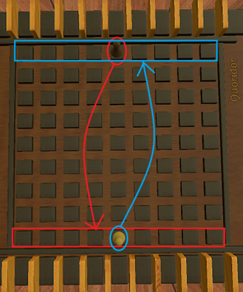
Idea Description
Game Idea ?
Anido
Rule
17x17 main board
2 or 4 players play with 10 obstacles each
Each player places character in the middle of the first row in front of player side.
Players select one of the following actions per turn:
- Move characters
- Set up one obstacle
Winning Condition
Placing character to any tiles in the opponent's front row

Slide 8
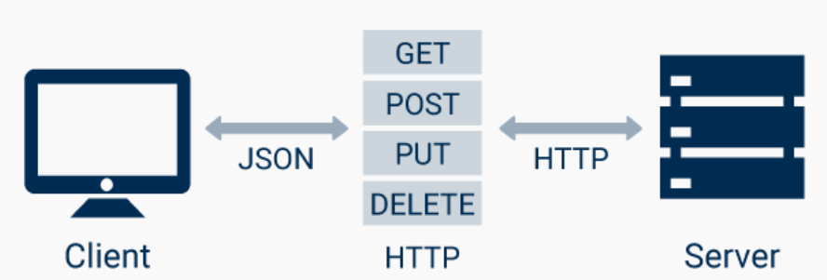
Idea Description & Motivation
Why Anido ? : Implementation
Switching turns between players would be a good idea to utilize the REST API
-> We chose a turn-based strategy board game.

Slide 9
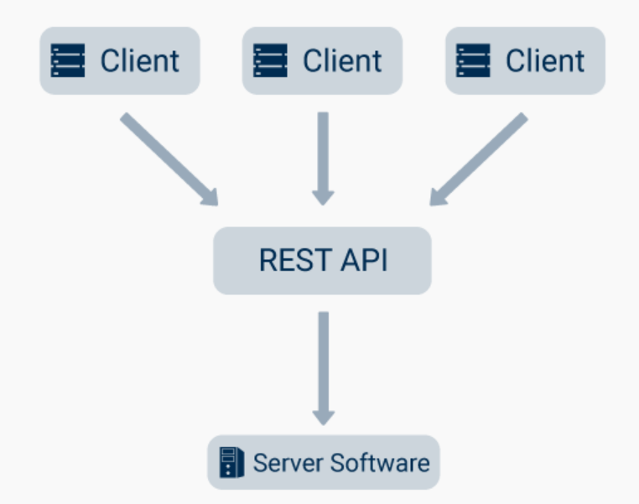
Idea Description & Motivation
Why Anido ? : Implementation
When a player ends their turn
by placing their character or obstacle where they want it,
the data is sent to the server and
the other player receives the data from the server.

Slide 10
Idea Description & Motivation
Why Anido ? : Approachable
Choose a casual theme to make it more approachable than traditional Quoridor games.
-> We chose a theme that utilizes nature and animals.
Map : Planning custom with Unity 3D
Objects : Nature Objects Unity Assets
Characters : Animals Unitiy Assets

Slide 11
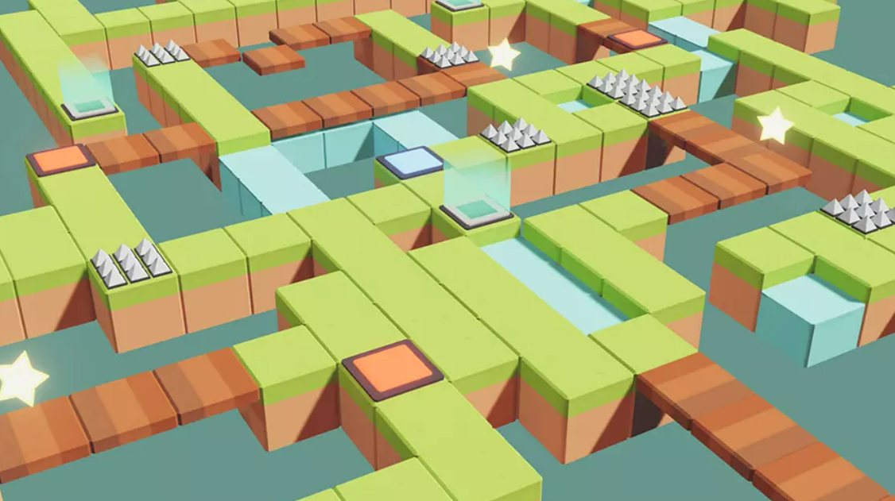
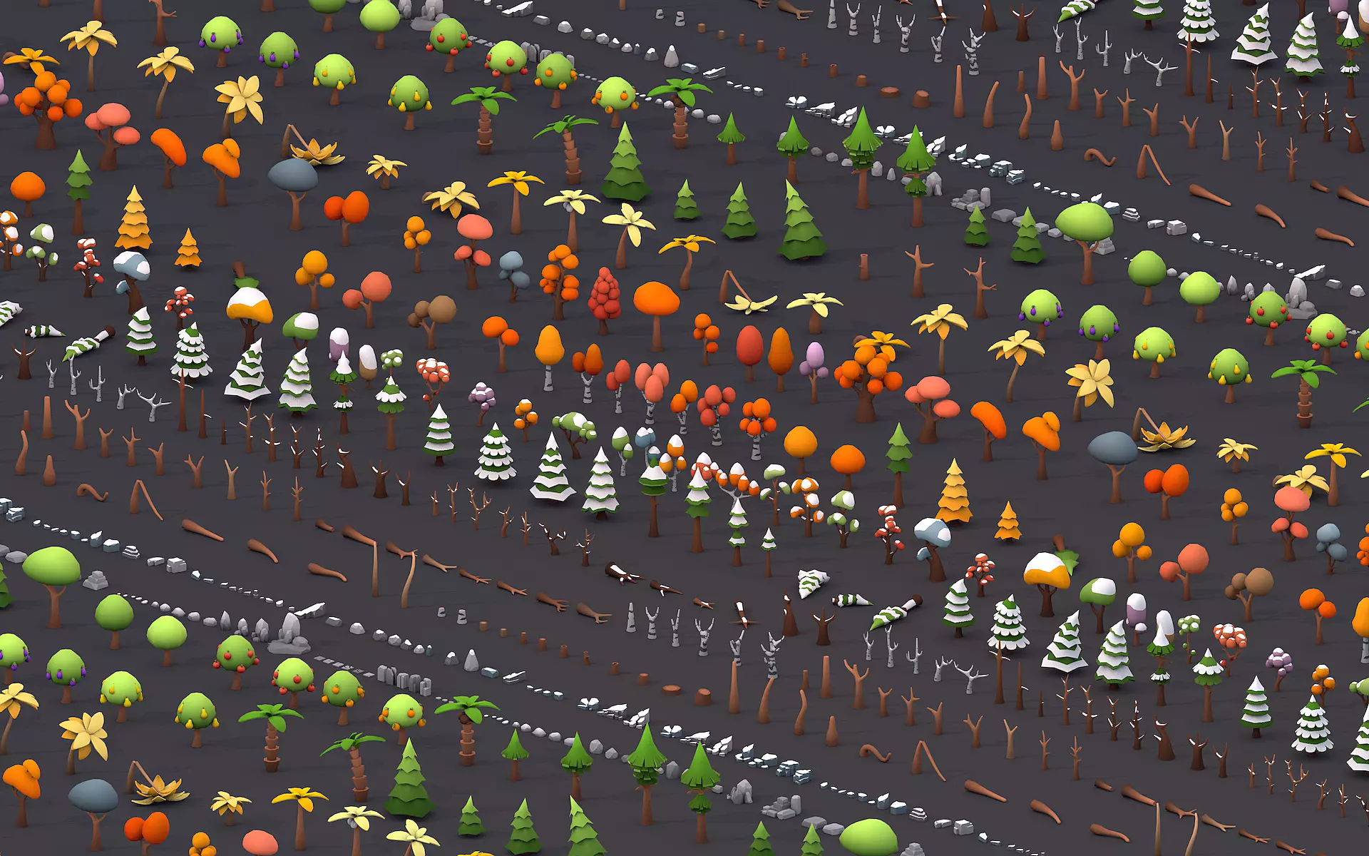
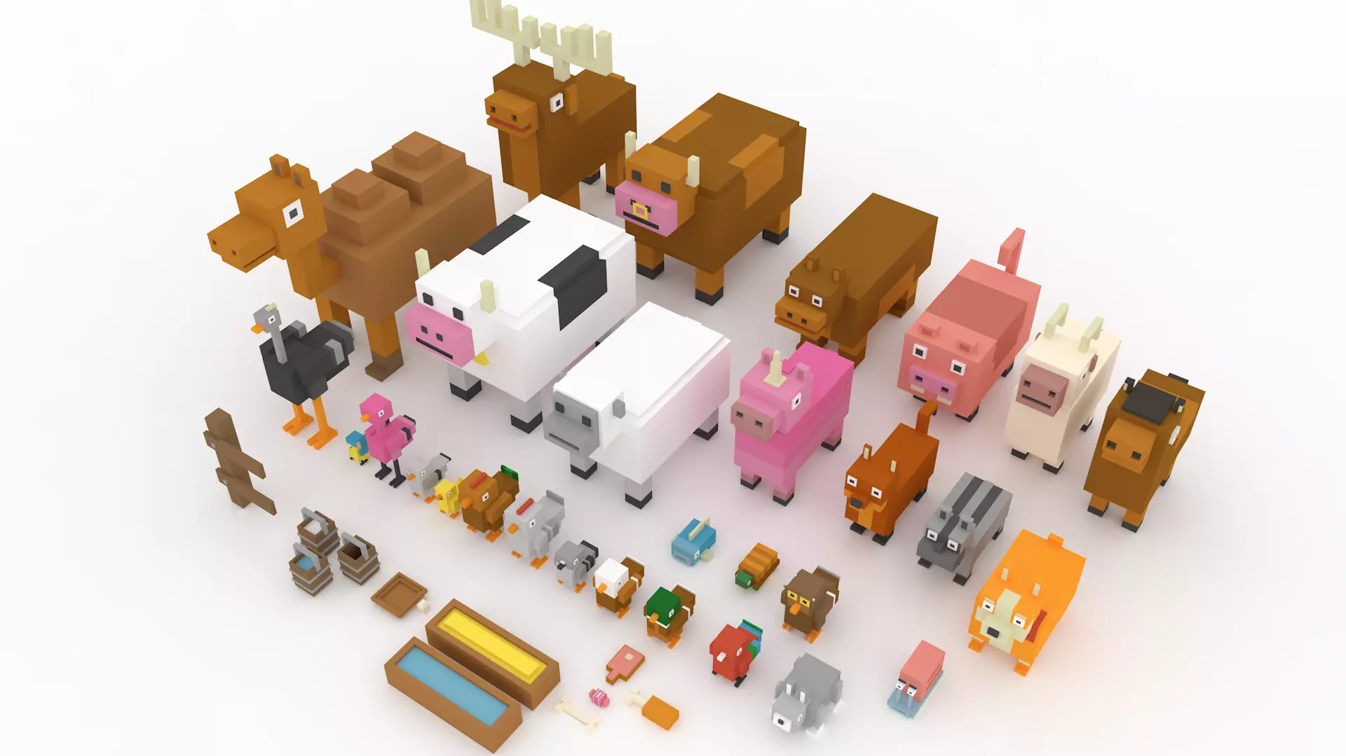
Idea Description & Motivation
Why Anido ? : Approachable
Map Objects Characters

Slide 12
Idea Description & Motivation
Why Anido ? : Approachable
Utilizing the casual nature of the theme in 3D,
the combination of cute animals and natural objects will provide
more fun than the existing Quoridor !

Slide 13
Game Features

Slide 14
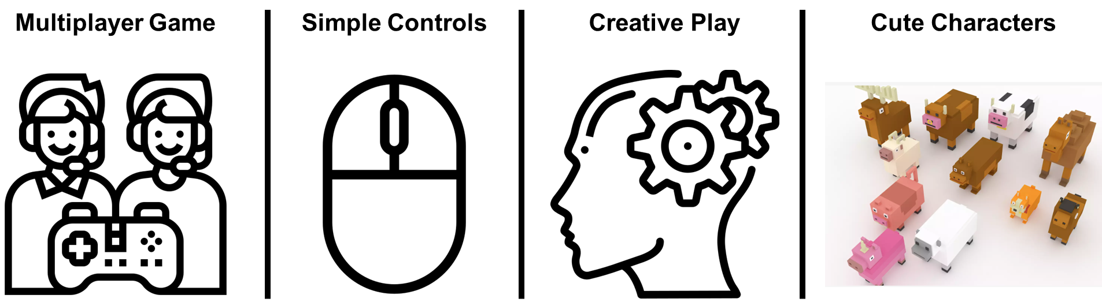
Game Features

Slide 15
Technology & tools

Slide 16





Technology & tools
Technology
Server-Client Architecture
HTTP protocol
REST API
MVC design pattern
Spring Framework

Slide 17





Technology & tools
Tools
Git & GitHub
Jira
Unity
Spring Tool Suite 4
Photoshop
illustrator

Slide 18
Product Backlog

Slide 19
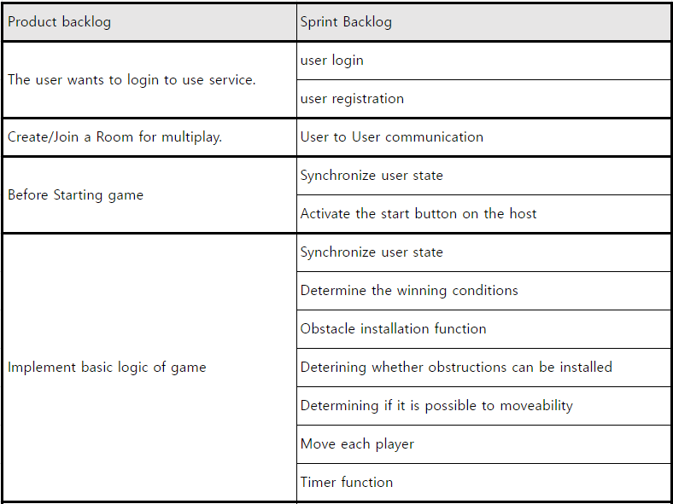
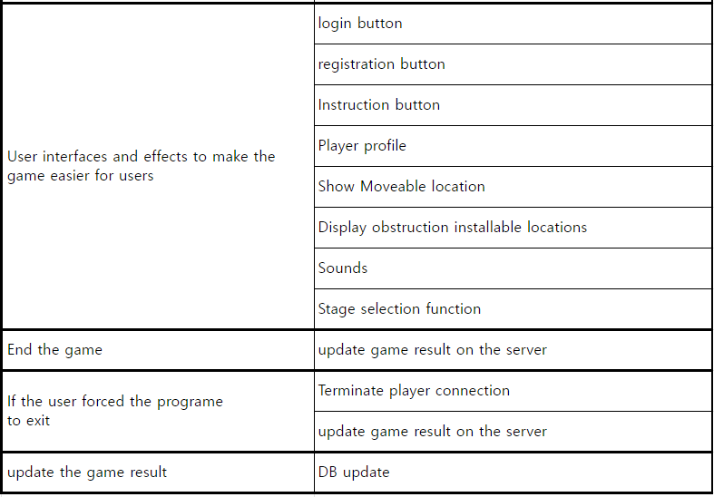
Product Backlog

Slide 20
Schedule

Slide 21
Schedule
~ 2nd milestone
~ 3rd milestone
1w | both | Sharing idea for game
2w | both | Preparing for 1st milestone
3w | server | Sharing git repository
 |  | Building a server
 | client | Implementing game frame
 |  | Creating key game objects
4w | both | Implementing game logic
5w | both | Implementing game logic
6w | server | Synchronization
 | client | Implementing game logic
7w | server | Synchronization
 | client | Implementing user interface
 | both | Preparing for 2nd milestone
8w | server | Implementing Sign in/Log in service
 | client | Implementing user interface
9w | server | Implementing database system
 | client | Implementing user interface
10w | server | Implementing database system
 | client | Implementing additional stages
11w,12w | both | Complementing final version of game
 |  | Preparing for 3rd milestone

Slide 22
Work Division

Slide 23
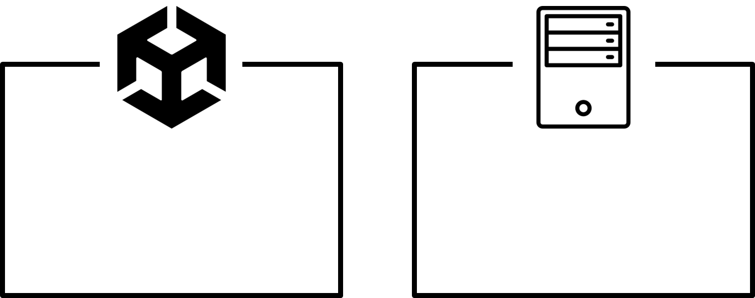
Work division
Dong Ho Choi
Song Heon Han
Seung Woo Lee
Dae Yong Kim

