Slide 1
Big Data, A.I. and Investing
Ken Liu

Slide 2
Automated Trading
Background and financial industry practice
Algo Trading Strategies
Exchange and market rules
Discussions
Develop Automated Trading System
Trading Signals
Dark Pool, Internal Crossing and Co-location

Slide 3
Industrial Example - IPO Stabilization
Queue up large quantity of buy orders during market open at IPO price
Accumulate stock positions at the IPO price if the stocks happens to trade around IPO price
When the stock price goes up later, use Stealth Algo to unload the position without showing in the order queue (HKEx display the broker ID)
Brokers | Size | Bid | Ask | Size | Brokers
2331,1234,8574,9574 | 1,000,000 | 9.5 | 9.6 | 20,000 | 5431,1234,8574,9574
9574,2331 | 500,000 | 9.4 | 9.7 | 50,000 | 9574,2331
5241,3881 | 700,000 | 9.3 | 9.8 | 80,000 | 5241,3881

Slide 4
Industrial Example - Index Rebalance
Some ETF funds (like HK Tracker Fund 盈富基金) passively track the underlying index constituents
The constituents may be re-weighted or new stocks will be added to the index. The ETF funds need to adjust the portfolio according to the new weighting
As the transaction performance are mark-to-market by the closing price, use Market-on-Close Algo to benchmark with the closing price
(Share a trader experience before using MOC Algos)

Slide 5
Industrial Example – Switching Trade
For a sector neutral portfolio where it maintains the same ratio of sectors with respect to the index, but actively manage the individual stocks within each sector
Use Pair Algo to do a switch trade where to sell the over-value stock and buy the under-value stock from the same sector
Or same companies in different markets (like China-A vs HK-H shares)

Slide 6
Industrial Practice – Biz
Main Drivers
Lower cost, less man power, speed and reduce error (in most circumstances)
Trading Desk
High Touch - Single Shares, Program Flow
Low Touch - DMA (Direct Market Access), DSA (Direct Strategy Access)
Flow
Agency (Client), Risk (Proprietary, Firm/House, Client Facilitation)
Compliance and Regulator
Algo documentation, training, testing and audit
Dark Pool License
Notes:
Before earn $10 share $5, now earn $10 but share only $1

Slide 7
Industrial Practice – Players
Buy Side
Hedge funds, Insurance companies, HFT (High Frequency Trading)
Sell Side
Brokers: ITG (White labelling), Instinet
Investment banks: Goldman Sachs, Citi, Credit Suisse
Algo Vendors
Fidessa (Selling systems and services on the cloud)
Market Data Vendors
Reuters, Bloomberg
Trading Networks
Liquidnet
Notes:
Before earn $10 share $5, now earn $10 but share only $1

Slide 8
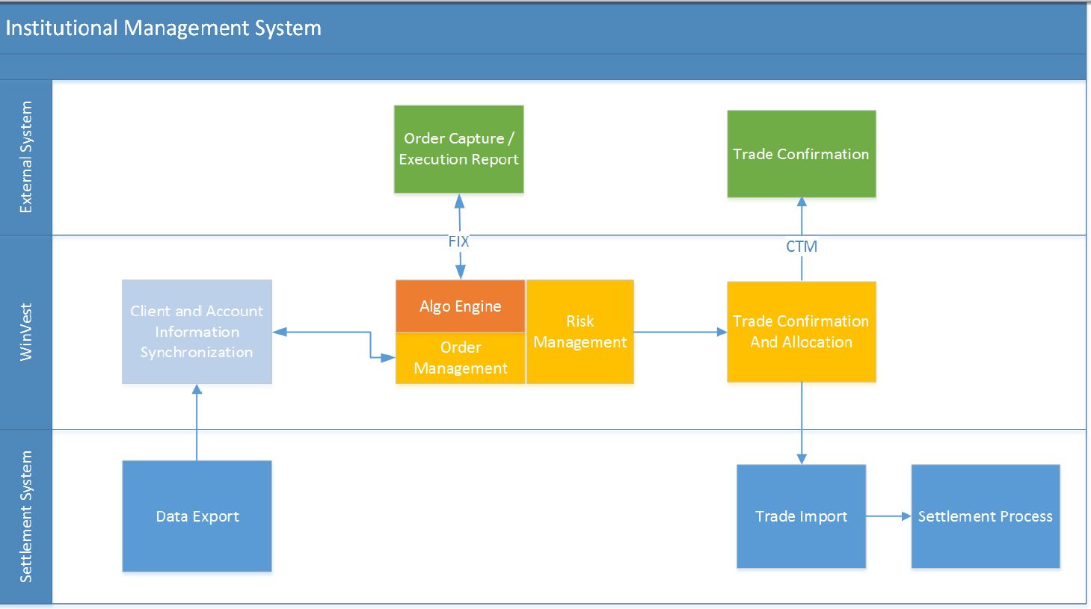
Industrial Practice – Example Systems

Slide 9
Industrial Practice – Main Components
Client Connective usually via FIX connectivity from Bloomberg or other trading GUIs
Credit Check (including Margin), Inventory check (for Sell)
Algo Trading System
SOR (Smart Order Routing) and Internal Crossing
OMS (Order Management System)
Exchange connectivity
Notes:
Before earn $10 share $5, now earn $10 but share only $1

Slide 10
Type of Algos
Agency Execution Algos (for commissions):
Break down large order for controlled market impact (e.g VWAP)
Prevent Information leakage (e.g. Stealth, Iceberg)
Portfolio / Proprietary / Risk Algos (for PnL):
Identify the investment or market opportunities (e.g. Market Making, Index/Statistical Arbitrage, Trend Following, Equities Long/Short, Macro)
High Frequency Trading (for PnL)
Latency and Venue Arbitrage
Notes:
Before earn $10 share $5, now earn $10 but share only $1

Slide 11
Algo - POV
POV (Percent of Volume) – execute an order relatively quick but do not want to cause too much market impact. POV% parameter controls the execution speed. Algo will try to make its executed volume to be POV% of the market executed volume.
X = POV% * MEV – OEV
X - quantity to be executed
POV% - POV parameter. e.g. 30%
MEV - Market executed volume since strategy started
OEV - Order executed volume since strategy started

Slide 12
Algo - POV
Volume Tracking
ITM vs OTM: if Algo has a limit price, only count the ITM (in-the-money) volume
Count only on-exchange trade
Additional parameters
Active: more willing to trade and track closer to the target
Normal: balance the speed and price improvement
Passive: more willing to wait for price improvement
Main Error Checks
Reject order with POV% > 50 as too much market impact. Industry practice is 33% for max desired impact

Slide 13
Algo - VWAP
VWAP (Volume Weighted Average Price) is a benchmark Algo which try to track or beat the volume adjusted average market price over the order trading duration.
Trade 1: 10,000 shares @ $70
Trade 2: 20,000 shares @ $72
VWAP = (10,000 * 70 + 20,000 * 72) / (10,000 + 20,000) = 71.33
Objective: trade a sizable CD (careful discretion) order that the trader does not have a specific view to the market direction. If there’s a view on the market direction, for example, buy order on a trending up market. For this case, the order is preferred to be traded by liquidity seeking algo that completes the order as quick as possible rather than worked by VWAP Algo gradually over the day (as the view is that the price is going to go up and buy earlier will give a better price).

Slide 14
Algo - VWAP
Two main components: Scheduling and Order Placement
Scheduling is the progress of order completion throughout the trading duration. It is based on a historical volume profile to predict the current day volume pattern. The profile is usually constructed based on 20 days average (or median) and taking away the outliers and special trading days (like half day trading or index rebalance days).
Not every stocks should have an individual stock volume profile
Only stocks that exhibit high correlation in daily volume patterns (It means those stocks exhibit relatively consistent volume patterns and the historical volume profiles should be a good proxy to predict the current day volume patterns. Those stocks are usually the liquid names like HSI names
For those stocks (usually mid-cap or illiquid stocks) that they do not have consistence volume profile, use market volume profile or TWAP

Slide 15
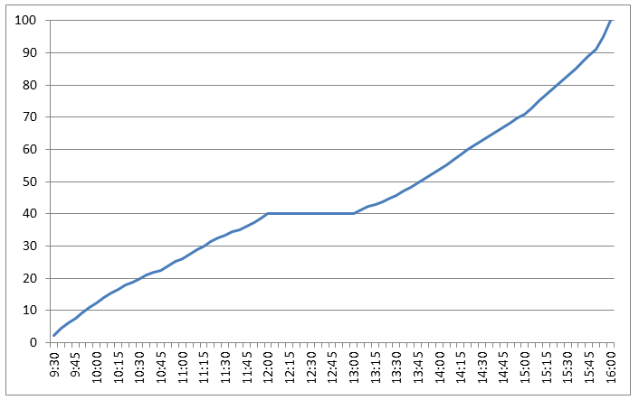
Algo - VWAP
A typical HK volume profile for a stock. Usually it has higher volume during the open and close. The volume profile tells the Algo the percentage of completion during different time periods. Using this volume profile as an example, for a full day VWAP order, the Algo will try to complete 12% of the order by 10:00, complete 40% by 12:00 and 71% by 15:00 etc.
Bonus Question: if the VWAP order arrive in the middle of day, say 11am, what will happen to the volume profile scheduling?

Slide 16
Algo - VWAP
Time | Volume (%)
09:30 | 0.24
09:35 | 3.66
09:40 | 5.56
09:45 | 6.40
09:50 | 8.10
09:55 | 9.11
10:00 | 10.29
.. | ..
.. | ..
.. | ..
.. | ..
.. | ..
15:30 | 67.79
15:35 | 69.42
15:40 | 71.33
15:45 | 73.13
15:50 | 75.80
15:55 | 79.34
16:00 | 100.00
The volume profile data is usually organized in 5-min bins (or 1-min)
All the time that are in-between the bin are interpolated
Normally for a VWAP market and ITM order is expected to be completed and it performs “finish up” (which trade very actively) to complete the order just before the order end time

Slide 17
Algo - VWAP
Order Placement: Once there is a target working schedule from volume profile, the Algo will decide on how to place the orders (price and quantities) to the exchange to achieve the schedule while getting the best possible price.
The general idea is to start with passive order to improve the pricing and work progressively if the Algo is starting to get behind the volume profile schedule
Timing
Ahead or behind Window, generally allows 2% to 5% deviate from the volume profile target. The windows size depends on the underlying stock profile (such as volatility)
When it’s behind the schedule, Algo will become more active.
Queue size
Queue sizes are the bid size (for buy order) or ask size (for sell order). When a queue size is large, the order that sent to exchange should be relatively bigger so that we can have sizable quantity waiting in a good queue position.
Notes:
SG market has long order queue

Slide 18
Algo - VWAP
Order Book Imbalance
The ratio between the bid and ask size. We can take into account the first few levels (for example 3 levels) of the order book while the top level of the book will have higher weighting.
For buying order, if the bid size is much larger than the ask size, like the example below, the VWAP Algo should be more willing to trade aggressively as the price is more likely to go up rather than down. Vice versa, if the Ask size is larger, the Algo should wait more patiently.
Size | Bid | Ask | Size
1,000,000 | 9.5 | 9.6 | 20,000
500,000 | 9.4 | 9.7 | 50,000
700,000 | 9.3 | 9.8 | 80,000
Video : VWAP Demo

Slide 19
Algo - VWAP
Order Running VWAP price vs Current Market Price
During trading, the Algo will compare the order running VWAP price to the current market price. If the current market price is better than the VWAP price, the Algo should be more aggressive to execute as it will improve the overall VWAP pricing.
For example, if the Buy Order running VWAP Price is 9.9, and the current market is offering at 9.6 (shown in the order book below), the Algo should be more active to take offer at 9.6 now.
Size | Bid | Ask | Size
1,000,000 | 9.5 | 9.6 | 20,000
500,000 | 9.4 | 9.7 | 50,000
700,000 | 9.3 | 9.8 | 80,000

Slide 20
Algo - VWAP
Bid/Ask Spread
Bid/Ask spread is the price different between bid and ask. It is the transaction cost when Algo crossing the spread to get immediate executions. Hence, when the Bid/Ask is wide (for example, it is 4 ticks in the order book below), the Algo should wait more patiently for the spread to be narrowed and avoid crossing the spread at this moment.
Size | Bid | Ask | Size
100,000 | 9.5 | 9.9 | 20,000
500,000 | 9.4 | 10 | 50,000
700,000 | 9.3 | 10.1 | 80,000

Slide 21
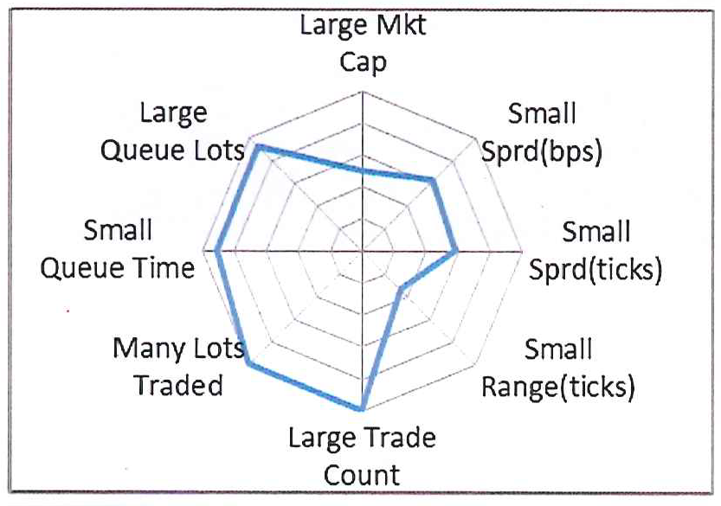
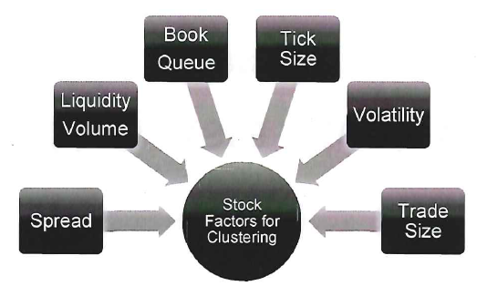
Algo - VWAP
Each individual factor is simple but put it altogether would require tuning and back test
Weighting and clustering are common techniques
Source: Goldman Sachs Securities Division

Slide 22
Algo - VWAP
Exchange Orders Management
When Algo needs to amend or cancel the orders in the exchange, it will always pick the one that loses the least queue priority. In the order book below (T denotes the orders from others, O is our orders. Smaller number indicates higher queue priority as they have been input to the book earlier), suppose we have to cancel one order at the 9.5 Bid queue, the Algo will cancel O16.
Broker Queue | Size | Bid | Ask | Size
T11, O12, T13, T14, T15, O16 | 1,000,000 | 9.5 | 9.6 | 20,000
T21,T22,O23 | 500,000 | 9.4 | 9.7 | 50,000
T31,T32,T33,T34,T35 | 700,000 | 9.3 | 9.8 | 80,000

Slide 23
Algo - VWAP
Exchange Orders Management
In certain cases, when Algo need to get execution, it will send a new order rather than amending any existing exchange orders to preserve the original queue priority.
Another exchange orders manager is to control the number of orders in the same price queue. As HK exchange shows the broker ID of each order in the price queue, it is generally considered not a good practice to display too many orders (Broker ID). The number of orders should be proportion to the numbers of orders in the queues (i.e. the Algo can send more orders if there are many other orders in the queue).
(HK shows Broker ID but not the quantity from each broker ID. If Algo sends too many of small orders, it will displays too many of the same Broker ID. For illiquid order queue, it may be questioned as the broker is trying to create false signal to fool the investors)
(Exercise: walk through order modification scenarios)

Slide 24
Algo - TWAP
TWAP (Time Weighted Average Price) is everything the same as VWAP Algo, except it does not use volume profile. Instead, the schedule is equally divided by the trading duration (can think of it as linear volume profile).
Use Case
Mid-cap or illiquid names that do not have stable daily volume patterns
Popular in markets that the volume patterns are not dominant (usually the markets with no lunch break and with short trading hours, such as Taiwan)

Slide 25
Algo – VWAP & TWAP
Additional Parameters (VWAP & TWAP)
POV%: it’s a volume constraints (rather than target) such that while VWAP/TWAP trade over the day gradually, it cannot trade over certain % of market volume. It is usually for relatively large order
Cleanup Price: if the stock reach certain price, Algo deviates from the volume curve schedule and demand liquidity actively at or better than the cleanup price. (what happen when the stock price moved away from cleanup price and order is still not completed?)
Other Notes
Half-day trading requires special half-day volume curve or map VWAP to TWAP
OTM (Out-of-Money) price and short sell orders may cause order stacking
HK VWAP off 5-6 bps; JP off 1-2 bps. May attribute to retail vs institutional flow

Slide 26
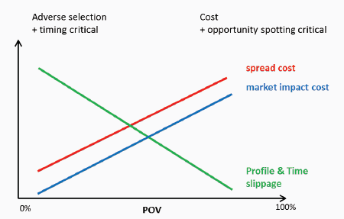
Algo - Implementation Shortfall
Implementation Shortfall: the difference between the decision price (usually arrival mid-price and the final execution price for a trade (aka the slippage).
Scheduling
The Algo generally balance the pace of executing too fast (market impact cost) vs too slow (opportunity cost of the price move away). The POV% increases when price is more favorable and vice versa.
Buy Price | POV%
5.6 | 10
5.5 | 15
Arrival Px → 5.4 | 20
5.3 | 25
5.2 | 30
Notes:
Assume mean-reversion.

Slide 27
Algo - Implementation Shortfall
The POV% schedule varies from different stocks. It is generally based on the stock cost model where mainly taking into account the historical volume pattern, liquidity and volatility.
The model implicitly assumes “mean reversion” (i.e. prices and returns eventually move back towards the mean or average). If stock is trending, may use other Algos (which one?).
Order Placement: the way to place the orders (price and quantities) to the exchange to achieve the schedule while getting the best possible price is the same as in VWAP
Notes:
Assume mean-reversion.

Slide 28
Transaction Cost Analysis
TCA is the study of trade prices to determine whether the trades were arranged at favorable prices (buy low price and sell high price) or at best execution
Pre-trade analysis
is the process of taking known parameters of a planned trade and determining an execution strategy that will minimize the cost of transacting for a given level of acceptable risk.
it is not possible to reduce both projected risk and cost past a certain efficient frontier, since reducing risk tolerance requires limiting market exposure and thus trading faster. In this situation, market impact cost is much greater than for trades that accept greater risk and are executed more slowly.
Notes:
Assume mean-reversion.

Slide 29
Transaction Cost Analysis
Post trade analysis
recording the data from previous trading periods, including trade timing, arrival price, average execution price, and relevant details about market movement.
these data are then measured and compared to several benchmarks, such as the volume-weighted average price, time-weighted average price, participation-weighted average price, or a variety of other measures.
Implementation shortfall is a commonly targeted benchmark, which is the sum of all explicit costs (transaction cost, spread) and implicit costs (market impact, delay cost, and opportunity cost)
after measurement, costs must be attributed to their underlying causes. This analysis is used to evaluate performance and monitor future transactions.
Notes:
Assume mean-reversion.

Slide 30
Algo – Market On Close
Market-on-Close (MOC) Algo benchmarks with the closing price
Daily closing trade or Index Rebalance trade where the index constituents re-weighting or adding new stocks. The ETF funds need to adjust the portfolio according to the new weighting
Orders non-completion can be hedged by the Index Future
Risk MOC: the firm takes the positions and guarantee performance (e.g. 10bps better than closing price)
Agency MOC: the firm purely acts as broker for conducting the transactions

Slide 31
Algo – Market On Close
Divide the order into pre-trade portion (trade before the closing auction) and on-close portion (trade into the closing auction). The ratio is decided by the trader
The objective is to balance the price improvement from the pre-trade portion vs the on-close portion which support the closing price itself.
If the order is in right flow (e.g. buying a name which is adding to the index or re-weighting upward), the stock is expected to have large buy pressure during the closing that should potentially push up the closing price. Hence the pre-trade portion (executed before closing) should have lower price and therefore improve the overall executed price.
(If pre-trade can generally improve the price performance, why not 100% pre-trade the MOC order?)

Slide 32
Algo – Market On Close
Pre-trade is generally done via VWAP-style with a reverse volume curve (calculated backwards from closing time)
The shape of the MOC volume curve is always concave towards the closing (why?). Traders adjust the volume skewness towards the closing time.
The order start time is calculated by ADV (or Rebalance ADV) or manually input a start time.
(Before HK closing auction, manage the last 1-min throttle)

Slide 33
Algo – Market On Close
Pre-trade volume curve

Slide 34
Benchmark Algos
 | Objective | Urgency | Scheduling | Completion
POV% | % of volume | High | Market volume driven | Can complete any time as long as seeing enough volume
VWAP/TWAP | Track volume or time adjusted average price | Low | Historical volume profile | Trade gradually along the order duration
Implementation Shortfall | Track arrival mid-price (or other) | Medium | Market volume driven and speed depends on the price | Can complete any time as long as seeing enough volume
Market on Close | Track closing price | Medium | Reverse (from end time) volume curve skewed toward closing | Complete at the market close
Notes:
Assume mean-reversion.

Slide 35
Algo – Stealth, Iceberg
Stealth
demand liquidity without signal the market
use FAK (Fill-And-Kill) order when the price is immediately executable
leave residual quantity (randomize) especially for illiquid names such that it will not move the price
Iceberg
only send (display) partial order quantity to the exchange at each time
refill the quantity when see fills
randomize the display quantity
broker ID market may only send new order after the partial order fully filled

Slide 36
Algo – Peg, Smart DMA
Peg
manage the order to follow Bid/Mid/Ask price
can have offset (+/- x ticks from the above price)
Smart DMA
simple limit or market order that trade according to the exchange rules
algo understands all the market irregularities and place the order to the exchanges accordingly
good for a portfolio or funds (especially overnight orders) that has multiple orders from different markets.
also useful for overnight orders and Good-Till-Date (GTD) and Good-Till-Cancel (GTC) orders that re-generated everyday.
In HK, it’s particularly useful as the algo monitor the price range for order input

Slide 37
Algo - Pair
Pair Algo has two legs (one buy and one sell with two different names).
For “switching trade” where to sell the over-value stock and buy the under-value stock from the same sector
Manage the execution progress of two legs and avoid legging (that’s one leg is executed faster than the others)
Can control which leg (usually sell side for Dollar neutral) to execute first. Also Short Sell side (why?) generally needs to be executed first
Input ratio usually expressed as Buy/Sell < Ratio (why < and other format?)

Slide 38
Algo - Pair
The execution happens when the specified ratio is met. It is when the immediate execution price (i.e. Buy on Ask and Sell on Bid) is within the ratio.
Buy/Sell < 0.5 Buy @ Ask (10) and Sell @ Bid (20) 10/20 = 0.5 which is NOT < 0.5 and hence NO execution
Buy |  |  | Sell
Bid | Ask |  | Bid | Ask
9.9 | 10 |  | 20 | 20.1
Buy @ Ask (10) and Sell @ Bid (20.1) 10/20.1 = 0.4975 which is < 0.5 and start execution
Buy |  |  | Sell
Bid | Ask |  | Bid | Ask
9.9 | 10 |  | 20.1 | 20.2

Slide 39
Algo - Pair
Can use bait order (either wait on bid or ask price) to improve the chance of execution. (If both are ok, which one to choose?)
Bait @ Bid (9.9) and once filled, Sell @ Bid (20) 9.9/20 = 0.495 which is < 0.5 and hence start execution
Buy |  |  | Sell
Bid | Ask |  | Bid | Ask
9.9 | 10 |  | 20 | 20.1
Bait @ Ask (20.1) and once filled, Buy @ Ask (10) 10/20.1 = 0.498 which is < 0.5 and hence start execution
Buy |  |  | Sell
Bid | Ask |  | Bid | Ask
9.9 | 10 |  | 20 | 20.1

Slide 40
Algo - Pair
Price Ratio can be adopted for Spread trade where the input is “Buy-Sell < Spread”. One example use case is for trading the Stock vs “Stock Right”
Cross market (A-H Pair) order needs FX feed to convert the price ratio to same currency
Additional parameters:
VWAP/TWAP: execute the ratio trade gradually over the day
POV%: execute as fast as possible but still within the volume constraints
Main Error Checks
Reject the order if the ratio (or spread) is 10% more ITM than the current market
Warn the order if the ratio (or spread) is 10% more OTM than the current market

Slide 41
Algo - Market Making
Business driver
Earn spread, Waive stamp duty / exchange fee
Typical products: Warrants, CBBC, Listed Future/Options, ETF
Type of Market Making (MM)
Quote Request: respond to the request to provide liquidity. Generally it only requires to full-fill certain % of the request per day
Continuous MM : continuously making the market to fulfill min spread, min show quantity, min show time, min hours of a trading day
Reference price calculation
Based on customized formula and can subscribe to multiple instruments to source the pricing information
Additionally for non-delta 1 products (such as Options and Warrants) based on underlying instruments and static data, use Quantlib Black-Scholes option pricing library to estimate the fair value, option Greeks (delta, gamma), implied volatility

Slide 42
Algo - Market Making
Market Making Orders Management
Placing two sided (buy & sell of same name) of market making orders into exchange continuously (react to price change and/or timer-based) or opportunistically (quote request)
The price and quantity of the orders are based on the underlying instrument spot price, reference price, conversion ration, min spread and liquidity obligations. For options type of products, also needs the Greeks and implied volatility
Adjusting (cancel or amend) the orders automatically according to the rules and market conditions
Monitor the order quantity and (partial) fill, depends on the objective of queue priority, can send new order or amend the existing quantity to maintain the liquidity
keeping track of order timing and can setup conditions to cancel and resubmit orders

Slide 43
Algo - Market Making
Manual Override
Setup the min/max spread on top of the existing requirements
Set offset from the calculated spread (e.g. ask -1 tick)
Widen the spread or temporarily suspend the market making if the market is too volatiles (e.g. Future drop 100 points in 5 mins, underlying go up 3% in 1 mins)
Reference Data
Include order capacity information to distinguish between Market Making or House orders
Position keeping on intraday or aggregated (e.g. monthly) level

Slide 44
Algo - Market Making
Risk Management
Setup automatic hedging of underlying instruments or with other Future and Options. When trading the underlying, follows the respective rules (such as short sell up-tick rule of the underlying stocks)
Unwinding the positions at the end of day according to specific rules
Directional (Delta Risk): Any unhedged long/short position
Interest Rate Risk (Rho Risk): Manage interest rate estimates
Dividend Risk: Manage Dividend payout estimates
Execution Risk: Fast system to capture the mis-pricing
Liquidity Risk: Determine appropriate trading size

Slide 45
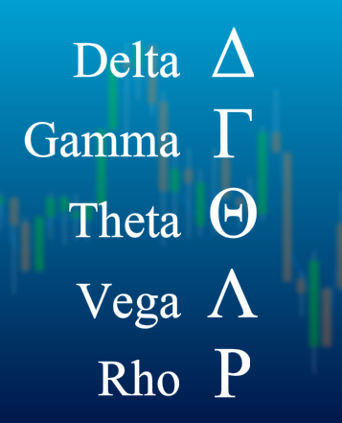
Algo - Market Making
The Greeks
Gamma Risk (Rate of Change of Delta)
Theta Risk (Time Decay)
Vega Risk (Implied volatility)
Hedging Calculation
Black-Sholes model
Finite Difference model

Slide 46

Trading Strategies – HK Warrant
Objective: Try to follow a “super trader” action (recall Social Trading) and profit from it.
Enter Trade when "super user" trade (when a single trade of notation greater than certain amount on a warrant and ask price move up (>= 1 tick) within 10ms to 5s
Exit Trade in these 3 modes
1: Profit mode: Sell if bid + 2 ticks >= avg px
2: Stop Loss: avg px - bid >= 3 ticks
3: Time mode: 15 mins before market close
Canberra Blackjack Experience for the 3 ticks stop loss

Slide 47
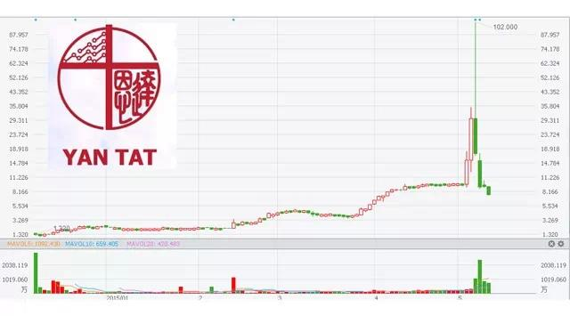
Trading Strategies – HK small caps
Objective: Track abnormal movements for small caps HK names

Slide 48
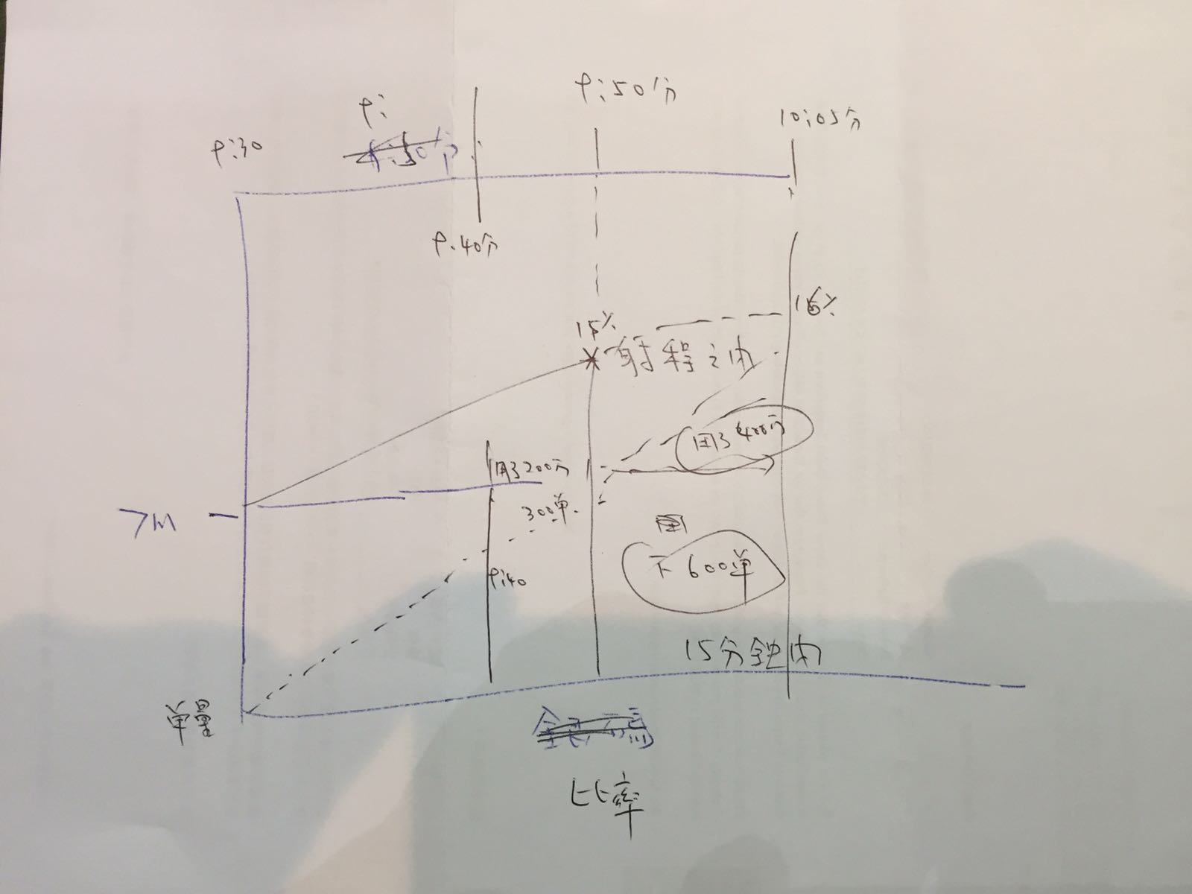
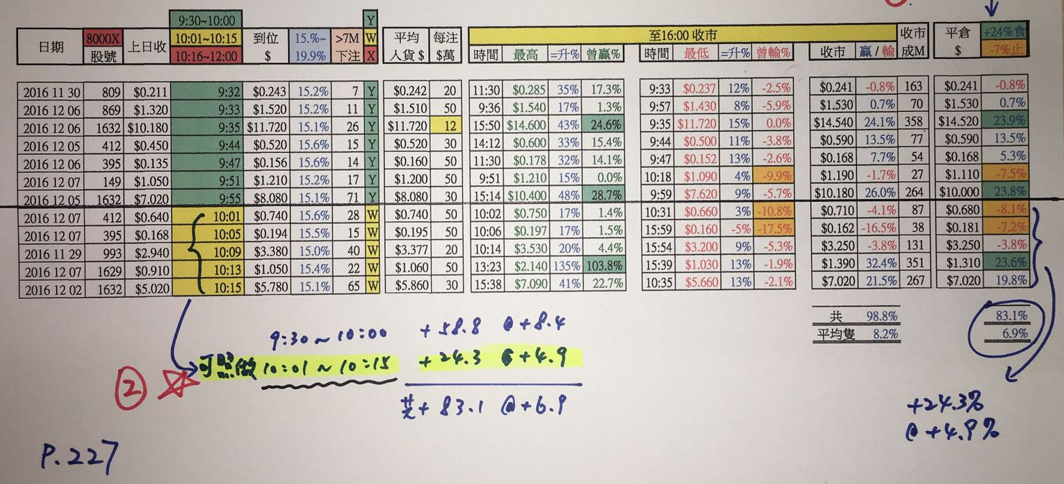
Trading Strategies – HK small caps
Criteria:
Daily movement > 10%
Market cap < HK$ 5 billions
Daily volume > HK$10M
No. of trades > 300 (or 10x last 50 day avg)

Slide 49
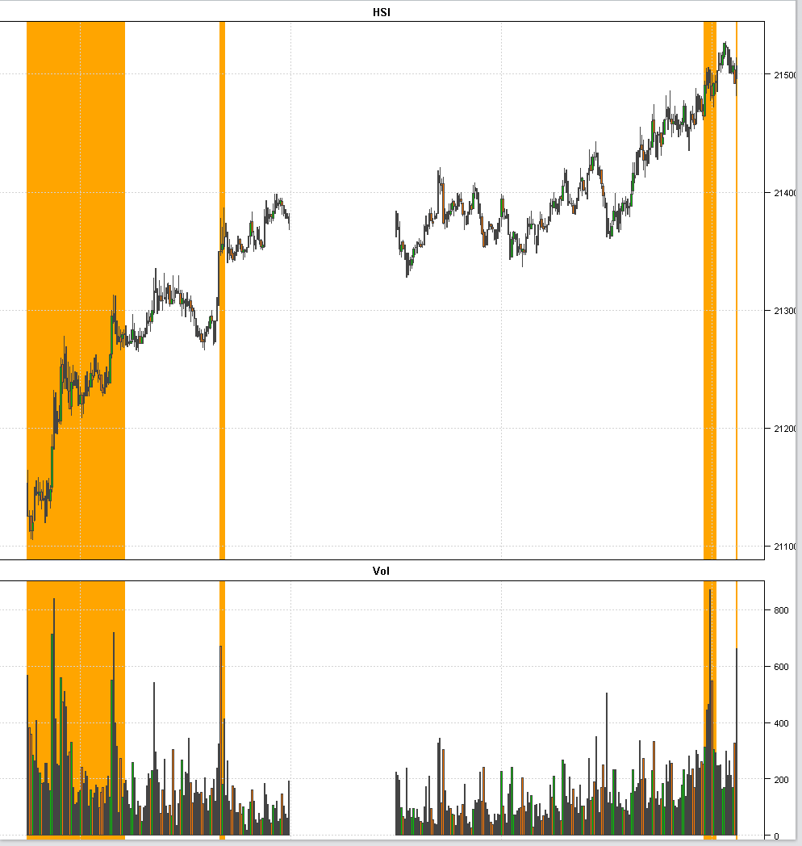
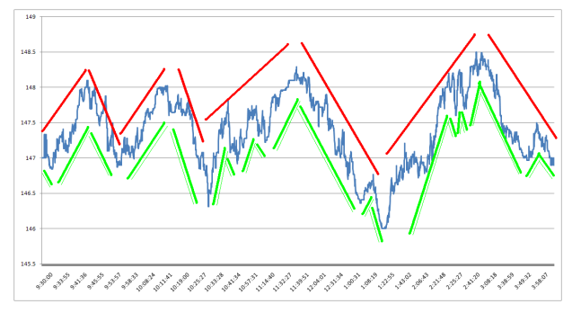
Trading Strategies – HKFE Wave Trading
Objective: detect short term trends and regime shift. Use HKFE because of lower transaction costs
The market goes through
volatility and volume regime intraday.
For short term price action,
a security goes typically through several trends

Slide 50
Demo: Bit Coin Trading
SMA Crossover Strategy: leading and a lagging simple moving averages
Leading SMA has a shorter look-back period that lagging moving average. Hence, by definition, leading SMA will be more sensitive to most recent price moves; lagging SMA will be slower to react
BUY if Leading SMA is above Lagging SMA by some threshold
SELL if Leading SMA is below Lagging SMA by some threshold
Threshold is applied to filter out weak signals (e.g. 2.5% of the current price)
(Comparing to Long/Short term Sentiment Analysis)

Slide 51
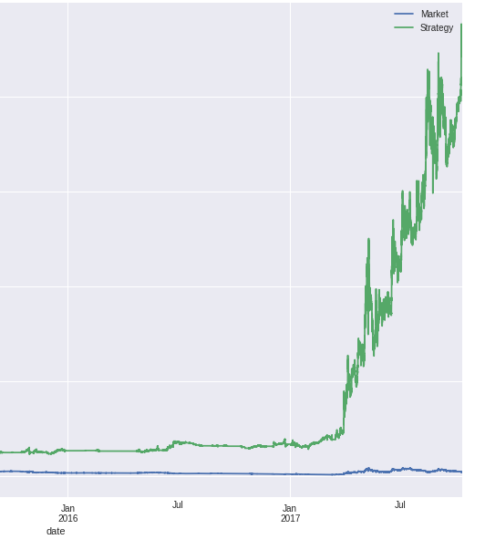
Demo: Bit Coin Trading
Back test shows good performance. However, it doesn’t consider the following factors:
Transaction Cost
Commissions
Shorting
Slippage (latency, spread cost etc)
Market Impact
Liquidity
Also the back test results are usually “over fit”

Slide 52
Market and Exchange Rules - Hours
HKEx Cash Equities Trading Hours
Open Auction | 9:00 | 9:15 |  | Order Input
 | 9:15 | 9:20 |  | Pre-order Matching
 | 9:20 | 9:28 |  | Order Matching
 | 9:28 | 9:30 |  | Blocking Period
Cont Trading | 10:00 | 12:00
Lunch break | 12:00 | 13:00
 | 12:30 | 13:00 |  | Afternoon Adjust
Cont Trading | 13:00 | 16:00
Closing Auction | 16:00 | 16:06 |  | Order Input
 | 16:06 | 16:08 |  | No-Cancel Period
 | 16:08 | 16:10 |  | Random Closing

Slide 53
Market and Exchange Rules - Auction
Open/Close auction
Open and Close price has significant meaning for benchmarking and mark-to-market
It is not desirable to have one trade to determine the open/close price (which is easier to manipulate)
Prevent too many orders at a single open/close time that may overload the trading systems; hence a few mins of auction period to spread out the transactions
Indicative price & volume (IEP & IEV in HK) is chosen that either maximize the execution quantity or notional
Can use random opening/closing time to prevent gaming

Slide 54
Market and Exchange Rules – HK Closing
HSBC incident and suspension of closing auction
https://www.ft.com/content/48be3f94-0f1d-11de-ba10-0000779fd2ac
Re-introduce with price range and random closing
http://www.hkex.com.hk/eng/market/sec_tradinfra/vcm_cas/Documents/Trading%20Mechanism%20of%20the%20CAS%20in%20the%20Securities%20Market.pdf
(Note: auction market order seems unnecessary)

Slide 55
Market and Exchange Rules - Order
Order Side: Buy, Sell, Short Sell
Order Type: Limit Order, Market Order, Auction Order, Funari Order (limit-to-close order in Japan), Centre Point Order (fill at midpoint of bid/ask in AU market)
(Algo Limit / Market Order vs Exchange Limit / Market order)
Order Amendment: Price, Quantity change (up/down), Cancel. Not all market support order amendment (such as China) and requires cancel/resend
Order Condition: Fill-or-Kill, Fill-And-Kill
TIF (Time-in-Force): Day Order, GTD (Good-Till-Date), GTC (Good-Till- Cancel)

Slide 56
Market and Exchange Rules – Short Sell
Most markets cannot do naked short and need to have stock borrow arrangement
Short Sell Uptick rules to prevent pushing down the price
HK: short sale must be placed at or above the current best ask price. Exceptions apply for authorized market makers of HKSE listed options and index arbitrage desks of brokerages. Some stocks (mostly ETF are excluded as well) are exception of tick rule.
JP: orders can be placed at or above the last price if it is an uptick but can only be placed above the last traded price if it is a downtick. Open Auction, it's closing + 1 tick. Exceptions for hedging and arbitrage

Slide 57
Market and Exchange Rules - Trade
Trade type: the nature of the execution. Most importantly is to determine if it happens on-exchange or off-exchange (e.g. block crossing trade). HK example below:
Type | Description
D | Odd lot transaction
M | Manual or Special lot non-Direct Business transaction
P | Pre-open transaction (trade concluded before market open including that concluded but not recorded in the system before market close of the previous trading day)
U | Auction transaction
X | Manual or Special lot Direct Business transaction
Y | Automatch Direct Business transaction
"" | Automatch non-Direct Business transaction
* | Rejected/Cancelled transaction

Slide 58
Market and Exchange Rules - Lot & Tick
Lot Size: the order quantity has to be in the multiple of lot size. Less than one lot is called odd lot. In HK, the lot size varies from stock to stock. In SG, it’s always 100
Tick Size: the smallest unit of price increment or decrement. In US, after Decimalization, all the tick size is 0.01 and also the lot size is 1 and hence made programming Algo system easier.
Min | Max | Tick Size
0 | 0.01 | 0
0.01 | 0.25 | 0.001
0.25 | 0.5 | 0.005
0.5 | 10 | 0.01
10 | 20 | 0.02
20 | 100 | 0.05
100 | 200 | 0.1
200 | 500 | 0.2
500 | 1000 | 0.5
1000 | 2000 | 1
2000 | 5000 | 2
5000 | 9995 | 5
HK Tick Size table

Slide 59
Market and Exchange Rules - Range
Price range: the max and min trading price of a stock
Market
Hong Kong | Quotation Rule: Order price not away more than 24 spreads from nomimal price in Cont Trading; +/- 24 in Auction
Taiwan | 10% from close
China | 10% from close
Singapore | 10% from close
Korea | 15% from close
HK uses dynamic price range which is the most difficult to program and monitor

Slide 60
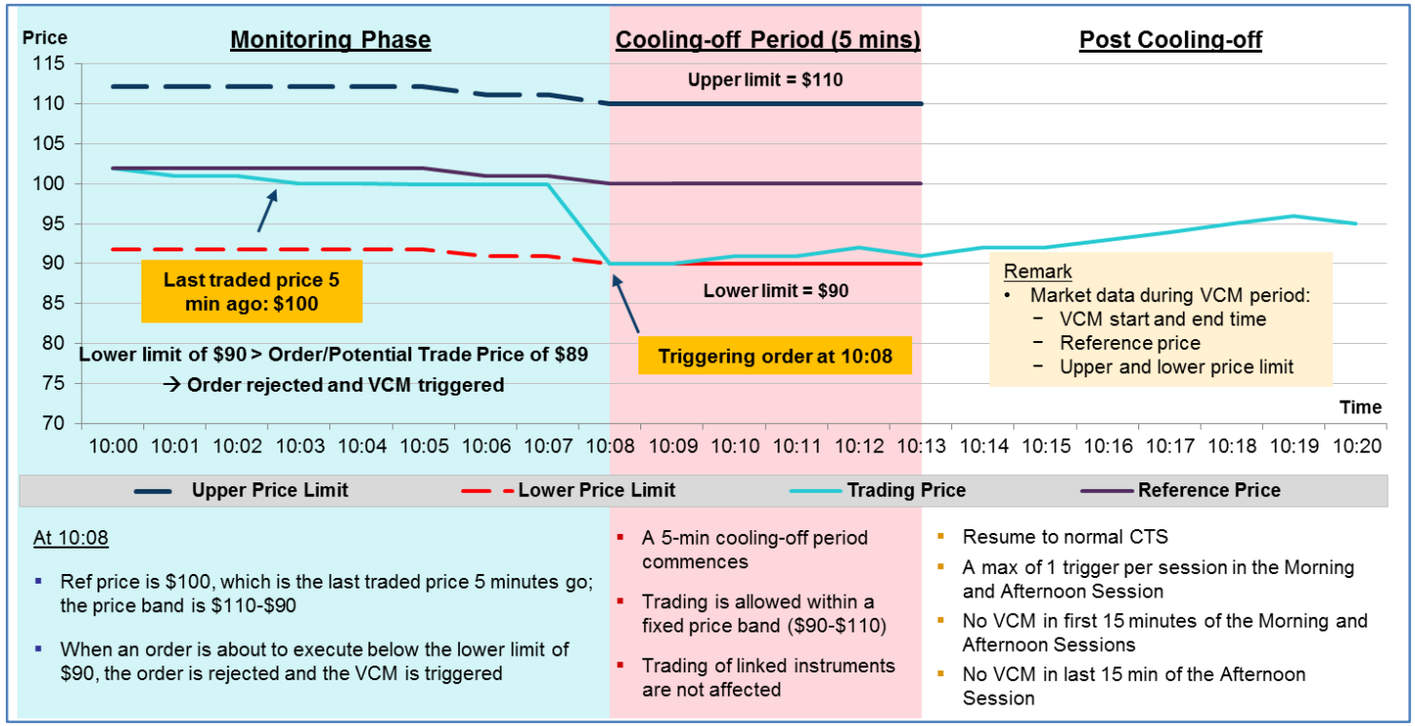
Market and Exchange Rules - Volatility
Volatility Control Mechanism (VCM): prevent or control the extreme volatility and provide cool down period: https://www.hkex.com.hk/vcm/en/index.htm

Slide 61
Market and Exchange Rules – HK Exchange
https://www.hkex.com.hk/Services/Trading/Securities/Overview/Trading-Mechanism?sc_lang=en
Order Type: At-auction, At-auction Limit, Enhanced Limit, Special Enhanced Limit (Fill-And-Kill)
(Enhanced Limit only on order entry. Once it is in order book, it becomes limit order. Price amend to a wrong price could result in order rejection)
Nominal Price & Quotation Rules
Non-CAS closing price calculation (Throttle Management)
Closing Price adjustment
Shows Broker ID
Notes:
TW IT people write game not finance

Slide 62
Market and Exchange Rules - Highlights
Market
Taiwan | Mini-batch at every 20s at continuous trading session No market data update during auctions
Japan | Use Special Indication to avoid big price move SQ Days – Future Price Calculation affect trading behavior Stock doesn't open if (auction) market orders not fully filled
Australia | Stage opening based on symbol names Central Point Order (Peg-to-mid)
Korea | Entrance Exam day delay opening hour Trading Systems located in KR (send with IP address)
Taiwan & Korea: ID market (show the investor); some stocks (like telco and media companies) subject to foreign holding limit
Notes:
TW IT people write game not finance

Slide 63
Market and Exchange Rules - Highlights
Market
Singapore | IPO start at half day Force key Tick size based on currency Buy-in, Unit Share market
India | Cannot determine on or off exchange trade type BSE and NSE parallel trading (SOR logic) Closing Price by last 30-min VWAP
Thailand | Local/Foreign board vs NVDR (Non-Voting Depository Receipts) Publish Order (exchange Iceberg order)
Indonesia | Friday trading hours are different due to religious reason
Notes:
TW IT people write game not finance

Slide 64
Discussions
Market Volatility: Algo brings more volatility to the market
Retail Investors: what is the impact to everyone’s trading decisions
Buy vs Build: can Algo solution startup survive? (buy companies build their own systems; smaller firms either doesn’t have enough volume or just route the order to bigger firms)
Crowd Trading: will Social Trading or Quantopian work?
Can we predict: does history repeat itself?
Trading Idea: any thoughts on trading strategies?

Slide 65
Develop Automated Trading System
Static Reference data
ADV (Average Daily Volume)
Average Bid/Ask (Queue) size
Average Spread
Historical volume profile
Instrument reference data (such as lot size, dividend, interest rate yield curve, volatility curve, repurchasing rate, contract date, expiry, and price multiplier)
Exchange rules: tick size, trading hours, price range etc.

Slide 66
Develop Automated Trading System
Real market data time feed
Market data adaptor for information vendors (such as Reuters, Interactive Broker)
Bid/ask price and size
Auction indicative price (e.g. IEP, IEV)
Level 2 or Market depth
Trade size and volume, accumulate volume, turnover
Reuters (popularly used real-time feed for trading systems)
Advantage: provide uniform access to many markets (Bloomberg is terminal based which is more human-oriented)
Closing Run: the time to update the closing Price
Speed: provide consolidate feed which the data is aggregated and distributed from the data center (Singapore Hub for Asia) which is slower than the Exchange Direct Feed. (the fastest market data is the co-located data feed)

Slide 67
Develop Automated Trading System
Connectivity
Upstream – support FIX connection to receive orders or manual input from the trading GUI. FIX message (tag=value pair) example below
8=FIX.4.4|9=126|35=A|49=theBroker.12345|56=CSERVER|34=1|52=20170117- 08:03:04|57=TRADE|50=any_string|98=0|108=30|141=Y|553=12345|554=passw0rd!|10=131
Downstream – adaptor to connect OMS (Order Management System), broker (IB) or exchange gateway
Trading signals – used to publish the trading signals and it’s generally separated from the trading system
Others - connection to the position and risk management systems

Slide 68
Develop Automated Trading System
Order Management
Parent order – validate Algo and parameters, handle amendments (price, quantity, parameters, Algo to Algo). Amend examples:
Amend price to more aggressive or passive
Increase or decrease quantity
Increase completed order quantity up
Increase POV%
VWAP -> POV Algo
Exchange order
(Pending) new, (Pending) accept, (Pending) cancel, (Pending) amend
Fills (partial and fully fill)
DFD (Done For Day), Reject

Slide 69
Develop Automated Trading System
Event Handling
Market data tick
Timer
Order events
Market signals
Algo events
Strategy rules
The core logic of the Algo itself
Market rules
Implement the exchange rules for each market

Slide 70
Develop Automated Trading System
Error & Risk Control
Fat Finger Limit (FFL): set the max quantity & notional, price deviation to catch unrealistic inputs due to extreme market conditions, human typos or erroneous setup
Transactions limit: no. of repeated cancel/resend (may be seen as flashing order for false signal); limit the no. of trans per minute
Prevent Own Execution: For certain Algos (Market Making), Buy/Sell price can never been crossed as it will lead to executions. This may be deemed as creating fake transactions
Emergency Control: A “panic” button to cancel / pause all orders in case of emergency. Pause order when disconnect from market data (or stale market data) or downstream systems (such as losing exchange connectivity).

Slide 71
Develop Automated Trading System
Order Monitoring: order overfill; order pending for too long (as may suggest issue or connection lost)
Market data check: During continuous trading session, bid ask cannot be crossed
Environment Segregation: Development, QA and production environment needs to be separated properly (accidentally send QA order to production is the major disaster)
Others (usually outside Algo system)
Position (inventory) Check: check if the client has enough position to do sell order
Credit Check: has enough margin or money to buy the stocks

Slide 72
Develop Automated Trading System
Performance
Reduce market data ticks processing power consumption: Tick Combine (e.g. merge the execution, discard the stale bid/ask)
Setup multiple instances with symbol range striping in each instance. Hence, each trading instance only listen and process certain symbol ranges of orders. Alternatively stripe by strategy such that each instance only process certain strategies (such as MOC).
Logging
Debug
Audit trail
Database
Order history
Transaction Cost Analysis

Slide 73
Develop Automated Trading System
Development Languages
Java, most popular these days
C#
C++
Why Java most popular
Large developers pools , communities and APIs
Acceptable latency: Algo trading is in millisecond range (HFT requires lower latency)
Relatively easy to code (compare to C++)
Challenges of Java
Garbage collection
JVM settings

Slide 74
Develop Automated Trading System
Testing
Unit Test: test induvial functions and calculations
Automatic Testing: test all the defined scenario for correctness during continuous development (code check-in)
Back testing: algo strategy performance (for VWAP performance bps)
System load testing: test the capacity to handle the no. of orders
Connectivity test: test the connection between upstream and downstream systems

Slide 75
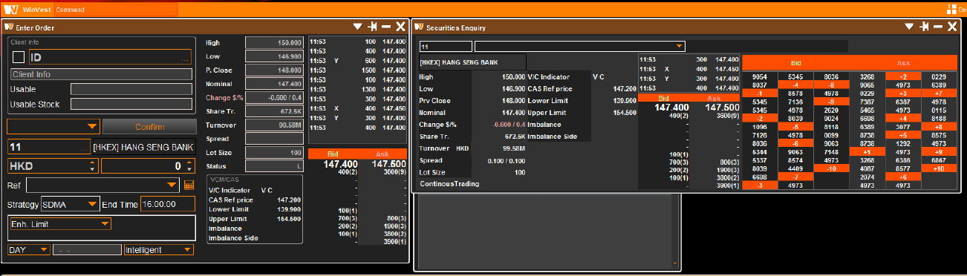
Develop Automated Trading System
Trading GUI
Control: stop/pause/resume orders, panic button, dynamically modify Algo (internal) parameters, input new order, split new child orders, cancel or amend orders.

Slide 76
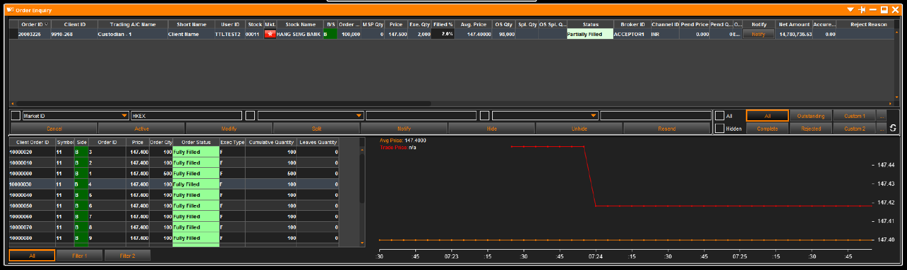
Develop Automated Trading System
Trading GUI
Monitoring: execution progress, strategy performance, market data

Slide 77
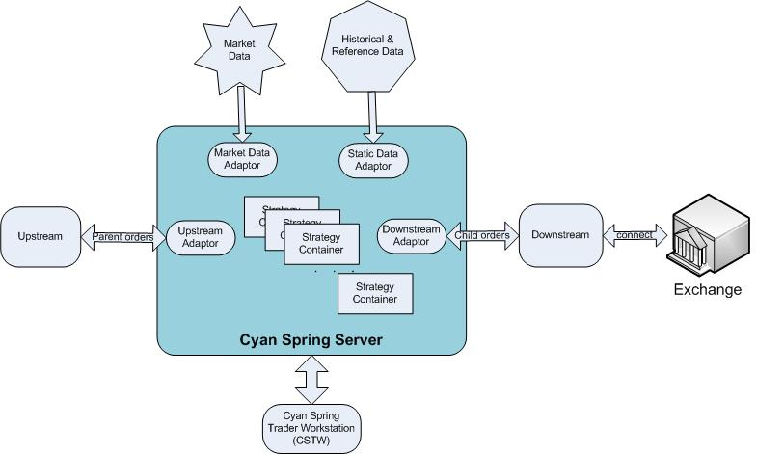
Develop Automated Trading System
CyanSpring - http://www.cyanspring.com
Notes:
Open the Web site

Slide 78
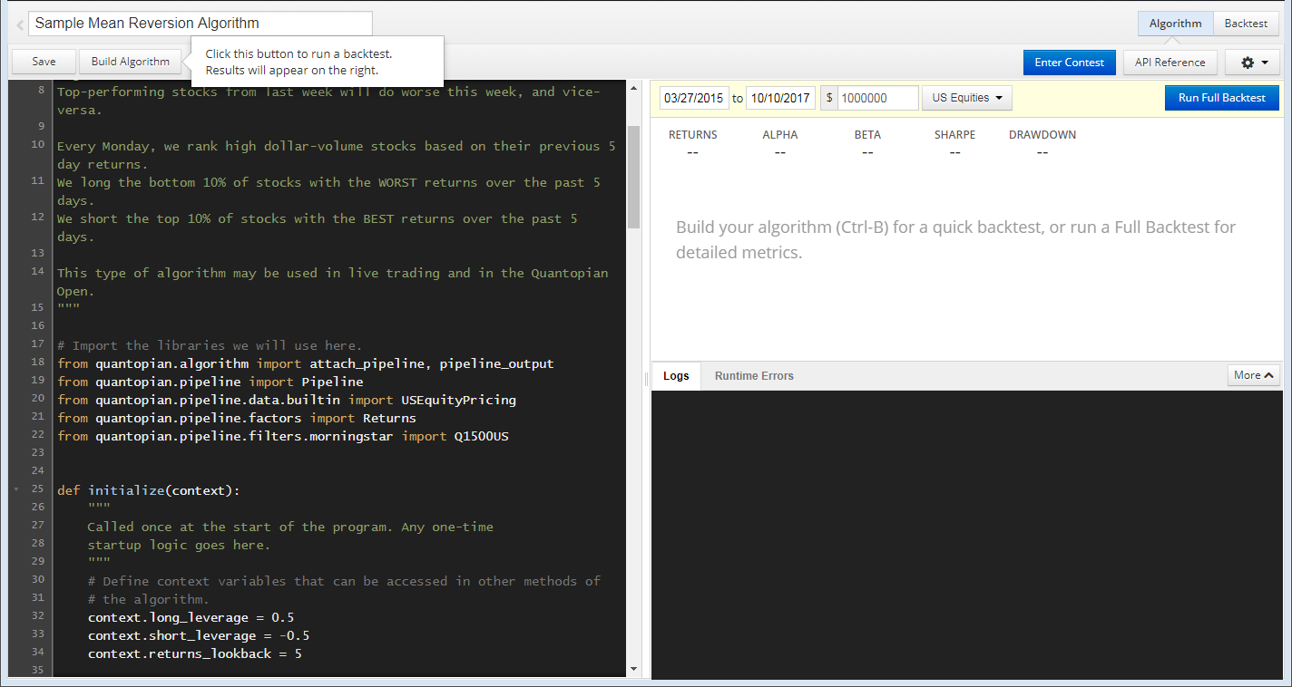
Develop Automated Trading System
Quantopian - https://www.quantopian.com/home

Slide 79
Trading Signals - Order Book Imbalance
Order Book Imbalance: the average ratio between the best bid and best ask size over a 1-min window. If the average bid size is larger than the ask size (hence a positive ratio), like the example below, it indicates the price is more likely to go up. Vice versa, the price is more likely to go down.
1min-Order Book-Imbalance = Avg (Log(Best BidSize/ Best AskSize))
Options: We can take into account the first few levels (for example 3 levels) of the order book while the top level of the book will have higher weighting. The 1-min duration can also be customized to a shorter or longer duration.
Size | Bid | Ask | Size
1,000,000 | 9.5 | 9.6 | 20,000
500,000 | 9.4 | 9.7 | 50,000
700,000 | 9.3 | 9.8 | 80,000
Notes:
Ask why taking log – because the asymmetry of +ve and –ve ratio

Slide 80
Trading Signals - Money flow
Money flow: when a stock is purchased at a higher price (i.e. Last > Previous Last), it is called uptick and be considered positive money flow. When the next trade is at a lower price (a downtick), this is considered to be negative money flow.
If more shares were bought throughout the 5-min window on the uptick than the downtick, net money flow is positive because more investors were willing to pay a premium for the stock. If money flow is negative when a stock's price is rising, this could spell trouble.
5min-MoneyFlow = Σ( (Last – Previous Last) * Last Size)
Options: The 5-min duration can also be customized to a shorter or longer duration.

Slide 81
Dark Pool and Internal Crossing
Dark Pool & Internal Cross: the order execution outside the main exchange
dark means the price is not visible to human traders
save commission and execute faster
without signal the outsider
can execute at mid-price or any price in between bid/ask (save transaction cost to both buy or sell side)
Alternative Trading Venues: also called “Lit” venue (contrast to dark). Another execution venue outside main exchange but the orders can be seen
Smart order routing: logic to decide which venues (dark pool, lit venue, main exchange) to place the orders

Slide 82
Dark Pool and Internal Crossing
Dark Pool related logic usually has
anti-gaming: “min execute quantity” to prevent pinging dark pool with small order
peg-to-mid order type
give preference to certain (client) flow
only match with certain type of flow
Algo related enhancements
Stealth: can rest all quantity in dark pool as the order is not visible to human
Benchmark Algos: can place certain portion into the dark pool with peg-to-mid order type to save spread costs

Slide 83
Dark Pool and Internal Crossing
Co-location: host the trading systems closer or at the exchange premise
receive market data and signal faster
increase the speed of transactions
Some news regarding Dark Pool in HK
https://www.finextra.com/news/announcement.aspx?pressreleaseid=53263
http://www.scmp.com/business/markets/article/1799052/hong-kongs-sfc-bans-retail-investors-dark-pool-trading-platforms
http://www.reuters.com/article/us-hongkong-jpmorgan-fine/hong-kong-watchdog-fines-jpmorgan-for-dark-pool-control-failures-idUSKBN0TY0XE20151215
Notes:
One change: remove the explicit Dark Pool Algo from the UI (in fact, use params can do)

Slide 84
Further Readings
Algorithmic Trading-Chapter 1, Elsevier Inc . 2013, The Science of Algorithmic Trading and Portfolio Management, Chapter 1, pp.1-45
Gated Bayesian networks for algorithmic trading, International Journal of Approximate Reasoning, February 2016, Vol.69, pp.58-80
Álvaro Cartea, Sebastian Jaimungal, José Penalva (2015).Algorithmic and High-Frequency Trading. Cambridge University Press.
Perry J. Kaufman (2013). Trading Systems and Methods (5th Edition). Wiley.
Robert Kissell (2013). The Science of Algorithmic Trading and Portfolio Management. Academic Press.
Kevin Davey (2014). Building Winning Algorithmic Trading Systems, + Website: A Trader's Journey From Data Mining to Monte Carlo Simulation to Live Trading. Wiley.

Slide 85

Thank you

