Slide 1
Natural Language Processing – word2vec
Ken Liu

Slide 2
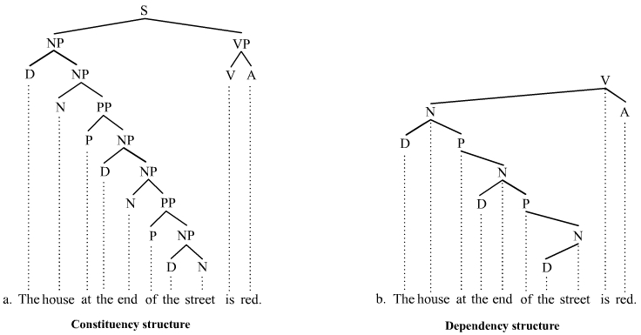
Treebanks
Notes:
Corpus, Treebank: manually prepare a lot data

Slide 3
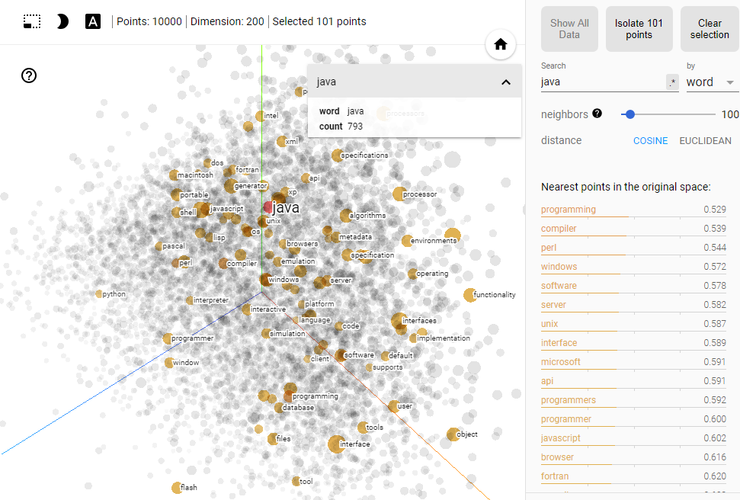
Word2Vec – Demo
http://projector.tensorflow.org/
https://colab.research.google.com/
https://github.com/kenwkliu/space

Slide 4
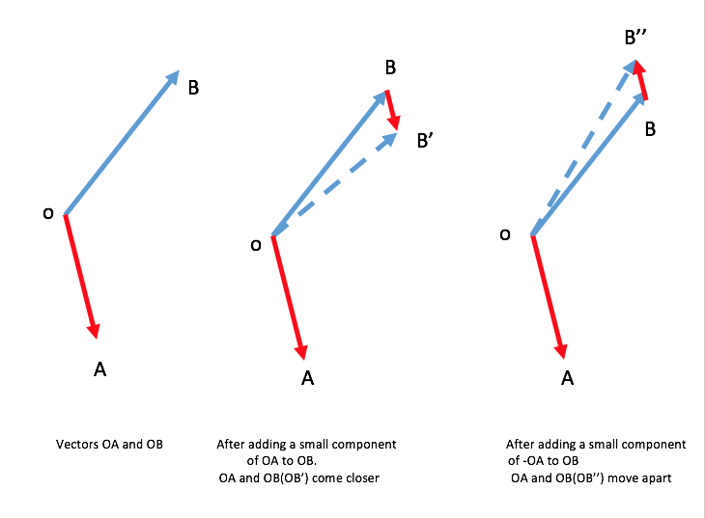
Word2Vec - Definition
Context: a fixed number of words in front of and behind the word of interest
Example: Mary is a very stubborn child. Her pervicacious nature always gets her in trouble: pervicacious is surrounded by stubborn, nature, and trouble. Learns the meaning of a given word by looking at its context and representing it numerically.
“a word is characterized by the company it keeps - John Rupert Firth”

Slide 5
Word2Vec – Similarity
most_similar('car')
[('cars', 0.5899946093559265),
('vehicle', 0.5460749864578247),
('vehicles', 0.455700546503067),
('auto', 0.38780486583709717),
('suv', 0.3466867208480835),
('minivan', 0.3353206515312195),
('truck', 0.31946268677711487),
('minicar', 0.3166467249393463),
('home', 0.314445436000824),
('bike', 0.3133225739002228)]
most_similar('risk')
[('risks', 0.5921677947044373),
('probability', 0.4140169024467468),
('likelihood', 0.3951364755630493),
('possibility', 0.3811781406402588),
('uncertainty', 0.34543055295944214),
('challenge', 0.322320818901062),
('concern', 0.288372278213501),
('uncertainly', 0.2852689027786255),
('odds', 0.271675169467926),
('threat', 0.2695636749267578)]

Slide 6
Word2Vec – Dissimilarity
doesnt_match('revenue tax sales income'.split())
Out: 'tax'
doesnt_match('apple samsung microsoft'.split())
Out: 'microsoft'
doesnt_match('apple ibm microsoft'.split())
Out: 'apple'
doesnt_match('dy pe pb growth'.split())
Out: 'growth'
doesnt_match('car pe pb growth'.split())
Out: 'car'
doesnt_match('excellent good bad'.split())
Out: 'bad'

Slide 7
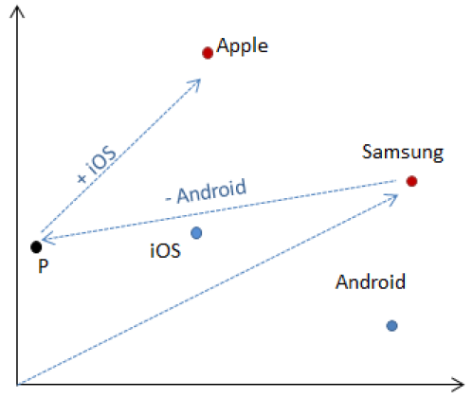
Word2Vec - Addition and subtraction
most_similar(
positive=['samsung', 'ios'],
negative=['android'])
[('apple', 0.35112401843070984),
('compal', 0.2893127202987671),
('renesas', 0.28568124771118164),
('sdc', 0.26545387506484985),
('memory', 0.26283740997314453),
('samsungs', 0.26225510239601135),
('netapp', 0.260621041059494),
('everlight', 0.2575075924396515),
('sec', 0.2570921778678894),
('wematch', 0.2497785985469818)]

Slide 8
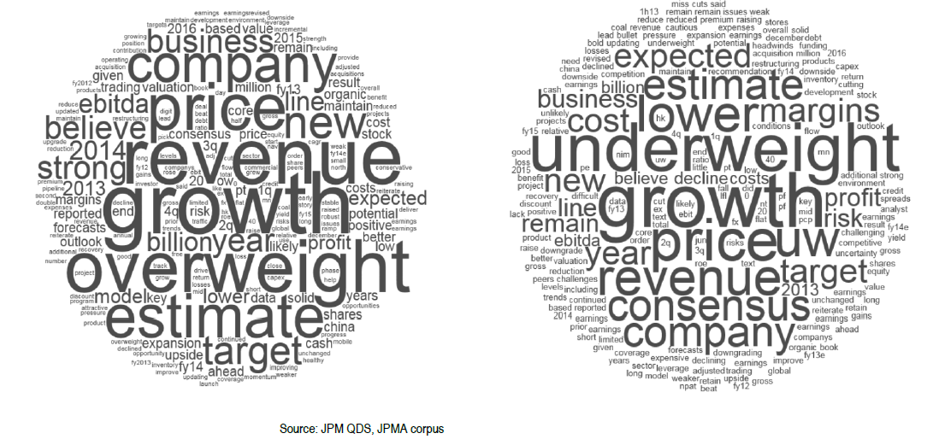
Word2Vec – Sentiment Analysis
https://multithreaded.stitchfix.com/blog/2015/03/11/word-is-worth-a-thousand-vectors/

