Slide 1
Reversing Trojan.Mebroot’s Obfuscation
Nicolas Falliere
Security Technology and Response

Slide 2
Mebroot Details
Trojan horse, appeared in the mid-2008
Other name: Sinowal
Installs a kernel-mode driver in the last sectors of the hard drive
Infects the MBR, hooks the Windows boot chain:
interrupt hook, ntldr hook, sector fetching, payload driver load
Super stealthy: no visible file on disk, no infected file, no registry modification
Low level hooks in kernel mode to bypass traffic sniffing on an infected host
Goal: download DLLs from the Internet, inject them into specific processes

Slide 3
Mebroot Obfuscation - Intro
One of the most complex malware there is
The threat is packed…
The payload driver has about 1000 routines
Extra protection: about 25% of these routines are obfuscated
Example:
Routines used to generate a random domain used to query a C&C server
Routines used to build up network packets
What’s the obfuscation like, how can we defeat it?

Slide 4
Obfuscation 101 - Spaghetti
Classic obfuscation used by threats make use of Spaghetti code
Conficker/Downadup, Hydraq, …
Characteristics:
JMP insertion inside function Basic Blocks (BB)
Blocks may be scattered in the file
Assembly reading is tricky
Decompiler can handle this easily (e.g., Hexrays)
This type of obfuscation does not require extra code (ie, extra logic)
Because it’s unconditional branches insertion
Easy to reverse:
Let BB1 and BB2 be two basic blocks
IF BB1 unconditionally branches to BB2 AND references_to(BB2) == {B1}, THEN merge(BB1, BB2)

Slide 5
Spaghetti - Example
BB1
BB2

Slide 6
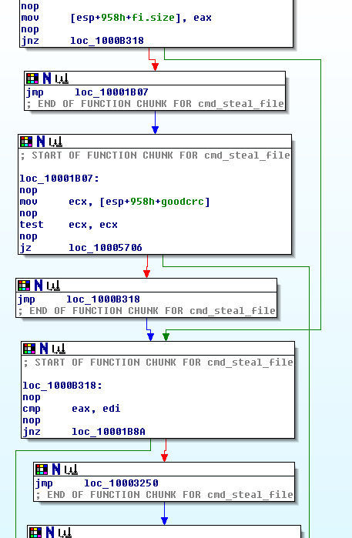

Slide 7
Mebroot Obfuscation - What
Mebroot uses a state machine-like obfuscation technique:
Sets up a state variable to hold a state value
After execution of a BB, the state is modified
A dispatcher is called, that will determine what BB execute next based on the updated state value
Consequences:
The flow of the original function is modified
State machine instructions overhead (+ junk)
Assembly unreadable, decompiled code even more unreadable

Slide 8
Representation of an obfuscated routine
Function EP
Dispatcher
Function blocks

Slide 9
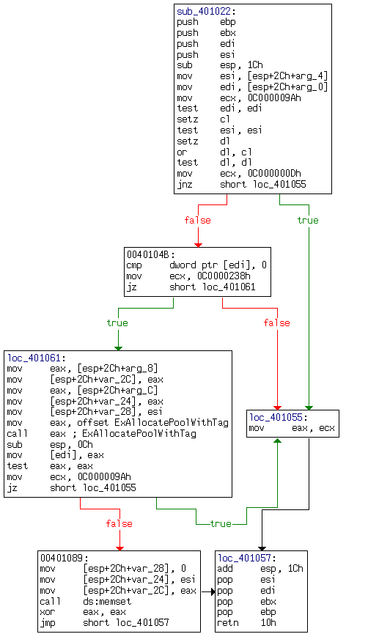
Alloc() – clean, ASM/Hexrays
signed int __stdcall alloc(
PVOID *pdata,
size_t size,
int pooltype,
ULONG tag)
{
signed int st; // ecx@1
signed int result; // eax@3
void *p; // eax@5
st = STATUS_INVALID_PARAMETER;
if ( pdata == 0 | size == 0
|| (st = STATUS_ADDRESS_ALREADY_ASSOCIATED, *pdata)
|| (p = ExAllocatePoolWithTag(pooltype, size, tag),
*pdata = p,
st = STATUS_INSUFFICIENT_RESOURCES, !p) )
{
result = st;
}
else
{
memset(p, 0, size);
result = 0;
}
return result;
}

Slide 10
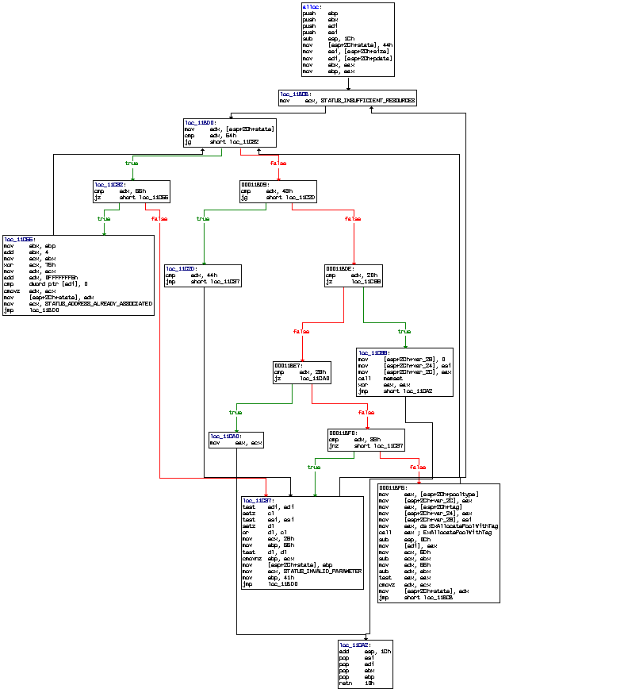
Alloc() – obfuscated, ASM

Slide 11
Alloc() – obfuscated, Hexrays
NTSTATUS __stdcall alloc(PVOID *pdata, SIZE_T size, POOL_TYPE pooltype, ULONG tag)
{
int x1; // ebx@1
signed int x2; // ebp@1
int eax0; // eax@1
signed int Status; // ecx@2
int x5; // edx@8
signed int x4; // ebp@13
int x3; // edx@16
PVOID p; // eax@19
signed int state; // [sp+18h] [bp-14h]@1
state = 68;
x1 = eax0;
x2 = eax0;
while ( 2 )
{
Status = STATUS_INSUFFICIENT_RESOURCES;
while ( 1 )
{
while ( state > 84 )
{
if ( state != 85 )
goto label0;
x1 = x2 + 4;
x3 = ((x2 + 4) ^ 0x76) - 11;
if ( !*pdata )
x3 = (x2 + 4) ^ 0x76;
state = x3;
Status = STATUS_ADDRESS_ALREADY_ASSOCIATED;
}
if ( state <= 67 )
break;
label0:
x4 = 85;
if ( pdata == 0 | size == 0 )
x4 = 40;
state = x4;
Status = STATUS_INVALID_PARAMETER;
x2 = 65;
}
if ( state == 32 )
{
memset(p, 0, size);
return 0;
}
if ( state != 40 )
{
if ( state == 51 )
{
p = ExAllocatePoolWithTag(pooltype, size, tag);
*pdata = p;
x5 = 101 - x1;
if ( !p )
x5 = 109 - x1;
state = x5;
continue;
}
goto label0;
}
return Status;
}
}

Slide 12
Solution 1 – Code Injection
Function prototype analysis
How do we call the function, what parameters?
Kernel code injection
We call the obfuscated routine, get the result
Works well if we know what the routine does (blackbox point of view)
Ex: generate_domain (complex, highly obfuscated)
But the prologue can be derived easily
signed int __stdcall generate_domain_random_method0(
PCHAR buffer, unsigned int buffersize, unsigned __int16 seed2, PTIME_FIELDS t)
{
if(!( buffer > *minaddress && buffersize && t > *minaddress ))
return 0;
return generate_domain(t->Year, t->Month, t->Day, buffer, buffersize, 91u, seed2);
}

Slide 13
Solution 2 – Reverse the obfuscation
How is the state machine/dispatcher implemented
.text:00011BB0 push ebp
.text:00011BB1 push ebx
.text:00011BB2 push edi
.text:00011BB3 push esi
.text:00011BB4 sub esp, 1Ch
.text:00011BB7 mov [esp+2Ch+state], 44h
.text:00011BBF mov esi, [esp+2Ch+arg_4]
.text:00011BC3 mov edi, [esp+2Ch+arg_0]
.text:00011BC7 mov ebx, eax
.text:00011BC9 mov ebp, eax
.text:00011BD0 mov edx, [esp+2Ch+var_14]
... ...
.text:00011BD0 mov edx, [esp+2Ch+state]
.text:00011BD4 cmp edx, 54h
.text:00011BD7 jg loc_A
.text:00011BD9 cmp edx, 43h
.text:00011BDC jg loc_B
.text:00011BDE cmp edx, 20h
.text:00011BE1 jz loc_C
.text:00011BE7 cmp edx, 28h
.text:00011BEA jz loc_D
.text:00011BF0 cmp edx, 33h
.text:00011BF3 jnz loc_E
... ...
Initial State
Junk
Read State
Dispatcher

Slide 14
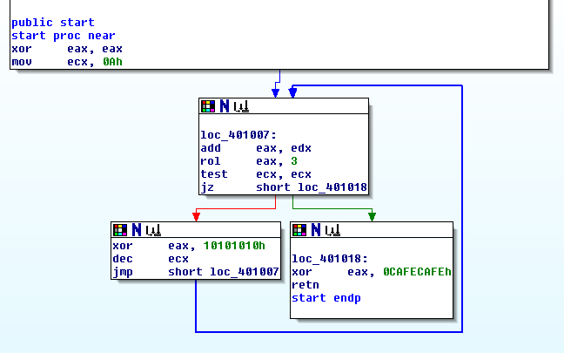
Reminder – Basic Blocks
Routine can be seen as a graph of Basic Blocks
Instructions of a BB are executed consecutively (exceptions apart)
No branching instructions; exception: CALL
4 types of BBs (3, really: Fallthrough == Uncond. branch)
Fallthrough
Cond. branch
Uncond. branch
Return to
Caller

Slide 15
Obfuscated BB type #1
Simple basic block of type RET:
...
State_XXX:
.text:00011CA2 add esp, 1Ch
.text:00011CA5 pop esi
.text:00011CA6 pop edi
.text:00011CA7 pop ebx
.text:00011CA8 pop ebp
.text:00011CA9 retn 10h
Difficulty: None
returns to Caller
No state update
The simplest kind of « transformed » block

Slide 16
Obfuscated BB type #2
Simple basic block of type JMP or Fallthrough:
...
State_YYY:
.dump:81728CC0 mov esi, ecx
.dump:81728CC2 and esi, 41h
.dump:81728CC5 mov edx, 42h
.dump:81728CCA sub edx, esi
.dump:81728CCC mov edi, MT_table[eax*4]
.dump:81728CD3 mov [esp+14h+state], edx
.dump:81728CD6 mov esi, edi
.dump:81728CD8 shr esi, 1Eh
.dump:81728CDB mov ebx, eax
.dump:81728CDD inc ebx
.dump:81728CDE jmp dispatch
Next state calculated
using arith. ops.
Updates state
Difficulty: Medium
Need to figure out what the next value of state is
The intermediate instructions (between state update and jmp dispatch) can be of any kind

Slide 17
Obfuscated BB type #3
Simple basic block of type JCC (cond. jump):
...
State_ZZZ:
.text:00011C65 mov ebx, ebp
.text:00011C67 add ebx, 4
.text:00011C6A mov ecx, ebx
.text:00011C6C xor ecx, 76h
.text:00011C6F mov edx, ecx
.text:00011C71 add edx, 0FFFFFFF5h
.text:00011C74 cmp dword ptr [edi], 0
.text:00011C77 cmovz edx, ecx
.text:00011C7A mov [esp+2Ch+state], edx
.text:00011C7E mov ecx, 0C0000238h
.text:00011C83 jmp dispatch
Next states calculation
Mebroot characteristic:
Uses cmovcc to set
the next state value
Updates state
Difficulty: High
Two potential state values
They should be calculable independently of program-state values (globals, input parameters, etc.)
The intermediary instructions (between state update and jmp dispatch) CANNOT modify the flags!

Slide 18
Tackling the obfuscation
What can be done
Identify the dispatcher
Find all valid states (ie, states that lead to executing a basic block)
Clean the code
Assemble the BBs
This could work well for 1 or 2 routines
There are hundreds of them…
Some of them huge
The dispatcher is sometimes messed up, and BBs don’t necessarily jump at its first instruction
We’d like to validate the code, for instance:
Make sure the state var is not updated where it should not

Slide 19
A solution
A combination of partial emulation and static analysis
Context-based emulation
Definition of « Context »:
ID = the state variable
Processor, Memory (emulator, virtual memory, x86 parser, etc.)
Items’ states (for registers, flags, memory): defined, undefined
Emulating an instruction with all items defined...
Means the execution result will be defined (D)
Emulating an instruction with one or more undefined items...
Means the execution result(s) will be undefined (UD)

Slide 20
Context-based emulation
mov X, Y
Y must be defined
X need not be defined
add X, Y
X must be defined
Y must be defined
push X
X must be defined
ESP must be defined

Slide 21
Context-based emulation (continued)
The operands (X, Y, etc) can be (simplified):
Immediate
Registers
Memory
Conditions of “operand is defined”:
Immediate: ALWAYS
Registers: MAYBE defined, can be partially defined (ex: AL of EAX)
Memory (size ptr [base + scale*index + disp])
BASE and INDEX registers defined
Memory item pointed to defined

Slide 22
Context-based emulation example
Context (ID=123):
Registers: all undefined, except esp(20000h), ecx(30000h)
Flags: all undefined
Memory: all undefined, except dword@30000h
mov eax, 12
add eax, ebx
push ecx
pop edx
xor dword [edx], eax
jz $+1234
: eax UD -> eax D
: eax D, ebx UD -> eax UD
: esp D, ecx D -> esp D, dw@20000 D
: esp D, edx UD -> esp D, edx D
: edx D, dw@edx D, eax UD! -> dw@edx UD
: target D, zeroflag UD -> ip UD
emulation stops

Slide 23
Mebroot specificities
When we reach state variable manipulation instructions, the instruction input items must be defined
Except for the flags in the case of cmovcc
When we reach a state variable update instruction (mov [esp+state], xxxx), the end of the «original» BB is getting closer:
It could be a block of type #2 (JMP, Fallthrough)
It could be a block of type #3 (JCC) -> ONLY if cmovcc stateX, state Y was encountered before
If reach a RET, we should not have encountered a state variable update instruction before
It is a block of type #1 (RET)

Slide 24
Contexts creation
Start with an initial context
New contexts are created:
BB type #1: none
BB type #2: one context
BB type #3: two contexts
The contexts are stacked up for analysis
Emulation of context ends when the « branch to dispatcher » instruction is found

Slide 25
Recap - Assumptions
The state variable is initialized in the function prologue:
mov [esp+state], xxx
Original BBs #1 – RET
Do not update the state variable
Do not branch to the dispatcher
End with RET
Original BBs #2 – JMP/FT
Update the state variable
Branch to the dispatcher
Original BBs #3 – JCC
Use cmovcc to set the next state to a temp register
Update the state variable
Branch to the dispatcher

Slide 26
The original blocks
The emulation trace constitutes an original basic block (dirty)
Clean up: remove all intermediary JCC/JMP that belong to the dispatcher’s execution
Remove junk, eventually
Add proper linkage instruction:
Type #1: RET
Type #2: Nothing (Fallthrough) or JMP
Type #3: JCC matching the CMOVCC
Finally, the blocks are assembled, the routine generated (taking care of imports, relocations, etc) and a clean PE is built

Slide 27
Processing a file
Finding the obfuscated routines is easy:
Pattern of routine prologue:
push reg0
push reg1
...
sub esp, xxxxxxxx
mov [esp],state0
The state variable location is derived
The initial context can be set up:
All memory items are undefined
All GP registers are defined
Flags are undefined

Slide 28
Example – alloc()
alloc proc near
push ebp
push ebx
push edi
push esi
sub esp, 1Ch
mov [esp+2Ch+state], 44h
mov esi, [esp+2Ch+arg_4]
mov edi, [esp+2Ch+arg_0]
mov ebx, eax
mov ebp, eax
loc_11BCB:
mov ecx, 0C000009Ah
loc_11BD0:
mov edx, [esp+2Ch+state]
cmp edx, 54h
jg short loc_11C32
cmp edx, 43h
jg short loc_11C2D
cmp edx, 20h
jz loc_11C88
cmp edx, 28h
jz loc_11CA0
cmp edx, 33h
jnz short loc_11C37
mov eax, [esp+2Ch+arg_8]
mov [esp+2Ch+var_2C], eax
mov eax, [esp+2Ch+arg_C]
mov [esp+2Ch+var_24], eax
mov [esp+2Ch+var_28], esi
mov eax, ds:ExAllocatePoolWithTag
call eax
sub esp, 0Ch
mov [edi], eax
mov ecx, 6Dh
sub ecx, ebx
mov edx, 65h
sub edx, ebx
test eax, eax
cmovz edx, ecx
mov [esp+2Ch+state], edx
jmp short loc_11BCB
loc_11C2D:
cmp edx, 44h
jmp short loc_11C37
loc_11C32:
cmp edx, 55h
jz short loc_11C65
loc_11C37:
test edi, edi
setz cl
test esi, esi
setz dl
or dl, cl
mov ecx, 28h
mov ebp, 55h
test dl, dl
cmovnz ebp, ecx
mov [esp+2Ch+state], ebp
mov ecx, 0C000000Dh
mov ebp, 41h
jmp loc_11BD0
.......
retn 10h
alloc endp

Slide 29
Example – context #0
Emulation of the initial context:
push ebp
push ebx
push edi
push esi
sub esp, 1Ch
mov [esp+2Ch+state], 44h
mov esi, [esp+2Ch+arg_4]
mov edi, [esp+2Ch+arg_0]
mov ebx, eax
mov ebp, eax
...
mov ecx, 0C000009Ah
...
mov edx, [esp+2Ch+state]
cmp edx, 54h
jg short loc_11C32
...
cmp edx, 43h
jg short loc_11C2D
...
(continued)
...
cmp edx, 44h
jmp short loc_11C37
...
test edi, edi
setz cl
test esi, esi
setz dl
or dl, cl
mov ecx, 28h
mov ebp, 55h
test dl, dl
cmovnz ebp, ecx
mov [esp+2Ch+state], ebp
mov ecx, 0C000000Dh
mov ebp, 41h
jmp loc_11BD0
...
mov edx, [esp+2Ch+state]
cmp edx, 54h
jg short loc_11C32
Initial state
Next states:
NZ->28
Z->55
State update
Dispatcher detected
End of emu.

Slide 30
Example – context #0 (continued)
Clean up the emulation trace of context #0:
Linkage
Final block
push ebp
push ebx
push edi
push esi
sub esp, 1Ch
mov esi, [esp+2Ch+arg_4]
mov edi, [esp+2Ch+arg_0]
mov ecx, 0C000009Ah
test edi, edi
setz cl
test esi, esi
setz dl
or dl, cl
mov ecx, 28h
mov ebp, 55h
test dl, dl
cmovnz ebp, ecx
mov ecx, 0C000000Dh
(link?)
push ebp
push ebx
push edi
push esi
sub esp, 1Ch
mov esi, [esp+2Ch+arg_4]
mov edi, [esp+2Ch+arg_0]
mov ecx, 0C000009Ah
test edi, edi
setz cl
test esi, esi
setz dl
or dl, cl
mov ecx, 28h
mov ebp, 55h
test dl, dl
mov ecx, 0C000000Dh
jnz block_55_else_28

Slide 31
Potential issues Q&A
How about regular CMOVCC?
They’re not followed by a state variable update
We cannot calculate the next state, some items are undefined
One of the assumptions is false…
Flag modifying instructions after a CMOVCC!
They’re most likely junk, otherwise relocate the instructions
How about the junk…
It’s a separate issue not addressed in this talk
API calls, calls to subroutines
Heuristics to determine calling conventions and parameters count

Slide 32
Conclusion
Mebroot binary’s obfuscation is unique
It yields code that:
Is spaghetized
Contains extra instructions: the state machine overhead
Is not decompilable
Reversing it can be done with emulation and context validation
The methodology has 2 key elements that are Mebroot-specific:
The cmovcc stopper
The state variable watcher

Slide 33
Questions?
Thank you for attending!
Contact: nicolas underscore falliere at symantec dot com
Two interesting papers on Mebroot:
Your computer is now stoned (...again!). The rise of MBR rootkits (Kimmo Kasslin, Elia Florio)
Torpig/Mebroot RCE (Andreas Greulich)

