Slide 1

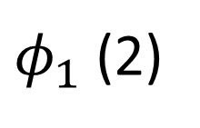

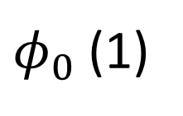

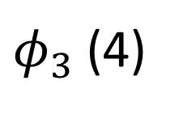
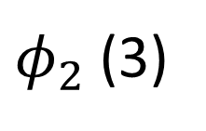
$φ_{3}$ (4)
$φ_{2}$ (3)
$φ_{1}$ (2)
$φ_{0}$ (1)
Chemical notation
$$Φ=\left|φ_{0}αφ_{0}βφ_{1}αφ_{1}β\right|$$
$$\left|φ_{0}αφ_{0}βφ_{3}αφ_{1}β\right|$$
$$\left|φ_{0}αφ_{1}βφ_{2}αφ_{2}β\right|$$
User notation
[1, -1, 2, -2]
[1, -1, 4, -2]
[1, -2, 3, -3]
Mapping by sd2indx
[0, 0, 1, 1]
[0, 0, 3, 1]
[0, 1, 2, 2]

Slide 2
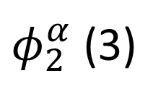
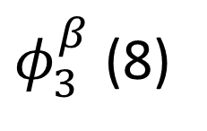
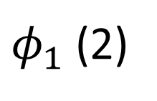
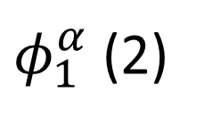
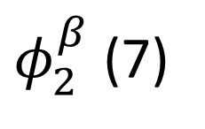
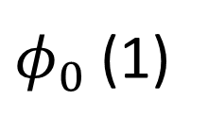
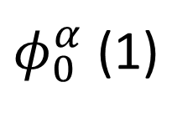
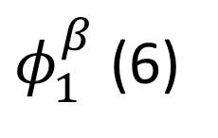
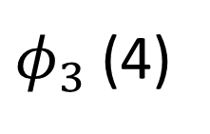
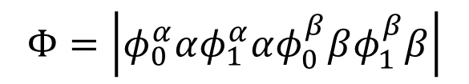
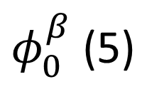
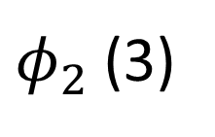
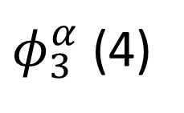

Shorthand User Notation
Extended User Notation
$φ_{3}$ (4)
$φ_{3}^{α}$ (4)
$φ_{3}^{β}$ (8)
$φ_{2}$ (3)
$φ_{2}^{α}$ (3)
$φ_{2}^{β}$ (7)
$φ_{1}^{α}$ (2)
$φ_{1}^{β}$ (6)
$φ_{1}$ (2)
$φ_{0}$ (1)
$φ_{0}^{α}$ (1)
$φ_{0}^{β}$ (5)
$$Φ=\left|φ_{0}αφ_{1}αφ_{0}βφ_{1}β\right|$$
$$Φ=\left|φ_{0}^{α}αφ_{1}^{α}αφ_{0}^{β}βφ_{1}^{β}β\right|$$
Chemical notation
[1, 2, -1, -2]
User notation
[1, 2, -5, -6]

