Slide 1
The Elements of Programming Style

Slide 2
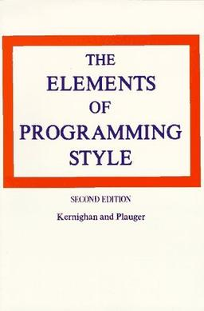
Classic text that focuses on principles and guidelines for writing clean, understandable, and efficient code.
Elements of Programming Style - Brian Kernighan
https://www.youtube.com/watch?v=8SUkrR7ZfTA

