Slide 1
The “Smart” Desk Fan
DAEMON MACKLIN

Slide 2
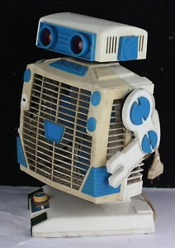
What is the “Smart” desk fan?
The Desk fan will sense the local temperature and turn on when the temperature it warm enough.
The temperature that this can be controlled from will be adjustable with a mobile device
The fan will record the temperature and when it was switched on through out the day.

Slide 3

Why?
I chose to do the desk fan because:
1. It was something simple and that would be able to be made in the time I have.
2. It was something I thought was interesting as a concept.
3. It is somewhat practical that can save on energy.

Slide 4
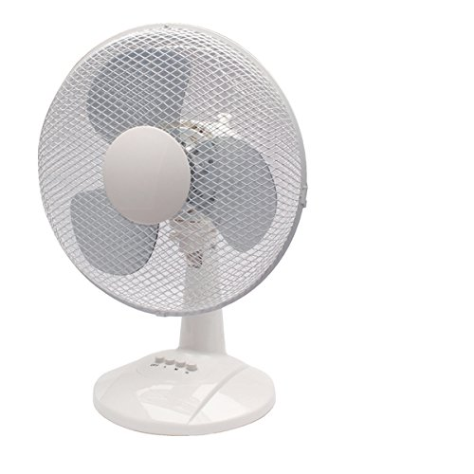
Design
The design is based of a simple desk fan anyone can buy.
There will be a small container to house the sensors and other kit the fan will use

Slide 5
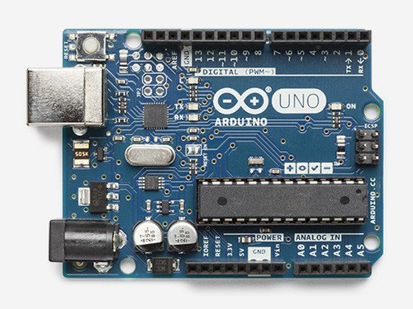
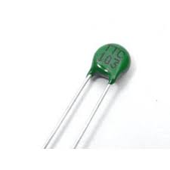
How will it work?
The fan will use and Arduino uno to do the computing.
The uno will be connected to a circuit containing a thermistor.
The thermistor will send readings to the uno which will be the determining input to decided if the fan is turned on.
The temperature that the fan turns on at will be controllable by the user via mobile device.

Slide 6


Tech used
The tech used will be the desk fan to start
An Arduino uno
A thermistor
A relay
Arduino ide
An IOT platform such as wyliodrin

Slide 7
Progress to date
So far I have created a working demo that turns on a light instead of the fan.
I have a program made using Arduino ide that takes sensor input from the thermistor
Can find all the source code and the project outline on the projects github page: https://github.com/Daemon-Macklin/iot-project1

Slide 8

Questions

