Slide 1
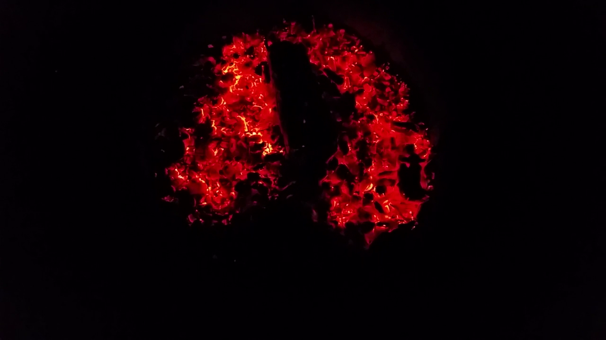
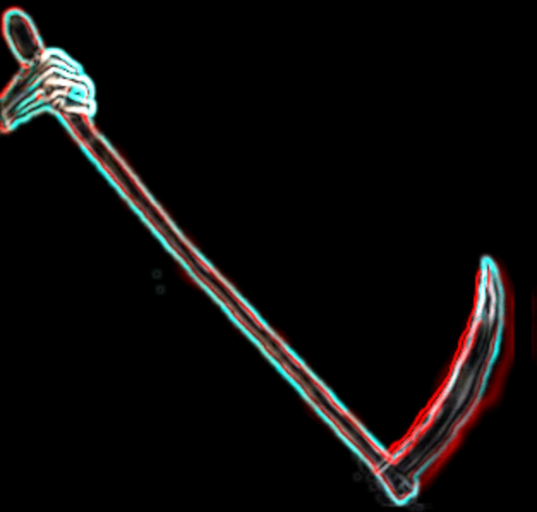
A Badlands Forge Creation
A
Badlands
Forge
Creation
Project: DoorKnocker / Company: Strajk

Slide 2
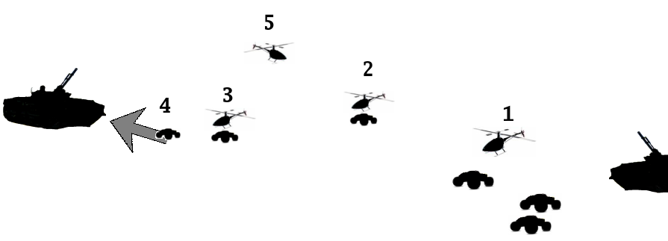
TADM (Teleoperated Air Dropped Munitions)
Deliver High Speed (90 km/hr)
High Payload (20kg HE)
MUGV onto MBT/AFV/IFV/APC/Defences
2007 System Concept

Slide 3
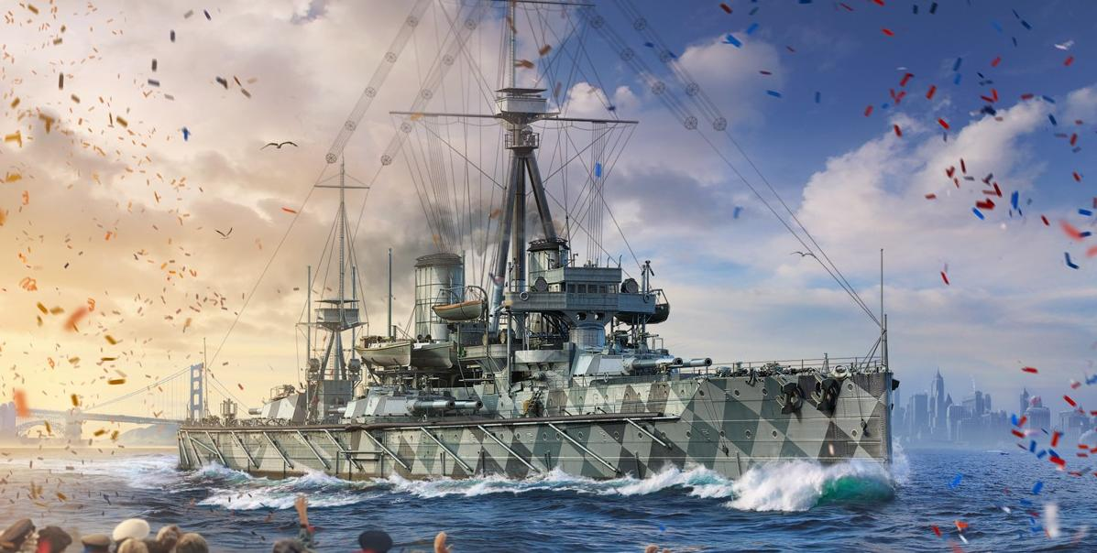
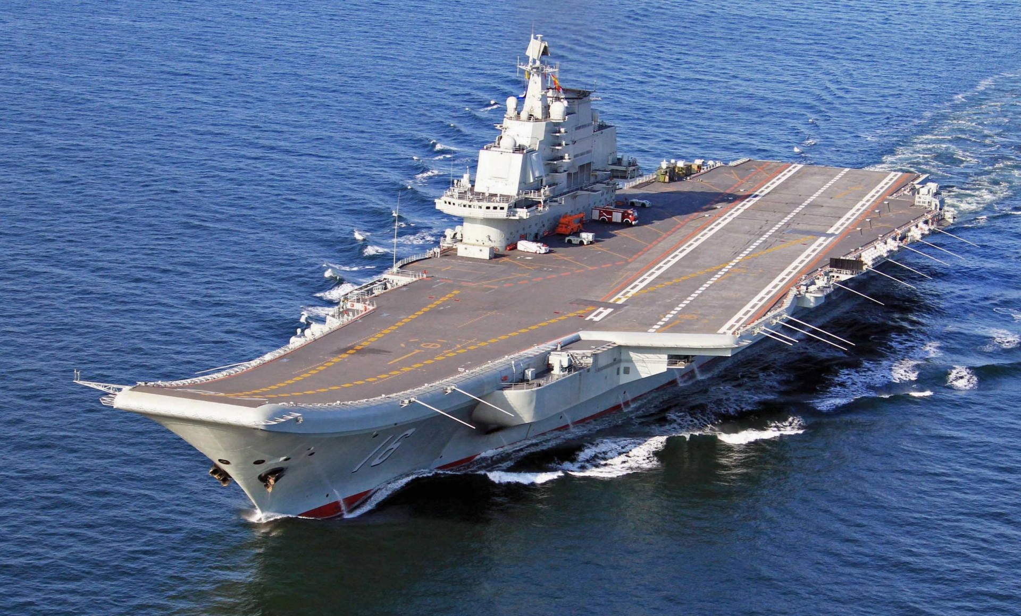
Tech Disruptive Outcome
Transforms MBT/IFV/APC/Technicals
Battleships Aircraft Carriers

Slide 4
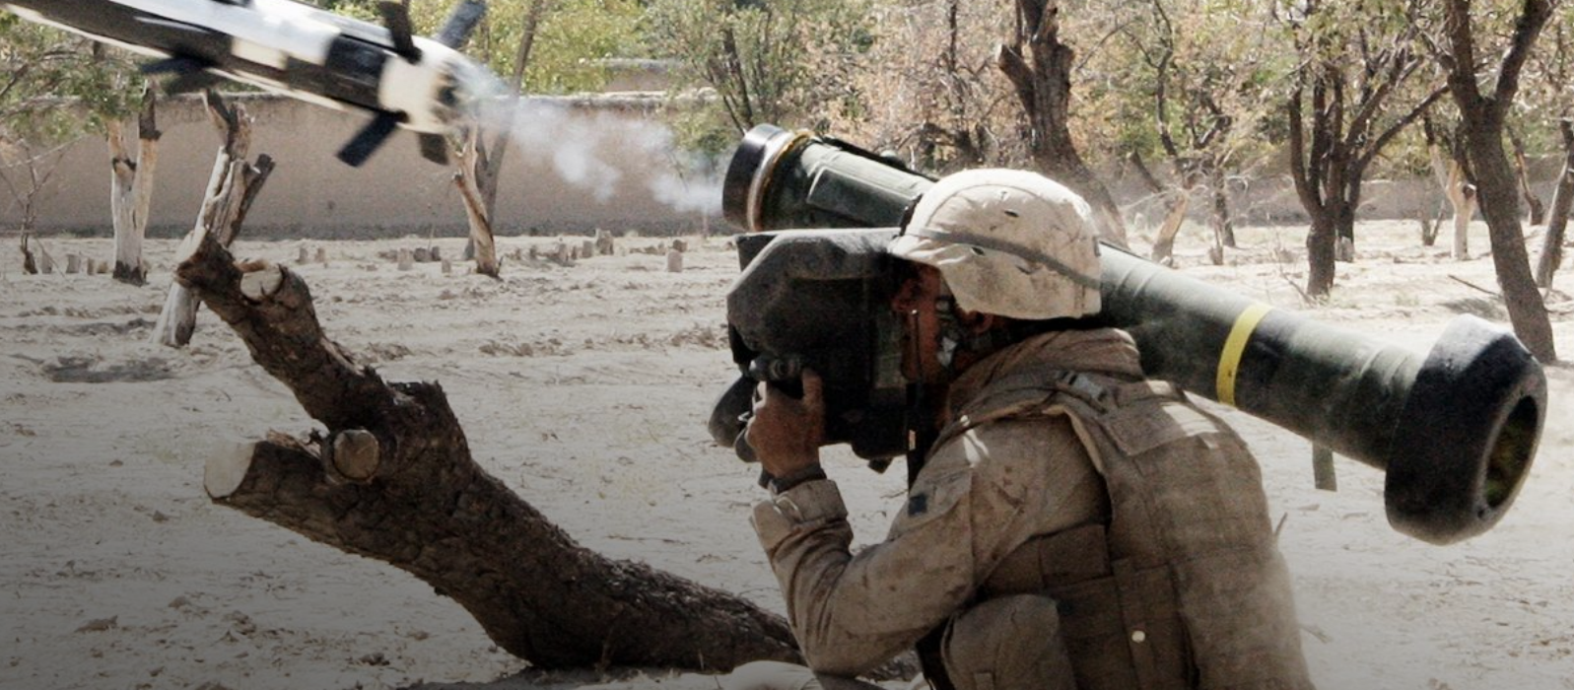
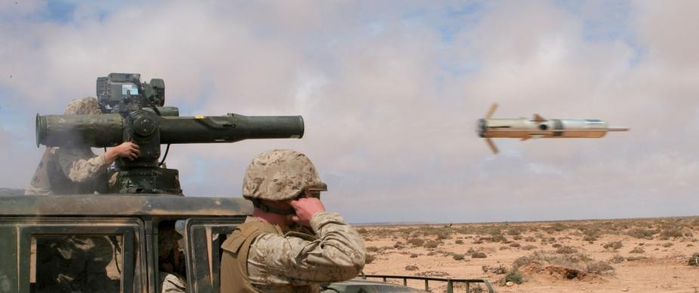
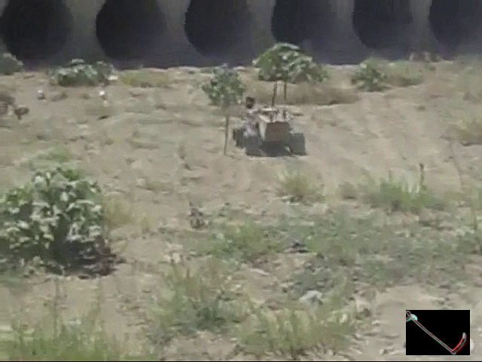
Value Proposition
COST SAVINGS
Javelin: $243,000 USD
Payload: < 8.5kg HEAT
93.8% savings
TOW-2B: $93,000 USD
Payload: < 6.145kg HEAT
83.8% savings
VIDEO A
DoorKnocker (x3): $15,000 USD
Payload: 60kg HE

Slide 5
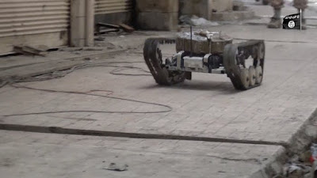
Why?
Enemy technology is in the wild.
Technique is proven.
Effectiveness is low-lying fruit ripe to leverage.
Collision is inevitable.
SEIZE THE INITIATIVE
ISIS Remote VBIED UGV

