Slide 1

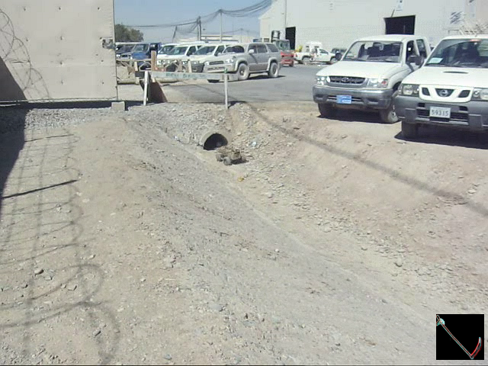
EVERY GROUND TARGET
VIDEO B
CAN BE REACHED

Slide 2
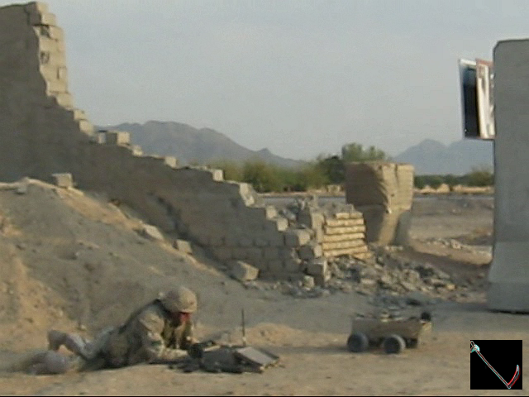
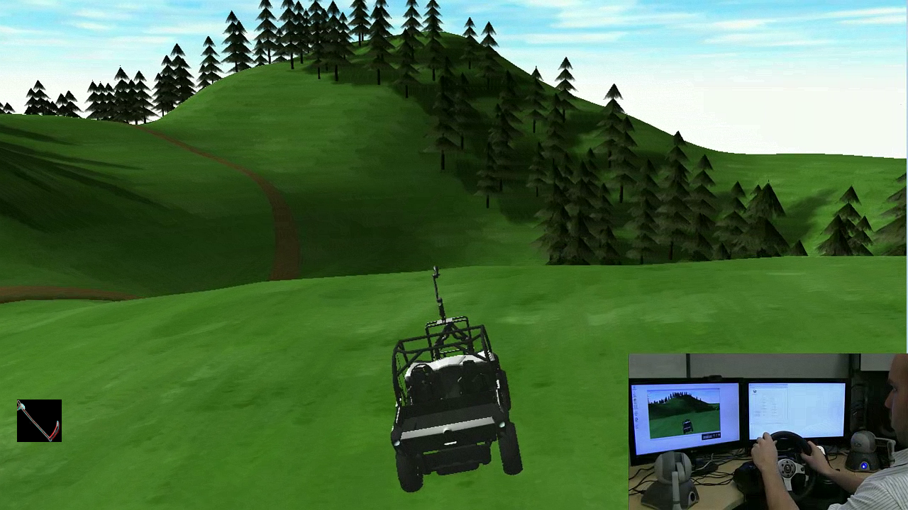
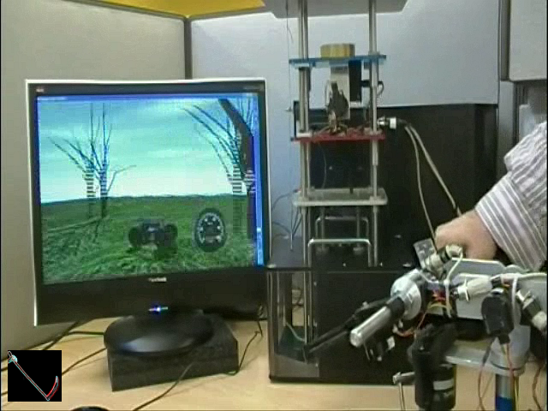
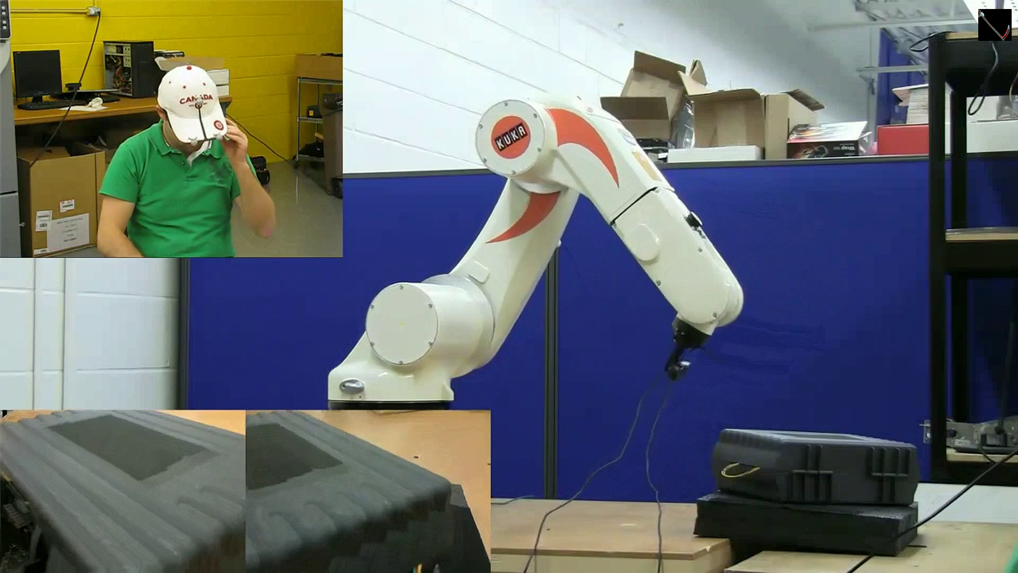
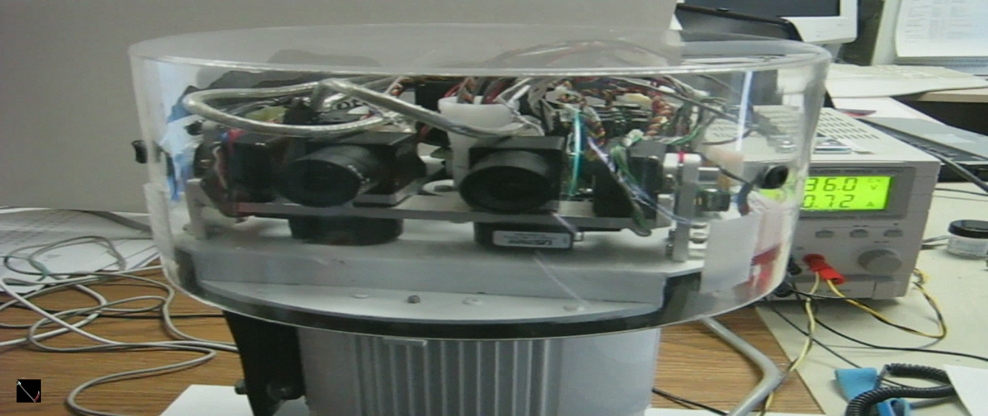
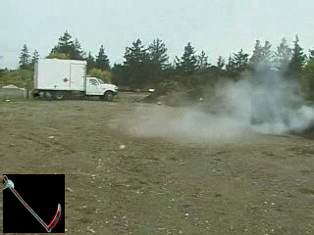
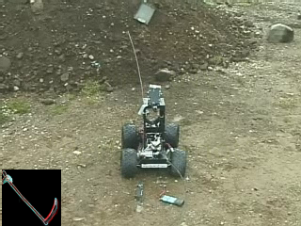
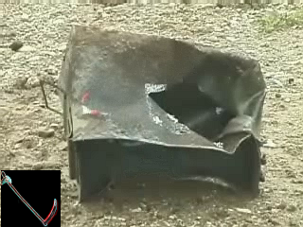
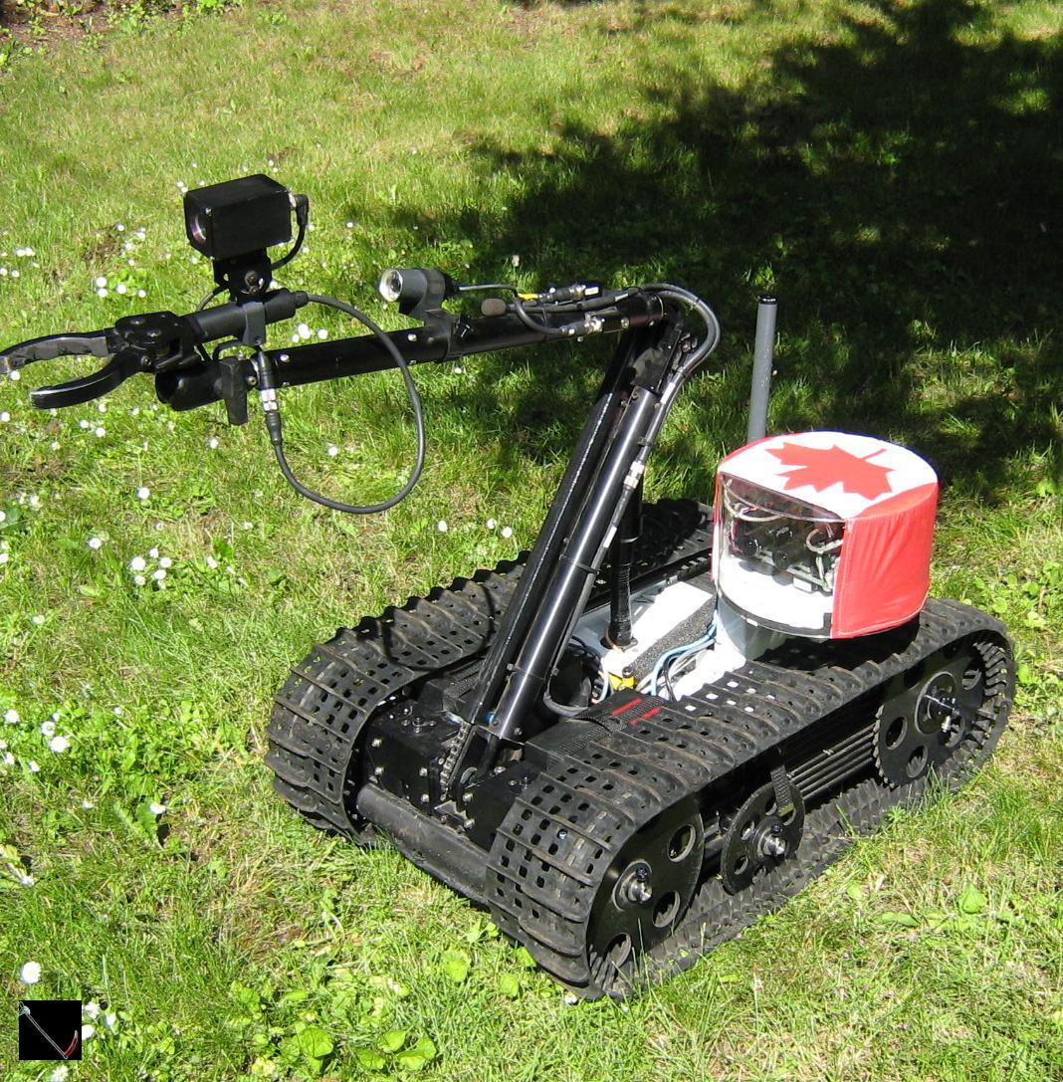
Proven Technology
MIL Ruggedized
Dynamic Model Teleop
Active Suspension
3D Heads-Up Helmet Control
Advanced AI EOD
3D Binocular Vergence Vision Control
ROBOT-GUIDED DEMOLITION
Videos C – Video C Snippets Folder

Slide 3
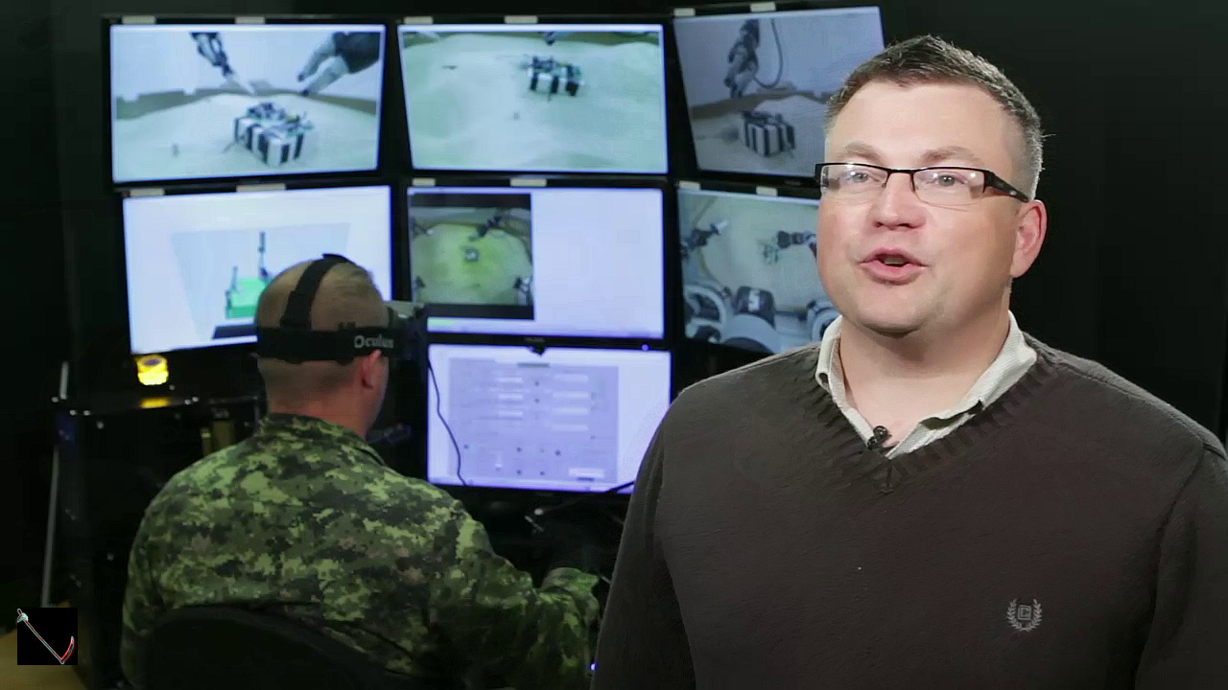
Why Dave Erickson?
LEAD INVENTOR
CA2870072C
WO2013152414A1
US9389611B2
US9579797B2
WO2015154172A1
CA2945189A1
CN106457569B
Defence Scientist 20+Yrs
100% Project Success
Video D
Erickson has ACCESS to ALL IP NEEDED

Slide 4
Hybrid
War
Advantages
ITAR-FREE PLATFORMS – TRADE-EMBARGO PROOF
NON-NATO STANAG EQUIPMENT (RF / ECM / IFF / LOGISTICS)
NO PRONE TO CAPTURE (PTK) ELECTRONICS (CRYPTO/FREQ)
THIRD PARTY DONATION WITHOUT ENCUMBERANCES
BUILD IN ANY NATION UNDER ANY BRAND
CUSTOMISABLE TO ANY HYBRID OPPONENT
( SCALE / PAYLOAD/ PLATFORM )
MEGACITIES-OPTIMIZED (DANGER VOLUMES / EFFECTS ) FOR
( [0,30km][0,30km][0,2km] XYZ ) KRULAK’S “3-Block War”
TELEOPERATED, AUTONOMOUS, COMMAND DETONATED, and LOCAL HAND-OFF / HAND-ON TO HYBRID AGENTS / ACTORS / SOF / 5th COLUMN

Slide 5
Biggest Advantage
We have ALL source code in portable form to implement real-time control on any hardware…

