Slide 1
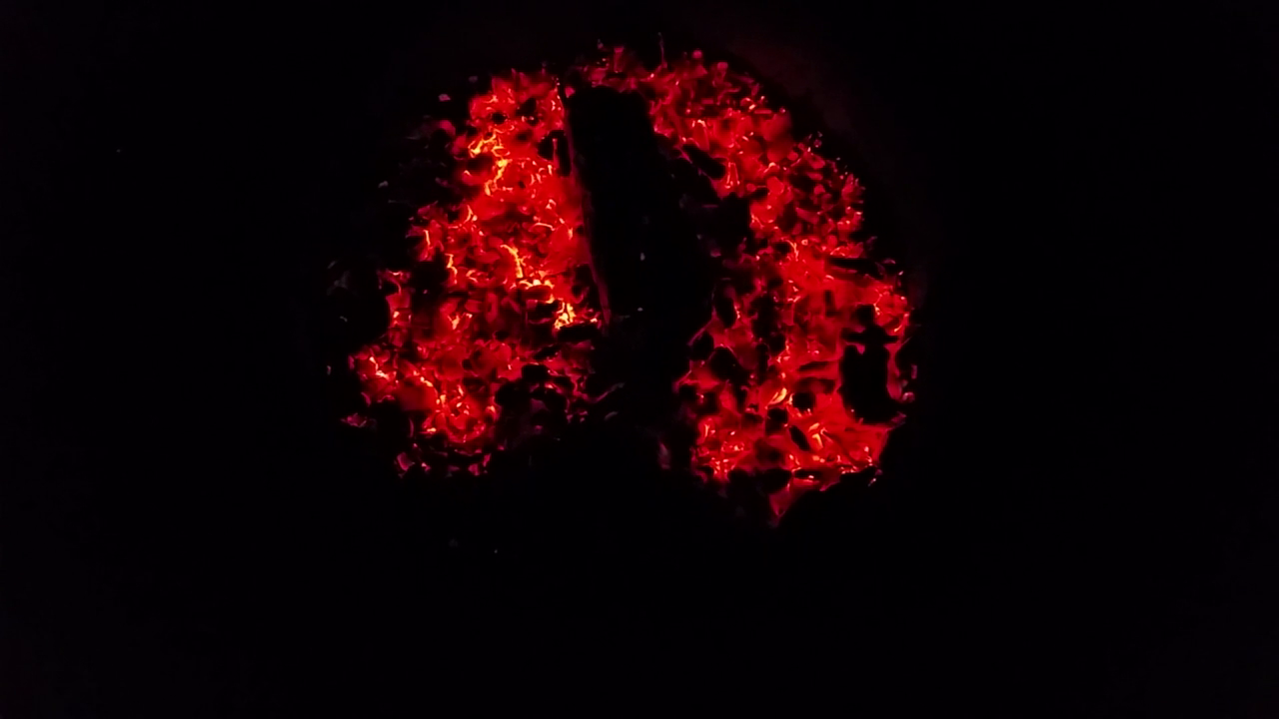
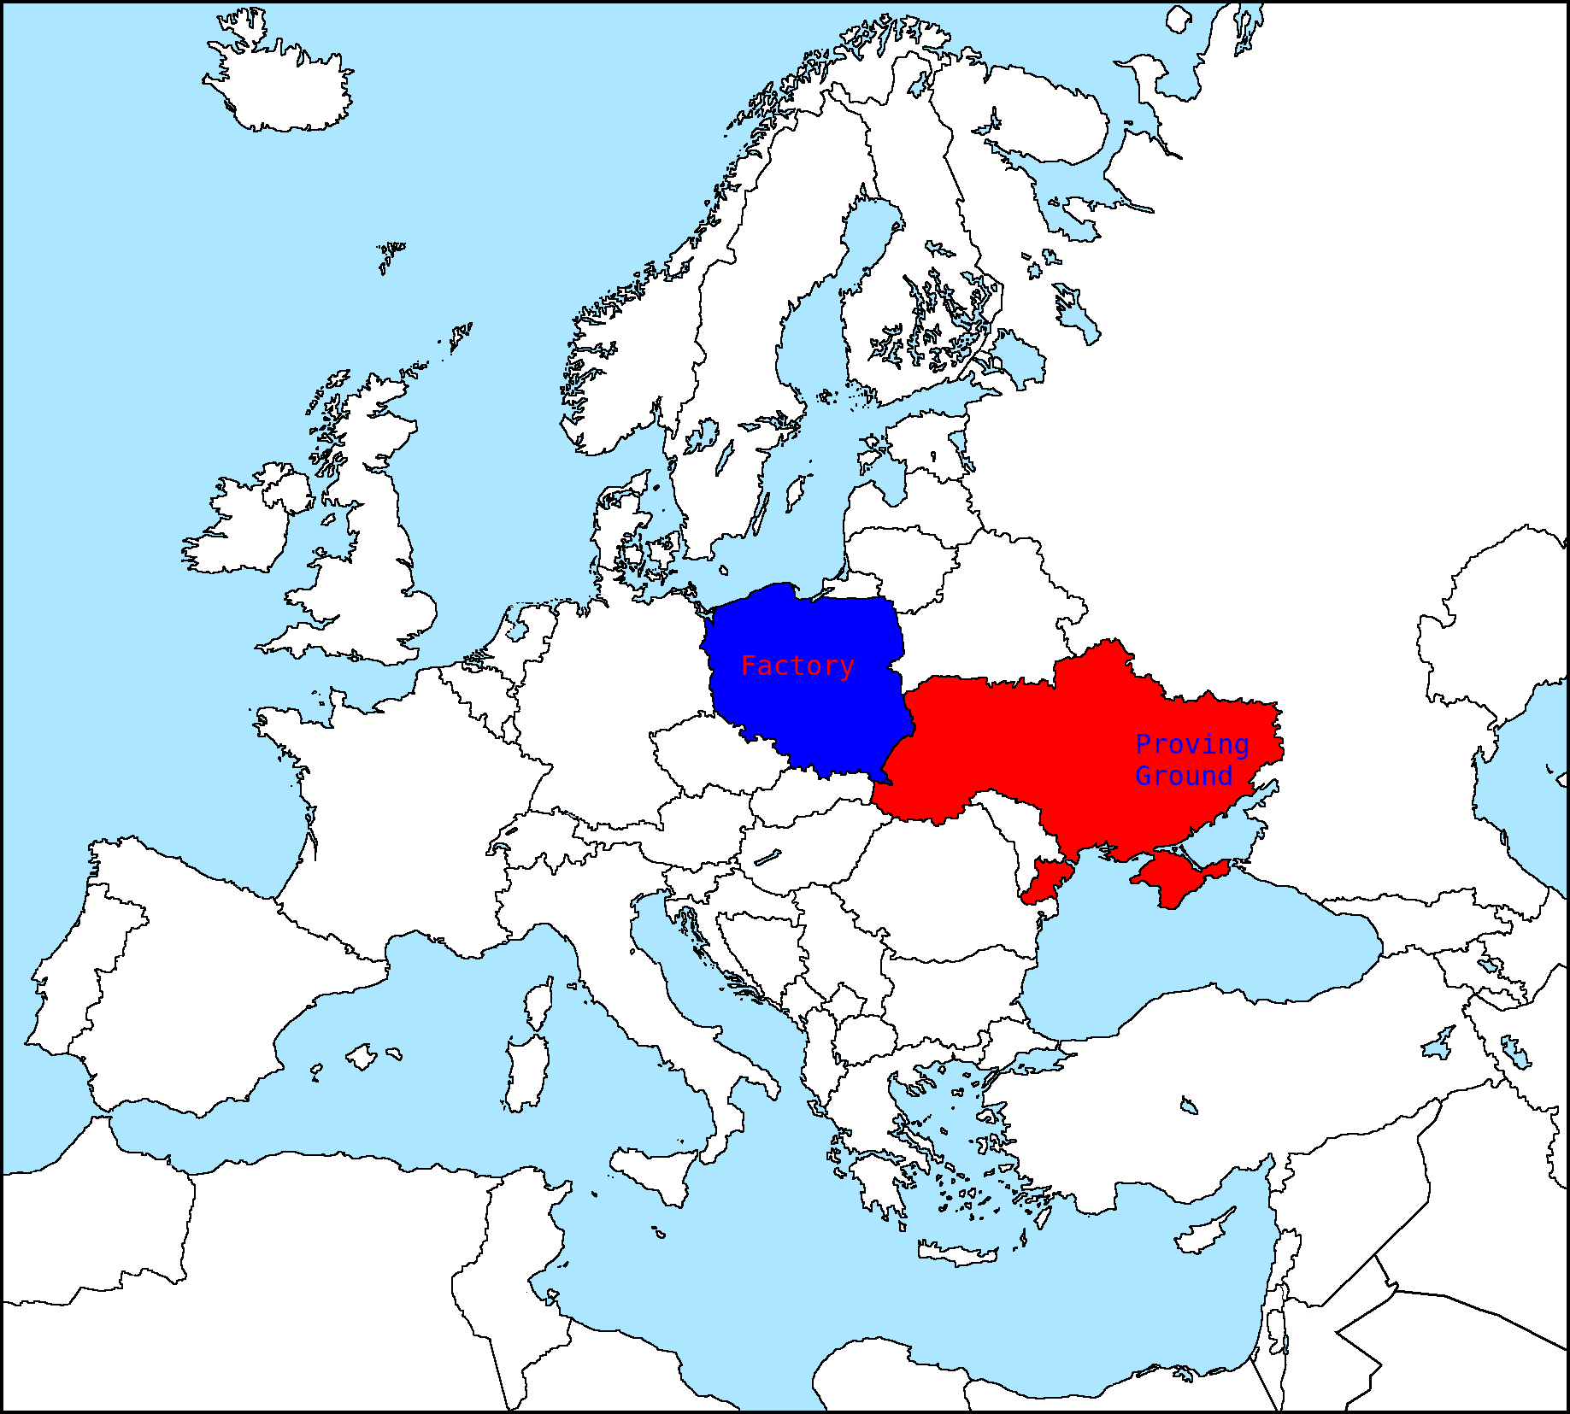





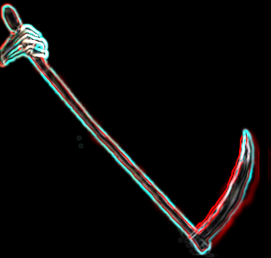










International Joint Venture
Joint Venture Compositon and Location
10%
10%
20%
TOP
TIER
10%
10%
10%
$14M CODE BASE
Holding 40%
EvergentTek.com
POTENTIAL SECOND TIER

Slide 2
Plan
Incorporate in Poland: Straik Ltd.
Factory Setup to Cell Manufacturing
Proving Ground Logistics: Planned, Implemented, and Optimized
3 Phase Development and Validation Progression
Phase 0: Baseline Production
Phase 1: 1- 5KM Experimental Validation
Phase 2: 5- 30KM Experimental Validation

Slide 3
TIMEFRAME
31 July 2022 : Letter of Interest Deadline :22: $200,000USD Deposit DUE
Negotiations: Ongoing in Parallel
1 September 2022: Phase 0 Kickoff
1 November 2022: Phase 1 Kickoff
1 May 2023: Full Production Capable
1 August 2023: Phase 2 Kickoff
1 April 2024: Phase 3 Kickoff

Slide 4
INVESTMENT
TOP TIER
20% = $5.5M (3 Board Seats) US VC
10% = $3M or in-kind contribution $4M
(1 Board Seat)
SECOND TIER
5% = $1.75M or or in-kind contribution $3M
2.5% = $950K or or in-kind contribution $2M
(4 Board Seat Rotation)

Slide 5
VIDEO LIBRARY
Email to view sanitized video library (~1GB)

Slide 6
DEADLINES
Email Interest by 31 July 2022
$200,000USD Cheque or Bank Draft
By 31 July 2022
Late forfeits shareholder’s tier

Slide 7
WHY THE RUSH?
EVERY DAY WASTED
IN NEGOTIATIONS MEANS:
1 LOST $100,000 USD
TEST & EVALUATION
SPIRAL ENGINEERING
DESIGN ITERATION
1 MONTH = -$3.1M USD OPPORTUNITY COST

Slide 8
EVERY DAY WASTED MEANS:
1 LOST OPPORTUNITY TO
DEMONSTRATE TECHNOLOGICAL
DISRUPTION
DEFEAT AGGRESSOR
VIA TECHNOLOGICAL SURPRISE
HOLDING NO COUNTERMEASURE
SAVE UKRAINIANS’ LIVES

