Slide 1
Challenge: “Revitalize the PDS”
PDS Analysis framework
Touko, Martin and Serge

Slide 2
Why – how - what
Data vs information.
Why flatfiles are pointless less than optimal.
Standardisation in the information age.
Build a structure / platform to access data.

Slide 3
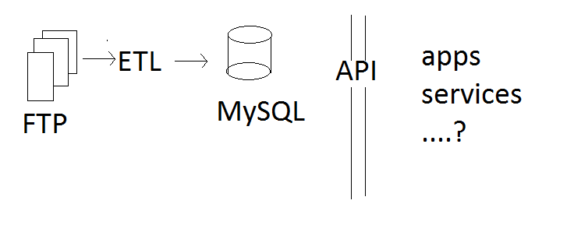
Components of the platform

Slide 4
FTP
Platform
FTP library (thank you, apache)
Simple implementation

Slide 5
ETL
Extract:
Figure out common structure in the data.
Translate: Load everything into objects (Which proved a minor challence)
Load: Auto-generate Inserts. (MySQL J-Connector)

Slide 6
API
Connects to the database
Output over standarddized protocol(s)
JSON
SOAP

Slide 7
Todo:
We didn’t have enough time for an API.
ETL algorithm doesn’t take into account all types. (Currently only lbl to tbl files…)
MySQL size management

