Slide 1
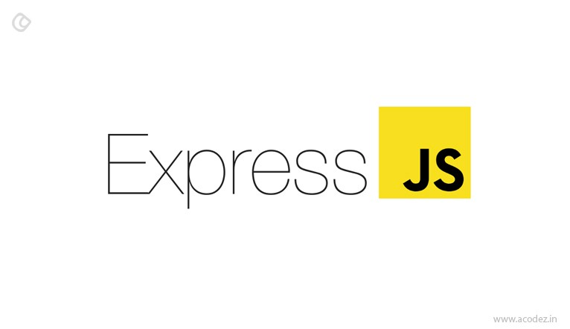

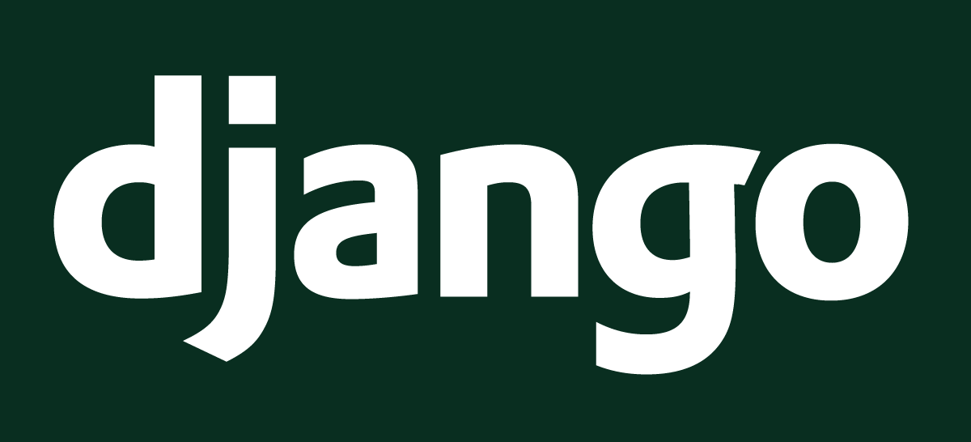
A comparison between two server-side web frameworks

Slide 2
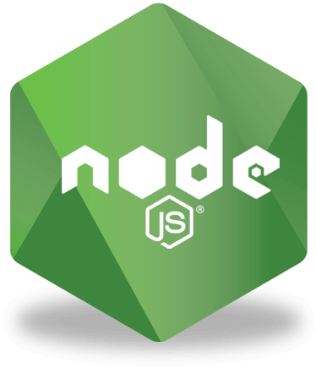
Express Framework
Open-source cross-platform web framework written in JavaScript
Development May 2009 by Ryan Dahl Express 16 November 2010
Support Only supported MacOS and Linux until July 2011 when a build was released that supported Windows

Slide 3
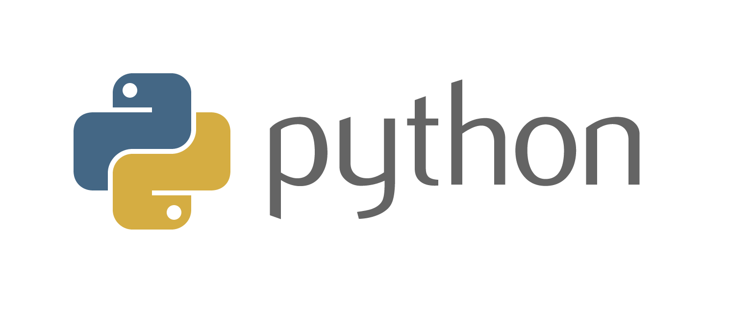
Django Rest Framework (DRF)
Open-source cross-platform web framework written in Python
Development 2003 by a team that began factoring out, reusing common code and design patterns evolving it into a web development framework named the Django Project
Support Windows, MacOS, Linux/Unix, Solaris among others

Slide 4


Projects
Batteries Included – “A blessing and a curse”
This means Django comes with a large variety of libraries and tools required for most common use cases. Such as
https://www.crowdbotics.com/blog/when-to-use-django-and-when-not-to

Slide 5
Projects
Batteries Included – “A blessing and a curse”
This means Django comes with a large variety of libraries and tools required for most common use cases. Such as
Django ORM
HTTP libraries
https://www.crowdbotics.com/blog/when-to-use-django-and-when-not-to

Slide 6
Projects
Batteries Included – “A blessing and a curse”
This means Django comes with a large variety of libraries and tools required for most common use cases. Such as
Django ORM
Middlewares
HTTP libraries
https://www.crowdbotics.com/blog/when-to-use-django-and-when-not-to

Slide 7
Projects
Batteries Included – “A blessing and a curse”
This means Django comes with a large variety of libraries and tools required for most common use cases. Such as
Django ORM
Middlewares
Template Engine
HTTP libraries
https://www.crowdbotics.com/blog/when-to-use-django-and-when-not-to

Slide 8
Projects
Batteries Included – “A blessing and a curse”
This means Django comes with a large variety of libraries and tools required for most common use cases. Such as
Django ORM
Middlewares
Multi-site Support
Template Engine
HTTP libraries
https://www.crowdbotics.com/blog/when-to-use-django-and-when-not-to

Slide 9
Projects
Batteries Included – “A blessing and a curse”
This means Django comes with a large variety of libraries and tools required for most common use cases. Such as
Django ORM
Middlewares
Multi-site Support
Django Admin
Template Engine
HTTP libraries
https://www.crowdbotics.com/blog/when-to-use-django-and-when-not-to

Slide 10
Projects
Batteries Included – “A blessing and a curse”
This means Django comes with a large variety of libraries and tools required for most common use cases. Such as
Authentication
Django ORM
Middleware's
Multi-site Support
Django Admin
Template Engine
https://www.crowdbotics.com/blog/when-to-use-django-and-when-not-to

Slide 11
Projects
Batteries Included – “A blessing and a curse”
This means Django comes with a large variety of libraries and tools required for most common use cases. Such as
Authentication
HTTP libraries
Django ORM
Middleware's
Multi-site Support
Django Admin
Template Engine
https://www.crowdbotics.com/blog/when-to-use-django-and-when-not-to

Slide 12
Projects
i18n
Batteries Included – “A blessing and a curse”
This means Django comes with a large variety of libraries and tools required for most common use cases. Such as
Authentication
HTTP libraries
Django ORM
Middleware's
Multi-site Support
Django Admin
Template Engine
https://www.crowdbotics.com/blog/when-to-use-django-and-when-not-to

Slide 13

The Django framework contains many features and functions but due to this ends up being an overkill for smaller projects.
The sheer size and nature of the framework tends to bogs down the performance of smaller applications.
Developers can get confused with all the unwanted and unique functionalities
Low-end websites struggle due to the server’s processing time caused by the sheer amount of code and functionalities

Slide 14



Projects
Versatility - ”Batteries included”
Exceedingly scalable
Pythons' High performance with the use of multiple threads
Python Machine Learning capabilities
70 million + songs
188million subscribers
1.3billion users
95 million photos and videos shared per day
2.1billion monthly users
720,000 hours content uploaded daily
800 million videos as of 2022

Slide 15
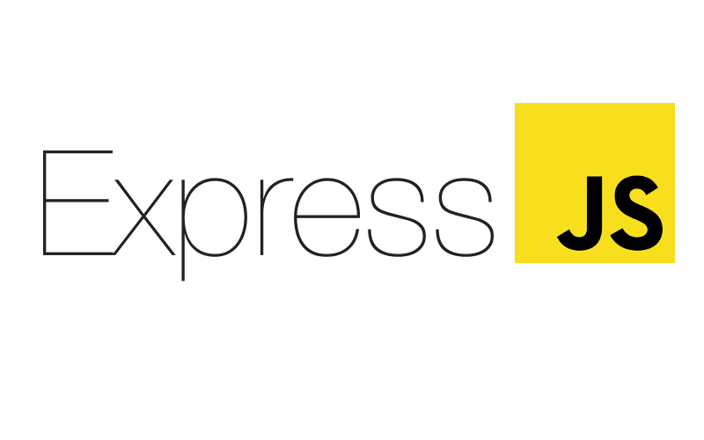
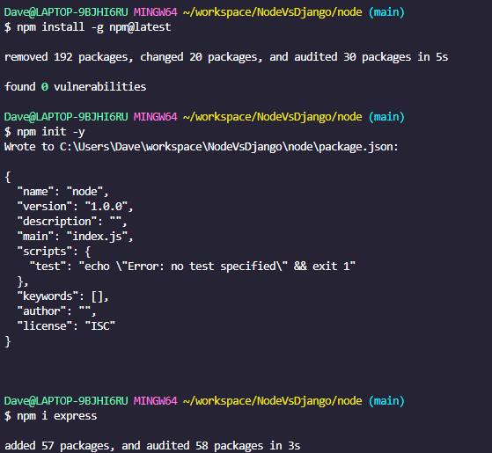
Projects
NPM “Node package Manager”
Built-in support NPM
Great for Low CPU intensive computation Applications can be built in JavaScript from “top-to-bottom” right down to the database level if using JSON storage Object DB such as MongoDB.

Slide 16
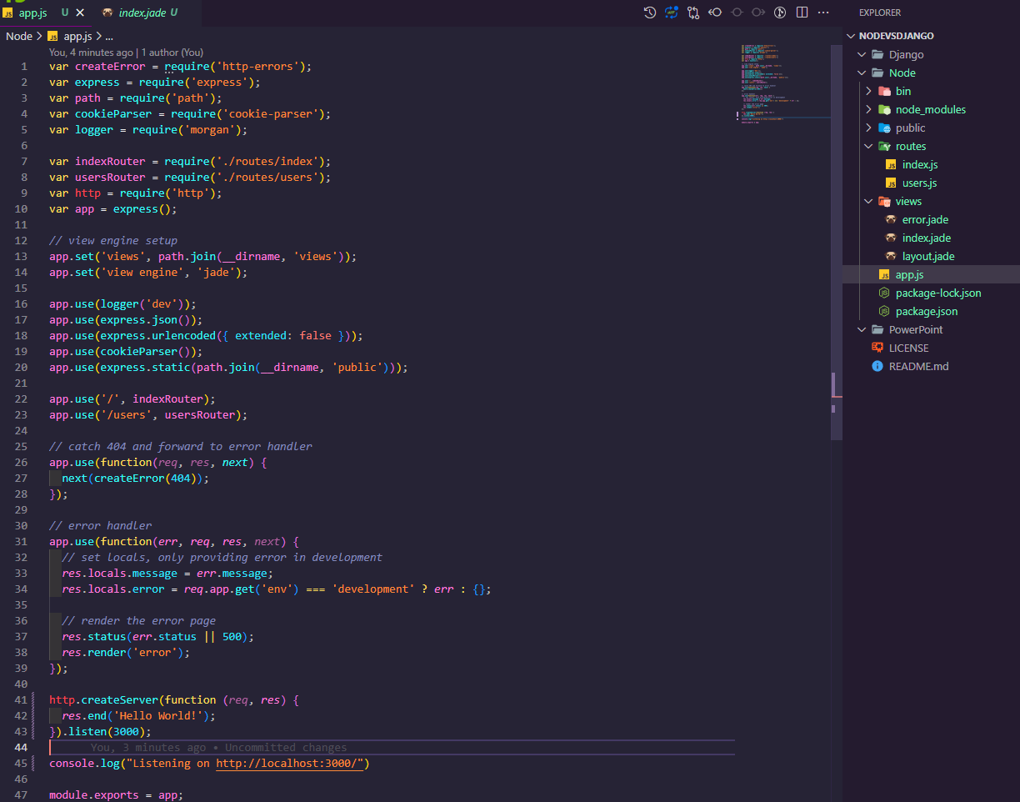
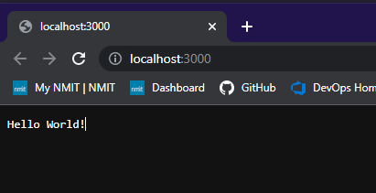

Slide 17

Pros:
Easy scalability for modern applications
Cost effective with Full stack JS
Reduces loading time by Quick caching
Great for building cross-platform applications
Cons:
Reduces performance when handling Heavy computing Tasks
NodeJS Asynchronous programming model makes it difficult to maintain code
Lack of library support can endanger your code

Slide 18




429 million users
15.4 billion transactions in 2020
(avg. 41 million per day)
118 million users
18.7 million trips per day
66 million active monthly users
220 million paid subscribers worldwide
https://brainhub.eu/library/famous-apps-built-with-nodejs#4-mozilla-and-nodejs

Slide 19

Speed of execution
Execution speed can mean anything from computing and executing instructions and code to searching a database
Execution speed in the context of webservices is everything it takes to process a request and generate a response to the client.

Slide 20
Single-threaded and asynchronous input/output activity does not interfere with other processes. This makes it possible to read and write files, query databases, and perform other tasks all at the same time.
V8 Engine The virtual machine in NodeJS responsible for executing JavaScript. Takes source code and compiles it into machine code. Frequently used “hot” functions can be compiled to machine code which speeds up execution
NodeJS usually performs better than Django most of the time
Python has a reputation for being slow
When comparing it to JavaScript, python code has a higher execution time. This it due to the fact internally python code is interpreted during run time rather than being complied to native code
Django performs better than NodeJS only in CPU-Intensive conditions

Slide 21

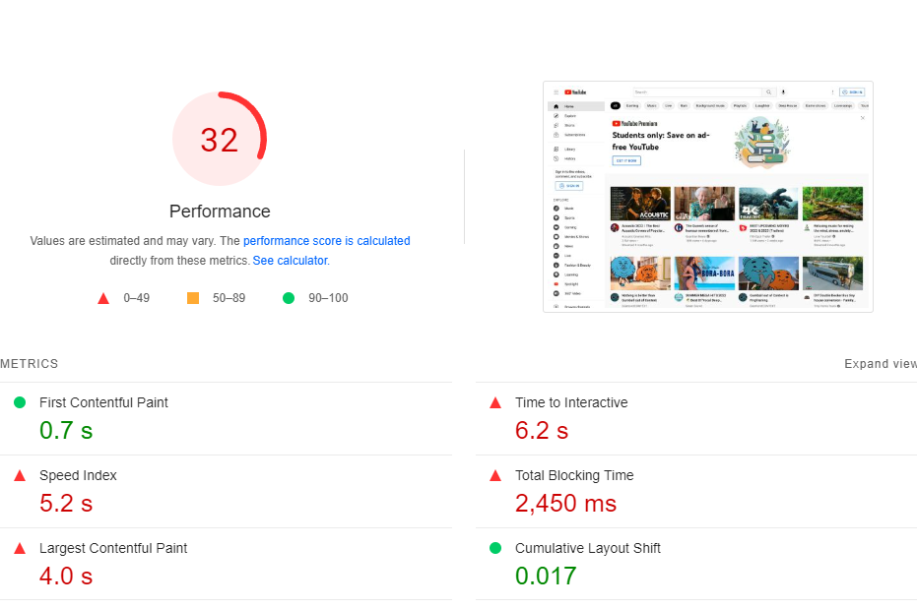
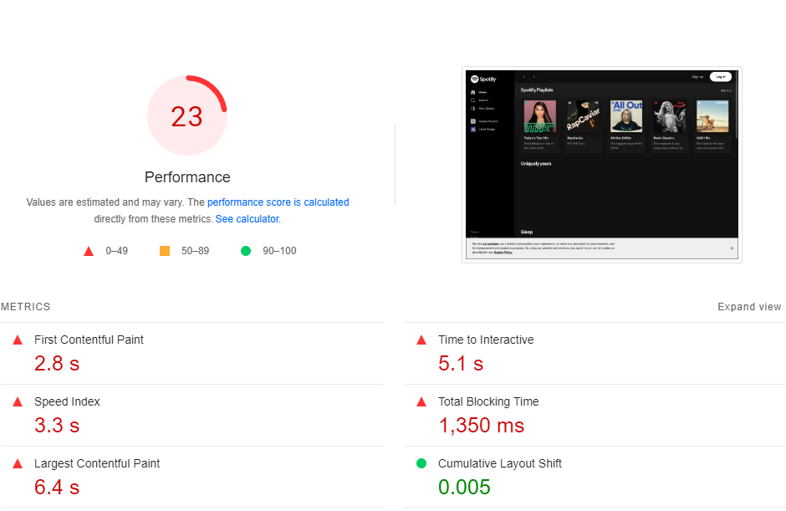
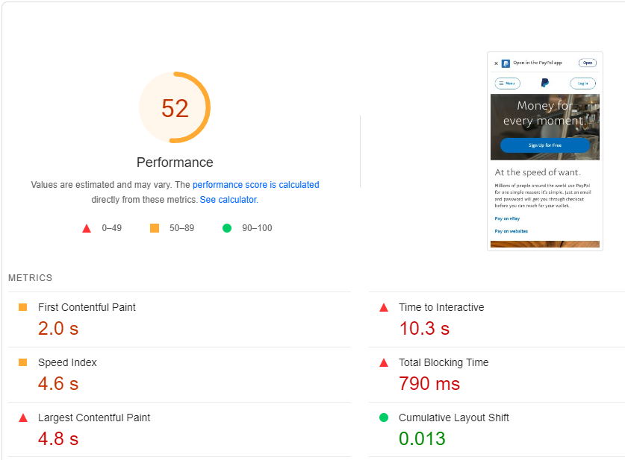
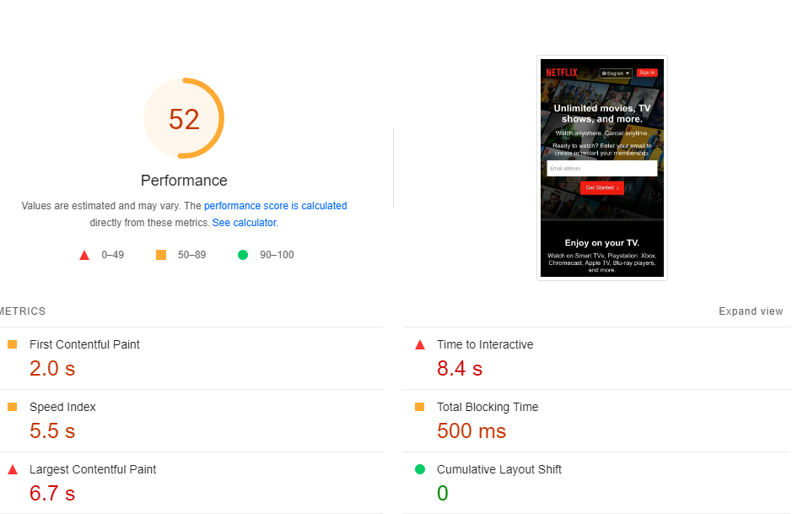
Webpage Performance

Slide 22
Webpage Execution guide
FCP (First Contentful Paint) User-centric metric for measuring perceived load speed. It marks the first point in the page load timeline where the user can see anything on the screen.
LCP (Largest Contentful Paint) User-centric metric for measuring perceived load speed. It marks the point in the page load timeline when the pages main content has likely loaded.
LCP (Largest Contentful Paint) This is a user-centric metric for measuring perceived load speed. It marks the point in the page load timeline when the pages main content has likely loaded.
INP (Interaction to Next Paint) Experimental metric that assesses responsiveness. Observes the latency of user interactions with the page. A Low INP indicates a page was consistently able to respond quickly to user interactions.
CLS (Cumulative Layout Shift) User-centric metric for measuring visual stability. Unexpected layout shifts.
https://web.dev/cls/

Slide 23

Learning Express or Django
W3Schools
Documentation
NodeSchool
Communities
FreeCodeCamp
Codecadmey

Slide 24
Learning Curve
Python Language is well known for being easy to read, write and learn.
The Django web framework is a bit more complex than NodeJS as the developers need to adhere to certain pathways for working out any problem.
Django has an in-depth documentation
it has a large active community of developers and comes with great documentation, which makes it easier to learn.
JavaScript is more difficult to master than Python.
JavaScript is the most popular programming language, learning node should require less effort and time.
Express is less complicated than Django because developers can solve any problem however he or she wants.

Slide 25

Plug-ins
Django uses Pythons PIP
Python library has more than 200,000 packages.
Node comes with NPM Online repository of open-source NodeJS projects that can be installed with a single command
NPM is regarded as the world’s largest Software library and contains over 800,000 code packages.
https://codete.com/blog/10-django-packages-every-developer-must-know

Slide 26
Django REST framework a base to build any HTTP-based REST API, providing powerful tool such as authentication polices, serialization and extensive documentation
Sentry A service for monitoring running applications and error or crashes that occur while its working.
Django GUID A Library enabling matching a single HTTP request with all messages coming from logs.
CookieCutter Django a framework for Django 3.1 that enables quick setup of a new Django Project
Django Debug Toolbar a Toolbar that helps debug a Django application in the browser
https://codete.com/blog/10-django-packages-every-developer-must-know

Slide 27
Pug A template engine for node. Compiles to HTML has a simplified syntax
Html-webpack-plugin Simplifies creation of HTML files
Mongoose a MongoDB object modelling tool designed to work in an asynchronous environment
LoDash JavaScript based library that provides 200+ functions for web development
https://codete.com/blog/10-django-packages-every-developer-must-know

Slide 28
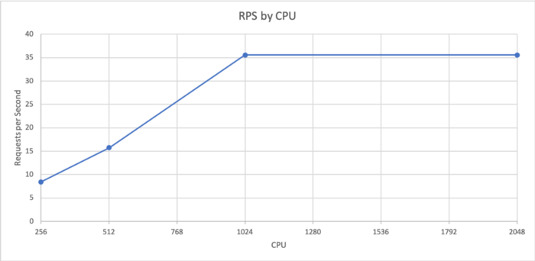
Scalability
Vertical -“Scaling by upgrading the machine”
Horizontal -“Scaling by adding more machines to your pool of resources”

Slide 29
Load Test
Artillery was used to load test the application starting at one request per second (RPS) and ramping up to 40 RPS over four minutes. By slowly ramping up over four minutes, we can more accurately see at which point the application starts to fail. This was repeated four times — once for each CPU size. The Artillery file and the results for all the tests can be found on GitHub. You will find .html files that can be downloaded to see the graphs. If you want the raw output, have a look at the .json files in the same directory. The endpoint that was tested was computing the 30th Fibonacci number. This is a computationally expensive task to complete, simulating a real-world application doing work.
The graphs below are from the 512 CPU test. The latency and concurrent users remain flat for the first part of the test. This shows the application is performing well and handling the load. Once the service becomes overwhelmed, the latency and concurrent users increase. Note how the concurrent user increases look exponential. The latency also increases dramatically from about 50 ms to over five seconds once the service has hit its limit. Once the service is receiving requests faster than it can process, the requests back up, which makes the service slower and causes more requests to back up.

Slide 30
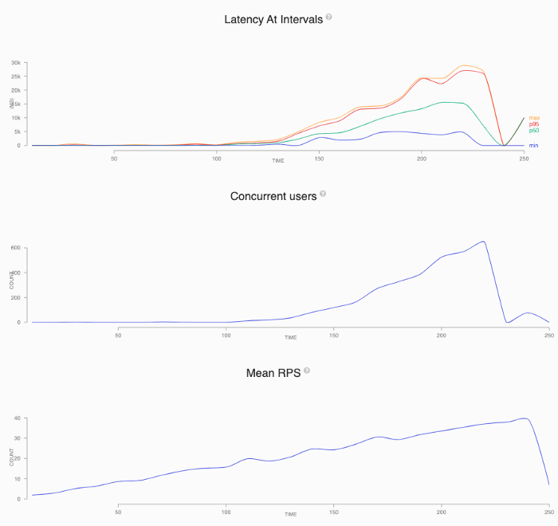
Node Load Test
This shows the application is performing well and handling the load. Once the service becomes overwhelmed, the latency and concurrent users increase. Note how the concurrent user increases look exponential. The latency also increases dramatically from about 50 ms to over five seconds once the service has hit its limit. Once the service is receiving requests faster than it can process, the requests back up, which makes the service slower and causes more requests to back up.
Results
After plotting the point at which each CPU’s test started to fail (when the concurrent users and response time increased), we can see that Node.js scales linearly with CPU. This means that in most cases, there is no benefit in terms of RPS per CPU to increasing the CPU. The graph below plots this. Note that there is no increase between 1024 and 2048. This is due to Node’s single-threaded nature. The extra CPU is sat idle. AWS Fargate charges per partial vCPU, so four 256 pods are the same price as one 1024 pod. As such, there is no financial benefit to creating larger pods.
As mentioned previously, when the application cannot handle the load, the concurrent requests and response time shoot up. If we use these metrics to auto scale on, by the time the metric has increased and we ask to scale up, the service is already affecting customers. The solution to this is to scale on RPS and set the value before the other metrics are affected. This maintains a good customer experience and allows some breathing room to be added.

Slide 31
Scalability
NodeJs supports microservices architecture a healthy pattern to build smaller, independent, and scalable services. It helps build applications with complicated and broad enterprise purposes.
While NodeJS can handle thousands of concurrent requests without compromising performance, microservices can create small modules for scalable applications
Django is an extremely scalable framework it allows the scale of an application horizontally and be able to support hundreds of millions of requests it why it has been used with applications such as Instagram

Slide 32
Benefits of Horizontal Scaling
The main benefit is cost. We are asking for a more precise amount of resources. This means there is less waste. If we could handle the load with half a CPU but only scale full CPUs, we are wasting the price of half a CPU.
If your service’s traffic changes throughout the day, you may scale down to the minimum amount of pods (usually two for resiliency). By keeping the CPU small, it keeps the price of your minimum cost down.
By having more pods in traffic, we also increase the resiliency. If a pod fails, the load is spread across the still-running pods. If we have ten pods handling 10 RPS each and one fails, the remaining nine pods will only gain 1.1 RPS. If we only have five serving 10 RPS and one fails, the remaining pods would gain 2.5 RPS. This could be enough to overwhelm the service. Having more pods will also spread the load over more availability zones and nodes if they are available.

Slide 33

Security
Django comes as a more secure tool compared to NodeJS as it has a built-in system that prevents from security threats, It has an inbuilt admin functionality and projects against common threats such as SQL injecting and Clickjacking. ANZ Developer Data and Insights are currently using Django Rest Framework
Express Framework built on NodeJS comes with a less secure built-in tool but manual operations covers the security deficiency
NodeJS is less secure than the Django framework because it needs a manual operation in the system to administer security flaws where the security of Django is better due to the fact it has a built-in system that protects it from any security failure.

Slide 34

Codebase Size
Every application’s codebase size varies on how small or complex it may be. A larger application is a lot harder to manage and if it contains an excessive amount of unnecessary code, it can become bogged down.

Slide 35
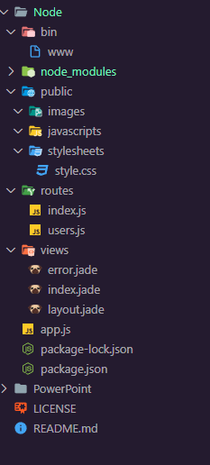
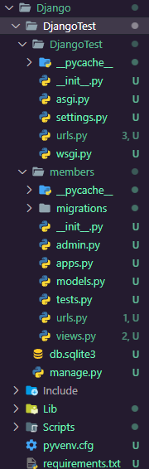
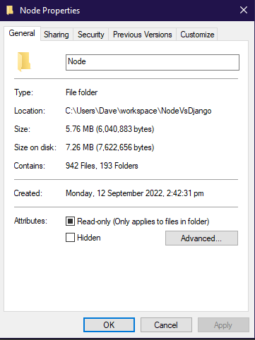
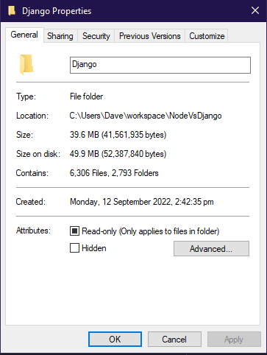
“Hello World!” File Structure/Folders and Size

Slide 36

Django the Monolith
Codebase size depends on how large or small the project is
Due to the fact Django is more equip to handle larger and more complex projects, its codebase tends to be on the larger scale.
An example of this would be Instagram's server-side is a monolith and contains millions of lines of code. It is a fast-moving monolith that requires hundreds of engineers making hundreds of commits everyday.
A project of this size is extremely difficult to keep its massive codebase devolving into complete chaos as it fly's along at hundreds of commits per day while deploying them every seven minutes.
https://instagram-engineering.com/static-analysis-at-scale-an-instagram-story-8f498ab71a0c

Slide 37
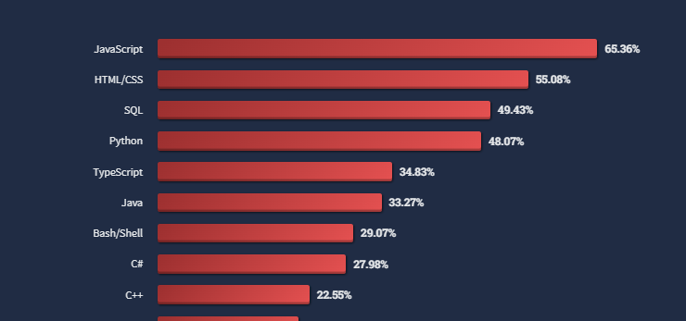
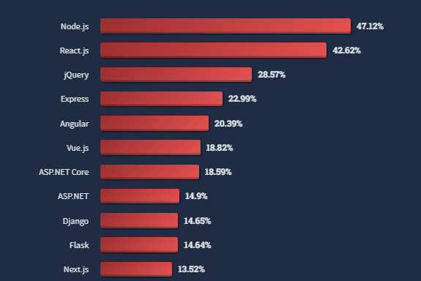
Community
2022 Stack overflow survey
Most popular languages (71,547 responses)
Most popular Web frameworks (58,743 responses)

Slide 38
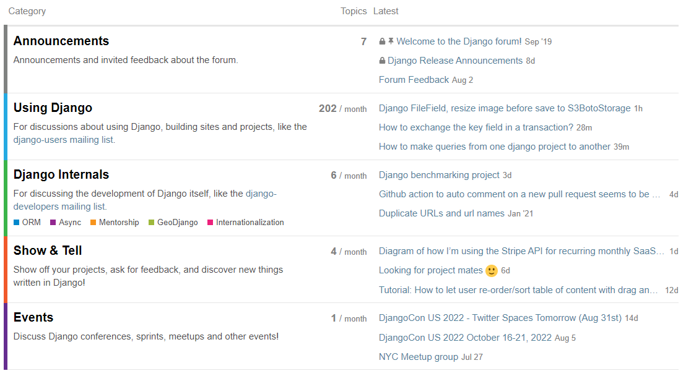
Django Community
Django Official Forums
Django Official forums
Stack overflow
Reddit (small but active)
Djangosnippets
Open-sourced Github Projects
Discord

Slide 39
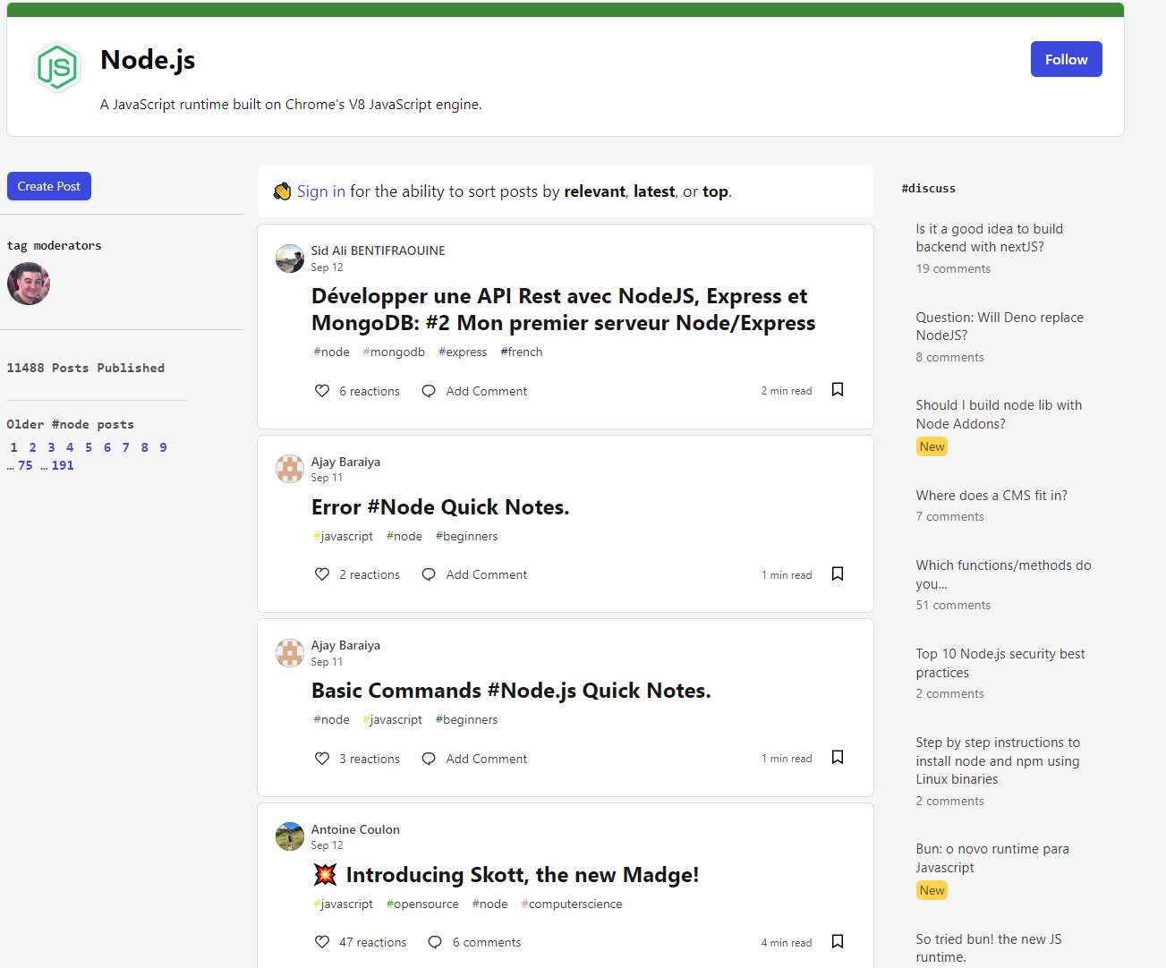
Community
Dev.to
Node Slackers
Open-sourced GitHub Projects
Twitter
Reddit (small but active)
NodeSchool

Slide 40


Slide 41
Conclusion
Both Django and Express have their strengths and weaknesses, however Express appears to be more capable of creating smaller projects than Django due to Djangos extreme size and bloated inbuilt tools. It also seems to be much easier to build generic websites with.
That being Said Django seems to have a higher ceiling when it comes to building complex applications, Both languages have a large amount of tools to get the job done. Django already comes with massive selections of tools to use where installing more tools with the NPM seems easier providing a lighter more customizable application
If you are more comfortable writing code in Python or JavaScript I would choose its respective framework as a starting point. If you want to build generic websites/pages Node.JS with Express would be the logical choice, where if you wanted to build a full scale application reusing multiple functions within your codebase and explore machine learning capabilities Django would be the go to.

