Slide 1
Basics of OFDM (2)
Zhen GAO
School of Electrical and Information Engineering
Tianjin University
email: zgao@tju.edu.cn

Slide 2
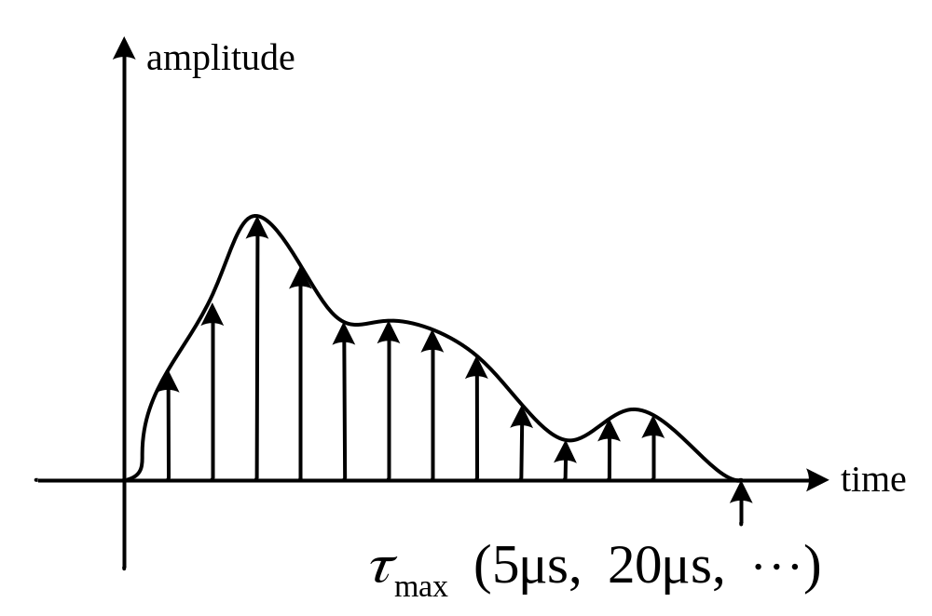

Fight with Multipath Channel
Inter-symbol Interference
Inter-carrier Interference

Slide 3
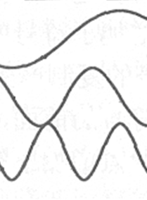
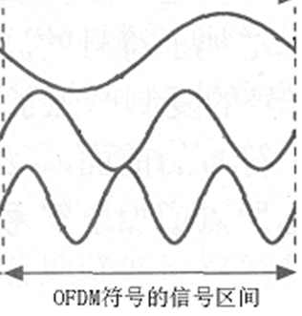
Inter-symbol Interference

Slide 4
Guard Interval between OFDM symbols
Guard interval
Guard interval
OFDM Symbol
OFDM Symbol
OFDM Symbol
Delay Spread
Delay Spread
Inter-symbol Interference
has been removed!

Slide 5
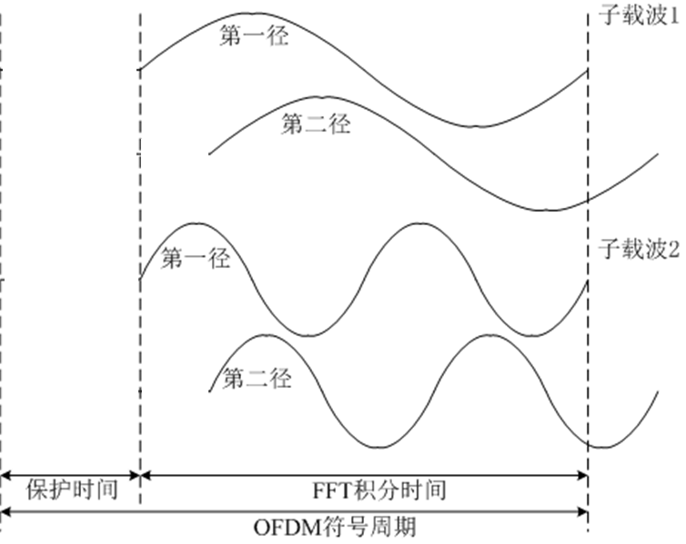
Inter-carrier Interference

Slide 6
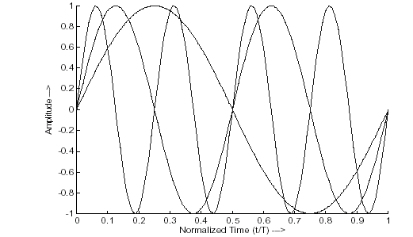
Orthogonality between subcarriers
  Every subcarrier has integer number of periods with symbol duration T
  Difference of number of periods for adjacent subcarriers is one.
天津大学电子信息工程学院通信系

Slide 7
Inter-carrier Interference (ICI)
For demodulation of subcarrier 1, the 2nd path of subcarrier 2 will introduce interference;
For demodulation of subcarrier 2, the 2nd path of subcarrier 1 will introduce interference;
Not integer number of periods;
Orthogonality between subcarriers is destroyed;
To remove ICI, the cyclic-prefix (CP) is proposed to transmit during the guard interval, so that there are always integer number of periods for each subcarriers during the duration of an OFDM symbol.

Slide 8

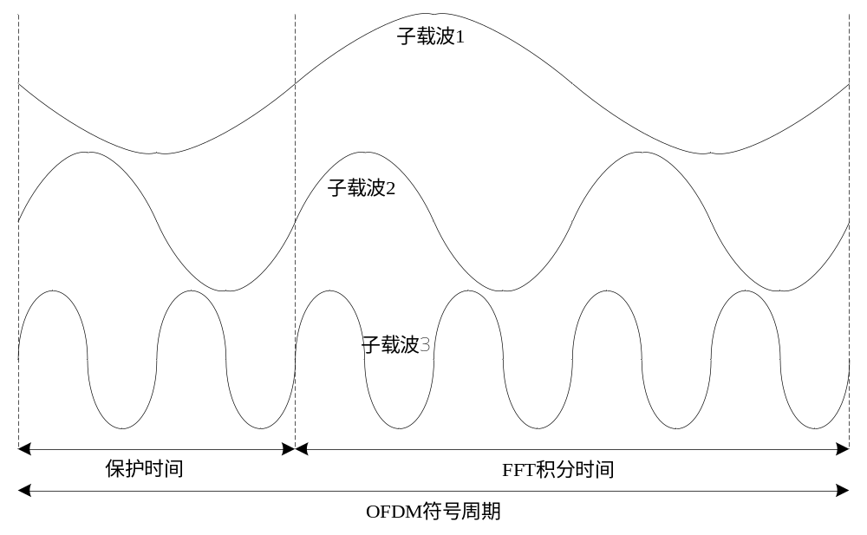
CP during Guard Interval
If multipath delay is smaller than the guard interval, there is no ICIs.

Slide 9
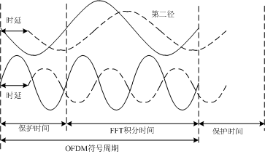
Always integer number of periods for each subcarriers during the duration of an OFDM symbol.
H₁X₁
H₂X₂

Slide 10
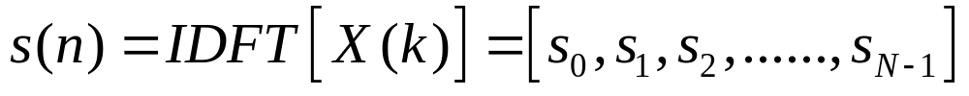
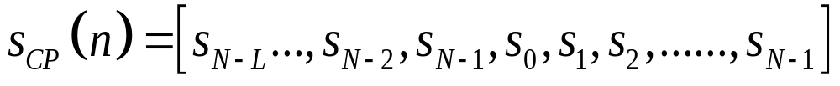
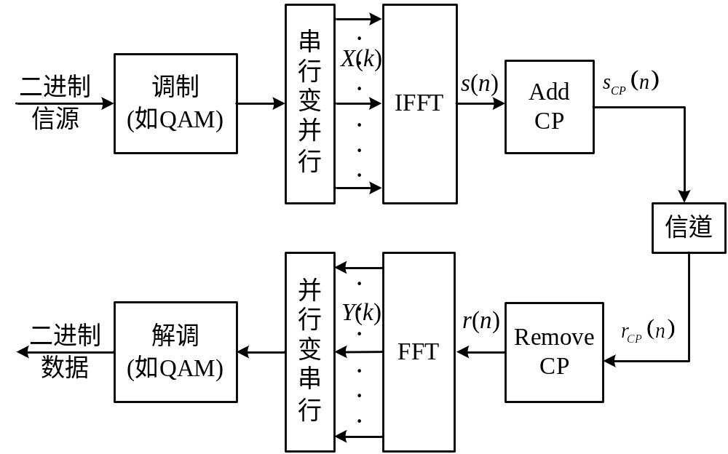
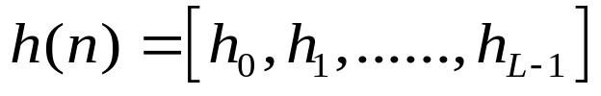
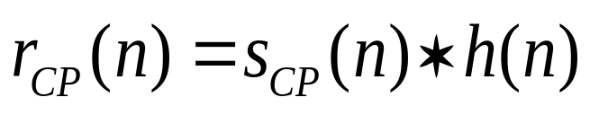
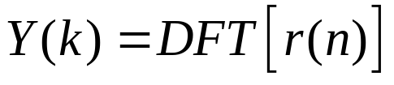

Slide 11
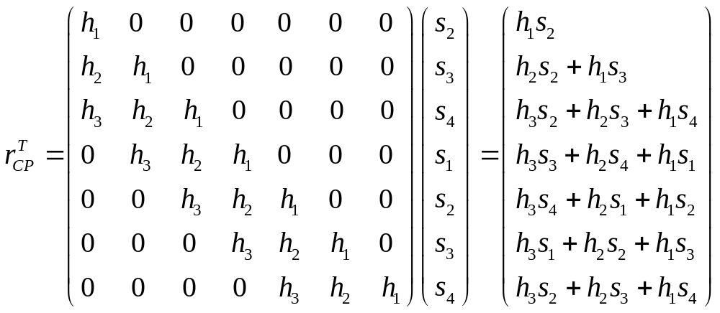
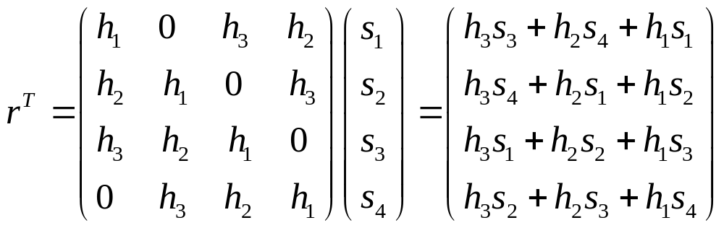
Linear Conv
Remove
CP
H
Circular Conv

Slide 12
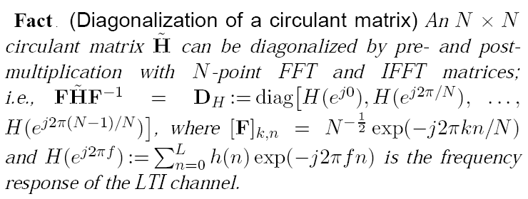

An important theorem
Zhengdao Wang and Georgios B. Giannakis,
Wireless Multicarrier Communications_where Fourier Meets Shannon
Notes:
LTI: Linear Time Invairant

Slide 13
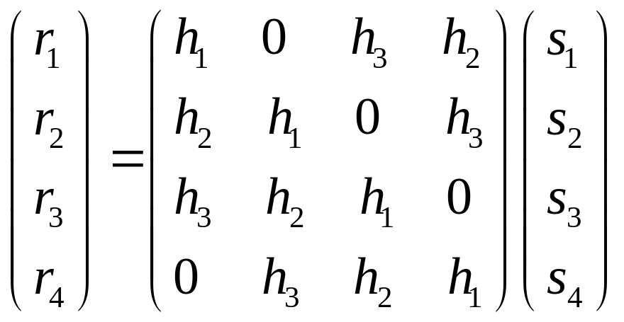
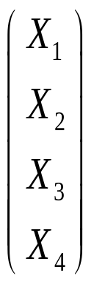
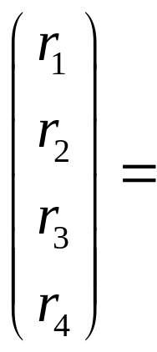
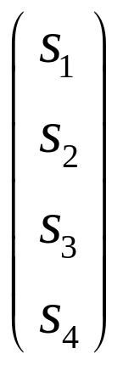
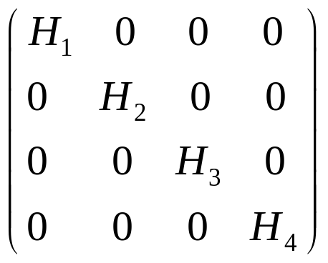
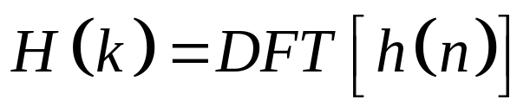
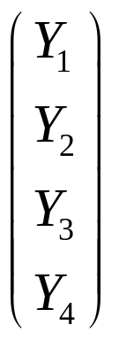
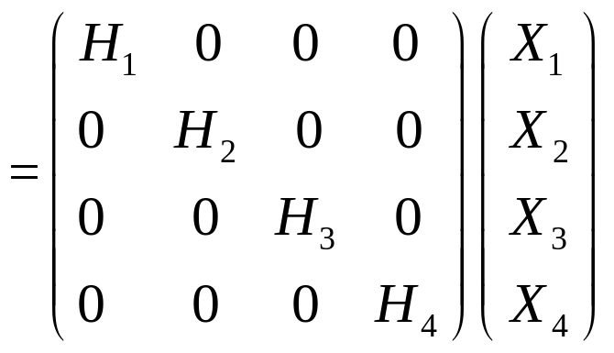
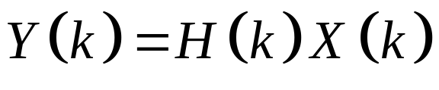
IDFT
IDFT
DFT
DFT

Slide 14

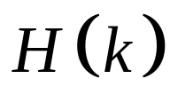
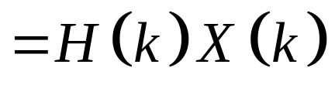

Slide 15
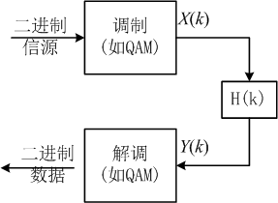
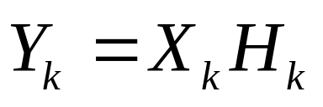
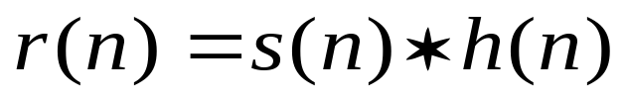
Each Subcarrier experiences flat fading;
Simple Equalization
Effect of Channel response is Linear Convolution
Add CP and Remove CP change it to circular convolution

Slide 16
Circular convolution holds only in the FFT integral duration

Slide 17
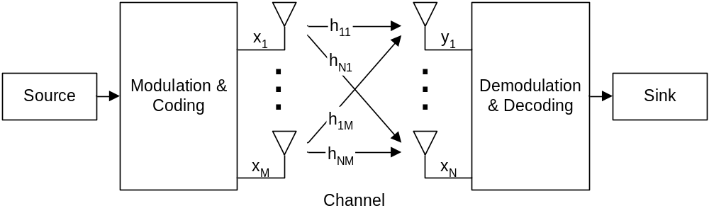
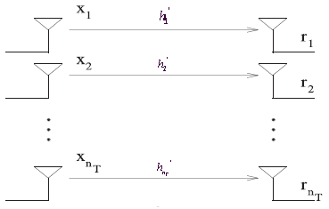
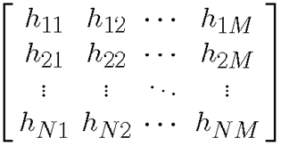
MIMO: Spatial Multiplexing
In rich scattering environments, independent data signals transmitted from different antennas can be uniquely decoded to yield an increase in channel capacity

Slide 18
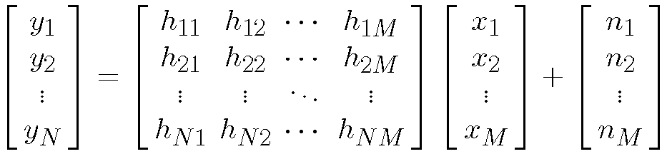
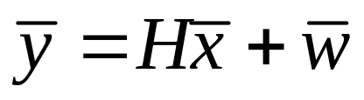
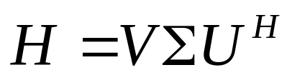
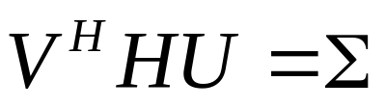
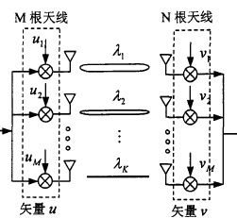
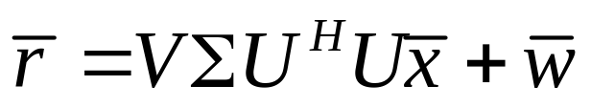
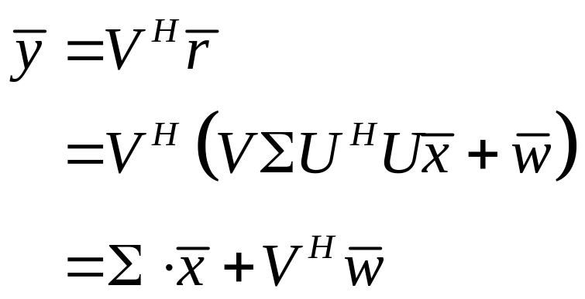
MIMO: Spatial Multiplexing

Slide 19
In OFDM systems, H is the circular conv matrix; U/V are IFFT/FFT matrix

Slide 20
Nothing is more practical than a good theory!

Slide 21
Flat-fading channel
Multi-path channel?
MIMO + OFDM!

Slide 22
Background
The capability of communication system is limited by the channel propagation characteristics.
For high rate data transmission, the channel delay spread may be larger than the symbol duration, which will cause severe inter-symbol interference (ISI), and degrade system performance dramatically.
Channel equalization is classic technology to remove ISI, and most mobile communication systems will apply Channel equalization.

Slide 23
Background
  For single carrier system, if the data rate is so high that the occupied bandwidth is much larger than the coherent bandwidth, equalizer with multiple tens or hundreds of taps is required, which is nightmare for hardware design;
  OFDM system transforms the high rate data stream into multiple parallel low rate data stream, and transmits them on overlapped subcarriers;
  By adding CP at the Tx and removing CP at Rx, the linear convolution of multipath channel is converted to circular convolution, which brings simple equalization in frequency domain.

Slide 24

Single Carrier: Complicated Equalization
OFDM: Simple Equalization
f₀
f_{N-1}

Slide 25
Penalty
We’re transmitting redundant signal (CP)
  Bandwidth penalty: N / (N + L)
  Power penalty: N / (N + L)
Penalty becomes negligible as N becomes large
But there are tradeoffs!

Slide 26
Advantages of OFDM
High spectral efficiency as compared to other double sideband modulation schemes, spread spectrum, etc.
Efficient implementation using FFT
Tuned sub-channel receiver filters are not required (unlike conventional FDM)
Can easily adapt to severe channel conditions without complex time-domain equalization.
Robust against inter-symbol interference (ISI) and fading caused by multipath propagation

Slide 27
Advantages of OFDM
Robust against narrow-band co-channel interference
Low sensitivity to time synchronization errors
Facilitates single frequency networks (SFNs) (i.e. transmitter macro diversity)

Slide 28
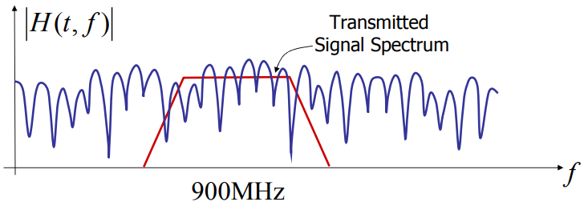
Robust against narrow-band co-channel interference
Coding + Interleaving
Recover the error bits
Frequency Selective is not absolutely bad;
Flat fading is not absolutely good.

Slide 29
Low sensitivity to time synchronization errors
H₁X₁
H₂X₂

Slide 30

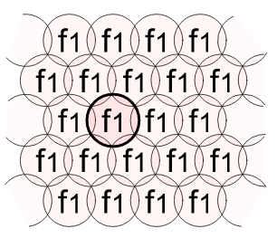
SFN
A single-frequency network (SFN) is a broadcast network where several transmitters simultaneously send the same signal over the same frequency channel. An SFN may increase the coverage area.
Man-
made
Strong
Multipath

Slide 31
Disadvantages of OFDM
Loss of efficiency caused by cyclic prefix/ guard interval;
Sensitive to CFO and Doppler shift;
Sensitive to frequency synchronization problems;
High peak-to-average-power ratio (PAPR), requiring linear transmitter circuitry, which suffers from poor power efficiency;

Slide 32
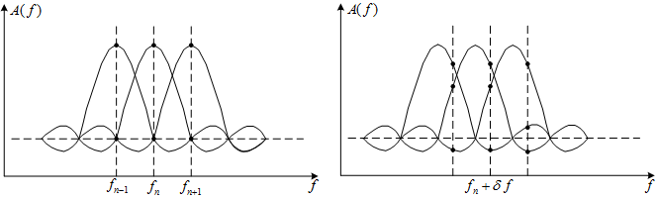
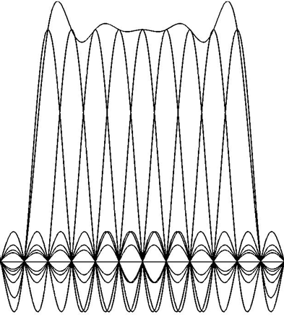
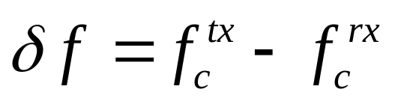
Effect of CFO and Doppler Shift
1/T_{FFT}
Inter-carrier Interference (ICI)
Carrier Frequency Offset
(CFO):
Doppler Shift
Larger N, more sensitive to freq sync error
Compensated by
Frequency
Synchronization

Slide 33
Summary of Basics of OFDM
OFDM is simple to use on channels that exhibit time delay spread or, equivalently, frequency selectivity.
Frequency selective channels are characterized by either delay spread or coherence bandwidth.
By choosing the sub-carrier spacing properly in relation to the channel coherence bandwidth, OFDM can be used to convert a frequency selective channel into a parallel collection of frequency flat sub channels.
With assistant of CP, the linear convolution of multiple path is converted to circular convolution, which produces dot product in frequency domain.
Techniques that are appropriate for flat fading channels can then be applied in a straight forward fashion.

