Slide 1
Basics of OFDM（1）
Zhen GAO (Associate Professor)
School of Electrical and Information Engineering
Tianjin University
email: zgao@tju.edu.cn

Slide 2
Content
Background
Multipath channel
Equalization (single carrier system)
FDM → OFDM
History of OFDM
Structure and mathematical description
  Analog Version
  Digital Version

Slide 3
Background
The capability of communication system is limited by the channel propagation characteristics.
For high rate data transmission, the channel delay spread may be larger than the symbol duration, which will cause severe inter-symbol interference (ISI), and degrade system performance dramatically.
Channel equalization is classic technology to remove ISI, and most mobile communication systems will apply Channel equalization.

Slide 4
Multipath channel
In wireless telecommunications, multipath is the propagation phenomenon that results in radio signals reaching the receiving antenna by two or more paths.
Causes of multipath include reflections and diffractions from terrestrial objects such as mountains and buildings.
Delay spread: multiple paths arrived at different time

Slide 5
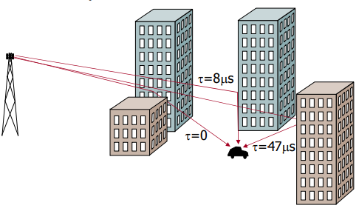
Multipath channel

Slide 6
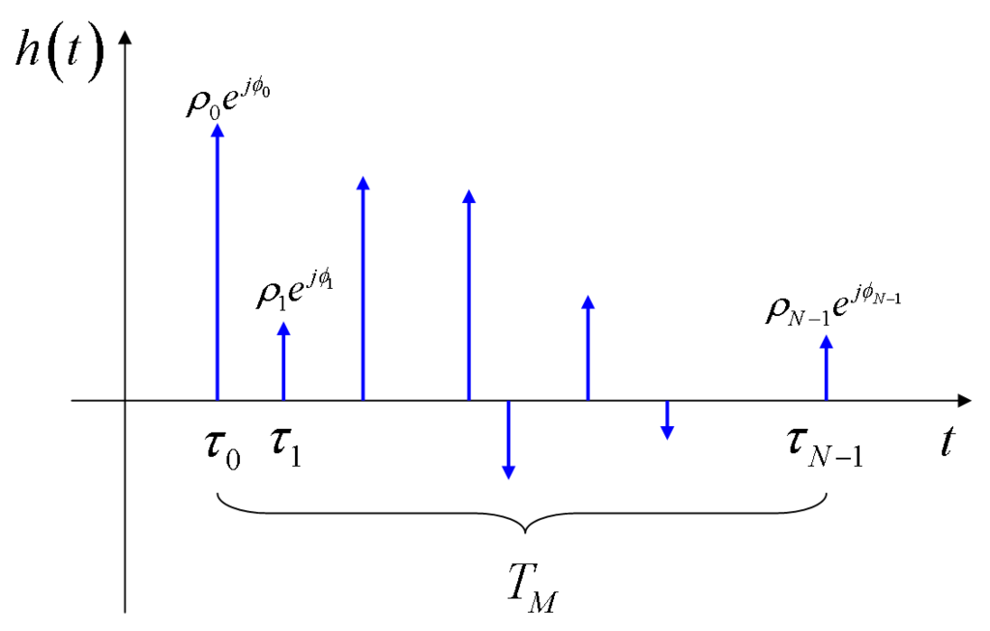
Multipath channel
Attenuation
and
Phase shift

Slide 7
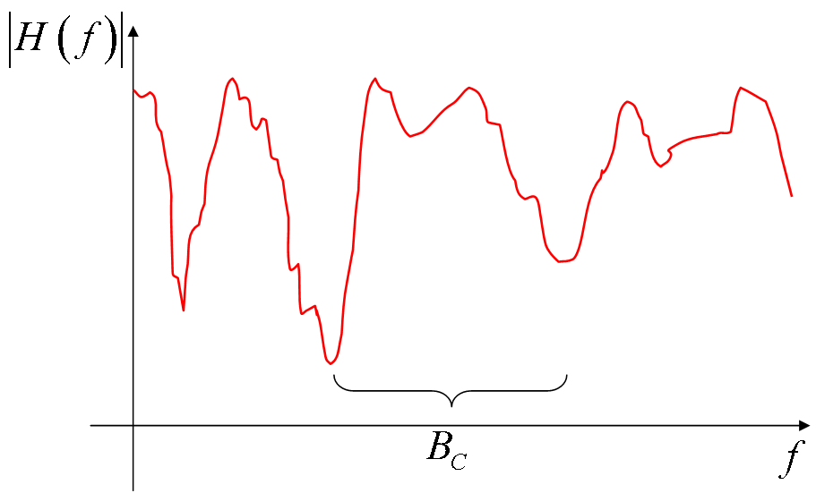
Channel Transfer Characteristic

Slide 8
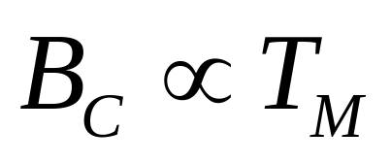
Channel Transfer Characteristic
The obtained channel transfer characteristic has a typical appearance of a sequence of peaks and valleys;
It can be shown that, on average, the distance (in Hz) between two consecutive valleys (or two consecutive peaks), is roughly inversely proportional to the multipath time.
Coherence bandwidth

Slide 9
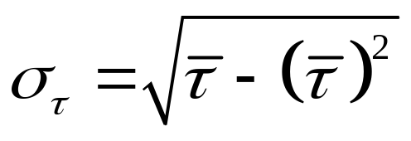
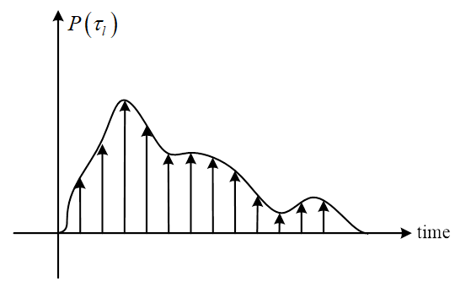
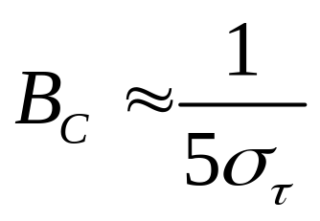
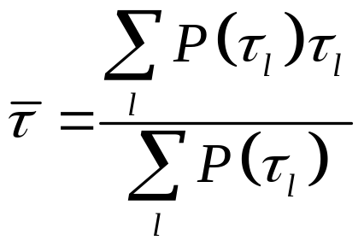
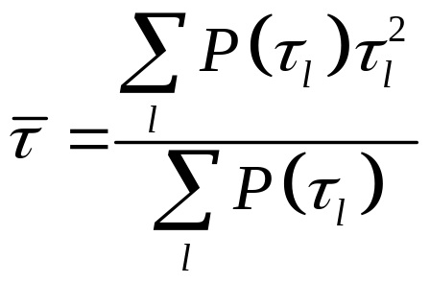
Channel Transfer Characteristic
The power delay profile (PDP) gives the intensity of a signal received through a multipath channel as a function of time delay.
RMS delay spread (root mean square)

Slide 10
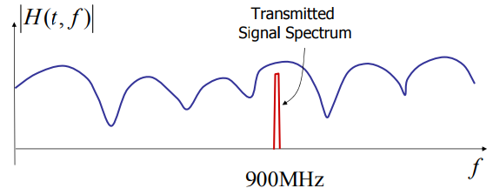
Flat fading
Flat fading: the signal bandwidth is much smaller than the coherent bandwidth
The channel appears to be flat to the signal

Slide 11
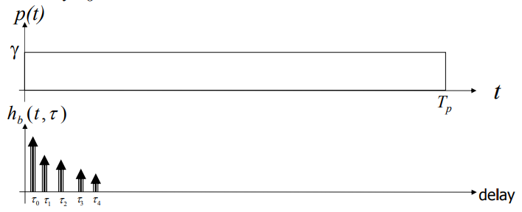
Flat fading
Delay spread is much smaller than symbol duration
“the multipath is not resolved”
Notes:
Resolution: 分辨率

Slide 12
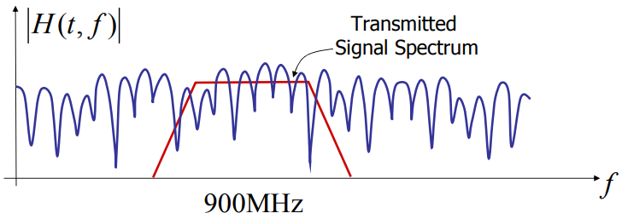
Frequency selective fading
The signal bandwidth is much larger than the coherent bandwidth;
The frequency response of the channel varies significantly with frequency over the bandwidth of the transmitted signal;

Slide 13
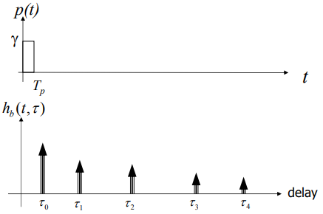
Frequency Selective Fading
Delay spread is much larger than symbol duration
Inter-symbol interference (ISI)

Slide 14
Summary of multipath channel
Multipath is objective physical phenomenon.
The channel characteristic is unchanged for a fixed scenario (e.g. delay spread, coherent bandwidth, frequency band);
Flat or Frequency selective fading, ISI or not, is determined by the relationship between the channel characteristics and the signal property, including the symbol duration (T) and signal bandwidth (B);

Slide 15
Summary of multipath channel
Channel: delay spread σ_{τ}, coherent bandwidth B_{c}
Signal: symbol duration T, bandwidth B
A. T >> σ_{τ}
Flat fading
B. T << σ_{τ}
Frequency Selective fading
C. B >>B_{c}
D. B <<B_{c}

Slide 16
Content
Background
Multipath channel
Equalization (single carrier system)
FDM → OFDM
History of OFDM
Structure and mathematical description
  Analog Version
  Digital Version

Slide 17
Equalization
In telecommunication, equalization is the reversal of distortion incurred by a signal transmitted through a channel;
Equalizers are used to render the frequency response—for instance of a telephone line—flat from end-to-end.
When a channel has been equalized the frequency domain attributes of the signal at the input are faithfully reproduced at the output.

Slide 18
Equalization
In digital communications, the equalizer's purpose is to reduce intersymbol interference to allow recovery of the transmit symbols. It may be a simple linear filter or a complex algorithm;
Linear equalizer: processes the incoming signal with a linear filter;
Zero forcing equalizer: approximates the inverse of the channel with a linear filter;
MMSE equalizer: designs the filter to minimize E[|e|²], where e is the error signal;

Slide 19
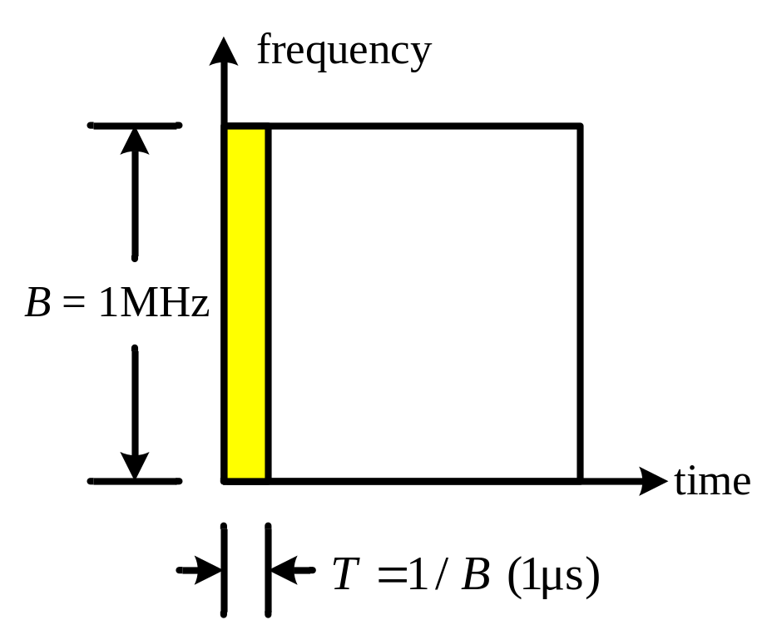
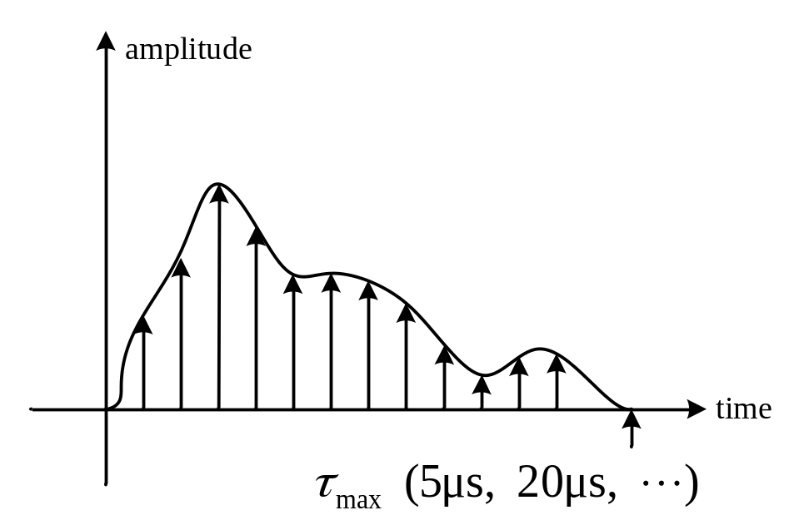
Single Carrier System
Bandwidth: B
Symbol duration:T = 1/B
Max delay spread:τ_{max} > T
Inter-symbol interference (ISI)
Equalization is used
to remove ISI

Slide 20

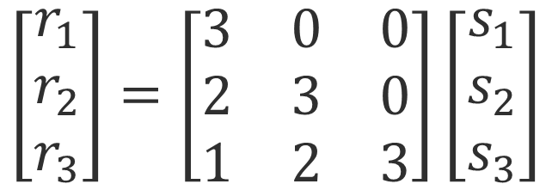


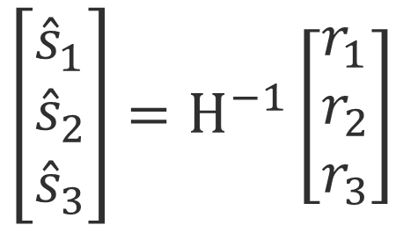
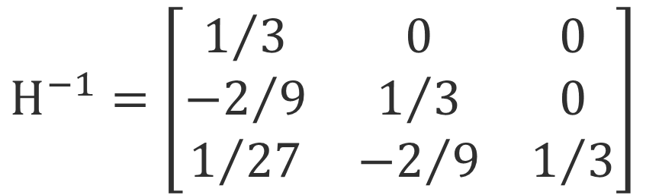
Equalization for SC systems (Example)
3
s₃
s₂
s₁
2
r₃
r₂
r₁
1
H

Slide 21
Equalization for SC systems
  If bandwidth is very large (data rate is very high), equalizer with multiple tens or hundreds of taps is required, which is nightmare for hardware design;
天津大学电子信息工程学院通信系

Slide 22
A possible solution
  A high rate data stream is divided to multiple low rate data streams, and each stream is transmitted by an independent carrier. Multiple carriers transmit in parallel;
  At receiver, each low rate data stream is demodulated separately, and then combined to recover the high rate data stream.
  The symbol duration for each low rate stream is much larger than the delay spread, so equalization is simple.
  High rate data transmission can be supported with simple equalization；
天津大学电子信息工程学院通信系

Slide 23
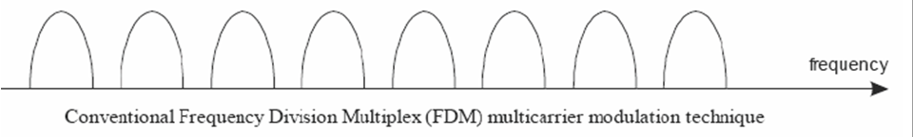
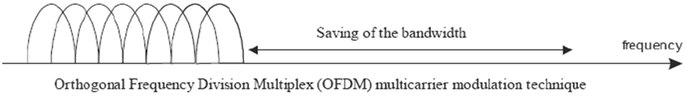
Multi-carrier Modulation
频域选择性衰落信道
一组
平衰落信道
FDM
OFDM
Any Problem?

Slide 24
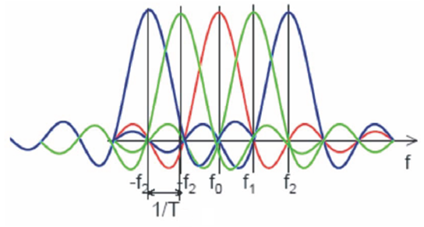
OFDM Definition
OFDM = Orthogonal FDM
Carrier centers are put on orthogonal frequencies
ORTHOGONALITY –indicates that there is a precise mathematical relationship between the frequencies of the carriers in the system.
Subcarriers are spaced by 1/T
Modulation
and
Multiplexing
Techniques

Slide 25
OFDM Definition
In OFDM, the sub-carrier frequencies are chosen so that the sub-carriers are orthogonal to each other, meaning that cross-talk between the sub-channels is eliminated and inter-carrier guard bands are not required.
This greatly simplifies the design of both the transmitter and the receiver;
Transmitter: IFFT
Receiver: FFT

Slide 26
History of OFDM
OFDM was introduced by Robert W. Chang of Bell Labs in 1966, “Synthesis of band-limited orthogonal signals for multichannel data transmission”
OFDM was improved by Weinstein and Ebert in 1971 with the application of DFT in modulation and demodulation process and introduction of a guard interval to provide better orthogonality in multipath transmission channels. Each sub-carrier is modulated with a conventional modulation scheme (such as QAM or PSK) at a low symbol rate. This maintains total data rates similar to conventional single-carrier modulation schemes in the same bandwidth.

Slide 27
History of OFDM
In 1980, Peled and Ruiz introduced cyclic prefix (CP) into OFDM system to solve the orthogonality problem with low complexity in paper “Frequency domain data transmission using reduced computational complexity algorithms”;

Slide 28
History of OFDM
1985: Cimini described use of OFDM for mobile communications
1987: Alard & Lasalle COFDM for digital broadcasting
1997: ETSI DVB-T standard
1999: IEEE 802.11a wireless LAN standard (Wi-Fi)
2000: Proprietary fixed wireless access (V-OFDM, FLASH-OFDM, etc.)
2002: IEEE 802.11g standard for wireless LAN
2004: IEEE 802.16 standard for wireless MAN (WiMAX)
2004: ETSI DVB-H standard
2004: Candidate for IEEE 802.11n standard for next generation WLAN
2005: OFDMA is candidate for the 3GPP Long Term Evolution (LTE) air interface E-UTRA downlink.
2007: The first complete LTE air interface implementation was demonstrated, including OFDM-MIMO, SC-FDMA and MU-MIMO
2011: LTE-Advanced is standardized by the 3rd Generation Partnership Project (3GPP) as 3GPP Release 10
Notes:
COFDM(Coded OFDM)
Proprietary: 专用的
WAN ：wide area network 广域网
LAN： Local Area Network 局域网
MAN： Metropolitan Area Network 城域网

Slide 29
顺便回顾一下
历代地面移动通信传输体制
2G：GSM，TDMA
3G：CDMA
4G：OFDM
5G：OFDM

Slide 30
Content
Background
Multipath channel
Equalization (single carrier system)
FDM → OFDM
History of OFDM
Structure and mathematical description
  SC vs. OFDM
  Analog Version
  Digital Version

Slide 31
Single Carrier System
Bandwidth: B
Symbol duration:T = 1/B
Max delay spread:τ_{max} > T
Inter-symbol interference (ISI)
Equalization is used
to remove ISI

Slide 32
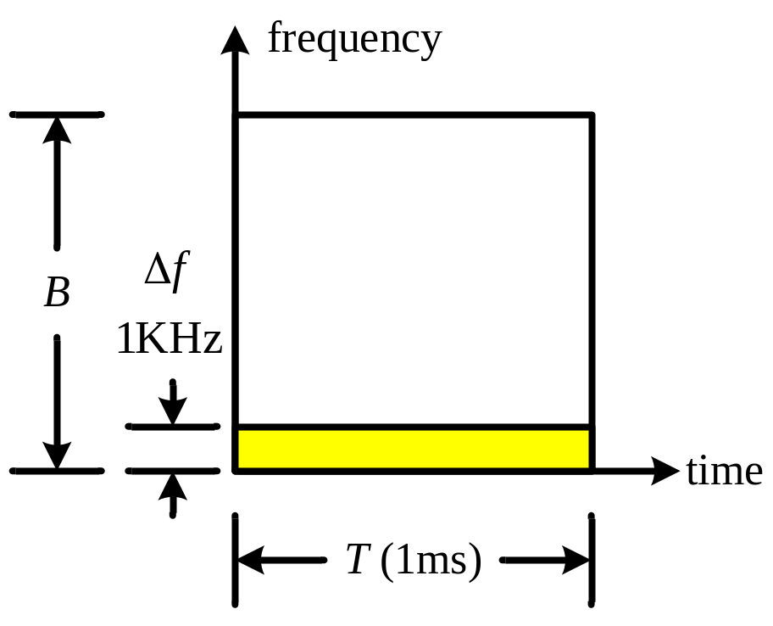
OFDM system with N subcarriers
The total bandwidth B are divided into N sub-carriers
The bandwidth for each sub-carrier is narrow, but the symbol duration becomes much longer
Δf = B / N
T = N / B
Δf = 1 / T

Slide 33
OFDM system with N subcarriers
The orthogonality requires that the sub-carrier spacing is Δf = 1/T Hz, where T seconds is the symbol duration.
Therefore, with N sub-carriers, the total bandwidth will be B ≈ N·Δf (Hz).
The sub-carriers have the minimum frequency separation required to maintain orthogonality of their corresponding time domain waveforms.

Slide 34
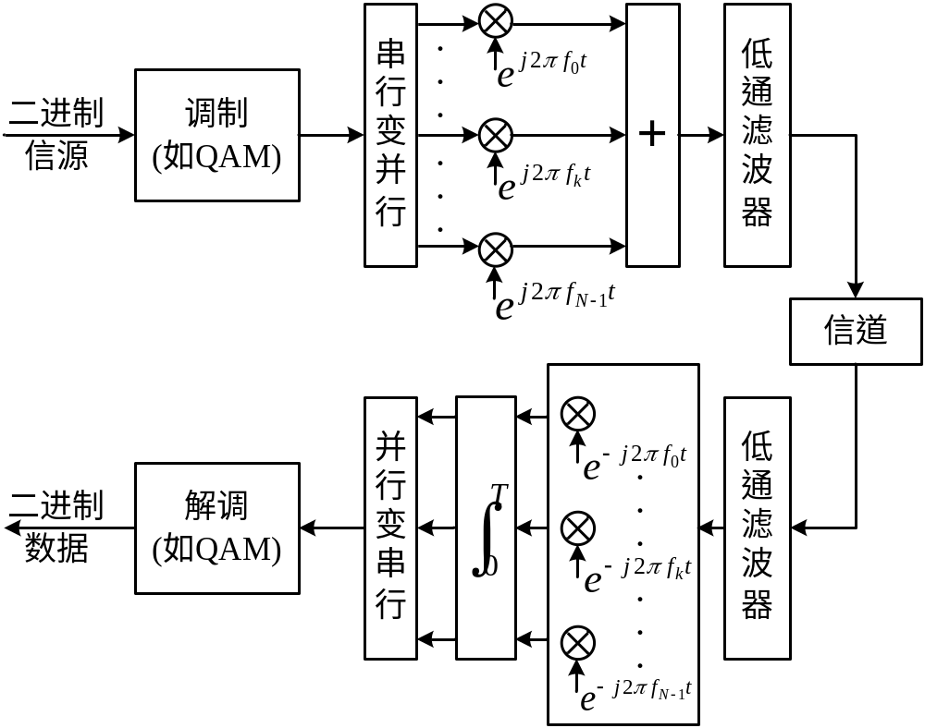


Multicarrier Transmission Systems
Sub-carrier Spacing

Slide 35
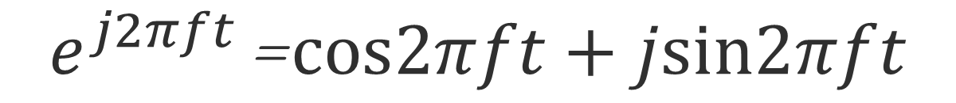
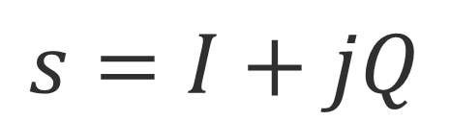
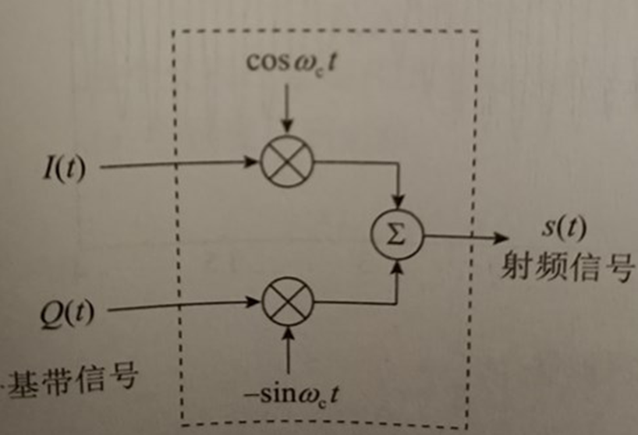

Slide 36
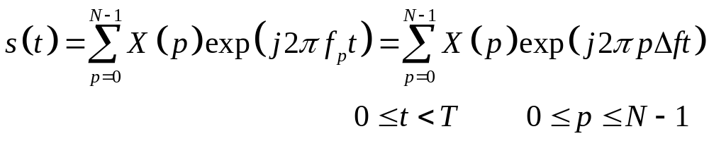
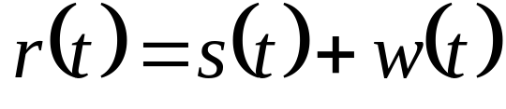
Mathematical Description
Tx Signal
  Information symbols: X(p), p = 0, 1, …, N -1
  Tx Signal s(t) can be expressed as
  in which T = 1 /Δf is the duration of an OFDM symbol
The Rx signal under AWGN channel can be expressed as

Slide 37
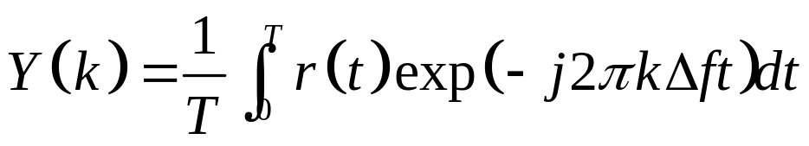
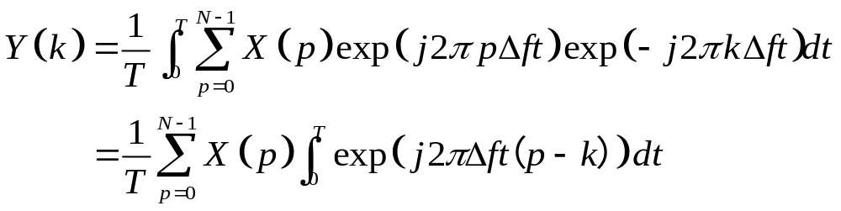
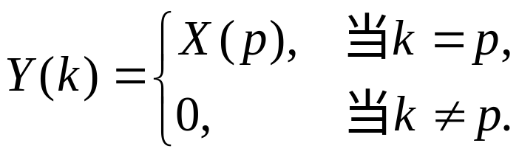
Mathematical Description
The signal on the k-th subcarrier can be obtained by
If w(t) = 0 (ideal case), Y(k) can be expressed as
Orthogonal property

Slide 38
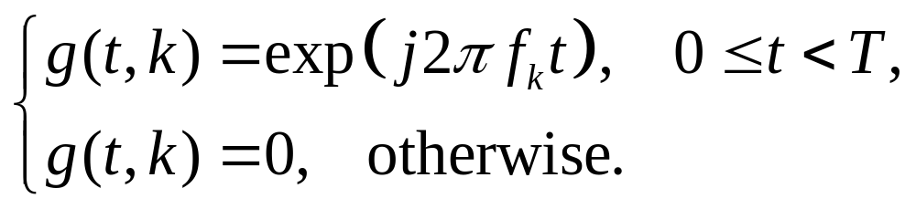
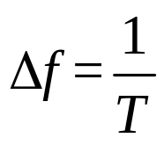
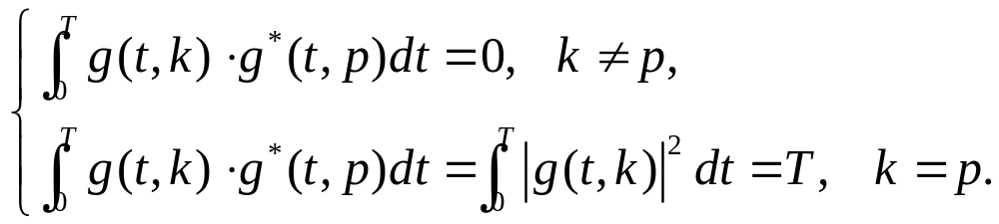
Orthogonal Basis
The orthogonal basis function for the k-th subcarrier is expressed as
Orthogonality between orthogonal basis functions

Slide 39
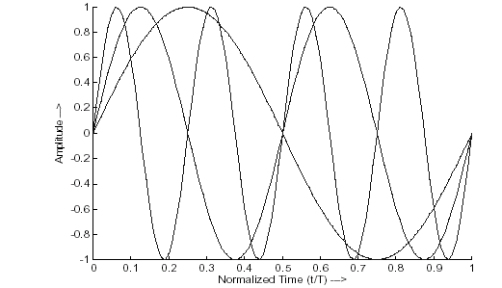
Orthogonality between subcarriers
  Every subcarrier has integer number of periods within symbol duration T
  Difference of number of periods for adjacent subcarriers is one.
天津大学电子信息工程学院通信系

Slide 40
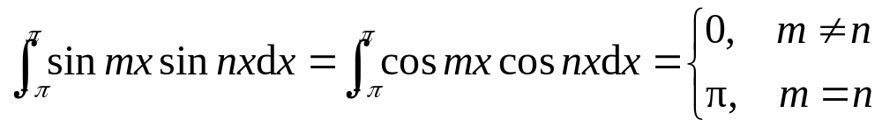
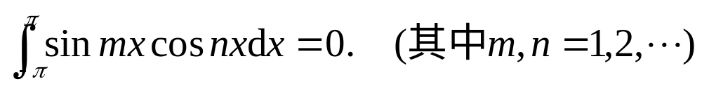
基础知识——正交(Orthogonality)
正交（ Orthogonal）：线性代数的概念，是直观概念中垂直的推广。
三角函数的正交性：
在周期区间上是两两相互正交的，即

Slide 41
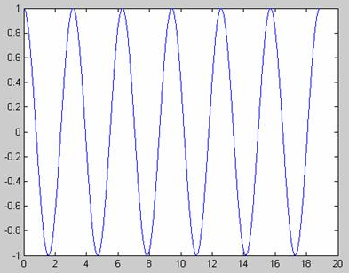
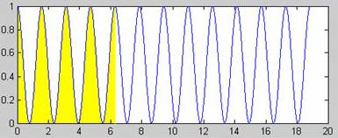
Orthogonality between subcarriers
以 cos 2ωt 乘 cos 2ωt 为例，
相乘后在周期内积分，
相当于求下图黄色部分的面积，面积大于0。

Slide 42
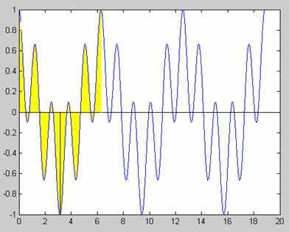
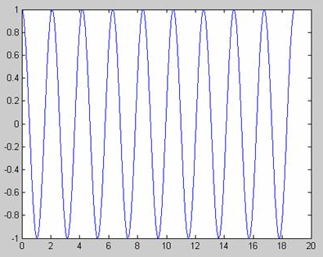
Orthogonality between subcarriers
以 cos 2ωt 乘 cos 3ωt 为例，
相乘再在周期内积分，
相当于求下图黄色部分的面积，面积为0。

Slide 43
Multicarrier Transmission Systems
Sub-carrier Spacing

Slide 44
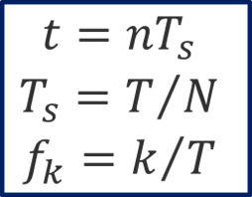
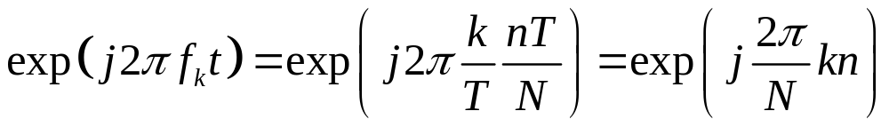
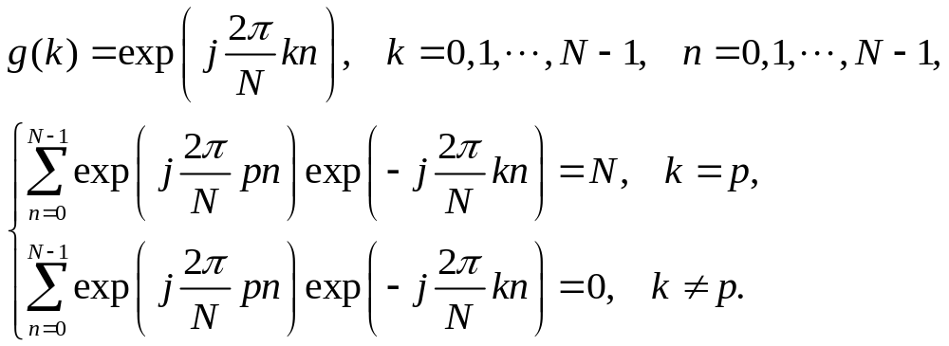
Discrete Orthogonal Basis

Slide 45
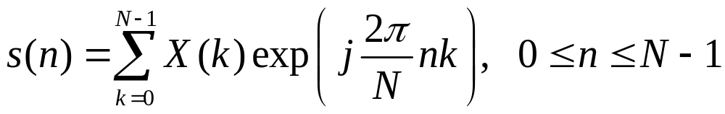
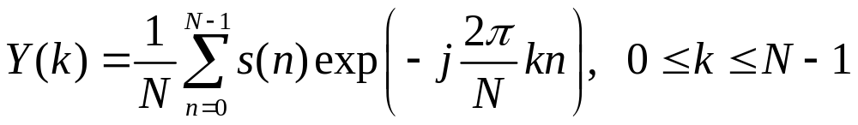
Implementation of OFDM based on IDFT and DFT
With signal on the k-th subcarrier of X(k), the Tx signal in the time domain is
At the receiver, the signal on the k-th subcarrier can be obtained by
In practice, modulation and demodulation of parallel data is implemented based on IFFT and FFT

Slide 46
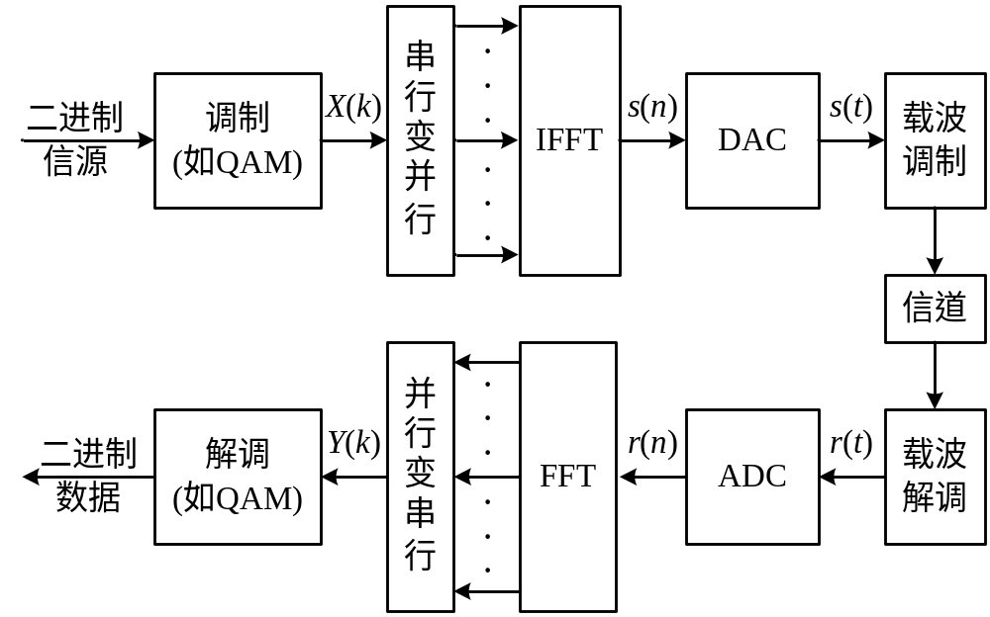
OFDM system structure based on FFT and IFFT
N Symbols
N Samples

Slide 47

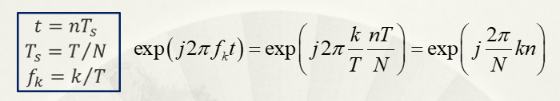
Mathematical Description of OFDM
Tx signal with continuous basis
Tx signal with discrete basis

Slide 48
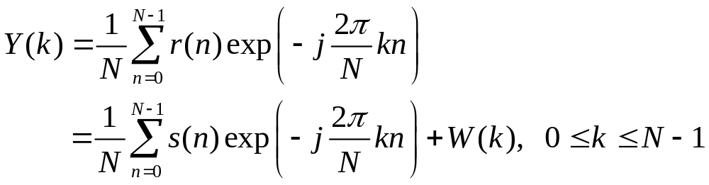
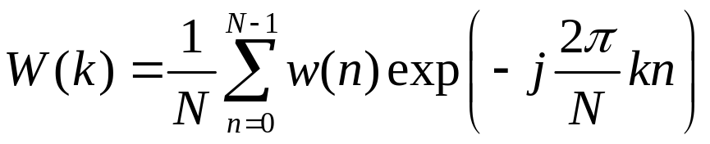
Mathematical Description of OFDM
Rx signal: r(t) = s(t) + w(t)
Sampling of r(t): r(n) = s(n) + w(n)
Symbol on the k-th subcarrier can be obtained by

Slide 49




SC vs. OFDM

Slide 50

An example of OFDM signal：
QPSK symbols: 1+j, -1-j, -1-j, 1+j on 4 subcarriers
Symbols in frequency domain
×
+
Signal in time domain

Slide 51

An example of OFDM signal：
BPSK symbols of 1, 1, 1, 1 on 4 subcarriers
High peak-to-average-power ratio (PAPR)

Slide 52

Spectra of OFDM Signal
  为什么长
  这个样子？
  Rectangular windowing causes sinc spectrum in frequency domain with zeros at 1/T

Slide 53

Signal shape in Freq/Time Domain

Slide 54

Signal shape in Freq/Time Domain

Slide 55
正交基的定义区间
模拟
数字

Slide 56

Spectra of OFDM Signal
The orthogonality allows high spectral efficiency

Slide 57

Spectra of OFDM Signal
When N is very large, the spectra of OFDM signal is close to rectangle

Slide 58

Spectra of OFDM Signal

Slide 59

Frequency Analysis of Time Domain Signal

Slide 60

OFDM system structure based on FFT and IFFT
AWGN

Slide 61

Serial to Parallel (S/P)

Slide 62
Discrete Orthogonal Basis

Slide 63



Hardamad Matrix

Slide 64



OFDM System
CDMA System

Slide 65
Homework 1
Matlab Simulation
To study the relationship between channel delay spread and coherent bandwidth
  Change position of the 2nd path;
  Change amplitude of the 2nd path;
  Change phases of two paths;
  Have more paths;

Slide 66
Homework 2
Matlab simulation: IFFT/FFT based OFDM transmission system (BPSK/QPSK/16QAM)
对比
码流
画星
座图
AWGN

