Slide 1
Home work
Zhen GAO (Associate Professor)
高镇
School of Electrical and Information Engineering
Tianjin University
email: zgao@tju.edu.cn

Slide 2
Homework 1
Matlab Simulation
To study the relationship between channel delay spread and coherent bandwidth
  Change position of the 2nd path;
  Change amplitude of the 2nd path;
  Change phases of two paths;
  Have more paths;

Slide 3
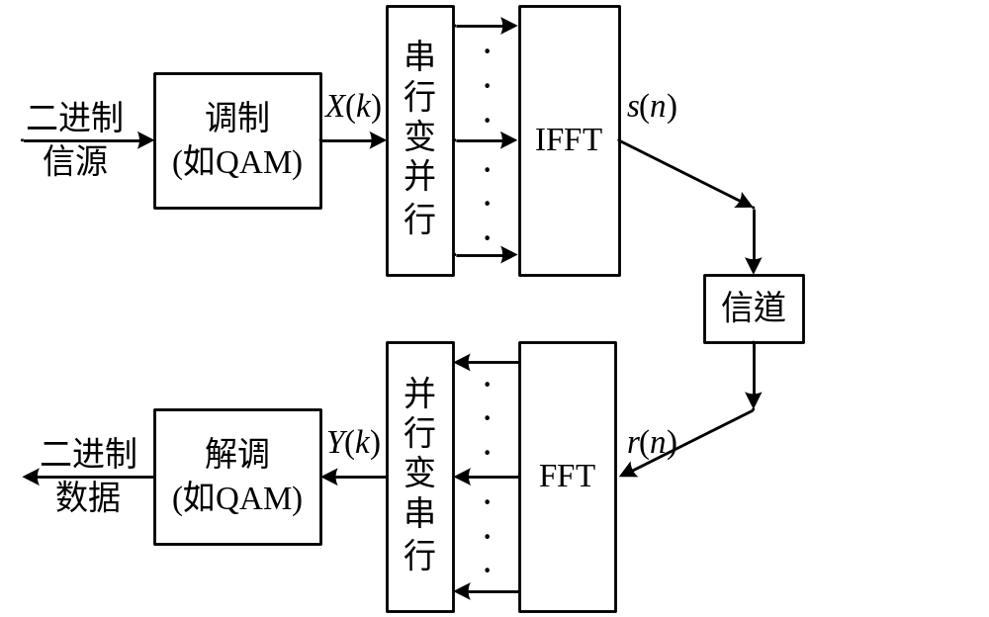
Homework 2
Matlab simulation: IFFT/FFT based OFDM transmission system (BPSK/QPSK/16QAM)
对比
码流
画星
座图
AWGN

Slide 4
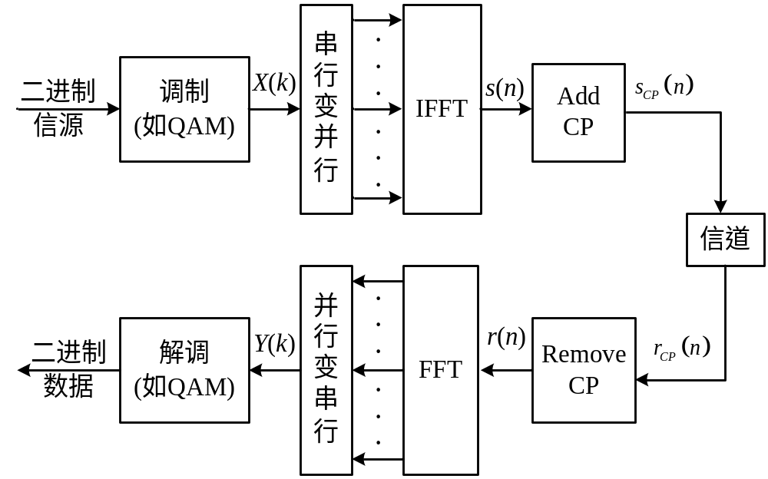
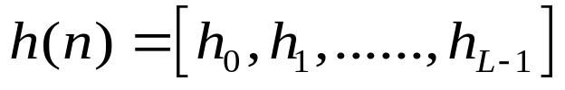
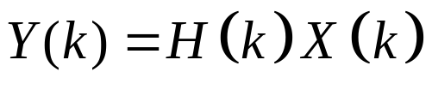
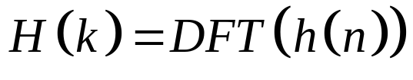
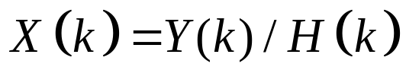
Homework 3
Matlab simulation: Add CP/Remove CP, Multipath Channel

Slide 5
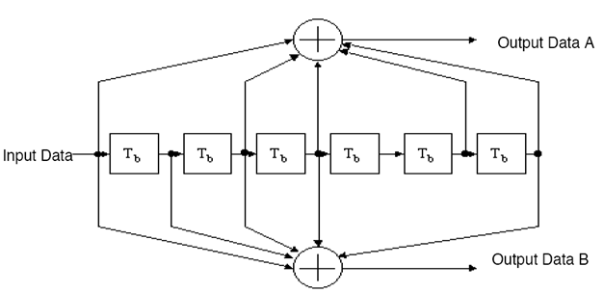
Homework 4
Matlab simulation: Convolutional code (133,171)
convenc(trellis), vitdec(trellis)
trellis = poly2trellis(7,[133 171])
SNR-BER
[1 0 1 1 0 1 1]=(133)₈
[1 1 1 1 0 0 1]=(171)₈

Slide 6
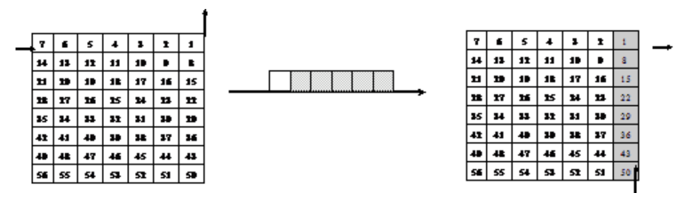
Homework 5
Matlab simulation: interleaving
Implement simple block interleaver
Compare the bit position before and after interleave
Interleaving
De-interleaving

Slide 7
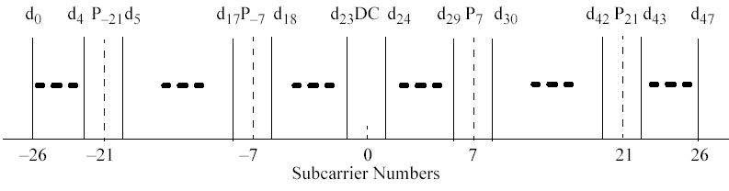
Homework 6
Matlab simulation: Mapping and De-mapping
52
Data Subc Patt: [1:5 7:19 21:26 27:32 34:46 48:52]
Pilot Subc Patt: [6 20 33 47]
Used Subc Idx: [7:32 34:59]
Data Subc Idx: [7:11 13:25 27:32 34:39 41:53 55:59];
Pilot Subc Idx: [12 26 40 54];
Reorder: [33:64 1:32];
64

Slide 8
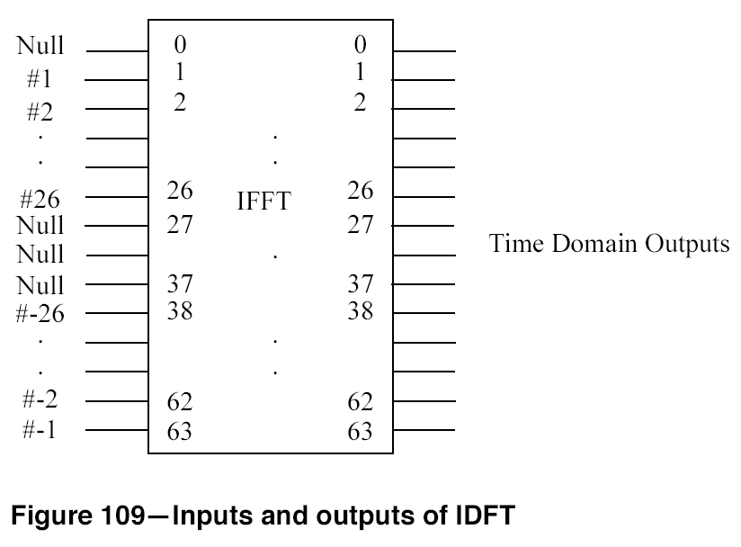
Homework 6
Symbols for subcarrier
1 to 26 mapped to #1 to # 26 input of IFFT;
Symbols for subcarrier -26 to -1 mapped to #38 to #63 input of IFFT;
#27 to #37 and the #0 inputs of IFFT set to be 0

Slide 9
Homework 7
Matlab simulation: generate preamble
Short_training
Long_training

Slide 10
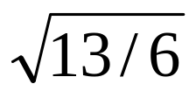
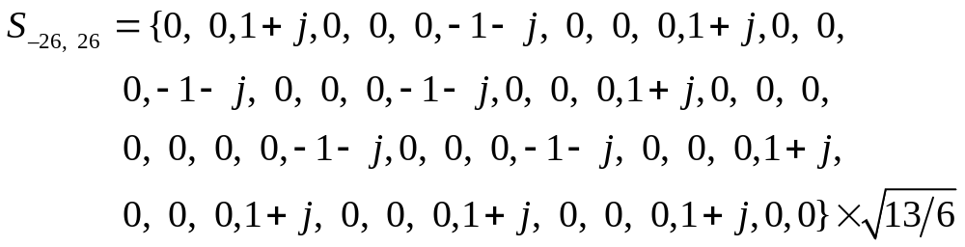
Short Training Symbols
12 non-zero subcarriers among 52 subcarriers
[-24, -20, -16, -12, -8, -4, 4, 8, 12, 16, 20, 24]
Factor is used for power normalization
Nonzero subcarrier every 4 subcarriers
Periodicity of T_{FFT}/4 = 0.8us in time domain

Slide 11
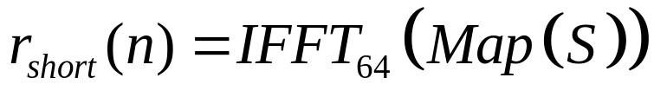
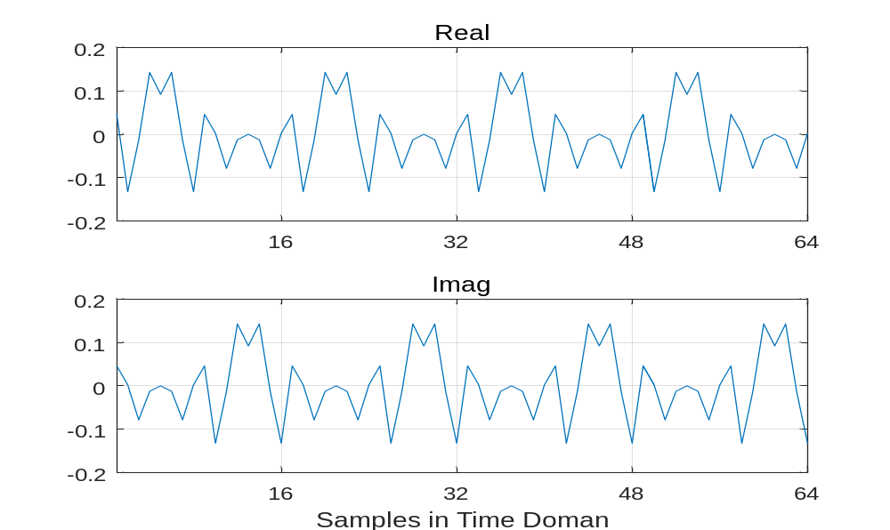
Short Training Symbols

Slide 12
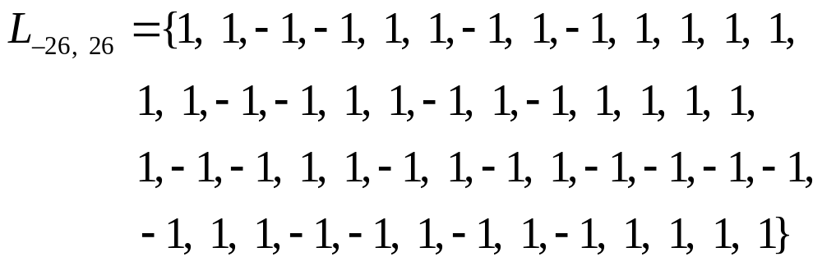
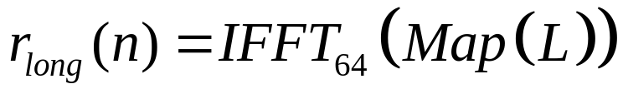
Long Training Symbols
A long OFDM training symbol consists of 52 subcarriers, which are modulated by the elements of the sequence L

