Slide 1
OFDM System Design (1)
Zhen GAO
School of Electrical and Information Engineering
Tianjin University
email: zgao@tju.edu.cn

Slide 2
Outline
Tx and Rx process of OFDM system
Main parameters
Example of System Design
Overview of Key Modules
Examples of OFDM systems

Slide 3
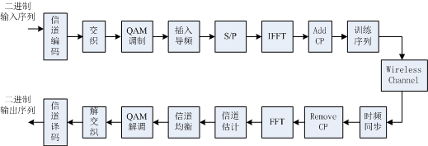
Tx/Rx process of OFDM system
信道编码：Channel Coding
交织：Interleaving
调制：Modulation
插入导频：Insert Pilots
训练序列：Training Sequence
S/P： Serial to Parallel
信道译码：Channel Decoding
解交织：De-Interleaving
解调：De-modulation
时频同步：Time/Freq Synchronization
信道估计：Channel Estimation
信道均衡：Channel Equalization
Notes:
S/P: Serial to Parallel

Slide 4
Main Parameters
中文名称 | 英文名称 | 符号 | 备注
系统带宽 | system bandwidth | B | /MHz
子载波个数 | subcarrier number | N
子载波宽度 | subcarrier bandwidth | B_{sub} | /MHz /kHz
FFT长度 | FFT length | T_{FFT} | us or # of samples
CP长度 | CP length | T_{CP} | us or # of samples
OFDM符号长度 | Symbol length | T | us or # of samples
导频个数 | pilots number | N_{p}
训练序列长度 | training seq length | T_{t} | us or # of samples
调制阶数 | modulation level | M
编码码率 | coding rate | r
传输速率 | transmission rate | R | /Mbps or /Kbps

Slide 5
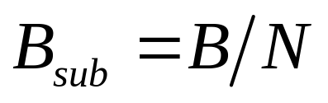
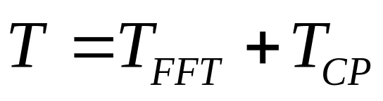


Relationship between main parameters
中文名称 | 英文名称 | 符号 | 备注
系统带宽 | system bandwidth | B | /MHz
子载波个数 | subcarrier number | N
子载波宽度 | subcarrier bandwidth | B_{sub} | /MHz /kHz
FFT长度 | FFT length | T_{FFT} | us
CP长度 | CP length | T_{CP} | us
OFDM符号长度 | Symbol length | T | us

Slide 6


Relationship between main parameters
中文名称 | 英文名称 | 符号 | 备注
子载波个数 | subcarrier number | N
OFDM符号长度 | Symbol length | T | us
调制阶数 | modulation level | M
编码码率 | coding rate | r
传输速率 | transmission rate | R | Mbps or Kbps
N subcarriers carry N constellation symbols
Each constellation symbol carries M coded bits, which include M·r information bits;
One OFDM symbol carry NMr information bits
Transmission rate R = NMr/T

Slide 7

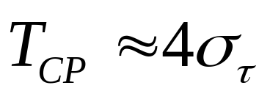
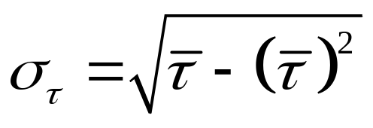
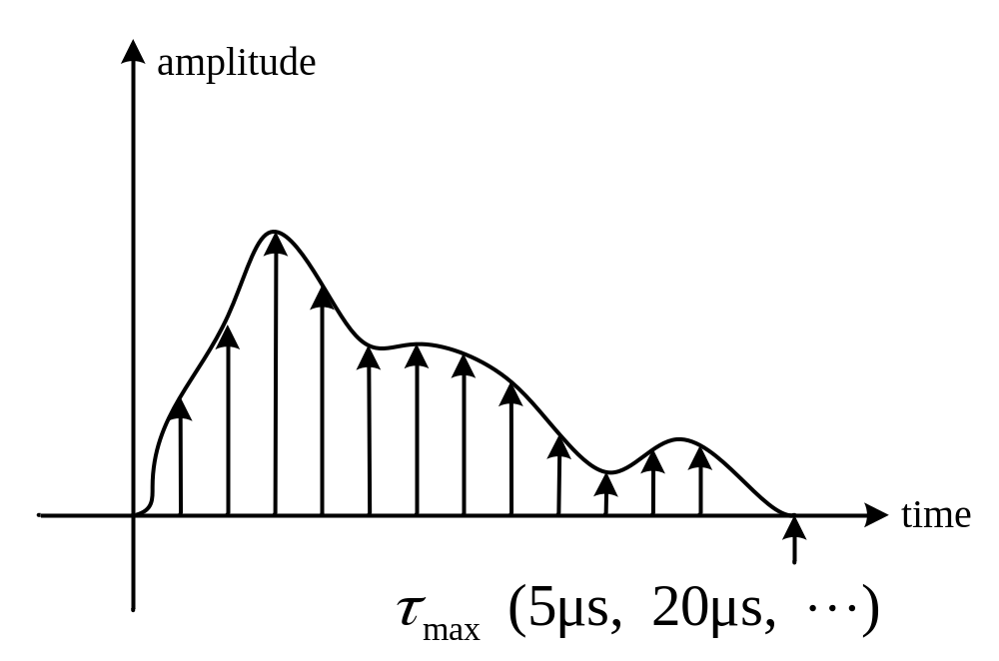
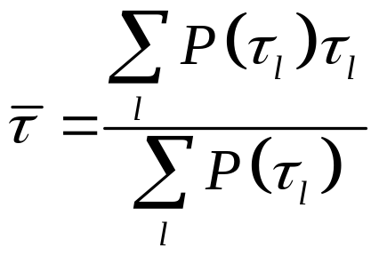
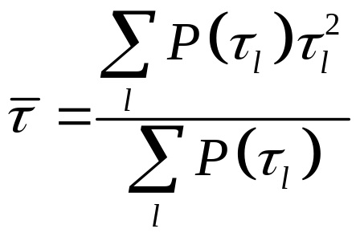
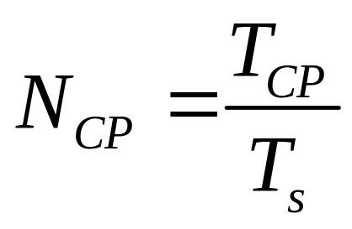
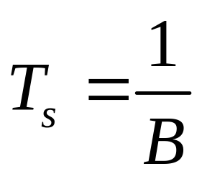
Principle for parameter setting (T_{CP})
Length of CP should be larger than the length of the multi-path channel impulse response (CIR)
rms delay spread
(root mean square)
工程上常取
保护间隔长度为信道时延扩展均方根的2～4倍
Notes:
rms: root mean square

Slide 8
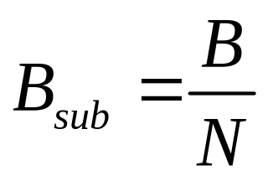
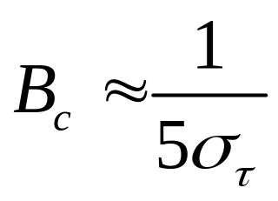
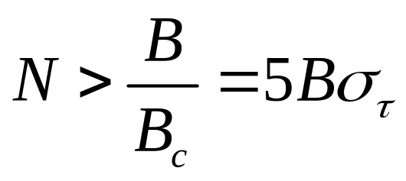
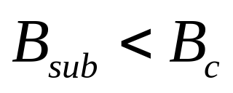
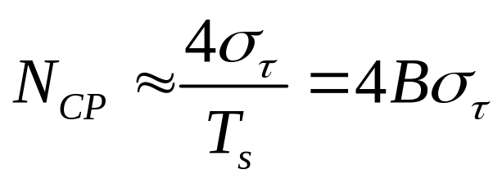
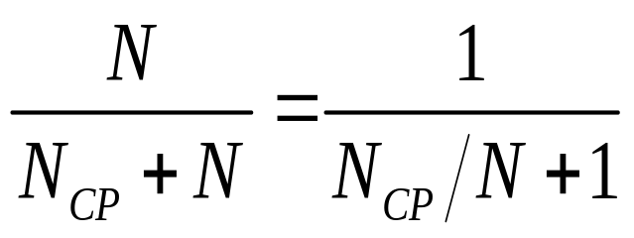
Principle for parameter setting (N)
Bandwidth of subcarrier should be smaller than coherent bandwidth
工程上常取
OFDM符号长度为信道CP 长度的
5~6倍 (2幂次方)

Slide 9
Outline
Tx and Rx process of OFDM system
Main parameters
Example of System Design
Overview of Key Modules
Examples of OFDM systems

Slide 10
Examples for System Design
Requirements and Conditions
  Bit Rate
  BER
  Scenario/Transmission Distance
  Carrier Frequency
  Channel Impulse Response
  Bandwidth
  Maximum Tx Power
  Maximum Tx/Rx Antenna Gain
  Receiving Sensitivity
Physical Layer
System Design
SC/OFDM
Framing
Coding
Modulation
……

Slide 11
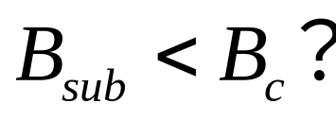


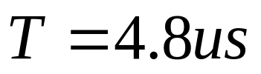
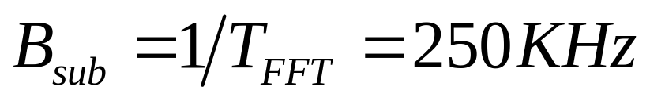
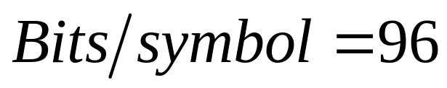
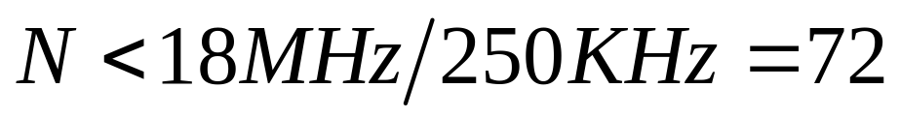

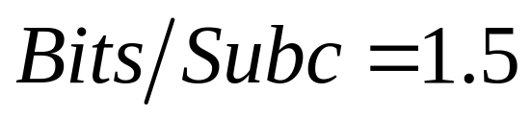
Examples for System Design
Requirements and Conditions
  Bit Rate 20Mbps
  Channel delay spread 200ns
  Bandwidth <18MHz
System Parameter Setting

Slide 12
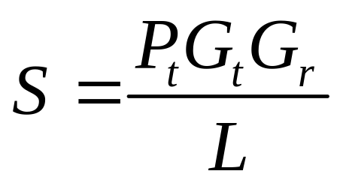
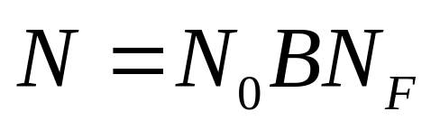
Examples for System Design
M·r = 1.5 → QPSK + 3/4Turbo
Requirements and Conditions
  BER (e.g. 10⁻⁵)
  Path Loss (f_{c}, D)
  Tx Power
  Tx/Rx Antenna Gain
  Noise Figure
Required
SNR

Slide 13
Outline
Tx and Rx process of OFDM system
Main parameters
Example of System Design
Overview of Key Modules
Examples of OFDM systems

Slide 14
Tx/Rx process of OFDM system

Slide 15
Time Synchronization
Inter-symbol Interference (ISI)
N
N
N
Find the start point of OFDM symbols
Get the ISI free N samples

Slide 16
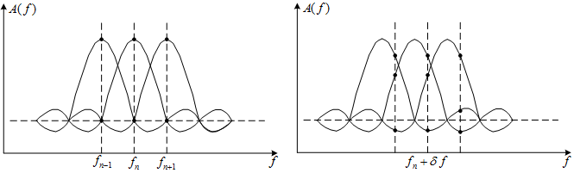
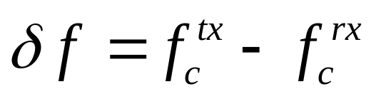
Frequency Synchronization
1/T_{FFT}
Inter-carrier Interference (ICI)
Carrier Frequency Offset (CFO):
Doppler Shift
CFO Estimation & Compensation
Remove ICI

Slide 17
Time/Frequency Synchronization
Find the start point of OFDM symbols (ISI free)
CFO Estimation & Compensation (ICI free)

Slide 18
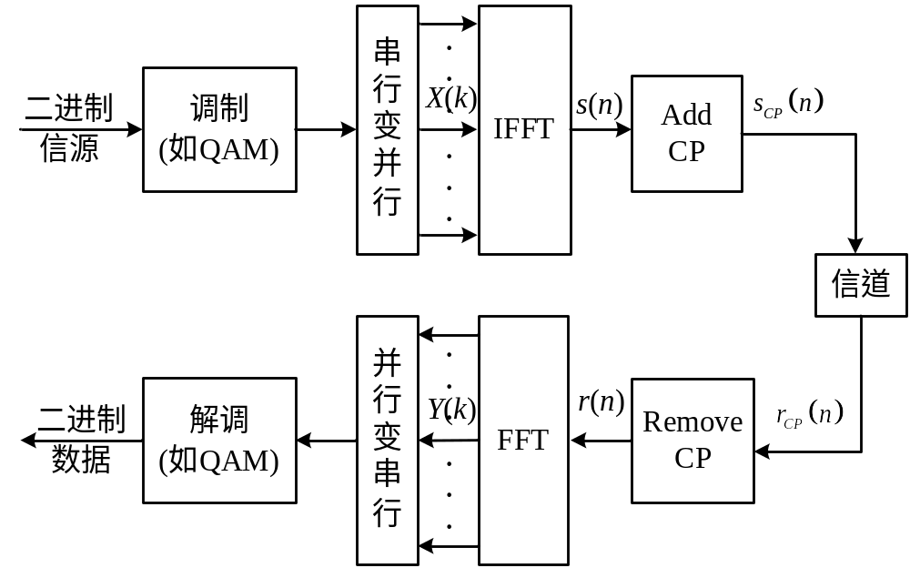
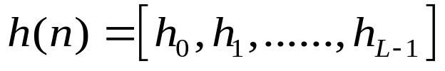
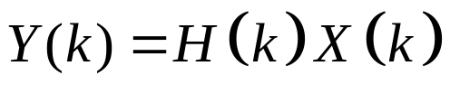
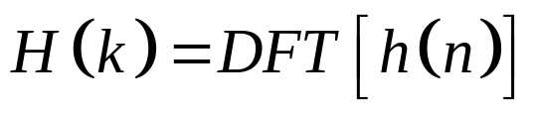
Channel Estimation & Equalization

Slide 19


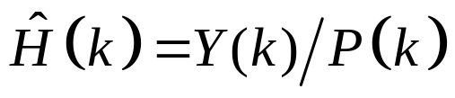

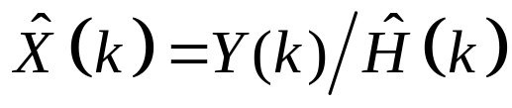
Channel Estimation & Equalization

Slide 20
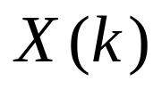
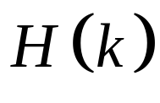
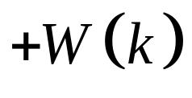
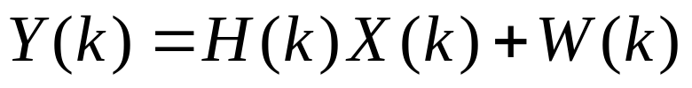
Demodulation Errors
f₀
f_{N-1}
Channel estimation errors (Amp/Phase )
Synchronization errors (ISIs/ICIs)
Errors in the equalized constellation symbols
Errors in the demodulated bits

Slide 21
Channel Coding
Channel coding for error bits recovery
Good at correct distributed error bits
Not good at correct burst error bits
64QAM: 6 bits
f₀
f_{N-1}

Slide 22
Interleaving/De-interleaving
Intra-frame Interleaving
Frequency Selective
Inter-frame Interleaving
Time Selective
Interleaving:
  Bits in one QAM is not continuous in the encoded bit sequence;
  Bits from same frame are assigned to different OFDM symbols;
De-interleaving: wrong bits spread in time and frequency;
Coding can recover non-burst error bits;

Slide 23
Summary of OFDM system design
Key Technology
Frequency selective fading
OFDM
Parallel flat fading
Coding
Recover deep faded bits
Interleaving
Spread deep faded bits
Frequency Diversity
Notes:
什么是Diversity？不把鸡蛋放到一个篮子里
一个信息在三个频带发送，相干带宽
一个信息在三个时间发送，相干时间
一个信息从三个天线发送，相干距离
三次重复是1/3编码

Slide 24
Outline
Tx and Rx process of OFDM system
Main parameters
Example of System Design
Overview of Key Modules
Examples of OFDM systems

Slide 25
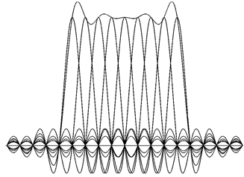
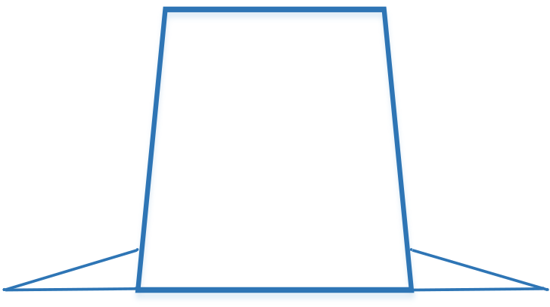
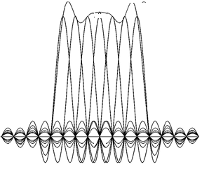
f_{c}-B
f_{c}
f_{c}+B
f
Adjacent
channel
interference
B
Silent
Subcarriers
f
Smaller adjacent channel interference

Slide 26
Examples of OFDM systems
Standard | DAB | DVB-T | DVB-H | DVB-T2 | DMB-T/H | 802.11a
B [MHz] | 1.712 | 6, 7, 8 | 5, 6, 7, 8 | 1.7, 5, 6, 7, 8, 10 | 8 | 20
FFT size (k=1,024) | 2k/1k/ 512/256 | 2k/8k | 2k, 4k, 8k | 1k/2k/4k, 8k/16k/32k | 4k | 64
Number of non-silent SubC, N | 1536/768 384/192 | 1705 6817 | 1705, 3409, 6817 | 853-27841 | 3780 | 52
FFT length, T_{FFT}(μs) | 1000/500, 250/125 | 224 896 | 224, 448, 896 | 112-3584 | 500 | 3.2
GI, T_{G} (frac of T_{FFT}) | 24.6% | ​¹⁄₄, ​¹⁄₈, ​¹⁄₁₆, ​¹⁄₃₂ | ​¹⁄₄, ​¹⁄₈, ​¹⁄₁₆, ​¹⁄₃₂ | 1/128, 1/32, 1/16, 19/256, 1/8, 19/128, 1/4. | ​¹⁄₄, ​¹⁄₆, ​¹⁄₉ | ​¹⁄₄
SubC spacing/Hz | 1K/2K 4K/8K | 4464 1116 | 4464, 2232, 1116 | 279-8929 | 2000 | 312.5 K
Notes:
T: Terrestrial; H: handheld; S: Satellite
Examples: DAB, DMB-T, 802.11
DAB: Bsub = 1/1ms = 1k; Nt = 1.712M/1k = 1712; Nns = 1536; Nfft = 2k;
DMB-T: Bsub = 1/0.5ms = 2kHz; 8MHz/2k = 4000; Nns = 3780; Nfft = 4096;
802.11: Bsub = 1/3.2us = 312.5kHz; 20MHz/312.5kHz = 64; Nns = 52; Nfft = 64;
About GI: DAB(fixed ratio) vs. DMBT(variable ratio)
Delay Spread: DAB GI = 0.25ms; 802.11 GI = 0.8us; (场景与频段原因)
Bc: DAB Bsub = 1kHz, 802 Bsub = 312.5kHz
DAB不同选项间速率不变，数量少则复杂度降低；
DMB算短CP长度会提升频谱效率

Slide 27
Examples of OFDM systems
Standard | DAB | DVB-T | DVB-H | DMB-T/H | DVB-T2 | 802.11a
Inner FEC | Conv code code rates ​¹⁄₄, ​³⁄₈, ​⁴⁄₉, ​¹⁄₂, ​⁴⁄₇, ​²⁄₃, ​³⁄₄, ​⁴⁄₅ | Conv code code rates​ ¹⁄₂, ​²⁄₃, ​³⁄₄, ​⁵⁄₆, ​⁷⁄₈ | Conv code code rates​ ¹⁄₂, ​²⁄₃, ​³⁄₄, ​⁵⁄₆, ​⁷⁄₈ | LDPC code rates 0.4, 0.6 or 0.8 | LDPC 1/2, 3/5, 2/3, 3/4, 4/5, 5/6 | Conv code code rates​ ¹⁄₂, ​²⁄₃, ​³⁄₄
Outer FEC (if any) | RS (120, 110, t = 5) | RS (204, 188, t=8) | RS (204, 188, t=8) | BCH code (762, 752) | BCH code
Time interleaving depth(ms) | 384 | 0.6–3.5 | 0.6–3.5 | 200–500 | up to 250
modulate | ​^{π}⁄₄-DQPSK | QPSK, 16QAM, 64QAM | QPSK, 16QAM 64QAM | QPSK 16QAM, 32QAM 64QAM. | QPSK, 16QAM, 64QAM, 256QAM | BPSK, QPSK, 16QAM 64QAM
Notes:
首先看时间交织深度 与 相干时间的关系
然后看一下Inner FEC和Outer FEC

Slide 28

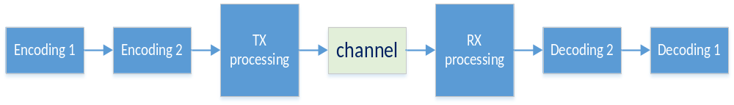

Inner and Outer FEC
Relative to the channel

Slide 29
Examples of OFDM systems
Standard | DAB | DVB-T | DVB-H | DMB-T/H | DVB-T2 | 802.11a
Inner FEC | Conv code code rates ​¹⁄₄, ​³⁄₈, ​⁴⁄₉, ​¹⁄₂, ​⁴⁄₇, ​²⁄₃, ​³⁄₄, ​⁴⁄₅ | Conv code code rates​ ¹⁄₂, ​²⁄₃, ​³⁄₄, ​⁵⁄₆, ​⁷⁄₈ | Conv code code rates​ ¹⁄₂, ​²⁄₃, ​³⁄₄, ​⁵⁄₆, ​⁷⁄₈ | LDPC code rates 0.4, 0.6 or 0.8 | LDPC 1/2, 3/5, 2/3, 3/4, 4/5, 5/6 | Conv code code rates​ ¹⁄₂, ​²⁄₃, ​³⁄₄
Outer FEC (if any) | RS (120, 110, t = 5) | RS (204, 188, t=8) | RS (204, 188, t=8) | BCH code (762, 752) | BCH code
Time interleaving depth(ms) | 384 | 0.6–3.5 | 0.6–3.5 | 200–500 | up to 250
modulate | ​^{π}⁄₄-DQPSK | QPSK, 16QAM, 64QAM | QPSK, 16QAM 64QAM | QPSK 16QAM, 32QAM 64QAM. | QPSK, 16QAM, 64QAM, 256QAM | BPSK, QPSK, 16QAM 64QAM
Notes:
时间交织深度 与 相干时间的关系

Slide 30
AMC (ACM)
Link adaptation, or adaptive coding and modulation (ACM), is a term used in wireless communications to denote the matching of the modulation, coding and other parameters to the conditions on the radio link (e.g. the pathloss, the interference, the sensitivity of the receiver, the available transmitter power margin, etc.).
Rate adaptation algorithm: adapts the modulation and coding scheme (MCS) according to the quality of the radio channel, and thus the bit rate and robustness of data transmission.

Slide 31
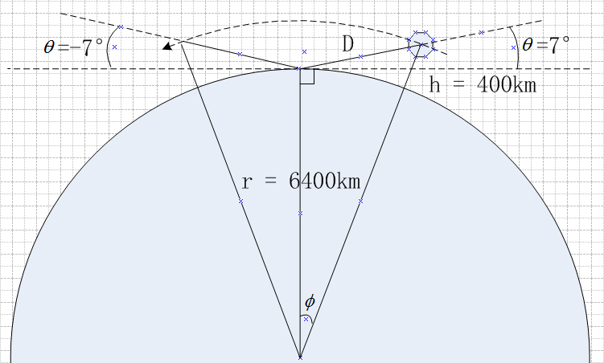
An example of ACM in SatComm.

Slide 32
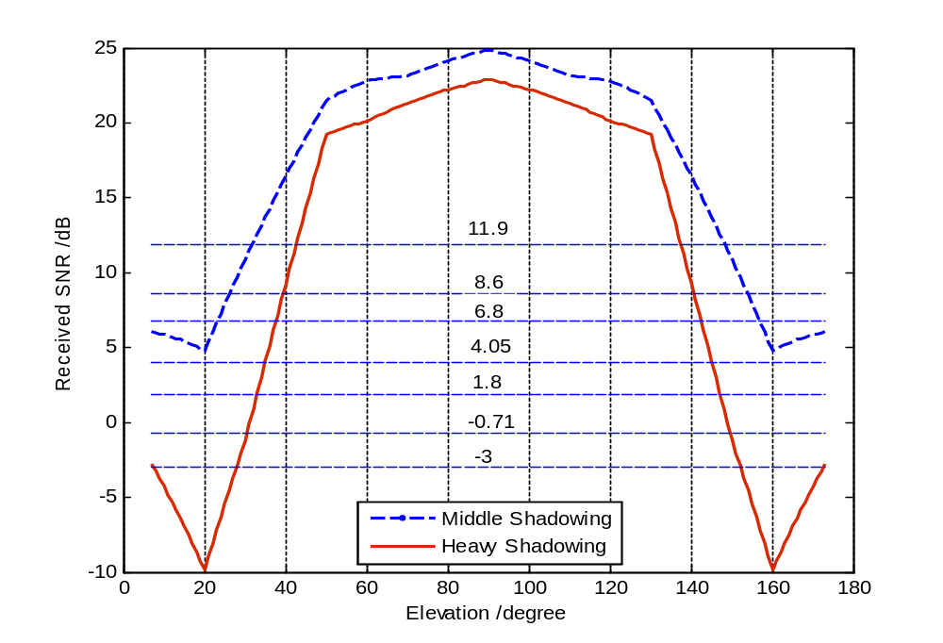

Slide 33
An example of ACM in SatComm.
SNR 区间 (dB) | 最佳传输方案 （调制+Turbo码率） | 传输效率 （bits per symbol）
-3.07 ~ -0.71 | BPSK +1/3 | 1/3
-0.71 ~ 1.8 | QPSK + 1/3 | 2/3
1.8 ~ 4.05 | QPSK + 1/2 | 1
4.05 ~ 6.8 | 16QAM + 1/3 | 4/3
6.8 ~ 8.6 | 16QAM + 1/2 | 2
8.6 ~ 11.9 | 16QAM + 3/5 | 2.4
> 11.9 | 16QAM + 4/5 | 3.2

