Slide 1

Traffic Density Estimation
GROUP 1 CV:
Matthew Harry Indriadi (24/532723/PA/22527)
Daffa Aryza Pasya (24/532884/PA/22549)
Ryan Ethan Halim (24/536718/PA/22765)
Hazelleno Ian Purnomo (24/546598/PA/23206)
Rafaela Anabel Purba (24/547080/PA/23218)
LOCALLY ROOTED,
GLOBALLY RESPECTED
ugm.ac.id

Slide 2
Abstract
This study presents a traditional computer vision approach to estimate traffic density from CCTV footage. The system processes image of a traffic through a pipeline which includes grayscale conversion, Gaussian blur, background subtraction, and binary segmentation to compute a pixel-ratio-based density score.

Slide 3
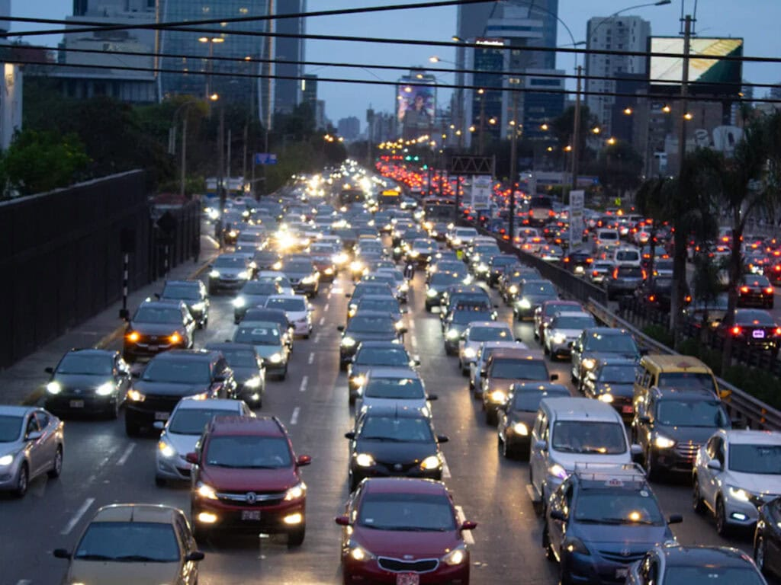
Background
Traffic congestion is a growing urban problem requiring automated monitoring solutions
Traditional CCTV systems rely on human observation inefficient and non-scalable
Computer vision offers a cost-effective alternative using existing camera infrastructure

Slide 4
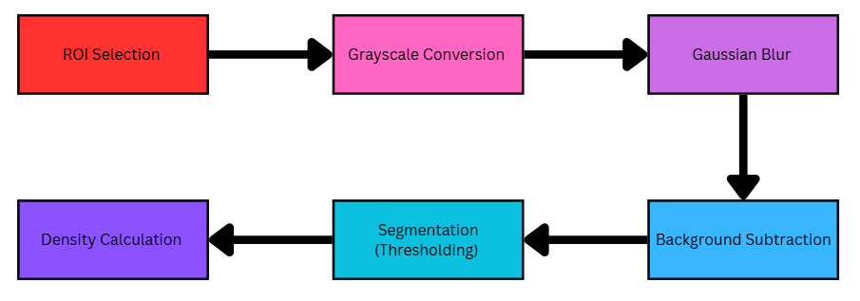
Pipeline

Slide 5
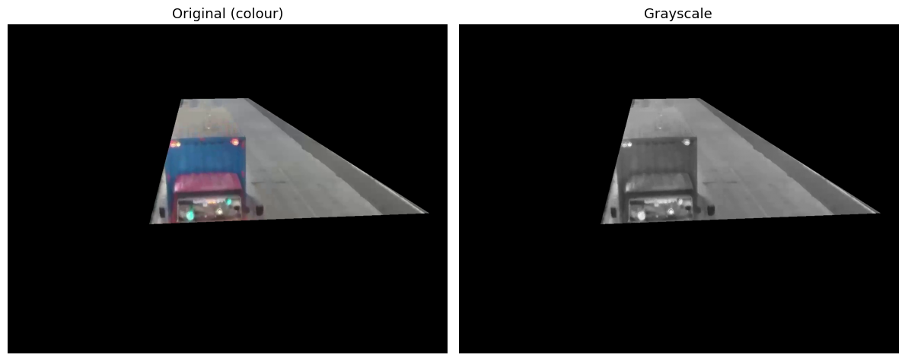
ROI & Grayscale
Region of Interest (ROI) + Grayscale Conversion
- ROI: Crop the video frame matrix *I to focus only on the road area
- Grayscale: Convert the 3-channel RGB image to a single-channel luminance image

Slide 6
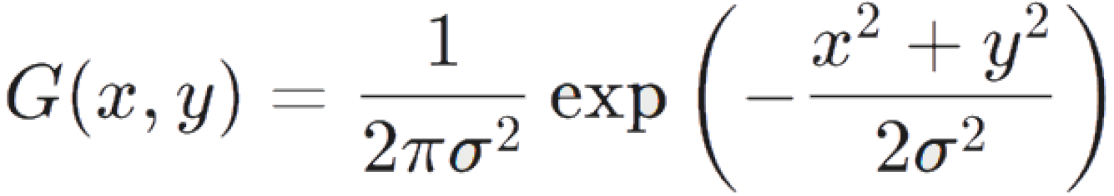
Gaussian Blur (Noise Reduction)
Before any gradient-based operations, the image must be smoothed to suppress noise
Applied via convolution with a Gaussian Kernel (typically 3×3 or 5×5):
Prevents false edge detection caused by sensor noise or compression artifacts in CCTV footage

Slide 7
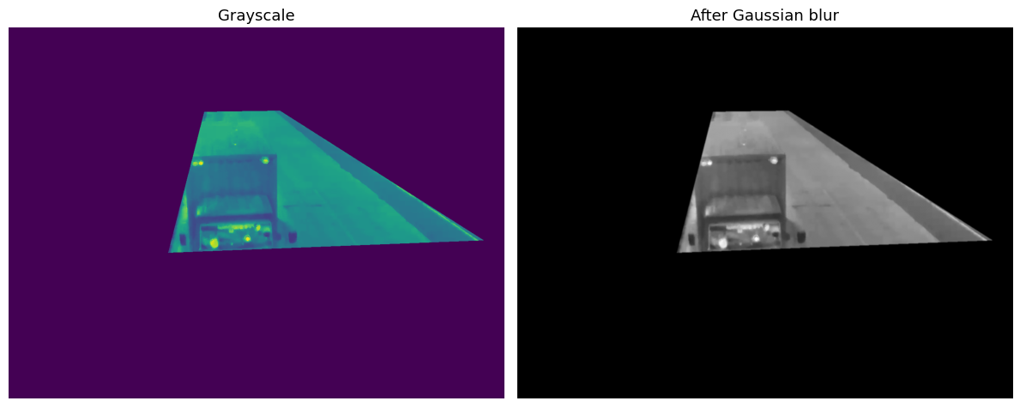
Gaussian Blur (Noise Reduction)

Slide 8
Background Subtraction
Isolates vehicle regions by comparing each frame against a learned background model
Detects presence of vehicles based on change, not color contrast, handles same-color vehicles better than edge detection
Pixels significantly different from the background are classified as foreground:
Otsu's method is used to automatically determine optimal threshold

Slide 9
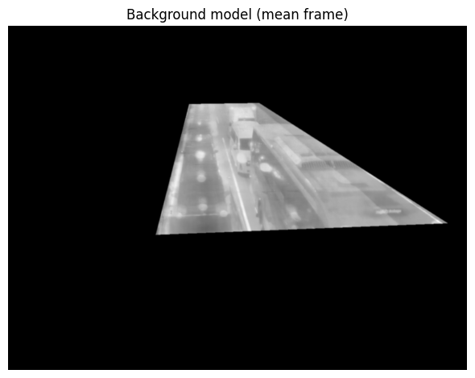
Background Subtraction
Since the camera is fixed, the temporal mean of a traffic scene converges toward an empty road. A static background model is built by computing the per pixel mean across all available frames.

Slide 10
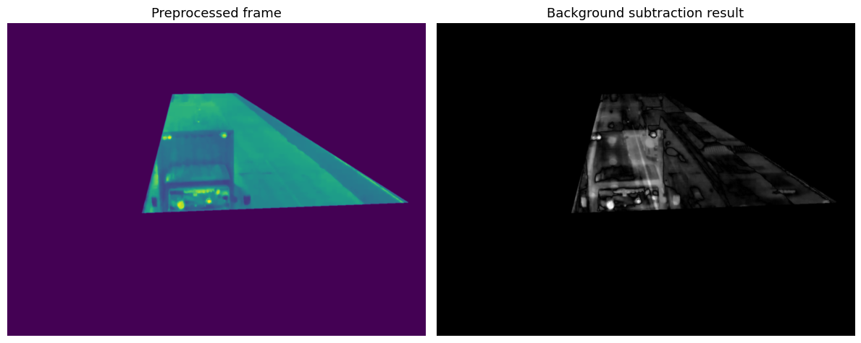
Background Subtraction
Each individual frame is then subtracted from this model to isolate moving object:
Otsu's method is used to automatically determine optimal threshold

Slide 11
Binary Segmentation (Thresholding)
- The gradient image is converted into a binary mask (0 or 1) using a threshold value:
- Pixels classified as 1 = object/vehicle features (high gradient = car edges)
- Pixels classified as 0 = flat background (road surface, sky)
- Result: A clean binary map distinguishing vehicles from background

Slide 12
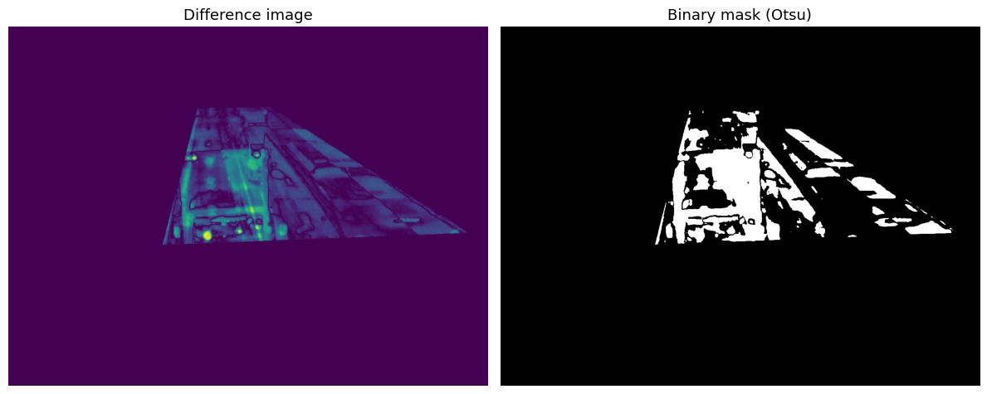
Binary Segmentation (Thresholding)

Slide 13
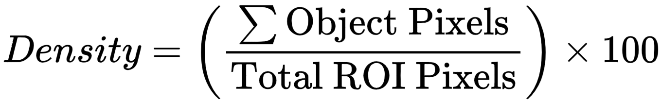
Traffic Density Formula (Pixel Ratio Analysis)
- Object Pixels: Count of pixels = 1 in the binary mask
- Total ROI Pixels: Fixed area of the defined region of interest
- Output: A percentage score representing how "filled" the road is
- Higher % → denser traffic | Lower % → lighter traffic

Slide 14
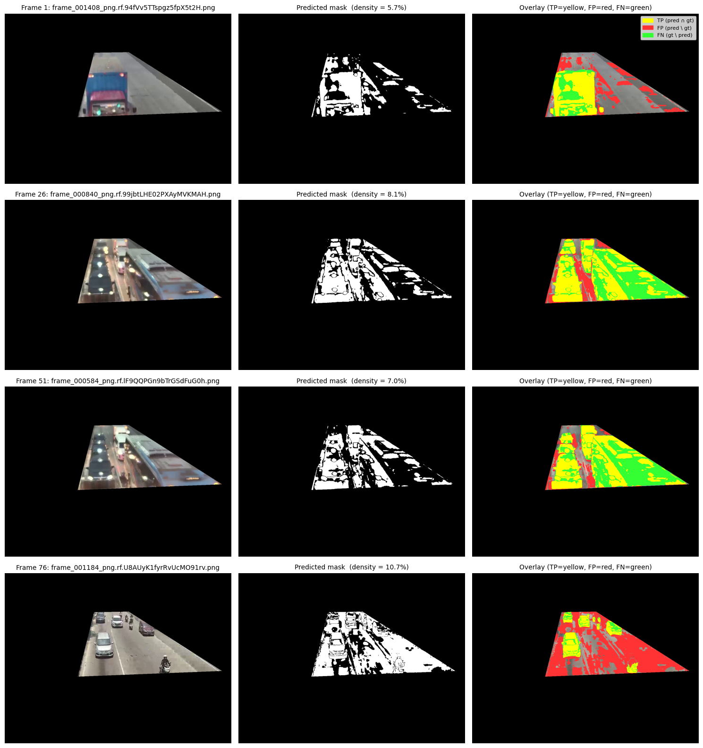
Qualitative Result
Large vehicles (trucks, vans) are detected reliably, their motion stands out clearly from the background.
Smaller vehicles are trickier. When their color is close to the road surface, we tend to miss them (shown in green).
False positives (red) show up in two places:
Around the edges of vehicles, near the decision boundary of the threshold
In areas with shadows or changing light, where the background slowly drifts
Generally, the predictions are spatially coherent. Detections line up where vehicles actually are.

Slide 15
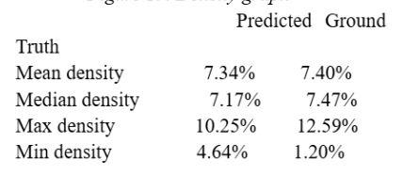

Density Estimation Accuracy
Comparison of Predicted Density vs. Ground-Truth (COCO segmentation annotations) evaluated across 100 benchmark frames.
Global accuracy: Predicted mean density (7.34%) closely aligns with ground truth (7.40%), indicating no systematic large-scale bias.
Balanced performance across typical frames: Predicted median (7.17%) closely matches ground truth (7.47%), demonstrating that the pipeline produces well-centered estimates across the majority of frames with only a marginal tendency to underestimate at the midpoint of the distribution.
Primary causes of residual error: Shadow regions, road surface variations, and gradual illumination changes (e.g., shifting sunlight) generate persistent low-level false activations not handled by the static background model.
Underestimation under peak congestion: Maximum predicted density (10.25%) falls below ground truth (12.59%), suggesting the pipeline moderately underestimates peak occupancy, likely due to vehicle overlap and occlusion causing clustered vehicles to merge into single foreground blobs.
Overestimation on empty frames: Minimum predicted density (4.64%) significantly exceeds ground truth (1.20%), indicating that residual false activations from shadows and illumination artifacts establish a practical lower bound, preventing the pipeline from correctly reflecting near-empty road conditions.

Slide 16
Pixel-Level Evaluation
Global Metrics (122.8M Pixels)
Evaluation conducted across all 100 frames treating each pixel as an independent binary sample.
Overall Accuracy: 93.61%
Precision: 50.83%
Recall: 58.62%
F1-Score: 54.45%
Metric Analysis
Accuracy Inflation: High accuracy (93.6%) is heavily driven by the dominant background road class (True Negatives).
Precision (50.8%): Roughly half of all predicted vehicle pixels are exactly correct.
Recall (58.6%): The model captures well over half of the actual vehicle pixels on the road.
F1-Score (54.4%): Reflects a moderate, balanced performance avoiding large-scale false alarms, but struggling with partial shadow/contrast misdetections.

Slide 17
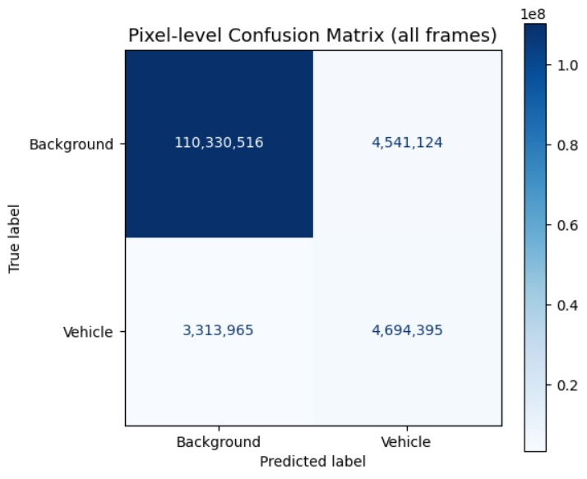
Confusion Matrix
True Negative (TN): 110,330,516 pixels (89.79%). Solid performance on identifying empty road.
True Positive (TP): 4,694,395 pixels (3.82%).
False Positive (FP): 4,541,124 pixels (3.70%). Incorrectly labeled as vehicles, primarily caused by shadow regions.
False Negative (FN): 3,313,965 pixels (2.70%). Undetected vehicle pixels due to low-contrast colors or stationary absorption.

Slide 18
Discussion & Limitations
Static Background Model
Computed once over 100 frames. Cannot adapt to gradual illumination shifts (clouds, time of day). Requires an adaptive GMM/MOG2 for long-term deployment.
Shadow Artifacts & Stationary Vehicles
Shadows produce pixel differences leading to False Positives. Stopped vehicles are eventually absorbed into the background model (False Negatives).
Lack of Morphological & Perspective Processing
No erosion/dilation applied to clean salt-and-pepper noise. No homographic warp applied, meaning farther vehicles contribute fewer pixels to the total density estimate.

Slide 19
Conclusion
Despite limitations, our proposed pipeline achieves its objective: a lightweight, interpretable, real-time-capable traffic density estimator. By multiplying the object pixel ratio by 100, we provide a physically meaningful metric computed on commodity hardware without requiring deep learning or labeled training data.

Slide 20
Thank you for your attention!
LOCALLY ROOTED, GLOBALLY RESPECTED
ugm.ac.id

