Slide 1
Battlebot
Lowie, Daphne, Daan en Jeroen

Slide 2
Contents
Our project
Realized
Server
Robot
Controller
Infrared
Potential expansions

Slide 3

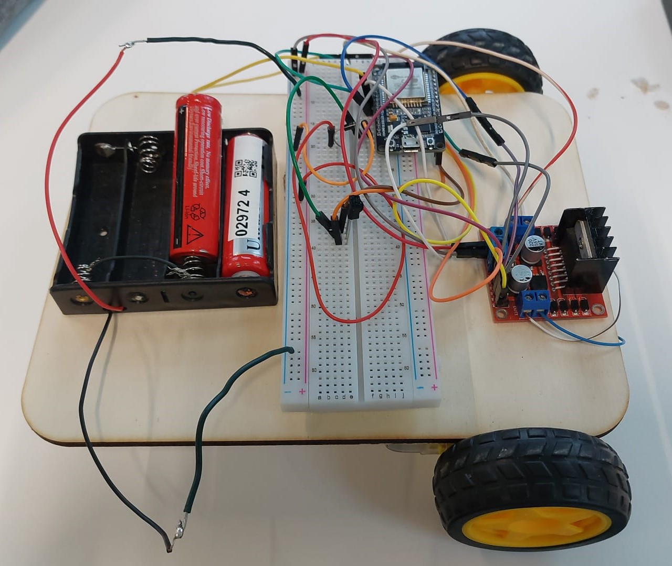
Our project
Battlebot
No destruction
Different gamemodes
Scalable
Wireless

Slide 4
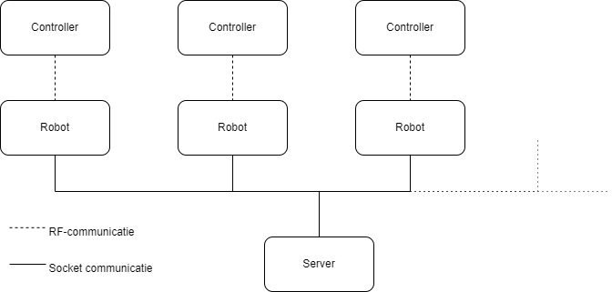
Realised
Messages from and to server
Wireless control of the bot
Infrared shooting system
Game management

Slide 5
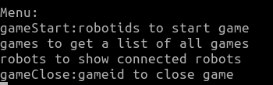
Server
Referee
Socket connection
Game

Slide 6
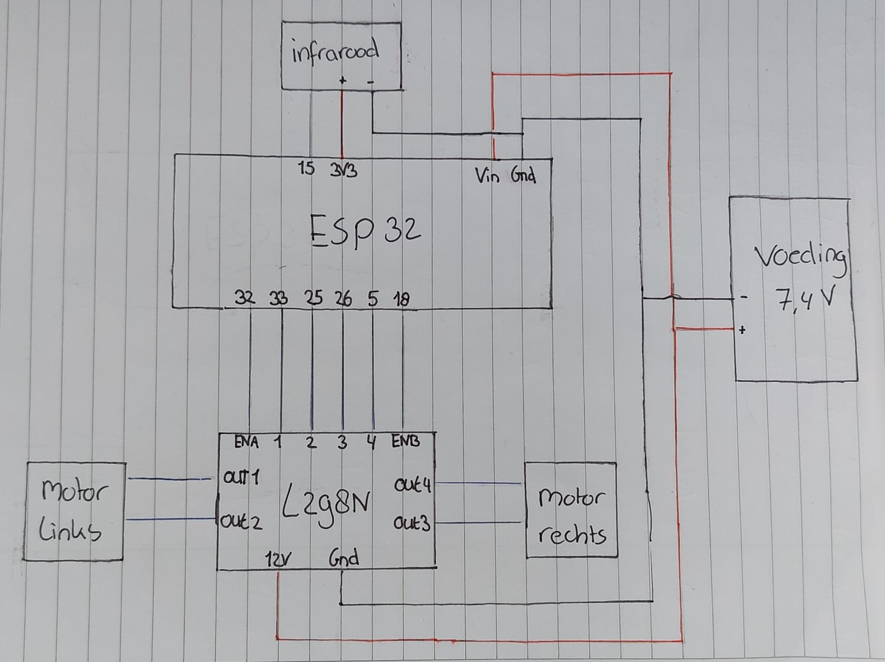
Robot
Motor shield
Power supply
Motor
ESP32

Slide 7
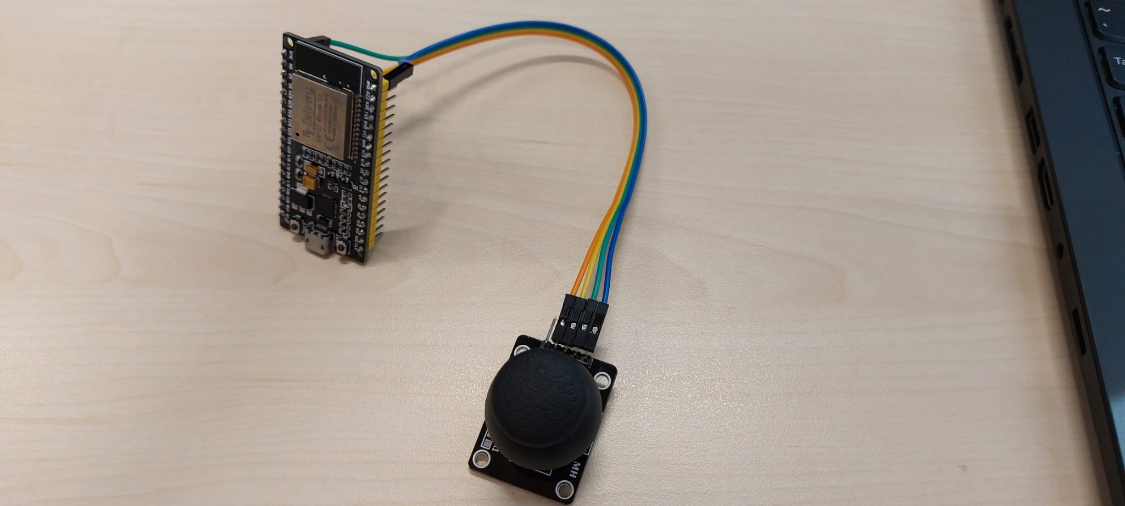
Controller
WiFi
UDP
16Hz / 60 ms

Slide 8
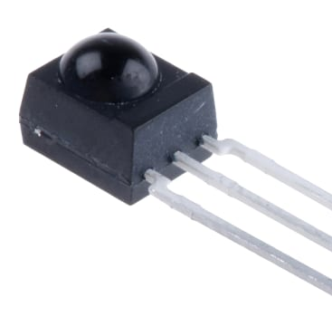
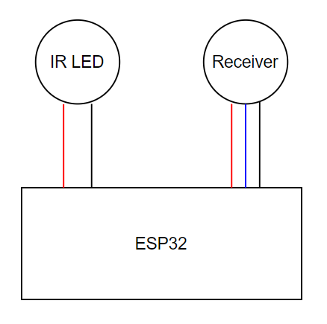
Infrared
TSOP34836
IR Receiver module
IR LED (sending)

Slide 9
Potential expansions
Different gamemodes
Multiple games
Multiple robots
IR Shooter

Slide 10
Demo

Slide 11
Questions?

