Slide 1
Brief Chemical Principles of B&W Photography
feeshy
2019/9/8

Slide 2
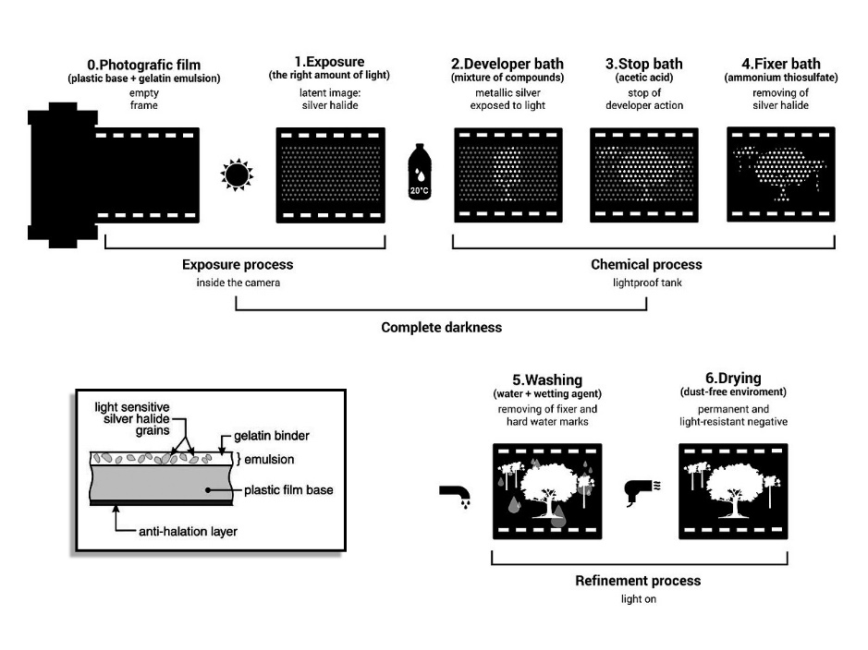
Brief Process

Slide 3

Brief Process
exposure
X– + hν → X + e–
e⁻ + Ag⁺ → Ag(5~50/10¹² atoms)
develop
Ag(5~50 atoms) → Ag(10¹⁰ to 10¹¹ atoms)
↑reduced
AgX
fix
AgX(s) + 2Na₂S₂O₃ → Na₃[Ag(S₂O₃)₂] + NaX
↓dissolved
(aq)

Slide 4



Ingredients of Developer
Developing Agent
selectively reducing those AgX grains which contain atoms of silver (latent image)
(‘recharge’ the oxidized metol or phenidone)
Metol / Phenidone 、 Hydroquinone
Restrainer
prevent unexposed AgX from being reduced
KBr
Buffer / Preservative
providing an alkaline and reduction environment
Na₂CO₃, NaBO₂·xH₂O, Na₂SO₃…….

Slide 5
Ingredients of Stop Bath and Fixer
Na₂S₂O₃
dissolving unexposed AgX
Acid
neutralizing the alkaline environment of developer
Acetic Acid、Boric Acid、NaHSO₃
Preservative
providing a reduction environment
Na₂SO₃

Slide 6
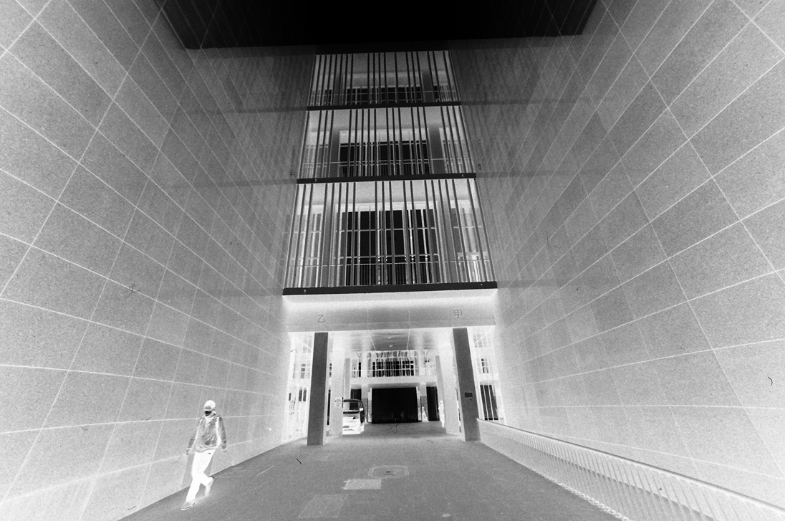
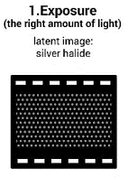
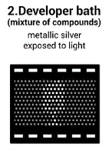
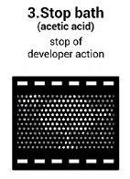
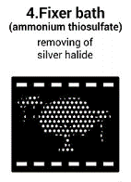
negative image

Slide 7
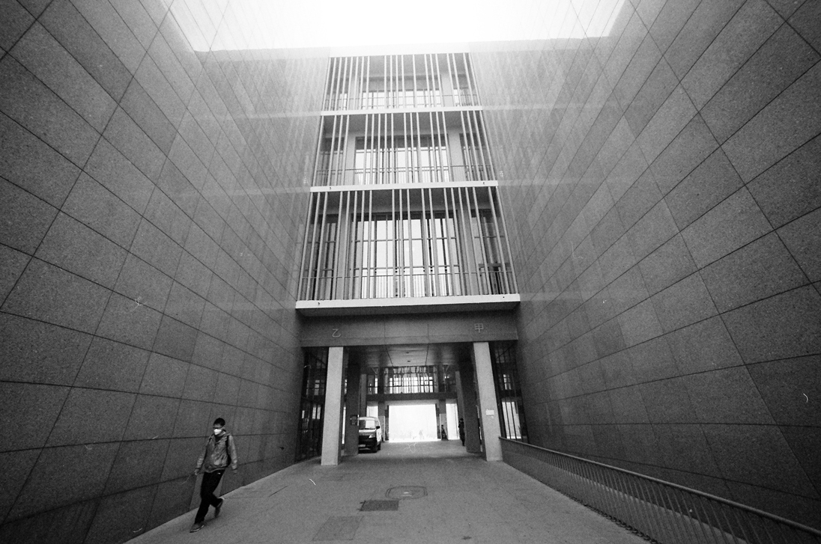
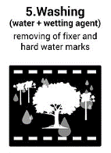
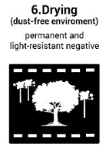
Na₂SO₃
replace the Na₂S₂O₃ on the base
Surfactant
clear water marks and dust on the base
positive image

Slide 8
Chemistry in Photography
• Analytical Chemistry
• Colloid and Surface Science
• Organic Photochemistry
• Synthetic Organic Chemistry
• Polymer Engineering and Materials Science
• Polymer Science
• Silver Halide Emulsions

