Slide 1
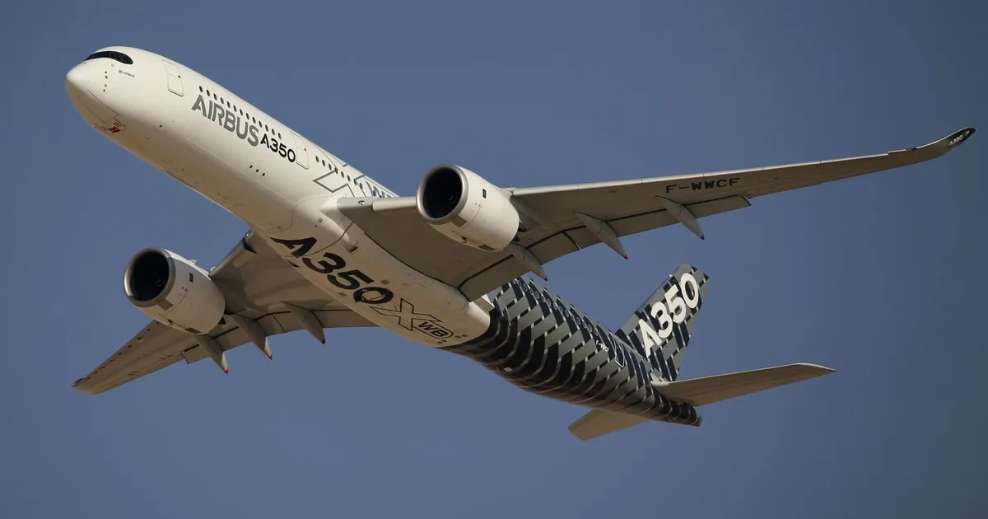
CORPORATE PROFILE 2026
Airbus
Engineering the Future
of Aviation
A Comprehensive Analysis
Financial Performance • Market Position • Strategic Outlook
2026

Slide 2
PRESENTATION OVERVIEW
Contents
01
Company Overview & Heritage
03
Business Segments
02
Financial Performance
From European consortium to global aviation leader
Strong revenue growth and profitability metrics
Commercial, Helicopters, Defence & Space divisions
04
Product Portfolio
05
Market Position
06
Manufacturing Excellence
Market-leading aircraft families and specifications
Competitive dynamics with Boeing and market share
Global production footprint and supply chain
07
Order Backlog
08
Sustainability Leadership
09
Strategic Outlook
Record 8,754 aircraft backlog and delivery performance
Decarbonization roadmap and ZEROe hydrogen program
Growth targets and transformation priorities through 2030

Slide 3
COMPANY FOUNDATION
A European Aviation Champion
Founding Vision
Current Scale
Founded December 18, 1970 as a Franco-German economic consortium (GIE), Airbus emerged from European collaboration to challenge American dominance in commercial aviation.
159K+
180+
Employees Worldwide
Countries & Locations
Initial funding from French and German governments launched the A300B, the world's first twin-engine widebody airliner, establishing Airbus as a credible competitor to Boeing's 700-series jets.
12K+
€47.4B
Direct Suppliers
9M 2025 Revenue
Global Headquarters
Evolution Timeline
Toulouse, France
1970
Airbus Industrie GIE formally created
Primary HQ & Final Assembly
1972
First A300 flight - twin-engine widebody pioneer
Hamburg, Germany
1987
A320 maiden flight - revolutionized with fly-by-wire
Major A320 Family FAL
2000
Transformed into single integrated company (Airbus SAS)
Mobile, Alabama
US Manufacturing Hub
2005
A380 first flight - world's largest passenger airliner
Tianjin, China
2019
Guillaume Faury appointed CEO
Asian Production Center

Slide 4
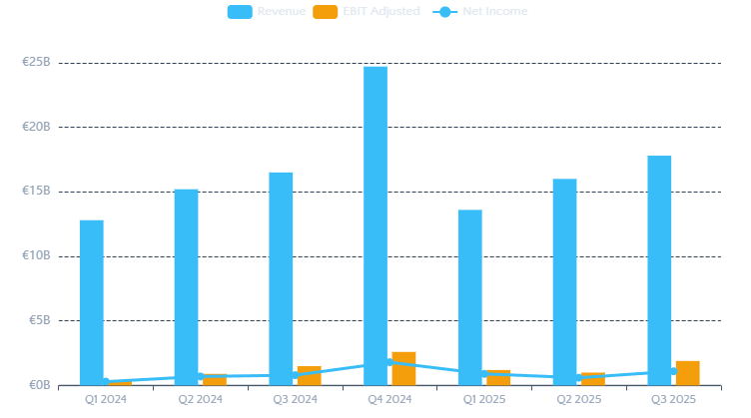
FINANCIAL HIGHLIGHTS
Strong Growth Trajectory
Nine-Month 2025 Results Demonstrate Operational Resilience
Revenue
EBIT Adjusted
Net Income
2025 Guidance
€47.4B
€4.1B
€2.64B
Aircraft Deliveries
820
+7%
vs 9M 2024
+48%
vs 9M 2024
+46%
vs 9M 2024
793 delivered (97%)
EBIT Adjusted
€7.0B
Quarterly Progression (€ Billions)
€4.1B achieved (9M)
FCF (Pre-Financing)
€4.5B
€-0.9B (9M, backloaded)
Key Metrics
EPS (Reported)
€3.34
R&D Expenses
€2.1B
Net Cash Position
€7.0B
Gross Cash
€21.3B
Credit Ratings
S&P: A (Stable)
Moody's: A1 (Stable)

Slide 5
OPERATIONAL DIVISIONS
Business Segment Performance
Three Divisions Driving Comprehensive Aerospace Leadership
Commercial Aircraft
Helicopters
Defence & Space
Core Business
Rotorcraft Leader
Security Solutions
€33.9B
€3.27B
€5.7B
€495M
€8.9B
€420M
Revenue
EBIT Adj.
Revenue
EBIT Adj.
Revenue
EBIT Adj.
+3% YoY
+8% YoY
+16% YoY
+18% YoY
+17% YoY
Turnaround
Deliveries (9M)
507 units
Deliveries (9M)
218 units
Key Programs:
A220
62
Strong performance in civil & military markets
• A400M military transport
A320 Family
392
• Eurofighter Typhoon
A330
20
Services growth driving profitability
• Satellite systems
A350
33
• Space exploration
Net Orders
306 units
Net Orders
514 aircraft
Backlog
981 units
Order Intake
€6.8B
Backlog
8,665 units
Space consolidation with Leonardo & Thales progressing

Slide 6
AIRCRAFT FAMILIES
Commercial Aircraft Portfolio
Market-Leading Products Serving All Market Segments
A220 Family
93
A330 Family
36
The Small Single-Aisle
Delivered 2025
Versatile Widebody
Delivered 2025
Capacity
Range
Capacity
Range
100-150 seats
3,600 nm
260-300 seats
7,200 nm
Acquired from Bombardier in 2018, the A220 offers superior economics for regional and thin routes. Production target: 12/month by 2026.
The A330neo delivers 25% better fuel efficiency than previous generation. Ideal for medium- to long-haul routes. Rate: 4/month, moving to 5 by 2029.
A320 Family
607
A350 Family
57
The Best-Selling Jet
Delivered 2025
Flagship Widebody
Delivered 2025
Capacity
A321XLR Range
Capacity
Range
120-244 seats
4,700 nm
300-410 seats
8,700 nm
The industry's workhorse with 80% of Airbus deliveries. Revolutionary fly-by-wire technology. Production ramping to 75/month by 2027.
Built with advanced composites, the A350 offers unmatched passenger comfort and efficiency. Target: 12/month by 2028. A350F freighter gaining traction.
Sustainability Commitment
Record Backlog: 8,754 Aircraft
All aircraft 50% SAF-capable today, 100% by 2030
Valued over $400B

Slide 7
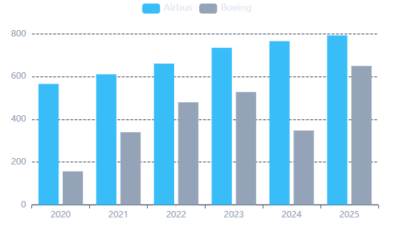
COMPETITIVE LANDSCAPE
Market Position: Leading Global Aviation
Airbus vs Boeing - The Duopoly Dynamics in 2025
2025 Delivery Performance
Single-Aisle Dominance
A320neo Family Orders 2025
504 orders
402 A321neo + 102 A320neo
737 MAX Orders 2025
461 orders
MAX 8 and MAX 10 variants
A321neo Success
The A321neo has become the most popular aircraft variant of all time, with superior economics and versatility driving airline demand.
Widebody Competition
793
~650
A330neo & A350: Record 295 widebody orders in 2025, backlog of 1,124
Airbus Deliveries
Boeing Deliveries
+4% YoY
Est. 2025
787 & 777: Boeing seeing renewed interest, especially 777X
Key Wins: Riyadh Air (25 A350-1000s), China Airlines (10 A350-1000s)
Market Leadership
"It's actually quite motivating to see Boeing back in the Major League after so many years; this competition is good."
Airbus maintains 10-15% delivery lead over Boeing, a position held consistently since 2019
— Christian Scherer, CEO Commercial Aircraft

Slide 8
PRODUCTION EXCELLENCE
Manufacturing & Supply Chain
Global Footprint with Strategic Production Ramp-Up
Global Final Assembly Lines
Supply Chain Challenges
Toulouse, France
Hamburg, Germany
Engine Delays
Primary HQ & A320, A330, A350 FAL
Major A320 Family FAL & Customization
A320neo engines arriving "very, very late" - Pratt & Whitney supply constraints
Flagship Site
Largest A320 FAL
Quality Issues
Mobile, Alabama
Tianjin, China
Fuselage panel supplier issues forced delivery target reduction from 820 to 790
A320 & A220 FAL for Americas
A320 FAL for Asian Market
US Market Hub
Asia-Pacific
Skills Shortage
Loss of technical expertise across industry requires intensive training
Mitigation Strategies
"Watchtowers" - Supplier performance monitoring
Expert Deployment - Airbus engineers assisting suppliers
Financial Support - Aid to critical supply partners
Production Rate Targets
Vertical Integration - Acquiring Spirit AeroSystems assets
75/mo
12/mo
5/mo
12/mo
Industry Impact
A320 Target 2027
A220 Target 2026
A330 Target 2029
A350 Target 2028
Supply chain issues cost airlines $11B annually. IATA projects challenges may persist for 8 years.
Current: ~65
Current: 7-8
Current: 4
Current: ~5

Slide 9

DEMAND MOMENTUM
Record Order Backlog
Unprecedented Demand Securing Multi-Year Production Visibility
8,754
2025 Order Highlights
Historic Backlog Achievement
Total Aircraft Backlog
Gross Orders
1,000
From 57 customers
1,124
7,630
$400B+
>10
Widebody
Single-Aisle
Backlog Value
Years Coverage
Net Orders
889
Record
87%
Est.
At Current Rate
After cancellations
Book-to-Bill Ratio >1.0: Sustained demand exceeds deliveries, indicating healthy market dynamics and strong airline confidence in Airbus products.
A320 Family
656
A350 Family
193
A330 Family
100
2025 Order Breakdown by Family
A220 Family
49
A330 MRTT
2
Notable 2025 Deals
flydubai: 150 A321neo (Dubai Air Show)
Riyadh Air: 25 A350-1000 (Paris Air Show)
IndiGo: A350-900 commitment
China Airlines: 10 A350-1000

Slide 10
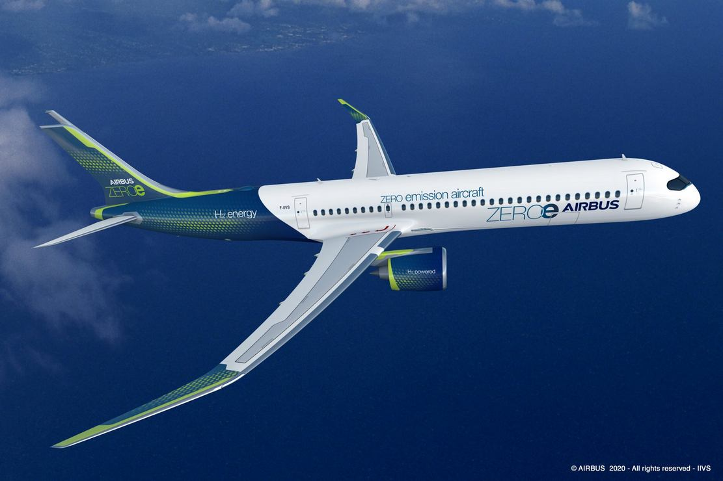
ENVIRONMENTAL LEADERSHIP
Sustainability & Innovation
Pioneering Decarbonization from Operations to Product Design
Decarbonization Targets
ZEROe Hydrogen Program
Scope 1 & 2 Emissions
-63% by 2030
Concept Unveiled: March 2025
Absolute GHG reduction from operations, validated by Science Based Targets initiative (SBTi)
100-seat aircraft with 1,000-nm range powered by liquid hydrogen (LH2) and fuel cell technology
Scope 3 Intensity
-46% by 2035
Four 2MW hydrogen-electric engines on high wing
Reduction in emissions intensity from aircraft usage vs 2015 baseline
Individual fuel cell stack per propeller
Liquid hydrogen tanks (exploring CFRP)
Net Zero Goal
2050
Exploring superconductivity for 20-30MW systems
Aligned with aviation industry long-term decarbonization commitment
Target Entry into Service: 2035
World's first hydrogen-powered commercial airliner
Sustainable Aviation Fuel (SAF)
Challenges & Partnerships
50%
Current Capability
All Airbus aircraft certified for 50% SAF blend
Key Challenges
100%
2030 Target
• Regulatory framework gaps
Full SAF compatibility across all aircraft & helicopters
• Airport hydrogen infrastructure
• Technology maturation required
Impact: SAF can reduce lifecycle CO2 emissions by up to 80% compared to conventional jet fuel
Collaboration Approach
Working with fuel producers, airlines, governments, and researchers to accelerate SAF production and hydrogen ecosystem development

Slide 11
FUTURE DIRECTION
Strategic Outlook: Growth & Transformation
Ambitious Targets Through 2030 and Beyond
Production & Revenue Targets
Space Consolidation
A320 Production Rate
75/month by 2027
MoU Signed: Create European Space Leader
Currently ~65/month, targeting 1,000+ annual deliveries
Partnership with Leonardo (35%) and Thales (32.5% each) to consolidate space activities
~€6.5B pro-forma revenues (end 2024)
Annual Revenue Target
€100B by 2030
~25,000 employees
From €69.2B in FY2024, requiring ~9% CAGR
Mid triple-digit €M annual synergies (5 years post-close)
Goal: Lead innovative European sovereign programs, foster innovation, increase competitiveness
A220 Profitability
Path to Profit
Rate 12 by 2026 essential for program economics
Leadership Perspective
Widebody Growth Strategy
A350: Target 12/month by 2028, A350F gaining market traction
"Our nine-month results reflect the level of commercial aircraft deliveries and a solid performance in the Defence and Space and Helicopters businesses. We continue to expand our industrial capacity to support the commercial aircraft ramp-up."
A330neo: Rate 5/month by 2029, capturing medium-haul demand
Record Backlog: 1,124 widebody orders provide visibility
— Guillaume Faury, Chief Executive Officer
Market Position: Targeting share growth vs Boeing 787/777
On Competition
"It's actually quite motivating to see Boeing back in the Major League after so many years; this competition is good." — Christian Scherer

Slide 12
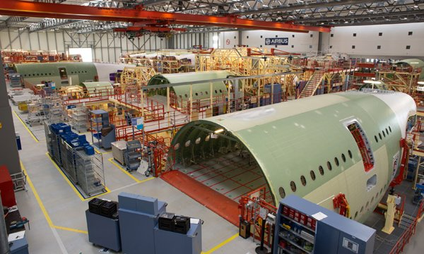
AIRBUS 2026
Engineering Excellence
Sustainable Future
Airbus stands at the forefront of aviation innovation, combining engineering excellence with a bold vision for sustainable flight. With record backlogs of 8,754 aircraft, strong financial performance, and industry-leading decarbonization initiatives, Airbus is positioned to shape the future of air transportation for decades to come.
From the A320 family's market dominance to the revolutionary ZEROe hydrogen program, Airbus continues to push the boundaries of what's possible in aerospace—proving that European collaboration, innovation, and determination can lead the world.
€47.4B
8,754
159K+
9M 2025 Revenue
Aircraft Backlog
Global Employees
Leading the Future of Aerospace

