Slide 1
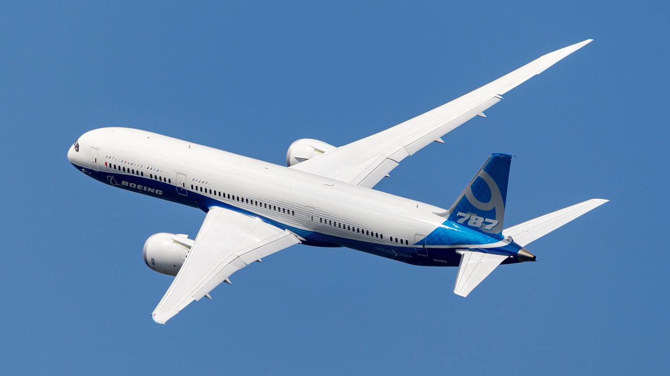
Strategic Analysis 2025
Boeing
Navigating Turbulence
Toward Recovery
A Strategic Overview of the Aerospace Giant's Challenges, Transformation, and Path Forward
Founded
Employees
NYSE
1916
170,000+
BA

Slide 2
Navigation
Executive Overview
01
Company Profile & Legacy
05
Global Services
09
Leadership Transformation
A century of aviation leadership and innovation
Support, maintenance, and digital solutions
Kelly Ortberg's turnaround strategy
02
Business Portfolio
06
Financial Performance
10
Production Recovery
Three pillars of aerospace excellence
Signs of recovery and growth trajectory
Ramping up while maintaining quality
03
Commercial Airplanes
07
Market Position
11
Strategic Outlook
Product lineup and market positioning
Duopoly dynamics and competitive landscape
Future opportunities and growth drivers
04
Defense, Space & Security
08
Safety & Quality Crisis
12
Key Takeaways
Protecting global interests worldwide
Lessons from 737 MAX and transformation
Critical insights and conclusions

Slide 3
Company Overview
A Century of Aviation Leadership
Founded in 1916 by William Boeing, The Boeing Company has evolved from a small Seattle-based airplane manufacturer into one of the world's largest aerospace conglomerates. With over 108 years of innovation , Boeing has shaped the aviation industry through iconic aircraft and technological breakthroughs.
Key Milestones
1916
William Boeing incorporates Pacific Aero Products Co.
1958
Boeing 707 enters service, ushering in jet age
1969
Boeing 747 "Jumbo Jet" makes maiden flight
Today, Boeing operates in more than 65 countries with a workforce exceeding 170,000 employees . The company's aircraft fleet of 14,000+ commercial jets serves airlines worldwide, while its defense systems protect allied nations across the globe.
1997
Merges with McDonnell Douglas, expands defense portfolio
2009
787 Dreamliner first flight, composite materials revolution
2011
Deliveries of the 787 Dreamliner begin.
2017
737 MAX enters service, most advanced single-aisle
2024
Leadership transition with Kelly Ortberg as CEO
Commercial Aviation Pioneer
Defense Industry Leader
Introduced the 707, first successful commercial jetliner, revolutionizing air travel in 1958
Major contractor to U.S. Department of Defense and allied military forces worldwide
108
170K+
65+
Years of Innovation
Global Employees
Operating Countries
Space Exploration
Global Reach
Key partner in NASA programs including International Space Station and Artemis missions
Customers in 150+ countries with manufacturing and service facilities across six continents

Slide 4
Business Structure
Three Pillars of Aerospace Excellence
Commercial Airplanes
Defense, Space & Security
Global Services
Design, manufacture, and sale of commercial jetliners, including the 737, 747, 767, 777, and 787 families. Serves passenger and cargo airlines worldwide with the industry's most complete aircraft portfolio.
Development and production of military aircraft, rotorcraft, space systems, satellites, and advanced weapons. Primary contractor to the U.S. Department of Defense and allied governments.
Comprehensive aftermarket services including parts supply, maintenance, engineering, digital analytics, and training. Supports commercial, government, and aviation industry customers with innovative solutions.
2025 Deliveries
600 aircraft
Key Programs
F-15, F/A-18, T-7A
Service Portfolio
MRO, Parts, Training
Order Backlog
6,130 units
Space Systems
Starliner, Satellites
Digital Solutions
Analytics, AI/ML
Market Position
#2 Globally
Defense Revenue
$7.42B Q4
Global Footprint
300+ Locations
$23.95B
57%
$400M
600
Q4 2025 Revenue
YoY Revenue Growth
Positive Cash Flow
Aircraft Delivered 2025

Slide 5
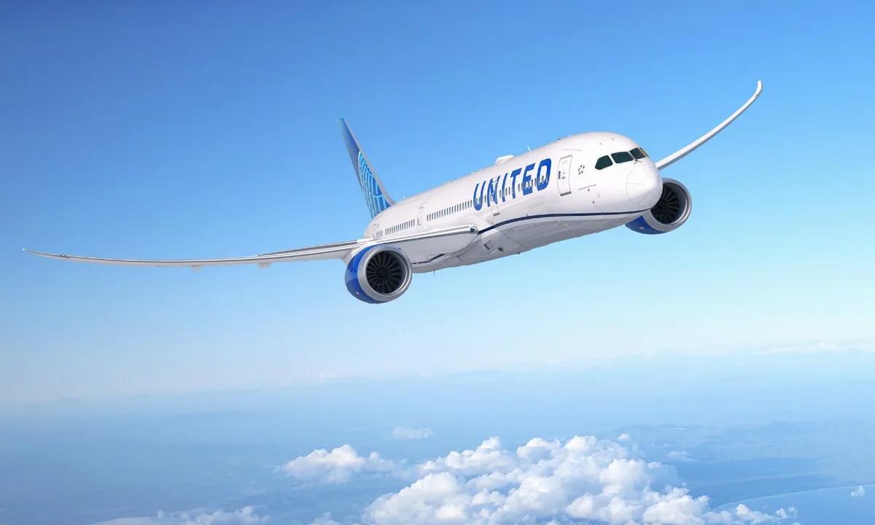
Commercial Division
Product Lineup & Market Position
Aircraft Portfolio Overview
Production Targets
737 MAX Family
Best Seller
787 Dreamliner
Widebody
737 MAX
42 → 52/month
Single-aisle workhorse, 138-230 passengers
Fuel-efficient twin-aisle, 248-336 passengers
Target: 47-52 by end of 2026
2025 Deliveries: 447
Backlog: 4,869
2025 Deliveries: 88
Backlog: 1,076
787 Dreamliner
8 → 10/month
Charleston expansion: $1B investment
777/777X
Flagship
767 Freighter
Cargo
777X
Certification
Long-haul leader, 365-426 passengers
Versatile cargo aircraft, 90%+ market share
First delivery: 2027
2025 Deliveries: 35
Backlog: 681
2025 Deliveries: 30
Backlog: 94
Key Customers 2025
2025 Delivery Performance
Delta Air Lines
Up to 60 787s
600
160
$11.38B
6,130
IAG
Major order
Total Deliveries
Q4 Deliveries
Q4 Revenue
Order Backlog
+72% vs 2024
Strong finish
+140% YoY
Years of work
Alaska Airlines
737 MAX
VietJet
737 MAX 8

Slide 6
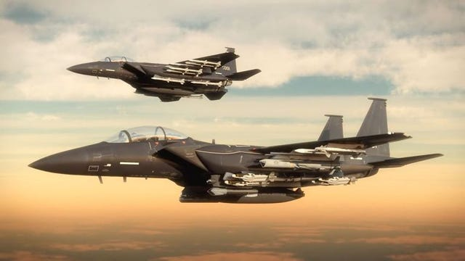

Defense Division
Protecting Global Interests
Boeing Defense, Space & Security (BDS) is a leading global provider of military aircraft, rotorcraft, space systems, and advanced defense technologies. As a primary contractor to the U.S. Department of Defense and allied nations, BDS delivers critical capabilities for national security and global stability.
Defense Revenue Breakdown
The division reported $7.42 billion in Q4 2025 revenue , representing a 37% year-over-year increase, demonstrating strong demand for defense capabilities amid global security challenges.
Military Aircraft
Rotorcraft
▸F-15 Eagle/Strike Eagle
▸AH-64 Apache Attack
Key Customers & Partners
▸F/A-18 Super Hornet
▸CH-47 Chinook Heavy-Lift
▸T-7A Red Hawk Trainer
▸V-22 Osprey Tiltrotor
U.S. Department of Defense
Primary
▸P-8 Poseidon Maritime
▸AH-6 Little Bird
NATO Allied Nations
International
NASA
Space
Space Systems
Weapons & Missiles
International Air Forces
Global
▸Starliner Crew Capsule
▸Precision Munitions
▸Satellite Systems
▸Missile Defense Systems
▸Space Launch Systems
▸Strategic Deterrence
Recent Developments
▸ISS Integration
▸Directed Energy
Starliner Challenges: NASA opted not to use Starliner for astronaut return from ISS, highlighting technical issues requiring resolution.
Leadership Change: Ted Colbert departed as BDS CEO; Steve Parker appointed interim leader under Ortberg's restructuring.

Slide 7
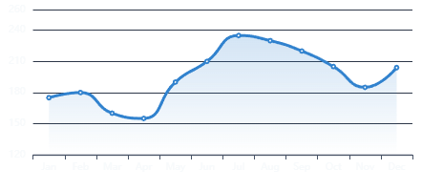
Financial Analysis
Signs of Recovery
Q4 2025 Financial Highlights
Stock Performance
Boeing's Q4 2025 results demonstrate significant momentum in the turnaround, with revenue exceeding Wall Street expectations and positive cash flow signaling stabilization after years of crisis.
Total Revenue
+57% YoY
Cash Flow
Positive
$23.95B
$400M
Beat expectations of $22.6B
Double analyst expectations
Commercial Revenue
+140%
Defense Revenue
+37%
$11.38B
$7.42B
Current Price
52-Week Range
~$204
$137 - $242
Driven by 600 deliveries
Strong government demand
CEO Outlook: Kelly Ortberg
2025 Full Year Performance
600
6,130
$9.6B
$1-3B
"We're marching to this $10 billion free cash flow number and it's going to take us a little bit of time but we've got a methodical plan to get there."
Aircraft Delivered
Order Backlog
Jeppesen Sale
2026 FCF Target
Best since 2018
+10% vs 2024
Strategic divestment
Path to $10B
Positive free cash flow expected 2026
Production ramp-up on track
Quality improvements showing results
Customer confidence rebuilding

Slide 8
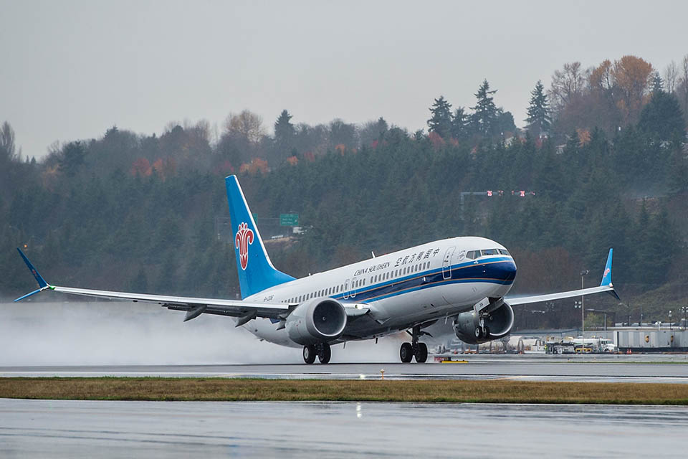
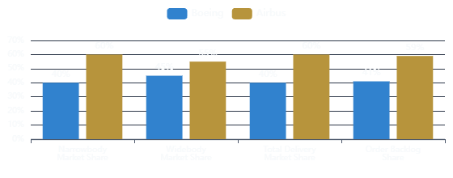
Competitive Landscape
The Duopoly Dynamics
Boeing and Airbus control ~99% of the global commercial jet market, creating an effective duopoly with extremely high barriers to entry. However, recent years have seen Airbus gaining significant momentum while Boeing navigates production and safety challenges.
Market Share by Segment
Boeing Position
Airbus Position
Market Share
36-40%
Market Share
56-60%
2025 Deliveries
600
2024 Deliveries
766
Order Backlog
6,130
Order Backlog
8,754
2025 Orders
~668
2024 Orders
878
Competitive Dynamics
Regional Market Strengths
Narrowbody Dominance
Airbus A320neo family commands 60%+ market share vs Boeing 737 MAX at ~40%
North America
Europe
Boeing's stronghold with 54% of revenue
Airbus dominates home market
Production Capacity
Advantage: Boeing
Advantage: Airbus
Airbus targets 75 A320s/month by 2026 vs Boeing's 47-52 737 MAX/month
Asia-Pacific
Widebody Market
Emerging Competition
Fastest growing region, $12B Boeing revenue
Boeing 787/777 vs Airbus A350
COMAC C919 gaining traction in China with 1,200+ orders, challenging duopoly
Competitive battleground
Boeing competitive
Order Momentum
Boeing outpaced Airbus in 2025 H1 orders (668 vs 494), signaling recovery

Slide 9
Critical Challenges
Safety & Quality Crisis
The 737 MAX Crisis Timeline
Remediation Actions
2018-2019
Two Fatal Crashes: Lion Air Flight 610 (October 2018) and Ethiopian Airlines Flight 302 (March 2019) killed 346 people, leading to global grounding of 737 MAX fleet
Quality Stand-Downs
10,000+ employees participated in factory-wide quality stand-downs to refocus on safety and discuss improvements
Jan 2024
Alaska Airlines Door Plug: Door panel blew out mid-flight on 737 MAX 9, exposing severe quality control failures and triggering FAA production audit
Enhanced Inspections
Mar 2024
Added layers of inspections, weekly compliance checks for every 737 work cell, dedicated shift time for FOD sweeps
FAA Audit Findings: 89 production audits conducted; Boeing failed 33 tests (37% failure rate), mostly related to manufacturing control procedures and quality escapes
Independent Assessment
Jul 2024
Guilty Plea: Boeing agreed to plead guilty to fraud and pay up to $487 million for misleading regulators about 737 MAX safety before certification
Appointed Admiral Kirkland Donald to complete independent assessment of Quality Management System
Eliminating Traveled Work
Stopped practice of unfinished jobs moving through production line; holding suppliers to same standard
Root Cause Analysis
Regulatory Compliance
Organizational Culture
Safety Management System
Working closely with FAA on production increases; won't allow rate hikes until quality control satisfied
Disconnect between senior management and employees on safety culture; financial incentives prioritized over safety metrics
Complex, constantly changing procedures created employee confusion; lack of awareness of safety metrics at all levels
Quality Control Failures
Whistleblower Retaliation
Key Metrics
Inadequate manufacturing controls, "traveled work" practices, and insufficient inspection procedures
Employees reported safety concerns but faced retaliation; warnings not escalated to board level
33/89
$487M
FAA Audit Failures
Fraud Settlement
3 Years
42
Independent Monitor
MAX/Month (FAA Cap)

Slide 10
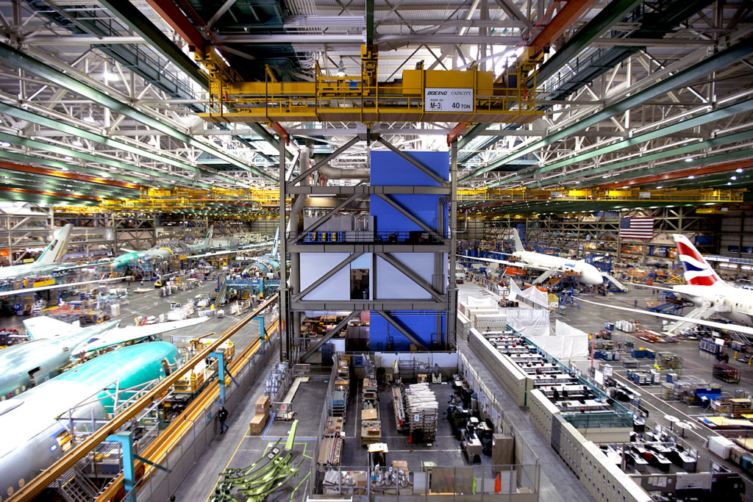
Management Changes
Leadership Transformation
Kelly Ortberg
2024 Leadership Changes
Chief Executive Officer
Dave Calhoun
Appointed August 2024
Departed
Former CEO stepped down at end of 2024 after leading company through crisis period
Ortberg brings 35+ years of aerospace experience, most recently as CEO of Rockwell Collins (now Collins Aerospace). Known for operational excellence and turnaround expertise, he came out of retirement to lead Boeing's recovery.
Larry Kellner
Departed
Board Chair stepped down; Steve Mollenkopf (ex-Qualcomm CEO) appointed
Stan Deal
Retired
Leadership Priorities
Commercial Airplanes CEO retired; Stephanie Pope appointed to lead BCA
▸Restore customer and regulator trust
Ted Colbert
Departed
▸Stabilize production while improving quality
Defense CEO left company; Steve Parker appointed interim BDS leader
▸Rebuild safety culture across organization
Brian West
Retained
▸Drive operational efficiency and profitability
CFO continues in role, providing financial continuity during transition
▸Position Boeing for long-term growth
Base Salary
Annual Incentives
Age (Retirement)
Board & Governance Changes
$1.5M
$20.5M
64 (65)
Aerospace Safety Committee
Ortberg's Turnaround Strategy
Established under Kellner's leadership to provide board-level oversight of safety culture
Weekly Operating Reviews
Supplier Accountability
New Independent Directors
Close tracking of commercial and defense businesses with direct oversight
Holding suppliers to same quality standards; stopped shipments from major supplier
Seven new directors recruited with deep engineering, safety, manufacturing expertise
Production Stability
Cash Flow Focus
Independent Monitor
"Go slow to get it right" philosophy; prioritizing quality over speed
Methodical plan to reach $10B free cash flow; $1-3B target for 2026
3-year independent monitor to oversee safety and quality improvements per DOJ agreement

Slide 11
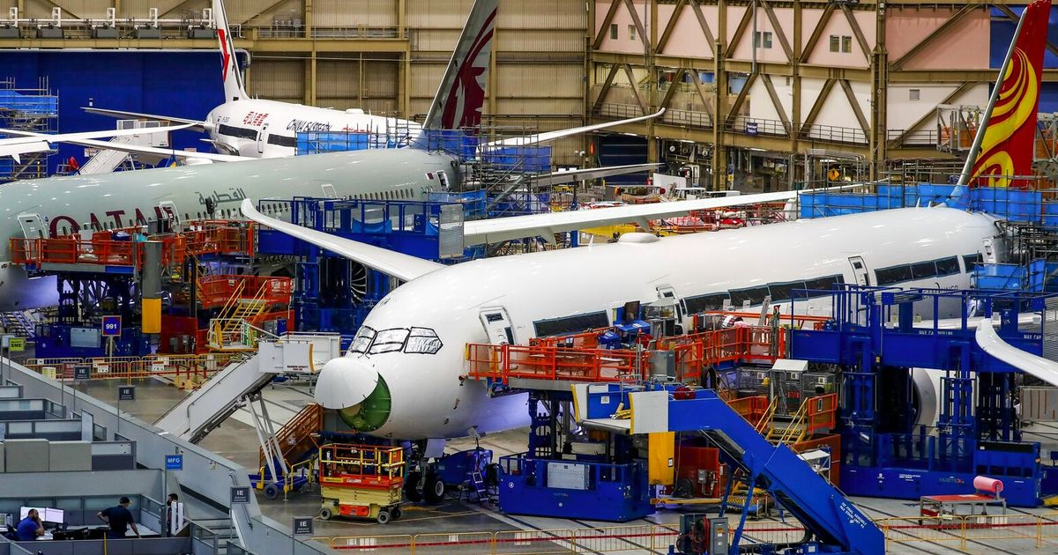
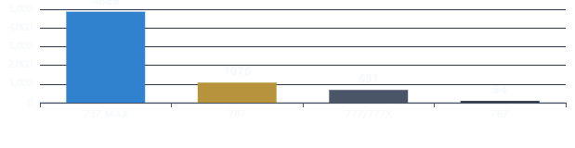
Future Outlook
Production Recovery & Strategic Path
Production Ramp-Up Strategy
Financial Outlook
Boeing is executing a methodical production recovery plan focused on stability and quality. The company aims to increase output while maintaining rigorous safety standards and meeting customer commitments.
2026 Free Cash Flow Target
$1-3B
positive FCF
737 MAX Program
42 → 52/month
Path to $10B FCF over next several years as production stabilizes
Current: 42/month (FAA cap)
Target: 47-52 by late 2026
MAX 7 & 10 certification expected by end of 2026
Cash Flow Headwinds
787 Dreamliner
8 → 10/month
▸777X predelivery payments lower than planned
▸Customer considerations for prior delays
▸Excess advances on 737/787 programs
Current: 8/month
Target: 10 by late 2025
▸Production system expenses higher than expected
Charleston expansion: $1B investment in two campuses
777X Program
2027 Delivery
Turnaround Timeline
2025
Stabilization
Status: Flight testing with FAA
First delivery: 2027
2026
Positive FCF
681 aircraft in backlog; predelivery payments lower than expected
2027
777X Delivery
2029
$10B FCF Target
Order Backlog by Program
Growth Drivers
Air travel recovery post-pandemic
Asia-Pacific fleet growth (142% by 2043)
Fleet modernization for fuel efficiency
Air cargo market expansion
Defense spending increases globally

Slide 12
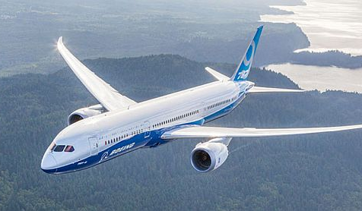
Conclusion
The Road Ahead
Challenges & Opportunities
Boeing stands at a critical juncture with significant challenges ahead: restoring customer and regulator trust, ramping up production while maintaining quality, managing 777X certification delays, and competing with Airbus's momentum. However, with strong order backlog of 6,130 aircraft , new leadership focused on safety culture, and recovering production rates, Boeing has a clear path to reclaiming its position as an aerospace leader.
Key Challenges
Strategic Opportunities
▸
Trust Restoration: Rebuilding confidence with customers, regulators, and flying public after safety failures
▸
Order Backlog Strength: 6,130 aircraft provide years of revenue visibility and production stability
▸
Production Quality Balance: Increasing output while maintaining rigorous safety standards
▸
Leadership Renewal: Kelly Ortberg's operational expertise and turnaround track record
▸
777X Delays: Certification pushed to 2027, impacting customer commitments and cash flow
▸
Production Recovery: 600 deliveries in 2025 show momentum; targeting 47-52 737s/month
▸
Market Share Erosion: Airbus leads with 56-60% delivery share; Boeing must regain momentum
▸
Widebody Leadership: 787 and 777X position Boeing strongly in profitable twin-aisle segment
▸
Cash Flow Pressure: Net cash use until 2029; managing customer considerations for delays
▸
Defense Growth: $7.42B Q4 revenue (+37% YoY) amid global security challenges
Critical Success Factor
Success will depend on executing the turnaround plan while prioritizing safety over speed. Boeing must prove it can build quality aircraft at scale while rebuilding trust with all stakeholders.

