Slide 1
Deep Research Deck
January 2025
Strategic Business Analysis 2025
LSE: LLOY
Lloyds Banking
Group plc
UK's Largest Digital Bank • £900bn Assets • 27M Customers
FTSE 100 Component
£32.4bn Market Cap
Helping Britain Prosper
Confidential
•
Strategic Analysis

Slide 2
Strategic Overview
Executive Summary
Strategic Position
Market Cap
£32.4bn
Lloyds Banking Group maintains its position as the UK's largest digital bank and mortgage lender, serving 27 million customers with £900bn in assets. The Group has successfully completed Phase 1 of its transformation strategy, exceeding revenue targets with £0.8bn in additional strategic revenues against a £0.7bn target.
3rd largest UK bank
Digital Users
Financial Performance
22.7M
2024 delivered robust results despite headwinds: Statutory profit of £4.5bn, with return on tangible equity of 12.3% (14.0% excluding motor finance provision). The Group maintains a strong capital position with CET1 ratio at 13.5% and distributed £3.6bn to shareholders.
+25% over 3 years
Mortgage Portfolio
£300bn+
Digital Transformation
UK Market Leader
Accelerating technology investment with £4bn committed through 2026. The Group has deployed 800+ AI models, migrated 20% of applications to cloud, and serves 22.7 million digitally active customers. AI initiatives projected to generate £50m incremental value in 2025, scaling to £150m.
Tech Investment
£1.9bn
Annual ICT spend

Slide 3
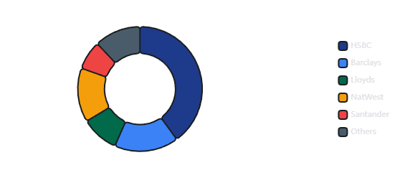
Competitive Analysis
#1
Market Position & Scale
UK Digital Bank
UK Banking Market Share
Operational Scale
27M
20M+
Total Customers
Mobile App Users
£300bn
£900bn
Mortgage Lending
Total Assets
#1 UK Position
Largest UK Bank
Big Four Control
Challenger Growth
Brand Portfolio
75% of UK current accounts held by HSBC, Barclays, Lloyds & NatWest
Digital banks now serve 50% of UK adults (up from 16% in 2018)
Lloyds Bank
Halifax
Bank of Scotland
Scottish Widows

Slide 4
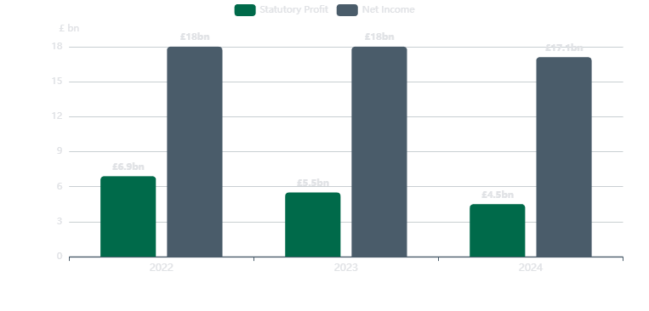
FY 2024 Results
£4.5bn
Financial Performance
Statutory Profit After Tax
Three-Year Financial Trend
Statutory Profit Change
-19%
vs 2023 (£5.5bn)
Return on Tangible Equity
12.3%
14.0% ex. motor finance
CET1 Ratio
13.5%
Strong capital position
Cost-to-Income Ratio
60.4%
Up from 54.7% in 2023
£17.1bn
2.95%
£3.6bn
£9.4bn
Net Income
Net Interest Margin
Shareholder Returns
Operating Costs
↓ 5% YoY
↓ from 3.11%
£1.7bn buyback + div
↑ 3% YoY

Slide 5
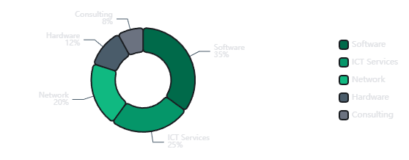
Technology Investment
£4bn
IT Spend & Digital Strategy
Through 2026
Technology Investment Roadmap
ICT Budget Allocation
1
Digital Transformation
£3bn invested (2022-2024), £4bn total through 2026
20% apps migrated to cloud
2
AI & Machine Learning
800+ AI models in production
£50m value target 2025
Annual ICT Spend
Tech Headcount
3
Legacy Modernization
$1.9bn
4,000+
10%+ legacy systems decommissioned since 2021
(~£1.5bn)
New hires since 2021
60% lending decisions automated
Key Technology Partners
Google Cloud
ServiceNow
Oracle
Thought Machine
Form3

Slide 6
Innovation Focus
AI & Digital Transformation
Strategic AI Initiatives
800+
20%
Aveni Investment
AI Models Deployed
Cloud Migration
Investment in FinLLM - financial services specific LLM
Across operations, risk, and customer service
Applications migrated to cloud platforms
Responsible AI
AI Value Creation Roadmap
Head of Responsible AI appointed Feb 2025
2024
£1.5bn cost savings
Launch Innovation
Partnership with Doshi for financial education
2025
£50m incremental
Mortgage AI
2026
£150m target
Income verification: days to seconds
Key Insight
18 GenAI Systems
200+ Specialists
27 Tonnes
76% of UK businesses using AI report increased profitability, validating Lloyds' £4bn digital investment strategy.
In production (April 2025)
AI Centre of Excellence
CO2 saved via ML

Slide 7
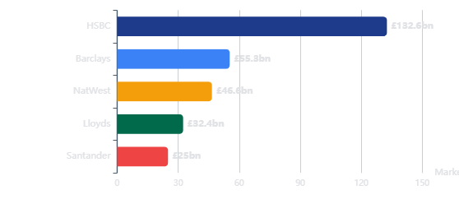
Competitive Analysis
Competitive Landscape
UK Banking Market
£180bn+
Market Share Comparison (Dec 2024)
Competitive Threats & Opportunities
Challenger Bank Pressure
Digital banks (Monzo, Starling, Revolut) now serve 50% of UK adults. Challengers account for 60% of SME lending growth.
Fintech Disruption
Revolut valued at $45bn (March 2025). BNPL providers (Klarna) and tech giants (Apple) entering financial services.
Lloyds' Defensive Moat
#1 mortgage lender position, 22.7M digital users, comprehensive brand portfolio, and £900bn asset scale provide defensive advantages.
Big Four Banks
HSBC
£132.6bn (41M customers)
Consolidation Activity
Barclays
£55.3bn (48M customers)
Nationwide's acquisition of Virgin Money reshaping competitive dynamics. Regulatory pressure on banking sector concentration.
Lloyds Banking Group
£32.4bn (27M customers)
NatWest Group
£46.6bn (19M customers)
40%
9%
3-4%
UK adults with digital-only accounts
Main debit cards held at neobanks
UK retail banking CAGR (5-year)

Slide 8
Strategic Roadmap
£1.5bn+
Growth Initiatives
Additional Income Target 2026
Strategic Transformation Progress
Key Performance Targets
Phase 1 Complete (2022-2024)
ACHIEVED
2026 ROTE Target
Exceeded £0.7bn revenue target, delivering £0.8bn in additional strategic revenues
>15%
vs 12.3% (2024)
Phase 2 Execution (2025-2026)
IN PROGRESS
Targeting £1.5bn additional income from strategic initiatives by 2026
Strategic Income
£1.5bn+
Additional by 2026
Wealth Management Expansion
Sustainable Finance
Cost Savings
Growing HNW segment, cross-selling investment products through Embark platform
£10.7bn commercial sustainable financing (2024), £20bn social housing funding since 2018
£1.5bn
Gross savings since 2021
NII Guidance 2025
£13.5bn
Digital Propositions
SME Banking Growth
Your Credit Score, Ready-Made Investments, refreshed mobile app with 6bn+ logins
60% automation of new business lending decisions, Amanda Murphy appointment (ex-HSBC)
Underlying net interest income
Strategic Priority
"Help Britain Prosper" - focusing on infrastructure, energy transition, housing and pensions

Slide 9
Risk Management
£899m
Risk & Regulatory Environment
Remediation Costs 2024
Key Risk Factors
Asset Quality & Impairments
Asset Quality Ratio
10bps
Motor Finance Commission
HIGH
£700m provision in Q4 2024 following Court of Appeal judgment (Wrench, Johnson, Hopcraft cases)
£433m
Supreme Court hearing scheduled April 2025
Underlying Impairments
Non-Performing Loans
1.42%
19bps excluding economic outlook improvements. Strong portfolio positioning with improved credit performance.
Interest Rate Sensitivity
MED
NIM pressure from rate cuts (BoE expected to cut to 3.25-3.50%). Asset-sensitive balance sheet exposed to declining rates.
Regulatory Focus Areas
Consumer Duty implementation
Competition & Margin Pressure
MED
Operational resilience requirements
Intense competition in mortgages and savings eroding NIM. Challenger banks gaining market share in key segments.
Digital fraud prevention (£15m invested)
Climate risk stress testing
Regulatory Capital Requirements
LOW
Ongoing Basel III implementation and potential increases in capital requirements. CET1 ratio 13.5% provides buffer.
Risk Mitigation
Strong capital generation (148bps pro forma), conservative lending criteria, and diversified portfolio provide resilience against economic uncertainty.

Slide 10
Governance
Executive Leadership Team
Group CEO
Charlie Nunn
CN
WC
RvK
CB
Charlie Nunn
William Chalmers
Ron van Kemenade
Chirantan Barua
Group CEO
CFO
COO
CEO, Scottish Widows
Since Aug 2021. Ex-HSBC Wealth & Personal Banking CEO, McKinsey & Accenture partner.
Since Aug 2019. Ex-Morgan Stanley & JP Morgan. Interim Group CEO May-Aug 2021.
Since June 2023. Ex-ING CTO (20 years). Leading technology & data transformation.
Since May 2023. Ex-HSBC Global Head of Strategy, McKinsey partner. 10M+ customers.
EC
JO
JS
SS
Elyn Corfield
Jayne Opperman
Jasjyot Singh OBE
Stephen Shelley
CEO, Business & Commercial
CEO, Consumer Lending
CEO, Consumer Relationships
Chief Risk Officer
Since July 2022. Ex-MBNA CFO. Leaving 2026, replaced by Amanda Murphy (ex-HSBC).
Since 2024. Ex-Barclays, Citi, Westpac. Leading mortgage, cards & motor finance.
16 years at Lloyds. OBE for COVID-19 financial services contribution. Digital & branches.
Since Sept 2017. Ex-Barclays Corporate CRO. Credit & risk management expertise.
Executive Committee: 14 members
Board Chair: Sir Robin Budenberg CBE
Employees: ~63,000

Slide 11
Forward Guidance
13.5%
2025-2026 Outlook
ROTE Target 2025
2025 Financial Guidance
Growth Drivers & Catalysts
Underlying Net Interest Income
~£13.5bn
Net Interest Margin Expansion
Expected stabilization and potential expansion in NIM as rate environment settles. Asset-sensitive balance sheet benefits from rate dynamics.
Operating Costs
~£9.7bn
Asset Quality Ratio
~25bps
AI-Driven Efficiency
£50m incremental value in 2025 scaling to £150m. Automation of lending decisions and customer service reducing cost-to-income ratio.
Return on Tangible Equity
~13.5%
Wealth & Insurance Growth
Capital Generation
~175bps
Expansion of Scottish Widows propositions and cross-selling through retail banking channels. Higher-margin revenue diversification.
2026 Strategic Targets
Mortgage Market Recovery
Return on Tangible Equity
>15%
Largest UK mortgage lender positioned for market share gains as housing market stabilizes. £6.1bn mortgage growth in 2024.
Strategic Income Generation
£1.5bn+
Key Assumption
Guidance based on current macroeconomic assumptions including Bank of England rate cuts to 3.25-3.50% and stable UK economic growth.

Slide 12
Strategic Assessment
Key Takeaways & Recommendations
1. Accelerate Digital-First Transformation
Investment Thesis
With 22.7M digital users and 800+ AI models deployed, Lloyds should continue aggressive cloud migration beyond the 20% target. Faster legacy decommissioning (currently 10% complete) is critical to reduce technical debt and improve agility against fintech challengers.
Market leadership position in UK retail banking
Strong capital return policy (£3.6bn in 2024)
Digital transformation delivering measurable ROI
Monitor motor finance provision uncertainty
2. Defend Mortgage Leadership Amid Rate Volatility
Interest rate sensitivity requires hedging
As the UK's #1 mortgage lender (£300bn+ portfolio), Lloyds must leverage its AI-driven income verification capabilities (reducing processing from days to seconds) to maintain market share during expected rate cuts. The 60% automation of lending decisions provides cost advantage in competitive refinancing market.
Key Metrics to Watch
NIM Quarterly Trend
2.95% → 3.03%
Cost-to-Income Ratio
60.4% target ↓
3. Resolve Motor Finance Uncertainty
Digital Adoption
22.7M users
The £700m provision for motor finance commission arrangements represents significant overhang. Proactive engagement with Supreme Court process (hearing April 2025) and potential settlement strategy needed to remove uncertainty and protect the 14.0% ROTE (ex-motor finance) from 12.3% reported.
CET1 Ratio
13.5%
BUY
4. Capitalize on Wealth Management Opportunity
Long-term Value Proposition
Target: >15% ROTE by 2026
With £10.2bn wealth deposits and Embark platform integration, Lloyds should aggressively cross-sell investment products to its 27M customer base. The £1.5bn strategic income target by 2026 depends heavily on wealth management expansion and Scottish Widows pension proposition growth.
Data sources: Lloyds Banking Group Annual Report 2024, Q1 2025 Trading Update, Regulatory Filings
Analysis date: January 2025 | For strategic planning purposes

