Slide 1

Optimization
And
Genetic Algorithm
Dr. Thi My Chinh Chu
Dr. Huseyin Kusetogullari

Slide 2






Simulation of natural evolution
On 1 July 1858, Charles Darwin presented his theory of evolution before the Linnean Society of London.
This day marks the beginning of a revolution in biology.
Darwin’s classical theory of evolution, together with Weismann’s theory of natural selection and Mendel’s concept of genetics, now represent the neo- Darwinian paradigm.
2

Slide 3
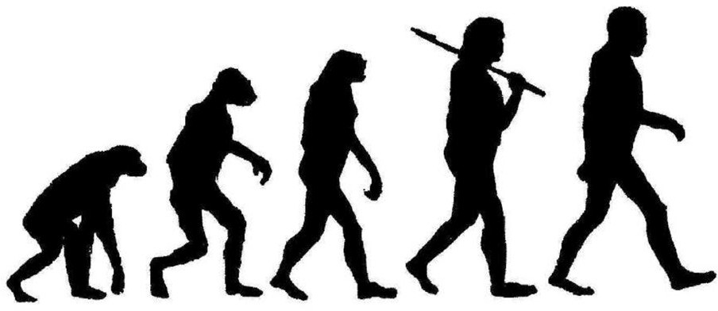



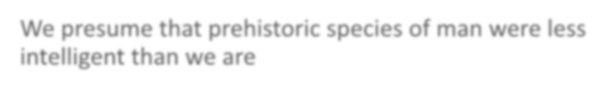
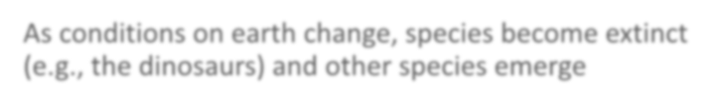

Evolutionary Computing
Humans have evolved (and continue to evolve) over time….
We presume that prehistoric species of man were less intelligent than we are
As conditions on earth change, species become extinct (e.g., the dinosaurs) and other species emerge
Can we model this process and use ”evolve” strategy in new programs for optimization problems?

Slide 4
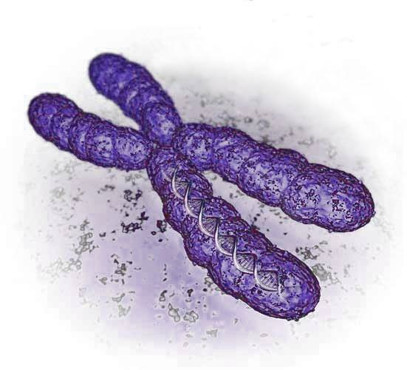
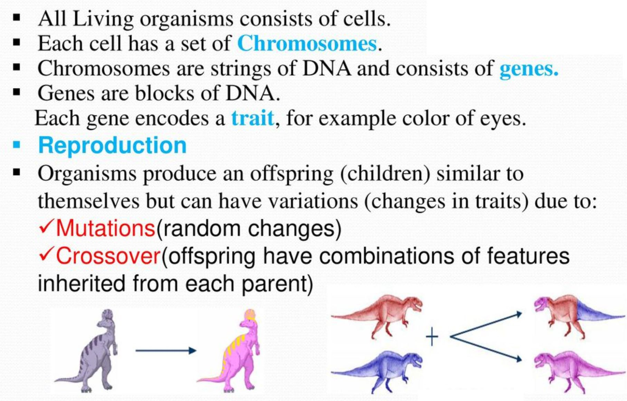
Biological Background

Slide 5
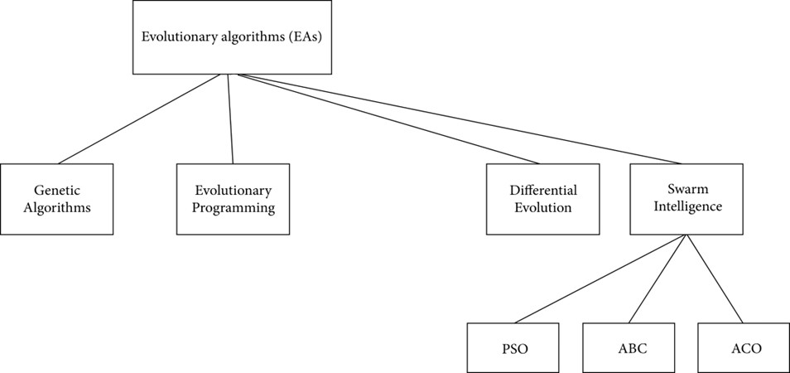
Evolutionary Algorithms

Slide 6
Genetic algorithms Quick Overview
Developed: in the 1970’s
Early names: J. Holland, K. DeJong, D. Goldberg
Typically applied to:
  discrete optimization
Attributed features:
  not too fast
  good heuristic for optimization problems
Special Features:
  Traditionally emphasizes combining information from good parents (crossover)
  many variants, e.g., reproduction models, operators

Slide 7
Genetic Algorithm
It is a search-based optimization technique based on the principles of Genetics and Natural Selection.
It is frequently used to find optimal or near-optimal solutions for the NP complex problems.
It helps to decrease the time to search a solution.

Slide 8
Genetic Algorithm: Optimization
Optimization problem is the problem of finding the best solution from all feasible solutions.
Optimization Problem: computational problem where we try to maximize or minimize some value

Slide 9
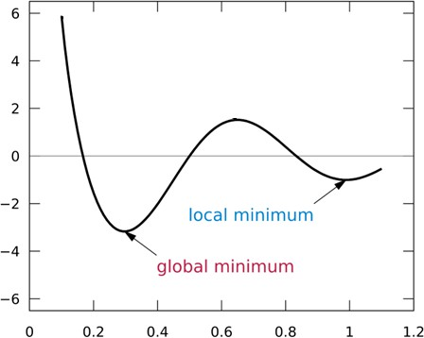
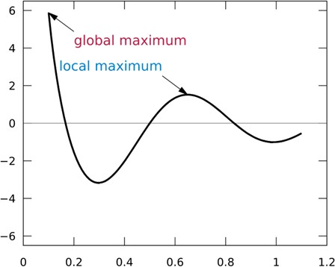
Genetic Algorithm: Optimization
Minimization
Maximization

Slide 10
Used mainly in
Finance
Economy
Computer Vision
Pattern Recognition
Medical
Communications
Scheduling
Planning
Routing
Autonomous cars
Many more…

Slide 11
Summary: Genetic Algorithms
A biological based method
Based on the Darwin’s theory (Evolution of species) Based on - survival of the fittest individual
Key steps: reproduction, survive
Try to simulate life. Individual = solution Environment = problem

Slide 12
Components of a GA
A problem to solve, and ...
Encoding technique
Initialization procedure
optimization problem
Evaluation function
Selection of parents
(gene, chromosome)
(creation), Random ‘guesses’ of the solution to an
(environment), calculates how good a guess solution is (selection)
Genetic operators
(crossover, mutation)
A method of mixing good solutions to produce better ones – Crossover.
An operator to introduce diversity within the population – Mutation.
Parameter settings
(practice and art)

Slide 13
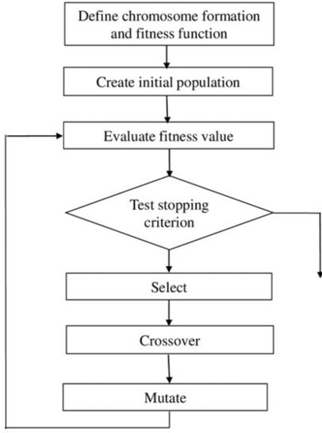

Genetic Algorithm
{
define fitness function; initialize population; evaluate population;
while TerminationCriteriaNotSatisfied
{
perform selection technique; perform Crossover and Mutation; new population;
evaluate population;
}
}
END

Slide 14
Genetic algorithms
Representation | Binary strings
Recombination | N-point or uniform
Mutation | Bitwise bit-flipping with fixed probability
Parent selection | Fitness
Survivor selection | All or some children replace parents
Speciality | Emphasis on crossover

Slide 15
Representation
Phenotype space
Genotype space =
{0,1}^{L}
Encoding
(representation)
10010001
10010010
010001001
011101001
Decoding
(inverse representation)

Slide 16
Initial population
Consist of number of chromosomes or solutions.
Generated randomly.
One time process.
It can be with a set of binary numbers, real numbers, etc.
1 | 0 | 1 | 1 | 0 | 1 | 0 | 0 | 1 | 0 | 1 | 1 | 0 | 1 | 0 | 0
A 16-bit binary string of an artificial chromosome

Slide 17
Fitness function
Definition: Fitness Function (also known as the Evaluation Function) evaluates how close a given solution is to the optimum solution of the desired problem.
The fitness function should quantitatively measure how fit a given solution is in solving the problem.
The fitness function should be clearly defined.
Should be able to understandable how the fitness score is calculated.
Each problem has its own fitness function.
The fitness function should be developed based on a given problem.

Slide 18
Evaluation
modified children
evaluated children
evaluation
The evaluator decodes a chromosome and assigns it a fitness measure.
The evaluator is the only link that provides evaluation of each chromosome or child.

Slide 19
Population
population
Chromosomes could be:
Bit strings
Real numbers
(0101 ... 1100)
(43.2 -33.1 ... 0.0 89.2)

Slide 20
Chromosome Modification: Reproduction
children
modification
modified children
Modifications are stochastically triggered
Operator types are:
  Mutation
  Crossover (recombination)

Slide 21
Crossover: Single-point
Crossover is a critical feature of genetic algorithms:
It greatly accelerates search early in evolution of a population
It leads to effective combination of schemata (subsolutions on different chromosomes)

Slide 22
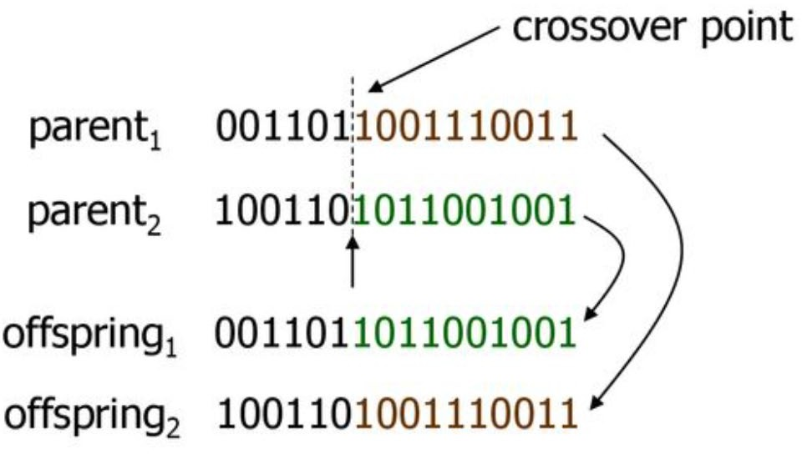
Examples
Crossover point
P1 (0 1 1 0 1 0 0 0)
P2 (1 1 0 1 1 0 1 0)
(1 1 0 1 1 0 0 0)
(0 1 1 0 1 0 1 0)
C1 - offspring 1
C2 – offspring 2

Slide 23
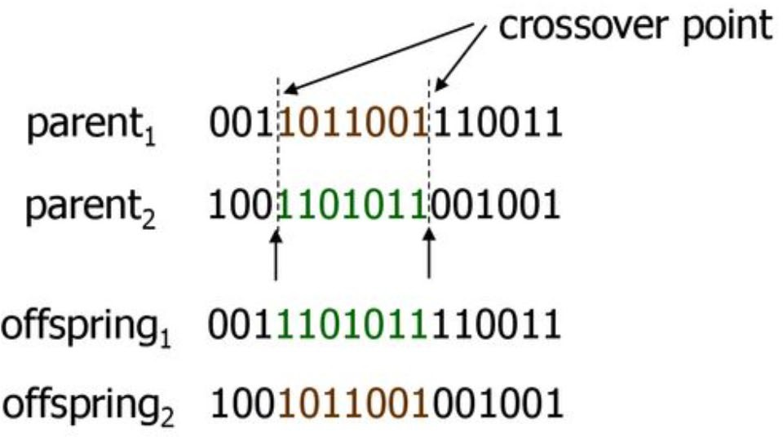
Crossover: two-point

Slide 24
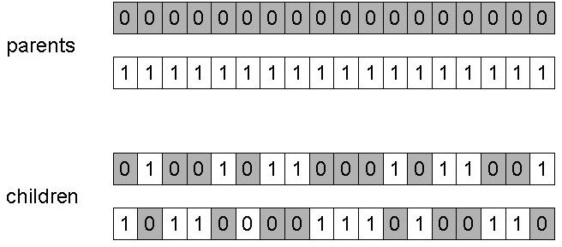
Uniform crossover
Assign 'heads' to one parent, 'tails' to the other
Flip a coin for each gene of the first child
Make an inverse copy of the gene for the second child
Inheritance is independent of position

Slide 25
Mutation: Local Modification
Before: | (1 | 0 | 1 | 1 | 0 | 1 | 1 | 0)
After: | (1 | 0 | 1 | 0 | 0 | 1 | 1 | 0)
Before: | (1.38 | -69.4 | 326.44 | 0.1)
After: | (1.38 | -67.5 | 326.44 | 0.1)
Causes movement in the search space (local or global)
Restores lost information to the population

Slide 26
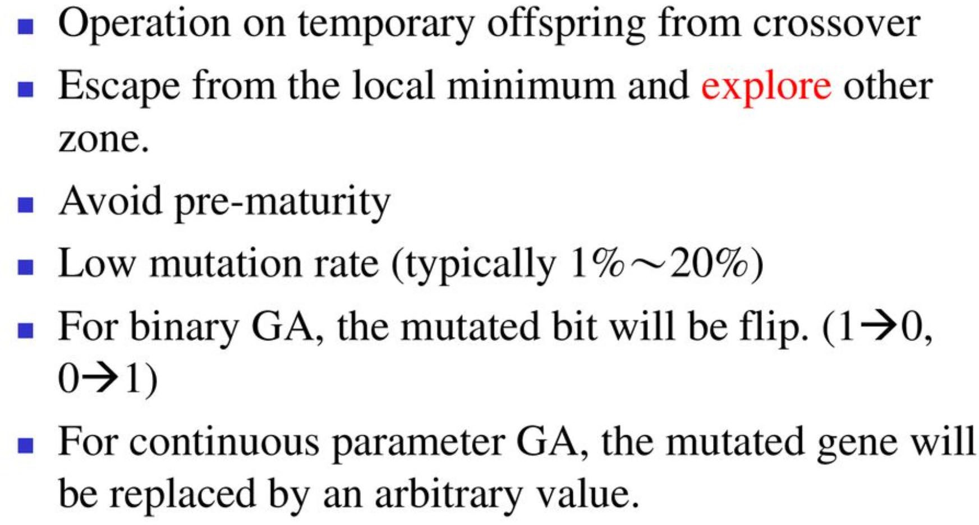
Mutation

Slide 27
Selection: Roulette Wheel Selection
Main idea: better individuals get higher chance
  Chances proportional to fitness
  Implementation: roulette wheel technique
    Assign to each individual a part of the roulette wheel
Spin the wheel n times to select n individuals
1/6 = 17%
A
3/6 = 50%
B
fitness(A) = 3
fitness(B) = 1
fitness(C) = 2
C
2/6 = 33%

Slide 28


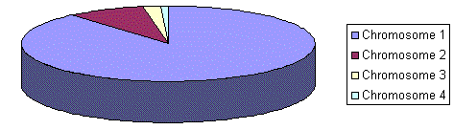
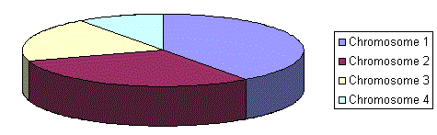
Rank Selection
All individuals are sorted according to their fitness.
Each individual is then assigned a probability of being selected from some prior probability density. (The worst will have fitness 1, second worst 2 etc. and the best will have fitness N (number of chromosomes in population).)
Situation before ranking (graph of fitnesses)
Situation after ranking (graph of order fitnesses)
* After this all the chromosomes have a chance to be selected. But this method can lead to slower convergence, because the best chromosomes do not differ so much from other ones.

Slide 29
Cont.
Steady State Selection: keep most of the existing population and replace only a few better individuals as a parent
Tournament Selection: randomly choose a small group of chromosomes, compare their fitness, and select the best one
Elitism Selection: make sure that the best few chromosomes is carried over to the next generation
Others: there are other many selection strategies, depending on the problem and the genetic algorithm being used

Slide 30
Deletion
population
discarded members
discard
Entire or some individuals in populations replaced with each iteration
A few members replaced each generation

Slide 31
Using Genetic Algorithm to Solve Optimization Problems

Slide 32
A Simple Example
The Traveling Salesman Problem (TSP):
Find a tour of a given set of cities so that
each city is visited only once
the total distance traveled is minimized

Slide 33
Representation
Representation is an ordered list of city numbers known as an order-based GA.
1) London | 3) Dunedin | 5) Beijing | 7) Tokyo
2) Venice | 4) Singapore | 6) Phoenix | 8) Victoria
CityList1 | (3 | 5 | 7 | 2 | 1 | 6 | 4 | 8)
CityList2 | (2 | 5 | 7 | 6 | 8 | 1 | 3 | 4)

Slide 34
Crossover
Crossover combines inversion and recombination:
Parent1 | (3 | 5 | 7 | 2 | 1 | 6 | 4 | 8)
Parent2 | (2 | 5 | 7 | 6 | 8 | 1 | 3 | 4)
Child1 | (3 | 5 | 7 | 2 | 1 | 6 | 3 | 4)
Child2 | (2 | 5 | 7 | 6 | 8 | 1 | 4 | 8)
This is one point crossover operator.

Slide 35
Permutation Crossover in GA for TSP
Goal: Create a new by combining two parent tours without repeating or losing any city.
Permutation crossover preserves a valid tour for TSP, such as, every city appears exactly once, no duplicate cities, no missing cities
Crossover | Main Idea | Simple Description
1. Partially Mapped Crossover (PMX) | Exchange a segment | Copies a section from one parent and uses a mapping to avoid duplicate cities.
2. Order Crossover (OX) | Preserve city order | Copies a segment, then fills the remaining cities according to their order in the other parent.

Slide 36
An Example of Partially Mapped Crossover
Parents: Parent 1: (1 2 3 | 4 5 6 | 7 8 9)
  Parent 2: (9 3 8 | 1 2 7 | 4 5 6)
Crossover Points: Choose two random cut points (marked by |)
Swap Segments: The middle segment of Parent 1 (4 5 6) goes into Offspring 1, and the middle segment of Parent 2 (1 2 7) goes into Offspring 2.
  Child 1: 9 3 8 | 4 5 6 |4 5 6)
  Child 2: (1 2 3 | 1 2 7 | 7 8 9)
Resolve Mappings: Map the swapped numbers to fix conflicts (duplicates) using the correspondence between the two middle segments (4↔1, 5↔2, 6↔7).
Final Offsprings:
  Child 1: (9 3 8| 4 5 6 |1 2 7)
  Child 2: (4 5 3| 1 2 7 |6 8 9)

Slide 37
An Example of Order Crossover
Parents:
  Parent 1: (1 2 3 | 4 5 6 | 7 8 9)
  Parent 2: (9 3 8 | 1 2 7 | 4 5 6)
Crossover Points: Choose two random cut points (marked by |)
Swap Segments: The middle segment of Parent 1 (4 5 6) goes into Offspring 1, and the middle segment of Parent 2 (1 2 7) goes into Offspring 2.
  Offspring 1: (- - -| 4 5 6 |- - -)
  Offspring 2: (- - - | 1 2 7 |- - -)
Fill the remaining empty positions in the offspring using the order of cities as they appear in the other Parent
  Offspring 1: (9 3 8| 4 5 6 |1 2 7)
  Offspring 2: (3 4 5| 1 2 7 |6 8 9)

Slide 38
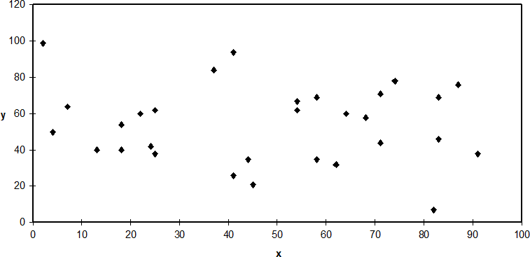
TSP Example: 30 Cities

Slide 39
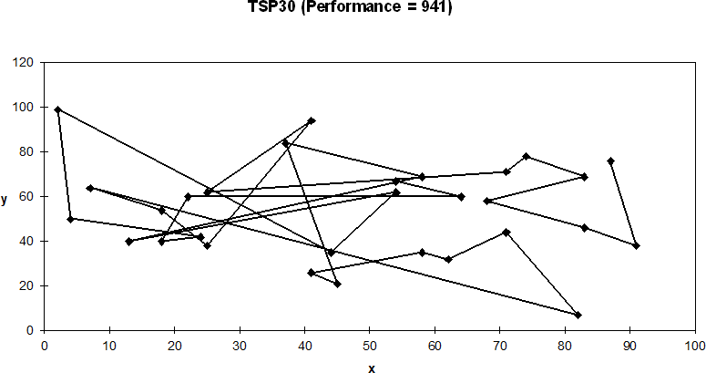
Solution (Distance = 941)

Slide 40
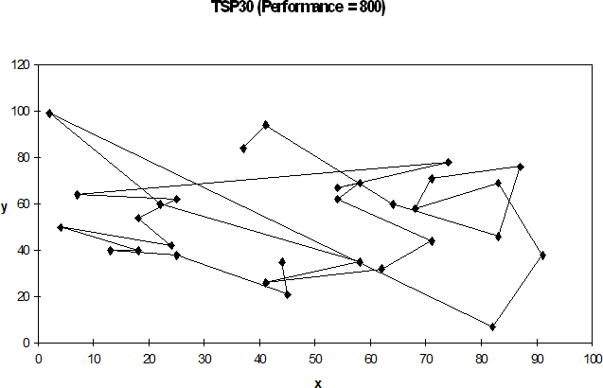
Solution (Distance = 800)

Slide 41

Solution (Distance = 652)
TSP30 (Performance = 652)
120
100
80
y
60
40
20
0
50
x
0
10
20
30
40
60
70
80
90
100

Slide 42
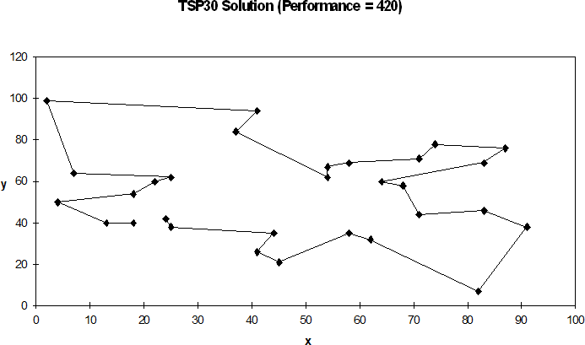
Best Solution (Distance = 420)

Slide 43
Example 2 (Negnevitsky, 2002)
To find the maximum value of the function (15x-x²), where parameter x varies between 0 and
15. Assumption: x takes only integer values.
Integer | Binary code
1 | 0001
2 | 0010
3 | 0011
4 | 0100
5 | 0101
6 | 0110
7 | 0111
8 | 1000
9 | 1001
10 | 1010
11 | 1011
12 | 1100
13 | 1101
14 | 1110
15 | 1111

Slide 44
Example (Contd.)
Suppose that the size of the chromosome population N is 6, the crossover probability p_{c} equals 0.7 and the mutation probability p_{m} equals 0.001, the fitness function in our example is defined by
f(x) = (15x-x²)

Slide 45
Example (Contd.)
The GA creates an
of
Chromosome label | Chromosome string | Decoded integer | Chromosome fitness | Fitness ratio %
X1 | 1100 | 12 | 36 | 16.5
X2 | 0100 | 4 | 44 | 20.2
X3 | 0001 | 1 | 14 | 6.4
X4 | 1110 | 14 | 14 | 6.4
X5 | 0111 | 7 | 56 | 25.7
X6 | 1001 | 9 | 54 | 24.8
initial population
chromosomes by filling six 4-bit strings with randomly generated ones and zeros.

Slide 46
Example (Cont.)
Last column in the previous table shows the ratio of the individual chromosome fitness to the populations total fitness.
According to the example, chromosomes X5 and X6 have a pretty good chance of being selected for mating, while X3 and X4 have a poor chance.
Roulette selection wheel is one of the the most commonly used chromosome selection technique.

Slide 47
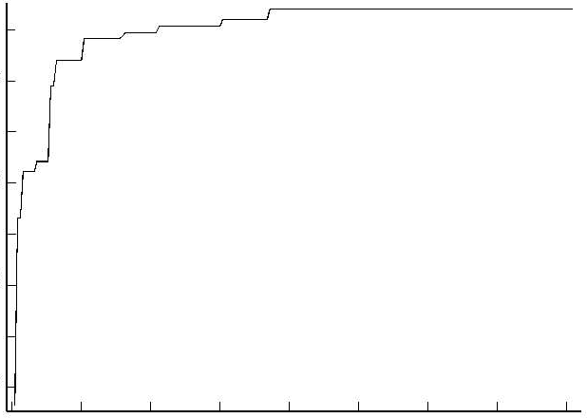
Genetic Algorithm: Maximization problems
-40
Fitness criteria
-50
-60
-70
0
50
100
150
Generations
200

Slide 48
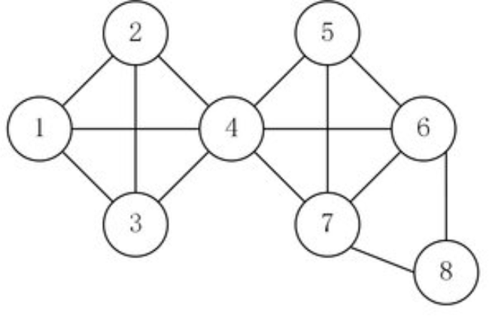
Network routing problem
Consider a network model with 8 nodes.
Find the shortest path between the starting node 1 and destination node 8 using GA. Minimization or Maximization?
Number of genes in a chromosome? Binary or real numbers? How to define a fitness function?
3
29
18
12
58
16
43
23
28
45
7
152
27
11

Slide 49
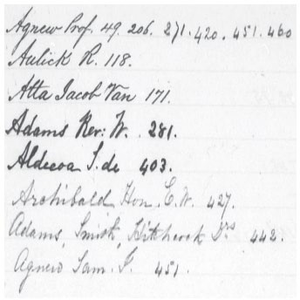
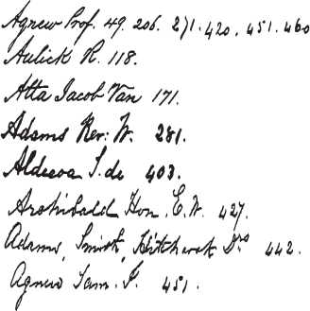
Example: Image application
How to design? parameters?
Genetic Algorithm
300
300
200
Input image
200
Target image
Minimization or Maximization problem?
Number of genes in a chromosome? Binary or real numbers? How to define a fitness function?

Slide 50
Genetic Algorithm Hyper-parameters
Genetic Algorithm has several parameters that can be tuned to obtain better results. The set of parameters is called Hyper-parameters. The most important hyper-parameters are:
Population size: number of chromosomes in the population. This parameter impacts
the algorithm running time. The more chromosomes in the population the longer the algorithm will take.
Crossover rate: percentage of chromosomes selected from generation t to be used in generation t+1 for reproduction.
Mutation rate: probability that a chromosome mutates.
Generation number: number of iterations of the algorithm before it stops. The running time is also directly impacted by this parameter.

Slide 51
Issues for GA Practitioners
Choosing basic implementation issues:
  representation
  population size, mutation rate, ...
  selection, deletion policies
  crossover, mutation operators
Termination Criteria
Performance, scalability
Solution is only as good as the evaluation function (often hardest part)

Slide 52
Benefits of Genetic Algorithms
Concept is easy to understand
Modular, separate from application
Supports multi-objective optimization
Good for “noisy” environments
Always an answer; answer gets better with time
Inherently parallel; easily distributed

Slide 53
Benefits of Genetic Algorithms (cont.)
Many ways to speed up and improve a GA-based application as knowledge about problem domain is gained
Easy to exploit previous or alternate solutions
Flexible building blocks for hybrid applications
Substantial history and range of use

Slide 54
When to Use a GA
Alternate solutions are too slow or overly complicated
Need an exploratory tool to examine new approaches
Problem is similar to one that has already been successfully solved by using a GA
Want to hybridize with an existing solution
Benefits of the GA technology meet key problem requirements

Slide 55
Thank you for listening

