Slide 1
THE ZENITHAL
Zenithal
Identification of URL-Based Attacks from IP Data
Problem Statement: SIH25229 · Theme: Cybersecurity · Category: Software
One detection brain for phishing links AND server-side URL attacks — fused with live IP intelligence.

Slide 2
The Problem
URLs are the #1 attack delivery vector — in two very different ways.
1 · Links that trick people
2 · Links that attack servers
▸ Phishing/smishing links via WhatsApp & SMS posing as bank/delivery/govt alerts
▸ Shortened URLs hide the real destination
▸ Newly-registered domains evade blacklists (zero-day)
▸ Users can't tell safe from malicious before clicking
▸ SQL injection, XSS, path traversal, command injection, LFI/RFI in request URLs
▸ Buried in millions of web-server access-log lines
▸ Attackers hide behind rotating IPs & bulletproof hosts
▸ Traditional filters miss obfuscated / encoded payloads
Over 1 billion phishing attacks were recorded in 2023 — and IP data, the key to tracing attackers, is rarely used.

Slide 3
Our Solution — Zenithal
A single platform that identifies URL-based attacks and correlates them by IP data.
🛡️ Engine 1 — Phishing URL
🧬 Engine 2 — URL Attacks
🌍 IP Intelligence
📊 Live SOC Dashboard
38-feature XGBoost + IP-domain correlation. Catches malicious links before a click.
Signatures + ML detect SQLi/XSS/traversal/cmd-injection from server logs.
GeoIP + ASN + reputation + reverse DNS + IP↔domain mismatch. The 'from IP data' core.
Real-time feed, attacker-IP leaderboard, world map, plain-language explanations.
Explainable · Offline-capable · Real-time · Scalable to millions of URLs

Slide 4
Technical Architecture
CLIENTS
React SOC dashboard · Chrome MV3 extension · WhatsApp/SMS message guard
API — FastAPI
/analyze/url · /analyze/message · /analyze/logfile · /ip · WebSocket /ws/feed
ENGINES
Engine 1 URL (XGBoost) · Engine 2 Payload (signatures + char-TFIDF) · IP Intel · Explainability
DATA / IP
MaxMind GeoLite2 (or offline reference) · ASN + reputation · SQLite (detections + attacker_ips)
Stack: FastAPI · XGBoost · scikit-learn · SQLAlchemy(async) · React · Vite · Tailwind · Recharts · Leaflet
Runs fully offline for demo reliability; optional live VirusTotal/WHOIS/GeoLite2 enrichment toggles.

Slide 5
How We Match the Problem Statement
"URL Based Attacks"
"from IP Data"
▸ Phishing / malicious URLs (Engine 1)
▸ SQL injection
▸ Cross-site scripting (XSS)
▸ Path / directory traversal
▸ Command injection
▸ LFI / RFI (all Engine 2)
▸ Geolocation → attacker world map
▸ ASN + hosting organisation
▸ Reputation (bulletproof / tor / abuse)
▸ Reverse DNS consistency
▸ IP↔domain brand-geo mismatch
▸ Attacker-IP aggregation & ranking
Every phrase of SIH25229 maps to a built, tested feature — see docs/PS_MAPPING.md.

Slide 6
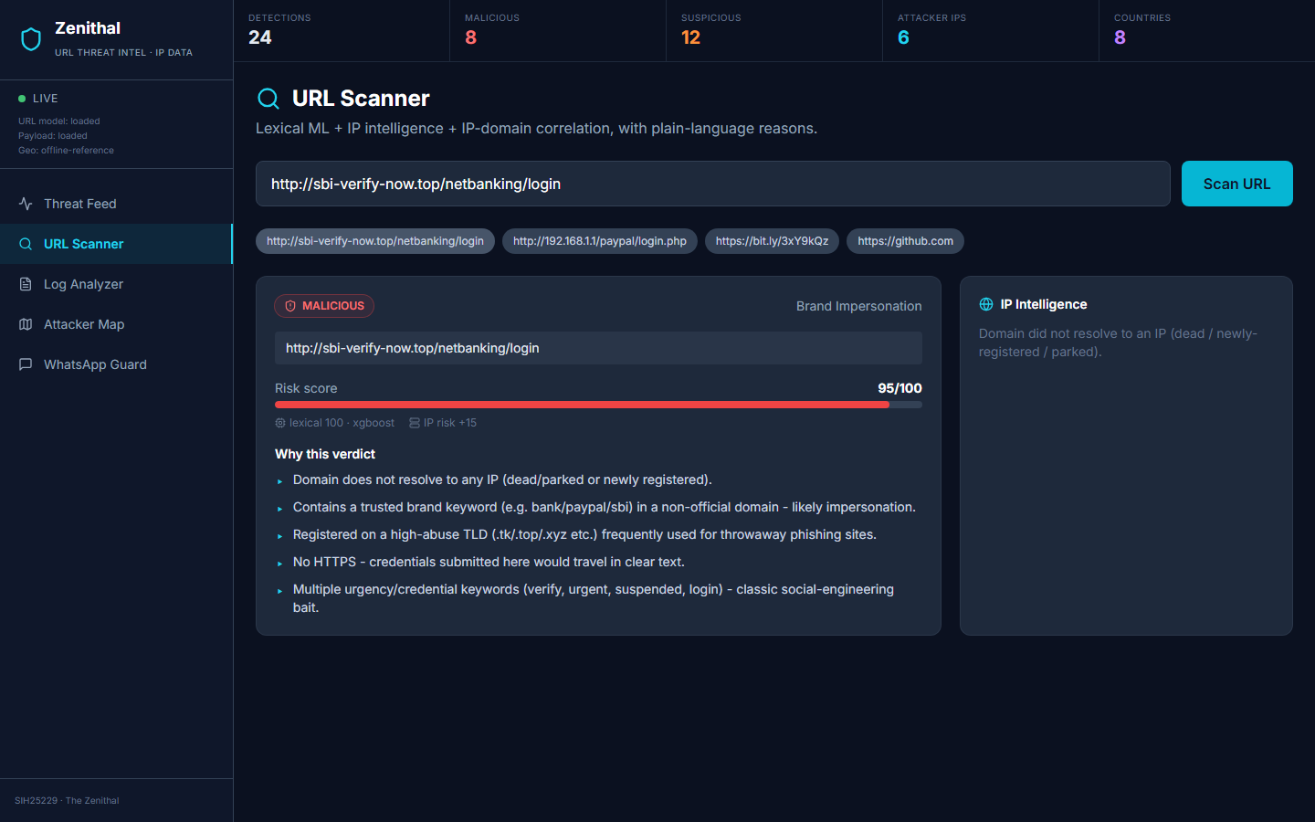
Live Demo · URL Scanner
Paste a URL → ML verdict + IP intelligence + plain-language reasons
sbi-verify-now.top → MALICIOUS 95/100: brand impersonation · high-risk TLD · no HTTPS.

Slide 7
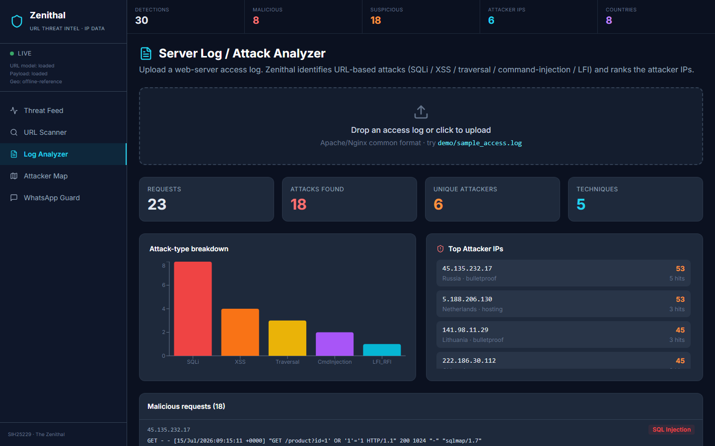
Live Demo · Server-Log Attack Analyzer
Upload an access log → detect URL attacks and rank attacker IPs
23 requests → 18 attacks across 5 techniques; top attacker 45.135.232.17 (Russia, bulletproof).

Slide 8
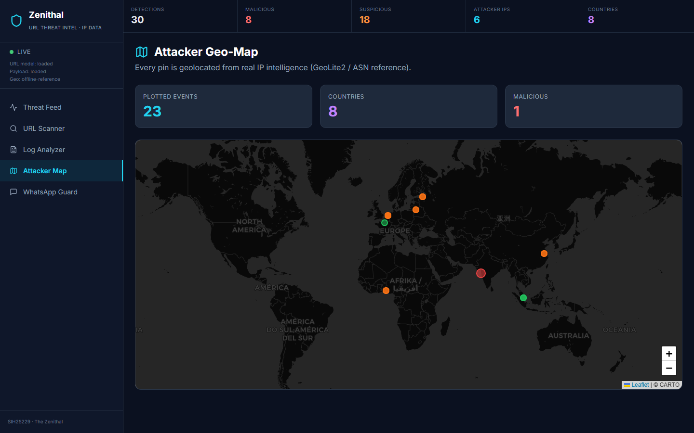
Live Demo · Attacker Geo-Map
Every attacker IP geolocated from real IP data
Pins coloured by verdict; correlate attack campaigns across countries and ASNs in real time.

Slide 9
Feasibility, Impact & Scale
Feasibility
Impact
Scalability
▸ Built on proven open-source: FastAPI, XGBoost, scikit-learn, React
▸ Public datasets: PhishTank/OpenPhish/Tranco, HTTP CSIC 2010
▸ Runs offline — no paid API required for the core
▸ Protects users from phishing/smishing before the click
▸ Gives SOC teams attacker-IP intelligence for faster response
▸ Supports national cyber-threat monitoring at scale
▸ Stateless engines → horizontal scale
▸ SQLite now → Postgres/Redis for production
▸ Docker-compose one-command deploy
Growing phishing/smishing volume → strong, immediate market and public-security demand.

Slide 10
Research Foundation & Differentiators
▸ RoBERTa/DistilBERT achieve >98% phishing-URL detection (arXiv:2311.04913) — our roadmap for scale-up.
▸ CodeBERT detects obfuscated/encoded URL payloads (EMNLP 2020) — informs our decode+ML payload layer.
▸ HTTP CSIC 2010 benchmark (36k normal + 25k attacks) — training set for Engine 2.
What sets Zenithal apart
▸ Literal PS match — both URL-attack families AND IP-data correlation, where most teams do only phishing links.
▸ IP data is used for detection (mismatch, attacker scoring), not decoration.
▸ Every verdict is explainable, and the whole stack demos live and offline.
The Zenithal · SIH25229 · Identification of URL-Based Attacks from IP Data

