Slide 1

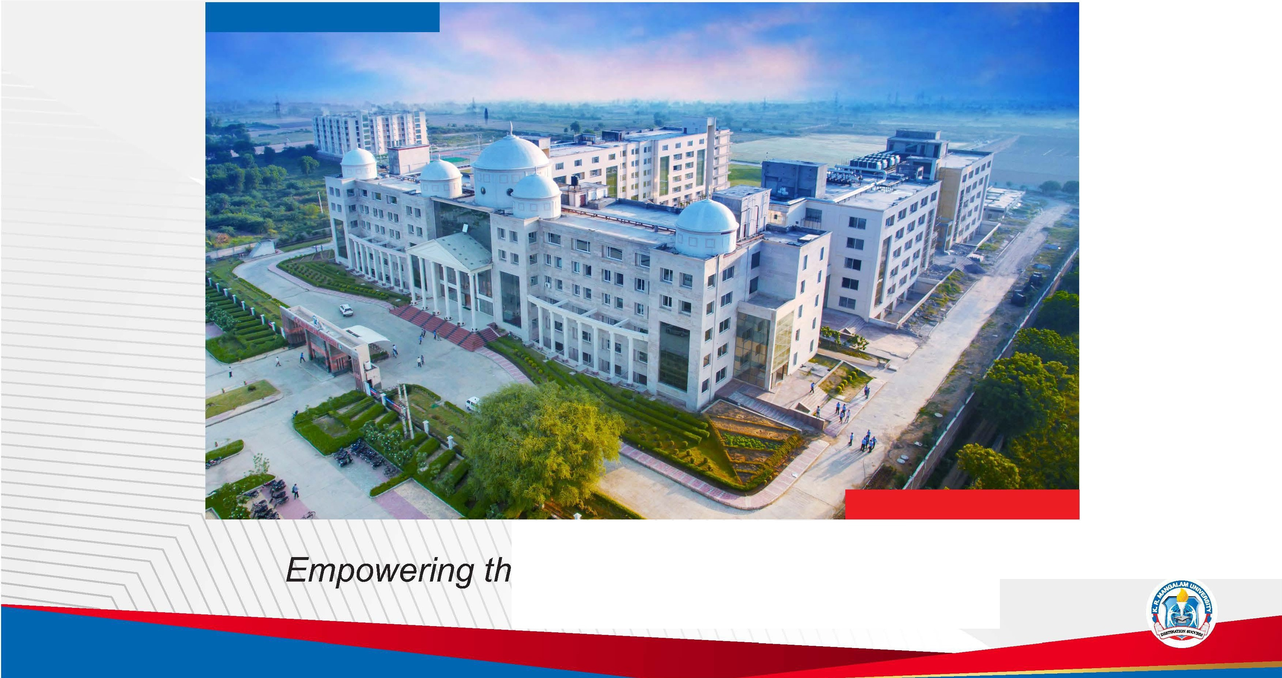
K.R. MANGALAM
UNIVERSITY
THE COMPLETE WORLD OF EDUCATION
Recognised under the section 2 (f) of the UGC Act 1956
e Youth; Empowering the Nation

Slide 2


AI-Based Student Performance Prediction &
Early Warning System
Pre-Final Year Project Progress Submitted by
ROLL | NAME
DEV DAGAR | 2301730073
SHUBHI TYAGI | 2301730132
ARYAN SHARMA | 2301730119
DEV SOOD | 2301730121
Industry Mentor:
Faculty Mentor: MS. LUCKY VERMA

Slide 3

Project Overview
The Academic Challenge (Problem Statement)
Reactive Assessment Models: Traditional institutional monitoring is inherently reactive, identifying academic deficiencies only after summative evaluations (final exams).
Operational Inefficiencies: Reliance on manual data entry and fragmented record-keeping leads to delayed identification of at-risk students.
Information Asymmetry: Lack of predictive tools prevents faculty from visualizing a student's academic trajectory in real-time.
The Intelligent Solution (Proposed System)
Proactive Early Warning System (EWS): Implementation of an automated framework that utilizes Educational Data Mining (EDM) to forecast outcomes.
Machine Learning Integration: Employs a Random Forest Classification algorithm to analyze multi-dimensional variables including attendance, internal assessments, and historical GPA.
Categorical Risk Assessment: Dynamically stratifies the student population into High, Medium, and Low-risk tiers for targeted intervention.

Slide 4
Specific Objectives
1. Data Intelligence & Analytics
To aggregate multi-dimensional student datasets including attendance logs, internal assessment scores, and historical GPA.
To perform Exploratory Data Analysis (EDA) to identify key correlations between student engagement and academic outcomes.
2. Predictive Model Development
To develop and optimize a Random Forest Classification model for precise risk-tier stratification.
To achieve high model reliability by validating performance through precision, recall, and F1-score metrics.
3. System Architecture & RBAC
To engineer a secure Role-Based Access Control (RBAC) system for three distinct user tiers: Admin, Mentor, and Student.
4. Early Warning & Intervention
To implement a real-time Early Warning System (EWS) that triggers automated notifications for students flagged as "High-Risk."
To provide mentors with actionable visual insights (via Plotly) for evidence-based academic counseling.

Slide 5
Key Features
Intelligent Prediction: Uses Random Forest to classify students into Low, Medium, or High-risk categories and forecast GPA.
Role-Based Dashboards: Secure portals for Admin (management), Mentor (cohort analytics), and Student (self-tracking).
Interactive Visuals: Real-time, hover-able charts powered by Plotly to visualize performance trends and feature importance.
Early Warning System: Automated notification gateway to instantly flag "High-Risk" students for immediate intervention.

Slide 6
Progress Summary
Current Status: 100% Overall Completion.
Phase 1: Requirement Analysis & Design — 100% Completed
SRS documentation, Feasibility Study, and System Architecture finalized.
Phase 2: Data Engineering — 100% Completed
Data collection, cleaning, and Feature Engineering (encoding & scaling) executed.
Phase 3: Model Development — 100% Completed
Random Forest Classifier trained and optimized for high accuracy.
Phase 4: System Integration — 100% Completed
Backend logic (Python) integrated with Frontend (Streamlit) and Database (SQLite3).
Phase 5: Testing & Deployment — 100% Completed
Functional testing of RBAC portals and model performance validation finished.

Slide 7
Detailed Progress – Development Phase
1. Data Engineering & ML Pipeline
Preprocessing: Executed Label Encoding and Min-Max Scaling to normalize student engagement metrics.
Model Selection: Implemented Random Forest Classifier for non-linear risk stratification.
Optimization: Tuned n_estimators and max_depth to achieve optimal accuracy and prevent overfitting.
2. Application & System Architecture
Frontend: Built a responsive UI using Streamlit for real-time risk visualization.
Backend/DB: Integrated Python logic with SQLite3 for secure, persistent data management.
Access Control: Deployed a 3-tier RBAC system (Admin/Mentor/Student) to ensure data privacy.
3. Performance Validation
Metrics: Validated via Confusion Matrix and F1-Score to ensure high reliability in "High-Risk" detection.

Slide 8

Methodology
1. Requirement Analysis:
Detailed study of academic monitoring needs.
Finalization of Hardware (8GB RAM, i5) and Software (Python, Streamlit) requirements.
2. System Design:
Development of System Architecture and 3-tier RBAC (Role-Based Access Control).
Designing the UI layout for Mentor and Student dashboards.
3. Implementation (Development):
Data Phase: Cleaning and encoding categorical student data.
ML Phase: Building the Random Forest Classifier and integrating it with the Streamlit frontend.
4. Testing & Validation:
Performing functional testing for user login and data entry.
Validating model accuracy via Confusion Matrix and F1-Score metrics.
5. Deployment:
Final integration of the local server environment using SQLite3 for persistent data storage.

Slide 9

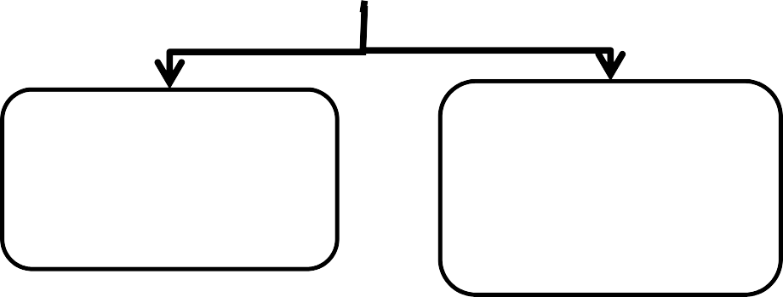
Prototype/Project Flow diagram/Architecture
DATA COLLECTION
Input:Student Performance Dataset(CSV)
DATA PREPROCESSING
MODEL INFERENCE
Tasks: Missing Value Handling,Feature Encoding
Serialized Random Forest Classifier(.pkl)
OUTPUT LAYER
RISK PREDICTION
ML Logic Processes Student Metrices
Data Stored in Database
MENTOR DASHBOARD DISPLAY
STUDENT PORTAL DISPLAY
RISK CATEGORISATION
Outputs mapped to LOW,Medium,High Tiers

Slide 10

Project Timeline
Phase 1: Conceptualization & Research (Month 1-2)
Literature review on Educational Data Mining (EDM).
Problem identification and feasibility analysis.
Phase 2: Data Acquisition & Preprocessing (Month 3-4)
Dataset selection and feature engineering.
Exploratory Data Analysis (EDA) to find academic correlations.
Phase 3: Model Development & Tuning (Month 5-6)
Algorithm selection (Random Forest) and training.
Hyperparameter optimization for maximum accuracy.
Phase 4: System Integration (Month 7-8)
Building the Streamlit UI and SQLite3 database.
Developing the Multi-role (RBAC) access control.
Phase 5: Final Validation & Documentation (Month 9-Present)
End-to-end testing and performance verification.
Final Project Report and Presentation preparation.

Slide 11
Data & Resources
1. Dataset Specifications
Source: Synthetic university academic records (EDM dataset).
Parameters: Attendance, Internal Marks, Project Scores, and Historical GPA.
Feature Engineering: Integrated Label Encoding for categorical variables and Min-Max Scaling for numerical consistency.
2. Software Resources
Language: Python 3.9+
ML Libraries: Scikit-learn (Random Forest), Pandas (Data manipulation), NumPy.
Visualization: Plotly (Interactive charts) and Seaborn (Static heatmaps).
Frontend Framework: Streamlit (Web Application).
Database: SQLite3 for persistent user and risk-log storage.
3. Hardware Resources
Workstation: Standard development machine (Minimum 8GB RAM, Intel i5/AMD Ryzen 5).
Storage: SSD for efficient data processing and model serialization (.pkl files).

Slide 12

Project Usecases & Scope
1. Primary Usecases
Institutional Academic Tracking: Enables faculty to monitor "class health" through a unified window, identifying students falling below the 75% attendance or passing threshold.
Data-Backed Counseling: Facilitates evidence-based discussions between mentors and parents regarding a student’s predicted trajectory.
Student Self-Correction: Empowers students to visualize their standing against class averages, encouraging proactive study habits.
2. Future Scope
Behavioral Data Integration: Expanding the model to include library logs, LMS activity, and digital footprint for holistic prediction.
NLP Chatbot Integration: Implementing an AI-driven chatbot for 24/7 academic query resolution and personalized study plans.
Scalability: Migrating the local database to a cloud-based architecture (AWS/Azure) for multi-departmental institutional deployment.
Deep Learning Models: Utilizing RNNs or LSTMs for time-series analysis of student performance over multiple semesters.

Slide 13
Expected Results & Impact
1. Quantitative Outcomes (Performance)
High Predictive Accuracy: The Random Forest model delivers consistent precision in identifying "High-Risk" students based on internal assessment trends.
Granular Risk Stratification: Successfully categorizes the student population into three distinct, actionable tiers (Low, Medium, and High).
2. Qualitative Impact (Institutional Value)
Proactive Academic Culture: Facilitates a shift from "Reactive" (post-failure) to "Proactive" (pre-exam) academic monitoring.
Improved Success Rates: Enables early institutional intervention (extra classes/counseling), leading to potentially higher pass percentages.
Operational Efficiency: Automates the manual data-tracking process, reducing the administrative burden on mentors by centralizing student records.
3. Data Integrity & Transparency
Provides clear, visual evidence of performance through interactive dashboards, ensuring transparency between Students, Mentors, and Administration.

Slide 14
THANK YOU

