Slide 1

Swimmer Performance Analysis:
Project Guide:
Dr. Ramesh NSVSC Sripada
Associate Professor
Team Members:
T. Bharathi (21P31A05C5)
K. Armaan Yusuf Khan (21P31A0591)
D. Phani Harsha (21P31A05D0)
D. Deepesh (21P31A0578)

Slide 2
Agenda
Abstract
Problem definition
Motivation behind the problem selection
Existing system
Proposed system
Block diagram
Feasibility study
Mathematical modeling
Designs of the Proposed Solution
Requirements ( Functional & Non – Functional )
Basic UI design and implementation
Main Code
Application
Conclusion
Future Scope

Slide 3

Abstract
Coaches often struggle to provide personalized feedback, relying on anecdotal observations rather than empirical data, which can hinder informed decision-making and lead to less effective training strategies. Outdated methods and a lack of adaptation to emerging techniques further limit performance improvement, causing swimmers to miss opportunities to enhance their skills and reach their full potential. To address these challenges, this study introduces an automated system for swimmer performance analysis using advanced image, data processing techniques. The system evaluates key performance indicators such as stroke mechanics, body posture, motion dynamics, and speed.

Slide 4
Problem Definition
The Issue:
Swimmers require consistent performance tracking to improve their techniques and achieve competitive goals.
Current methods of analyzing swimming performance are often manual, time-consuming, and lack detailed insights.
There is a need for an efficient and automated system to measure and evaluate swimmer performance with accuracy.
The Solution:
Developing a system to analyze swimmer performance using advanced data analysis techniques.
Leverage Python and the KNN algorithm to classify and evaluate swimmer metrics, such as speed, stroke efficiency, and lap times.
Provide actionable insights through visualizations and analytics to help swimmers and coaches identify areas for improvement.

Slide 5
Motivation
Achieving excellence in competitive sports, optimizing swimmer performance has become crucial for reaching peak results and maintaining athletic competitiveness.
Traditional methods of analyzing swimmer techniques often rely on manual observation and subjective evaluation, which can be time-consuming, inconsistent, and prone to errors.
To overcome these limitations, this project aims to develop an automated system for swimmer performance analysis that evaluates key factors like stroke mechanics, body posture, motion patterns, and speed.
By leveraging advanced technologies like Convolutional Neural Networks (CNN), Support Vector Machines (SVM), Machine Learning, the system offers accurate, non-intrusive, and consistent performance insights.
This innovative approach empowers coaches and athletes with actionable data, enabling them to refine techniques, improve training efficiency, and unlock the full potential of swimmers.

Slide 6
Existing System - Drawbacks
JSON Serialization Failure: The core issue is a TypeError: Object of type int64 is not JSON serializable
Limited Metric Scope: While the system calculates several key metrics, it lacks the flexibility to incorporate more advanced or personalized metrics. This can limit the depth of analysis and the ability to tailor recommendations to individual swimmers' needs.
Lack of User Authentication and Profiles: The system doesn't include user authentication or profiles, preventing personalized data storage and retrieval.
Static Data Dependency: The system relies on manually updated text files, limiting its ability to provide real-time or up-to-the-minute performance insights.

Slide 7
Existing System - Methodology
System: Pose Estimation and Optical Flow models to analyze swimmer performance by tracking body posture, stroke mechanics, and motion dynamics.
Data Acquisition:
Swimmer performance data is stored in individual text files.
Each file's name follows a specific format (e.g., "SwimmerName-Age-Distance-Stroke.txt"), encoding key information. Lap times for each race are recorded as comma-separated values within these files.
Data Analysis:
A Python script using the os module scans a designated directory for .txt files.
The filename is parsed to extract swimmer name, age, distance, and stroke
The file content (lap times) is read, and each time string (e.g., "1:10.50") is converted into seconds using a custom parse_time() function.
The parsed data is organized into a Pandas DataFrame for efficient manipulation and analysis.

Slide 8
Performance Metric Calculation:
Key performance metrics are calculated using Pandas.
Average Lap Time: Calculated by averaging the lap times for each race
Velocity: Calculated by dividing the distance by the total time of the race
Heart Rate: Is assumptionally calculated based on the age of the swimmer, and the distance of the race.
The calculated metrics are stored in a dictionary.
Performance Prediction:
Matplotlib is used to generate graphs
The graphs are saved as PNG images and encoded as base64 strings for embedding in the web page.
Scikit-learn's LinearRegression model is used to predict future race times.
The model is trained on the swimmer's historical total race times, using race number as the independent variable.
The trained model predicts the time for the next race.

Slide 9
Proposed Systems
System: Pose Estimation, Optical Flow, and Machine Learning
Dataset: Dataset consists of over 1,000 individual text files, each representing a swimmer's race history
Key features of the proposed system:
Advanced Predictive Analytics and Personalized Metrics:
This focuses on improving the accuracy of future predictions through more sophisticated machine learning models and expanding the range of available metrics.
Improved User Experience and Scalability:
This encompasses enhancing the user interface with interactive elements and dynamic visualizations, as well as optimizing the system for handling larger datasets

Slide 10
Block Diagram
Data Files
(Swimmer Data)
JSON Encoding
& Conversion
Data Parsing & Processing
Data Analysis
& Prediction
Data Storage
(Pandas DF)
Flask API Send
(Data to Front)
Metric/Predict.
Calc & Model
User Display
(Web Browser)

Slide 11
Feasibility Study
Data Collection: Accurately collect performance metrics like stroke count, heart rate, and lap times.
ML Algorithms: Linear Regression and KNN are computationally efficient and work well for small to medium-scale datasets.
Visualization: Libraries like Matplotlib (Python) can create detailed graphs and charts.
Operational Feasibility:
User-Focused Design: An intuitive interface (web/mobile) ensures accessibility for coaches and swimmers.
Automation: Automatic data collection and report generation reduce manual effort.
Economic Feasibility:
Initial Costs: Development involves integrating APIs, building a backend database, and deploying the application.
Return on Investment: Improved swimmer performance and reduced manual workload provide significant long-term value.
Scalability:
For Larger Teams: Shift from SQL to distributed databases (e.g., MongoDB or Hadoop).
For Advanced Analysis: Integrate neural networks for more pattern detection as data grows.

Slide 12
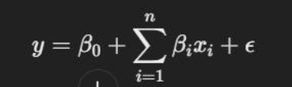
Mathematical Modelling
Problem Statement: Predict future swimming performance based on historical data and provide actionable insights for improvement.
Key Metrics and Objectives: Predict lap times (y) based on input features (X) like stroke rate, heart rate, and distance per stroke.
Classify performance trends (e.g., improving, stagnating, or declining).
Suggest optimal training plans based on predicted outcomes.
Mathematical Formulations:
Linear Regression for Performance Prediction:
y = β₀ + Σⁿᵢ₌₁ βᵢxᵢ + ε y: Predicted metric (e.g., lap time). xi: Features (e.g., heart rate, distance per stroke). βi: Coefficients learned from the data. ε: Error term

Slide 13
y: The predicted swimming performance (e.g., lap time, stroke efficiency, or overall score).
β0​: The intercept (baseline performance when all predictors are zero).
β1​,β2​,…,βn​: The coefficients representing the contribution of each predictor to the performance.
​x1,x2​,…,xn ​: The predictor variables (e.g., swimmer's age, training hours, body mass index, stroke rate, or previous performances).
ϵ: The error term accounting for variability not explained by the predictors.
The formula might look like this:
y=12.5 − 0.3 * 1​− 0.5 * 2​ + 0.2 * 3
​Interpretation:
β0​=12.5: The baseline lap time when all predictors are zero.
β1​=−0.3: For each additional stroke per minute, lap time decreases by 0.3 seconds.
β2​=−0.5: For each additional training hour per week, lap time decreases by 0.5 seconds.
β3​=0.2: For each 1% increase in body fat, lap time increases by 0.2 seconds.

Slide 14
Designs of the Proposed Solution
System Architecture:
Text Files (Input): Raw data storage; each file represents a swimmer's race history, named with a specific pattern
Python/Flask Backend: Core processing unit; handles data parsing, analysis, prediction, and API requests.
Scikit-learn (Linear Regression): Provides the machine learning model for predicting future performance based on historical data.
Matplotlib: Generates visual representations of performance data, making it easier to identify trends and patterns.
JSON API: Facilitates communication between the backend and frontend
Web Frontend (HTML, CSS, JavaScript): User interface for interacting with the system, displaying results, and providing recommendations.

Slide 15
Data Flow:
When a user enters a swimmer's name and clicks "Analyze," the frontend sends a request to the Flask API (/swimmer/<swimmerName>).
The Flask backend retrieves the corresponding data files and processes them.
The results, including metrics, graph data (base64 encoded), and recommendations, are packaged into a JSON response.
The frontend receives the JSON response, parses it, and dynamically updates the webpage with the results.
Modular Approach:
The code is organized into functions, each with a specific purpose (e.g., process_files, analyze_swimmer, generate_recommendation).
This modularity allows for easier debugging, maintenance, and future expansion of the system.

Slide 16
Requirements ( Functional & Non – Functional )
Functional Requirements:
Data Parsing: The system must accurately read and interpret data from text files with a predefined format.
Metric Calculation: Calculation of key metrics like average lap time, velocity, and heart rate, which are essential for performance evaluation.
Visualization: Generation of clear and informative graphs to visualize performance trends over time and across different strokes.
Recommendations: Provision of actionable recommendations based on the analysis of performance metrics

Slide 17
Prediction: Accurate prediction of future race times using a linear regression model.
Web Interface: A user-friendly web interface for easy access to the system's functionality.
JSON API: Must provide the data in a Json format so that the front end can display the data

Slide 18
Non-Functional Requirements:
Performance: The system should process data and generate results quickly, providing a responsive user experience.
Usability: The interface should be intuitive, allowing users to easily input swimmer names and view analysis results.
Maintainability: The codebase should be well-documented and follow coding best practices for easy maintenance and updates.
Reliability: The system should consistently produce accurate results and handle errors gracefully.
Error handling: The system must handle the fact that the Numpy int64 datatype is not Json serializable, and convert those values into a standard int datatype. This is a critical point, and must be highlighted.

Slide 19
Basic UI design and implementation
UI Design:
The UI is designed to be simple and focused, allowing users to quickly access and understand the analysis results.
The input form is prominently placed for easy data entry.
The metrics table provides a clear and organized display of key performance indicators.
Graphs are displayed below the metrics table, allowing users to visually analyze performance trends.
Recommendations are displayed in a separate section, highlighting areas for improvement.

Slide 20
Implementation:
HTML provides the structure of the webpage, CSS handles the styling, and JavaScript adds interactivity.
JavaScript uses the Fetch API to send requests to the Flask backend and receive JSON responses.
The DOM (Document Object Model) is dynamically updated with the received data, creating the metrics table, displaying graphs, and showing recommendations.
Key UI Elements:
Input Field: Allows users to enter the name of the swimmer to be analyzed
Analyze Button: Triggers the data analysis process.
Metrics Table: Displays key performance metrics in a structured format.
Graph Display: Shows visual representations of performance data.
Recommendation Display: Provides actionable recommendations based on the analysis.

Slide 21
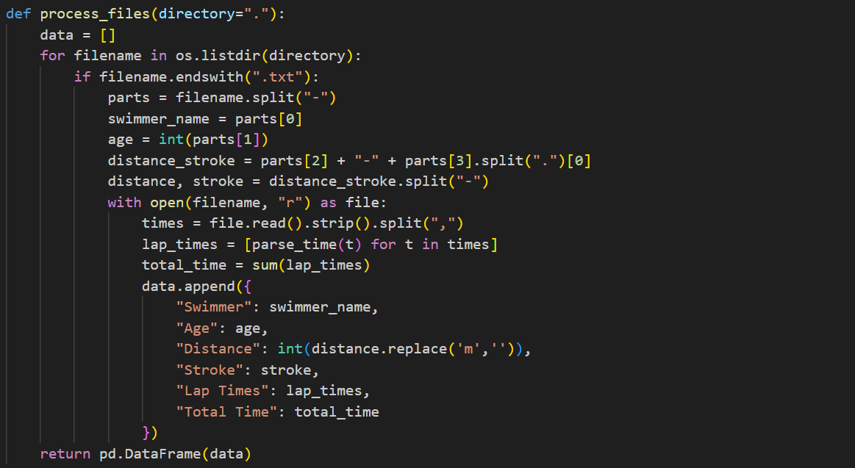
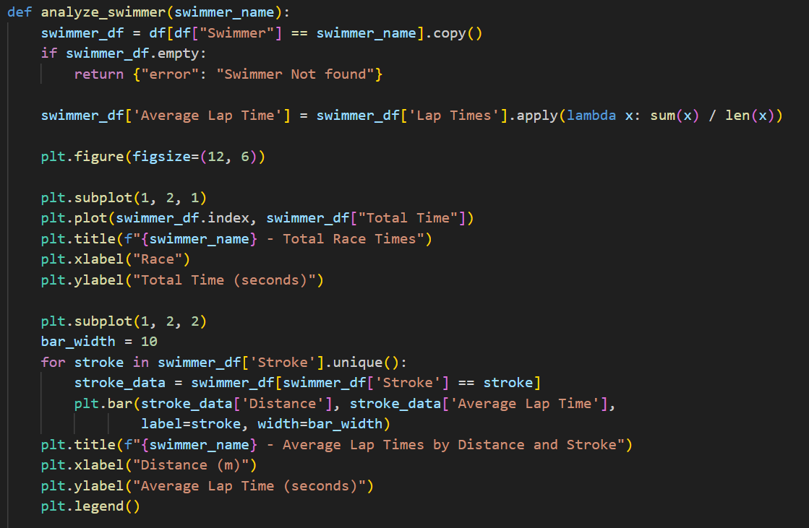
Main Code
Data Processing and Metric Calculation
We parse the filenames to extract swimmer name, age, distance, and stroke. We then read the lap times from the files and convert them into numerical values for analysis
Visualization and Prediction
We use Matplotlib to create visualizations of the swimmer's performance data. This includes graphs showing total race times and average lap times across different distances and strokes.

Slide 22
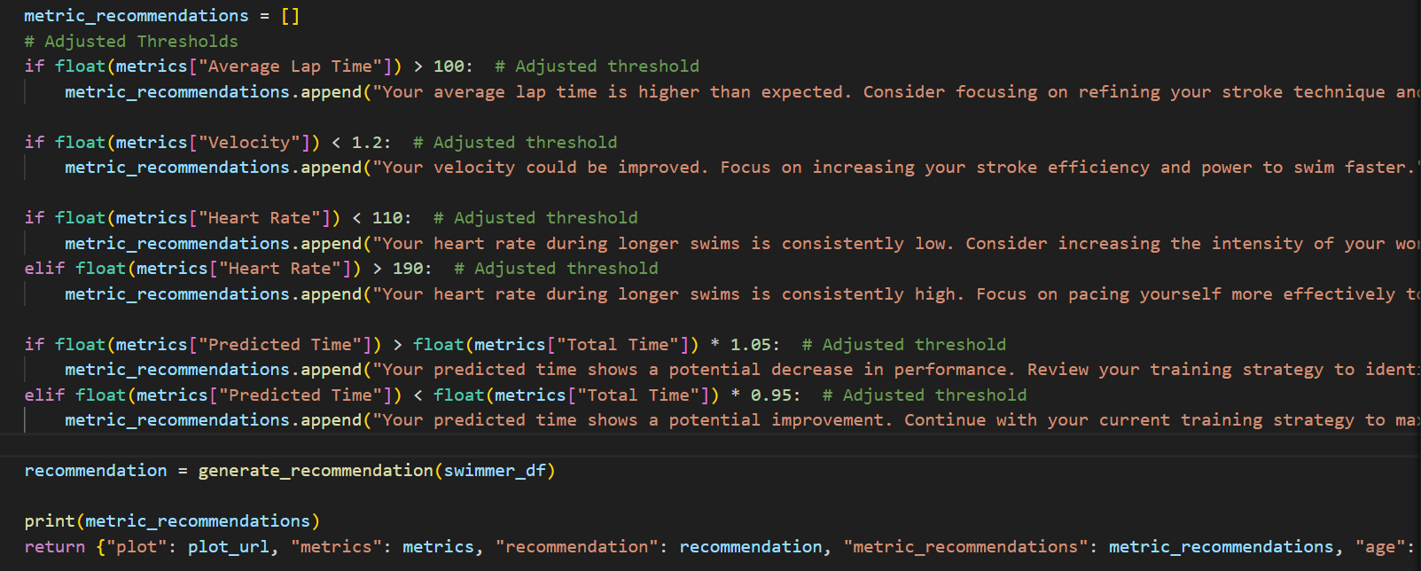
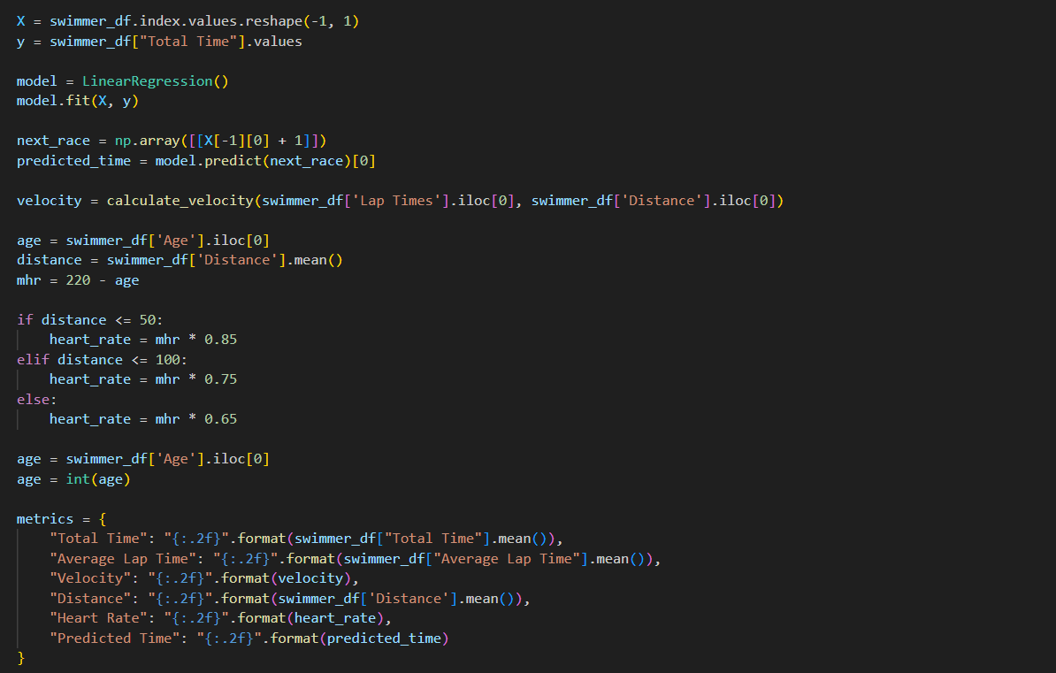
Metric-Specific Recommendations
We start by creating an empty list called metric_recommendations. This list will store the specific recommendations we generate for the swimmer based on their performance metrics
Linear Regression Model Training and Prediction
This line trains the linear regression model using the prepared data (X and y). The model learns the relationship between race number and total time.
calculates the swimmer's velocity, calculates the swimmer's maximum heart rate, dictionary will be converted to JSON and sent to the frontend.

Slide 23
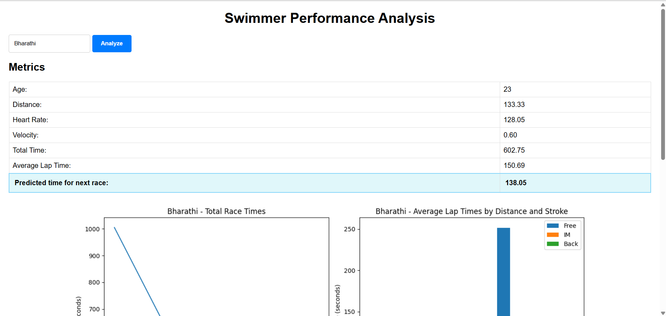
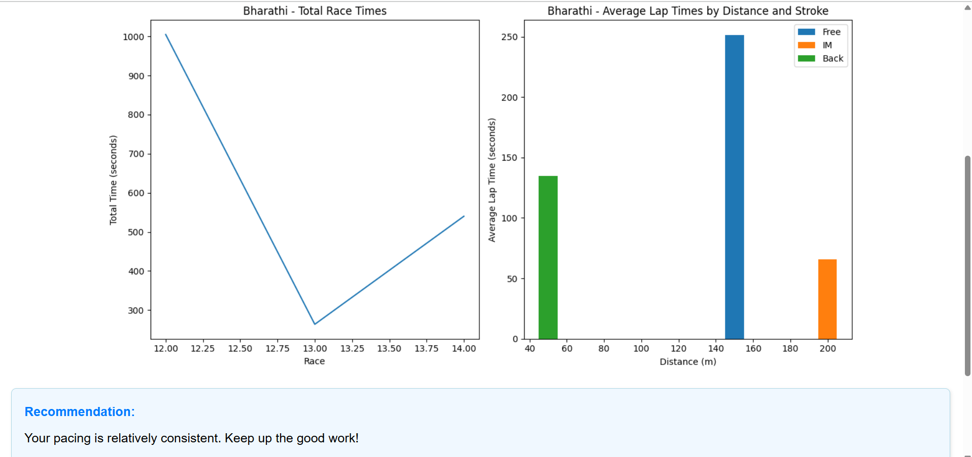
APPLICATION

Slide 24
Conclusion
Summary of Project Goals and Achievements:
"This project successfully developed a system for analyzing swimmer performance using historical data from text files. We achieved the goal of providing key performance metrics, visualizations, and predictions to aid swimmers and coaches in improving training strategies.“
Highlight Key Functionality:
“The system effectively parses and processes swimmer data, calculates relevant metrics such as average lap time, velocity, and estimated heart rate, and generates informative graphs. Furthermore, it implements linear regression to predict future race times, providing a valuable tool for performance analysis.“
Emphasis on the Value of Predictions and Recommendations:
"The inclusion of predicted race times and metric-specific recommendations offers actionable insights, helping swimmers identify areas for improvement and optimize their training."

Slide 25
Future Scope
Real-Time Data Integration:
Integrate real-time data from wearable devices or sensors to provide live performance analysis during training and races.
Advanced Predictive Modeling:
Explore and implement more advanced machine learning models, such as time series analysis or neural networks, to improve prediction accuracy and capture complex performance patterns.
Personalized Training Plans:
Develop personalized training plans based on individual swimmer performance, goals, and strengths and weaknesses.
Cloud Deployment and Scalability:
Deploy the application on a cloud platform to improve scalability and accessibility for a wider range of users

