Slide 1


International football results from 1872 to 2019

Slide 2
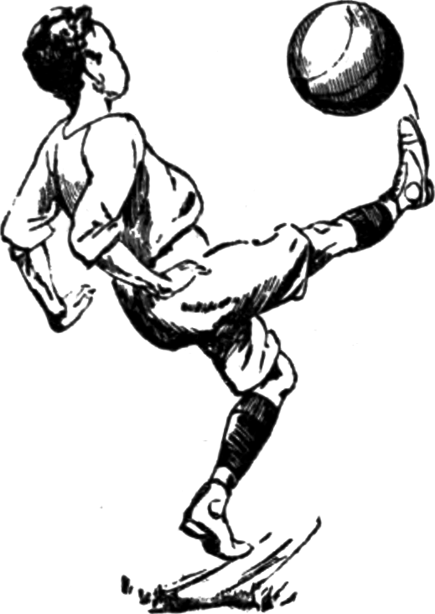
Contents :-
Data explanation
Analytical tasks
Motivation behind the analysis
Hypotheses
Experiments,
Results
Knowledge discovery

Slide 3

Data Explanation :-
41,540 results of international football matches from 1872 up to 2019.
FIFA World Cup, UEFA Euro League, and regular friendly matches.
Data format
date - date of the match
home_team - the name of the home team
away_team - the name of the away team
home_score - full-time home team score including extra time, not including penalty-shootouts
away_score - full-time away team score including extra time, not including penalty-shootouts
tournament - the name of the tournament
city - the name of the city/town/administrative unit where the match was played
country - the name of the country where the match was played
neutral - TRUE/FALSE column indicating whether the match was played at a neutral venue
Sources : Wikipedia, fifa.com, rsssf.com and individual football associations' websites.

Slide 4
Number of international soccer games :-
Motivation
To check how many games were played each year and how the total number of international games evolve with time.
Visualize
Line graph is plotted to visualize the evolution of number of games.
Knowledge discovery
Number of games is rising, with high growth in the 80s/90s.
It seems there is a peak around 2010, with a slight decrease since.

Slide 5
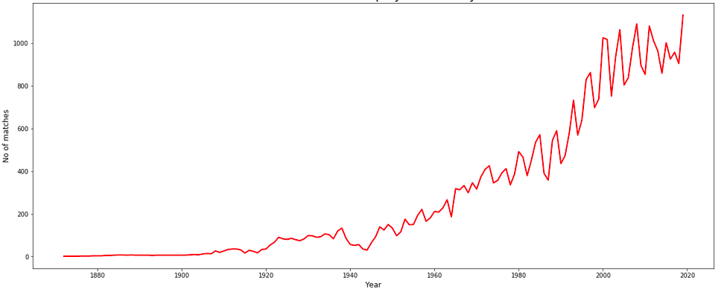
Number of international soccer games :-

Slide 6
Top countries with most wins :-
Motivation
To find out the countries with most wins from the games played with total number of wins to find out leading countries in the football game.
Visualize
Bar chart is plotted to visualize the top 20 countries with most wins.

Slide 7
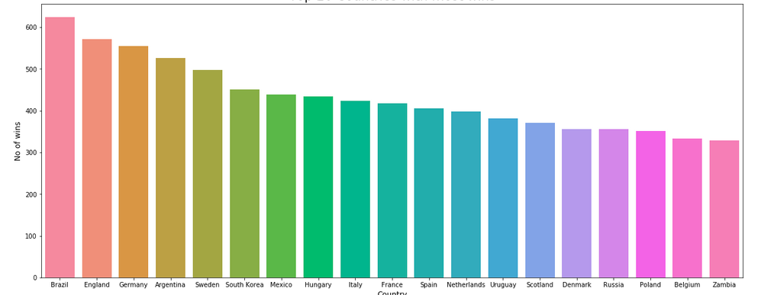
Top countries with most wins :-

Slide 8
Favourite ground for top country :-
Motivation
To analyze which city has been the most favourable for maximum number of wins for the leading country Brazil in the game.
Visualize
Horizontal Bar chart is plotted to visualize the maximum wins of Brazil across different cities.

Slide 9
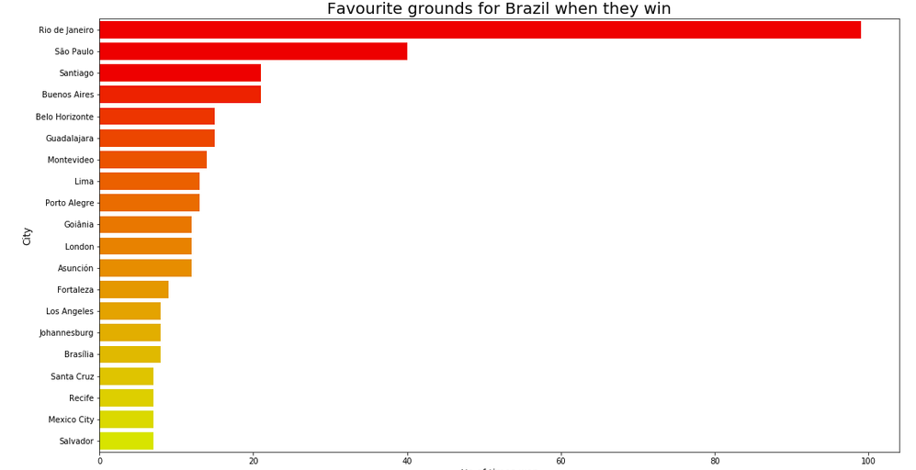
Favourite ground for top country :-

Slide 10
Most played leagues :-
Motivation
To analyze which are different tournaments that has been played most over time.
Visualize
Pie chart with percentage of tournament type played is plotted to visualize the top 20 most played leagues.

Slide 11
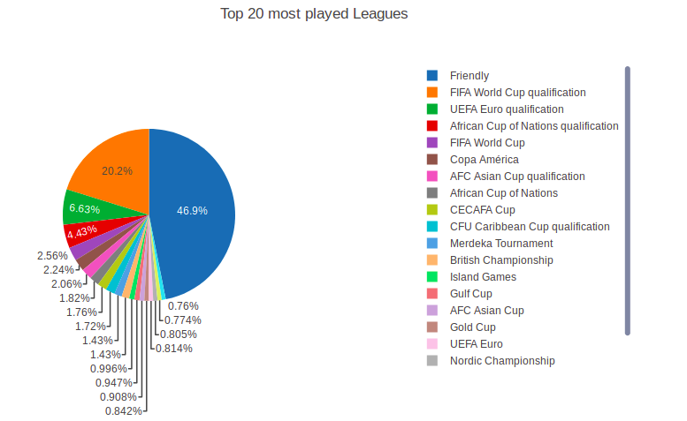
Most played leagues :-

Slide 12
World wide soccer adoption :-
Motivation
To analyze when did soccer start to be widely played, i.e. when do most nations start playing international games.
Visualize
Line chart is plotted to visualize the number of teams that has adopted football game over time.
Knowledge discovery
The number of teams steadily increased 1902 and this increase accelerated up to 1920.
From there, the pace of addition of new teams increase much faster and stalls a bit around the late 40's
Then we see a steady and rapid growth up to the mid 1990's.

Slide 13
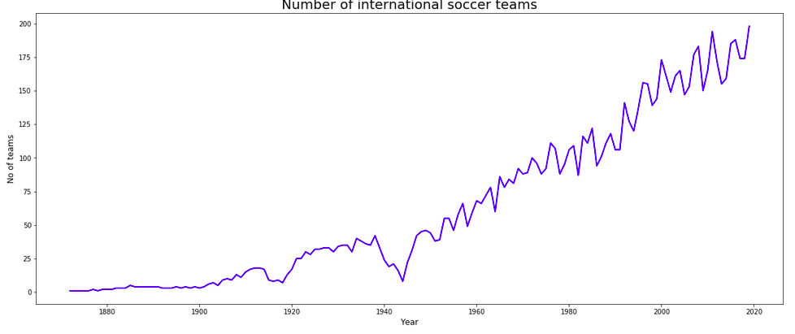
World wide soccer adoption :-

Slide 14
Evolution of goals scored :-
Motivation
To analyze the heart of soccer: goals. How did this evolve with time?
Visualize
To visualize this heat map is plotted to view the evolution of number of goals over month and years.
Knowledge discovery
Although it started low then number of goals per games quickly skyrocketed.
The first games mostly occur during Spring months and since then, some month have known some peaks of popularity for intenational games at different period (e.g. many games happened in December in the 1940s)
Before 1900, the average number of goals per game per year were around 8. This average then stabilized around 4 until 1950 and then decreased down to 2.5 in a more modern era.

Slide 15
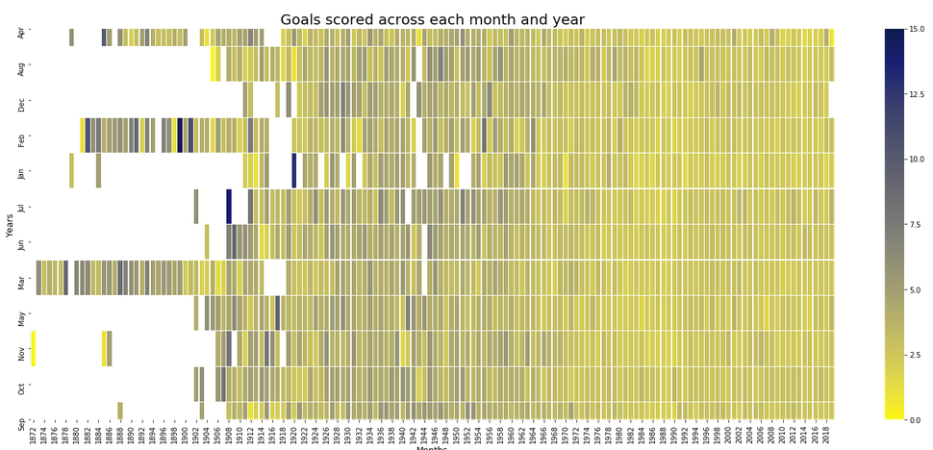
Evolution of goals scored :-

Slide 16
Total & Home goals scored by countries :-
Motivation
To analyze the countries with highest total number of goals and home goals scored over time.
Visualize
To visualize this stacked bar chart is plotted to view the top 30 countries with most total and home goals scored by each country.

Slide 17
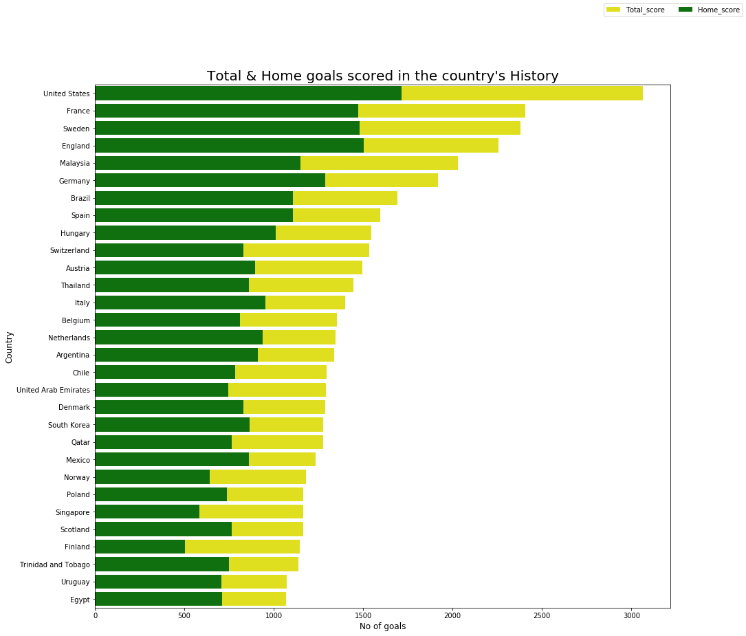
Total & Home goals scored by countries :-

Slide 18
Number of matches played by countries :-
Motivation
To analyze the countries that has played most number of matches along with home matches and away matches.
Visualize
To visualize this scatter lines binded with cufflinks modules in python is used.
Knowledge discovery
Europe was the first continent to provide many soccer teams, followed by the American continent (North and South) which shows European teams have most number of matches played followed by American teams.

Slide 19
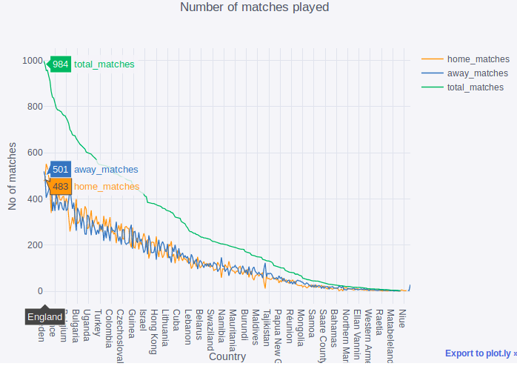

Number of matches played by countries :-

Slide 20
Win prediction based on history of victories :-
Motivation
To predict the results of the game played among different countries based on the historical victory ratios of each country team.
Visualize
To visualize this layer wise node link diagram is used.
Data calculation
Based on the victory ratio calculated based on home wins and away wins, top 16 countries are selected.
Further, based on the victory ratios of these 16 countries the results of each round is predicted.

Slide 21
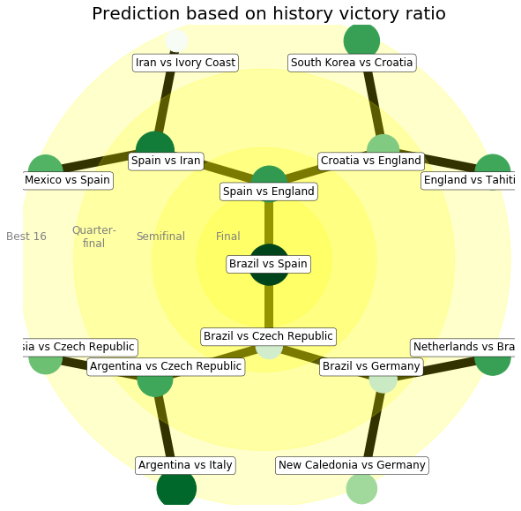
Win prediction based on history of victories :-

Slide 22
Predicting winning rate/losing rate :-
Motivation
To guess how probably a team wins/loses if it is home team or away team or irrespective of both.
Data Calculation
Firstly, we exploit python and its main libraries to extract from the dataset
Calculate the result of teams based on home score and away score if it (#wins, #draws, #losses). Now aggregate based on home teams/away team, then get win count and loss count and divide it by total count to get percentage.

Slide 23
Predicting winning rate/losing rate :-
Visualize
We plot choropleth map in plotly and giving color scale based on percentages.
The winning rate/losing rate based on home teams, away teams or all teams can be plotted based on user selection.
Knowledge Discovery
England which is the country who has created the football game, has played more games than Brasil. For this reason, the Brazilian victory rate is higher than the English one
Finally, with 625 victories over 997 games, we can declare Brazil the champion above any others. On the other hand, Liechtenstein with 154 losses over 194 games played is the worst National football team in history in terms of results.

Slide 24
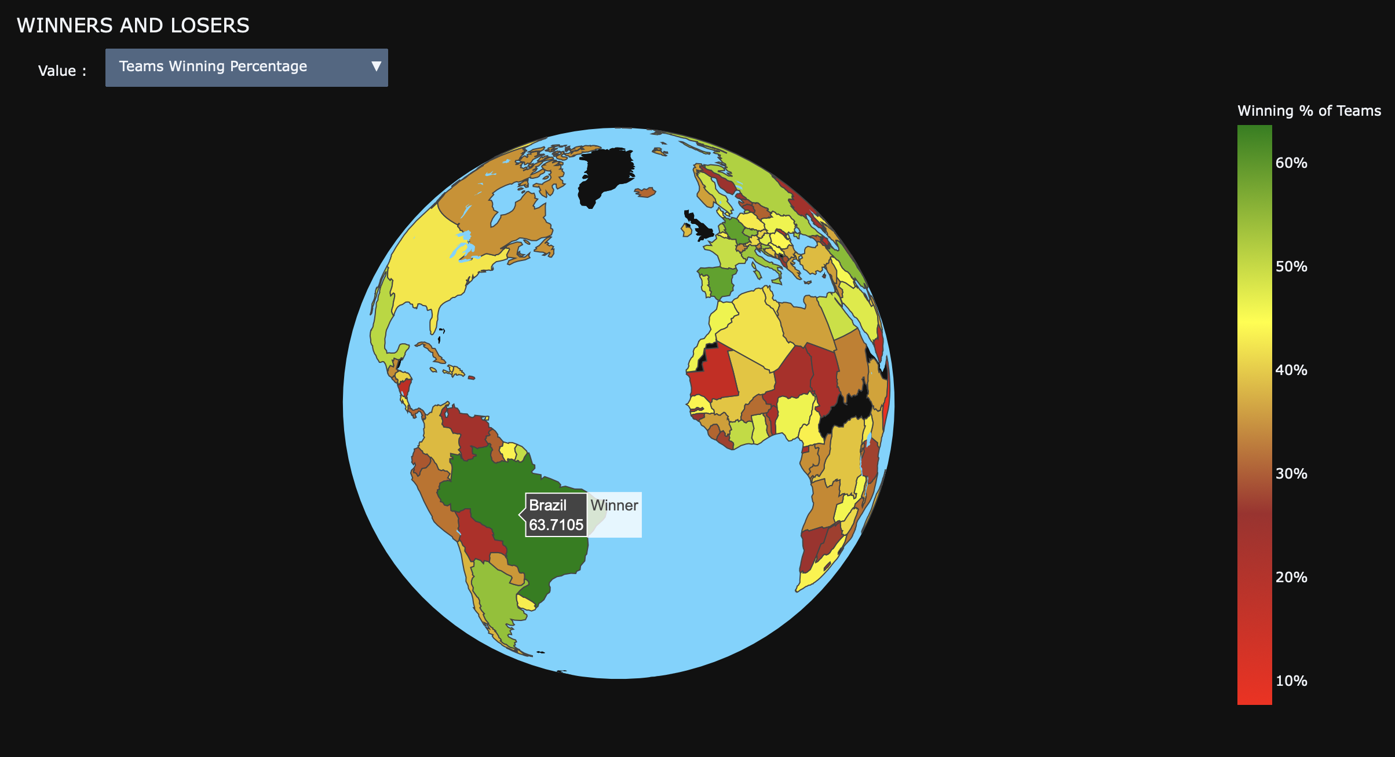
Predicting winning rate/losing rate :-

Slide 25
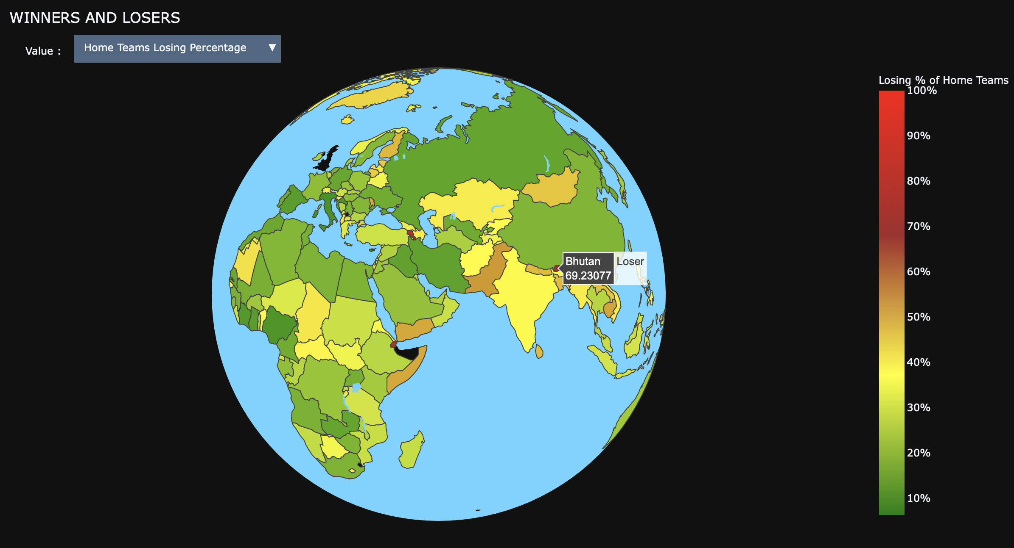
Predicting winning rate/losing rate :-

Slide 26
Favorability of teams :-
Motivation
When a team want to know about it rival team-based previous histories of matches of the rival team with other teams, and it’s favorability of winning the match with the teams.
Data Analysis
The dataset contains 39672 matches played by 294 different teams. They are aggregated to obtain favorability(#wins, #draws, #losses) for all team pairs in the dataset.
There are 6500 unique pairs in the dataset. Given that there are choose(294, 2) = 43071 possible pairs, this means that only 15.09% of possible matches actually took place.
Here the order of pair is not concerned and the aggregation performed is irrespective of order.

Slide 27
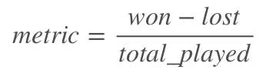
Favorability of teams :-
Favorability Metric Calculation
The metric ranges from -1 (all games lost against given rival) to 1 (all games won). In case of even balance it equals to 0.
Visualization
We visualize the favorability of country using choropleth map, where a range of between 1,0,-1 are plotted using a color scale of green, white and red respectively. If there is no match with that country team it is colored black.

Slide 28
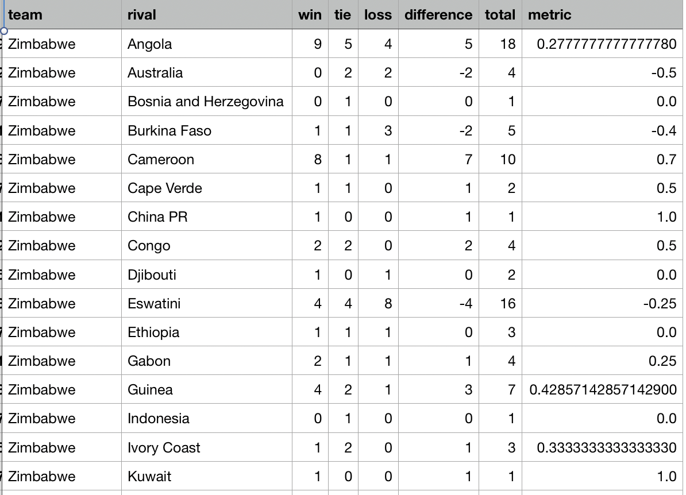
Favorability of teams :-
Data Table

Slide 29
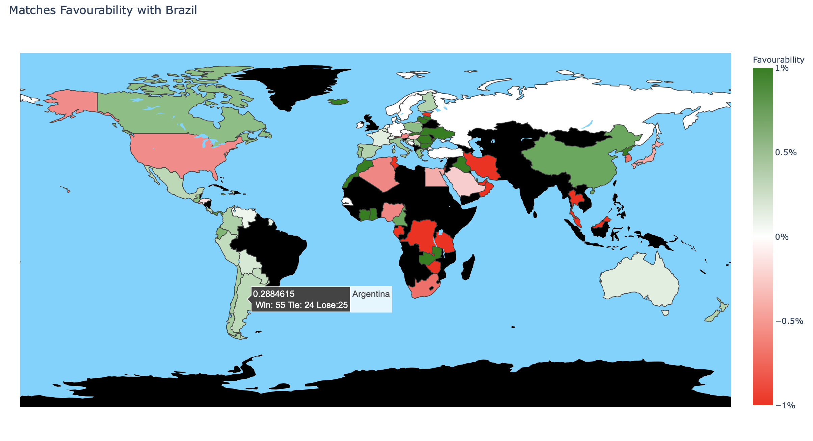
Favorability of teams :-

Slide 30

Thank You!

