Slide 1
Human Computer Interaction
Chapter One: Introduction to HCI
Human Computer Interaction
Chapter one: Introduction
DMU School of computing
Department of Software Engineering
Haymanot F.
January 2014 E.C.

Slide 2
Contents
What is HCI?
Why we Study HCI?
    Disasters Caused by Poorly Designed User Interfaces
What fields does HCI cover?
Historical root
Key concepts for user centred design

Slide 3
What is HCI?
Interacting with technology has become an essential part of everyday life for the majority of people.
People are busy and may spend little or no time actually learning a new system.
Therefore, computer systems should be easy to use, easy to learn, and with no errors.
To design and develop of such a system is a major concern of HCI
HCI is the study of interaction between people (users) and computers

Slide 4
CON…
HCI consists of three parts:
  Human: could be an individual user or a group of users.
  Computer: could be any technology ranging from the general desktop computer to a large scale computer system.
  Interaction: any direct or indirect communication between a human and computer.

Slide 5
CON…
Also called
    Man-machine-interaction (MMI)
    Computer-human-interaction (CHI)
  HCI is
    Not primarily the study of Human
    Not primarily the study of Computer
    The study of bridge between them.
The knowledge gained from this study/discipline is used to create information systems and work environments which help
    To make people more productive and
    More satisfied with their work life.

Slide 6
Con…
HCI concerns:
    design, implementation and evaluation on
      interactive computing systems for human use. And
      the study of major phenomena surrounding them
HCI Analysis the involved interactions e.g.
      Are all the steps involved are necessary
Human consequences after interacting with computers, e.g.,
      Can the user perform his task correctly?
      Does he enjoy working with the computer?

Slide 7
Why we study HCI
The goals of HCI are to produce usable and safe systems, as well as functional systems.
Computers have to be designed in such a way that they are ‘user friendly’ (should have an ‘easy to use’ interfaces)
In the past, computers were expensive & used by technical people only
Now, computers are cheap and used by non-technical people (different backgrounds, needs, knowledge, skills)
HCI is not about making the interface look pretty
  Must be easy to use/user friendlily
  support the tasks the people actually want to do

Slide 8
Con…
User friendliness can affect:
  Effectiveness
  Productivity
  Morale
  Safety
A system may be thrown away because of bad user interface.
    people no longer willing to accept products with poor interfaces
So generally the HCI goals is to enhance the quality of the interaction between people and computers.

Slide 9
CON…
HCI enable us to design interactive products to support people in their everyday and working lives.
Used to develop usable product(easy to learn, effective to use)
In order to fulfill that, developers must attempt to:
  Understand how people use technology
  Building suitable systems
  Achieve efficient, effective, and safe interaction
  Put people first: People needs, capabilities and preferences should come first.

Slide 10
  HCI Goals
Ensuring usability.
“A usable software system is one that supports the effective and efficient completion of tasks in a given work context” (Karat and Dayton 1995).
The bottom-line benefits of more usable software system to business users include:
  Increased productivity
  Decreased user training time and cost
  Decreased user errors
  Increased accuracy of data input and data interpretation
  Decreased need for ongoing technical support
So among the HCI goals, one is to enhance the quality of the interaction between people and computers.

Slide 11
Con…
Allow users to carry out tasks
  Safely
  Effectively and efficiently
  Enjoyably
Specifically, HCI has interests in:
  Methodologies and processes for designing interfaces
  Methods for implementing interfaces
  Techniques for evaluating and comparing interfaces
  Developing new interfaces and interaction techniques

Slide 12
  Disasters Caused by Poorly Designed User Interfaces…
The Herald of Free Enterprise
  What happened? a ferry between Belgium and England sunk
  Reason: open door-forgot to close the door that allows cars to board the ferry because it had no any kind of indicator that the door or is open.
  Damage: 193 passengers and crew died
Air Inter Flight 148
  What happened? crashed while approaching an airport in Strasbourg
  Reason: Display Screen Was Too Small - It was approaching a mountain and the pilots intended the plane to descend toward the airport at an angle of 3.3 degrees but “-3.3” enterer which is 3,300 feet
  Damage: 82 passengers & 5 crew members died

Slide 13
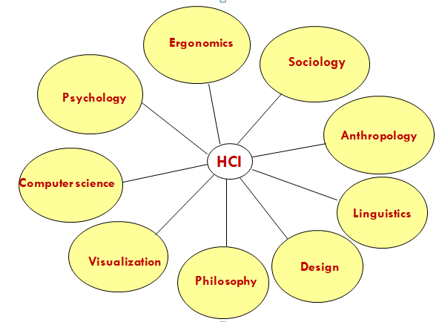
What fields does HCI cover?

Slide 14
What fields does HCI cover?
  Computer science: is concerned with the application design and engineering of the human interfaces
  Psychology: is concerned with the cognitive processes of humans and the behavior of users.
  - Cognitive: mental process of knowing, reasoning …
  Ergonomics: Study of how equipment and things can be arranged and designed in order to people can use in more efficient and safe way
  The Goal of ergonomics is to ‘fit the job to the person,’ rather than making the person fit the job.” Ergotech

Slide 15
Con…
  Sociology and Anthropology
    Sociology – study of human society at a given period of time
    Anthropology – study of human beings and their ancestors in terms social relations and culture
    Both contribute observational techniques that help HCI analyst understand the user/ operation culture
  Linguistics
    is concerned with the study of human speech including its structure and modification of language.

Slide 16
Historical root of HCI
Human-computer interaction (HCI) is an area of research and practice that emerged in the early 1980s, initially as a specialty area in computer science and human factors engineering.
Humans interact with computers in many ways
  GUI, Voice user interface(VUI), Gesture
New computing technologies arrive, creating a new perception of the human-computer relationship.
Understanding HCI history is largely about understanding a series of paradigm shifts
We can trace some of these shifts in the history of interactive technologies.
The current technologies were the product of previous HCI concept.

Slide 17
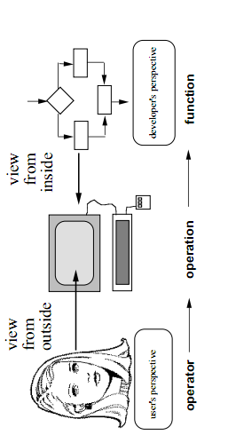
Con…

Slide 18
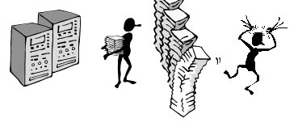
Con…
The initial paradigm
    Batch processing
  Computer had one task, performed sequentially
  No “interaction” between computer operator and computer after starting the run
  Punch cards, tapes for input
  Serial operation
  Called Impersonal computing

Slide 19
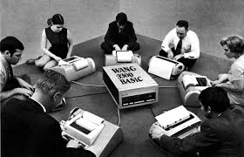
Con…
Example Paradigm Shifts…
    Batch processing
    Time-sharing: single computer supports multiple users.
    Interactive computing

Slide 20
Con..
Example Paradigm Shifts…
  Batch processing
  Timesharing
    Networking: Many computers interconnected to share resources.
    networked computing devices pass data to each other along network links
Called Community computing

Slide 21
Con…
Example Paradigm Shifts…
  Batch processing
  Timesharing
  Networking
  Graphical display: Monitor, mouse, ……
  Microprocessor: CPU incorporated in a single IC
  WWW: HTTP,HTML,….

Slide 22
discussion
What about you ?
Have you noticed such bad or good designs in your
surrounding ?

Slide 23
Con…
Design problems on some mobile devices
    Space Vs Number of keys: More keys lay on small surface;
    Keys/buttons are very congested. Thus proper usage on each keys is so difficult →This generate type error and limit writing speed.
    Key Vs its function: This can be acceptable, however
    there is lack of consistency among these available devices.
    Even some are completely differ from the usual or common
    devices

Slide 24
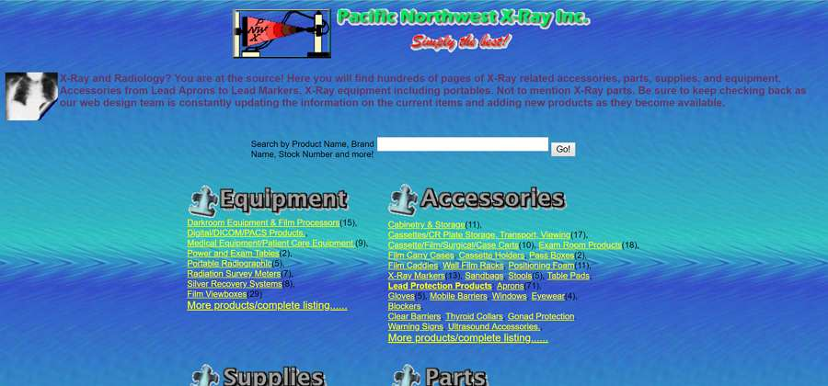
Bad user interface design

Slide 25
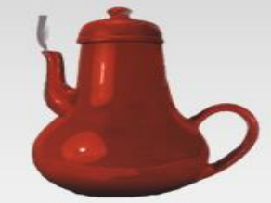
Kitchen Appliance: “Funny Mistake”
Poor handling

Slide 26
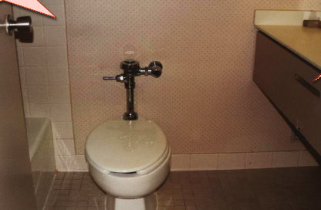
Toilet Paper: In a luxuries hotel, having sat down and done the business then you lost where the toilet paper.
Toilet Paper

Slide 27
Key Concepts for user centred design
Donald Norman in his book (The design of everyday things) introduces six key concepts for User centred Design:
  1. Affordances
  2. Constraints
  3. Mappings
  4. Conceptual models
  5. Visibility
  6. Feedback

Slide 28
Affordance
Things by their shape and other attributes should suggest what you can do to them
Their shape should say something
Like shape of the things should give a clue to the user on how to use it or on the operations of things just by looking
Example
  a mouse button invites scrolling
  a cap handle affords grasping(take hold)
  Door handle affords for pulling or pushing

Slide 29
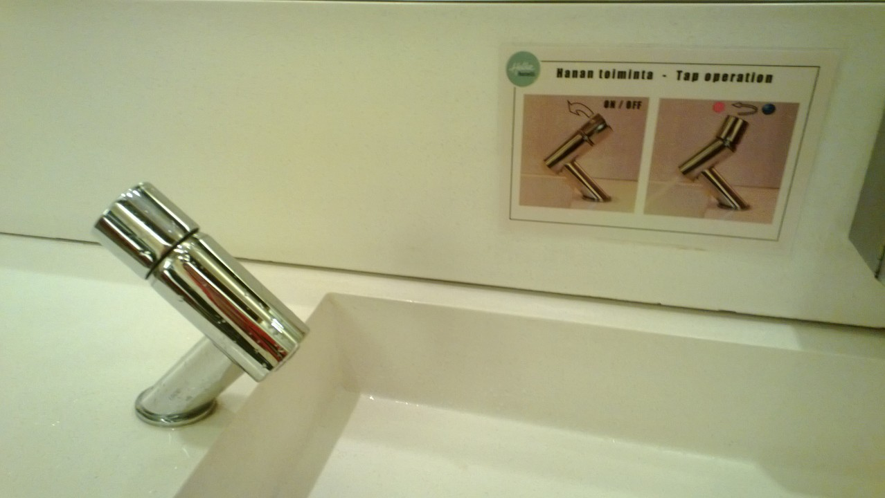
Con...
A faucet with bad affordance
Invites you to rotate the knob, but no water comes out if you do so

Slide 30
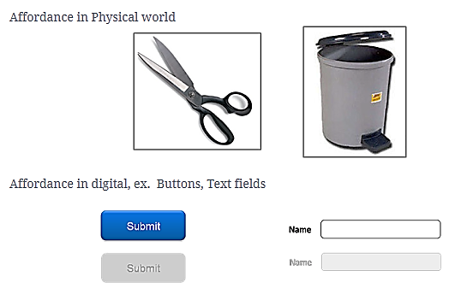

Slide 31
Con…
Affordances are not fundamental, but depend on the background and culture of users
Complex things may required explanation, but simple things should not need Picture, Label or instruction
When simple things need pictures, labels, or instructions, the design has failed

Slide 32
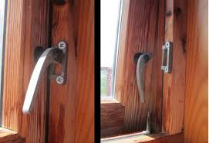
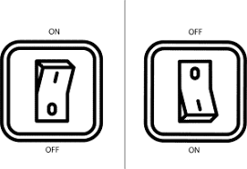
Affordance example

Slide 33
Constraints
Are restrictions that protects the system from entering into an invalid state
Prevent invalid data from being entered and prevent invalid actions from being performed
Its directly related to the number of possibilities
Constraints can take many forms
  Word processors disable the “Copy” and “Cut” commands when no text is currently selected

Slide 34
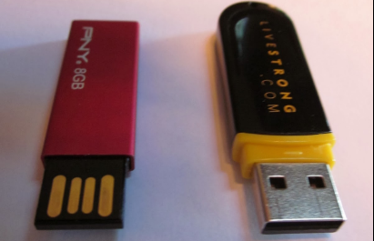
Con…
Outer cover that serves as a constraints prohibiting one from inserting in a wrong way is added
The left one is cool but it lacks constraint
  It can be inserted either direction. May not work

Slide 35
Mapping
Mappings are the relationships between controls and their effects on a system
It is the relationship of mental model that we have in our head to items we encounter in the world.
Example 1.
  Turning steering wheel clockwise should turn the car to the right
  Rotating volume control clockwise should increase volume

Slide 36
Conceptual model
A conceptual model is a mental model of how something works, which is formed inside a person’s brain
Conceptual model built up in a user is influenced by numerous factors, including:
  familiarity with similar devices interacting with the device affordances, mapping, constraints, instructions
Conceptual models may be wrong, particularly if the above factors are misleading

Slide 37
visibility
Controls should have placed in a visible place in our design
For tasks that involve a series of steps, having clearly-marked controls in a visible location can help the user figure out what to do next
Helps users to form correct mental models
And Important elements should be able to tell at a glance (quick look) what they can and cannot do

Slide 38
Feedback
Feedback from a system provides information about the effect of users’ action
It sends back to the user information about
  What action has actually been done
  What results has been accomplished
If you press a button and nothing seems to happen, it’s wondering.

Slide 39
Con…
You can’t know whether the button is working properly or whether there is a delay between the button press and the expected action?
The principle of feedback suggests that you should give users confirmation that an action has been performed successfully (or unsuccessfully).
Example: confirmation message in a pop-up dialog sending an e-mail.
E.g. When a button is pushed, a tone is fed back to the user and tells that the button had been properly pushed

Slide 40
summery
HCI is about
Understanding the users
Understanding users tasks
Understanding the surrounding environment
Requirements gathering and analysis
Design prototype
Evaluate the system
Advantage of HCI
Can Preventing accidents(make safe design)
reduce the cost of customer training and support

Slide 41
Thank you!
Question?

