Slide 1
Chapter Four: Design Rules and User Support
2014 E.C.

Slide 2
Contents
Design rules
  Principles
  Standards
  Guidelines
HCI design patterns
User support

Slide 3
Design rules
Designing for maximum usability is the goal of interactive systems design.
Design rules
  Are rules a designer should follow in order to increase the usability of the eventual software product
  Provide designers with the ability to determine the usability of their design decisions.

Slide 4
Design Rules…
Three types of design rules
  Principles - Collections of statements that advice the designer on how to proceed (e.g., “know the user”). Abstract(rekik) design rules.
  Standards - Are specific design rules and measurable with limited application e.g. ISO 9241
  Guidelines - Collections of tests that can be applied to an interface to determine if it is satisfactory
  Advice on how to achieve principle
  e.g., provide an average response time of less than 1sec.

Slide 5
Principles
Principles tend to be very general and would apply pretty much across different technologies and systems.
Three main categories of principles
  Learnability: The ease(simplicity) with which new users can begin effective interaction and achieve maximal performance
  Flexibility: The multiplicity of ways the user and system exchange information
  Robustness /strength : The level of the system to cope(control) up with different conditions during execution for successful achievement and assessment of goals.
        ability of system to remain functioning under disturbances

Slide 6
Principles affecting Learnability
A. Predictability
  Determining effect of future actions based on past interaction history
  i.e. The user’s ability to determine the effect of future interactions
  Assumes that the user has some mental model of how the system behaves
  Examples : 0, 3, 6, …. next number?
B. Familiarity: How pervious knowledge applies to new system e.g. Guessability, affordance
C. Consistency: e.g. consistency in command naming and other functionalities

Slide 7
Principles affecting Flexibility
A. Multithreading
    Ability of system to support user interaction for more than one task at a time or Concurrent tasks
B. Substitutivity
  Allowing equivalent values of input and output to be substituted for each other
  E.g. Enter an input for length in meter(1m, 1 meter, 1) or (100cm, 100centimeter, 100)
C. Customizability
  Modifiability of the user interface by user or system

Slide 8
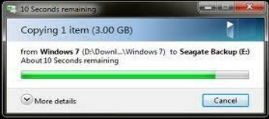

Principles affecting Robustness
A. Observability
  Ability of user to evaluate the internal state of the system from its perceivable representation
B. Recoverability
  Ability of user to take corrective action once an error has been recognized
  forward/backward recovery.

Slide 9
Principles affecting Robustness …
C. Responsiveness
  Measures the rate of communication between the system and the user.
    Response time - duration of time needed by the system to express state changes to the user.
D. Task conformance
  Degree to which system services support all of the tasks the user wishes to perform
    task completeness - the coverage issue

Slide 10
Standards
HCI standards are more suitable for hardware than software (more common)
Set by national or International bodies to ensure fulfilment with a set of design rules by a large community standards
e.g. ISO, International Telecommunication Union(ITU), Institute of Electrical and Electronics Engineers(IEEE)
International Organization for Standardization (ISO) is a nongovernmental organization that comprises standards bodies from more than 160 countries ,
  With one standards body representing each member country.
  For example, the American National Standards Institute(ANSI) represents the United States
ISO 9241 defines usability as
  Effectiveness - accuracy and completeness
  Efficiency - the resources (time, memory) expended
  Satisfaction - comfort and acceptability

Slide 11
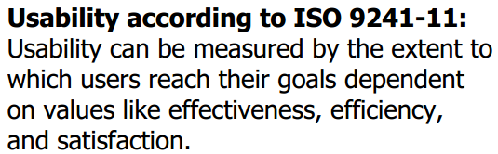
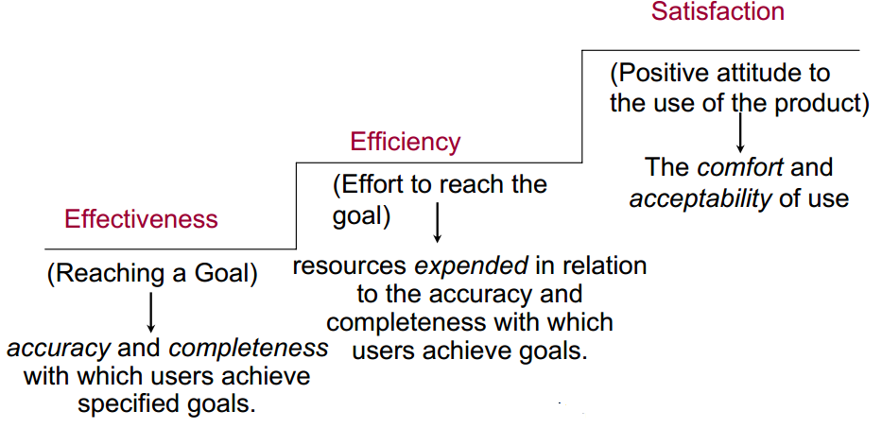
Standards

Slide 12
Guidelines
  Guidelines tend to be more specific to a device or system and general in application.
More suggestive and general
Many textbooks and reports full of guidelines
Applicable during early and later life cycle activities
Example
  Shneiderman’s 8 Golden Rules
  Norman’s 7 Principles
  Nielsen's Ten Heuristic Principles [Reading Assignment]

Slide 13
Shneiderman’s 8 Golden Rules
1. Strive for consistency: lay-out, terminologies, command usage, etc.
2. Enable frequent users to use shortcuts: recognize the requirements of diverse users and technology. For instance add features for beginner e.g. shortcuts
3. Offer(give) informative feedback: for every user action, offer relevant feedback and information . (e.g. Fill in form → submit → Confirmation)
4. Design dialogs to yield closure:

Slide 14
Cont…
5. Offer error prevention and simple error handling
  prevention and (clear and informative guidance to) recovery; error management
6. Permit(permission) easy reversal of actions: to relieve anxiety and encourage exploration, because the user knows s/he can always go back to previous states
7. Support internal locus of control: make the user feel that she/he is in control of the system, which responds to his/her instructions/commands.
8.Reduce short-term memory load: make menus and UI elements/items visible, easily available/retrievable.

Slide 15
Norman’s 7 Principles
1. Use both knowledge in the world and knowledge in the head.
  The systems should provide the necessary knowledge within the environment
  And their operation should be transparent to support the user in building an appropriate mental model of what is going on.
2. Simplify the structure of tasks.
3. Make things visible
4. Get the mappings right - intentions to controls & actions to event
5. Exploit the power of constraints
6. Design for error: Design recovery for the system
7. When all else fails, standardize. If there are no natural mappings then arbitrary mappings should be standardized

Slide 16
Guidelines for general interaction
Be consistent.
Offer significant feedback.
Ask for authentication of any non-trivial critical action.
Authorize easy reversal of most actions.
Excuse mistakes.
Classify activities by function and establish screen geography accordingly.
Deliver help services that are context sensitive.
Use simple action verbs or short verb phrases to name commands
Reduce the number of input actions required of the user.
Interaction should be flexible.

Slide 17
HCI design patterns
One way to approach design is to learn from examples that have proven to be successful in the past:
  So to reuse the knowledge of what made a system - or paradigm - successful.
Patterns: are an approach to capturing and reusing this knowledge - of abstracting the essential details of successful design so that these can be applied again and again in new situations.
It is approach of reusing knowledge about successful design solutions

Slide 18
Cont…
Reasons to use design patterns
  Teaching beginners some best practices and common approaches
  Reducing time and costs in the design and development lifecycle
  Making more usable designs
  Eliminate wasted time spent for reinventing.
  Ensuring users have a consistent and predictable experience within an application or service

Slide 19
Characteristics of Patterns
Capture design practice not theory
Capture the essential common properties of good examples of design
Represent design knowledge at varying levels: social, organisational, conceptual, detailed
Are sensitive , readable and can be used for communication between all stakeholders

Slide 20
User support
There is often an implicit assumption properly designed interactive system can be used by anybody with little or no help or training, but it is far from true.
So, designing help into an interactive system is important
Types of user support:
  Quick reference, Task specific help, Full explanation, Tutorial
Each type may be on-line and off-line (documentation)
User Supportd are provided by help and documentation
  Help - (problem-oriented) and
      Command assistance: User requests help on particular command. E.g. DOS help
  Documentation - (system-oriented )
        On-line documentation: Paper documentation is made available on computer.

Slide 21
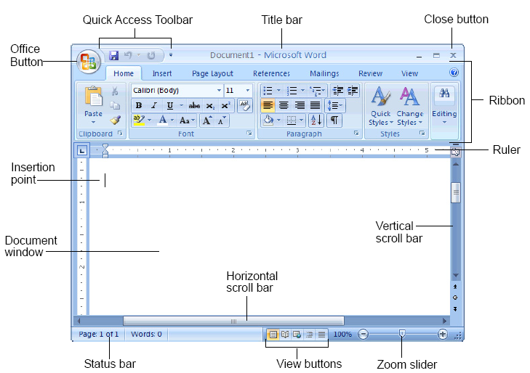
Quick Reference
Quick reference is used primarily as a reminder to the user of the details of tools
It is basically familiar with and has used before.
It may be used to find a particular command option, or to remind the user of the syntax of the command.
Example: Word 2007 Screen

Slide 22
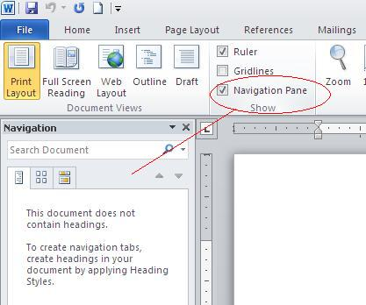
Task Specific Help
Task specific help is required when the user has encountered a problem in performing a particular task
or when he is uncertain how to apply the tool to his particular problem.
The help that is offered is directly related to what is being done.

Slide 23
Full Explanation
The more experienced or interested user may require a full explanation of a tool or command to enable him to understand it more fully.
This explanation will almost certainly include information that the user does not need at that time.
Tutorial
This is particularly aimed at new users of a tool and provides step-by-step instruction
Perhaps it give support by working examples of how to use the tool.

Slide 24
Requirements for user support
Availability
  The user needs to be able to access help at any time during his interaction with the system
  Continuous access concurrent to main application
Accuracy and completeness
  Help matches and covers actual system behaviour
  It may seem obvious to state that the assistance provided should be accurate and complete
Consistency
  The help provided by each of these must be consistent with all the others and within itself
  It should be consistent in terms of content, terminology and style of presentation
  Online help should also be consistent with paper documentation
Robustness
  It is important that the help system itself should be robust, both by correct error handling and predictable behavior
Flexibility
  Allows user to interact in a way appropriate to experience and task

Slide 25
Designing User Support
User support is not an ‘add on’ - it should be designed integrally with system.
Should concentrate on content and context of help rather than technological issues
Effective presentation requires
  Clear, familiar, consistent language
  Instructional rather than descriptive language
  Avoidance of blocks of text
  Clear indication of summary and example information
There are implementation & presentation issues

Slide 26
Designing User Support…
Presentation Issues
How is help requested?
  Command
  Button
  Function (on/off)
  Separate application
How is help displayed?
  New window, whole screen, split screen,
  Pop-up boxes, hint icons
Implementation Issues
What resources are available
  Screen space
  Memory capacity
  Speed
Structure of help data
  Single file
  File hierarchy
  Database

Slide 27
Thanks…

