Slide 1
Chapter - Five
Universal Design and Evaluation Techniques

Slide 2
Contents
Universal design
Universal Design Principles
What is evaluation
Goals of evaluation
Evaluation Techniques

Slide 3
Universal design
People have different
  Abilities and weaknesses; they come from different backgrounds and cultures;
  Interests, viewpoints and experiences; they are different ages and sizes.
All of these things have an impact on
  The way in which an individual will use a particular computing application and,
  Whether or not they can use it at all.
Universal design is the process of designing products so that they can be used by as many people as possible in as many situations as possible

Slide 4
Universal Design Principles
In reality, we may not be able to design everything to be accessible to everyone
  but we can work toward the aim of universal design and try to provide an equivalent experience.
The seven general principles of universal design may help us in this regard
  Equitable use
  Flexibility in use
  Simple and intuitive(asiteway) to use
  Perceptible information
  Tolerance for error
  Low physical effort
  Size and space for approach and use

Slide 5
Con…
Equitable use. The design is useful and marketable to people with diverse abilities.
  Example: A professor's website is designed so that it is accessible to everyone, including students who are blind and using text-to-speech software.
Flexibility in use. The design accommodates a wide range of individual preferences and abilities.
  Provide choice in methods of use.
  Example: A museum, visited as a field trip for a course, allows each student to choose to read or listen to a description of the contents of display cases.
Simple and intuitive use. Use of the design is easy to understand, regardless of the user's experience, knowledge, language skills, or current concentration level.
  Eliminate unnecessary complexity.
  Be consistent with user expectations and insight.
  Example: Control buttons on science equipment are labeled with text and symbols that are simple and intuitive to understand.
Perceptible information. The design communicates necessary information effectively to the user, regardless of ambient(akababiawi) conditions or the user's sensory abilities.

Slide 6
Con…
Example: A video presentation projected in a course includes captions.
Tolerance for error. The design minimizes hazards and the adverse consequences of accidental or unintended actions. Example: Educational software provides guidance and background information when the student makes an inappropriate response.
Low physical effort. The design can be used efficiently, comfortably, and with a minimum of fatigue(tierd). Example: Doors to a lecture hall open automatically for people with a wide variety of physical characteristics.
Size and space for approach and use. Appropriate size and space is provided for approach, reach, manipulation, and use regardless of the user's body size, posture, or mobility.
Example: A flexible science lab work area has adequate workspace for students who are left- or right-handed and for those who need to work from a standing or seated position.

Slide 7
Evaluation
Designers
  Assume that if they and their colleagues can use the software and find it attractive, others will too.
  Prefer to avoid doing evaluation because it adds development time and costs money.
So why is evaluation important?
  To be designers sure that their software is usable and is what users want.
  It saves effort that would be spent fixing problems that are discovered after the systems have been shipped to customers
Evaluation involves users directly and indirectly to understand their needs and psychology

Slide 8
Con…
Evaluation
  Tests usability and functionality of system
  Occurs in laboratory, field and/or in collaboration with users
  Evaluates both design and implementation
  Should be considered at all stages in the design life cycle
    Design proceeds through iterative cycles of ‘design-test-redesign’
  Is a key ingredient for a successful design.
Notes:
Furthermore, developing systems in this way usually turns out to be
less expensive (Karat, 1993). Studies also suggest that the business case for
using systems with good usability is compelling (Dumas and Redish, 1999; Mayhew,
1999): thousands of dollars can be saved.

Slide 9
Goals of Evaluation
Assess degree of system functionality
  Does it satisfy requirements
  system should enable users to perform their intended tasks more easily.
  Involves matching the use of the system to the user’s expectations
Assess effect of interface on user
  How easy the system is to learn, its usability, the user’s satisfaction with it
  May also include his/her enjoyment and emotional response
Identify specific problems
  Finding defects on both functionality and usability of the design

Slide 10
Evaluation Techniques
Evaluation techniques can be broadly categorized into two
  Expert analysis: number of methods have been proposed to evaluate interactive systems through expert analysis
    Cognitive Walkthrough
    Heuristic Evaluation
    Model-based evaluation
  User participation

Slide 11
Cognitive Walkthrough
Expert ‘walks through’ design to identify potential problems
Evaluates design on how well it supports user in learning task
Usually performed by expert in cognitive psychology
Using psychological principles
  Focus of the cognitive walkthrough is to establish how easy a system is to learn.
Walkthrough focuses on goals and knowledge
  Does the design lead the user to generate the correct goals?

Slide 12
Cognitive Walkthrough….
To do a walkthrough you need four things:
  A specification or prototype of the system
  A description of the task the user is to perform on the system
  A written list of the actions needed to complete the task with the proposed system
  An indication of who the users are and what kind of experience and knowledge the evaluators can assume about the users.
The evaluators step through the action sequence in step C to critique the system and tell a believable story about its usability.

Slide 13
Cognitive Walkthrough….
To do this, for each action, the evaluators try to answer the following four questions for each step in the action sequence,
Is the effect of the action the same as the user’s goal at that point?
Will users see that the action is available?
Once users have found the correct action, will they know it is the one they need?
After the action is taken, will users understand the feedback they get?

Slide 14
Heuristic Evaluation
A heuristic is a guideline or rule of thumb
  That can guide a design decision or
  That can be used to critique a decision that has already been made.
Heuristic evaluation,
  Is a method for structuring the critique of a system using a set of relatively simple and general heuristics.
  Can be performed on a design specification, prototypes, storyboards and fully functioning systems.
  It is flexible, relatively cheap approach-
  Several evaluators ( 3 to 5) independently critique a system to come up with potential usability problems
To aid the evaluators in discovering usability problems, a set of 10 heuristic (Nielsen’s ten heuristics )are provided.
Notes:
If the design itself can be evaluated, expensive mistakes
can be avoided, since the design can be altered prior to any major resource
commitments.

Slide 15
Phases of Heuristic Evaluation
Training session
  Reviewers practice detailed heuristics
Evaluation
  Each reviewer evaluates with a list of standard heuristics the interface - normally 4 iterations
  Tests the general flows of tasks and functions of the various interface elements (not strictly task-oriented)
  Observer takes notes of identified problems
  Reviewers communicate only after their iterations
Results and reviewer session
  Make list of problems (violated principles + reasons)
  Detailed descriptions of the problems

Slide 16
Phases of Heuristic Evaluation…
Problem assessment
  How serious and unavoidable is a usability problem?
  Each reviewer assesses each identified problem with respect to its severity:
    0 - don‘t agree that this is a usability problem
    1 - cosmetic problem
    2 - minor usability problem
    3 - major usability problem - important to fix
    4 - usability catastrophe; imperative (very important) to fix
  Final ranking of all problems
Advantage of heuristic Evaluation:
  Fast, cheap, qualitatively good results
Problems of heuristic Evaluation:
  Experts aren‘t real users
  Heuristics do not cover all possible problems

Slide 17
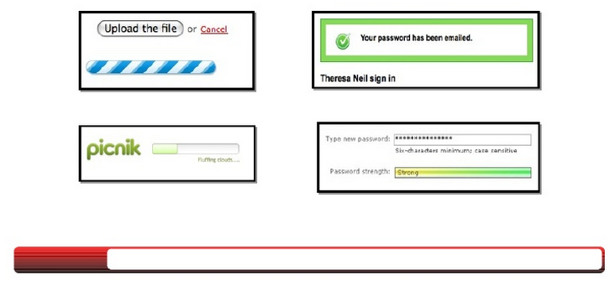
Nielsen’s ten heuristics
1. Visibility of system status
  The system should always keep users informed about what is going on through appropriate feedback within reasonable time.
Notes:
If the design itself can be evaluated, expensive mistakes
can be avoided, since the design can be altered prior to any major resource
commitments.

Slide 18
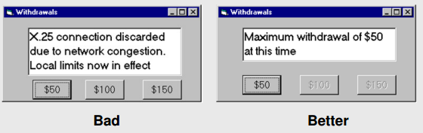
Nielsen’s ten heuristics …
2. Match Between System and Real World
  The system should speak the users' language, with words, phrases and concepts familiar to the user, rather than system-oriented terms
  Follow real-world conventions, making information appear in a natural and logical order.

Slide 19

Nielsen’s ten heuristics …
3. User Control and Freedom
  Users often choose system functions by mistake
  They will need a clearly marked "emergency exit" to leave the unwanted state without having to go through an extended dialogue
  E.g. Support undo and redo.
Clearly marks where the person is and where they can go by showing the selection in each menu

Slide 20

Nielsen’s ten heuristics …
4. Consistency and Standards
  Users should not have to wonder whether different words, situations, or actions mean the same thing
  Follow platform conventions
Use same information/controls in same location on all screens / dialog boxes
5. Error Prevention
  Make it difficult to make errors.
  Even good error messages is a careful design that prevents a problem from occurring in the first place.

Slide 21
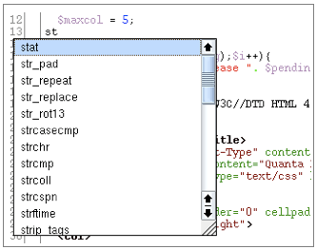
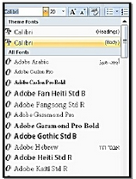
Nielsen’s ten heuristics …
6. Recognition Rather Than Recall
  Make objects, actions, and options visible - The user should not have to remember information from one part of the dialogue to another
  Instructions for use of the system should be visible or easily retrievable whenever appropriate

Slide 22
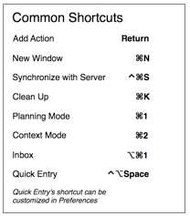
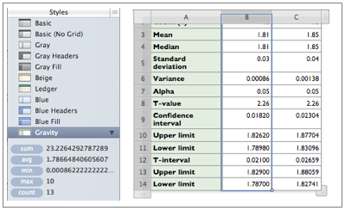
Nielsen’s ten heuristics …
7. Flexibility and Efficiency of Use
  Accelerators --unseen by the novice user -- may often speed up the interaction for the expert user such that the system can cater to both inexperienced and experienced users
  Allow users to adapt frequent actions

Slide 23
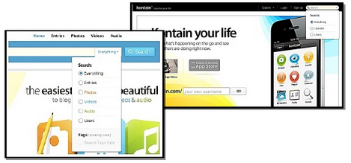
Nielsen’s ten heuristics …
8. Aesthetic (colour decorate)and Minimalist Design
  Dialogues should not contain information which is irrelevant or rarely needed
  Every extra unit of information in a dialogue competes with the relevant units of information and diminishes their relative visibility.

Slide 24
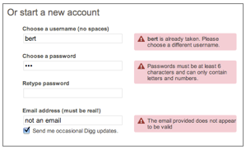
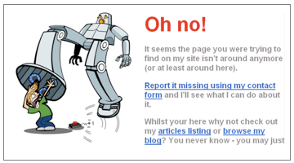
Nielsen’s ten heuristics …
9. Help Users Recognise, Diagnose and Recover from Errors
  Error messages should:
    Be expressed in plain language (no codes)
    Precisely indicate the problem
    Constructively suggest a solution

Slide 25
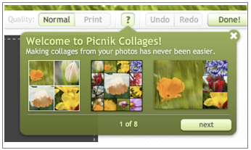
Nielsen’s ten heuristics …
10. Help and Documentation
  It is better if the system can be used without documentation
  But it may be necessary to provide help and documentation
  Any such information should:
  Be easy to search
  Be focused on the user's task
  List concrete steps to be carried out
  Not be too large

Slide 26
Model-based evaluation
Certain cognitive and design models provide a means of combining design specification and evaluation into the same framework.
  Example
    GOMS - predicts user performance
    KLM (keystroke-level model) - provide predictions of the time users will take to perform low-level physical tasks.

Slide 27
Evaluation Through User participation
There are different approaches to evaluation through user participation
  Experimental methods
  Observational methods
  Query techniques
  Physiological methods
Most of the approaches are applied at later stages of development when there is at least a working prototype of the system in place

Slide 28
1. Experimental Evaluation
Involves controlled evaluation of specific aspects of interactive behaviour
  This provides empirical evidence to support a particular claim or hypothesis
Any experiment has the same basic form
  Evaluator chooses hypothesis to be tested
  A number of experimental conditions are considered which differ only in the value of some controlled variable.
  Changes in behavioural measure are attributed to different conditions
There are a number of factors that are important to the overall reliability of the experiment in experimental design: participants, variables, and hypothesis

Slide 29
Experimental Evaluation…
Participants/Subjects
  The choice of participants is vital to the success of any experiment
    Should be chosen to match the expected user population as closely as possible in age, level of education, etc
      Testing with the actual users is highly acceptable but this is not always possible
    Choose right sample size
      Should be large enough to match the design of the experiment and the statistical methods chosen.
Variables
  Experiments manipulate and measure variables under controlled conditions, in order to test the hypothesis.
  Two types of variables: Dependant & Independent Variables

Slide 30
Experimental Evaluation
  Independent variable (IV)
    Characteristic manipulated/changed to produce different conditions
      e.g. interface style, number of menu items, level of help, …
    Each value that is used in an experiment is known as a level of the variable
      E.g. In an experiment that wants to test whether search speed improves as the number of menu items decreases may consider menus with five, seven, and ten items
    More complex experiments may have more than one independent variable
      E.g. the speed of the user’s response depends on both the number of menu items and the choice of commands used on the menu.

Slide 31
Experimental Evaluation…
  Dependent variable (DV)
    Are variables that can be measured in the experiment
    Their value is ‘dependent’ on the changes made to the independent variable, and as far as possible, unaffected by other factors
    e.g. Time taken, Number of errors
    Hypothesis
  Is a prediction of the outcome of an experiment- framed in terms of IV and DV
    e.g. “Error rate will increase as font size decreases”
  The aim of the experiment is to show that this prediction is correct
  This is done by disproving the null hypothesis,
    Null hypothesis - states that there is no difference in the dependent variable between the levels of the independent variable.
    It says that there is no statistical significance between the two variables in the hypothesis
    e.g. null hypothesis “no change with font size”

Slide 32
2. Observational Methods
Involves gathering information about actual use of a system while users interacting with it
  The evaluator watches and records the users’ actions using a variety of techniques
This method does not always give insight into their decision processes or attitude, so, users are asked to elaborate their actions by ‘thinking aloud’
Techniques e.g.
  Cooperative evaluation - user evaluates together with expert -Both can ask each other questions
  Think aloud – observing user while performing task and asking to describe
    What s/he is doing,
    What s/he is expecting to happen
    Why, what s/he thinks is happening etc.

Slide 33
3. Query Techniques
Involves asking the user about the interface directly
  E.g. Interview, Questionnaire
This methods can be used in evaluation and more widely to collect information about user requirements and tasks
Useful in eliciting detail of the user’s view of a system.
  Good to get the user’s viewpoint directly and may reveal issues that have not been considered by the designer
  Relatively simple and cheap to administer
However,
  The information gained is necessarily subjective
  Difficult to get accurate feedback about alternative designs if the user has not experienced them

Slide 34
4. Physiological methods
Drawback of most evaluation techniques is that we are reliant on
  Observation and
  The users telling us what they are doing and how they are feeling
What if we were able to measure these things directly?
  Interest grown on objective usability testing - ways of monitoring physiological aspects of computer use
Advantages
  Allow us not only to see more clearly exactly what users do when they interact with computers, but also to measure how they feel.
Eye tracking and physiological measurement are examples
Physiological measurements :- emotional response is closely tied to physiological changes. These include changes in heart rate, breathing and skin secretions

Slide 35
Thanks…

