Slide 1
CS363 - Operating System
1/1/2013
Operating System CoSc2032
/
1. Introduction
CoSc2032
Operating System
1
2
What is an Operating System?
An operating system is a program that manages the computer hardware.
It also provides a basis for application programs and acts as an intermediary between the computer user and computer hardware.
Introduction
What is an operation system?
History of Operating Systems
OS Services and OS Structure
3
4

Slide 2
What do OS Do
The computer system can be divided roughly into four components:
The hardware
The operating system
The application software
The Users

Slide 4
History of OS
The First Generation (1945 – 55)
Vaccum Tubes and Plugboards
Each machine designed, built, programmed, operated, and maintained a single group of people
Mode of operation:
Programmers signup for a block of time
Programmers insert a plugboard into the computer in the machine room
Plugboard was replaced by punched card in early 1950s

Slide 5

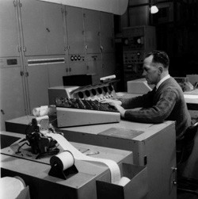


CS363 - Operating System
1/1/2013
History of OS
The Second Generation (1955 – 65)
Transistors and Batch Systems
Computers became reliable enough to be used by customers (users)
Clear separation between professions
Designers, builders, operators, programmers and maintenance personnel
History of OS
The Second Generation (1955 – 65)
Mainframe
Job
Programming (FORTRAN)
Batch System
5
6
History of OS
The Second Generation (1955 – 65)
Input Room
History of OS
The Second Generation (1955 – 65)
Input Room
Main Frame
Output Room
Main Frame
Output Room
7
8

Slide 6
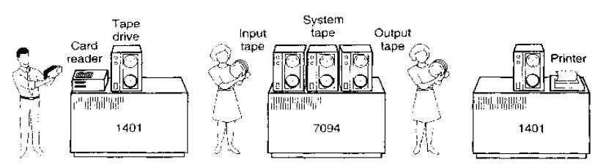
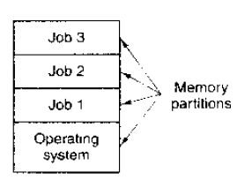

CS363 - Operating System
1/1/2013
History of OS
The Second Generation (1955 – 65)
History of OS
The Third Generation (1965 – 80)
– IC and Multi Programming
9
10
History of OS
The Third Generation (1965 – 80)
Spooling: ability of reading jobs from cards onto the disk
IBM 1401s were not needed
Much of carrying of tapes disappeared
However, 3rd generation systems were still batch system
Problems of batch system paved the way to timesharing
History of OS
The Third Generation (1965 – 80)
– Timesharing
Terminal
11
12

Slide 7


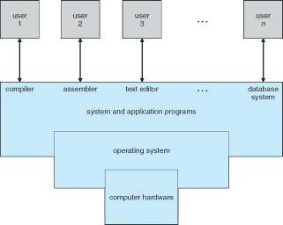
CS363 - Operating System
1/1/2013
History of OS
The Third Generation (1965 – 80)
– Timesharing
History of OS
The Fourth Generation (1980 – ???)
Personal Computers
No basic difference between Micro and Mini
Business drama
Intel’s 8080 € Digital Research’s CP/M (1977)
The deal between IBM PC and Bill Gate’s BASIC Interpreter (1980s)
Seattle Computer Products (DOS)
DOS/BASIC
Time Paterson MS-DOS retrospect
Steve Jobs followed Doug Engelbart’s GUI
Lisa € Macintosh
MS Windows influenced by Macintosh
– …
…
User 1
User 2
User N
13
14
What is an operation system?
A layer in the modern computer system that is responsible to manage several devices and provide user programs with a simpler interface to the hardware.
Extended Machine
Resource Manager
What is an operation system?
15
16

Slide 8
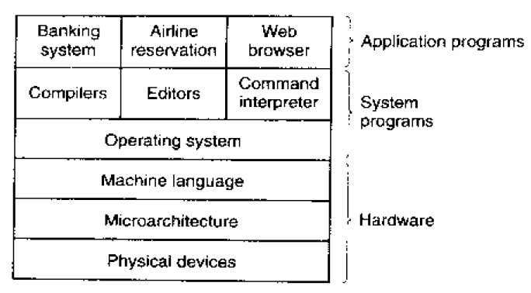
CS363 - Operating System
1/1/2013
OS Structure and Services
OS Structure and Services
Kernel Mode
Protected from user application tampering the hardware
User Mode
The mode in which applications and system programs run
Permits only a subset of the instructions to be executed and a subset of features to be accessed
Disallow I/O instruction, Memory Protection, PSW Setting
17
18
Reading Assignment
Architectures of Operating Systems
Monolithic
Layered
Kernel
Microkernel
Virtual Machines
Increasing Efficiency
Multi program
Multi User
Monolithic Architecture
Monolithic Architecture—the early operating systems
– Every component is contained in the kernel, can directly communicate with other components
19
20

Slide 9
CS363 - Operating System
1/1/2013
Monolithic Architecture
Monolithic Architecture
Pros
Highly efficient – by direct intercommunication between components
Cons
difficult to develop
difficult to isolate the source of bugs and other errors
particularly susceptible to damage from malicious code
Applications User Space
System Calls
OS Layer
Computer Hardware
HiLCoE 2012
CS363 - Operating System
21
HiLCoE 2012
CS363 - Operating System
22
Layered Architecture
Layered OS structure:
– Group components that perform similar functions into layers. Each layer communicates only with neighbour layer
User Space
Layered Architecture
Pros
It provides good modularity – helps simplify the development of an OS
Cons
Less efficient
Complex design – each functionality has to be divided into parts to fit into different layers.
Layer 3
Layer 2
Layer 1
Layer 0
Kernel Space
Computer Hardware
23
24

Slide 10
CS363 - Operating System
1/1/2013
Kernel Based Architecture
It separates the machine-independent parts from the machine-dependent parts
– Kernel is machine-dependent. It contains the basic component of OS.
User Space
Kernel Based Architecture
Pros
Better portability—Kernel encloses all the machine-dependent code
Cons
Ensuring security and extensibility is a challenge
Operating System
OS Kernel
Computer Hardware
CS363 - Operating System
25
26
Microkernel Based Architecture
As OS expanded, the kernel became large and difficult to manage
Microkernel approach removes all nonessential components from the kernel and implementing them as system and user-level programs.
Result: A smaller kernel
Microkernel Based Architecture
User Space
Operating System
Microkernel
Computer Hardware
27
28

Slide 11
CS363 - Operating System
1/1/2013
Microkernel Based Architecture
Pros
Enhance portability, extensibility, reliability and security
Cons
Less efficient—increased system function overhead
Virtual Machines
Can create the illusion that there are more than one separate machines.
User Space User Space
User Space
Kernel
Kernel
VM1 VM1
Virtual machine implementation
Host Operating System
Computer Hardware
29
30
OS Structure and Services
To obtain services from the operating system, a user program must make a system call
The interface between the operating system and the user programs is defined by the set of system calls that the operating system provides.
OS Structure and Services
OS Services
Process Management
Memory Management
File Management
I/O Management
User Management
31
32

