Slide 1
DIGITAL LOGIC CIRCUITS
Introduction
Chapter One

Slide 2
1.1 Digital Computer
Binary
  Two discrete values
    True 1 3.0 volts
    False 0 0.5 volts
  Very reliable
Hardware
  Electronic components
  Electromechanical devices
Software
  Instructions and data manipulated by hardware

Slide 3
Hardware
Central Processing Unit (CPU)
  Arithmetic and Logic unit (ALU)
  Registers – holding data
  Fetch and execute control circuits
Random Access Memory (RAM)
Input Output Processor (IOP)
  Transfer data between computer and outside world
    Input, output, and input/output (I/O) devices
RAM
CPU
Input Devices
IOP
Output Devices

Slide 4
Definitions
Computer hardware can be seen from three different points of view depending on the interest of the investigator: computer organization, computer design and computer architecture
Computer architecture (conceptual view)
  Describes major components of the computer
  User perspective of computer structure and behavior
  Architectural design deals with component specs (e.g. Processor speed, memory capacity) and combining them to build a computer
  Eg. 1. Instruction sets, addressing techniques.
  Eg. 2. Is there a multiply instruction.

Slide 5
Definitions …
Computer organization
  Describes how the computer works
  How hardware components operate and the way they are connected together to form the computer system
    Eg. 1. Control signals
    Eg.2. Is there a hardware multiply unit or is it done by repeated addition
Computer design (computer implementation)
  Describes how the computer is built
  Once the computer specifications are formulated this step is performed
  Determines which hardware should be used and how parts are connected
    E.g. Choosing the ECL (emitter-coupled logic) circuit family for supercomputers over other types such as TTL (transistor-transistor logic)

Slide 6
1.2 Logic Gates
Logic Gates
Binary
Digital
Input
Signals
Binary
Digital
Output
Signal
.
.
Gate
.
Functions of Gates can be described by
- Truth Table
- Boolean Function
- Karnaugh Map(k-Map)

Slide 7
COMBINATIONAL GATES
Logic Gates
Name Symbol Function Truth Table
A X = A • B
X or
B X = AB
A B X
AND
0 0 0
0 1 0
1 0 0
1 1 1
0 0 0
0 1 1
1 0 1
1 1 1
A
X X = A + B
B
A B X
OR
Inverter or I
A X
A X X = A’
0 1
1 0
Buffer A X X = A
A X
0 0
1 1
A B X
NAND
A
X X = (AB)’
B
0 0 1
0 1 1
1 0 1
1 1 0
A
X X = (A + B)’
B
A B X
NOR
0 0 1
0 1 0
1 0 0
1 1 0
XOR
Exclusive OR
A X = A ⊕ B
X or
B X = A’B + AB’
A B X
0 0 0
0 1 1
1 0 1
1 1 0
XNOR
A X = (A ⊕ B)’
X or
B X = A’B’+ AB
A B X
0 0 1
0 1 0
1 0 0
1 1 1
Exclusive NOR
or Equivalence

Slide 8
1.3 BOOLEAN ALGEBRA
Boolean Algebra
Boolean Algebra
* Algebra with Binary(Boolean) Variable and Logic Operations
* Boolean Algebra is useful in Analysis and Synthesis of
Digital Logic Circuits
- Input and Output signals can be
represented by Boolean Variables, and
- Function of the Digital Logic Circuits can be represented by
Logic Operations, i.e., Boolean Function(s)
- From a Boolean function, a logic diagram
can be constructed using AND, OR, and Inverter(I)
Truth Table
* The most elementary specification of the function of a Digital Logic
Circuit is the Truth Table
- It is a table that describes the Output Values for all the combinations
of the Input Values, called MINTERMS
- n input variables → 2^{n} minterms

Slide 9
LOGIC CIRCUIT DESIGN
Boolean Algebra
x y z F
0 0 0 0
0 0 1 1
0 1 0 0
0 1 1 0
1 0 0 1
1 0 1 1
1 1 0 1
1 1 1 1
Truth
Table
Boolean
Function
F = x + y’z
x
F
Logic
Diagram
y
z

Slide 10
BASIC IDENTITIES OF BOOLEAN ALGEBRA
Boolean Algebra
[1] x + 0 = x
[3] x + 1 = 1
[5] x + x = x
[7] x + x’ = 1
[9] x + y = y + x
[11] x + (y + z) = (x + y) + z
[13] x(y + z) = xy +xz
[15] (x + y)’ = x’y’
[17] (x’)’ = x
[2] x • 0 = 0
[4] x • 1 = x
[6] x • x = x
[8] x • X’ = 0
[10] xy = yx
[12] x(yz) = (xy)z
[14] x + yz = (x + y)(x + z)
[16] (xy)’ = x’ + y’
Usefulness of this Table
- Simplification of the Boolean function
- Derivation of equivalent Boolean functions
to obtain logic diagrams utilizing different logic gates
-- Ordinarily ANDs, ORs, and Inverters are used to build the circuit
-- But a certain different form of Boolean function may be convenient
to obtain with NANDs or NORs
→ Applications of De Morgans Theorem
x’y’ = (x + y)’ x’+ y’= (xy)’
I, AND → NOR I, OR → NAND
[15] and [16] : De Morgan’s Theorem

Slide 11
Gates
Two graphic symbols for NOR gate
X
Y
Z
X
Y
Z
(x+y+z)’
x’y’z’=(x+y+z)’
(a) OR- invert (b) invert-AND
Two graphic symbols for NAND gate
X
Y
Z
X
Y
Z
(xyz)’
x’+y’+z’=(xyz)’
(a) AND- invert (b) invert-OR

Slide 12
EQUIVALENT CIRCUITS
Boolean Algebra
Many different logic diagrams are possible for a given Function
F = ABC + ABC’ + A’C .......…… (1)
= AB(C + C’) + A’C [13] ..…. (2)
= AB • 1 + A’C [7]
= AB + A’C [4] ...…. (3)
A
B
C
(1)
(2)
(3)
F
A
B
C
F
A
B
C
F

Slide 13
Logic Gates > 2 Inputs
AND
  X=1 if and only if all inputs =1
OR
  X=1 if any input =1
Exclusive-OR
  X=1 if an odd number of inputs=1
NAND
  Complement of AND
NOR
  Complement of OR
Exclusive-NOR
  Complement of exclusive-OR
All gates except NAND/NOR/Exclusive-NOR can be constructed from 2 input gates by cascading. But this is not the case for NAND/NOR/Exclusive-NOR because of their definitions (i.e., NAND is always opposite of AND, NOR is always opposite of OR, & Exclusive- NOR is always opposite of XOR).

Slide 14
1.4 Map SIMPLIFICATION
Map Simplification
Truth
Table
Boolean
Function
Unique
Many different expressions exist
Simplification from Boolean function
- Finding an equivalent expression that is least expensive to implement
- For a simple function, it is possible to obtain
a simple expression for low cost implementation
- But, with complex functions, it is a very difficult task
Karnaugh Map (K-map) is a simple procedure for
simplifying Boolean expressions.
Truth
Table
Simplified
Boolean
Function
Karnaugh
Map
Boolean
function

Slide 15
KARNAUGH MAP
Map Simplification
Karnaugh Map for an n-input digital logic circuit (n-variable sum-of-products
form of Boolean Function, or Truth Table) is
- Rectangle divided into 2^{n} cells
- Each cell is associated with a Minterm
- An output(function) value for each input value associated with a
minterm is written in the cell representing the minterm
→ 1-cell, 0-cell
Each Minterm is identified by a decimal number whose binary representation
is identical to the binary interpretation of the input values of the minterm.
Minterms are arranged using reflected binary code or Gray code
(named after Frank Gray).
Generating Gray codes: Reflect-and-prefix method
Purpose is to successive values differ in one bit.
This is useful for combining adjacent squares.
Adjacent squares are squares that differ by only one variable, i.e., by the complemented and uncomplemented versions of the variable. Adjacent squares are placed horizontally or vertically not diagonally.

Slide 16
Karnaugh Map
x
0
Identification
of the cell
x
0
value
of F
x F
0 1
1 0
0
1
1
1
1
0
F(x) =
∑ (0)
1-cell
y
0 1
x y F
0 0 0
0 1 1
1 0 1
1 1 1
x
y
0 1
0
0 1
2 3
x
1
0
0 1
1
1 1
F(x,y) = ∑ (1,2,3)

Slide 17
KARNAUGH MAP
Map Simplification
x y z F
0 0 0 0
0 0 1 1
0 1 0 1
0 1 1 0
1 0 0 1
1 0 1 0
1 1 0 0
1 1 1 0
yz
y
yz
x
00 01 11 10
x
00 01 11 10
0
0 1 3 2
4 5 7 6
0
0 1 0 1
x
1
1
1 0 0 0
z
F(x,y,z) = ∑ (1,2,4)
wx
w
u v w x F
uv
00 01 11 10
0 0 0 0 0
0 0 0 1 1
0 0 1 0 0
0 0 1 1 1
0 1 0 0 0
0 1 0 1 0
0 1 1 0 1
0 1 1 1 0
1 0 0 0 1
1 0 0 1 1
1 0 1 0 0
1 0 1 1 1
1 1 0 0 0
1 1 0 1 0
1 1 1 0 1
1 1 1 1 0
00
0 1 3 2
v
01
4 5 7 6
u
11
12 13 15 14
10
8 9 11 10
x
wx
uv
00 01 11 10
00
0 1 1 0
01
0 0 0 1
11 0 0 0 1
10 1 1 1 0
F(u,v,w,x) = ∑ (1,3,6,8,9,11,14)

Slide 18
MAP SIMPLIFICATION - Rules-
Map Simplification
Insert a “1” into each square that the function generates a value of 1
Form one or more rectangles by grouping together adjacent squares containing a 1
  Number of square in each rectangle must be a power of 2
  Top and bottom squares in a column are adjacent
  Left- and right-most squares in a row are adjacent
  All four corner squares are adjacent
  Minimize number of rectangles and maximize number of adjacent squares combined
  Groups of combined adjacent squares may share one or more squares with one or more groups

Slide 19
MAP SIMPLIFICATION - Rules-
Map Simplification
F = xy’+ xy can be reduced to F = x
From the map
y
0 1
x
0
0 0
2 adjacent cells xy’ and xy
→ merge them to a larger cell x
1
1 1
F(x,y) =
∑ (2,3)
= xy’+ xy
= x

Slide 20
MAP SIMPLIFICATION - MORE THAN 2 CELLS -
Map Simplification
wx
u’v’
wx
u’x’
u’v’w’x’ + u’v’w’x + u’v’wx + u’v’wx’
= u’v’w’(x’+x) + u’v’w(x+x’)
= u’v’w’ + u’v’w
= u’v’(w’+w)
= u’v’
w
uv
w
uv
1 1 1 1
1 1 1 1
vw’
1 1
1 1
v
v
u
1 1
1 1
u
1 1
1 1
x
uw
x
v’x
u’v’w’x’+u’v’w’x+u’vw’x’+u’vw’x+uvw’x’+uvw’x+uv’w’x’+uv’w’x
= u’v’w’(x’+x) + u’vw’(x’+x) + uvw’(x’+x) + uv’w’(x’+x)
= u’(v’+v)w’ + u(v’+v)w’
= (u’+u)w’ = w’
wx
w
uv
w
uv
V’
w’
1 1
1 1 1 1
1 1
v
v
1 1
1 1
1 1
u
1 1
u
u
1 1
1 1
x
x

Slide 21
MAP SIMPLIFICATION
Map Simplification
F(u,v,w,x) = ∑ (0,1,2,9,13,15)
wx
uv
00 01 11 10
w
00
1 1 0 1
1
1
0
1
01 0 0 0 0
0
0
0
0
v
11 0 1 1 0
0
1
1
0
10 0 1 0 0
u
0
0
0
1
x
F = u’v’x’ + v’w’x + uvx

Slide 22
IMPLEMENTATION OF K-MAPS - Sum-of-Products Form -
Map Simplification
Logic function represented by a Karnaugh map
can be implemented in the form of I-AND-OR
A cell or a collection of the adjacent 1-cells can
be realized by an AND gate, with some inversion of the input variables.
y
x’
x’
1
1
y
y’
z’
x’
z’
x
1
⇒
y
x
z’
1 1
z
y
z’
z’
1
F(x,y,z) = ∑ (0,2,6)
x’
y’
x
z’
⇒
x’
F
z
F
y
z’
y
x
z
y
z’
I AND OR

Slide 23
IMPLEMENTATION OF K-MAPS - Product-of-Sums Form -
Map Simplification
Logic function represented by a Karnaugh map
can be implemented in the form of I-OR-AND
If we implement a Karnaugh map using 0-cells,
the complement of F, i.e., F’, can be obtained.
Thus, by complementing F’ using DeMorgan’s
theorem F can be obtained
F(x,y,z) = (0,2,6)
y
F’ = xy’ + z
F = (xy’)’z’
= (x’ + y)z’
1
0
0
1
z
x
0
0
0
1
x
z
y’
x
y
F
z
I OR AND

Slide 24
Alternative Implementations
NAND implementation of sum-of-products
  Eg. F(x,y,z) = (0,2,6)
x
x
⇒
z
z
F
F
y
y
z
z
I NAND NAND
I NAND NAND

Slide 25
Alternative Implementations …
NOR implementation of product-of-sums
  Eg. F(x,y,z) = (0,2,6)
x
x
y
y
F
z
F
z
I NOR NOR
I NOR NOR

Slide 26
IMPLEMENTATION OF K-MAPS
- Don’t-Care Conditions -
Map Simplification
In some logic circuits, the output responses
for some input conditions are don’t cares
i.e. they can be either 1 or 0.
In K-maps, don’t-care conditions are represented
by x’s in the corresponding cells.
Don’t-care conditions are useful in minimizing
the logic functions using K-map.
- Can be considered either 1 or 0
- Thus increases the chances of merging cells into the larger cells
→Combine 1’s and x’s to enclose the maximum number of adjacent
squares
→ Reduce the number of variables in the product terms
E.g.: F(A,B,C)=∑(0,2,6)
d(A,B,C)=∑(1,3,5)
y
x’
1 x x 1
x
x 1
z
yz’
x
F
y
z

Slide 27
1.5 COMBINATIONAL LOGIC CIRCUITS
Cluster of logic gates with some number of inputs and outputs
Output values are determined by the binary computations performed on the input values
Can be described by
  A truth table
  A Boolean function for each output

Slide 28
COMBINATIONAL LOGIC CIRCUITS
Combinational Logic Circuits
y
y
Half Adder
x y c s
x
y
0 0 0 0
0 1 0 1
1 0 0 1
1 1 1 0
0
0
0
1
c
s
x
0
1
x
1
0
c = xy s = xy’ + x’y
= x ⊕ y
Full Adder
y
x y c_{n-1} c_{n} s
y
0 0 0 0 0
0 0 1 0 1
0 1 0 0 1
0 1 1 1 0
1 0 0 0 1
1 0 1 1 0
1 1 0 1 0
1 1 1 1 1
0
0
0
1
0
1
c_{n-1}
1
0
c_{n-1}
x
1
1
x
0
1
0
1
1
0
c_{n}
s
c_{n} = xy + xc_{n-1}+ yc_{n-1}
= xy + (x ⊕ y)c_{n-1}
s = x’y’c_{n-1}+x’yc’_{n-1}+xy’c’_{n-1}+xyc_{n-1}
= x ⊕ y ⊕ c_{n-1} = (x ⊕ y) ⊕ c_{n-1}
x
y
S
c_{n}
Q. How can you construct a full adder from two half adders?
c_{n-1}

Slide 29
1.6 Flip Flops
Combinational circuits vs sequential circuits (sc)
  For combinational circuits the outputs at any given time are entirely dependent on the inputs that are present at that time.
  Sequential circuits contain storage elements
  so that the output depends on previous inputs

Slide 30
1.6 Flip Flops
Types of SC
  Synchronous (clocked synchronous circuits)
    Most common
    All storage elements of the circuit are affected at discrete instants of time
    Achieved through a timing device called clock pulse generator
    Affected (or operated) when the clock pulse is either 1 or 0

Slide 31
Flip Flops …
Asynchronous
  No clock to synchronize parts of the system
  This creates a number of problems and hence these are not widely used
SC use storage elements called flip-flops. Many types exist.
Flip-flop is binary cell that can hold the value of one bit
Two outputs
  Normal value
  Complement
Maintains state until next clock pulse
  We have many types of flip-flops

Slide 32
FLIP FLOPS …
Flip Flops
Characteristics
- 2 stable states
- Memory capability
- Operation is specified by a Characteristic Table
In order to be used in the computer circuits, the flip flop should
have input terminals and output terminals so that it can be set to a certain
state, and its state can be read externally.
R
S R Q(t+1)
0 0 Q(t) No change
0 1 0 Clear to 0
1 0 1 Set to 1
1 1 indeterminate
(forbidden)
Q
S
Q’
SR-Flip Flop (Latch) (SR- Set , Reset)

Slide 33
CLOCKED FLIP FLOPS
Flip Flops
In a large digital system with many flip flops, operations of individual flip flops
are required to be synchronized to a clock pulse. Otherwise,
the operations of the system may be unpredictable.
R
Q
c
(clock)
S
Q’
Clock pulse allows the flip flop to change state only
when there is a clock pulse appearing at the c terminal.
We call the above flip flop a Clocked RS Latch, and symbolically as
S Q
S Q
c
c
R Q’
R Q’
operates when operates when
clock is high clock is low

Slide 34
D Flip-Flop
Flip Flops
D-Latch
Forbidden input values are forced not to occur
by using an inverter between the inputs
D Q
Q
Q’
Q’
D(data)
D Q(t+1)
0 0
1 1
Its characteristic equation is Q(t+1)=D

Slide 35
D Flip-Flop …
Flip Flops
What if you want to store a 1?
After D=1→ D=0, next clock pulse causes Q(t+1)=0
Solution:
Disable clock or
Feed output of Q to D input
D Q
Q
c
Q’

Slide 36
FLIP FLOPS …
Flip Flops
JK Flip-flop
J K Q(t+1)
0 0 Q(t) No change
0 1 0 Clear to 0
1 0 1 Set to 1
1 1 Q’(t) Complement
J Q
c
k Q’
T Flip-Flop
  Apply signal to toggle (switch) from one
  state to another
  Characteristic equation is
    Q(t+1)=Q(t) XOR T
T Q(t+1)
0 Q(t) No change
1 Q’(t) Complement
J Q
T
c
k Q’

Slide 37
EDGE-TRIGGERED FLIP FLOPS
Flip Flops
Characteristics
- State transition occurs at the rising edge or
falling edge of the clock pulse
Rising edge (positive)
Falling edge (negative)
respond to the input only at this time
S Q
c
R Q’
respond to the input only at this time

Slide 38
Flip-Flop Excitation Table
Flip Flops
What input values generate a given pair of current and next values
of Q?
  Used for the design of sequential circuits.

Slide 39
SR Flip-Flop
Flip Flops
S R Q(t+1)
0 0 Q(t)
0 1 0
1 0 1
1 1 ?
Q(t) Q(t+1) S R
0 0 0 x
0 1 1 0
1 0 0 1
1 1 x 0
Characteristic
Excitation

Slide 40
D Flip-Flop
Flip Flops
D Q(t+1)
0 0
1
Q(t) Q(t+1) D
0 0 0
0 1 1
1 0 0
1 1 1
Characteristic
Excitation

Slide 41
JK Flip-Flop
Flip Flops
J K Q(t+1)
0 0 Q(t)
0 1 0
1 0 1
1 1 Q’(t)
Q(t) Q(t+1) J K
0 0 0 x
0 1 1 x
1 0 x 1
1 1 x 0
Characteristic
Excitation

Slide 42
T Flip-Flop
Flip Flops
T Q(t+1)
0 Q(t)
1 Q’(t)
Q(t) Q(t+1) T
0 0 0
0 1 1
1 0 1
1 1 0
Characteristic
Excitation

Slide 43
1.7 SEQUENTIAL CIRCUITS
Flip Flops
Flip-flops and gates connected together
Combinational circuit block
  Gates only
  Input from external sources and flip-flop output
  Output goes to external destinations and flip-flops
Flip-flops
  Input from clock and combinational circuit
  Output to external destinations and combinational circuit
Flip-flop input equations are output of combinational circuits that is fed to flip-flop inputs
Combinational circuit
Inputs
Flip-Flops
Output
Clock

Slide 44
SEQUENTIAL CIRCUIT BLOCK DIAGRAM
Flip Flops
A set of flip-flop input equations specifies a sequential circuit in algebraic form
  Equivalently, a sequential circuit is specified by: time sequence of external inputs, external outputs, and internal flip-flop states
Outputs are determined by external inputs and present state of flip-flops
State changes occur whenever clock signal arrives
State table helps in the design of sequential circuits
  It shows the state transition of flip-flops from their present states to their n-ext states given the external inputs. It also shows values for the external o-utputs

Slide 45
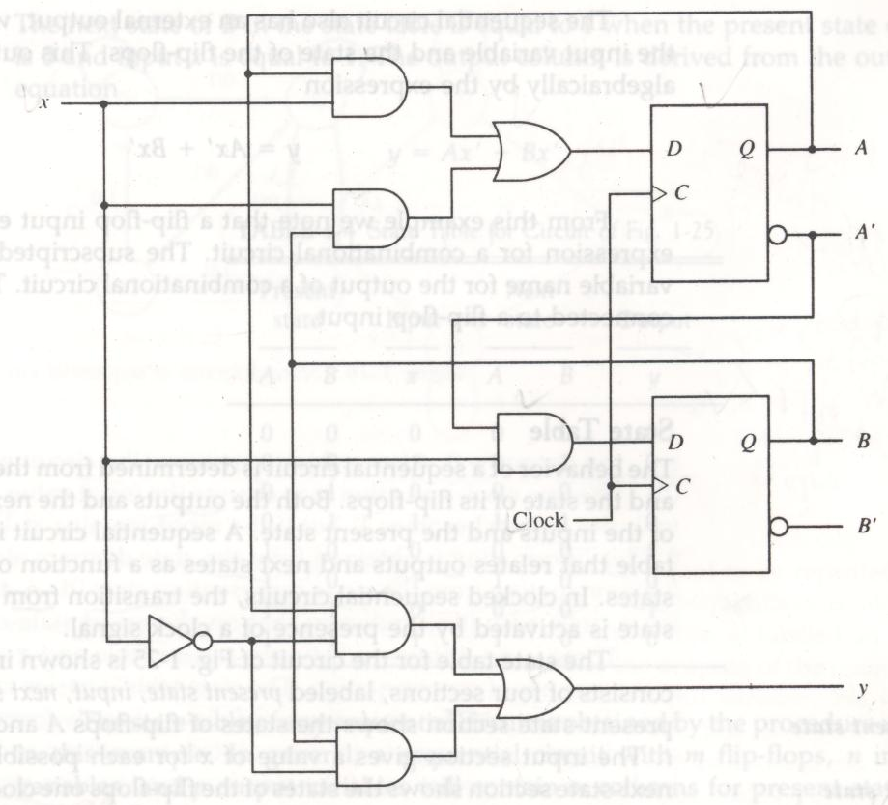
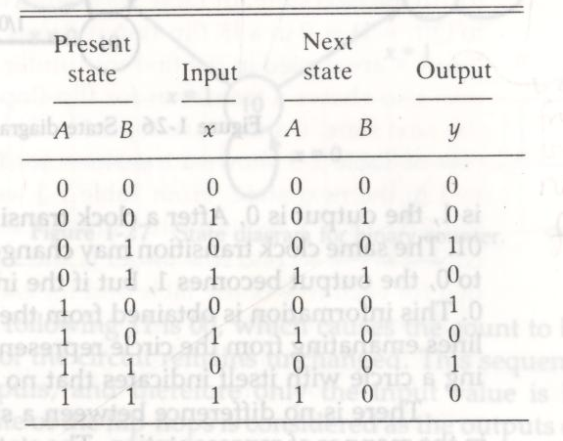
Example of a sequential circuit
  State table for the example circuit
Flip-flop input equations: D_{A}=Ax+Bx and D_{B}=A’X
External output: y=Ax’+Bx’

Slide 46
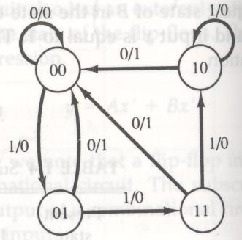
State Diagram
State Diagram
  Same information as state table
    Different representation
  Circle is state
    Flip-flop values inside
  Line connecting circles is transition
    “Input value/ output value” for present state

Slide 47
SEQUENTIAL CIRCUITS - DESIGN EXAMPLE
Flip Flops
Design Problem
  Clocked sequential circuit that is a two bit binary counter
    Increment when input x is 1
    Remain unchanged when input x is 0
  Construct
    State diagram
    Excitation table
    Logic circuit diagram
  Note: Number of flip-flops needed for the circuit is equal to the number of bits listed within the circles of the state diagram

Slide 48
SEQUENTIAL CIRCUITS - DESIGN EXAMPLE …
Sequential Circuits
Design Procedure:
Specification ⇒ State Diagram ⇒ State Table ⇒
Excitation Table ⇒ Karnaugh Map ⇒ Circuit Diagram
Example: 2-bit Counter -> 2 FF's
x=0
current next
state input state FF inputs
A B x A B Ja Ka Jb Kb
0 0 0 0 0 0 d 0 d
0 0 1 0 1 0 d 1 d
0 1 0 0 1 0 d d 0
0 1 1 1 0 1 d d 1
1 0 0 1 0 d 0 0 d
1 0 1 1 1 d 0 1 d
1 1 0 1 1 d 0 d 0
1 1 1 0 0 d 1 d 1
x=1
00
x=1
x=0
01
11
x=0
x=1
x=1
10
x=0
B
B
B
B
d d
d
d
1
d d
x
1 d
x
d
1
x
d d
x
1
1 d
d
1
x
A
B
A
A
A
A
J Q
C
K Q'
J Q
C
K Q'
d d
d
d
Ja
Ka
Jb
Kb
clock
Ja = Bx Ka = Bx Jb = x Kb = x

